Slide 1
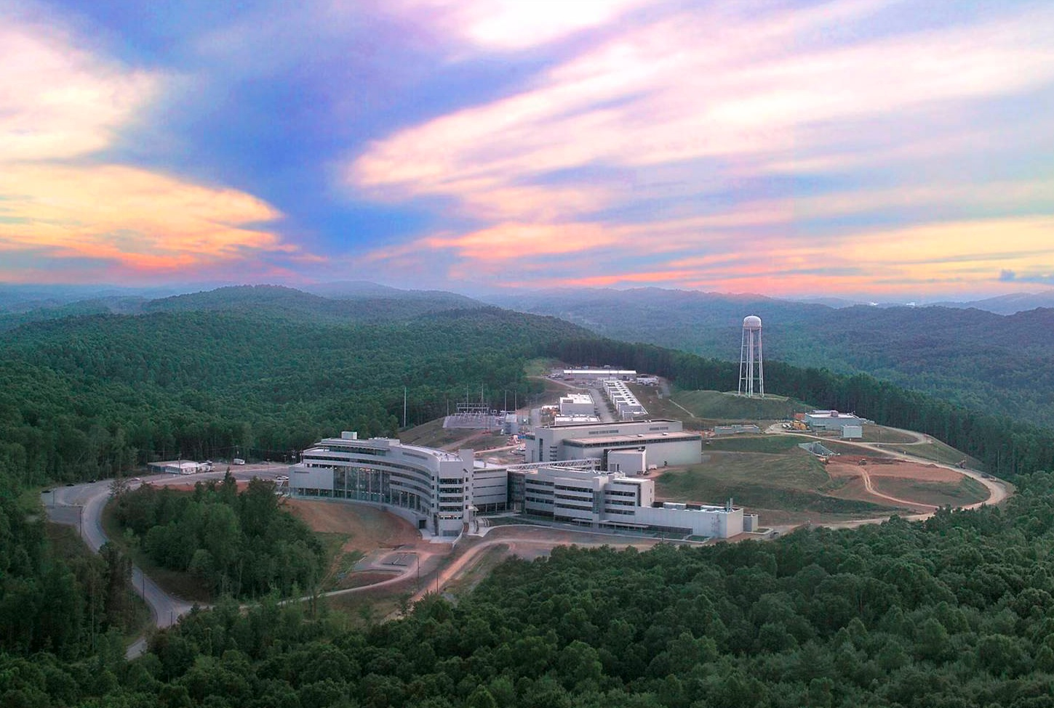
New Results from the NPDGamma
Parity Violation Experiment at the Spallation Neutron Source
Christopher Crawford
University of Kentucky, Dept. Physics and Astronomy

Slide 2

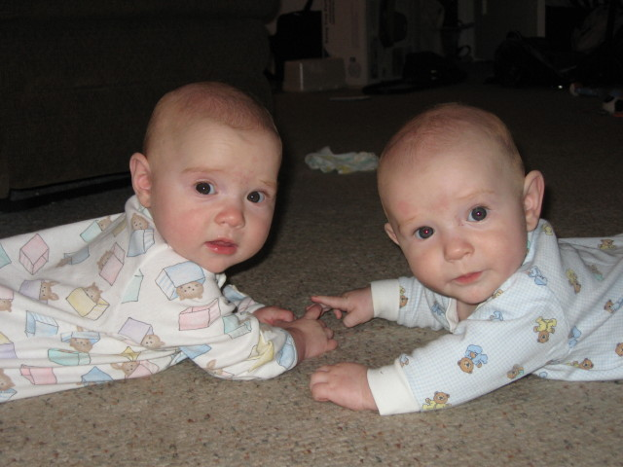
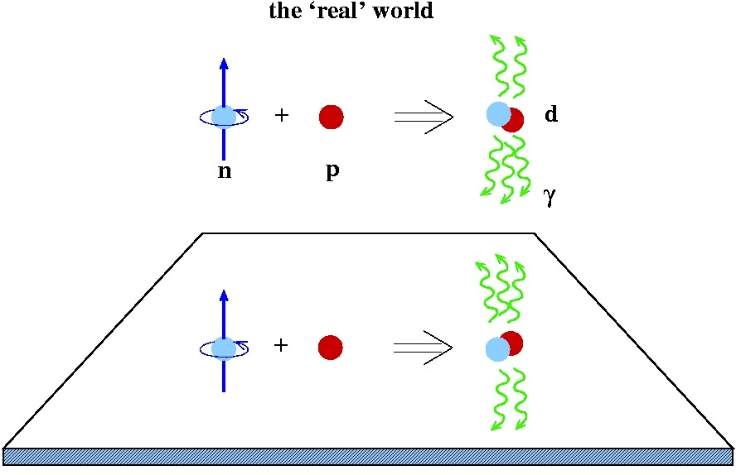

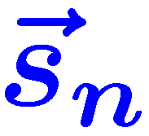
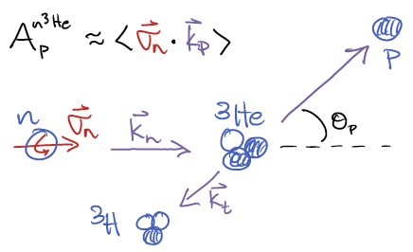
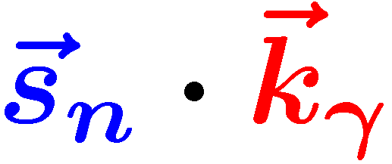
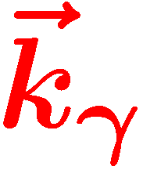
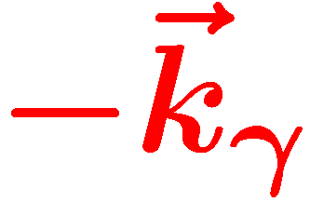

Hadronic Parity Violation – Outline
Hadronic Parity Violation
  Hadronic Weak Interaction
  Existing HPV Data
New Experiments at the SNS
  NPDGamma experiment
  n-³He experiment
Madison
Spencer

Slide 3

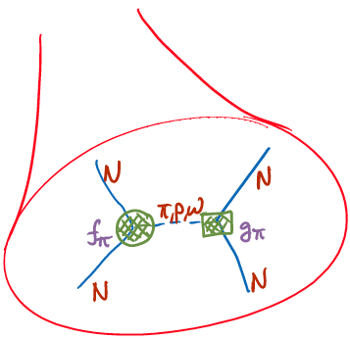


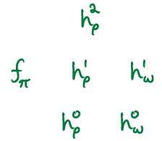


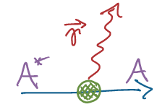
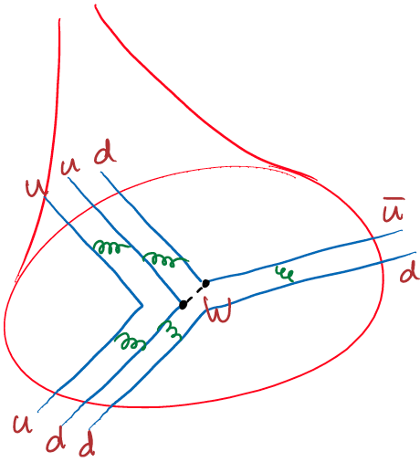
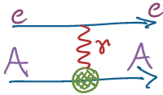




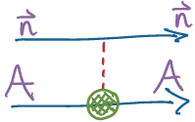

Hadronic Weak Interaction in a nutshell
Viviani et al, PRC 82 (2010), 044001
Nuclear
<structure>
Hadronic
Nuclear PV
<structure>
EW
Few-body PV
Wasem, PRC 85 (2012), 022501

Slide 4
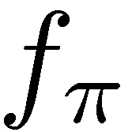
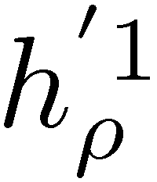
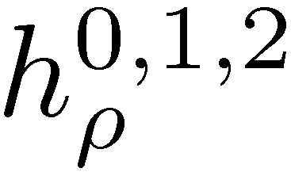
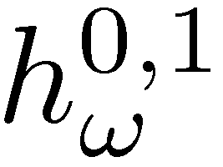

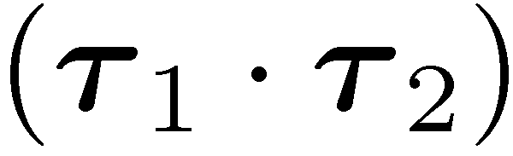
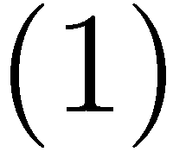
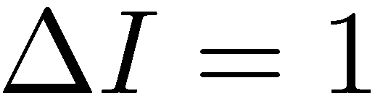
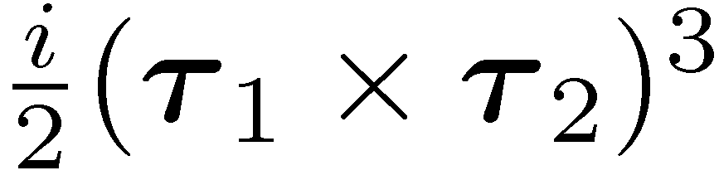
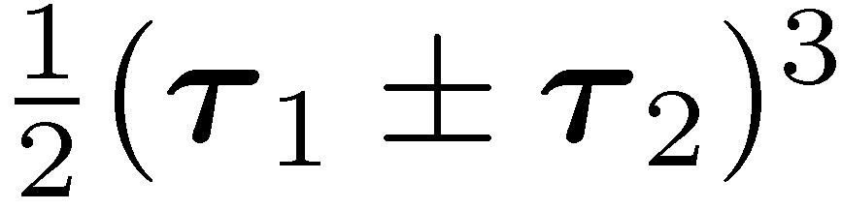
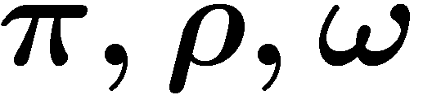
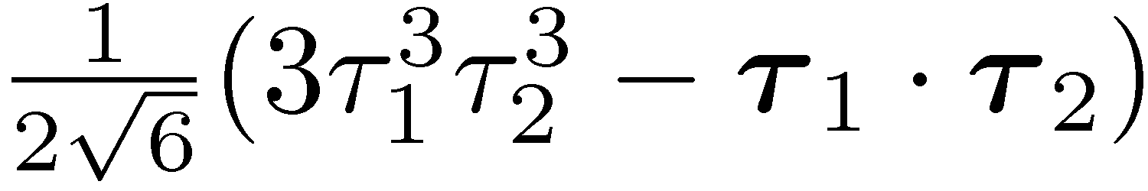
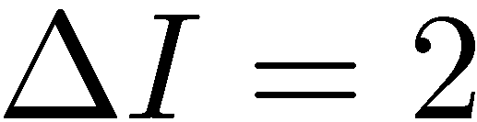
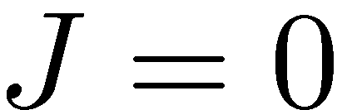
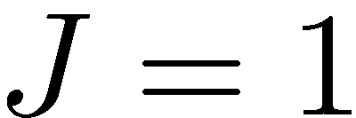
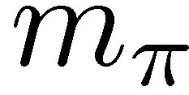
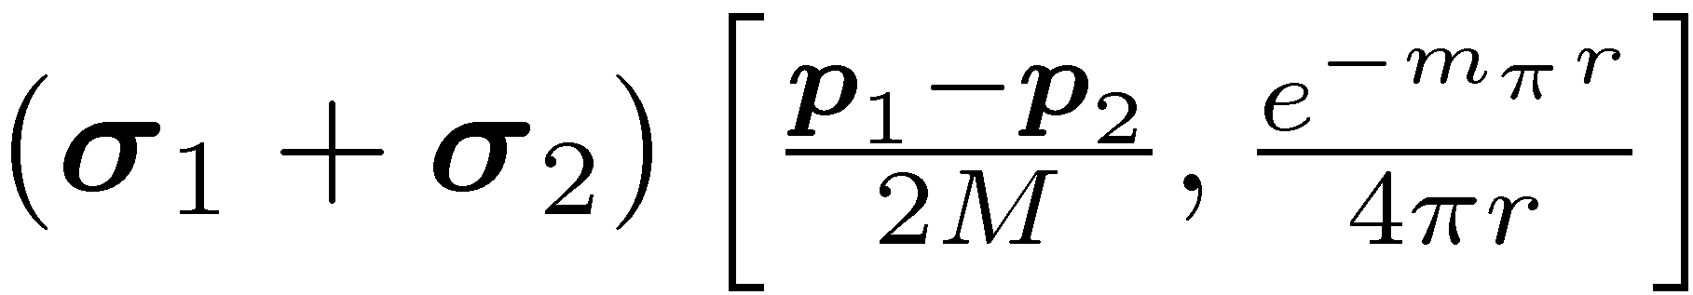
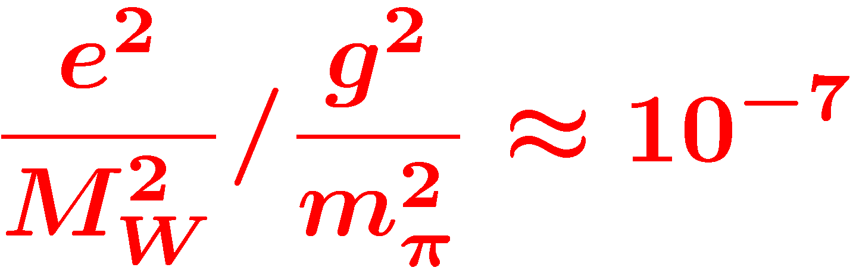
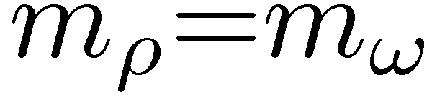

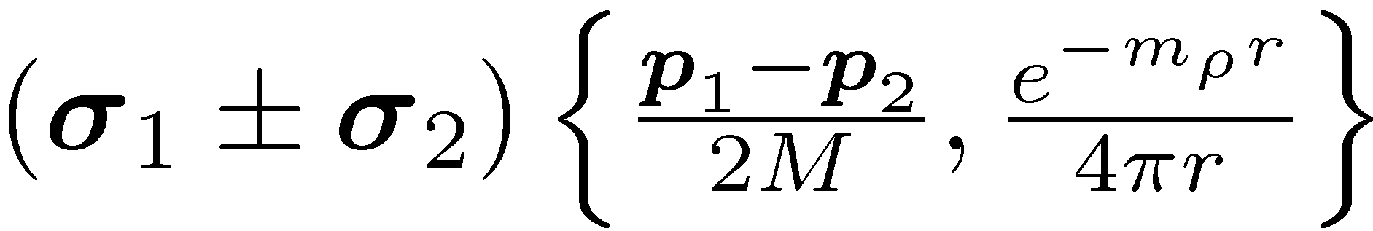
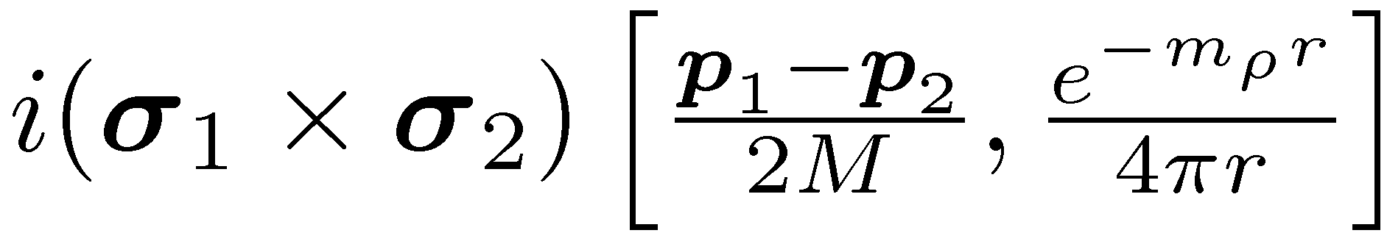
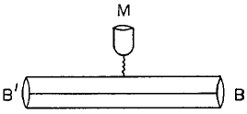
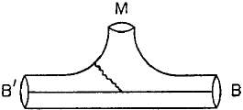
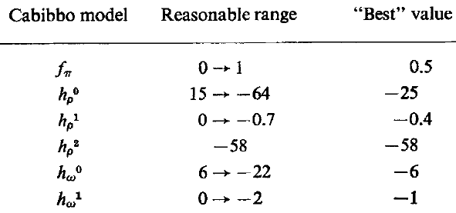
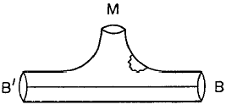
DDH Potential
PV meson exchange
N
N
isospin
STRONG
(PC)
WEAK
(PV)
Meson
exchange
N
N
range
Desplanques, Donoghue, Holstein,
Annals of Physics 124, 449 (1980)

Slide 5
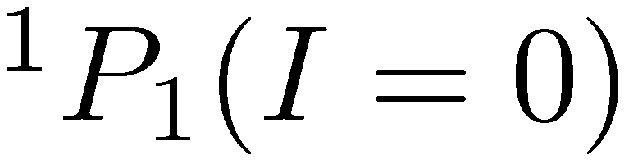
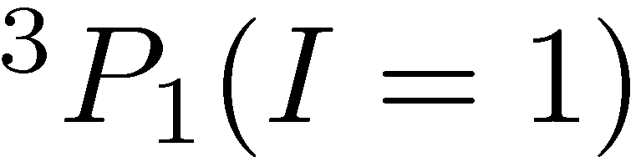
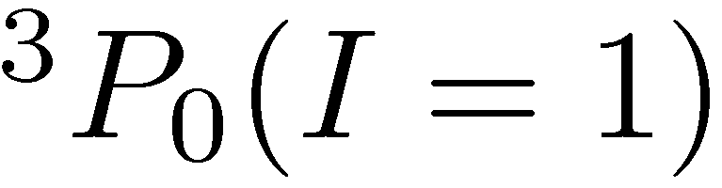
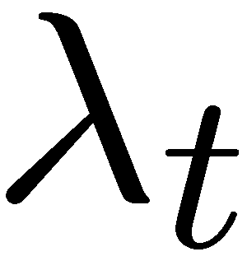
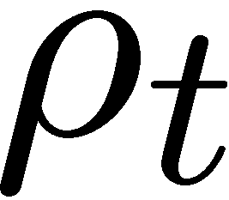
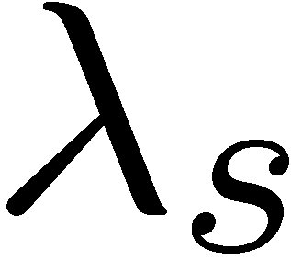
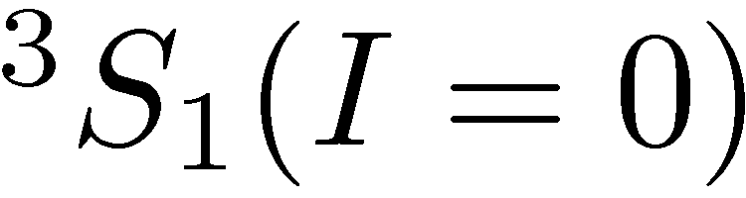
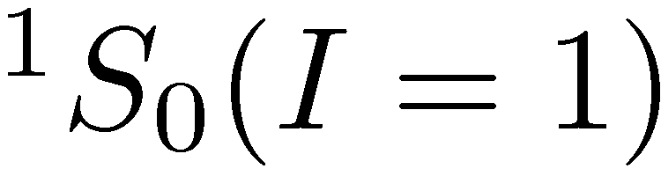
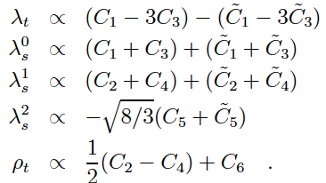
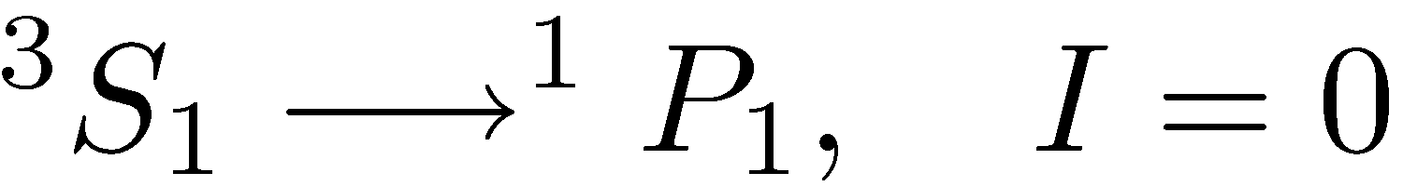
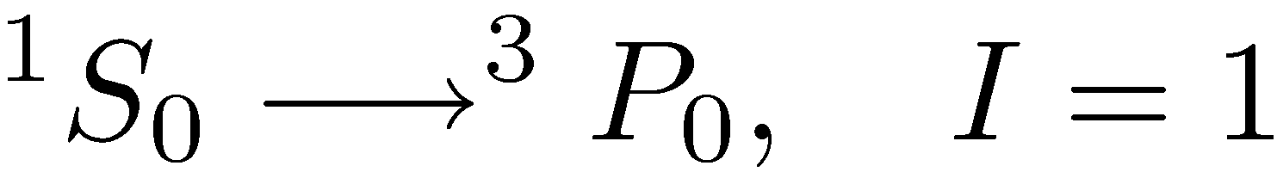
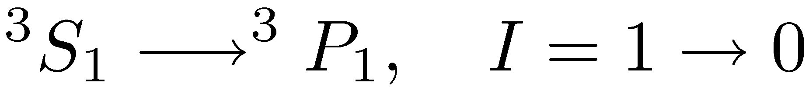
Danilov parameters / EFT
Elastic NN scattering
S-P transition (PV)
S=1/2+1/2 , I=1/2+1/2
Antisymmetric in L, S, I
Conservation of J
Equivalent to Effective
Field Theory (EFT)
in low energy limit
C.-P. Liu, PRC 75, 065501 (2007)

Slide 6


EFT NN potential revisited to NNLO
Viviani et al., preliminary (PAVI 11)
  (a) Q⁰ h¹_{π} g_{π}(r)
  (CT) Q¹ C_{1,2,3,4,5} Z(r)
  (b,c) Q² zero
  (e,h) Q² renorm./absorb in h¹_{π}
  (d), Q² h¹_{π+}C₃ (triangle) L(r)
  (f,g,g’) Q² h¹_{π} (box) H(r)+L(r)
A_{z}^{n3He} (prelim) using N3LO (Emtem & Macheleidt) + 3N N2LO (Navratil)
Λ = 500: a₀=-0.15 a₁=.026 a₂=.021 a₃=0.11 a₄=-.043 a₅=-.0022
Notes:
----- Meeting Notes (2013-01-23 09:38) -----
Michele Viviani has been working towards a full EFT calculation, but before that, they revisited the perturbative expansion of the weak NN-potential to order Q2. The long-range fpi is Q0, PV contact interactions Q1, and the good news is that all of the Q2 diagrams can be absorbed into the existing coefficients. Here are preliminary coefficients for n3He, but we need analysis of all existing reactions in order project the value of Az

Slide 7


Existing HPV data
p-p scat. 15, 45 MeV A_{z}^{pp}
p-α scat. 46 MeV A_{z}^{pp}
p-p scat. 220 MeV A_{z}^{pp}
n+p→d+γ circ. pol. P_{γ}^{d}
n+p→d+γ asym. A_{γ}^{d}
n-α spin rot. dφ^{nα}/dz
¹⁸F asym. ΔI =1
¹⁹F, ⁴¹K, ¹⁷⁵Lu, ¹⁸¹Ta asym.
²¹Ne (even-odd)
¹³³Cs, ²⁰⁵Tl anapole moment
GOAL – resolve coupling
constants from few-body
PV experiments only
Wasem, Phys. Rev. C 85 (2012) 022501
h¹_{πNN} = (1.099 ±0.505^{+0.058} ) x10⁻⁷
_{-0.064}
p-p and nuclei
Anapole

Slide 8



Extraction of DDH couplings
 | np A_{γ} | nD A_{γ} | n³He A_{p} | np φ | nα φ | pp A_{z} | pα A_{z}
f_{π} | -0.11 | 0.92 | -0.18 | -3.12 | -0.97 |  | -0.34
h_{r}⁰ |  | -0.50 | -0.14 | -0. 23 | -0.32 | 0.08 | 0.14
h_{r}¹ | -0.001 | 0.10 | 0.027 |  | 0.11 | 0.08 | 0.05
h_{ρ}² |  | 0.05 | 0.0012 | -0.25 |  | 0.03
h_{ω}⁰ |  | -0.16 | -0.13 | -0. 23 | -0.22 | -0.07 | 0.06
h_{ω}¹ | -0.003 | -0.002 | 0.05 |  | 0.22 | 0.07 | 0.06
n-³He: M. Viviani (PISA),
Phys. Rev. C 82 (2010) 044001
dA=1x10⁻⁸
dA=1x10⁻⁸

Slide 9
NPDGamma Collaboration
R. Alarcon¹, S. Balascuta¹, L. Barron-Palos², S. Baeßler³, D. Bowman⁴, J. Calarco ,R. Carlini⁵, W. Chen⁶,
T. Chupp⁷, C. Crawford⁸, M. Dabaghyan⁹, A. Danagoulian¹⁰, M. Dawkins¹¹, N. Fomin¹², S. Freedman¹³,
T. Gentile⁶, M. Gericke¹⁴ C. Gillis¹¹, G. Greene^{4,12}, F. Hersman⁹, T. Ino¹⁵, G. Jones¹⁶, B. Lauss¹⁷, W. Lee¹⁸, M. M. Leuschner¹¹, W. Losowski¹¹, R. Mahurin¹², Y. Masuda¹⁵, J. Mei¹¹, G. Mitchell¹⁹, S. Muto¹⁵, H. Nann¹¹, S. Page¹⁴, D. Pocinic, S. Penttila⁴, D. Ramsay^{14,20}, A. Salas Bacci³, S. Santra²¹, P.-N. Seo²², E. Sharapov²³, M. Sharma⁷, T. Smith²⁴, W. Snow¹¹, W. Wilburn¹⁰, V. Yuan¹⁰
¹Arizona State University
²Universidad Nacional Autonoma de Mexico
³University of Virginia
⁴Oak Ridge National Laboratory
⁵Thomas Jefferson National Laboratory
⁶National Institute of Standards and Technology
⁷Univeristy of Michigan, Ann Arbor
⁸University of Kentucky
⁹University of New Hampshire
¹⁰Los Alamos National Laboratory
¹¹Indiana University
¹²University of Tennessee
¹³University of California at Berkeley
¹⁴University of Manitoba, Canada
¹⁵High Energy Accelerator Research
Organization (KEK), Japan
¹⁶Hamilton College
¹⁷Paul Scherer Institute, Switzerland
¹⁸Spallation Neutron Source
¹⁹University of California at Davis
²⁰TRIUMF, Canada
²¹Bhabha Atomic Research Center, India
²²Duke University
²³Joint Institute of Nuclear Research,
Dubna, Russia
²⁴University of Dayton

Slide 10






Experimental Layout
Supermirror Polarizer
Beam Monitors
RF Spin Rotator
LH₂ Target
Gamma Detectors

Slide 11

Experimental setup at the FnPB
CsI Detector Array
Supermirror
polarizer
Liquid H₂ Target
H₂ Vent Line
H₂ Manifold Enclosure
Magnetic Shielding
FNPB guide
Magnetic Field Coils
Beam Stop

Slide 12


Spallation neutron source
spallation sources: LANL, SNS
  pulsed -> TOF -> energy
LH2 moderator: cold neutrons
  thermal equilibrium in ~30 interactions
Notes:
226 us RMS width moderated pulse
18 m, TOF=11-27 ms, v = 1700-650 ms/s
E=15 – 2.3 meV

Slide 13

Neutron Flux at the SNS FnPB
Flux = 6.5x10¹⁰ n/s/MW
2.5 Å < λ < 6.0 Å
15 meV LH₂ threshold
SNS TOF window

Slide 14
Time-of-flight choppers

Slide 15
Chopped & folded spectrum
Notes:
here is a plot of our He3 beam monitor, it is our first beam monitor in the beam guide, As you can see, these notches are aluminum bragg edges, and here is when the chopper is closing and here is the opening edge of the chopper.

Slide 16




Measurement of Beam Flux and Profile

Slide 17



Nuclear interaction: neutron optics
Fermi potential:
Optical potential:
Index of refraction:
V
+μ•B
V_{nuc}
-μ•B
z

Slide 18



FnPB supermirror polarizer
Fe/Si on boron float glass, no Gd
m = 3.0 critical angle
n = 45 channels
r = 9.6 m radius of curvature
l = 40 cm length
d = 0.3mm vane thickness
T=25.8% transmission
P=95.3% polarization
N=2.2£10¹⁰ n/s output flux (chopped)
simulations using
McStas / ROOT ntuple
S. Balascuta, .., CBC, et al., Nucl. Instr. Meth. A671 137 (2012)

Slide 19



Polarimetry – ³He spin filter

Slide 20



Longitudinal RF spin rotator
Resonant RF spin rotator,
  1/t RF amplitude tuned to velocity of neutrons
  Affects spin only – NOT velocity! (no static gradients)
essential to reduce instrumental systematics
  spin sequence: ↑↓↓↑ ↓↑↑↓ cancels drift to 2nd order
  danger: must isolate fields from detector
  false asymmetries: additive & multiplicave
holding field
s_{n}
B_{RF}
P. Neo-Seo, .., CBC, et al. Phys. Rev. ST Accel. Beams 11 084701 (2008)

Slide 21



Neutron beam monitors
Purpose:
  – Neutron Flux monitor
  – Neutron Polarimetry
  (in conjunction with
  ³He analyzer)
  – Monitor ortho/para
  ratio in the target
Improvements:
  – Larger beam cross section
  – Wires electrodes instead of plate
  Reduced absorption and scattering of beam
  Reduced microphonic noise pickup
Similar chamber being constructed for n-³He exp.

Slide 22


16L liquid para-hydrogen target
30 cm long → 1 interaction length
99.97% para → 1% depolarization
Improvements: pressure-stamped vessel
thinner windows
p
p
ΔE =
15 meV
p
p
para-H₂
ortho-H₂
ortho
15 meV
para
σ (b)
capture
E_{n} (meV)

Slide 23
Ortho vs. Para H₂ neutron scattering
Simulation by
Kyle Grammer
L. Barron-Palos, .., CBC, et al., Nucl. Instr. Meth. A671 137 (2012)

Slide 24

Installation of the LH₂ target in the FnPB
Target Commissioned
December 2011

Slide 25




CsI(Tl) Detector Array
4 rings of 12 detectors each
  15 x 15 x 15 cm³ each
VPD’s insensitive to B field
detection efficiency: 95%
current-mode operation
  5 x 10⁷ gammas/pulse
  counting statistics limited

Slide 26


LH₂ run at LANSCE – Fall 2006
A _{γ,UD}=(-1.2 ± 2.1 ± 0.2) x10⁻⁷
A _{γ,LR}=(-1.8 ± 1.9 ± 0.2) x10⁻⁷
Number of good runs
5401 / 750 h
Average delivered proton current
89 A at 80 kW
Average beam pol. (3He spin filter)
55 +/- 7.5 %
Spin-flip efficiency
98 +/- 0.8%
Para-hydrogen fraction in LH2 target
99.98 %
Beam depolarization in target
2 %
Data loss (cuts, bad events)
~1 %
M. Gericke, .., CBC, et al., Phys. Rev. C 83 015505 (2011)

Slide 27
Chlorine PV asymmetry
10.5 hr data, 2% uncertainty
Integrated test of complete system

Slide 28



Aluminum Asymmetry
UKy Aluminum target
Dominant systematic effect
  25% background at LANL
  Al thickness reduced by 50%
Fit beta-delayed gammas
  Lifetime ¿ = 27 min
Must measure ±A = 3£ 10⁻⁸
Preliminary data
PRELIMINARY

Slide 29
Recent Hydrogen Data
200 hr. of data from Fall 2012
Preliminary result:
A_{UD} = (-7.14 ± 4.4) x 10⁻⁸ A_{LR} = (-0.91 ± 4.3) x 10⁻⁸

Slide 30

Systematic & Statistical Uncertainties

Slide 31
Experimental setup at the FnPB
FnPB cold
neutron guide
supermirror
bender polarizer
(transverse)
10 Gauss
solenoid
³He Beam
Monitor
RF spin
rotator
³He target /
ion chamber
FNPB
n-³He
longitudinal holding field – suppressed PC nuclear asymmetry
A=1.7x10⁻⁶ (Hales) s_{n} • k_{n} x k_{p} suppressed by two small angles
RF spin flipper – negligible spin-dependence of neutron velocity
³He ion chamber – both target and detector
Notes:
31
So what do we need for the experiment? Polarized neutrons which we already have on the FnPB.
We need to longitudinalize the neutrons, for reasons I’ll explain later, with an adiabatic transition,
So we also need a new type of spin flipper (for fast spin reversals)
The reaction takes place right in the ion chamber, which measures the outgoing products.

Slide 32


Transverse RFSR for n-³He Expt.
extension of NPDGamma design
  Resonant RF spin rotator
  TEM RF waveguide
new resonator for n-³He expt.
  Transverse horizontal RF B-field
  Longitudinal / transverse flipping
  No fringe field - 100% efficiency
  Compact geometry – efficient
  matched to NPDG electronics
NPDGamma
windings
n-³He
windings

Slide 33



n-³He target / ion chamber
Chamber all aluminum except for the knife edges.
  4 feedthrough ports (153 readout channels)
  2 HV ports + 2 gas inlets/outlets
  12 inch aluminum windows (0.9 mm thick).
Macor wire frames
  Platinum-gold thick film wire solder pads
Filled with 1 atm of 3He

Slide 34



Asymmetry Measurement – Statistics
PV Physics asymmetry is extracted from weighted average of
single-wire spin asymmetries
Two Monte Carlo simulations:
  a code based on GEANT4
  a stand-alone code
  including wire correlations
N = 1.5x10¹⁰ n/s flux (chopped)
x 10⁷ s (116 days)
P = 96.2% neutron polarization
σ_{d} = 6 detector inefficiency
15% measurement in 1 beam cycle (without contingency),
assuming A_{z}= 1.15 x 10⁻⁷
Notes:
The neutron captures here, and we want to measure the proton asymmetry, or the proton angle as a function of spin.
But the event rate is too large to reconstruct tracks, so we must measure spin asymmetries on each wire.
The opposite triton dilutes the proton asymmetry, and also protons coming from decays downstream, but most decays happen at the front of the chamber.
Even with a large detector inefficiency, the event rates are so high that we expect an error of 1.6e-8, which may be the best relative precision for a few-body HWI experiment.

Slide 35



Systematic Uncertainties
Beam fluctuations, polarization, RFSF efficiency:
k_{n}r ~ 10⁻⁵ small for cold neutrons
PC asymmetries minimized with longitudinal polarization
Alignment of field, beam, and chamber to 10 mrad is achievable
Unlike n p -> d ° or n d -> t °,
n-³He is very insensitive to gammas (only Compton electrons)
Notes:
To reduce the spin asymmetry

Slide 36


Assembly in the FnPB cave

Slide 37









Commissioning / run plan
Scan beam profile upstream
and transfer centroid to crosshairs
Scan beam profile downstream
Align theodolite to crosshairs
Align B-field to theodolite
Field map in RFSR/Target region
Align the position / angle of target with theodolite / autocollimator
Tune RSFR / measure polarization
Measure physics asymmetry

Slide 38
Summary n-3He collaboration
NPDGamma is the cleanest measurement of f_{¼} coupling
Preliminary result: ±A = 4.4x10⁻⁸
Expect ±A = 1x10⁻⁸ by June 2014
n-³He is the last measurement needed to characterize the Hadronic Weak Interaction
15% projected uncertainty
will be the most accurate
HWI experiment in a
few-body system
FnPB beam time scheduled
from June 2014 – Dec 2015

Slide 39




Acknowledgements
Yunchang Shin
Elise Martin
Daniel Wagner
Binita Hona
Andrew McNamara
Michael Brown
Josh Henry
Mary Estes
Adam Ruff
Haynes Wood
Chris Menard
Roel Flores
Charles Fieseler
Robert Milburn
Jodie Lusby
Kayla Craycraft
Anna Butler
William Berry
Mario Fugal
Justin Tomey
Will Bates
Edward Goodman
Forrest Simmons
Brad Irvin
Alec Gilbert
Dustin Doss
Joseph Natter
Deborah Ferguson
Rebecca Schladt
Mykalin Jones

