Slide 1
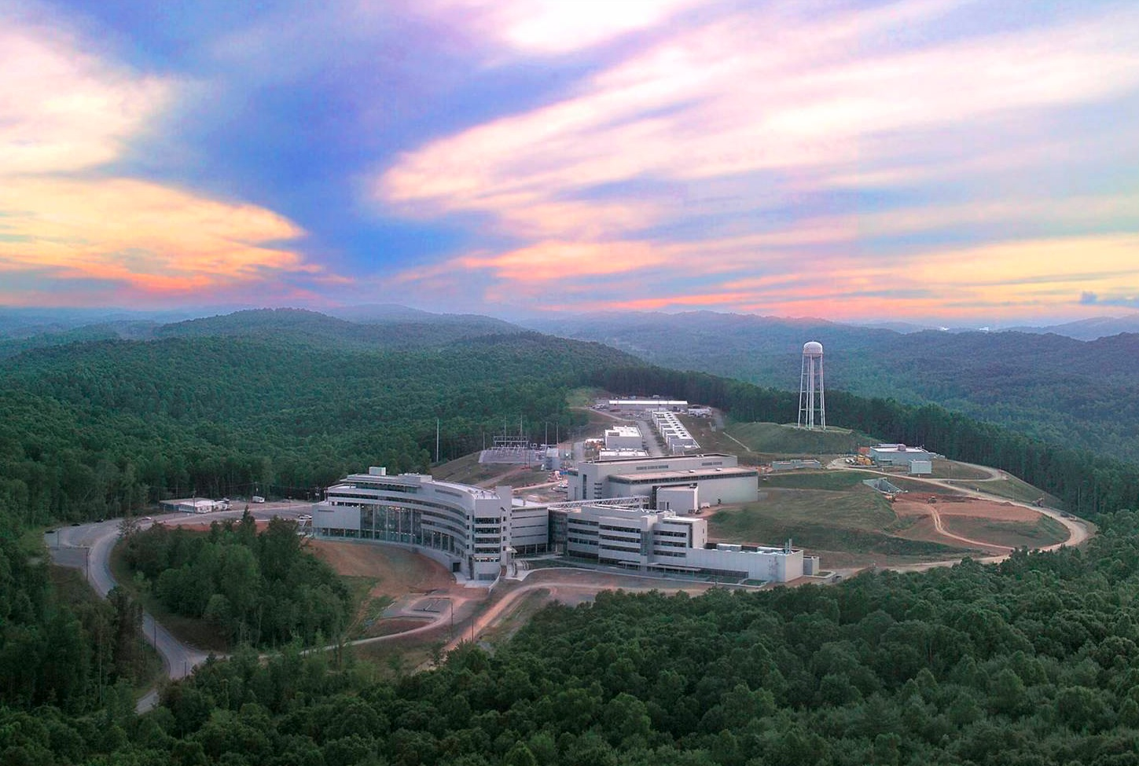
A New Era in
Discrete Hadronic Symmetries
Christopher Crawford, University of Kentucky
APS DNP Meeting
Vancouver, BC 2016-10-14

Slide 2
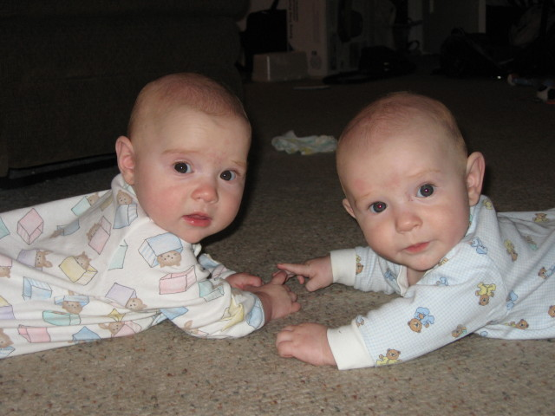
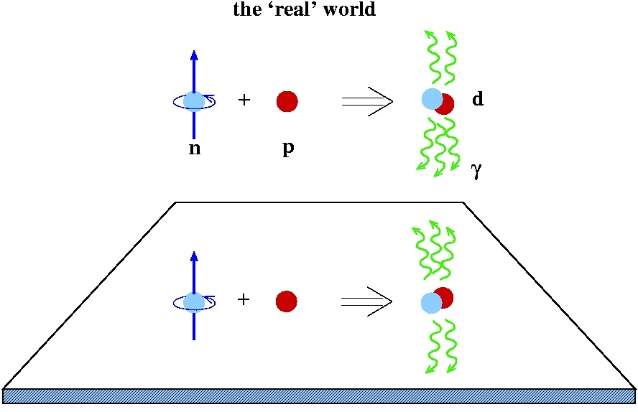
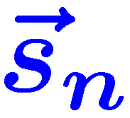
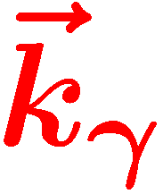
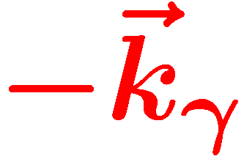

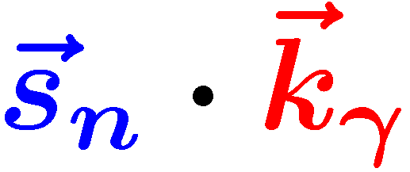

Outline
Hadronic Parity Violation
  Hadronic Weak Interaction (HWI) formalism
  Extraction of weak couplings
A few Few-Body Experiments
  NPDGamma Experiment
  n-³He Experiment
  NSR Experiment
Beyond the HWI
Madison
Spencer
Is a parity odd pseudoscalar!
Notes:
Before we get started, let me introduce you to our parity doublet, Spencer and Madison, who were born just before I joined the NDPGamma experiment in Los Alamos 10 years ago. And they want you all to know is that this spin-momentum correlation in the n+p to d+gamma reaction is parity odd, and therefore is exclusively sensitive to weak contributions to the NN potential.

Slide 3
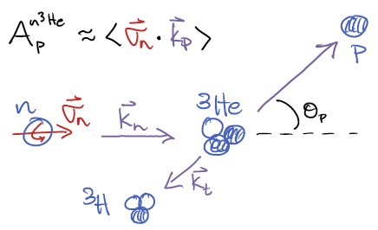

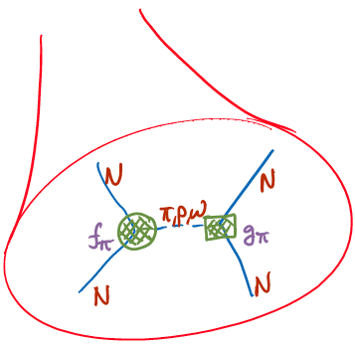


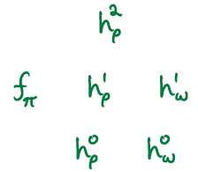


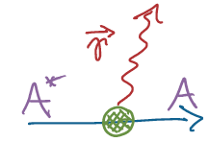
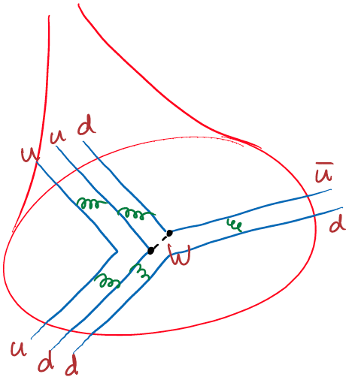

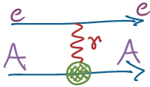



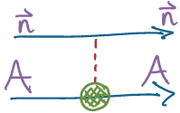

Hadronic Weak Interaction in a nutshell
Nuclear
<nuclear structure>
Hadronic
Nuclear PV
<QCD structure>
Few-body PV
Parton
Notes:
Let me summarize the significance of the hadronic interaction using another example reaction n + 3He into a proton and triton,
measuring neutron spin-dependence of the proton cross section.
The NN-potential is predominantly Yukawa, with the exchange of a meson.
If one of the vertices is parity odd, then we get the Hadronic Weak Interaction.
We can characterize it with 6 different couplings by its spin and isospin dependence.
Of those, two have small contributions and are fairly well constrained
At the quark level the weak vertex involves the exchange of a Z or W-boson, which is well known,
so the weak coupling is a new probe of the structure and dynamics of the nucleon.
Coming back to real observables, once we have characterized the different couplings, we can use parity violation as a sensitive probe of nuclear structure.
So the hadronic interaction is really about structure: we can probe both structure of the nucleon, and structure of compound nuclei.
So how do we isolate it? We need at least 4 independent observables.
Parity violation has been observed in heavy nuclei, which the effect is amplified due to closely spaced parity even and odd states,
but we should characterize the couplings using few-body systems which can be interpreted in terms of exact wave functions.
We already have elastic polarized proton-proton scattering at two different energies which are senstive to the isospin 2 coupling and a combination of I=0 and I=2.
I will talk about the NPDG reaction, which is sensitive to the long-range pion coupling, and then the n3He experiment, which is sensitive to different combinat of I=0

Slide 4
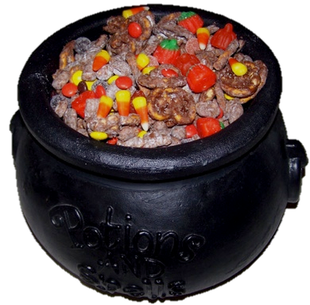



The Hallowe’en Interaction (HW’I)
Trick or Treat Diagram

Slide 5
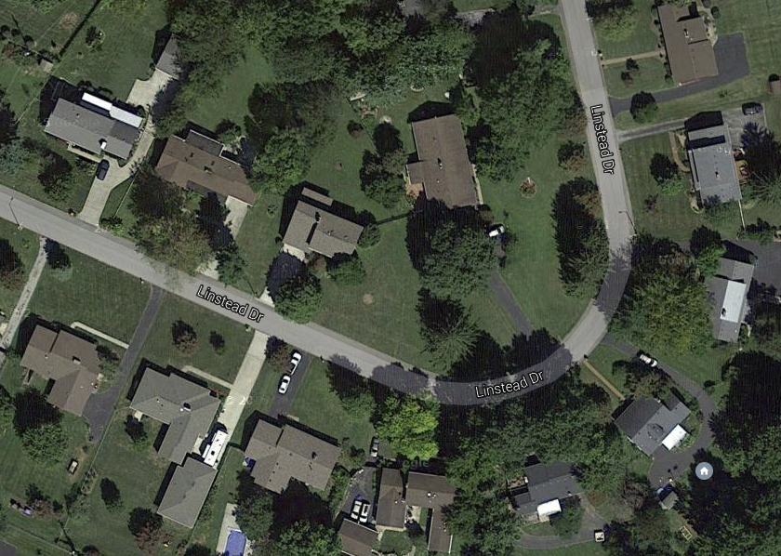
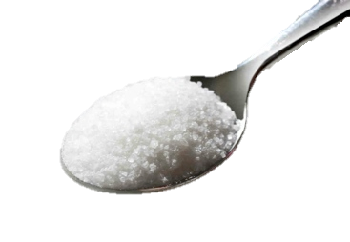








The Hallowe’en Interaction (HW’I)
What can we learn?
Must … have … sugar…

Slide 6
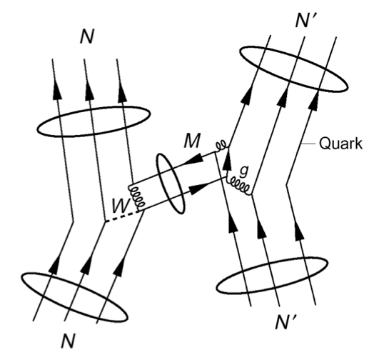
Motivation the studying the HWI
Least understood weak interaction
  EW: Quarks & Leptons, Semileptonic, Hadronic
  Complicated by nuclear structure
  Strongly suppressed by M_{π}^{2/}M_{W}² ~ 10⁻⁷
  Unique PV signature
Orthogonal probe of QCD structure
  test of QCD structure in ΔS = 0 sector
  (ΔI=1/2 rule not understood)
  Study the NC in hadronic systems –
  forbidden by ΔS = 1 by GIM mechanism
  W,Z range = 0.002 fm – probe of
  short-range quark correlations
  in QCD nonperturbative regime
  Nuclear and atomic PV test of nuclear structure models
  physics input to PV electron scattering experiments
  0νββ decay – matrix elements of 4-quark operators
  Same formalism used for Hadronic TRIV (complementary to EDM)
Notes:
Motivation for studying the HWI over the last 60 years has evolved according to theoretical interests,
starting with experimental searches for parity violation, and the role of neutral currents in hadronic systems,
and to elucidate the isospin dependence of kaon decays in the strangeness changing sector.
But in general the HWI is a complementary to strong reactions in studying the NN potential, nuclear and nucleonic structure.
The HWI couplings are also input for other experiments, including exciting new possibilities for discovery of time reversal violation and hadrons.

Slide 7
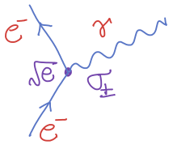
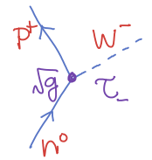
The neutron as a Nucleon
Particle states: Spin vs. Isospin
  2 x 2 = 4 spin/isospin states
  Two copies of SU(2) symmetry
  Pauli exclusion principle: L x S x T
Interactions: generalized forces
  Classical forces E = F•dx , p = F dt
  Spin: exchange angular momentum J
  Isospin: exchange charge q
Symmetries and Interactions:
  Is the ΔI=3/2 rule in ΔS=1 decays dynamical
  or is it evidence of some new symmetry?
  Strongly-interacting [unlike electron scattering / form factors]
isospin 1/2
p
n
up
spin 1/2
p
n
down
uud
udd

Slide 8
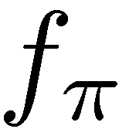
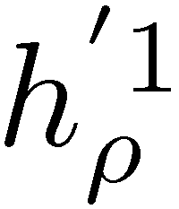
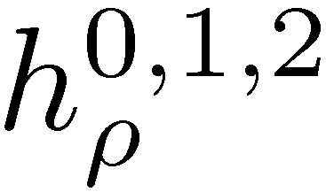
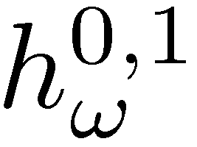

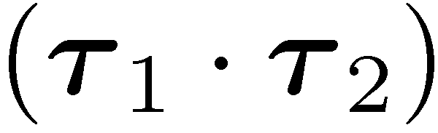
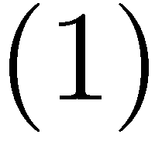

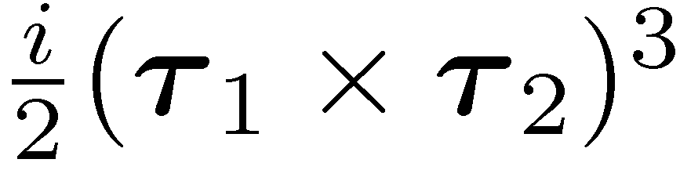
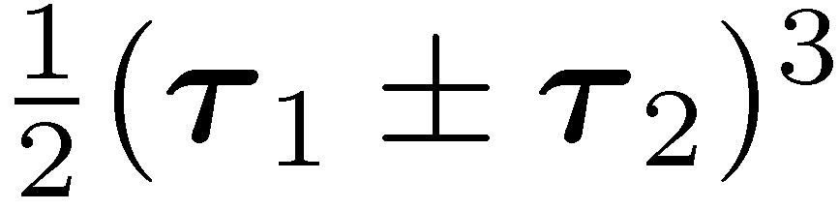
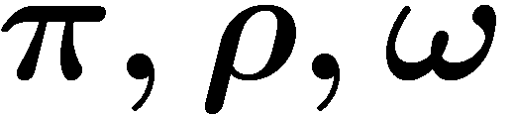

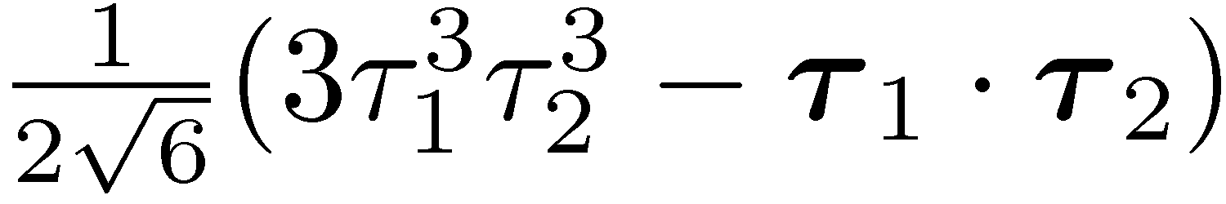
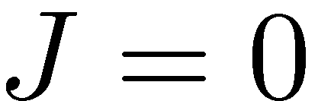
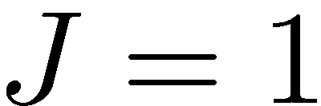
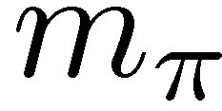
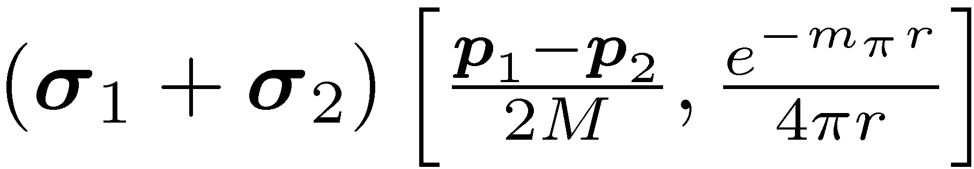
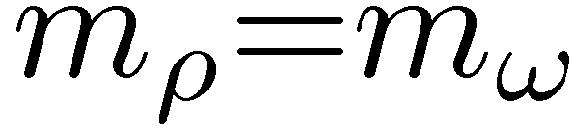

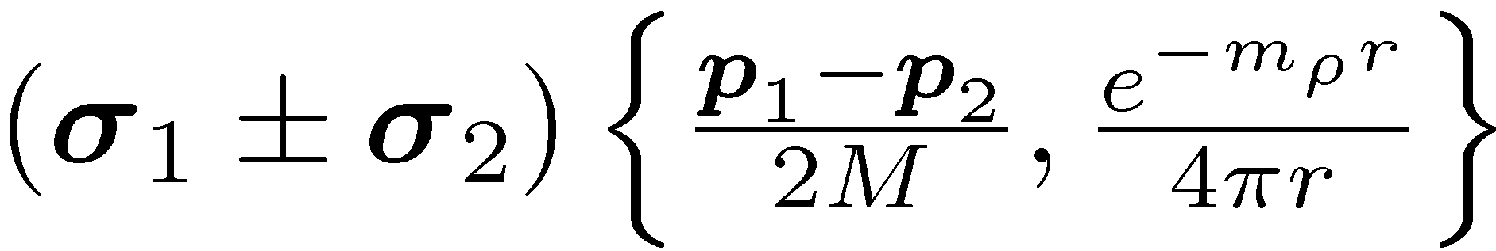
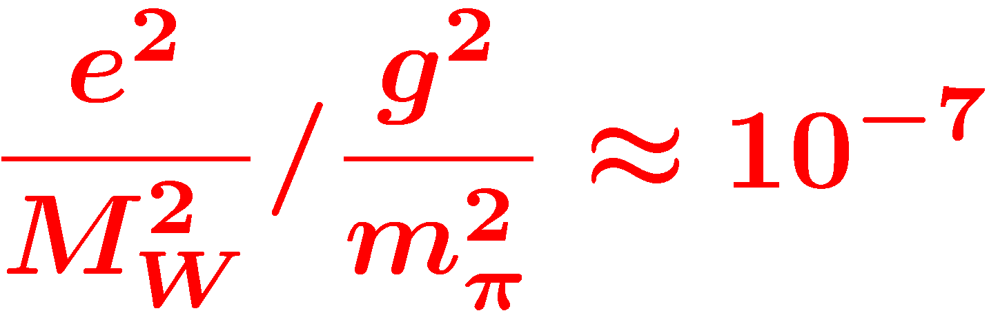
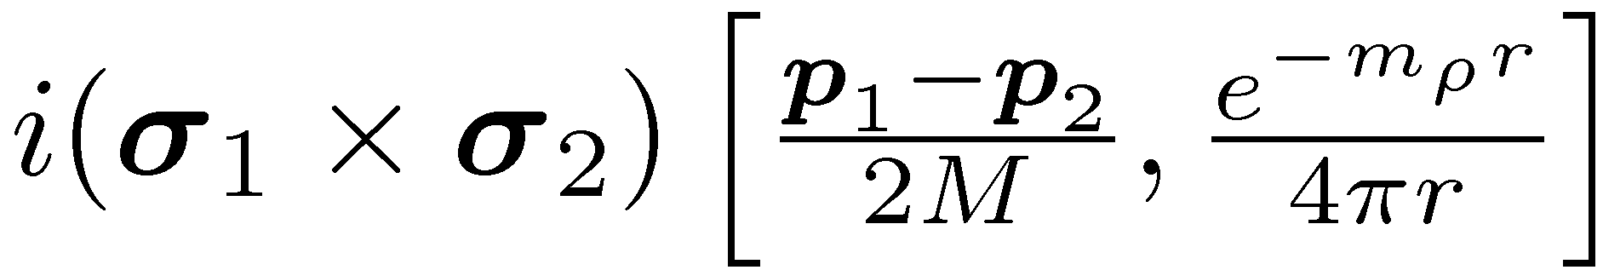
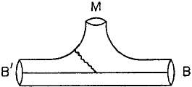
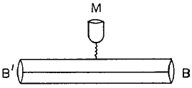
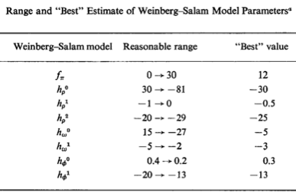
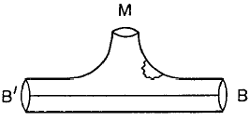
DDH Meson-exchange potential
PV meson exchange
isospin
N
N
STRONG
(PC)
WEAK
(PV)
Meson
exchange
range
N
N
Desplanques, Donoghue, Holstein,
Annals of Physics 124, 449 (1980)
Wasem, Phys. Rev. C 85 (2012) 022501
1st Lattice QCD result of f_{π} !!
Notes:
Here is a list of the various isospin, spin and spatial operators associated with the different couplings
in the de facto DDH meson exchange potential, with their reasonable ranges.
The ratio of weak to strong scales is about 10^-7, which is level of asymmetries we must observe to extract values of these couplings.

Slide 9
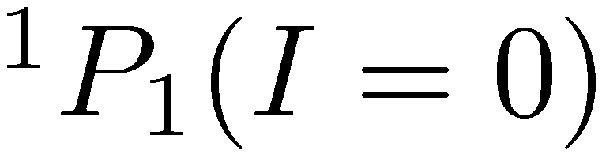
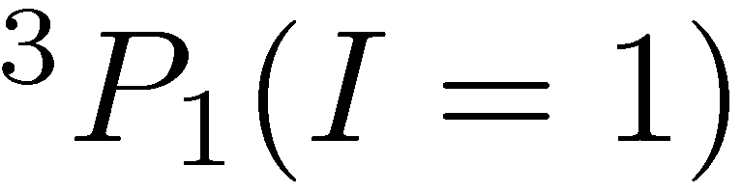
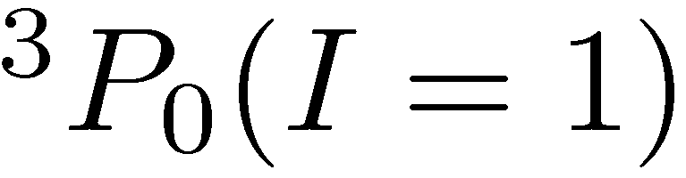
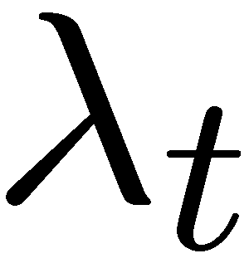
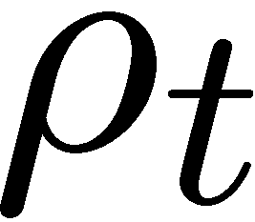
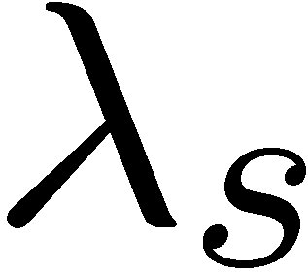
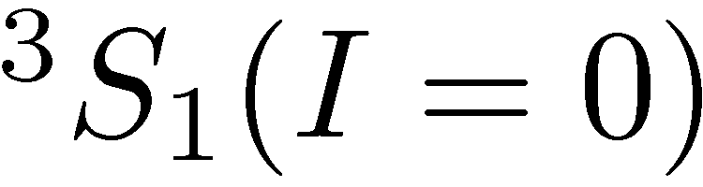
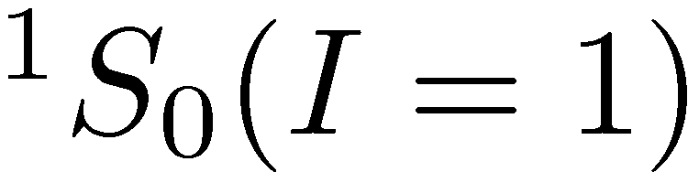

Danilov parameters / EFT
Elastic NN scattering
at low energy (<40 MeV)
S-P transition (PV)
S_{z}=±1/2 I₃=±1/2
Antisymmetric in L, S, I
Conservation of J
Equivalent to pion-less
Effective Field Theory (EFT)
in the low energy limit
C.-P. Liu, P.R.C. 75, 065501 (2007)
Viviani et al., P.R.C. 89 064004 (2014)
Haxton & Holstein, P.P.N.P. 7, 1851 (2013)
Notes:
Now days people use the EFT framework to characterize the HWI in a systematic model-independent way,
but as Haxton and Holstein showed, the low energy coupling constants are quite related.
In fact, they published a “Rosetta stone” to relate both theories back to the 5 basic S-P elastic scattering amplitudes.

Slide 10
Existing HPV Data
p-p scattering 13.6, 15, 45, 220 MeV single spin asymmetry
  A_{l}^{pp} = (-740±190, -1.7±.8, -1.57±0.23, −0.84±0.34 ) x10⁻⁷
p-α scattering 46 MeV single spin asymmetry
  A_{z}^{pp} = (-3.3±0.9) x10⁻⁷
n+p→d+γ gamma circular polarization
  P_{γ}^{d} = (-3.3±0.9) x10⁻⁷
n+p→d+γ gamma spin asymmetry
  A_{γ}^{d} = (-3.3±0.9) x10⁻⁷
n-α neutron spin rotation
  dφ^{nα}/dz = (1.7±9.1±1.4) x10⁻⁷rad/m
¹⁸F gamma circular polarization (ΔI =1)
  P_{γ} = (1200±3680 ) x10⁻⁷
¹⁹F, [⁴¹K, ¹⁷⁵Lu, ¹⁸¹Ta] asymmetry (odd-even nuclei)
  A_{γ} = (-740±190 ) x10⁻⁷
¹³³Cs, ²⁰⁵Tl anapole moment
  κ_{tot}= (0.112 ± 0.016, 0.105±0.28)

Slide 11







Few-body HWI PV Observables
n + p –> d + γ reaction
  Desplanques, NP A 335, 147 (1980)
  PV mixing in final bound state
  + PV transition amplitudes
  Dominated by long range h¹_{π}
n + 3He –> p + 3H reaction
  Mixed states in ⁴He intermediate state
  Viviani, et al, PRC 82, 044001 (2010)
  4-body wave functions + P_{odd} operators
  Sensitive to h¹_{π,} h¹_{ρ,} h¹_{ω}
n + 4He spin rotation
  HPV causes a spin-dependent index of refraction
  Interference between spin states rotates spin vector
  Also sensitive to h¹_{π,} h¹_{ρ,} h¹_{ω} : immediate test of HWI
PV observables are LINEAR in weak couplings
20.578
19.815
Notes:
Few-body observables have a clean interpretation in terms of the couplings because the wave functions are exactly calculable using the strong NN potential.
Parity violation comes from both weak mixing in the initial and final states, as well as the transition operator.
NPDGamma is almost exclusively sensitive to the long range pion coupling, the same circular polarization from 18F transitions.
Although there is a way of extracting the relevant nuclear information from beta
while n3He is also sensitive to the isospin 1 couplings.

Slide 12
Extraction of DDH couplings
 | np A_{γ} | nD A_{γ} | n³He A_{p} | np φ | nα φ | pp A_{z} | pα A_{z}
f_{π} | -0.11 | 0.69 | -0.185 | -3.12 | -0.97 |  | -0.34
h_{ρ}⁰ |  | -0.33 | -0.038 | -0.23 | -0.32 | 0.08 | 0.14
h_{ρ}¹ | -0.001 | 0.99 | 0.023 |  | 0.11 | 0.08 | 0.05
h_{ρ}² |  | 0.05 | -0.0011 | -0.25 |  | 0.03
h_{ω}⁰ |  | -0.22 | -0.023 | -0.23 | -0.22 | -0.07 | 0.06
h_{ω}¹ | -0.003 | -0.05 | 0.050 |  | 0.22 | 0.07 | 0.06
Adelberger, Haxton,
A.R.N.P.S. 35, 501 (1985)
Viviani (PISA), [n-³He]
P.R.C. 82, 044001 (2010)
Notes:
With linear sensitivities of the observables to the couplings, you can create a sensitivity matrix, which you can invert to obtain each coupling with uncertainties.
Our goal with the NPDGamma and n-3He experiments is improve the precision of the four largest couplings, while dropping the dependence on few-body observables.

Slide 13


ΔI=0 vs ΔI=1 Projection
Haxton & Wieman, A.R.N.P.S. 51, 261 (2001)
Haxton & Holstein, P.P.N.P. 7, 1851 (2013)

Slide 14





4-Parameter DDH Extraction
x10⁻⁷
h_{π}¹
h_{ρ}⁰
h_{ρ}²
h_{ω}⁰
Existing
world data
Existing
few-body
data only
+ NPDGamma
δA=0.14x10⁻⁷
+ n-³He
δA=0.14x10⁻⁷
+ NSR
δφ=2x10⁻⁷
(assuming null
measurements)
DDH
DDH
DDH
DDH

Slide 15
Common features of HPV experiments
Background-rich, but statistics-poor physics
  1:10⁷ signal to noise ratio
  Need ~10¹⁷ events for δA ~ 10⁻⁸
Neutron capture / scattering spin rotation
  Statistics-starved: 10¹⁰ n/s for 10⁷ s
  Neutron polarizer/analyzer and spin manipulation techniques
Proton scattering experiments
  Higher beam current available
  Different systematics due to a charged beam
Atomic PV
  Amplification of PV signal by closely spaced parity doublets
  Measure parity forbidden optical transitions
  Either atomic beams or atom traps

Slide 16


Spallation neutron source
spallation sources: LANL, SNS
  pulsed -> TOF -> energy
LH2 moderator: cold neutrons
  thermal equilibrium in ~30 interactions
Notes:
226 us RMS width moderated pulse
18 m, TOF=11-27 ms, v = 1700-650 ms/s
E=15 – 2.3 meV

Slide 17



Neutron Flux at the SNS FnPB
Flux = 6.5x10¹⁰ n/s/MW
2.5 Å < λ < 6.0 Å
15 meV LH₂ threshold
SNS TOF window

Slide 18

Unfolding single-pulse spectrum

Slide 19
Single neutron “Negative image” pulse

Slide 20




FnPB supermirror polarizer
T=25.8% transmission
P=95.3% polarization
N=2.2£10¹⁰ n/s output flux (chopped)
simulations using
McStas / ROOT ntuple
S. Balascuta et al., Nucl. Instr. Meth. A671 137 (2012)

Slide 21




Resonant RF spin rotator
holding field
Resonant RF spin rotator,
  1/t RF amplitude tuned to velocity of neutrons
  Affects spin only–NOT velocity (no static gradient)
essential to reduce instrumental systematics
  danger: must isolate spin state from the detector
  false asymmetries: additive & multiplicave
s_{n}
B_{RF}
Larmor precession
+ Rabi oscillation
P. Neo-Seo, et al. Phys. Rev. ST Accel. Beams 11 084701 (2008)

Slide 22




Transverse RF Spin Rotator
Double-cosine-theta coil
  Fringeless transverse RF field
  Longitudinal OR transverse
  Designed using scalar potential
Univ. Kentucky / Univ. Tennessee

Slide 23





³He transmission polarimetry
Larmor
Resonance
Rabi
Oscillation
Polarization of ³He Cell
Beam Polarization
Spin Flip Efficiency

Slide 24

n-⁴He spin rotation input coil
Designed and constructed using scalar potential
  Libertád Baron, Marissa Maldonado, Univ. Nacional Autónoma de México

Slide 25
NPDGamma Collaboration
R. Alarcon¹, R. Allen¹⁸, L.P. Alonzi³, E. Askanazi³, S. Baeßler³, S. Balascuta¹, L. Barron-Palos², A. Barzilov²⁷, W. Berry⁸, C. Blessinger¹⁸, D. Blythe¹, D. Bowman⁴, M. Bychkov³, J. Calarco ,R. Carlini⁵, W. Chen⁶, T. Chupp⁷, C. Crawford⁸, M. Dabaghyan⁹, A. Danagoulian¹⁰, M. Dawkins¹¹, D. Evans³, J. Favela², N. Fomin¹², W. Fox¹¹, E. Frlez³, S. Freedman¹³, J. Fry¹¹, C. Fu¹¹, C. Garcia², T. Gentile⁶, M. Gericke¹⁴ C. Gillis¹¹, K Grammer¹², G. Greene^{4,12}, J Hamblen²⁶, C. Hayes¹², F. Hersman⁹, T. Ino¹⁵, E. Iverson⁴, G. Jones¹⁶, K. Latiful⁸, K. Kraycraft⁸, S. Kucuker¹², B. Lauss¹⁷, Y. Li³⁰, W. Lee¹⁸, M. Leuschner¹¹, W. Losowski¹¹, R. Mahurin¹², M. Maldonado-Velazquez², E. Martin⁸, Y. Masuda¹⁵, M. McCrea¹⁴, J. Mei¹¹, G. Mitchell¹⁹, S. Muto¹⁵, H. Nann¹¹, I. Novikov²⁵, S. Page¹⁴, D. Parsons²⁶, S. Penttila⁴, D. Pocinic³, D. Ramsay^{14,20}, A. Salas-Bacci³, S. Santra²¹, S. Schroeder³, P.-N. Seo²², E. Sharapov²³, M. Sharma⁷, T. Smith²⁴, W. Snow¹¹, J. Stuart²⁶, Z. Tang¹¹, J. Thomison¹⁸, T. Tong¹⁸, J. Vanderwerp¹¹, S. Waldecker²⁶, W. Wilburn¹⁰, W. Xu³⁰, V. Yuan¹⁰, Y. Zhang²⁹
¹Arizona State University
²Universidad Nacional Autonoma de Mexico
³University of Virginia
⁴Oak Ridge National Laboratory
⁵Thomas Jefferson National Laboratory
⁶National Institute of Standards and Technology
⁷Univeristy of Michigan, Ann Arbor
⁸University of Kentucky
⁹University of New Hampshire
¹⁰Los Alamos National Laboratory
¹¹Indiana University
¹²University of Tennessee, Knoxville
¹³University of California at Berkeley
¹⁴University of Manitoba, Canada
¹⁵High Energy Accelerator Research
Organization (KEK), Japan
¹⁶Hamilton College
¹⁷Paul Scherer Institute, Switzerland
¹⁸Spallation Neutron Source, ORNL
¹⁹University of California at Davis
²⁰TRIUMF, Canada
²¹Bhabha Atomic Research Center, India
²²Duke University
²³Joint Institute of Nuclear Research,
Dubna, Russia
²⁴University of Dayton
²⁵Western Kentucky University
²⁶University of Tennessee at Chattanooga
²⁷Univeristy of Nevada at Los Vegas
²⁸University of California, Davis
²⁹Lanzhou University
³⁰Shanghai Institute of Applied Physics
http://npdgamma.com
Notes:
Before I talk about the NPDGamma experiment, I would like to recognize the collaborators from Canada, US, Mexico, Germany, Russia, and Japan.
As a reminder, we need to capture a polarized neutron beam on hydrogen, and measure the direction of outgoing gammas.

Slide 26






Experimental Layout
Supermirror Polarizer
Beam Monitors
RF Spin Rotator
LH₂ Target
Gamma Detectors

Slide 27


16L liquid para-hydrogen target
30 cm long → 1 interaction length
99.97% para → 1% depolarization
Improvements: pressure-stamped vessel
thinner windows
p
p
ΔE =
15 meV
p
p
para-H₂
ortho-H₂
ortho
15 meV
para
σ (b)
capture
E_{n} (meV)

Slide 28




CsI(Tl) Detector Array
4 rings of 12 detectors each
  15 x 15 x 15 cm³ each
VPD’s insensitive to B field
detection efficiency: 95%
current-mode operation
  5 x 10⁷ gammas/pulse
  counting statistics limited

Slide 29




Background Sub. & Geometry Factors
Aluminum
asymmetry
neutron
pol.
RFSF
eff.
target
depol.
Aluminum
background

Slide 30
Result for Hydrogen asymmetry
Unsubtracted PV asymmetries
  A_{LH} = - 4.0 ± 0.9
  A_{Al} = - 9.8 ± 2.3
Window subtraction assuming disk and cryostat the same
  A_{H} = - 3.1 ± 1.3
  This is a 2.4σ effect
Correction for Mn asymmetry
  A₆₀₆₁ = A₃₀₀₄ – A_{Mn} = - 9.5 ± 19.
  The large uncertainty in A₆₀₆₁ comes from the large experimental uncertainty in the Mn asymmetry, which gives 20% of the prompt yield.
Window subtraction with Mn correction:
  A_{H} = - 2.8 ± 0.9 (stat. LH) ± 4.0 (stat. Al)
  This was an urgent call for reduction the background contribution!
All asymmetries
In units of 10⁻⁸

Slide 31

Systematic & Statistical Uncertainties
<1%
2.6%

Slide 32
n-³He Collaboration
R. Alarcon¹, S. Baeßler³, S. Balascuta¹, L. Barron-Palos², A. Barzilov⁷, D. Bowman⁴, J. Calarco⁹, V. Cianciolo⁴, C. Crawford⁵, J. Favela², N. Fomin^{4,13}, I. Garishvili¹³, M. Gericke⁶, C. Gillis⁸, G. Greene^{4,13}, V. Gudkov¹¹, J. Hamblen¹², C. Hayes¹³, E. Iverson⁴, K. Latiful⁵, S. Kucuker¹³, M. Maldonado-Velazquez², M. McCrea⁶, I. Novikov¹⁵, C. Olguin⁶, S. Penttila⁴, E. Plemons¹², A. Ramirez², P.-N. Seo¹⁴, Y. Song¹¹, A. Sprow⁵, J. Thomison⁴, T. Tong⁴, M. Viviani¹⁰, C. Wichersham¹²
¹Arizona State University
²Universidad Nacional Autonoma de Mexico
³University of Virginia
⁴Oak Ridge National Laboratory
⁵University of Kentucky
⁶University of Manitoba, Canada
⁷Univeristy of Nevada at Los Vegas
⁸Indiana University
⁹University of New Hampshire
¹⁰Instituto Nazionale di Fisica Nucleare, Sezione di Pisa
¹¹University of South Carolina
¹²University of Tennessee at Chattanooga
¹³University of Tennessee, Knoxville
¹⁴Duke University
¹⁵Western Kentucky University
https://n3he.wikispaces.com

Slide 33




n-³He Experimental setup
10 Gauss
Holding field
FnPB cold
neutron guide
Super-mirror
polarizer
y
x
³He Beam
Monitor
RF spin
rotator
Collimator
³He target /
ion chamber
z
FNPB
n-³He
Notes:
33
----- Meeting Notes (2013-01-23 09:38) -----
Here is a schematic of the experiment.

Slide 34






Asymmetry extraction – statistics
PV physics asymmetry
  Extracted from weighted average
  of single-wire spin asymmetries
Geometry Factors: G = < cos(θ) >
Notes:
The neutron captures here, and we want to measure the proton asymmetry, or the proton angle as a function of spin.
But the event rate is too large to reconstruct tracks, so we must measure spin asymmetries on each wire.
The opposite triton dilutes the proton asymmetry, and also protons coming from decays downstream, but most decays happen at the front of the chamber.
Even with a large detector inefficiency, the event rates are so high that we expect an error of 1.6e-8, which may be the best relative precision for a few-body HWI experiment.

Slide 35


Active Target / Ion Chamber
³He for both target and ionization gas
  Macor frames with 9 x 16 sense wires, 8 x 17 HV wires
  All aluminum chamber except for knife edges
  12” x 0.9 mm CF aluminum windows
  16 mCi tritium over life of experiment
University of Manitoba

Slide 36


Ion chamber yield from neutron beam
Detector yield in Correlation matrix
individual wire cells

Slide 37



Systematic uncertainties
Beam fluctuations, polarization, RFSF efficiency:
k_{n}r ~ 10⁻⁵ small for cold neutrons
PC asymmetries minimized with longitudinal polarization
Alignment of field, beam, and chamber to 10 mrad is achievable
Unlike n p –> d γ or n d –> t γ,
n-³He is very insensitive to gammas (only Compton electrons)
Notes:
To reduce the spin asymmetry

Slide 38

NSR Collaboration

Slide 39


n⁴He Spin Rotation Experiment
F,L
B,R
3He
n-detector
Analyzer
Back
Target
Chamber
π – Coil
Front
Target
Chamber
Polarizer
  2 helicity components of |↑>_{y}=1/√2(| ↑>_{z}+ |↓>_{z})
  accumulate different phases from s_{n}·k_{n} term
  in forward scattering amplitude
  dφ/dz = [+1.7 ± 9.1(stat.) ± 1.4(sys.)] × 10⁻⁷ rad/m
  PRC 83 022501 (2011)
  planning new experiment at NIST NGC beam line
Cold Neutron Beam

Slide 40


Future HWI symmetry measurements
Exotic mesoscopic-range interactions using polarized neutrons
  Many BSM theories possess symmetries which lead to weakly-coupled light particles with relatively long-range interactions (axions, familons, majorons)
  Present constraints on spin-dependent forces are rather poor
LANSCE beam time awarded – Jan 2015
  Neutron Spin Rotation collaboration

Slide 41





Relation between HPV and EDMs
Tree level diagrams
Bowman, Gudkov, PRC 90, 065503 (2014)

Slide 42

Future HWI symmetry measurements
T-violating neutron transmission (0°) through polarized nuclei
  Amplification factors of 10⁵–10⁶ in heavy nuclei: ¹³⁹La, ¹³¹Xe, and ⁸¹Br
  Complementary with searches for EDMs
  Alignment errors cancel
  by rotating both target
  and analyzer
LANSCE beam time awarded
  To investigate TOF resolution
  48 m beamline with single-
  crystal monochromator
Bowman, Gudkov, PRC 90, 065503 (2014)

Slide 43

Conclusion
Hadronic Parity Violation
  Goal: a full complement of
  few-body HPV observables
  to extract weak couplings
  and test consistency.
NPDGamma Experiment
  Sensitive to long-range h¹_{π}
  Estimated sensitivity δA=1.3x10⁻⁸
  Finalizing Al background analysis
n-3He Experiment
  Sensitive to h¹_{π} , also h⁰_{ρ} , h⁰_{ω}
  Estimated sensitivity δA=1.4x10⁻⁸
  Finalizing geometry factors
NSR Experiment
  Sensitive to h¹_{π} , also h⁰_{ρ} , h⁰_{ω}
  Run 3 planned for NG-C guide
On the horizon …
  Time-reversal invariance violation
Thank you!

Slide 44
Detector asymmetry without cuts

Slide 45
Example problematic beam pulses
α_{0,1,2} = 1.1, α₃₋₈ = 0.96
α_{0,1} = 0.89, α₂₋₈ = 1.01
α₁ = 0.98, α₂ =1.02

Slide 46
Cut 1: Minimum amplitude
A gross cut eliminating the dropped pulses which accounts for the majority of the cut data
Batch H1

Slide 47
Cut 2: Chopper Phases
Chopper Phase: Eliminate chopper phase variations to keep data with known polarization and pedestal from fits
Batch H1

Slide 48
Cut 3: Pulse to Pulse Stability
Eliminate pulse to pulse variations at the 1% level to keep data with the same statistical weight
Batch H1

Slide 49


Chlorine PV asymmetry
Data set
  To verify sensitivity & geometry factors
  40 hr. over 4 run periods
Corrections
  Background Subtraction
  Beam Polarization / Depolarization
  RFSF Efficiency
Prev. Measurement | Asymmetry (x10⁻⁶)
LANL | -29.1 ± 6.7
Leningrad | -27.8 ± 4.9
ILL | -21.2 ± 1.72

Slide 50


Aluminum Asymmetry
Dominant systematic effect
15–25% background at SNS
after thinning windows and adding extra neutron shielding in cryostat
Extracted from decay amplitude
Lifetime τ = 27 min
Additional τ = 3 hr amplitude
was the first indication of Mn in the background target (not in 6061)
Confirmed by neutron activation analysis at NIST
τ_{fit} = 12.9 10³ sec
τ_{Mn}= 13.4 10³ sec

Slide 51



2016 Al Background Run
To reduce systematic errors due to Aluminum background we cut up all pieces that neutrons interacted with:
SF window
cryostat windows
LH2 vessel entry dome
LH2 vessel side walls.
Their contributions to final Al signal were estimated with MCNP and data were collected correspondingly.
PV data collected for 10 weeks from February to June 2016.
Data analysis is in the final stage:
δA_{Al} = 2.3 x 10⁻⁸
Impact on hydrogen asymmetry:
δA_{Al} = 1.3 x 10⁻⁸

Slide 52






Readout electronics
T₀
dirty ground
Ionization read out in current mode
  144 channels read out simultaneously
  Low-noise I-V preamplifiers mounted on chamber
  24-bit, 100 kS/s, 48 channel Δ-Σ ADC FMC modules
Oak Ridge National Lab, Univ. Kentucky, Univ. Tennessee
Divider
Sig.Gen
Amp.
RFSR
Electronic Tests:
Instrumental
false asymmetry
measurements:
δA_{in}<(.12±.07)x10⁻⁸
optical
isolator
Preamp
ADC
clean ground
Ion chamber ground

Slide 53


Preliminary L/R asymmetries
Raw Asymmetry
PARITY CONSERVING L/R
  δA=7.5x10⁻⁸
Physics Asymmetry
PARITY CONSERVING L/R

Slide 54


Preliminary U/D asymmetries
Raw Asymmetry
PARITY VIOLATING U/D
  δA=1.4x10⁻⁸
Physics Asymmetry
PARITY VIOLATING U/D

