Slide 1

A spooky peek in the mirror: probing the weak nuclear force
Christopher Crawford, University of Kentucky
University of Kentucky Nuclear Physics Seminar
Lexington, 2013-10-31

Slide 2
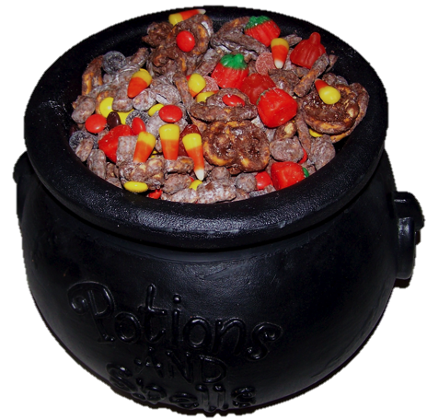


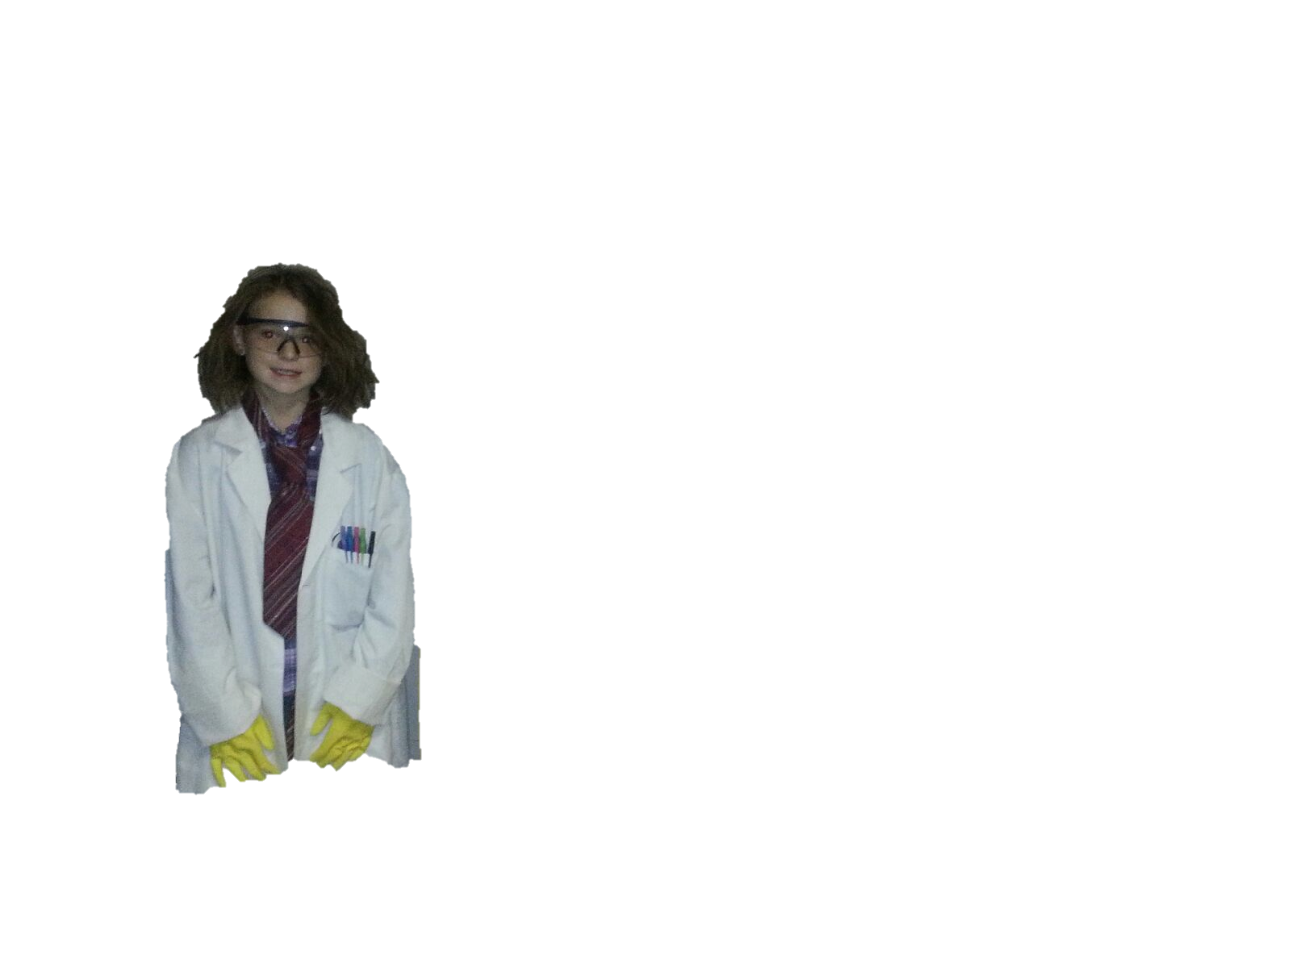
The Hallowe’en Interaction (HWI)
Trick or Treat Diagram

Slide 3

The Hallowe’en Interaction (HWI)
Trick or Treat Diagram

Slide 4
The Hallowe’en Interaction (HWI)
Trick or Treat Diagram

Slide 5
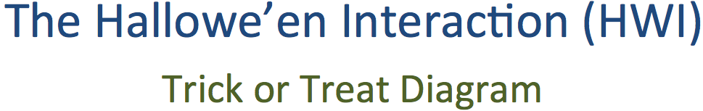

Slide 6
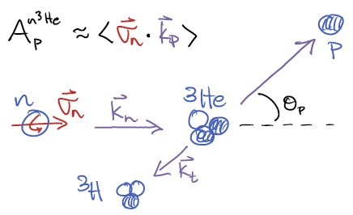

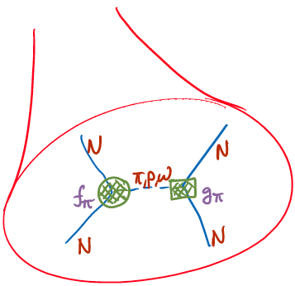


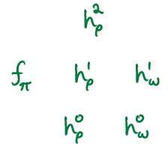


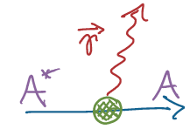
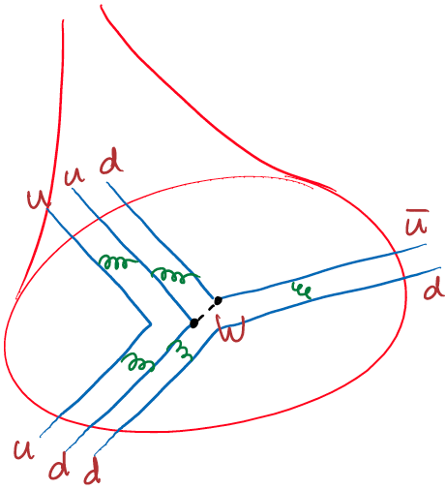

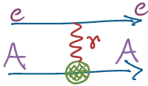



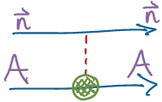

Hadronic Weak Interaction in a nutshell
Nuclear
<nuclear structure>
Hadronic
Nuclear PV
<QCD structure>
EW
Few-body PV

Slide 7
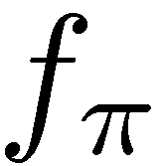
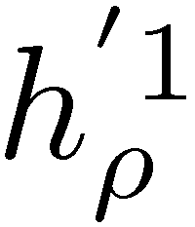
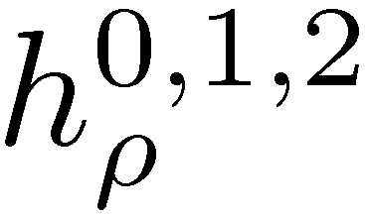
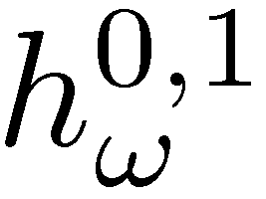

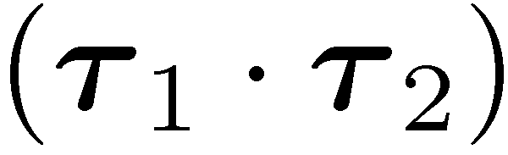
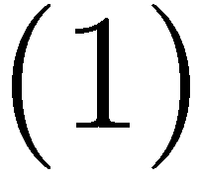

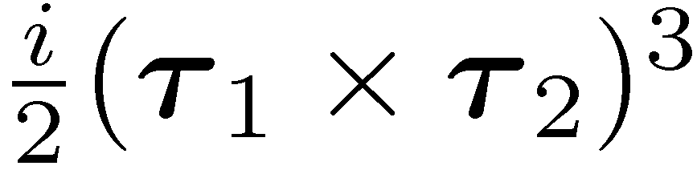
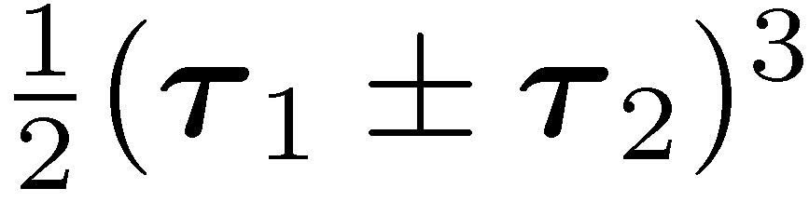
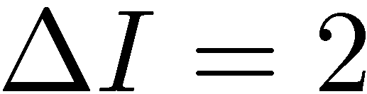
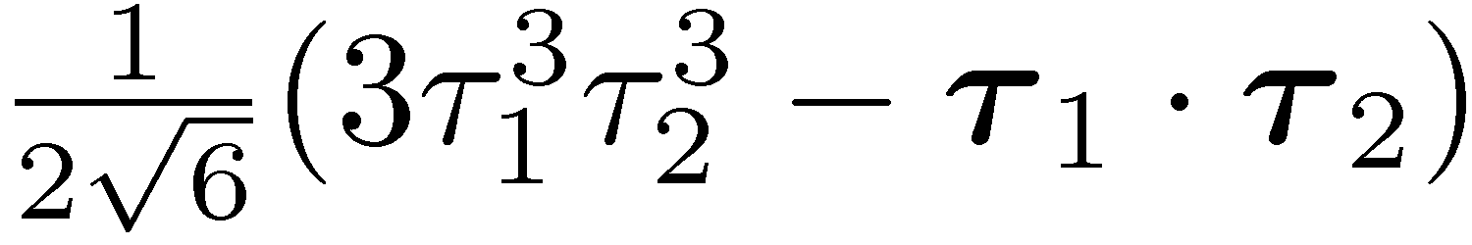

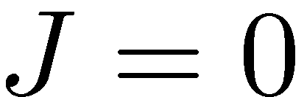
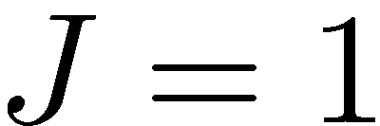
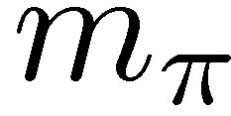
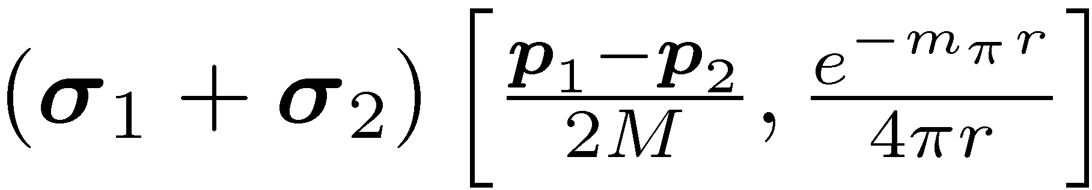
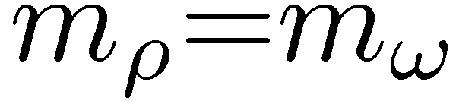

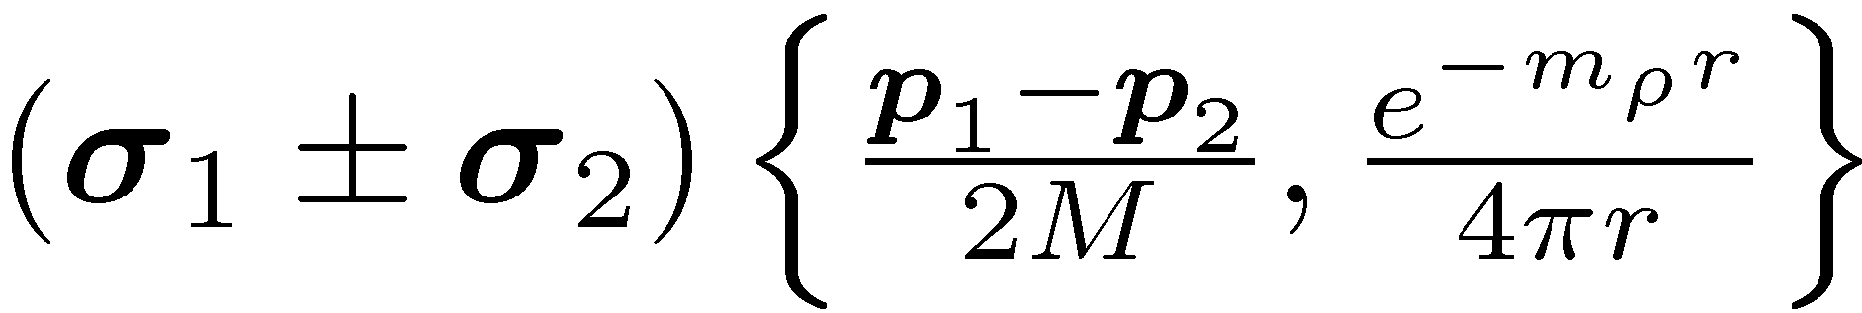
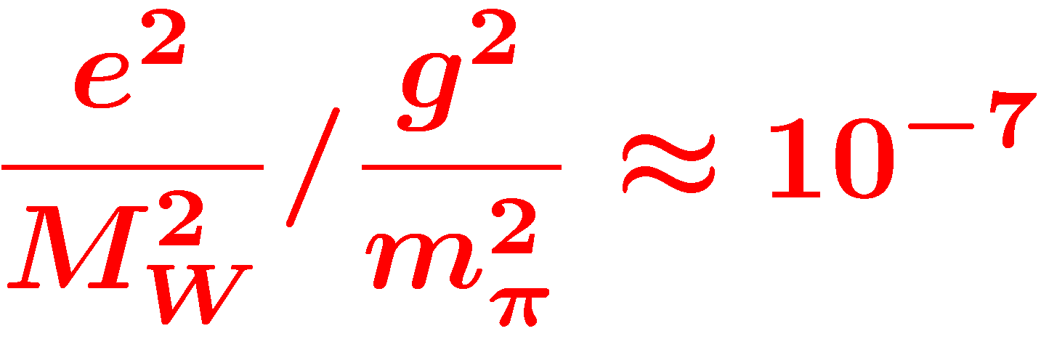
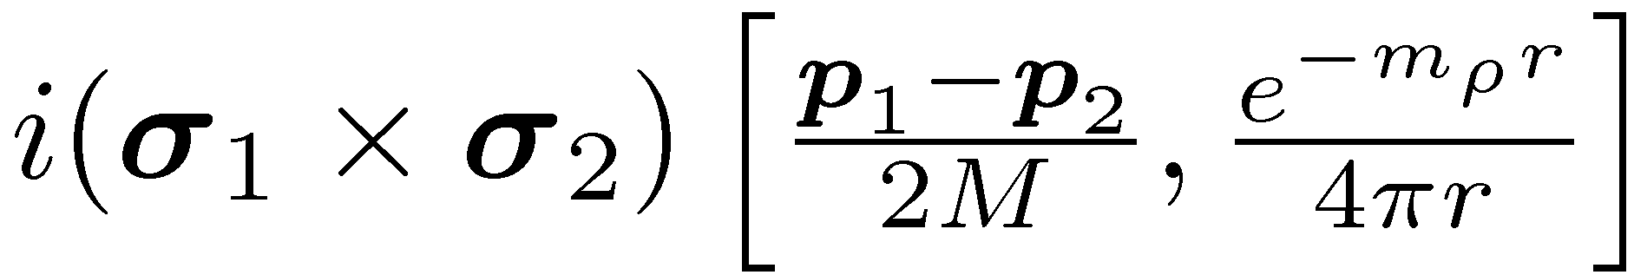
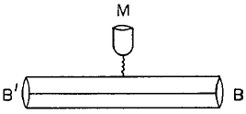
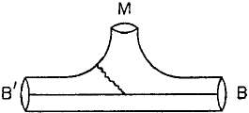
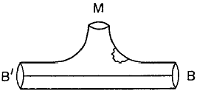
DDH Potential
PV meson exchange
N
N
isospin
STRONG
(PC)
WEAK
(PV)
Meson
exchange
range
N
N
 | np A_{γ} | nD A_{γ} | n³He A_{p} | np φ | nα φ | pp A_{z} | pα A_{z}
f_{π} | -0.11 | 0.92 | -0.18 | -3.12 | -0.97 |  | -0.34
h_{r}⁰ |  | -0.50 | -0.14 | -0. 23 | -0.32 | 0.08 | 0.14
h_{r}¹ | -0.001 | 0.10 | 0.027 |  | 0.11 | 0.08 | 0.05
h_{ρ}² |  | 0.05 | 0.0012 | -0.25 |  | 0.03
h_{ω}⁰ |  | -0.16 | -0.13 | -0. 23 | -0.22 | -0.07 | 0.06
h_{ω}¹ | -0.003 | -0.002 | 0.05 |  | 0.22 | 0.07 | 0.06
Desplanques, Donoghue, Holstein,
Annals of Physics 124, 449 (1980)
Adelberger, Haxton, A.R.N.P.S. 35, 501 (1985)

Slide 8
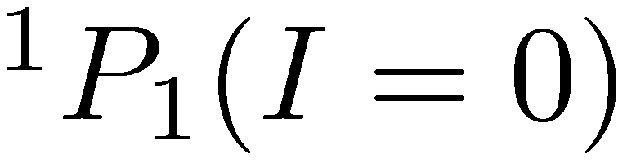
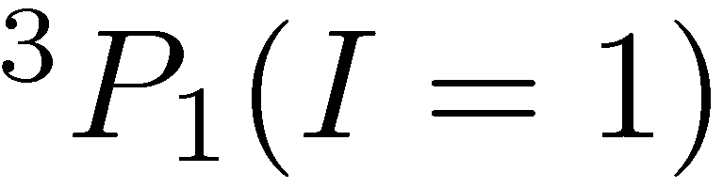
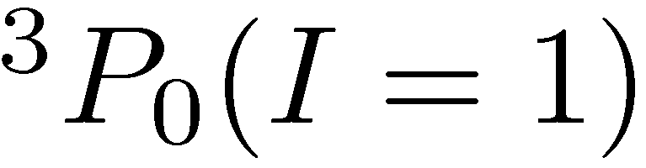
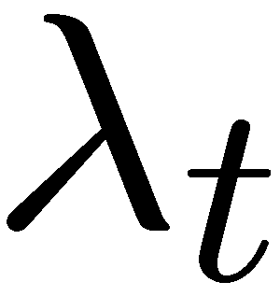
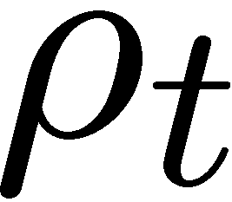
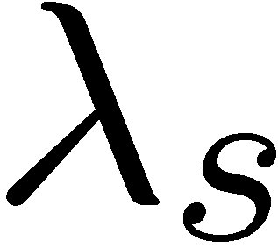
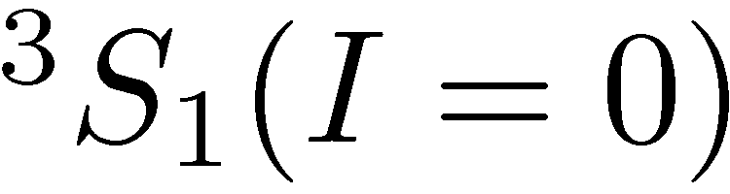
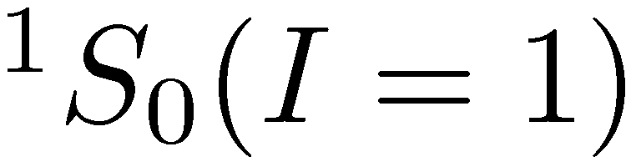
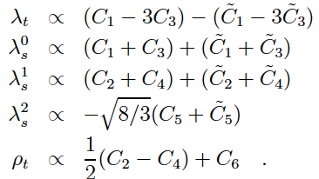
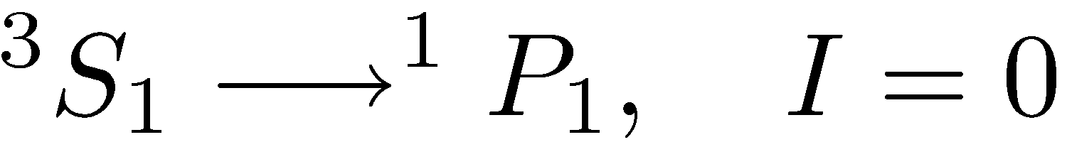
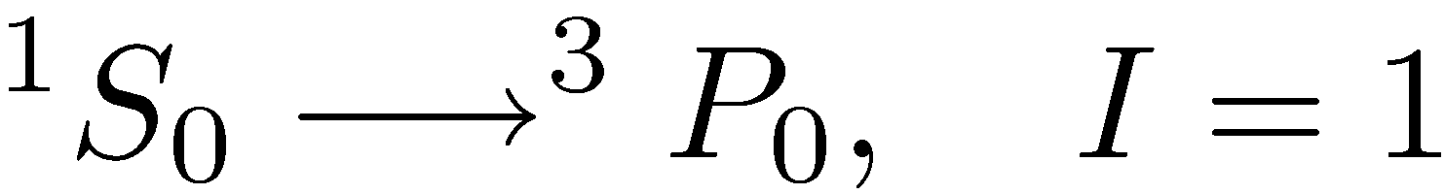
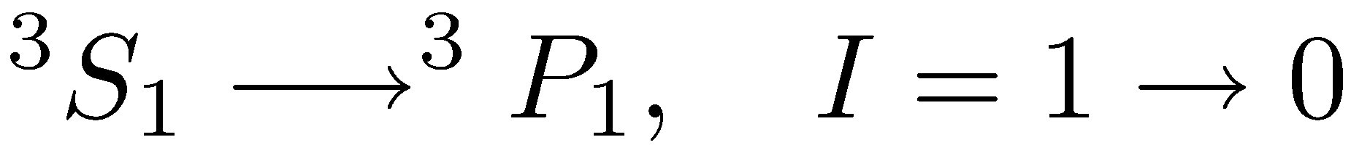
Danilov parameters / EFT
Elastic NN scattering
at low energy (<40 MeV)
S-P transition (PV)
S=1/2+1/2 , I=1/2+1/2
Antisymmetric in L, S, I
Conservation of J
Equivalent to Effective
Field Theory (EFT)
in low energy limit
C.-P. Liu, PRC 75, 065501 (2007)

Slide 9
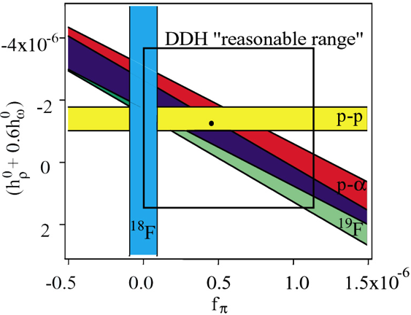
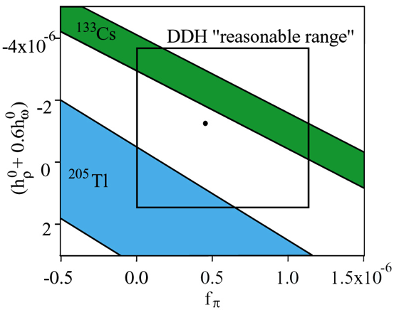
Existing HPV data
p-p scat. 15, 45 MeV A_{z}^{pp}
p-α scat. 46 MeV A_{z}^{pp}
p-p scat. 220 MeV A_{z}^{pp}
n+p→d+γ circ. pol. P_{γ}^{d}
n+p→d+γ asym. A_{γ}^{d}
n-α spin rot. dφ^{nα}/dz
¹⁸F asym. ΔI =1
¹⁹F, ⁴¹K, ¹⁷⁵Lu, ¹⁸¹Ta asym.
²¹Ne (even-odd)
¹³³Cs, ²⁰⁵Tl anapole moment
GOAL – resolve coupling
constants from few-body
PV experiments only
Wasem, Phys. Rev. C 85 (2012) 022501
1st Lattice QCD result
NPDGamma
p-p and nuclei
Anapole
Notes:
Wasem: 1.099+-.505 +.058-.064

Slide 10
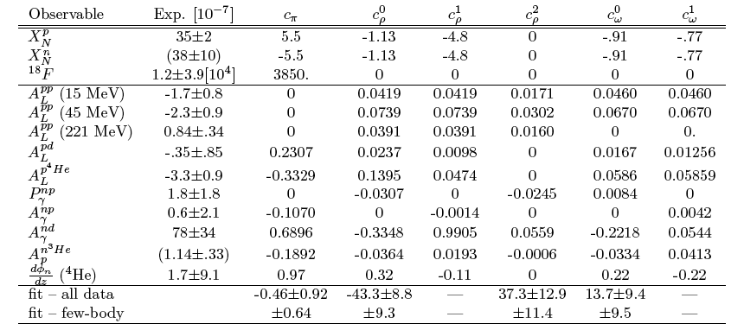
Sensitivity matrix for few-body reactions
Contribution: 1.15 0.087 1.55 – -.002 -0.47 –
Notes:
----- Meeting Notes (2013-01-23 09:38) -----
Here are the results of their calculation. You can see the strong I=1 dependence and the two I=0 terms. David went through the existing nuclear PV data and fit for 4 coefficients (ignoring the two other I=1 terms). If you use those values, you see that the total asymmetry is 1.15e-7, with a sizable I=0 contribution of two terms of opposite sign. Even if they completely cancel out, this is one of two linear combinations needed to resolve I=0 terms. Here is the improvement with n3He + NPDG excluding many-body reactions.

Slide 11
Experimental Sensitivities
Courtesy: Jason Fry

Slide 12
NPDGamma Collaboration
R. Alarcon¹, R. Allen¹⁸, L.P. Alonzi³, E. Askanazi³, S. Baeßler³, S. Balascuta¹, L. Barron-Palos², A. Barzilov²⁷, W. Berry⁸, C. Blessinger¹⁸, D. Blythe¹, D. Bowman⁴, M. Bychkov³, J. Calarco ,R. Carlini⁵, W. Chen⁶, T. Chupp⁷, C. Crawford⁸, M. Dabaghyan⁹, A. Danagoulian¹⁰, M. Dawkins¹¹, D. Evans³, J. Favela², N. Fomin¹², W. Fox¹¹, E. Frlez³, S. Freedman¹³, J. Fry¹¹, C. Fu¹¹, C. Garcia², T. Gentile⁶, M. Gericke¹⁴ C. Gillis¹¹, K Grammer¹², G. Greene^{4,12}, J Hamblen²⁶, C. Hayes¹², F. Hersman⁹, T. Ino¹⁵, E. Iverson⁴, G. Jones¹⁶, K. Latiful⁸, K. Kraycraft⁸, S. Kucuker¹², B. Lauss¹⁷, Y. Li³⁰, W. Lee¹⁸, M. Leuschner¹¹, W. Losowski¹¹, R. Mahurin¹², M. Maldonado-Velazquez², E. Martin⁸, Y. Masuda¹⁵, M. McCrea¹⁴, J. Mei¹¹, G. Mitchell¹⁹, S. Muto¹⁵, H. Nann¹¹, I. Novikov²⁵, S. Page¹⁴, D. Parsons²⁶, S. Penttila⁴, D. Pocinic³, D. Ramsay^{14,20}, A. Salas-Bacci³, S. Santra²¹, S. Schroeder³, P.-N. Seo²², E. Sharapov²³, M. Sharma⁷, T. Smith²⁴, W. Snow¹¹, J. Stuart²⁶, Z. Tang¹¹, J. Thomison¹⁸, T. Tong¹⁸, J. Vanderwerp¹¹, S. Waldecker²⁶, W. Wilburn¹⁰, W. Xu³⁰, V. Yuan¹⁰, Y. Zhang²⁹
¹Arizona State University
²Universidad Nacional Autonoma de Mexico
³University of Virginia
⁴Oak Ridge National Laboratory
⁵Thomas Jefferson National Laboratory
⁶National Institute of Standards and Technology
⁷Univeristy of Michigan, Ann Arbor
⁸University of Kentucky
⁹University of New Hampshire
¹⁰Los Alamos National Laboratory
¹¹Indiana University
¹²University of Tennessee, Knoxville
¹³University of California at Berkeley
¹⁴University of Manitoba, Canada
¹⁵High Energy Accelerator Research
Organization (KEK), Japan
¹⁶Hamilton College
¹⁷Paul Scherer Institute, Switzerland
¹⁸Spallation Neutron Source, ORNL
¹⁹University of California at Davis
²⁰TRIUMF, Canada
²¹Bhabha Atomic Research Center, India
²²Duke University
²³Joint Institute of Nuclear Research,
Dubna, Russia
²⁴University of Dayton
²⁵Western Kentucky University
²⁶University of Tennessee at Chattanooga
²⁷Univeristy of Nevada at Los Vegas
²⁸University of California, Davis
²⁹Lanzhou University
³⁰Shanghai Institute of Applied Physics

Slide 13
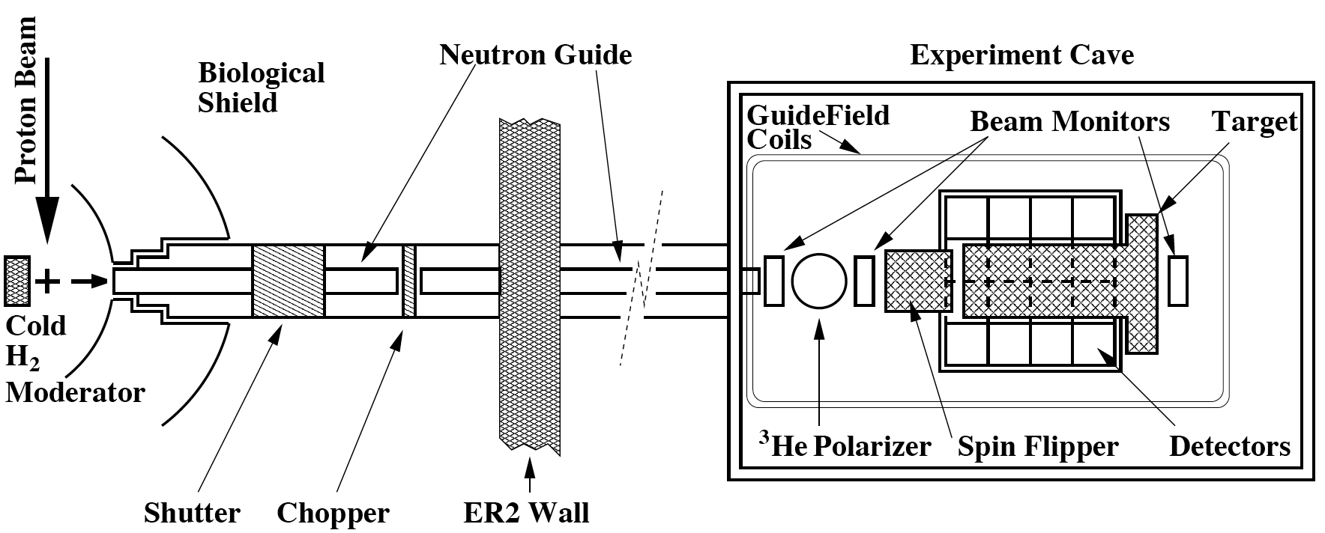
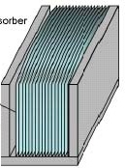
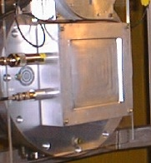
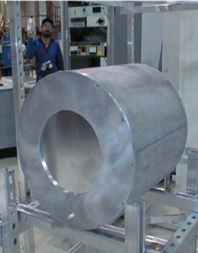


Experimental Layout
Supermirror Polarizer
Beam Monitors
RF Spin Rotator
LH₂ Target
Gamma Detectors

Slide 14

Experimental setup at the FnPB
CsI Detector Array
Supermirror
polarizer
Liquid H₂ Target
H₂ Vent Line
H₂ Manifold Enclosure
Magnetic Shielding
FNPB guide
Magnetic Field Coils
Beam Stop

Slide 15


Spallation neutron source
spallation sources: LANL, SNS
  pulsed -> TOF -> energy
LH2 moderator: cold neutrons
  thermal equilibrium in ~30 interactions
Notes:
226 us RMS width moderated pulse
18 m, TOF=11-27 ms, v = 1700-650 ms/s
E=15 – 2.3 meV

Slide 16

Neutron Flux at the SNS FnPB
Flux = 6.5x10¹⁰ n/s/MW
2.5 Å < λ < 6.0 Å
15 meV LH₂ threshold
SNS TOF window

Slide 17
Chopped & folded spectrum
Notes:
here is a plot of our He3 beam monitor, it is our first beam monitor in the beam guide, As you can see, these notches are aluminum bragg edges, and here is when the chopper is closing and here is the opening edge of the chopper.

Slide 18




Measurement of Beam Flux and Profile

Slide 19




Nuclear interaction: neutron optics
Fermi potential:
Optical potential:
Index of refraction:

Slide 20



FnPB supermirror polarizer
Fe/Si on boron float glass, no Gd
m = 3.0 critical angle
n = 45 channels
r = 9.6 m radius of curvature
l = 40 cm length
d = 0.3mm vane thickness
T=25.8% transmission
P=95.3% polarization
N=2.2£10¹⁰ n/s output flux (chopped)
simulations using
McStas / ROOT ntuple
S. Balascuta et al., Nucl. Instr. Meth. A671 137 (2012)

Slide 21





Polarimetry – ³He spin filter

Slide 22



Longitudinal RF spin rotator
Resonant RF spin rotator,
  1/t RF amplitude tuned to velocity of neutrons
  Affects spin only – NOT velocity! (no static gradients)
essential to reduce instrumental systematics
  spin sequence: ↑↓↓↑ ↓↑↑↓ cancels drift to 2nd order
  danger: must isolate fields from detector
  false asymmetries: additive & multiplicave
holding field
s_{n}
B_{RF}
P. Neo-Seo, et al. Phys. Rev. ST Accel. Beams 11 084701 (2008)

Slide 23



Neutron beam monitors
Purpose:
  – Neutron Flux monitor
  – Neutron Polarimetry
  (in conjunction with
  ³He analyzer)
  – Monitor ortho/para
  ratio in the target
Improvements:
  – Larger beam cross section
  – Wires electrodes instead of plate
  Reduced absorption and scattering of beam
  Reduced microphonic noise pickup
Similar chamber being constructed for n-³He exp.

Slide 24


16L liquid para-hydrogen target
30 cm long → 1 interaction length
99.97% para → 1% depolarization
Improvements: pressure-stamped vessel
thinner windows
p
p
ΔE =
15 meV
p
p
para-H₂
ortho-H₂
ortho
15 meV
para
σ (b)
capture
E_{n} (meV)

Slide 25
Ortho vs. Para H₂ neutron scattering
Simulation by
Kyle Grammer
L. Barron-Palos et al., Nucl. Instr. Meth. A671 137 (2012)

Slide 26

Installation of the LH₂ target in the FnPB
Target Commissioned
December 2011

Slide 27




CsI(Tl) Detector Array
4 rings of 12 detectors each
  15 x 15 x 15 cm³ each
VPD’s insensitive to B field
detection efficiency: 95%
current-mode operation
  5 x 10⁷ gammas/pulse
  counting statistics limited

Slide 28




Background Sub. & Geometry Factors
Aluminum
asymmetry
neutron
pol.
RFSF
eff.
target
depol.
Aluminum
background
UP-DOWN
LEFT-RIGHT

Slide 29
Chlorine PV asymmetry
Data set
  40 hr. over 4 run periods
Corrections
  Background Subtraction
  Beam Polarization
  Beam Depolarization
  RFSF Efficiency
  Geometric factors (1% uncertainty)
Measurement | Asymmetry (x10⁻⁶)
LANL | -29.1 ± 6.7
Leningrad | -27.8 ± 4.9
ILL | -21.2 ± 1.72
SNS (Current result) | -25.9 ± 0.6

Slide 30



Aluminum Asymmetry
Dominant systematic effect
  15–25% background at SNS
Extracted from decay amplitude
  Lifetime τ = 27 min
Must measure δA = 3 x 10⁻⁸
PRELIMINARY

Slide 31
Recent Hydrogen Data
200 hr. of data from Fall 2012
Preliminary result:
A_{UD} = (-7.14 ± 4.4) x 10⁻⁸
A_{LR} = (-0.91 ± 4.3) x 10⁻⁸

Slide 32

Systematic & Statistical Uncertainties

Slide 33
n-3He Collaboration

Slide 34









n-³He PV Asymmetry
+
p
n
p
+
n
n
PV observables:
n
n
p
n
p
p
p
~ k_{n} very small for
low-energy neutrons
S(I):
- essentially the same asym.
- must discriminate between
back-to-back proton-triton
4He J^{π} =0⁺ resonance
sensitive to EFT coupling
or DDH couplings
~10% ΔI=1 contribution
(Gerry Hale, qualitative)
A ~ -1–3x10⁻⁷ (M. Viviani, PISA)
A ~ -1–4x10⁻⁷ (Gudkov)
mixing between 0⁺, 0⁻ resonance
Naïve scaling of p-p scattering
at 22.5 MeV: A ~ 5x10⁻⁸
20.578
19.815
Tilley, Weller, Hale, Nucl. Phys. A541, 1 (1992)
Notes:
Theory for this reaction is possible due to extensive study of the 4-body system by Gerry Hale. The n+3He -> p t reaction has a strong 4He 0+ resonance. The reaction is exothermic so capture is in the S-wave, and makes detection easy. All of the reactants and products are I=1/2 s=1/2 states, but 4He resonance dictates it it as an I=0 transition. Parity violation is due to mixing between the 0+ and 0- state. The spin zero would loose memory of the initial neutron spin, excpet for the mixing of the j=2- state, so really it’s at least the three lowest states that combine to give a PV asymmetry.
Here are the PV observables: the first scales as the neutron velocity and is un-measurable. The proton and triton asymmetries are essentially the same since they decay back-to-back. There is a small dI=1 contribution, but the main contribution is from the dI=0 coupling coefficients.

Slide 35
Theoretical calculations – progress
Gerry Hale (LANL) PC A_{y}(90) = -1.7 +/- 0.3 x 10⁻⁶
  R matrix calculation of PC asymmetry,
  nuclear structure , and resonance properties
Michele Viviani et al. (INFN Pisa) PV A = -(.248 – .944)£10⁻⁷
  full 4-body calculation of scattering wave function
    Kohn variational method with hyperspherical functions
    No parity mixing in this step: J^{π} = 0⁺, 0⁻, 1⁺, 1⁻
    Tested against n-³He scattering lengths
  evaluation of weak <J⁻|V_{PV}|J⁺> matrix elements
    In terms of DDH potential
  Viviani, Schiavilla, Girlanda, Kievsky, Marcucci, PRC 82, 044001 (2010)
  Girlanda, Kievsky, Marcucci, Pastore, Schiavilla, Viviani, PRL 105 232502 (2010)
Vladimir Gudkov (USC) PV A = -(1 – 4)£10⁻⁷
  PV reaction theory
  Gudkov, PRC 82, 065502 (2010)
Michele Viviani et al. (INFN Pisa) PV V_{NN}^{EFT}, a₀ – a₅
  Viviani, PAVI (2011), preliminary
Notes:
A major achievement since the PRAC is a full calculation of the PV asymmetry in the DDH framework by the Viviani group in PISA. It is still preliminary, but so far the value is right about where we expect based on level-mixing estimations. More important that the asymmetry is the dependence on all of the DDH coeficients.
----- Meeting Notes (2013-01-23 09:38) -----
On the theory side, at the first PRAC we presented an order of magnitude estimate of Az, and the guidance was to get a real calculation. Viviani and collaborators had full 4-body calculations of nuclear wavefunctions, and they were interested in using them to calculate the parity odd matrix elements. Then we came back and the guidance was to have a modern EFT calculation, and we now have preliminary calculation from the same group.

Slide 36
Experimental setup at the FnPB
FnPB cold
neutron guide
supermirror
bender polarizer
(transverse)
10 Gauss
solenoid
³He Beam
Monitor
RF spin
rotator
³He target /
ion chamber
FNPB
n-³He
longitudinal holding field – suppressed PC nuclear asymmetry
A=1.7x10⁻⁶ (Hales) s_{n} • k_{n} x k_{p} suppressed by two small angles
RF spin flipper – negligible spin-dependence of neutron velocity
³He ion chamber – both target and detector
Notes:
36
So what do we need for the experiment? Polarized neutrons which we already have on the FnPB.
We need to longitudinalize the neutrons, for reasons I’ll explain later, with an adiabatic transition,
So we also need a new type of spin flipper (for fast spin reversals)
The reaction takes place right in the ion chamber, which measures the outgoing products.

Slide 37

Transverse RF spin rotator
Resonant RF spin rotator
  P-N Seo et al., Phys. Rev. S.T.
  Accel. Beam 11, 084701 (2008)
Properties suitable for n-³He expt.
  Transverse horizontal RF B-field
  Longitudinal or transverse flipping
  No fringe field - 100% efficiency
  Real, not eddy currents along outside
  minimizes RF leaked outside SR
  Doesn’t affect neutron velocity
  Compact geometry
  Matched to the driver electronics
  of the NPDGamma spin flipper
Construction
  Development in parallel with similar design for nEDM neutron guide field
  Few-winding prototype built at UKy; Production RFSF being built now
NPDGamma
windings
n-³He
windings
field lines
end cap windings

Slide 38




Inner / outer coil design
Windings calculated using scalar potential
  Uniform transverse RF field inside
  Zero leakage field enforced by B.C.’s
  Copper wires run along equipotentials
  Inner region:
  Intermediate:
  Outer region:
4:1 inside / outside winding ratio
  By choosing
  appropriate radii
  Perfect cos theta
  windings inside & out
  48 inner loops of
  18 AWG wire

Slide 39



Target Chamber
Chamber design finished in 2010
  delivered to U. of Manitoba, Fall 2010
All aluminum except for the knife edges.
  4 feedthrough ports (200 readout channels)
  2 HV ports + 2 gas inlets/outlets
  12 inch Conflat aluminum windows (0.9 mm thick).

Slide 40



Frame Design and Construction
Chamber frame design finished in 2012
Received 50 Macor wire frames (up to 25 signal and 25 HV) $30K
Final feature machining planned for early this year at UT shop.
Platinum-Gold thick film wire solder pads on Macor to be completed early this year by Hybrid Sources Inc..

Slide 41



Frame Assembly and Signal Readout
The frame mounting structure is designed
  pieces will be ordered in the spring
Two options for frame mounting:
  Mount into exit flange with threaded rods
  Insert into existing exit window flange
Signal readout via circuit board traces
  Single HV connections
  Guide wires to feedthroughs with PMT-
  inspired stand-offs and ceramic beads

Slide 42



Asymmetry Measurement – Statistics
PV Physics asymmetry is extracted from weighted average of
single-wire spin asymmetries
Two Monte Carlo simulations:
  a code based on GEANT4
  a stand-alone code
  including wire correlations
N = 1.5x10¹⁰ n/s flux (chopped)
x 10⁷ s (116 days)
P = 96.2% neutron polarization
σ_{d} = 6 detector inefficiency
15% measurement in 1 beam cycle (without contingency),
assuming A_{z}= 1.15 x 10⁻⁷
Notes:
The neutron captures here, and we want to measure the proton asymmetry, or the proton angle as a function of spin.
But the event rate is too large to reconstruct tracks, so we must measure spin asymmetries on each wire.
The opposite triton dilutes the proton asymmetry, and also protons coming from decays downstream, but most decays happen at the front of the chamber.
Even with a large detector inefficiency, the event rates are so high that we expect an error of 1.6e-8, which may be the best relative precision for a few-body HWI experiment.

Slide 43



Systematic Uncertainties
Beam fluctuations, polarization, RFSF efficiency:
k_{n}r ~ 10⁻⁵ small for cold neutrons
PC asymmetries minimized with longitudinal polarization
Alignment of field, beam, and chamber to 10 mrad is achievable
Unlike n p -> d ° or n d -> t °,
n-³He is very insensitive to gammas (only Compton electrons)
Notes:
To reduce the spin asymmetry

Slide 44


Assembly in the FnPB cave

Slide 45









Commissioning / run plan
Scan beam profile upstream
and transfer centroid to crosshairs
Scan beam profile downstream
Align theodolite to crosshairs
Align B-field to theodolite
Field map in RFSR/Target region
Align the position / angle of target with theodolite / autocollimator
Tune RSFR / measure polarization
Measure physics asymmetry

Slide 46

Conclusion
Hadronic Parity Violation
  Is a complementary probe of
  nuclear and nucleonic structure
  A suite of at least four independent
  observables is needed to isolate
  the spin and isospin dependence
  With the five experiments:
  pp (45MeV), pp (220 MeV),
  NPDGamma, n-3He, NSR-III
  we can test the self-consistency
  of HWI formalisms
NPDGamma Experiment
  Sensitive to long-range coupling f_{¼}
  Statistics-limited experiment
  A_{γ} = (-7.1 ± 4.4) x 10⁻⁸
  Expect full data set by June 2014
  Goal sensitivity: δA = 1 x 10⁻⁸
n-³He Experiment
  Last to characterize HWI
  15% projected uncertainty most accurate few-body HWI experiment
  FnPB beam: June 2014 – Dec 2015
NSR-III Experiment
  Gives us an over-constrained system
  of HWI observables

Slide 47




Acknowledgements
Yunchang Shin
Elise Martin
Daniel Wagner
Binita Hona
Andrew McNamara
Michael Brown
Aaron Sprow
Kabir Latiful
Chris Hayes
Josh Henry
Mary Estes
Adam Ruff
Haynes Wood
Chris Menard
Roel Flores
Charles Fieseler
Robert Milburn
Jodie Lusby
Kayla Craycraft
Anna Butler
William Berry
Mario Fugal
Justin Tomey
Will Bates
Edward Goodman
Forrest Simmons
Brad Irvin
Alec Gilbert
Dustin Doss
Joseph Natter
Deborah Ferguson
Rebecca Schladt
Mykalin Jones

Slide 48


New Pi-coil Geometry
Features:
  Flat surface supports
  and straight line windings
  Field lines kink at
  current-sheet interface
  between wedges
  Uniform flux density everywhere
  Crossovers in between wedges
  for automatic double-winding

