Slide 1
The Physics of Global Warming
Joseph P. Straley
Department of Physics & Astronomy
University of Kentucky
straley@pa.uky.edu

Slide 2
The Method of Science
Collect facts
Look for patterns and explanations that unite the facts. The best explanation is called The Theory.
The Theory usually implies effects that haven’t been noticed. Look for these effects.
If they are found, add them to the list of facts. If not, improve The Theory.
Repeat from step 1!

Slide 3
The idea of science
Things happen for a reason; there are natural laws that relate cause and effect
These laws are simple enough that we can figure them out
By finding out how the world works, we can improve our environment and make useful things.

Slide 4
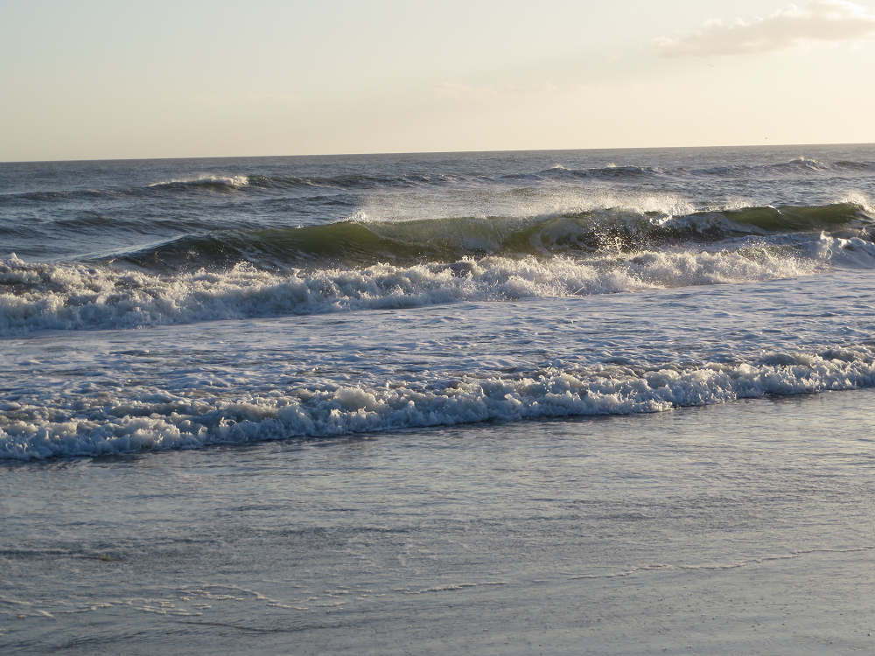
Can we predict the waves?

Slide 5
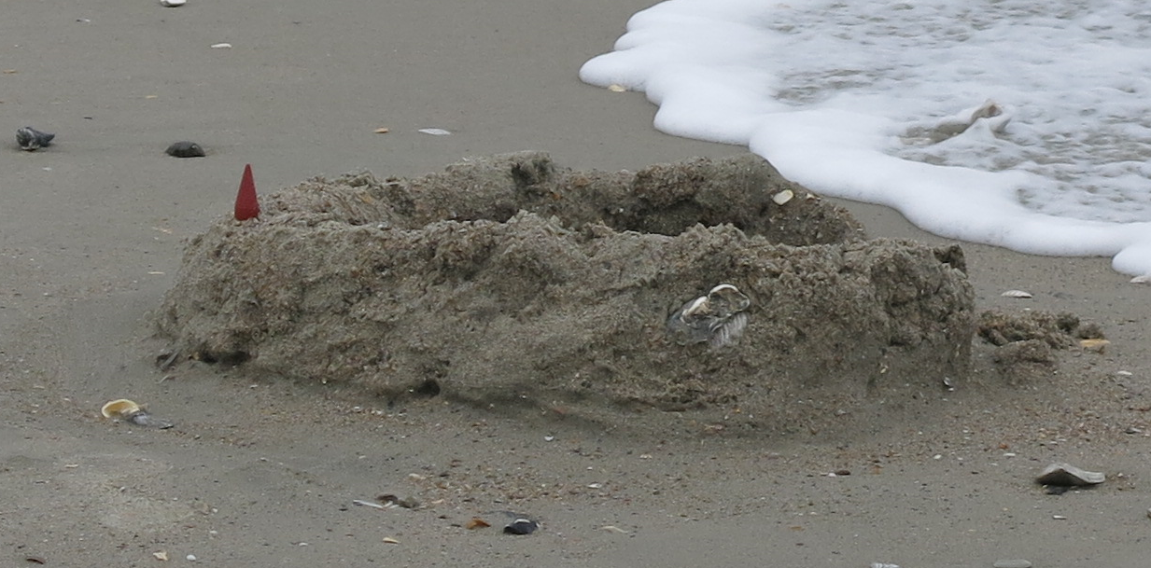
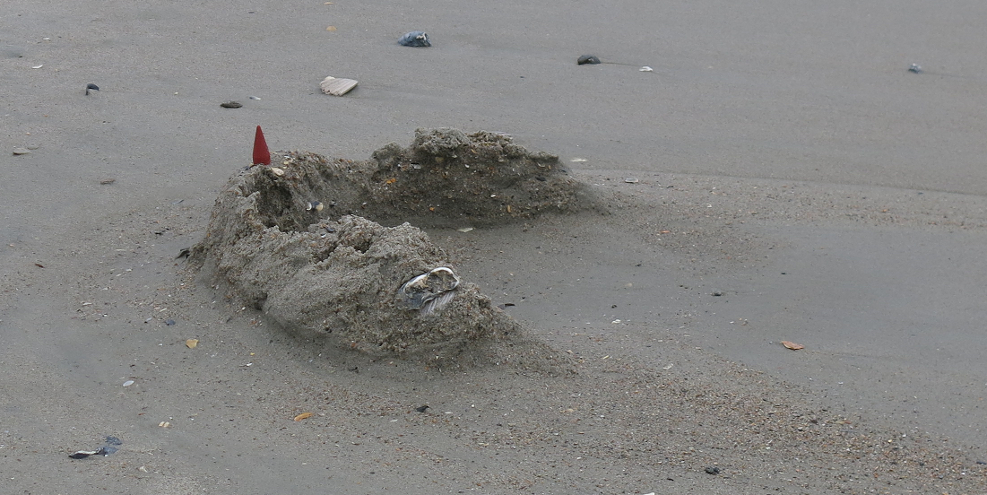
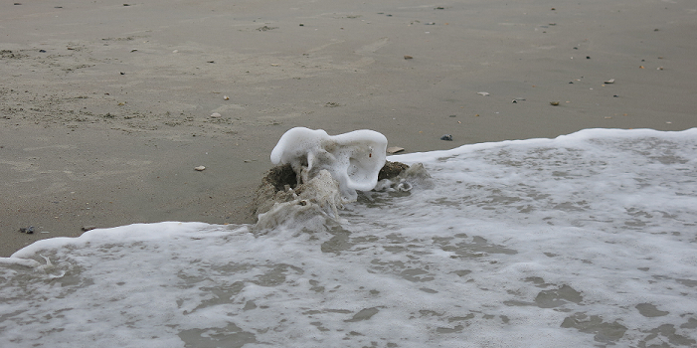
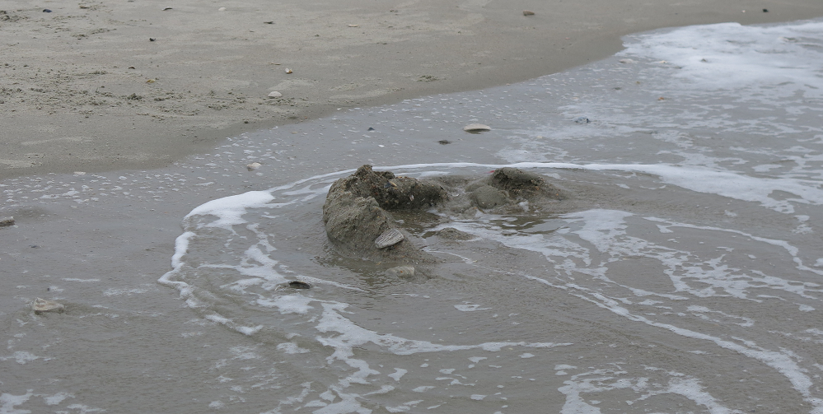
Can we predict what will happen?

Slide 6
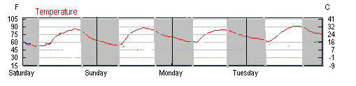
Fact: it gets cold at night.
The temperature steadily decreases at night. Why?
X X X X X X X X
Bertie says, “Because the sun is not shining.”
Carla objects, “But it isn’t cold in a closet!”

Slide 7
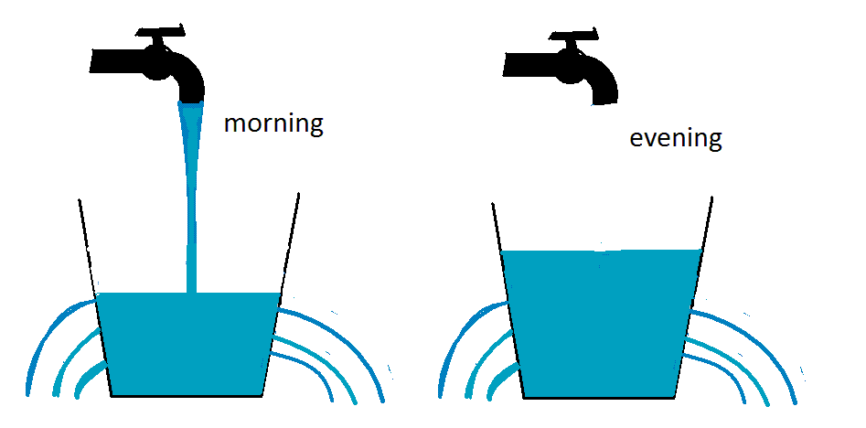
The leaky bucket model
The water level corresponds to the temperature
It goes up during the day. It goes down at night.
Water is “conserved.”
Energy is conserved.

Slide 8
The temperature goes up during the day, and decreases at night

Slide 9
The leaky bucket model
What are the leaks?
Where does the energy go?

Slide 10
Physics news:
All objects emit light
Sufficiently hot objects glow –
Red hot == 500 C
Yellow hot == 1000 C
White hot (like the sun) == 6000 C
Near room temperature the emission is not visible (infrared light), and low power

Slide 11
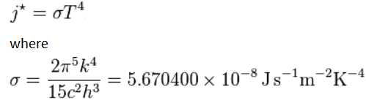
Stefan-Boltzmann Law
The power radiated per square meter at Kelvin temperature T is
At T = 300 K (room temperature),
J = 460 Watt/m²

Slide 12
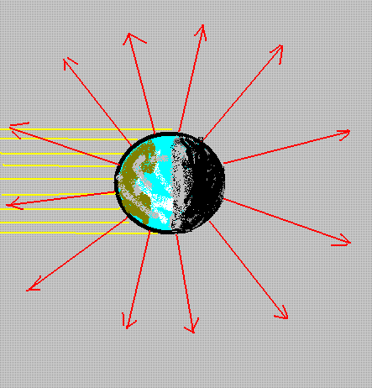
Radiation cools the earth
Energy comes from the sun in the form of visible light, during the daylight hours.
Energy leaves the earth all the time, in the form of infrared light.

Slide 13
The temperature goes up during the day, and decreases at night

Slide 14
The temperature of the earth
Energy comes from the sun in the form of visible light
All of this energy is reemitted, so that the energy of the earth stays the same from day to day.
Both input and output are nearly constant in time.
This determines the average temperature of the earth

Slide 15
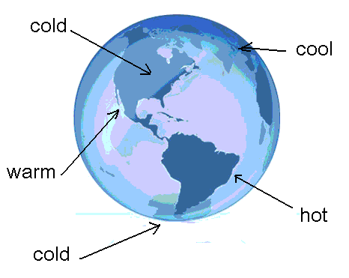
The temperature of the earth
Different parts get different amounts of sun.
Weather moves the energy around.
The average temperature is constant.

Slide 16
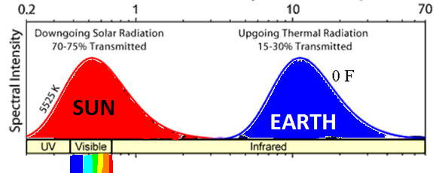
The temperature of the earth
Energy comes from the sun in the form of visible light, and leaves in the form of infrared light..
This determines the average temperature of the earth

Slide 17
Any questions?

Slide 18
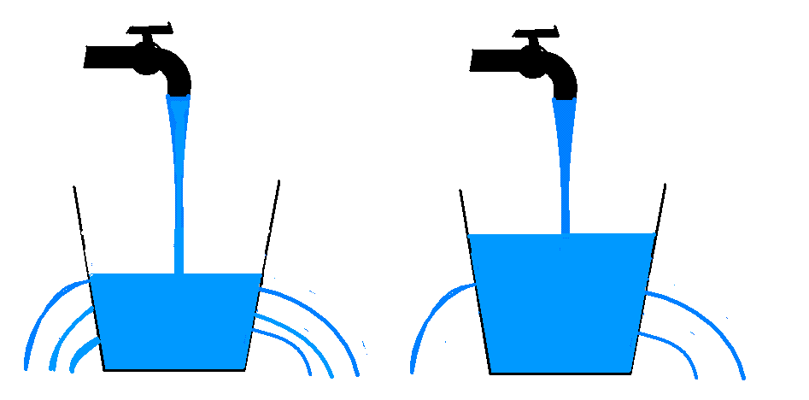
The temperature of the earth
There’s a problem with the theory: It predicts that the earth should be much colder than it is. Energy is not leaking away as fast as it should
This means that something is blocking some of the leaks.

Slide 19
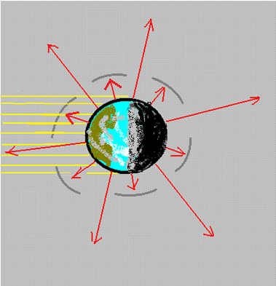
The earth is warmer than expected
The earth is warmer than expected, because some of the energy emitted from the ground is absorbed by the atmosphere (plugging part of the “leak”). But the visible light from the sun is not affected. This raises the temperature of the earth from 0 F to 55 F.

Slide 20
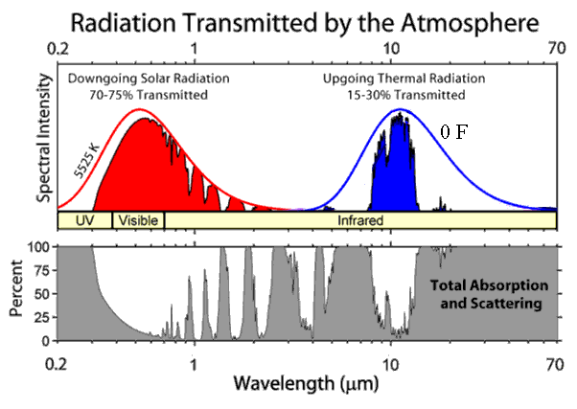
What is plugging the leaks?
The atmosphere is transparent in the visible, but not in the infrared. This is due to the presence of “greenhouse gases”:

Slide 21
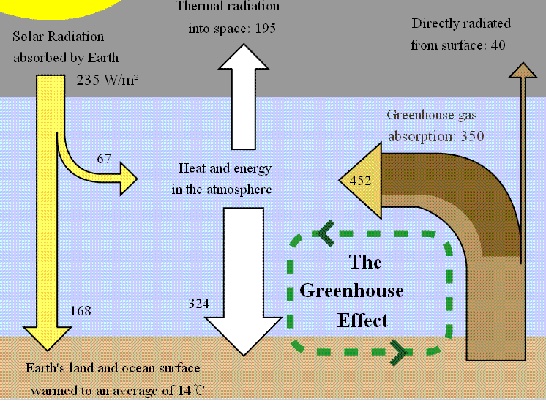
Greenhouse effect

Slide 22
Greenhouse gases
Water vapor -- 2/3 of the effect
Carbon dioxide (CO₂) -- 1/4
Methane and other gases -- 1/10

Slide 23
Any questions?

Slide 24
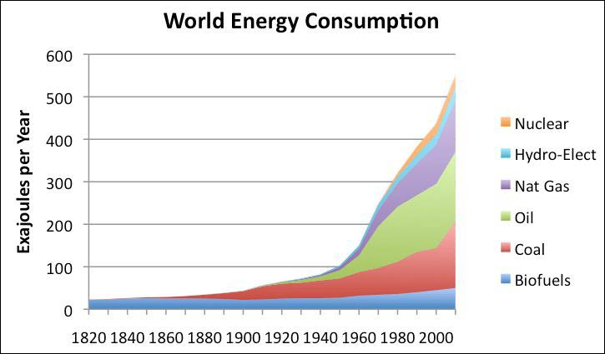
Where does our energy come from?
… from burning fossil fuels.

Slide 25
Burning fossil fuels
Fossil fuels are the remains of plants that lived 300 million years ago. They turned carbon dioxide from the atmosphere into plant material (like leaves) that have been buried ever since. When we burn coal and oil and gas we put the carbon dioxide back into the atmosphere.

Slide 26
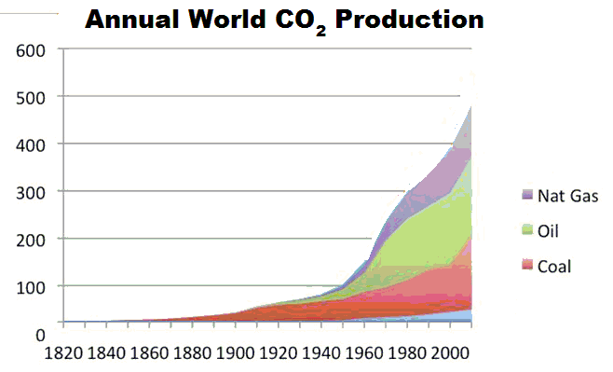
Burning fossil fuels
A chemical reaction:
Fuel + oxygen → energy + CO₂

Slide 27
What happens to the CO₂?
Theory: It gets stored in various reservoirs:
Mineralization Really slow
Deep ocean 500 year time scale
Plants Not being accumulated now
Ocean surface water
The atmosphere

Slide 28
Reservoirs for CO₂
The atmosphere
Ocean surface water
Plants
The atmosphere and the ocean surface water are closely coupled: CO₂ freely moves among them, and is shared in a fixed proportion.

Slide 29
Implication of the theory
The CO₂ content of the atmosphere is cumulative of all burning of fossil fuels. It is a permanent change (on a 500-year time scale). The amount of CO₂ in the atmosphere should be steadily rising, and this will continue as long as we continue to burn fossil fuels.

Slide 30
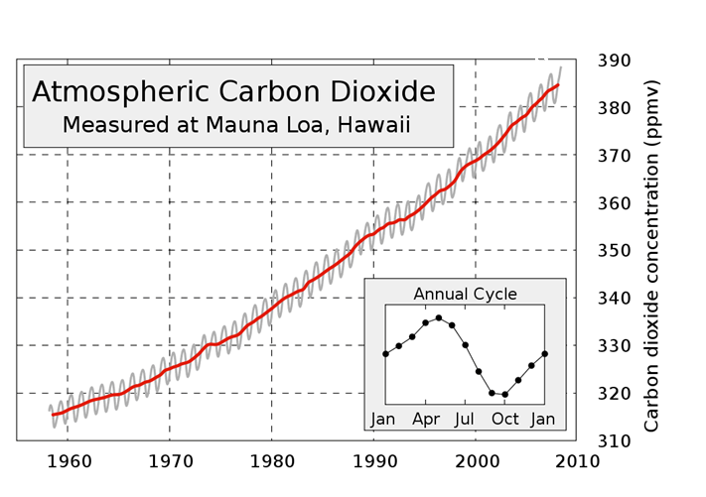
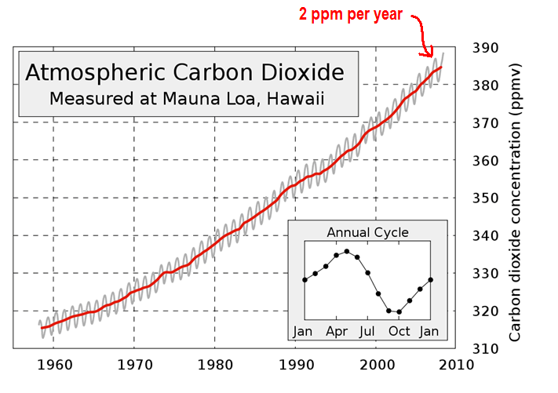
Increasing carbon dioxide

Slide 31
Did humans cause the increase?
It seems likely. We know how much coal and oil we burn in a year (the equivalent of 10 billion tons of coal) and we know how much CO₂ there is in the atmosphere.
The CO₂ concentration would be increasing by 3.3 parts per million per year if it all stayed in the atmosphere.

Slide 32
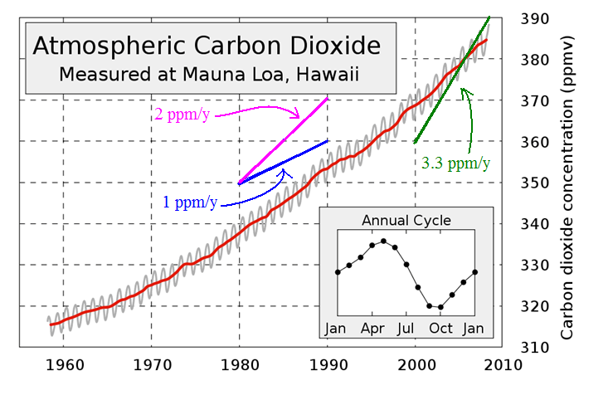
Did humans cause the increase?
It seems likely. We know how much coal and oil we burn in a year.

Slide 33
Any questions?

Slide 34
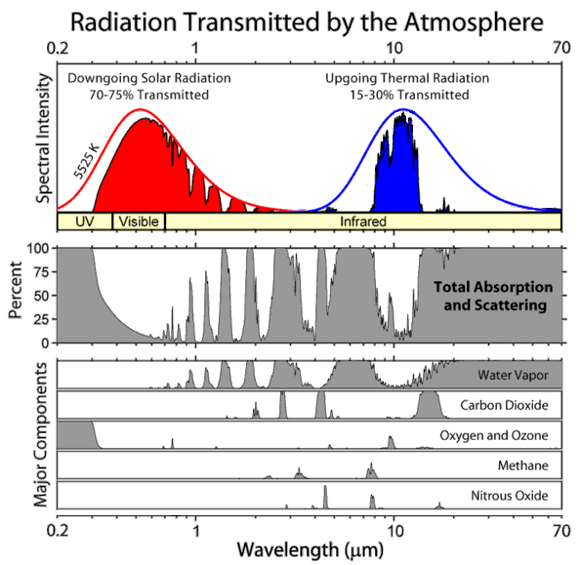
http://en.wikipedia.org/wiki/File:Atmospheric_Transmission.png

Slide 35
Greenhouse gases, again
The concentration of water in the atmosphere doesn’t change.
Methane doesn’t last very long.
CO₂ is accumulating in the environment. This should cause the earth to get warmer (another theory!).

Slide 36
Any questions?
Some infrared radiation is being absorbed by water vapor, carbon dioxide, and some other gases. The atmosphere should be making the earth warmer, just as a blanket keeps you warm.

Slide 37
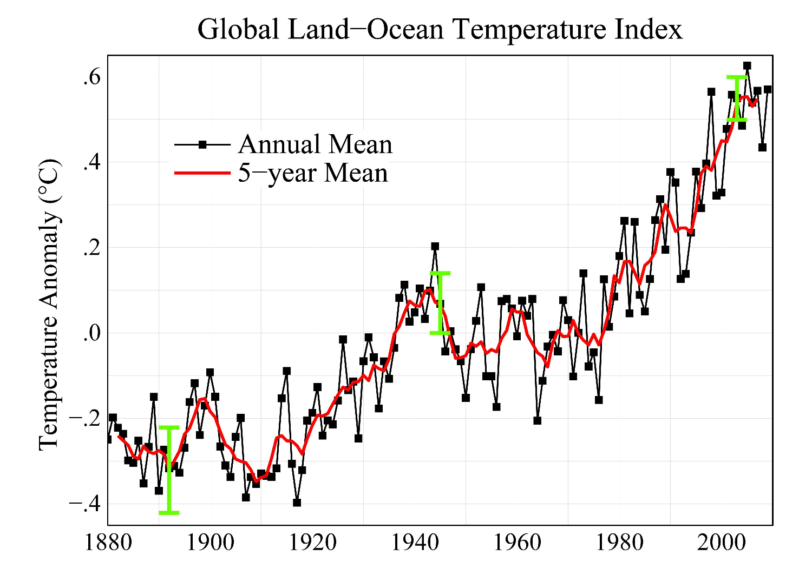
Is the temperature increasing?

Slide 38
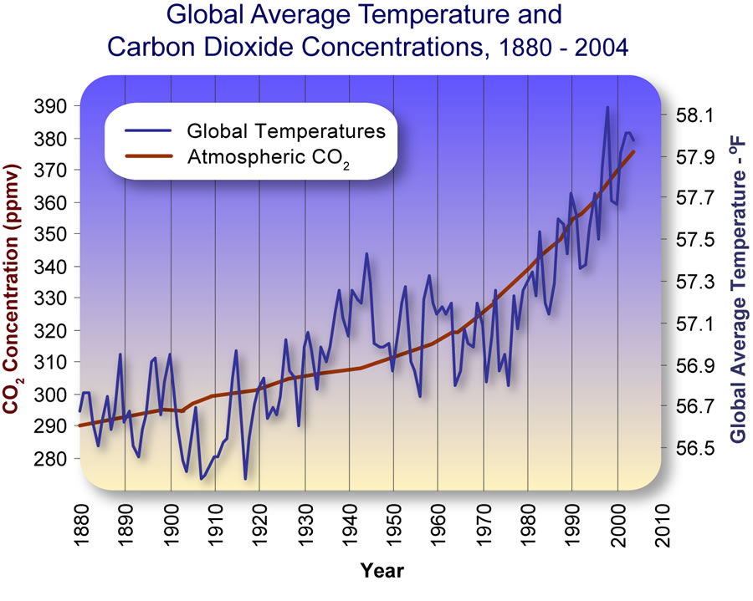
Overlaying two graphs

Slide 39
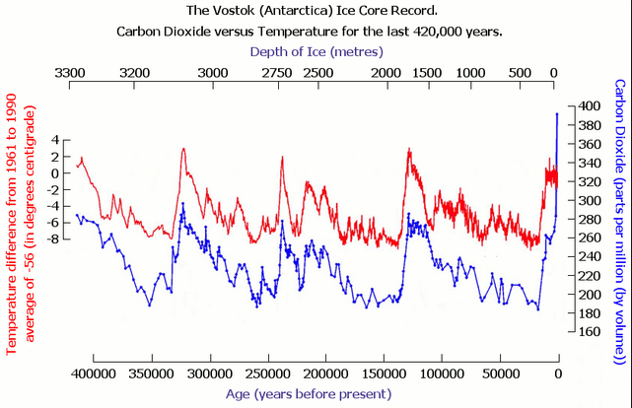
History of the earth’s temperature

Slide 40
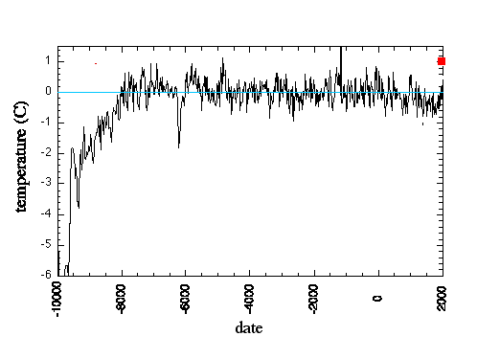
History of the earth’s temperature

Slide 41
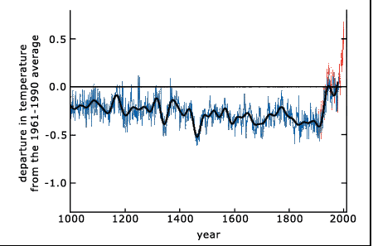
History of the earth’s temperature

Slide 42
Apparently, the earth is getting warmer
It amounts to about 2 Fahrenheit degrees over the last century.
Did the increase in CO₂ in the atmosphere cause this?

Slide 43
Can we calculate the effect of CO₂ on the temperature of the earth?
This is hard, because of feedback effects.
Increasing temperature → more water vapor
Increasing water vapor → more clouds
Increasing temperature → less snow and ice
Increasing temperature → more CO₂
The temperature rise is small, because CO₂ is only a small part of the atmosphere, and the CO₂ concentration hasn’t increased much … yet.

Slide 44
Apparently, the earth is getting warmer
If this is due to increasing CO₂ concentration in the atmosphere, it will lead to a permanent temperature rise. It is a distant but unstoppable problem for our descendants.

Slide 45
Why do we care about climate change?

Slide 46
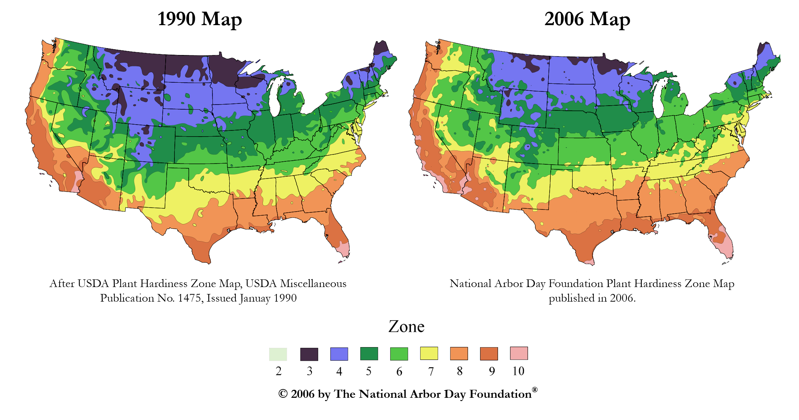
Changes in USDA Plant Hardiness Zones

Slide 47
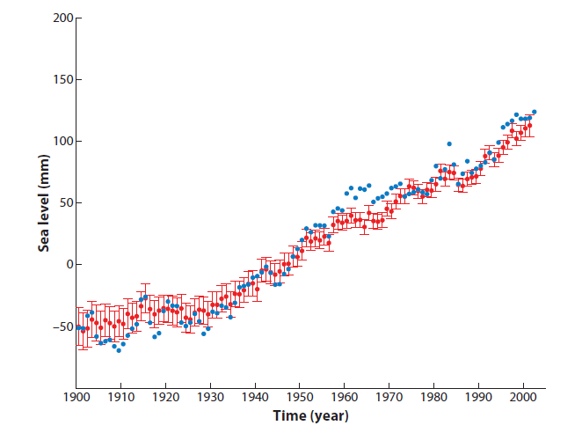
Observed global mean sea level (from tide gauges)
In geologic past, sea level changed 10-20 m for every 1°C. (Archer, 2012, Global Warming. J. Wiley.
Cazenave and Llovel. 2010. Contemporary Sea Level Rise. Annu. Rev. Mar. Sci. 2:145–73

Slide 48
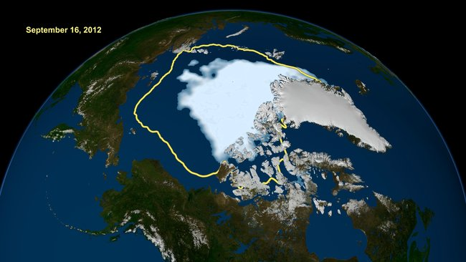
Arctic sea ice
A NASA image shows how the record-low Arctic sea ice extent compares with the average minimum extent over the past 30 years, in yellow.

Slide 49
Why do we care?
Areas that are hot now will get hotter.
Areas with poor rainfall now might get drier.
Insects, plants, and people are accommodated to the climate they now have.
Sea level change could affect a lot of people.
We don’t know what is going to happen.

Slide 50
What should we do?
Agree that there is a problem!
Improve efficiency of fossil fuel use
Nuclear power wherever it can be applied
Solar power for heating
Solar power for electricity where the climate allows this
Adapt to a warmer climate

Slide 51
Summary
The earth has definitely gotten warmer in the last century
The increase in carbon dioxide in the atmosphere is the likely cause; this theory implies that the temperature will continue to go up in the future.
We need to agree that there might be a problem, discuss the implications, and develop a plan.

Slide 52
Any questions?
The earth has definitely gotten warmer in the last century
The increase in carbon dioxide in the atmosphere is the likely cause; this theory implies that the temperature will continue to go up in the future.
We need discuss the implications and develop a plan

