Slide 1
Four Jaw Collimator

Slide 2
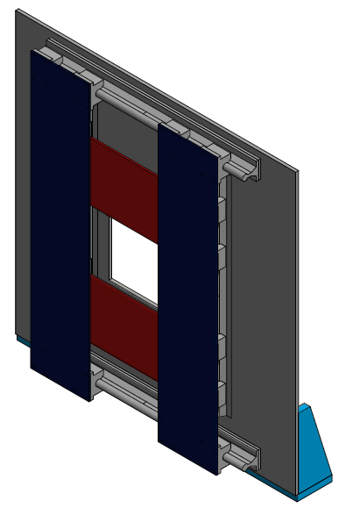
Dimensions of collimator are 24 X 24 inches. This is 61 cm on a side.
Almost as large as inside dimensions of B-field coils.
Two sets of doors on vertical and horizontal rails
Doors made of Cadmium?
Doors can be ~1/16 inches apart
Central hole is 8” x 8” with
Doors fully open

Slide 3
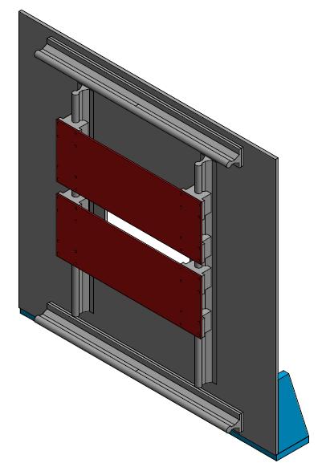
Inner Jaws Only
Need to include design for a micrometer for each door
Need a way to hold the doors in place once they are set correct position.
Large vertical doors:
23.5” x 5.0”
Small Horizontal doors:
13.5” x 5.0”
Back Plate is ¼ inch Aluminum

Slide 4
Rails/Pillow Blocks
Rails and Pillow Blocks are off the shelf items.

Slide 5
Rails

Slide 6
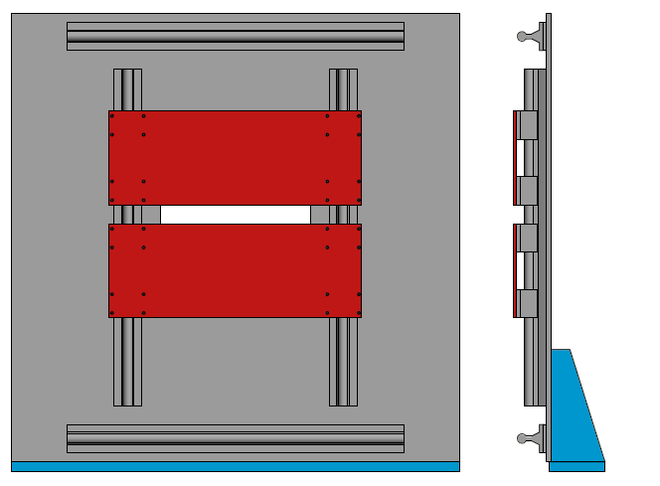
Front and Side View
Less than 2 inches thick without mount

Slide 7
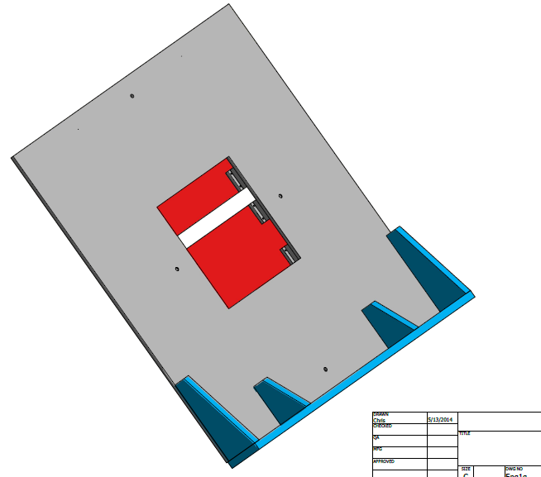
Collimator mounted to
Large Kanya beams

