Slide 1
Alignment NOtes

Slide 2
Electrical/Computer
XY-Tables Controlled by a computer with parallel 25 pin D-connector interface (Laptops don’t have this connector)
Need a long cable routed outside the cave
Need to install PCI card on the back of one of the nHe-3 computers to operate XY-Tables

Slide 3
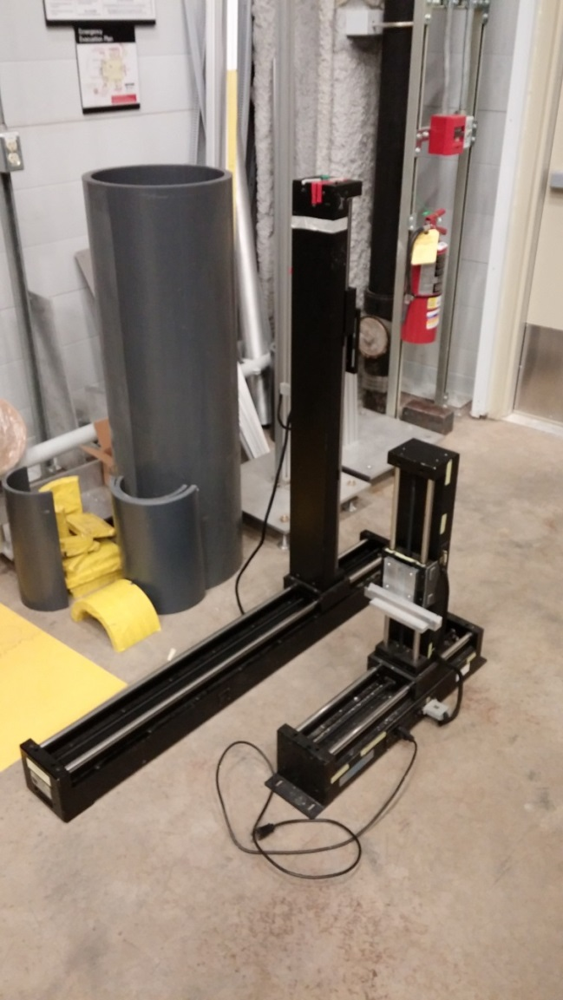
XY Tables
Dimensions of XY Tables:
Large Table:
Length: 50.5 inches
Height(From floor): 49.5 inches
Small Table
Length: 26 inches (Not including end mounts)
Height(From floor): 29.25 inches

Slide 4
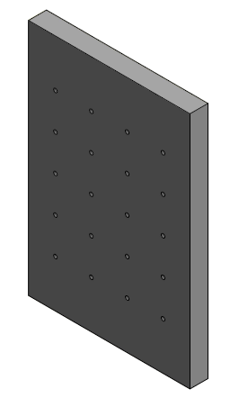
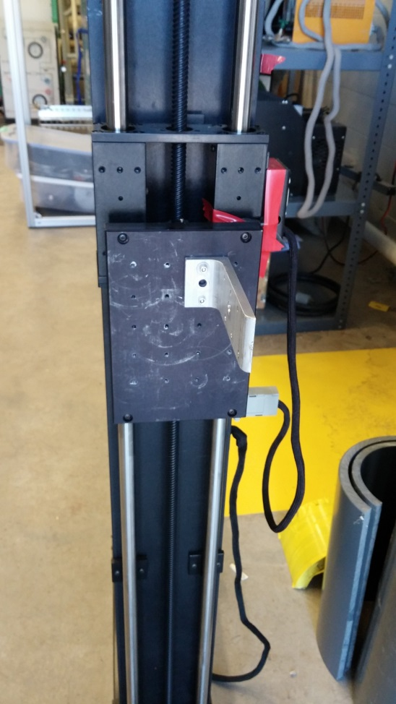
Two Mounts on Large XY Table
Extra Mount?

Slide 5
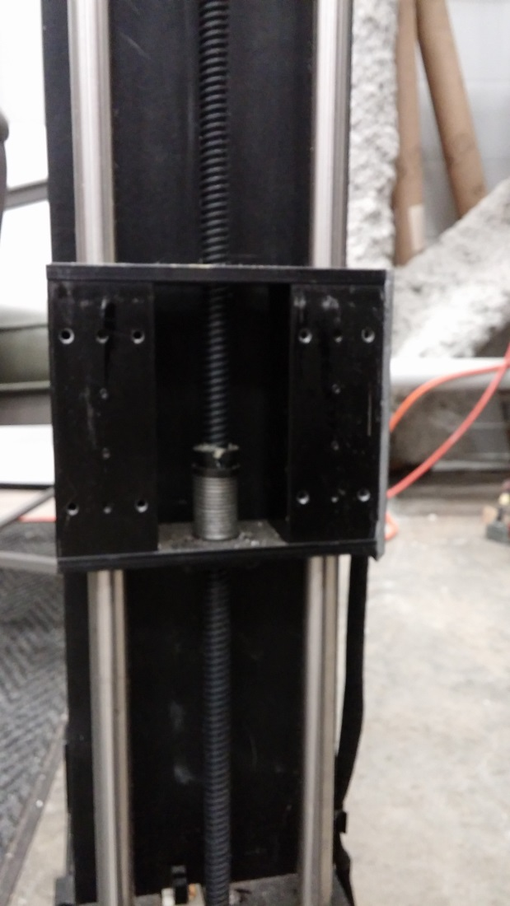
Mount for Small XY Table

Slide 6
Cabling for XY Tables
Power cable for beam monitor (Battery operated)
Signal cable from beam monitor to pre-amp
Power Cable for preamp
Signal cable from pre-amp to DAQ
Power/Signal cable from XY table to Computer

Slide 7
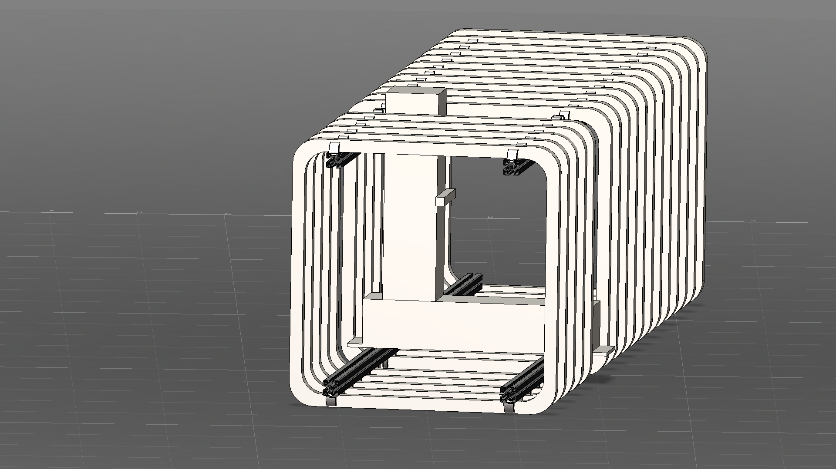
Placement for small XY table?

Slide 8
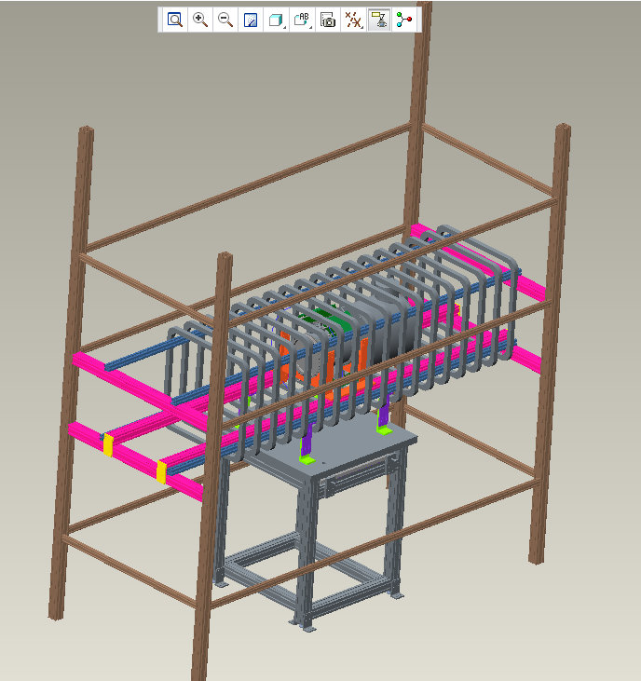

Slide 9
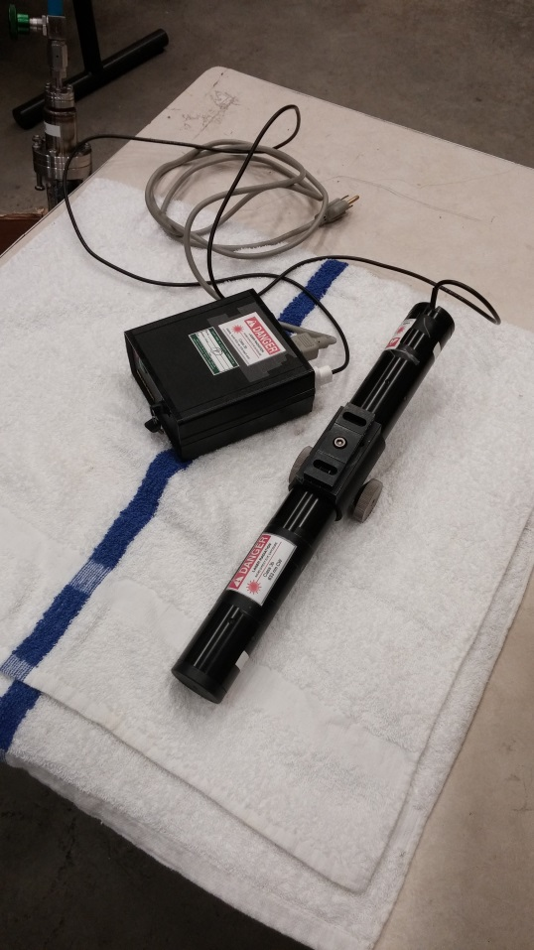
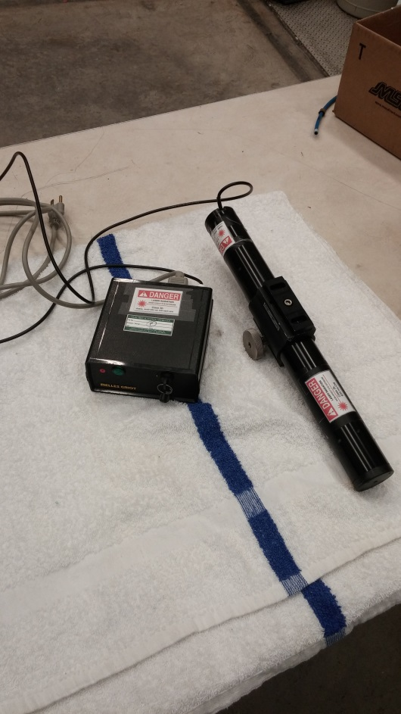
Laser Beam
Melles Griot: Class 3b 633nm CW
Beam emitted at both ends
Outputs 4mWatts at each end
Beam is ~1/8 inch diameter at close range
Safety Requirements apply

Slide 10
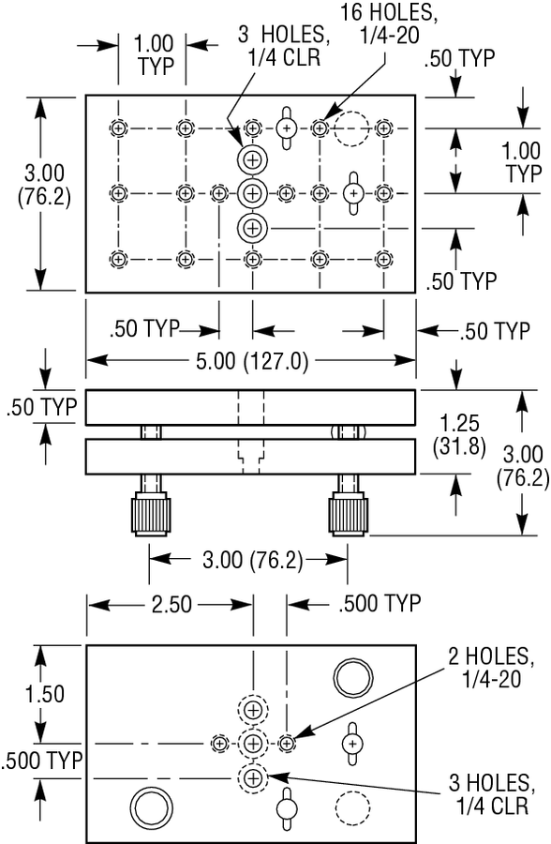
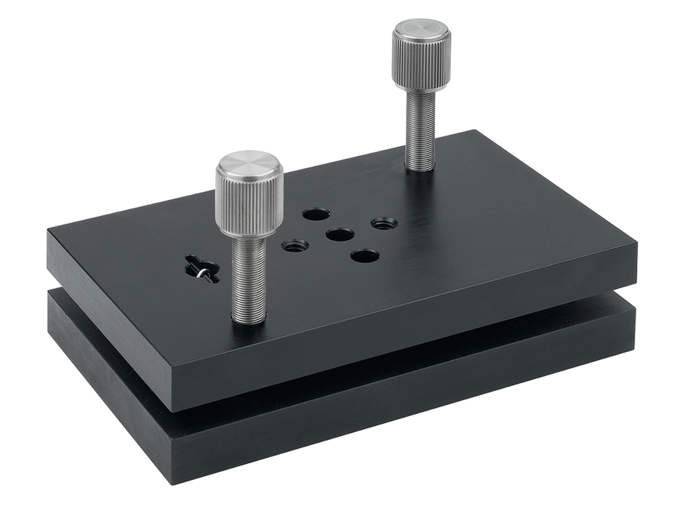
Mount for Laser Beam
Newport Model 39
Two-axis tilt platform
-3.5 to 14 degrees on long axis
-5 to 16 degrees on short axis

Slide 11
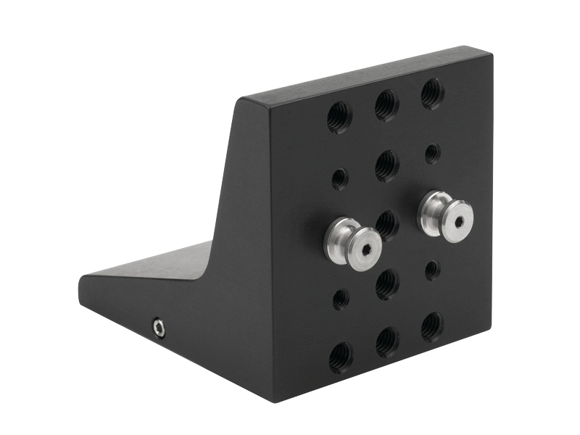
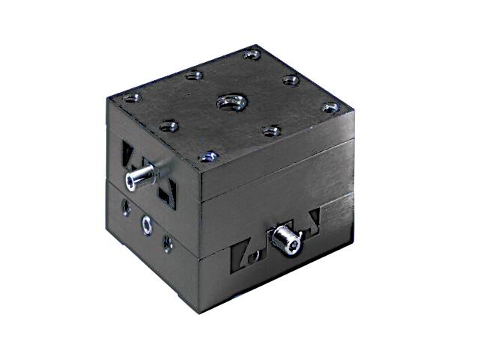
Mount for Laser Beam
Newport model 460P – 90BK
90 degree angle bracket
Newport DS40-XY linear stage
0.55 inches travel in both directions

Slide 12


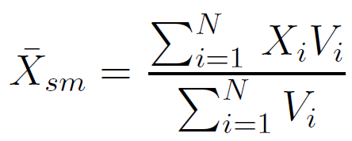
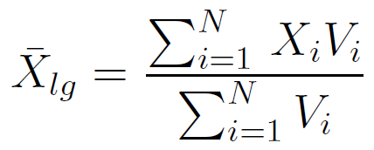
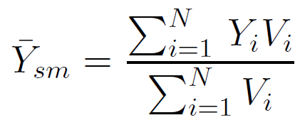
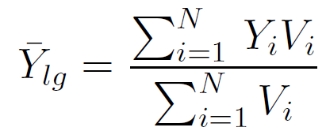
Determine Beam Centroid
X1,Y1
X1,Y4
Data points are ordered triples:
Beam Centroid Determined from data from large/small xy-tables:

Slide 13
Beam Centroid
Need a plan for taking data points
4 Jaw Collimator
Square hole aperture

