Slide 1
B-Field Alignment

Slide 2
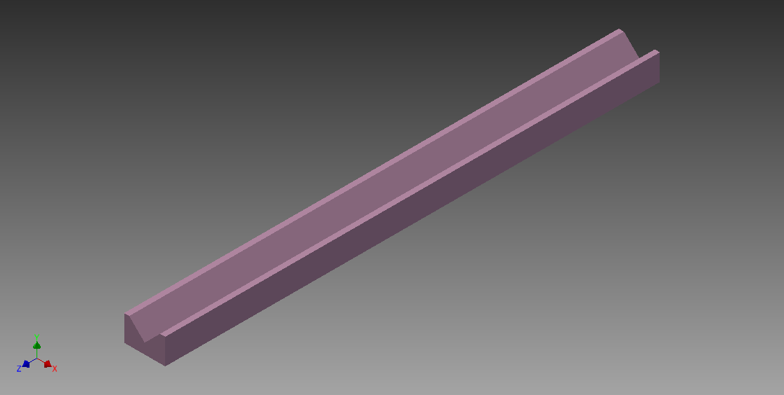
Slide
Slide is approximately 5 feet long

Slide 3
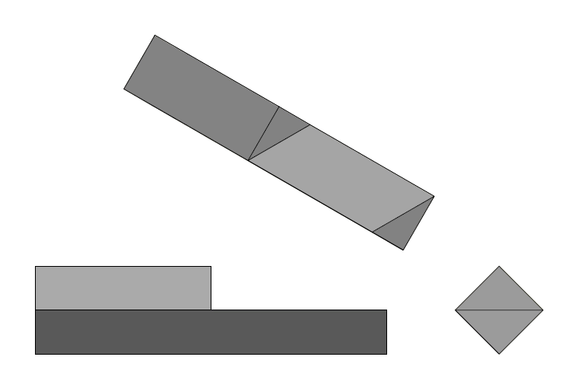
Sled For Track
Sled is 1 foot long and has a x-section of 3x3

Slide 4
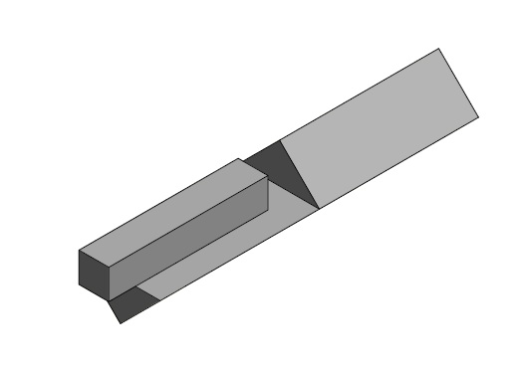
Sled with Mounted Magnetometer
Dimensions of Magnetometer: 1.125 in x 1.125 in x 6 in

Slide 5
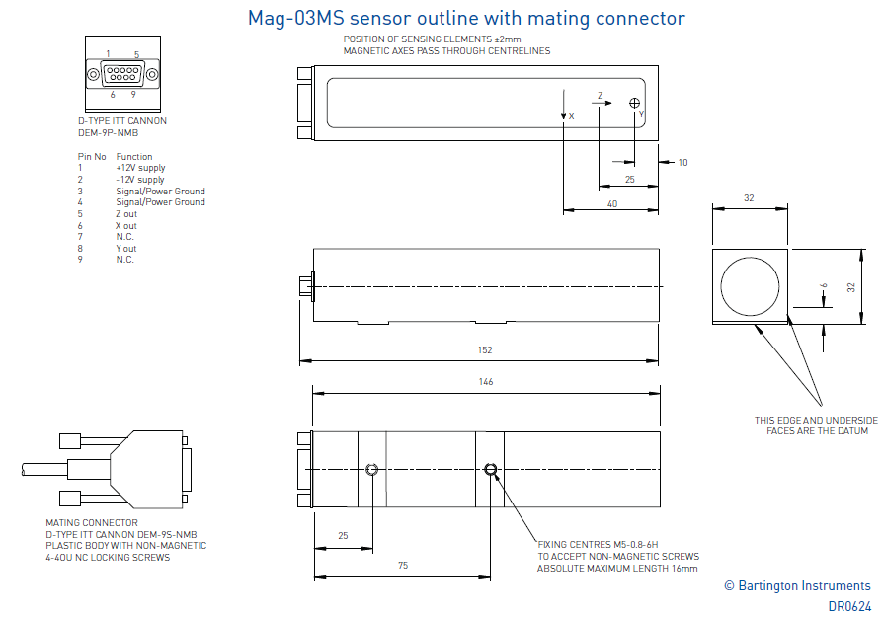
Magnetometer Drawing

