Slide 1
Beam scanner mount

Slide 2
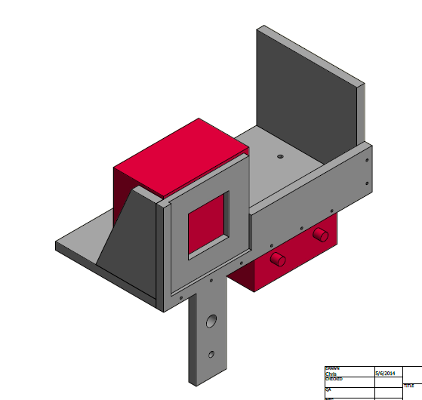
Isometric Top Right View
Beam Monitor
Cross Hairs and extra hole
For SA
Preamp

Slide 3
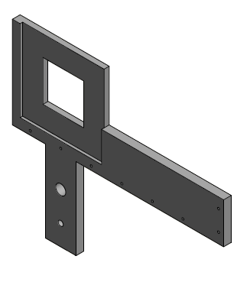
Front Piece

Slide 4
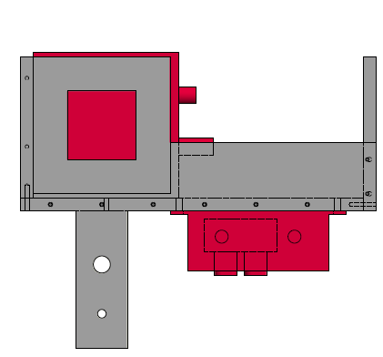
Front View
.

Slide 5
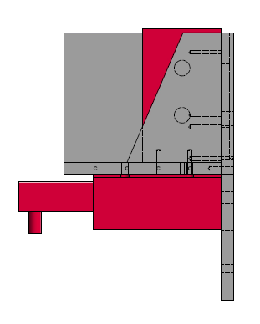
Side View

