Slide 1
Towards final tests with new ACQ1002 modules
The DAQ team

Slide 2
“Duplicated(repeated) sample issue”
Per David’s suggestion to reduce low frequency noise looking at the distribution of the
difference between consecutive (even/odd) pairs of ADC samples
Discovered that in each channel, from time to time, ADC samples are duplicated
from previous, or even earlier samples. (Will explain in detail in the following slides)
First saw this in “synchronized trigger mode”, however the issue is observed in
“continuous mode”.
The issue is independent of chosen frequency, FPGA averaging or ADC box
Perhaps it is indicative of memory issue at the readout stage in FPGA ?
“duplication issue” appears to be random so in principle shouldn’t introduce
additional false asymmetry

Slide 3
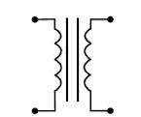
DAQ test setup in CONTINUOUS mode
ACQ1002 ADC Box
Picard

Slide 4
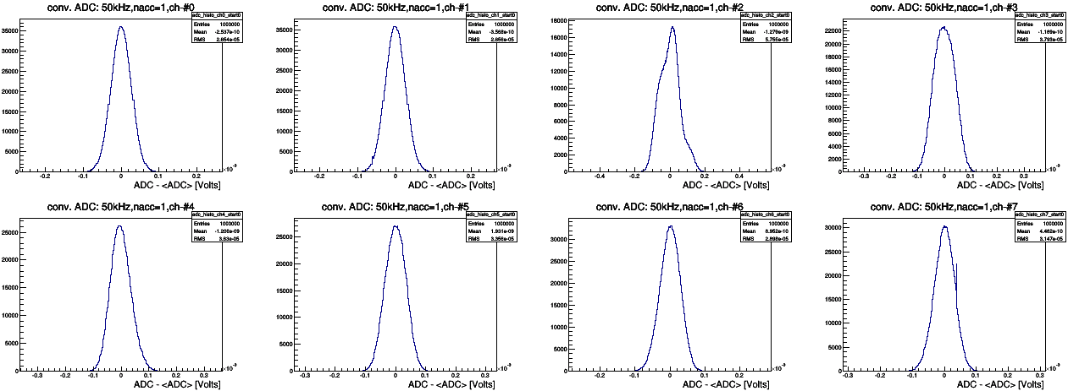
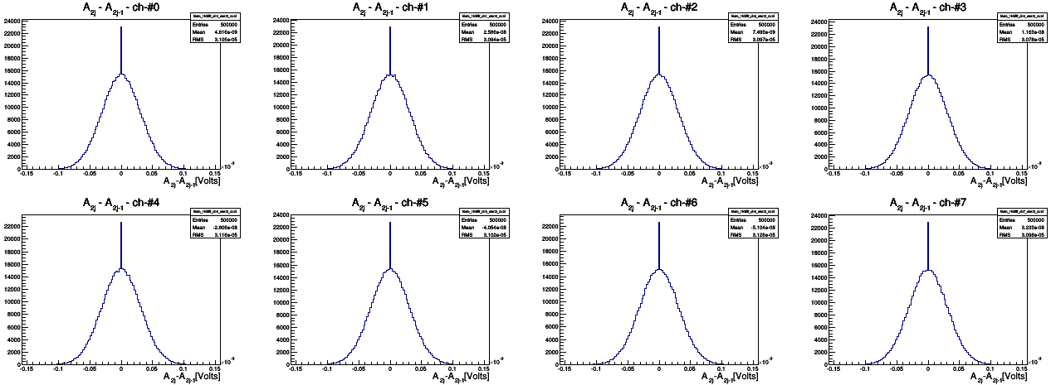
Single vs. “pair” ADC sample distributions: CONT, 50kHz, nacc=1
Single ADC (conv) distribution for first 8 channels of box021:
1.) CONTINUOUS
2.) 50 kHz
3.) nacc=1 (No Averaging
A_{2j} – A_{2j-1}: adjacent pair difference distribution for first 8 channels of box021:
1.) CONTINUOUS
2.) 50 kHz
3.) nacc=1 (No Averaging

Slide 5
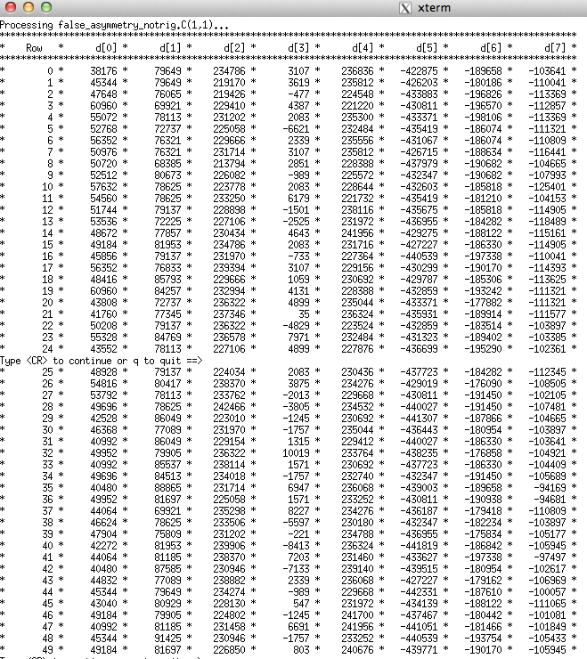
Raw datastream: Box021, CONT, 50kHz, No averaging
Printout of raw ADC DataStream indeed confirms the existence of “duplicate” adjacent samples
But “duplication” issue goes beyond adjacent samples
Samples are often repeated after
Several

Slide 6
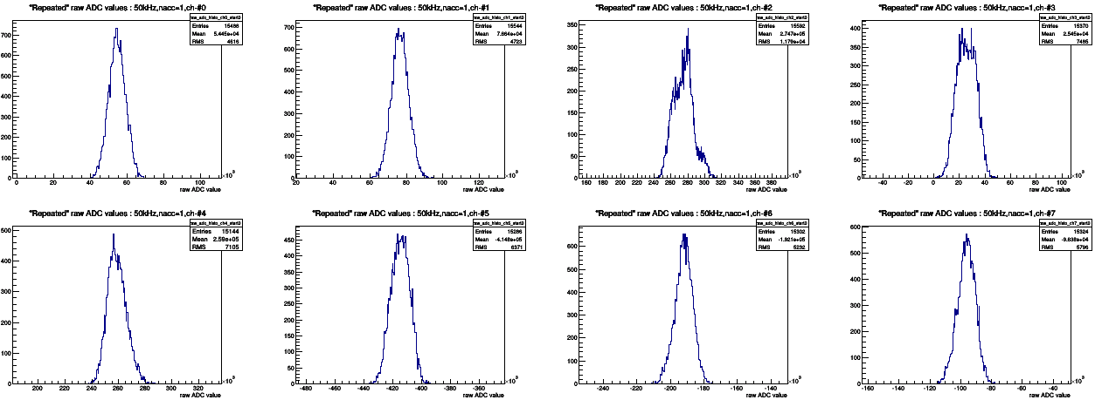
Single ADC sample distr. ALL vs. ONLY duplicated : CONT, 50kHz, nacc=1
Single ADC (conv) distribution for first 8 channels of box021:
1.) CONTINUOUS
2.) 50 kHz
3.) nacc=1 (No Averaging
Raw ADC samples ONLY when “adjacent duplication” occurs
The shape of upper and lower distributions look alike, which shows that duplicated sample values are random!

Slide 7
Pair distributions for testing data
“difference between ADC sample pairs” distributions:
A₁, A₂, A₃, A₄, A₅, A₆, A₇, A₈, A₉, A₁₀, …..
“adjacent pair diff” (A₂-A₁), (A₄-A₃), (A₆-A₅), (A₈-A₇), (A₁₀-A₉), …
“NN pair diff” (A₃-A₁), (A₄-A₂), (A₇-A₅), (A₈-A₆), (A₁₁-A₉), (A₁₂-A₁₀), …
“NNN pair diff” (A₄-A₁), (A₅-A₂), (A₆-A₃), (A₁₀-A₇), (A₁₁-A₈), (A₁₂-A₉), …
“NNNN pair diff” (A₅-A₁), (A₆-A₂), (A₇-A₃), (A₈-A₄), (A₁₁-A₈), …

Slide 8
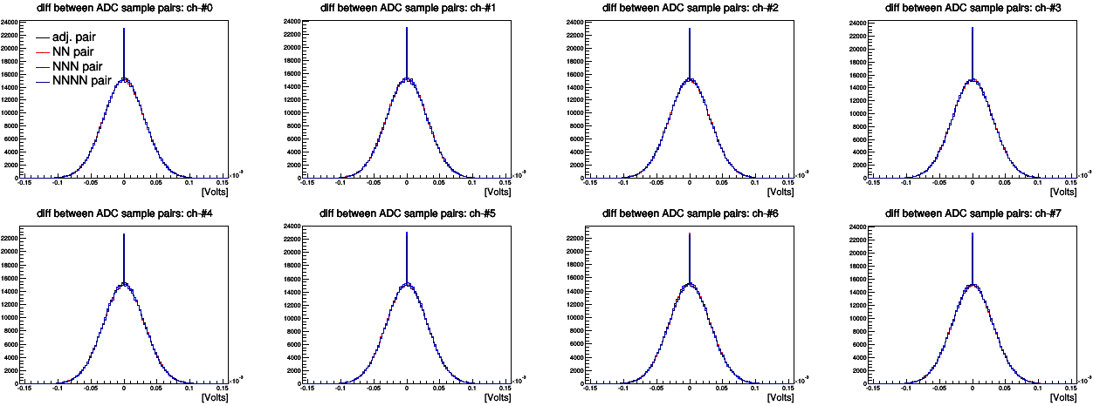
Adjacent and beyond “pair” ADC sample distributions: CONT, 50kHz, nacc=1
The effect is still there for Next-to-Next-to-Next-to-Next pair difference distributions

Slide 9
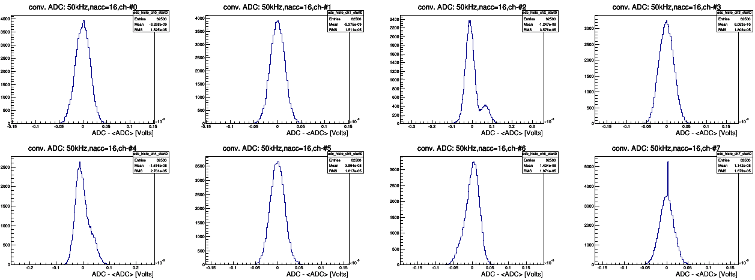
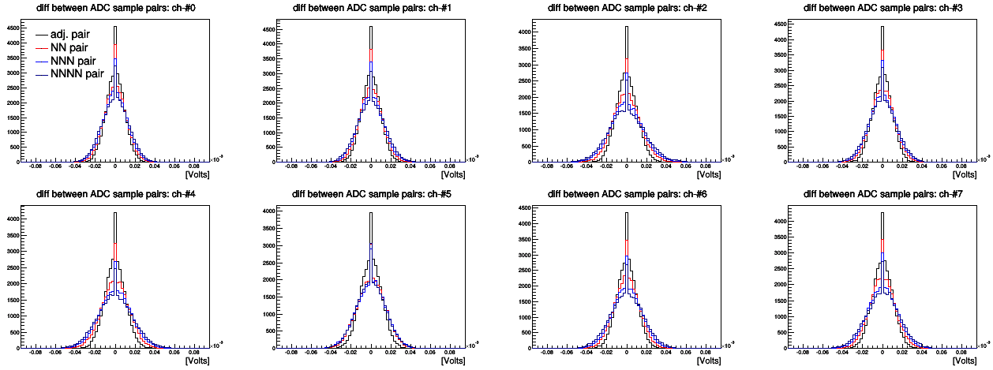
How about when we FPGA Average data? CONT, 50kHz, nacc=16
Single ADC (conv) distribution for first 8 channels of box021:
1.) CONTINUOUS
2.) 50 kHz
3.) nacc=16
Duplication issue still there from pair distributions when we FPGA average
But width of the distributions varying, which wasn’t the case for Non-Averaged case!

Slide 10
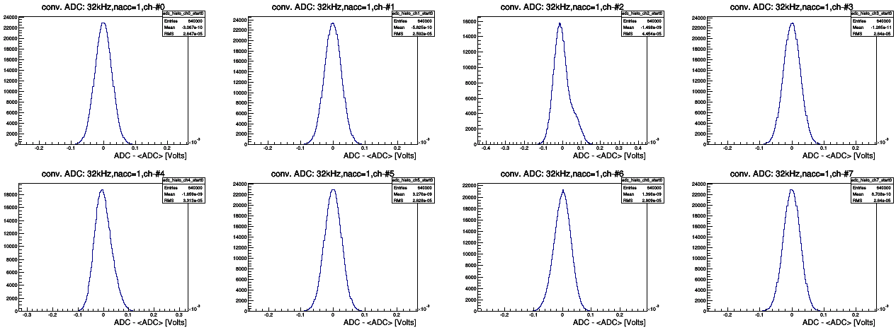
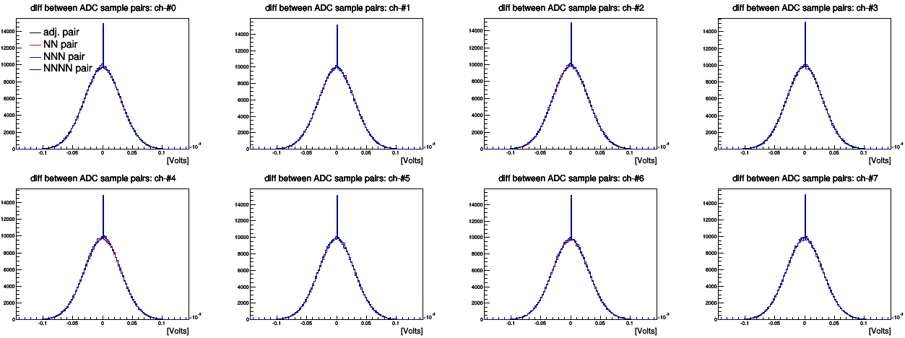
Let’s change sampling rate? CONT, 32kHz, nacc=1
Single ADC (conv) distribution for first 8 channels of box021:
1.) CONTINUOUS
2.) 32 kHz
3.) nacc=1
Same effect!
“duplication” doesn’t depend on sampling rate

Slide 11
Conclusions
I quickly checked data with “old” ACQ2006 box and the issue is there as well.
The duplication doesn’t depend on running mode, sampling rate, box
Vince suggested that this might be a FIFO memory issue at the readout. But this is really Peter’s job to determine
Very next step is to check this thing with input signal. Sinusoidal, Slope, etc.
Other quick tests.
But looks like the issue is random.

Slide 12
Backup slides

Slide 13
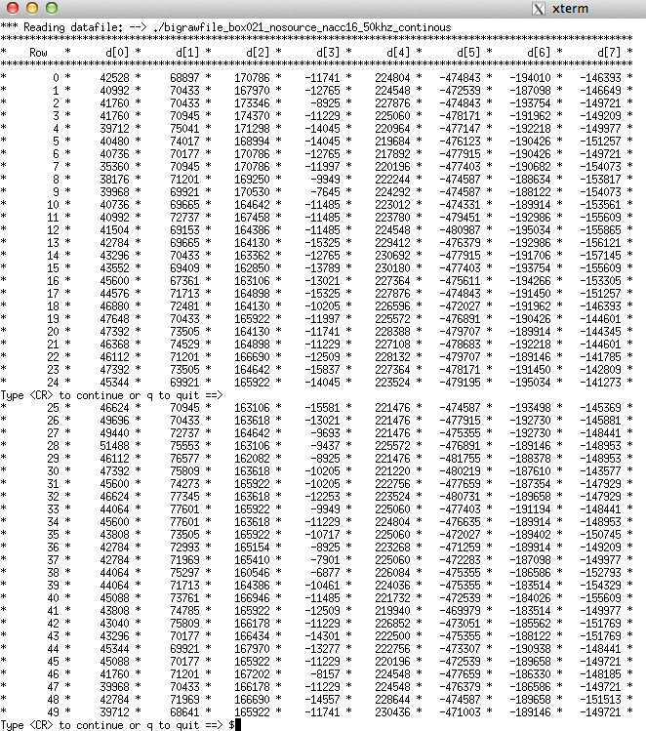
Raw datastream: Box021, CONT, 50kHz, ave coef = 16

Slide 14
