Slide 1
Synchronization tests with new ACQ1002 modules

Slide 2
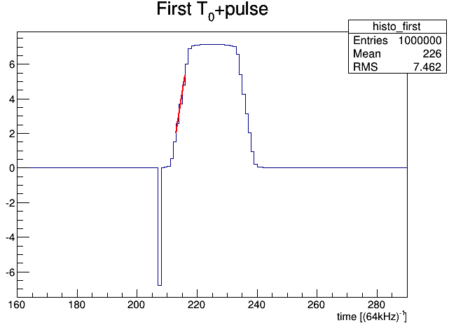
test signal and the algorithm
Our high precision pulse generator
simultaneously generates 60 Hz trigger
signal (for the ADC “trigger” input) and
synchronized to it RC shaped square
pulse with the following parameters:
Leading/Trailing edge = 100 μs
WIDTH (incl. Le. edge) = 320 μs
For every pulse:
1.) We fit middle part (3 bins) of the Leading edge by a straight line and calculate the y=0 intercept
2.) We calculate ΔT = T₁ – T₀ for every pulse
We looked first at 1000 pulses and then at total of 6000 pulses
Intercept at y=0
defined as T₁
Header – serving as T₀
§ Units on X (time) axis throughout the talk are in 1/64kHz ≈ 15.6 μsec

Slide 3
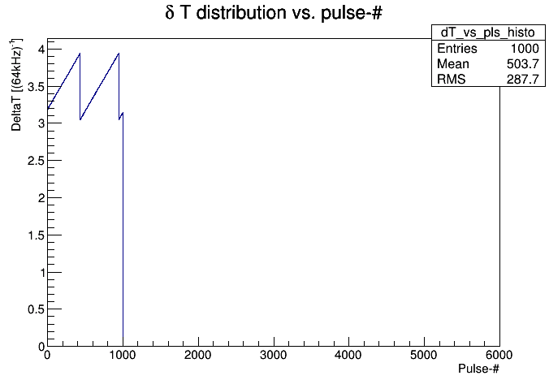
Individual ΔT vs. pulse number (SYNC)
As can be seen in sync case ΔT distribution “drifts” systematically in one direction. After roughly a cycle of 500 triggers it “resets” back and does the same thing all over again.
Our initial guess was that the “drift per pulse” was only 1 time tick, i.e. 1/32MHz.
However upon further inspection we noticed that it is not quite true. The shift can be up to 2-3 ticks in both directions (up or down) as demonstrated on the next slide

Slide 4
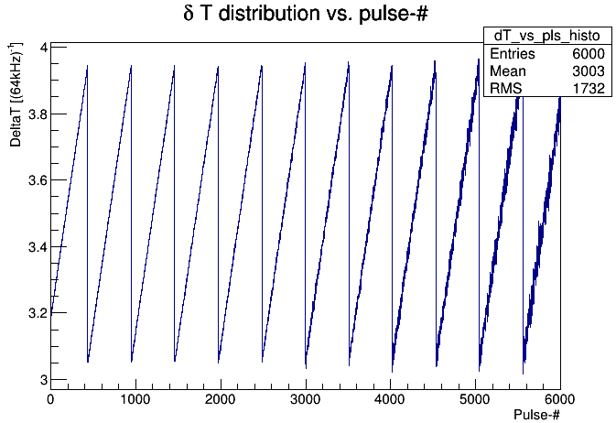
Looking at more data: 6000 pulses
Last night we actually looked at more data and noticed that fluctuation of “the drift” from pulse to pulse gets larger.

Slide 5
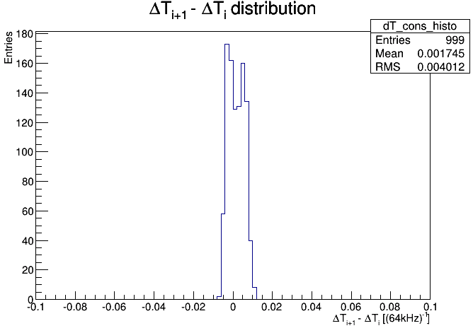
ΔT between two consecutive pulses (SYNC)
The distribution of the ΔT difference between two consecutive pulses show the overall “drift” distribution from pulse to pulse.
An negative side (down tick direction) it peaks at roughly -1.0 * 1/32MHz.
At positive side (up tick direction) it peaks at roughly about + 2.0 * 1/32 MHz

Slide 6
Updated Results with the fresh FPGA upgrades

Slide 7
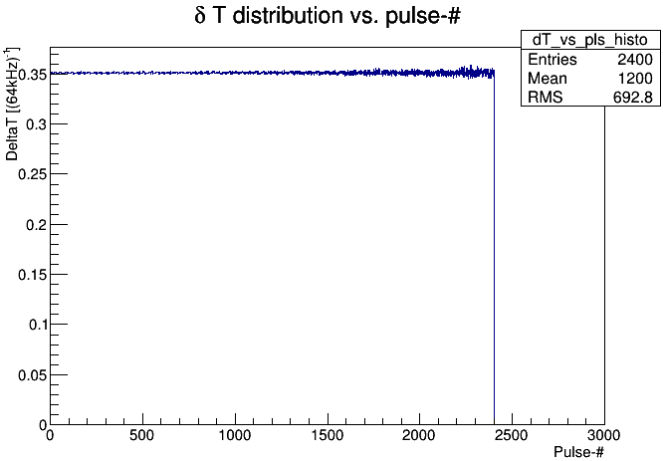

Slide 8
