Slide 1
Synchronization tests with new ACQ1002 modules
Kabir, Irakli, Vince

Slide 2
Introduction
Trying to measure synchronization between Master Clock at 32 MHz and the
ACQ435 module clock w/ sampling rate 64kHz
Testing or trying to confirm that in “synchronized mode” jitter between T₀ and
First sampled point is from 0 - 32 MHz
In “Non-sync mode” jitter is expected to be from 0 – 64 kHz
Using hp 8161A Pulse Generator borrowed from nEDM (Vince) we have
triggering at 60Hz and “modified square pulse” synchronized with the generated
trigger
Leading/Trailing edge = 100 μs
WIDTH (incl. Le. edge) = 320 μs
Time
T₀ trigger
T₁ - Slope intercept

Slide 3
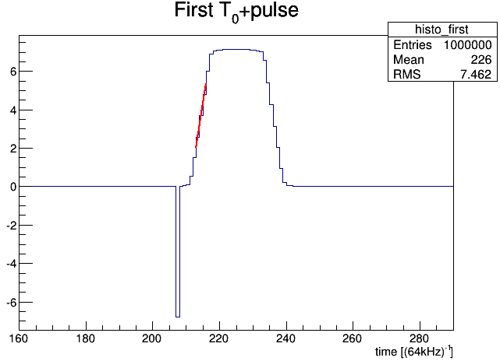
test signal from ADC and algorithm
Because RC delay from generator
Leading edge starts ~ 40 μs from T₀
Fitting middle (3 bins) of the Leading edge
by pol1 and calculating the y=0 intercept
Calculating ΔT = T1 – T0 for every pulse
Comparing ΔT distributions between “sync”
and “non-sync” modes
Header – serving as T0

Slide 4
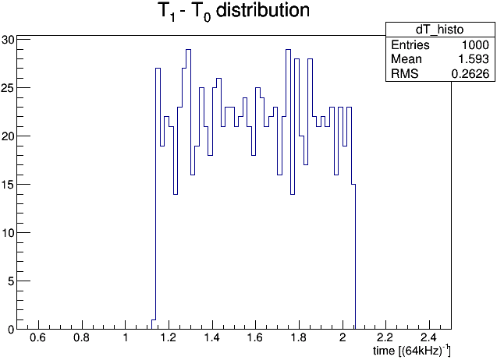
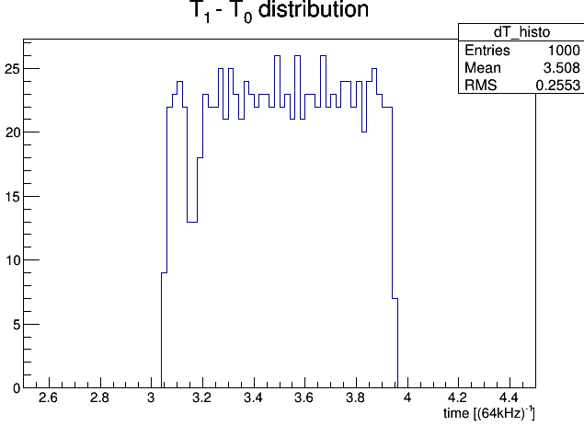
NON-SYNC
ΔT distribution
X-axis in units of 1/64kHz
Expected spread:
~ 1/64kHz for NON-sync
~ 1/32MHz for SYNC, i.e. much smaller
But both appear to be of the same size ~ 64kHz
No synchronization ?
SYNC

Slide 5
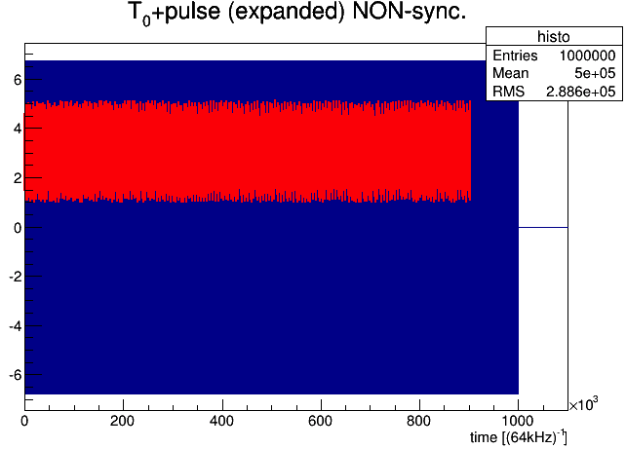
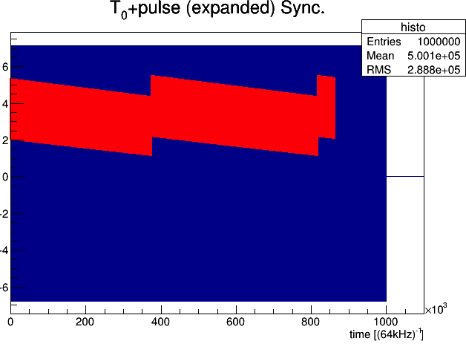
All pulses w/ fits
In Non-sync mode samples appears to be randomly distributed after T₀ with width ~ 1/64 kHz… as expected
In Sync mode it is systematically shifting and then “resetting” back and shifting again…resulting in the similar width
But if truly synchronized shouldn’t we see also random distribution of samples with respect to T₀ with width of 32 MHz ?
Last night Vince pointed out that “drifting cycle” is suspiciously close to 500 counts. (500 x 64kHz = 32 MHz)
Could it be that every T₀ trigger samples are drifting away from it by single Master clock tick (1/32MHz) and then resetting????

Slide 6
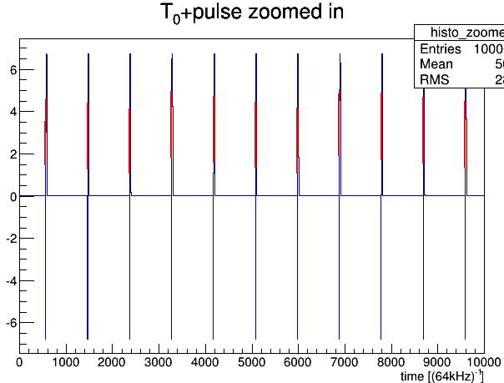
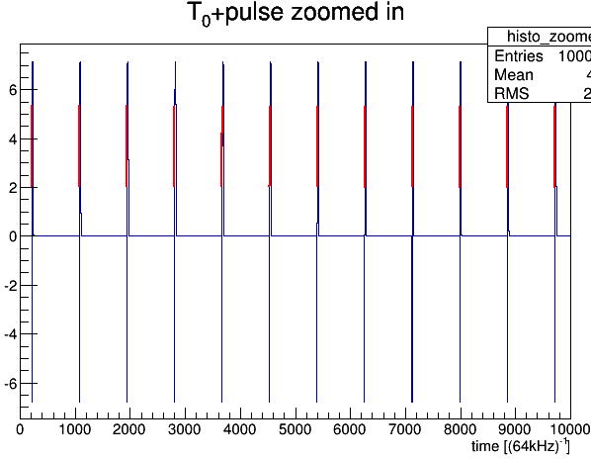
NON-SYNC
Just another note:
First few pulses
After “START” data sampling starts before First T₀ trigger.
This is sometimes the case even for “SYNC mode” as shown (lower plot)
Kabir noticed that sometimes data sampling does start with the first T₀ trigger for SYNC mode … but only sometimes!
SYNC

