Slide 1
Characterizing the Hadronic Weak Interaction with the n-³He Experiment at the Spallation Neutron Source
Josh Hamblen
University of Tennessee-Chattanooga
For the n-³He Collaboration

Slide 2
Motivation
Reaction of Interest:
Our goal is to measure the parity violating (PV) asymmetry, A_{p}, between the spin of the incident cold neutron and the momentum direction of the resultant proton
PV is a clear signature of the weak force between nucleons in a reaction dominated by the strong force
We aim to measure the asymmetry to a precision of 1.6 x 10⁻⁸

Slide 3
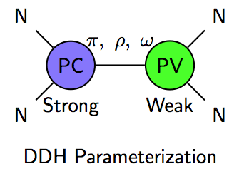
Theory
We can characterize the weak force in nuclear reactions
The hadronic weak interaction has been expressed as a parameterization of coupling constants involving π, ρ, ω exchange
Experimental asymmetry measurement will help constrain models.
Desplanques, Donoghue, Holstein, Annals of Physics (1980) 124
Viviani et al, PRC 82 (2010), 044001
Theoretical calculation:
A_{p} ≈ (-9.4➔-2.5) x 10⁻⁸

Slide 4
Experimental Setup
FnPB cold
neutron guide
10 Gauss
solenoid
Super-mirror
polarizer
³He Beam
Monitor
RF spin rotator
³He target /
ion chamber
FNPB
n-³He
FNPB: Fundamental Neutron Physics Beamline at Spallation Neutron Source; produces cold polarized neutrons
RF spin flipper – negligible spin-dependence of neutron velocity
³He ion chamber – serves as both target and detector
Estimated statistical uncertainty assuming: N = 1.5x10¹⁰ n/s (neutron flux for 1 beam cycle) P = 96.2% (neutron polarization) σ_{d} = 6 (error dilution due to detector inefficiencies)
= 1.6 x 10⁻⁸

Slide 5
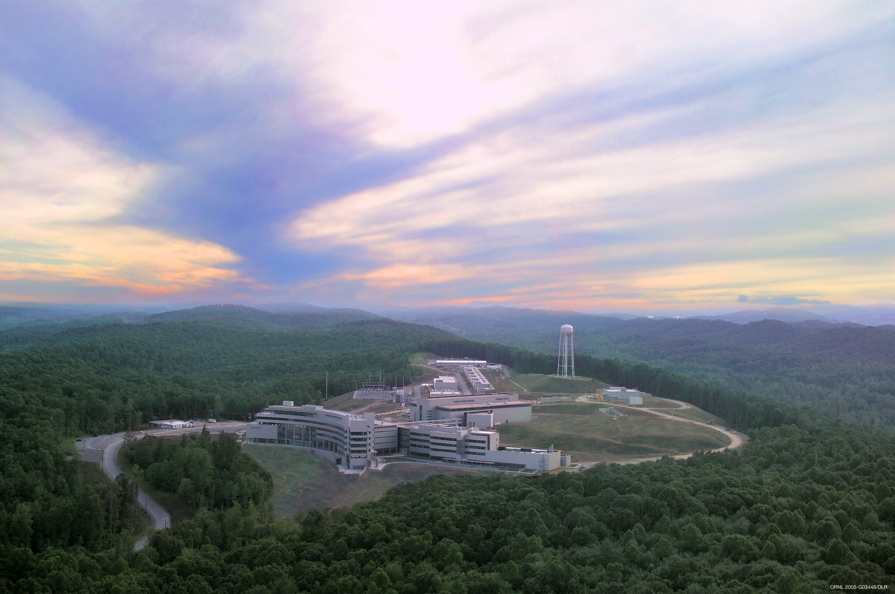
The Spallation Neutron Source at Oak Ridge National Laboratory
Commissioned in 2006
Most powerful pulsed spallation neutron source in the world
Design capability: 1.4 MW at 60 Hz pulse rate
17 beamlines in use
Many different fields of research
(materials research, biology, nanotechnology, fundamental physics, …)
n3He will be located at the Fundamental Neutron Physics Beamline
20K liquid hydrogen moderator produces cold neutrons

Slide 6
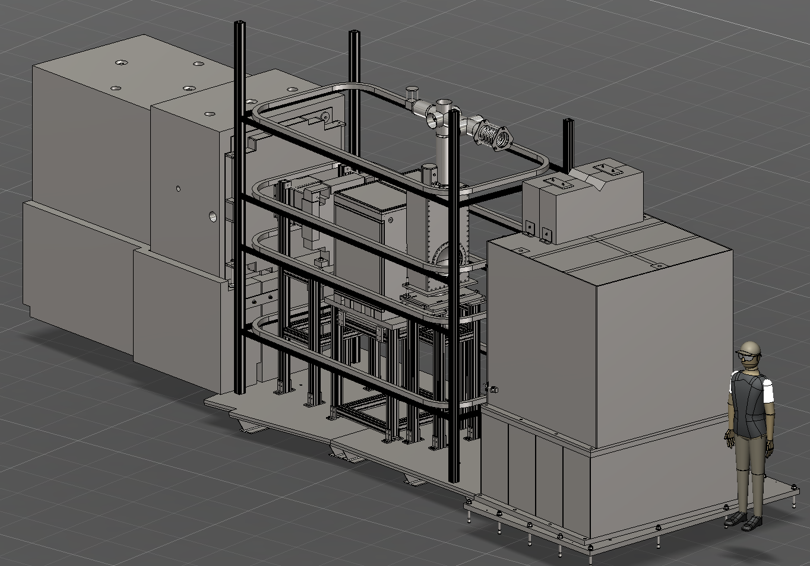
Current Setup at FNPB: The NPDGamma Experiment
Studying the reaction: n + p ➔ d + γ
Running ends in June

Slide 7
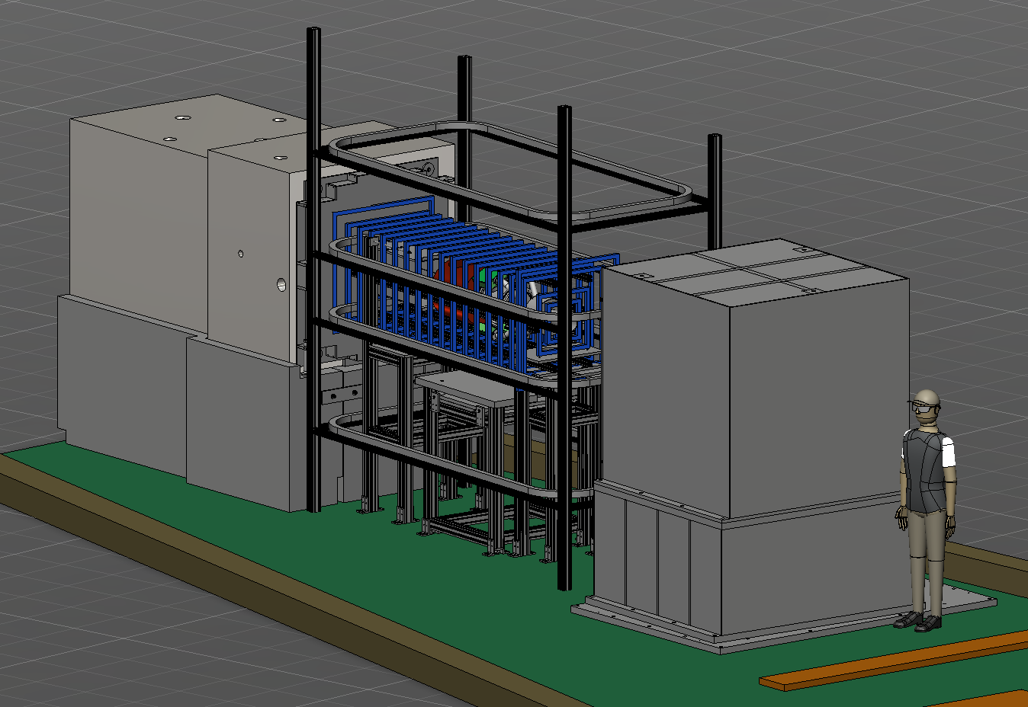
n³He at FNPB
n3He will be installed in summer 2014 at the conclusion of NPDGamma

Slide 8
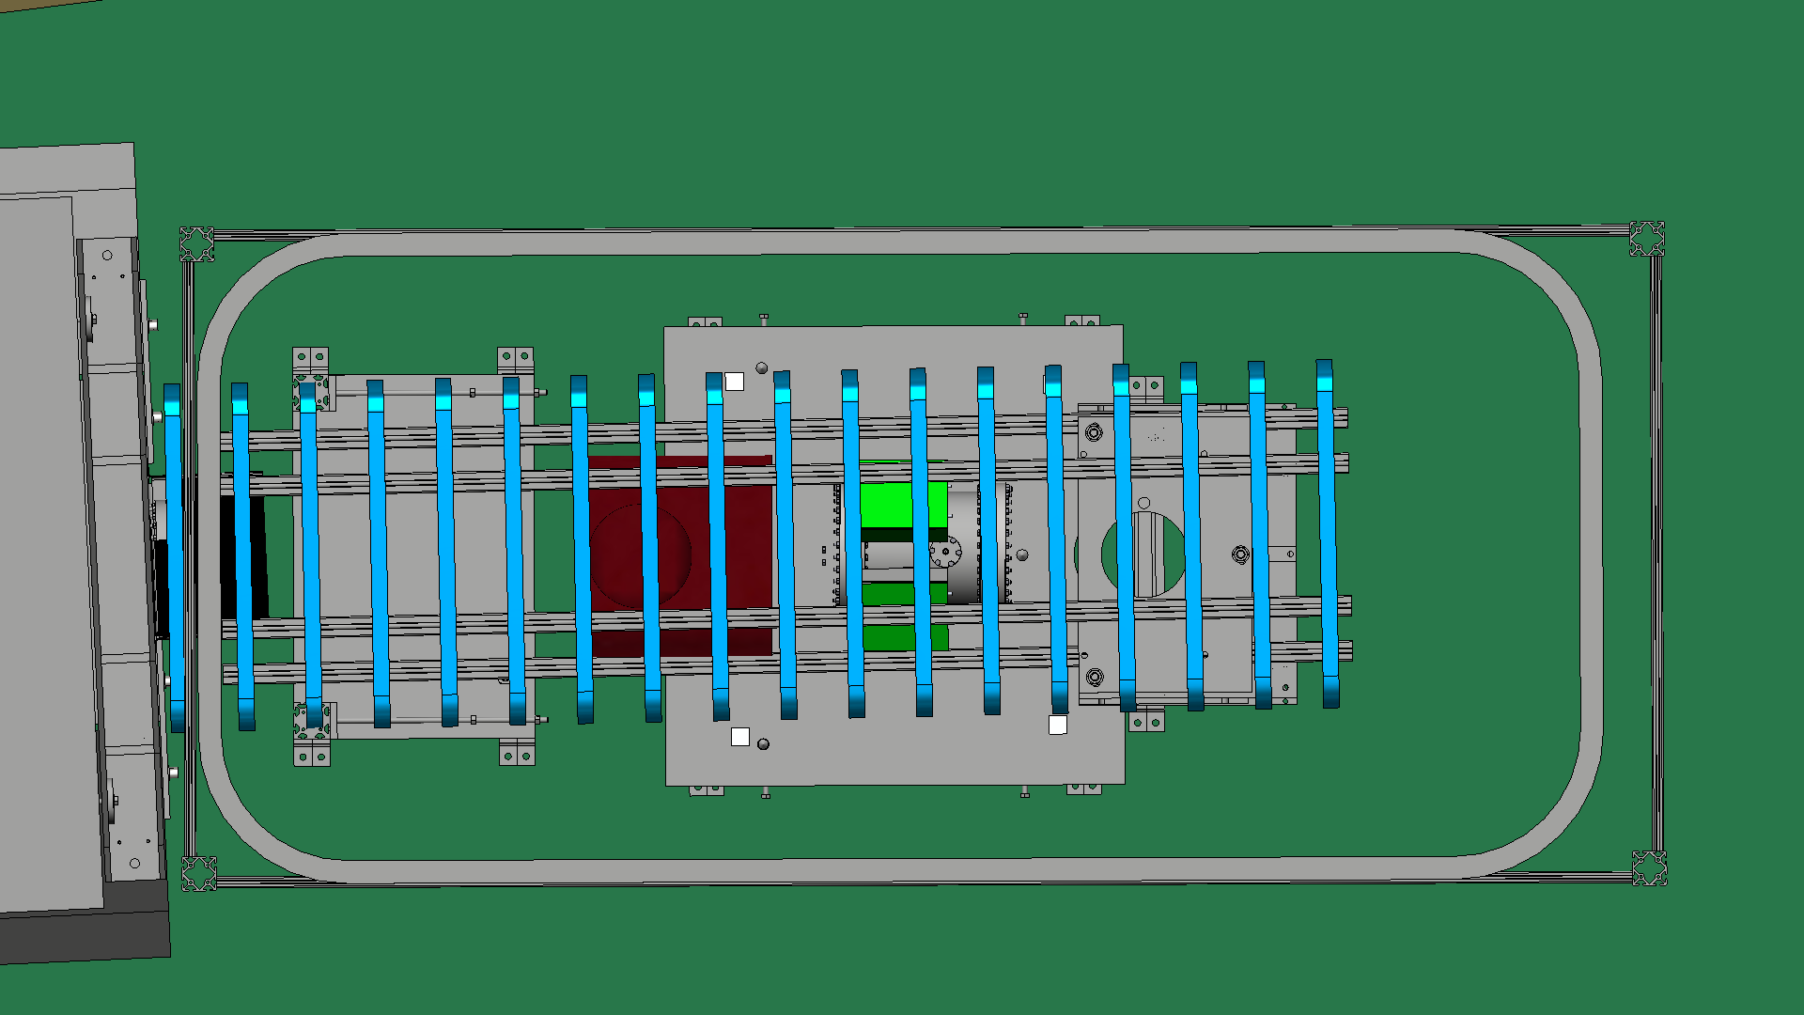
Top View of n³He
Holding Field
n³He Schematic
Rotates spin to longitudinal direction

Slide 9
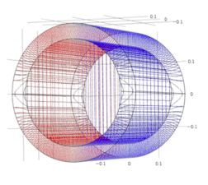
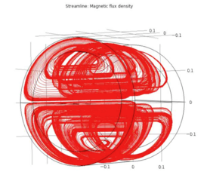
Transverse RF Spin Rotator
The neutrons enter the experiment with a transverse polarization.
RFSF rotates them to either along or against the neutron momentum direction.
RFSR
n³He Schematic

Slide 10
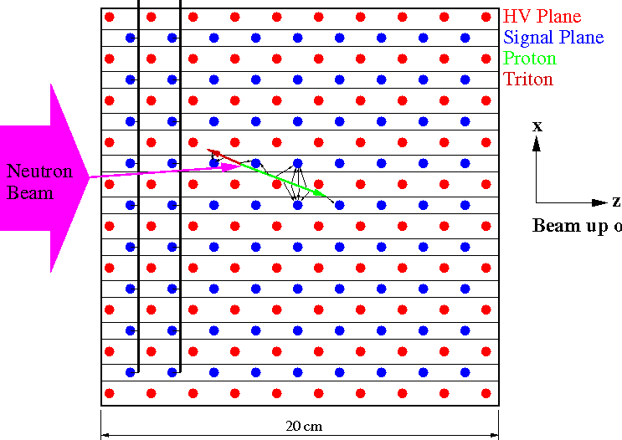
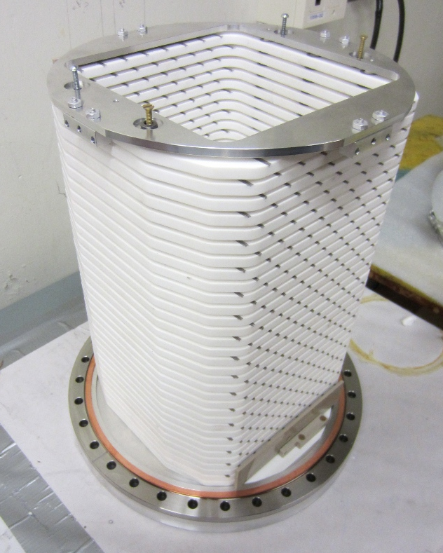
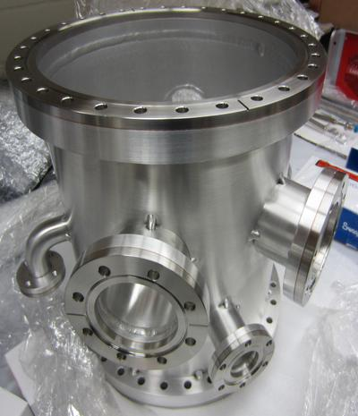
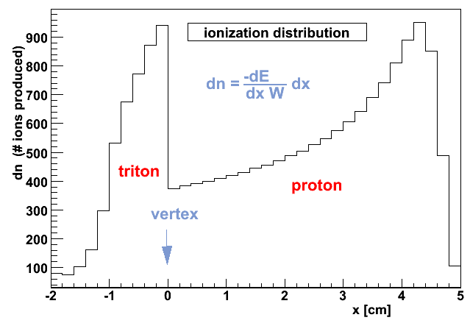
³He Chamber
To be filled with ³He at 1 atm
17 HV Frames with 8 wires
16 Signal Frames with 9 wires
Chamber
n³He Schematic

Slide 11
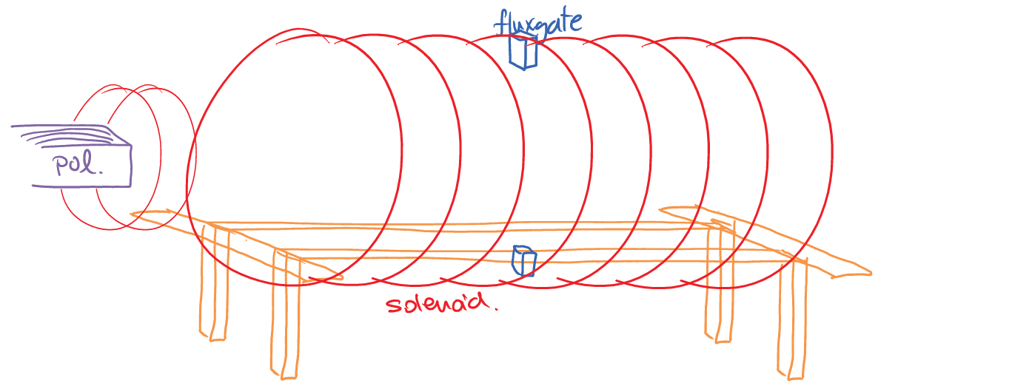
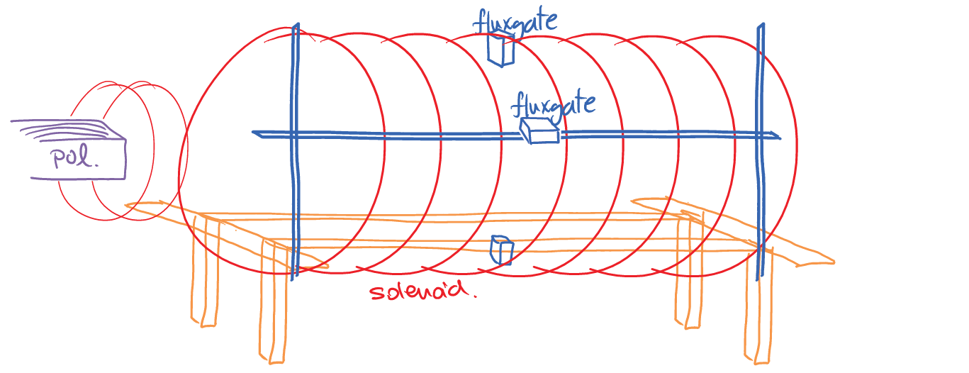
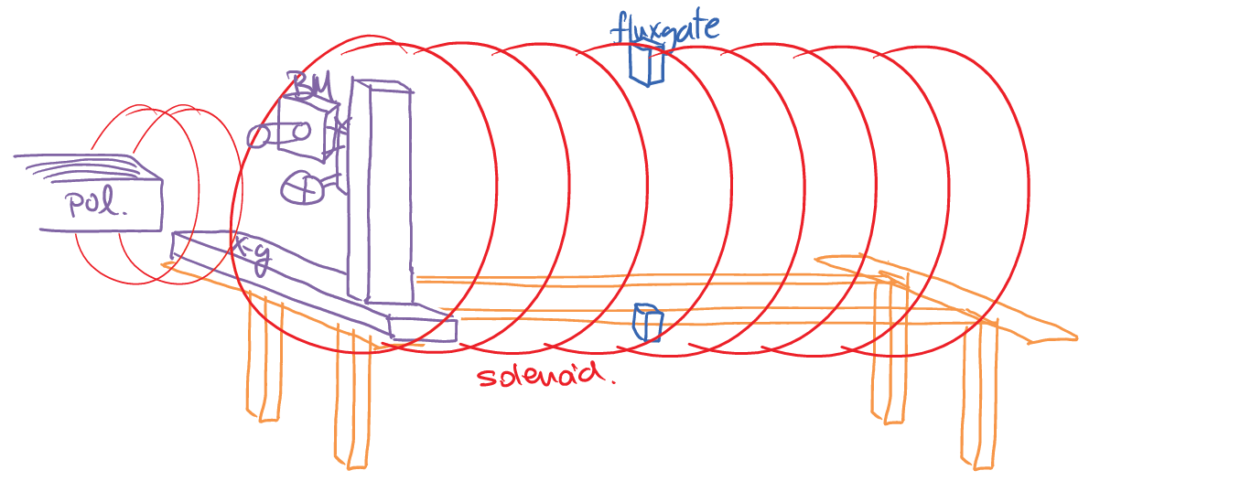
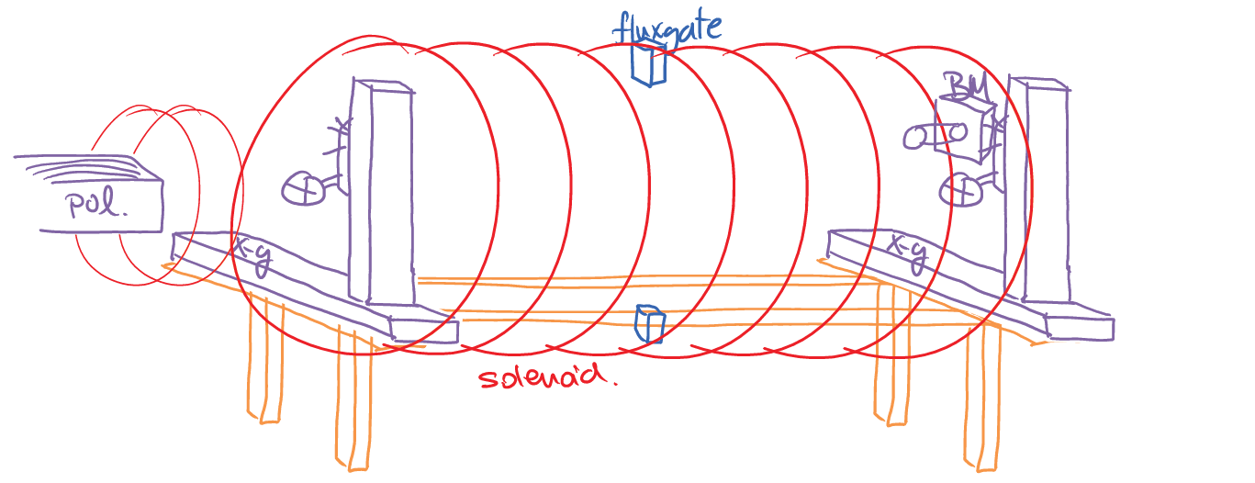
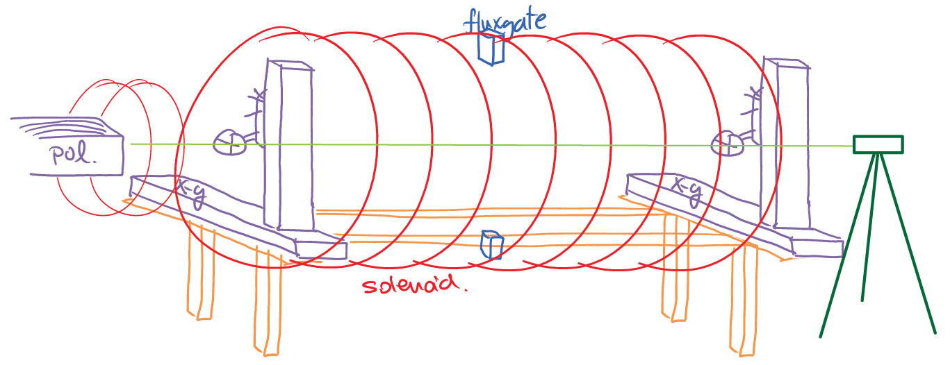
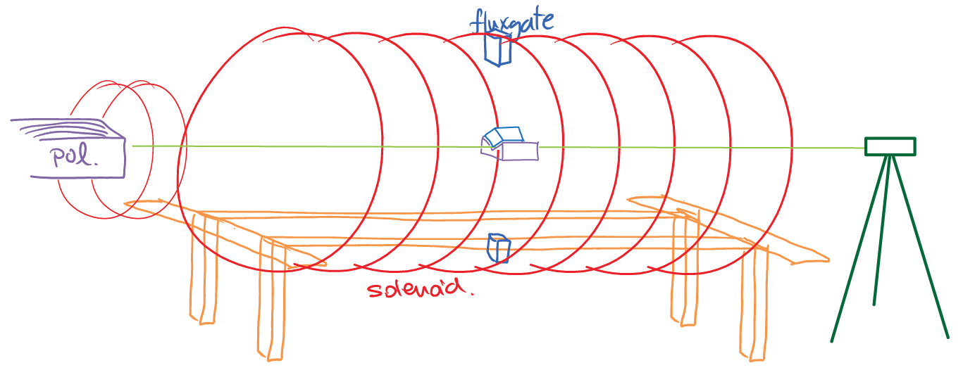
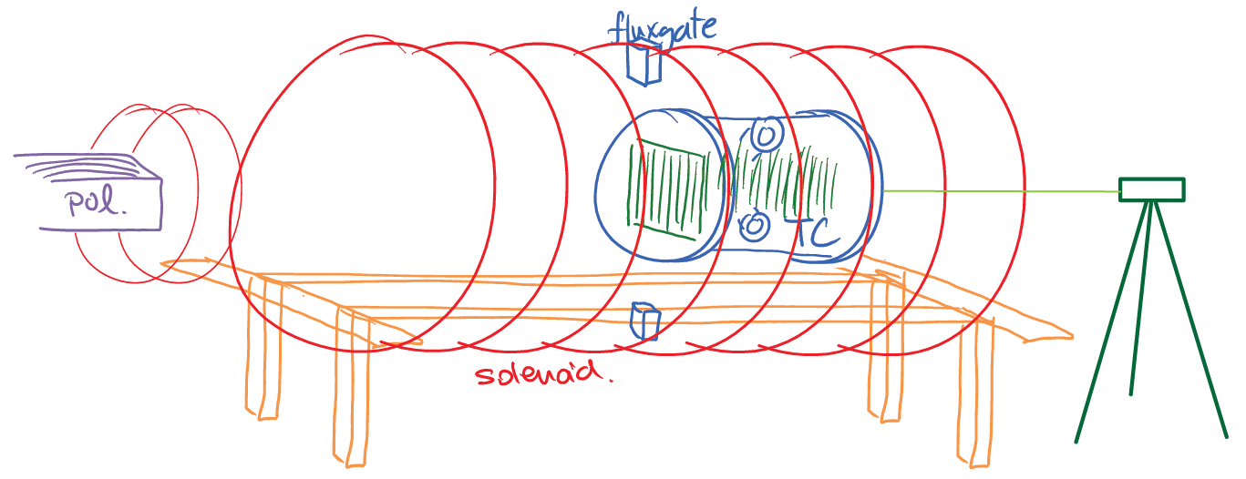
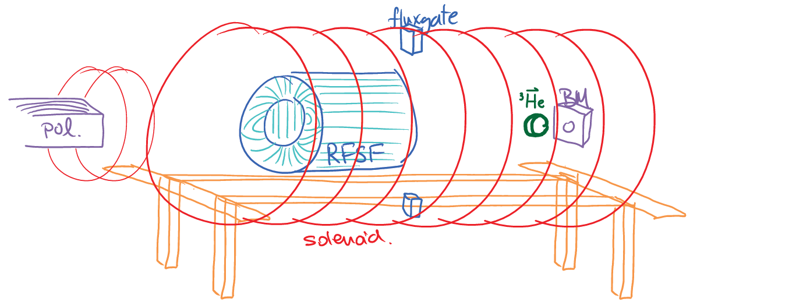
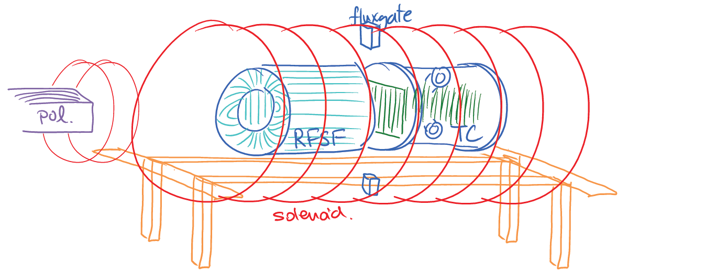
Alignment of Subsystems
Minimizes systematic uncertainties due to detector asymmetries transverse to beam direction.
Feasible to align field, beam, and chamber to within 10 mrad.
Scan beam profile upstream and transfer centroid to crosshairs
Scan beam profile downstream
Align theodolite to crosshairs
Align B-field to theodolite
Field map in RFSR/Target region
Align the position / angle of target with theodolite / autocollimator
Tune RFSR / measure polarization
Measure physics asymmetry

Slide 12
The n³He Collaboration
Spokespersons:
D. Bowman, M. Gericke, C. Crawford
Local Project Manager: S. Penttila
Project Engineer: Jack Thomison
Work Subpackage Leaders:
G. Greene Neutronics
L. Barrón Solenoid
C. Crawford Spin rotator
M. Gericke Target / detector
D. Bowman Preamplifiers
C. Crawford Data acquisition
N. Fomin Online analysis
J. Hamblen Integration
D. Bowman Commissioning

Slide 13
Status and Schedule
Construction of subsystems is being completed
Preassembly in staging area near beamline will begin in May while NPDGamma completes running.
NPDGamma removed from beamline at the end of June
Installation of n³He: July-August
Alignment: September-October
Commissioning: October-November
Data Collection: Dec 2014 through Dec 2015

