Slide 1
Input Signal For the Spin Flipper

Slide 2
Summary
ArbExpress Waveform Editing Tool from Tektronix
Design Waveforms or upload to Tektronix AWG 3022 thru USB port
Waveforms can be designed with up to 2¹⁶ points (65536 points)

Slide 3
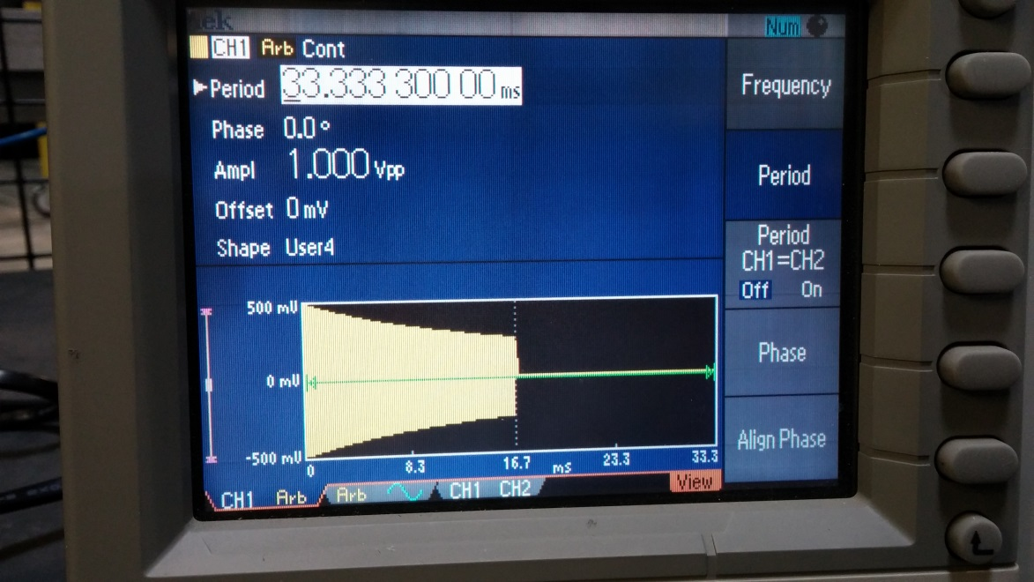
User defined waveform in Tektronix 3022
T = 33.3333 ms
1/t envelope contains 444 sinusoidal oscillations. Each 2\pi oscillation built out of approximately 150 points.
Height of envelope at end points is easily adjustable with ArbExpress software
Can be triggered with SNS logic signal

Slide 4
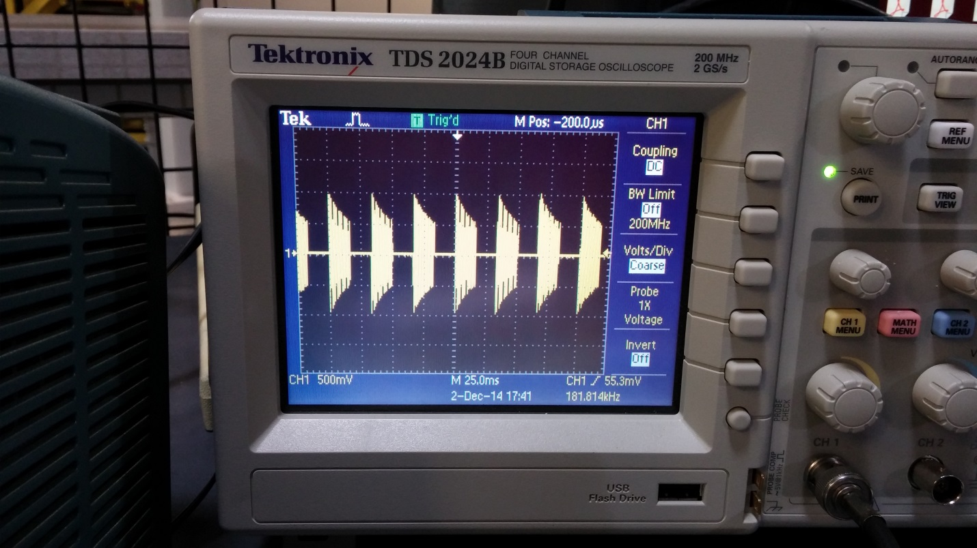
Picture of uploaded waveform on Scope

