Slide 1
Laser Mount

Slide 2
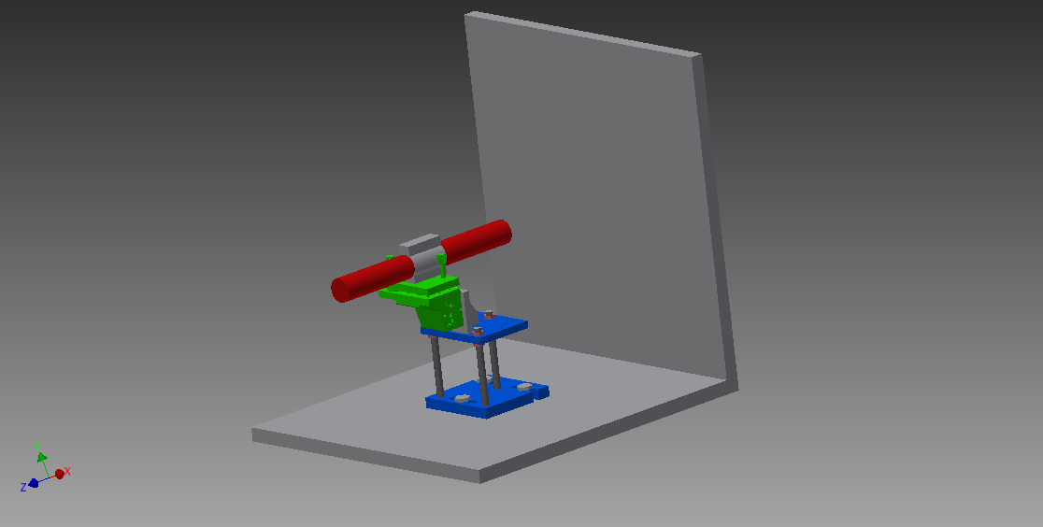
Pictures of Mount/Laser
Picture showing Laser and two faces of the beam stop alcove

Slide 3
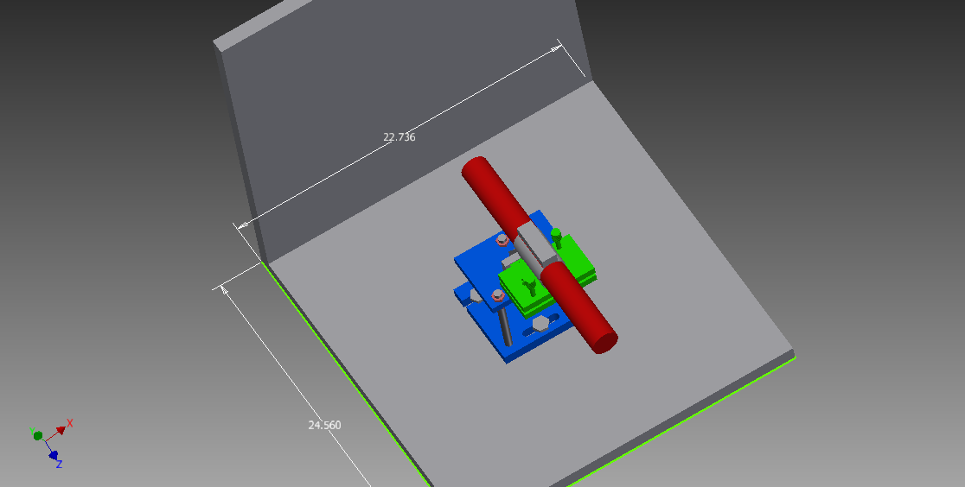
View from Above
Laser shoots beam in both directions unless one end is covered

Slide 4
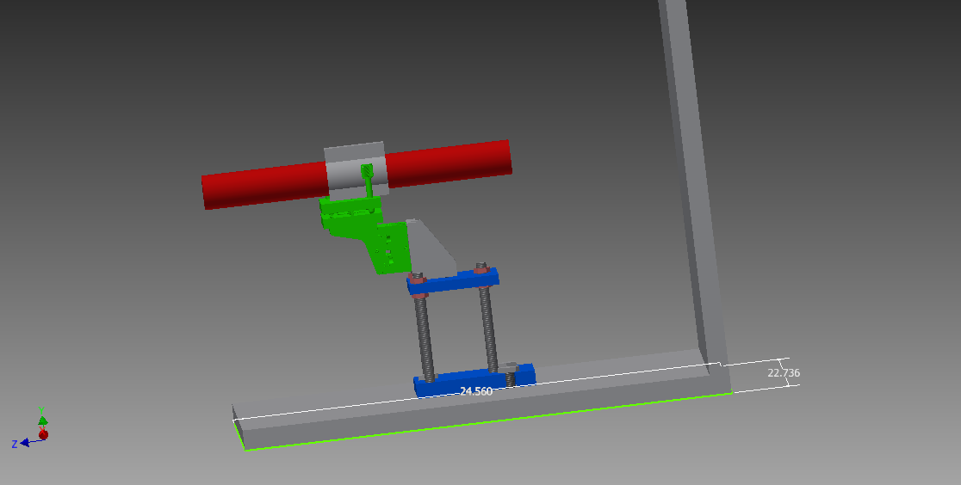
Another Picture
Laser can slide within its holder to different positions
Top of laser sits ~12.5 inches above base of alcove.

Slide 5
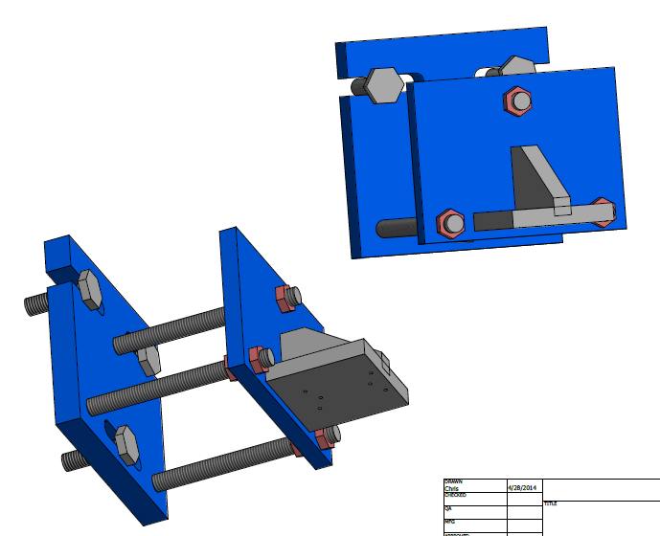
Laser Mount
Pictures showing part of laser mount that needs to be built in a machine shop.
Base measures 6” x 6”

Slide 6
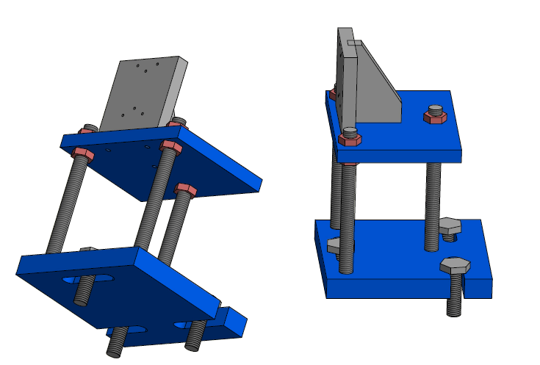
More views
Base allows for 2 inches of transverse motion
Vertical Threaded rods are 6 inches long (probably should be 8 inches long)
Rods are ½ inch thick.

Slide 7
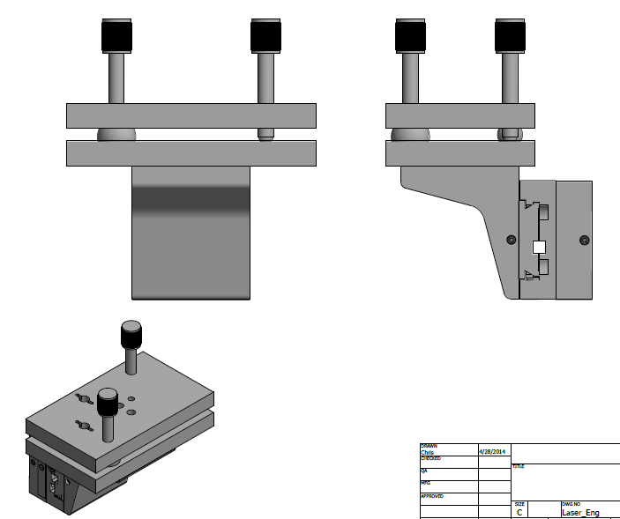
Pics of Linear/Tilt stages

Slide 8
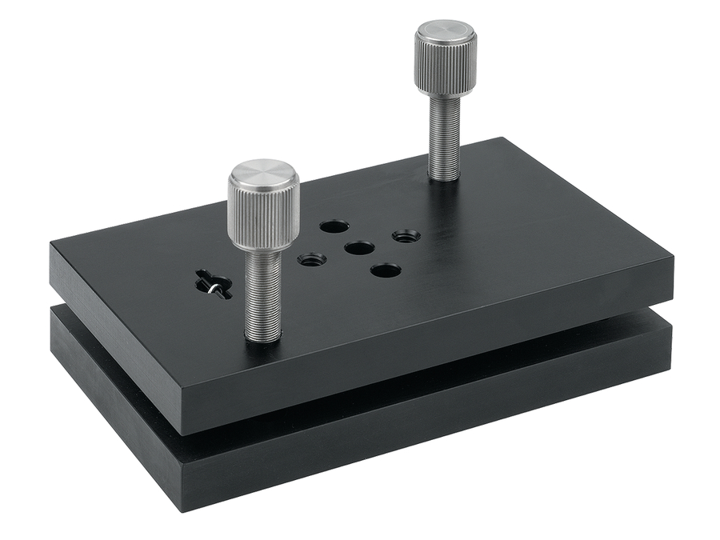
Precision Parts from Newport
Newport Model 39 Two-axis tilt platform
-3.5 to 14 degrees on long axis
-5 to 16 degrees on short axis

Slide 9
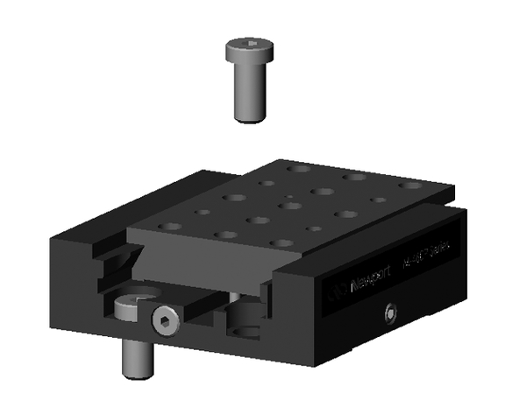
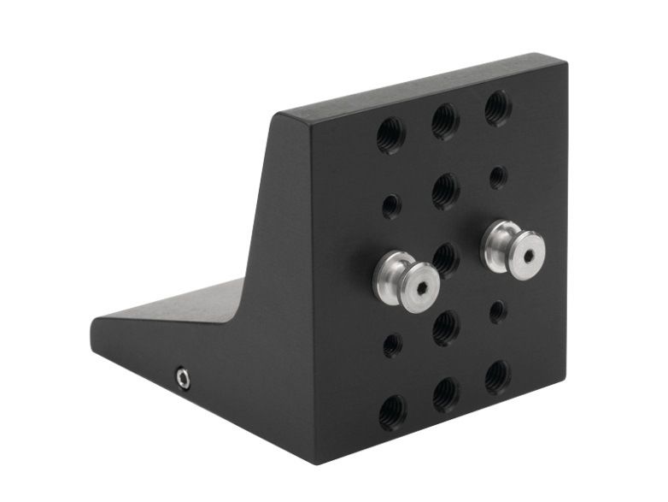
Precision Parts from Newport
90 degree angle bracket
(Need 1 of these)
Single axis linear stage
(Need 2 of these)
Pegs
(Need 4 of these)

Slide 10
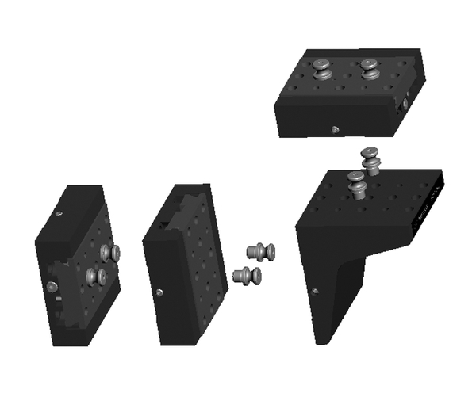
Joining Newport Precision Parts
Don’t need pegs on top of angle bracket

Slide 11
Prices for Optical Mounts
Linear Stage (460PD-X) ………………………….$195.94
Linear Stage (460PD-X)………….………………..$195.94
90 Degree Angle Bracket(960P-BK)……………..$99.94
Two-Axis Tilt Platform (Model 39)………………$189.94
Pegs (PEG-10) …… ……………………………… $79.94
Total: …………$761.70

Slide 12
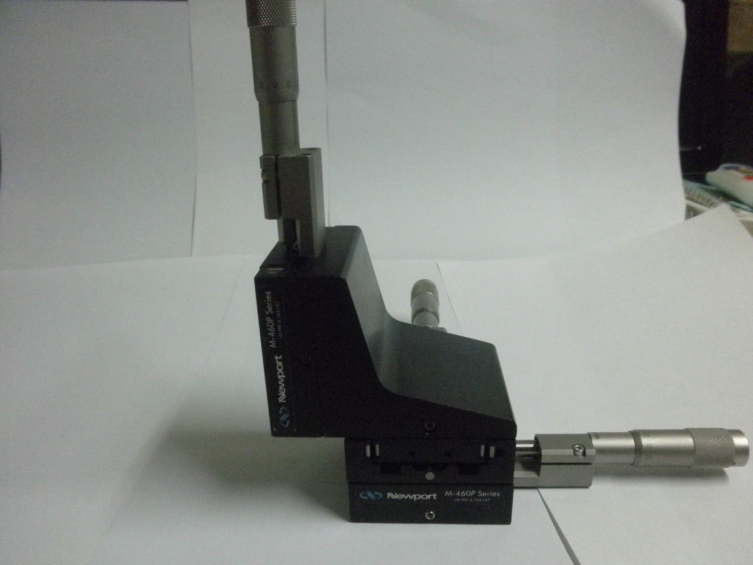
Newport Parts on e-bay
E-bay lists starting bid for entire part with micrometers and extra z-dimension for $350.00.

