Slide 1
The n3He Experiment
Michael Gericke
University of Manitoba
for the n3He collaboration
March 2014 FnPB Proposal Review & Advisory Committee Meeting

Slide 2
Outline
Brief overview of the experiment
Schedule overview / summary (based on current status)
Current status of construction and recent progress
Beamline components
Magnetic holding field
Spin rotator
Target/detector chamber
Preamplifers and DAQ
Installation and commissioning plans

Slide 3
The n3He Collaboration
Spokespersons
D. Bowman, M. Gericke, C. Crawford
Local Project Manager
S. Penttila
Project Engineer
Jack Thomison
Work Subpackage Leaders
G. Greene Neutronics
L. Barrón Solenoid
C. Crawford Spin rotator
M. Gericke Target / detector
D. Bowman Preamplifiers
C. Crawford Data acquisition
N. Fomin Online analysis
J. Hamblen Integration
D. Bowman Commissioning

Slide 4

Experimental Setup
FnPB cold
neutron guide
10 Gauss
solenoid
³He Beam
Monitor
RF spin rotator
³He target /
ion chamber
FNPB
n-³He
Measure PV spin asymmetry to 2x10⁻⁸
Longitudinal holding field – suppressing PC nuclear asymmetry:
(1.7x10⁻⁶ ∝ s_{n} • k_{n} x k_{p} (Hale) suppressed by two small angles
RF spin flipper – negligible spin-dependence of neutron velocity
³He ion chamber – both target and detector

Slide 5
Schedule Overview
Complete component construction / bench testing now - May
Preassemble in staging are May - June
Facility summer maintenance break June-27 – Aug-15
Removal of NPDGamma June-27 – July -7
Installation of n-3He on beam line July-7 - Aug-15
IRR August
Alignment of the experiment with beam Sep – Oct -2014
Commissioning; 60 days Oct – Nov - 2014
Measurement of PC transverse asymmetry; 15 days Dec - 2014
Facility winter maintenance break Dec - 2014 - Feb - 2015
Measurement of PV longitudinal asymmetry; 200 days Feb-2015 – Dec- 2015

Slide 6
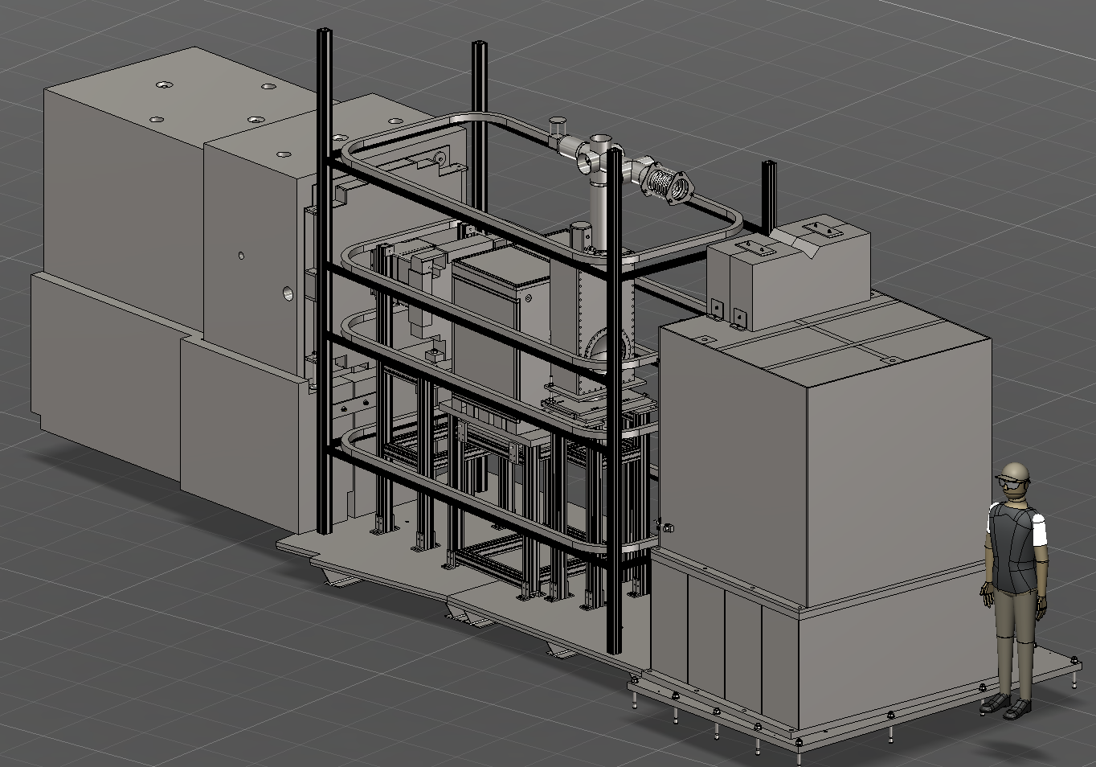
Experimental Setup

Slide 7
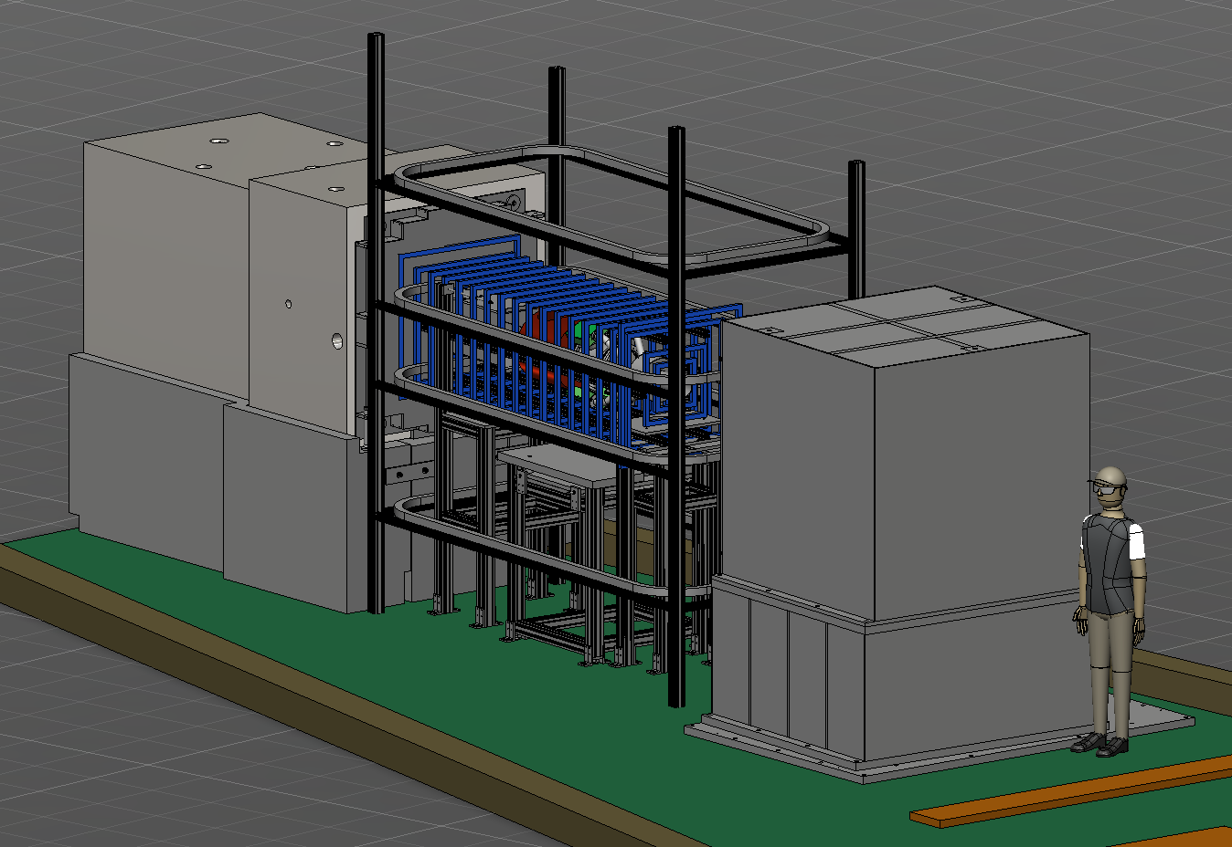
Experimental Setup

Slide 8
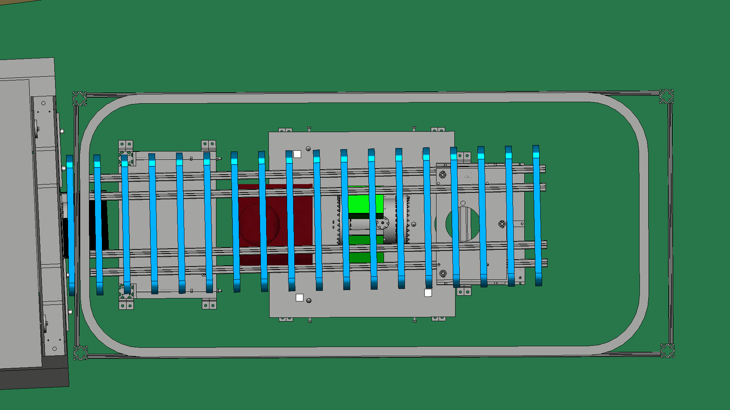
Unistructure support – preliminary CAD model
TOP VIEW

Slide 9
Beamline
Scope
FnPB guide, polarizer, beam monitors – stays UNCHANGED
PPS remains UNCHANGED
Beam profile scanners, polarimetry
Status
All equipment is being used for NPDG experiment except the beam profile scanners
XY-scanners in hand and tested
Remaining work
Design shielding and mounts for xy-scanner – April
Design mount for ³He analyzer (polarimetry) – April
Modify beamline shielding – April
Chris Hayes, Kabir Latiful Josh Hamblen
Geoff Greene

Slide 10
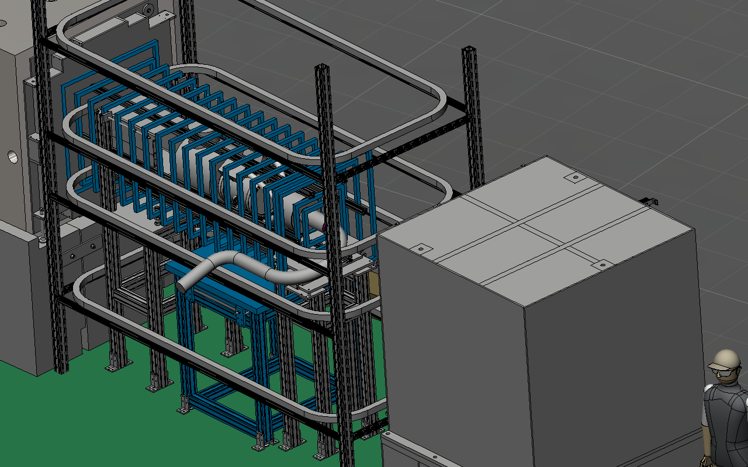
Magnetic Field

Slide 11
Magnetic Field
Scope
Magnetic field simulations to verify adiabatic spin rotation and uniformity
Unistructure frame for Magnetic coils, Spin rotator, and Target/detector mounts directly onto existing NPDG stands on the beamline
Design, construction, and testing of longitudinal solenoid 10 Gauss holding field, just like NDPG
Status
Calculations indicate adiabaticity, coils being machined (winding in parallel) 18(+1) coils, 15 cm apart, 70(52) cm sides, 150 A turns
Materials for frame and coil supports are in hand
Remaining work
Machining of coil supports: April
Coil completion: May
Coil delivery to ORNL: June
Andrés Ramirez,
Libertad Barrón

Slide 12
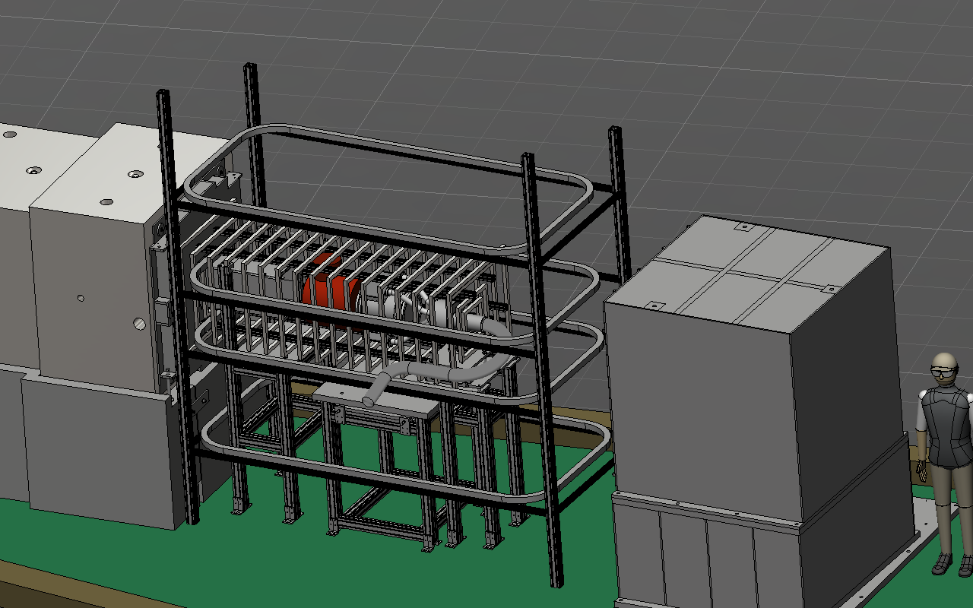
Spin Rotator

Slide 13
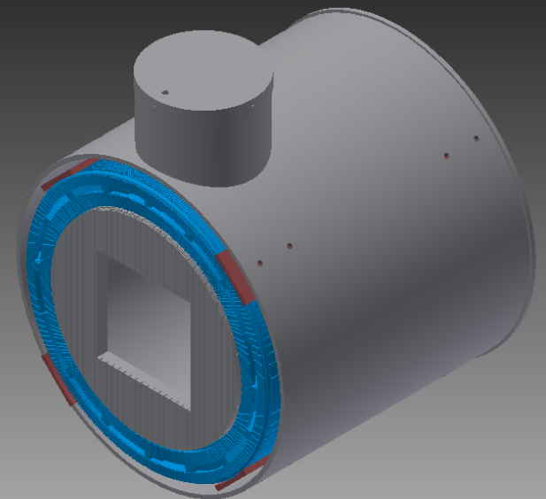
Spin Rotator
Scope
Design of RF double cos-theta coil
Machining forms for inner/outer coils, aluminum enclosure, mounts
RF driver electronics
Field mapping and testing
Status
Design complete
Machining of coils complete
Winding of coils Complete
RF driver electronics exist and are being used for NPDG
Remaining work
Construction of enclosure: In progress
Testing and field mapping: In progress
Chris Hayes,
Geoff Greene
Chris Crawford

Slide 14
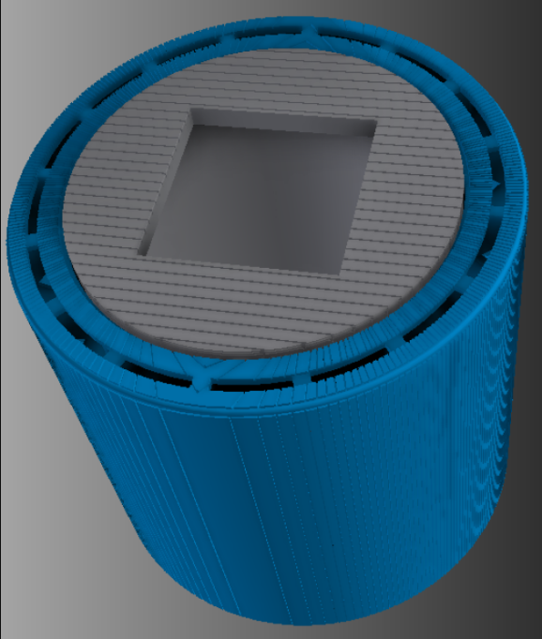
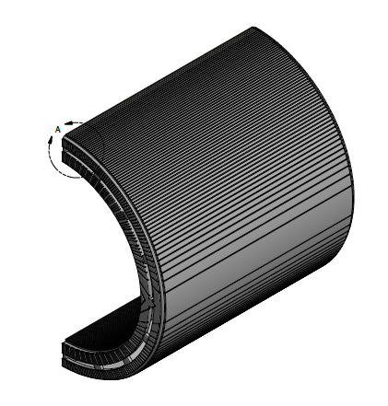
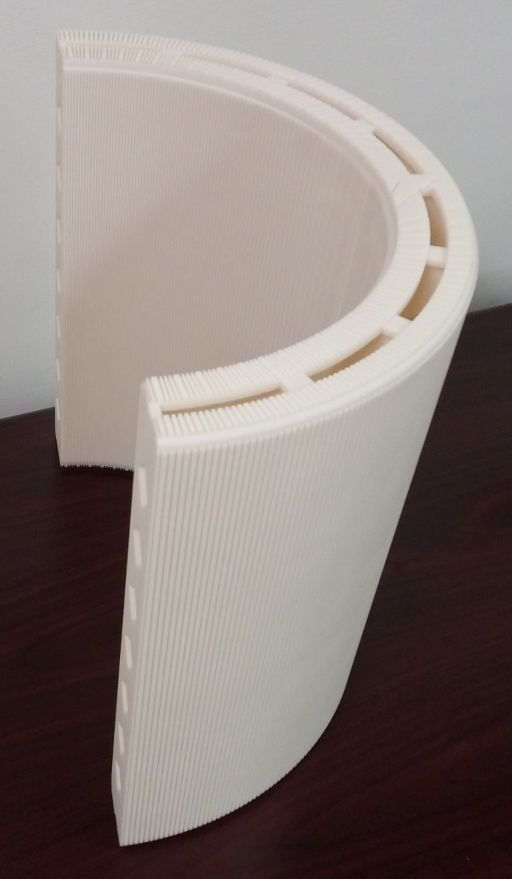
Spin Rotator (Coils)
Design and Construction:
Complete
Inner cylinder made from PVC
Outer coils fabricated using 3D print Technology.

Slide 15
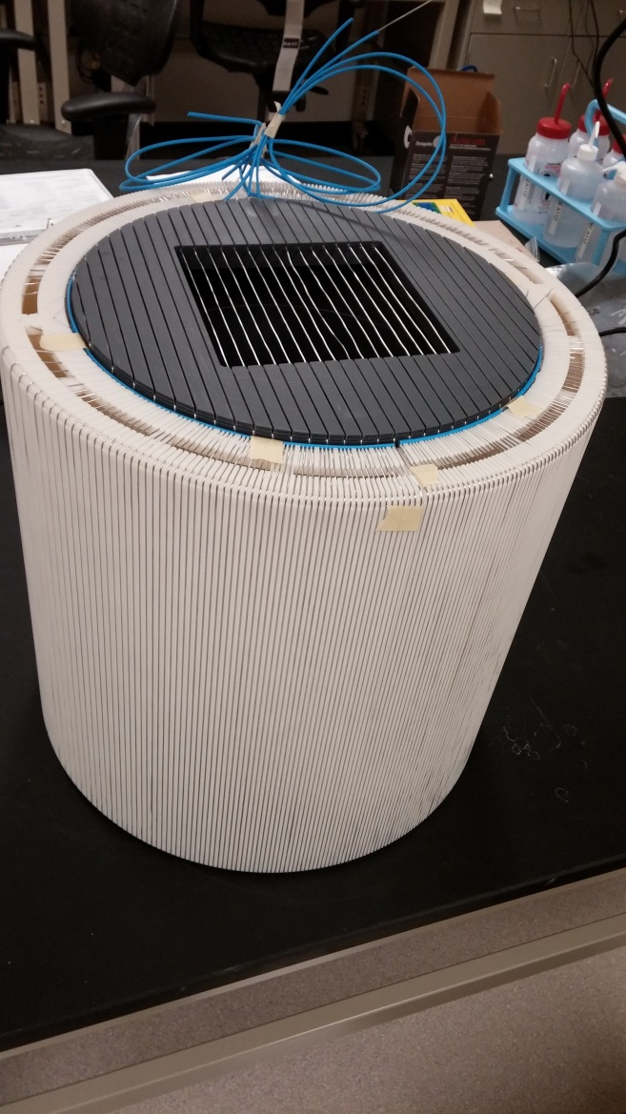
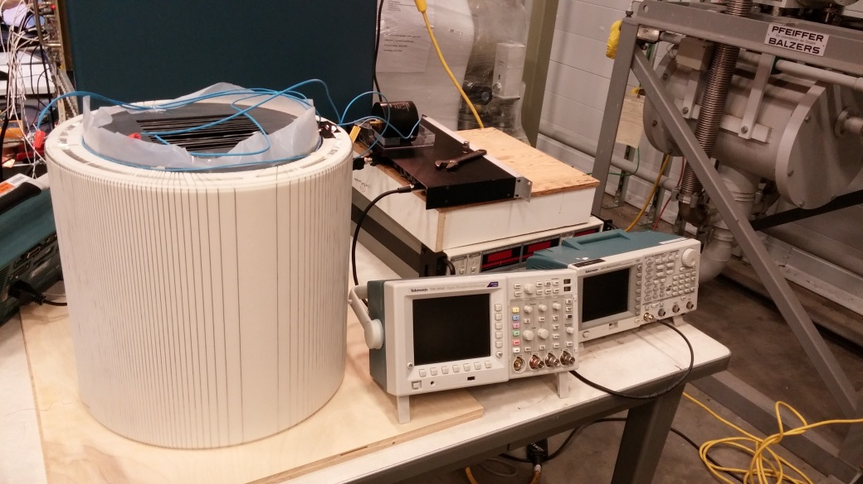
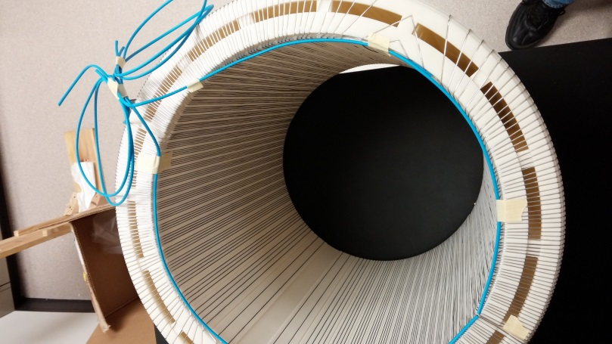
Spin Rotator (Photographs)

Slide 16
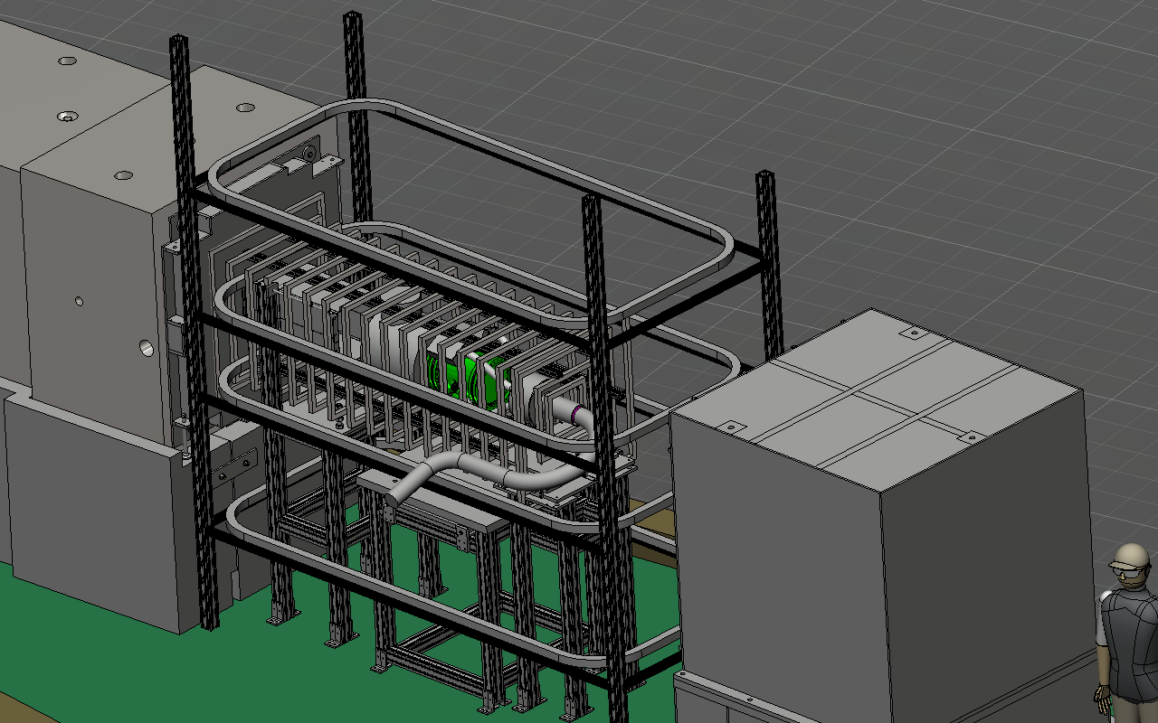
Target / Detector

Slide 17
Target / Detector
Scope
Vacuum enclosure with 1 atm ³He
144 channels of sense wires
low leakage / noise
good charge collection
Status
Vacuum enclosure in hand
Wires soldered to frames
Remaining work
Assemble wire plane stack, readout plane: March
HV test and vacuum tests March
Fill with ³He: April
Electronics noise testing with chamber April
Mark McCrea
Michael Gericke
Seppo Penttila

Slide 18
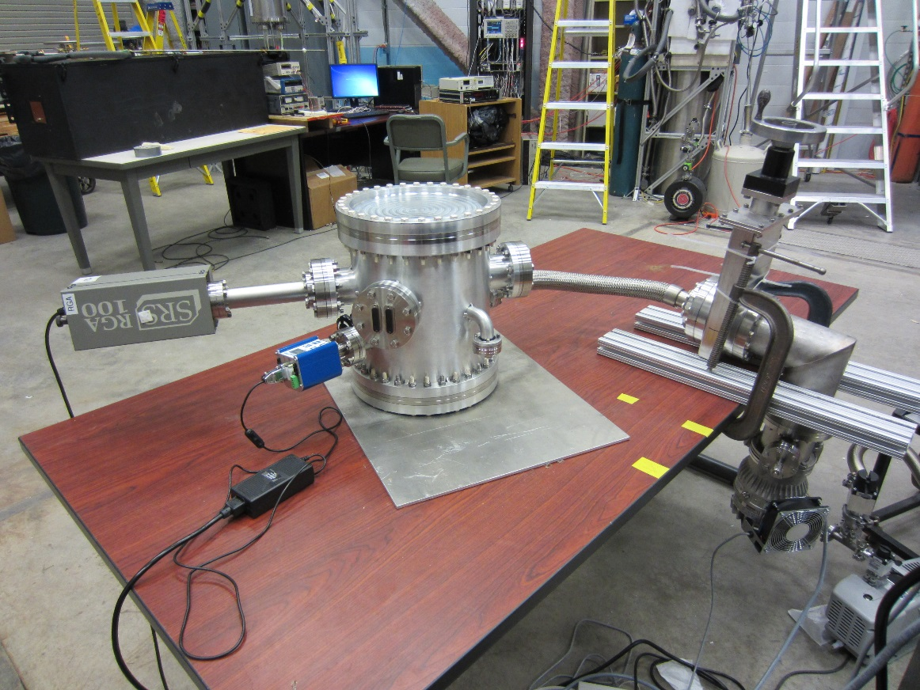
Target / Detector (Housing)
12” Conflat end flanges
1 mm Al windows
Fill gas: 1 atm ³He
Feedthroughs: 4x signal, 2x high voltage, 2x vacuum

Slide 19
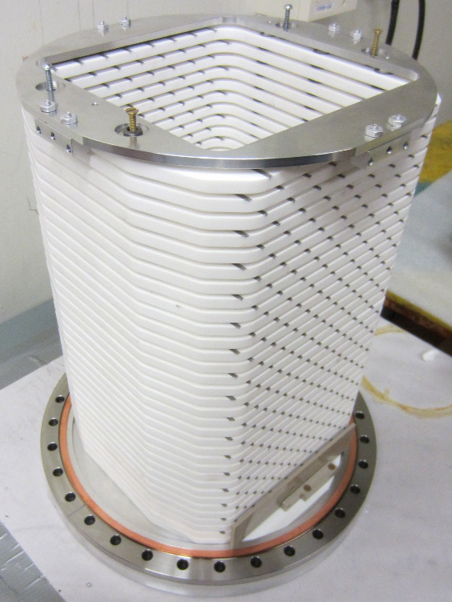
Target / Detector (Wire frame stack)
17 HV planes
16 signal planes
144 signal wires
All wires soldered to frames
Mounting hardware and fittings all constructed
PCB readout boards will arrive late March
Assembly March-April
Testing starting in April

Slide 20
Target / Detector (Wire frame stack)
17 HV planes
16 signal planes
144 signal wires
All wires soldered to frames
Mounting hardware and fittings all constructed
PCB readout boards will arrive late March
Assembly March-April
Testing starting in April

Slide 21
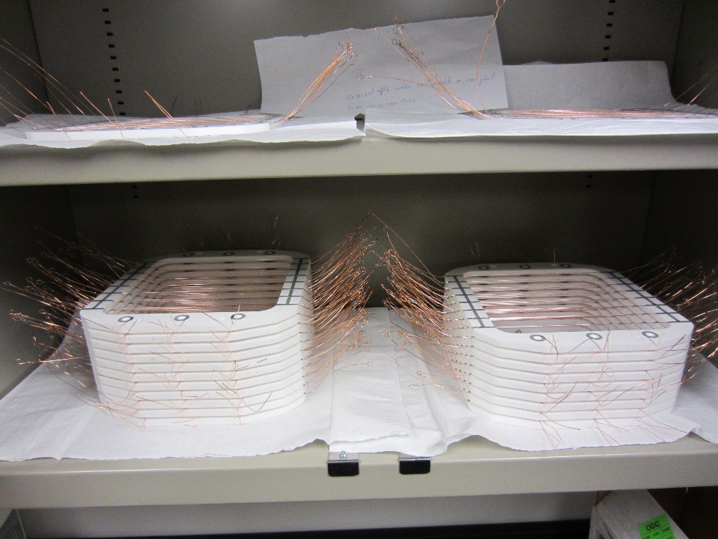
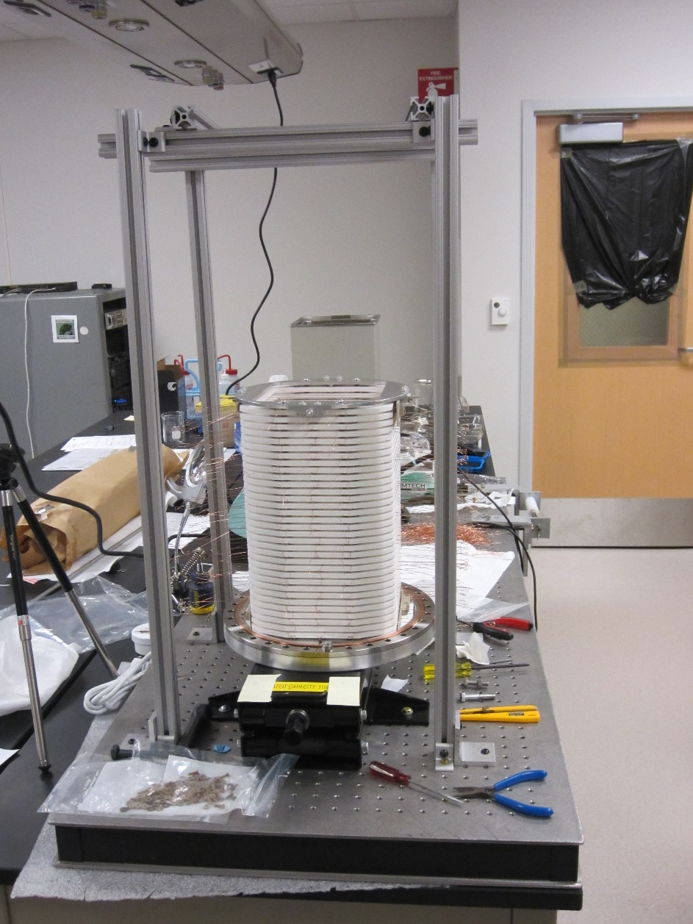
Target / Detector (Wire frame stack)

Slide 22
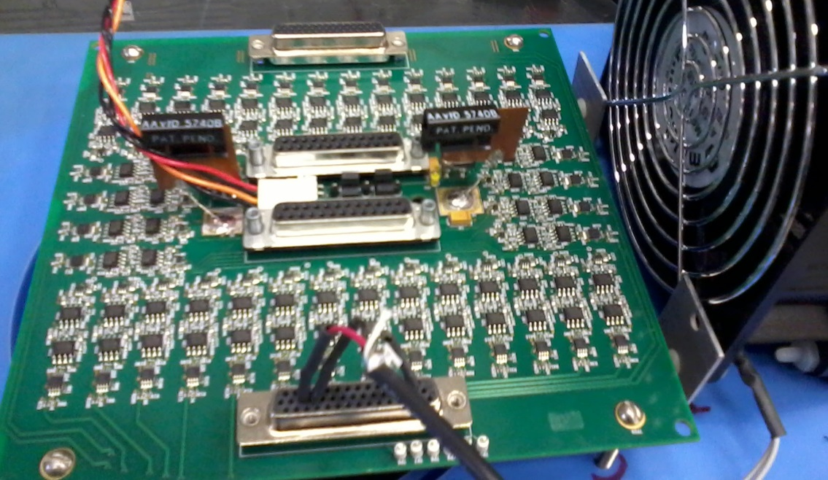
Pre-amplifiers
Kabir Latiful
Irakli Garishvili
David Bowman
Scope
4 enclosures (one per vacuum feedthrough) with 36 channels each
Circuit board designed locally at ORNL
Connector to ion chamber vacuum port and cabling to DAQ module
Status
Prototype circuit board tested
Achieved theoretical limit on some channels, testing in progress
Remaining work
Test cooled prototype
inside enclosures
Build final preamps
Build cables
Test all channels
Measure instrumental
asymmetries with spin
rotator and target

Slide 23
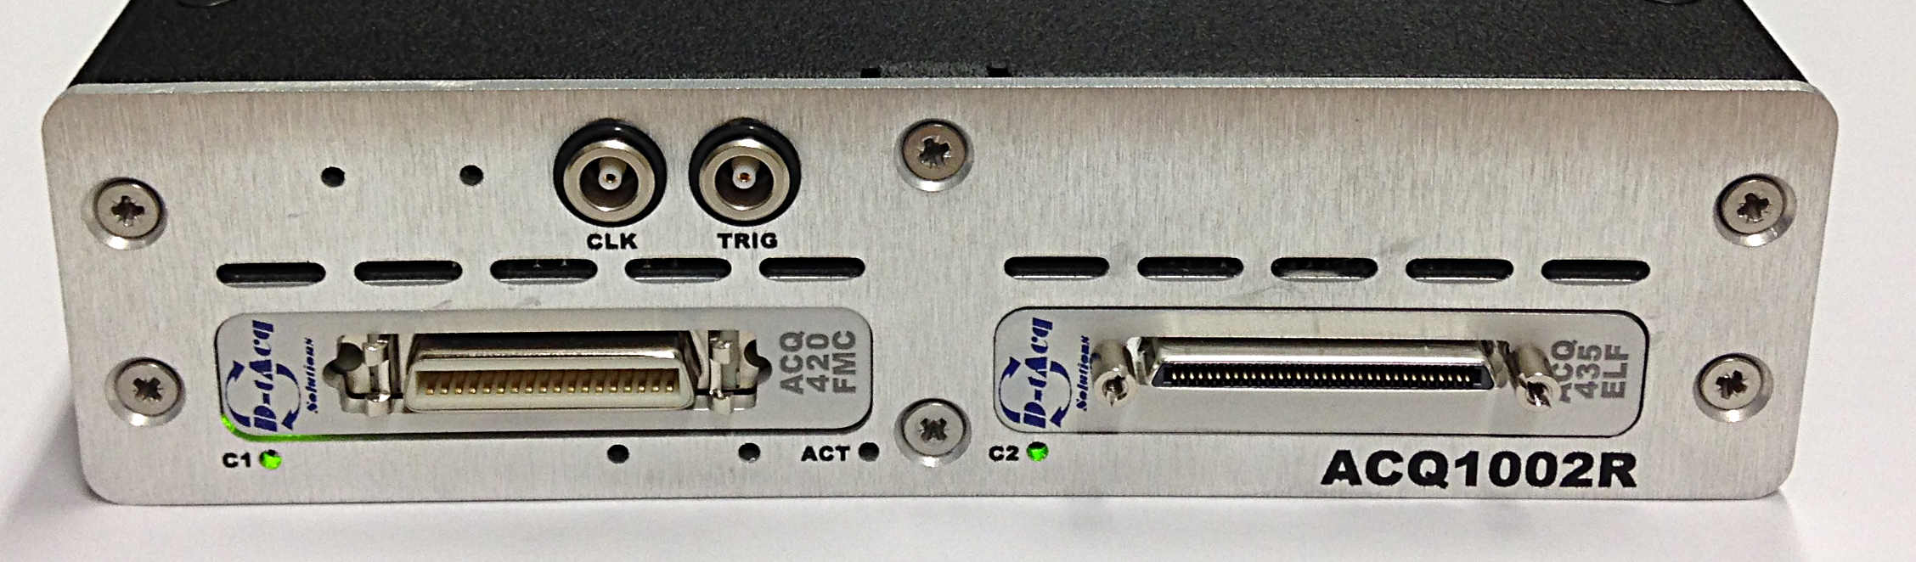
Data acquisition
Kabir Latiful
Irakli Garishvili
Nadia Fomin
Chris Crawford
Scope
144 channels of 24 bit, 128 KS/s ADC
Progress
Basic software used to take and analyze data
Extensive testing of two prototype systems
Preliminary measurements of instrumental false asymmetry
ADCs ordered, delivery: April 9th; custom firmware by end of May
Two DAQ computers acquired; RAID array ordered
Remaining work
Test complete DAQ hardware: April–May
Adjust software for final hardware and custom firmware: May–June

Slide 24
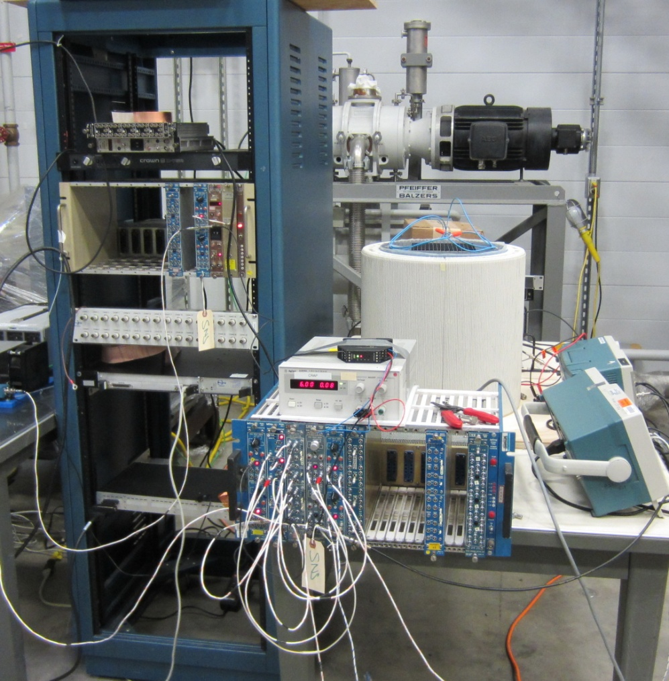




Instrumental false asymmetry measurement
Measurements with RFSR, preamps, and ADC modules
Trigger optically isolated
Kabir Latiful
Irakli Garishvili
David Bowman
Chris Crawford
dirty ground
Divider
Sig. Gen
Amp.
optical isolator
RFSR
Fake T₀
Preamp
clean ground
ADC

Slide 25
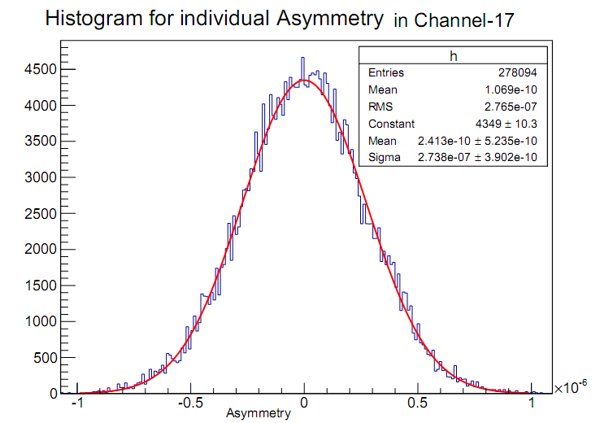
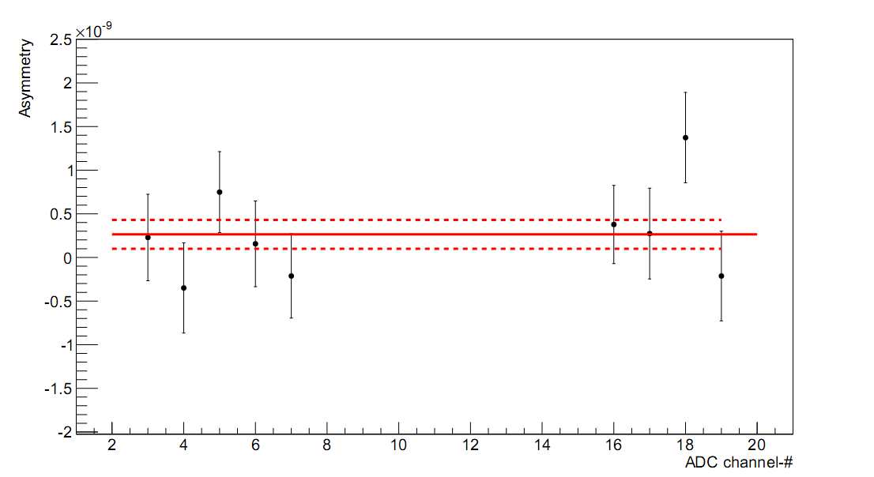
Instrumental false asymmetry measurement
Data taken for 5 hours
A = (2.64 ± 1.64) x 10⁻¹⁰
Will repeat measurements with delivered DAQ and wire chamber

Slide 26
Schedule Overview
Complete component construction / bench testing now - May
Preassemble in staging are May - June
Facility summer maintenance break June-27 – Aug-15
Removal of NPDGamma June-27 – July -7
Installation of n-3He on beam line July-7 - Aug-15
IRR August
Alignment of the experiment with beam Sep – Oct -2014
Commissioning; 60 days Oct – Nov - 2014
Measurement of PC transverse asymmetry; 15 days Dec - 2014
Facility winter maintenance break Dec - 2014 - Feb - 2015
Measurement of PV longitudinal asymmetry; 200 days Feb-2015 – Dec- 2015

Slide 27
Integration / Pre-assembly
Scope:
Design of unistructure support frame
Design, construction of mounting and alignment hardware
Maintain 3d solid model of experiment
Ensure components fit and that support frame matche the NPDGamma stands
Status:
Preliminary solid model exists
Conceptual design for mounts and alignment
Model is added to beamline model by SNS designers
Remaining work:
Final design of stand and mounting
Construction of mounting, alignment hardware: April
Assembly of complete system in staging area: May-June
Alignment testing: June
Caleb Wickersham
Mark McCrea
Jack Thomison
Geoff Greene
Josh Hamblen

Slide 28
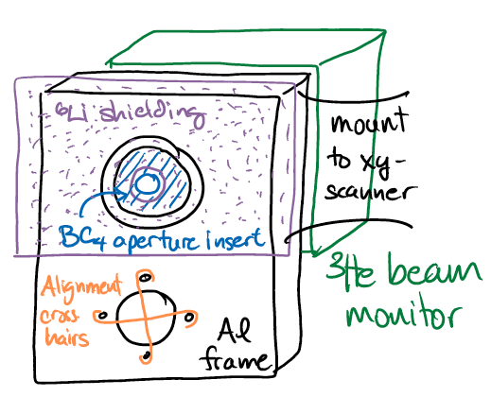
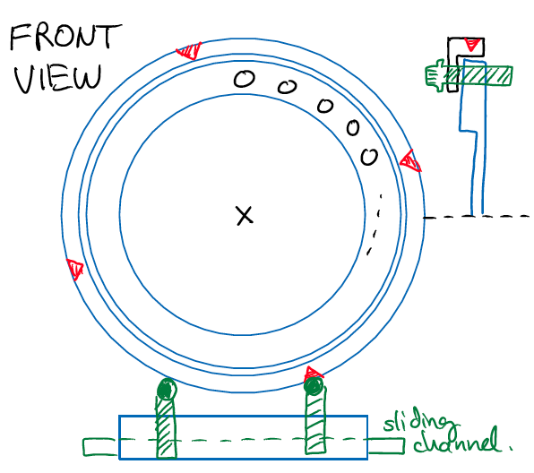
Alignment
Mounting / alignment components
Aperture / crosshairs for beam scan
Support stand and xy-adjustment for theodolite
Alignment V-block for trimming B-field
Optical system and adjustable mount for target
10 mrad tolerance – no need for S/A crew

Slide 29
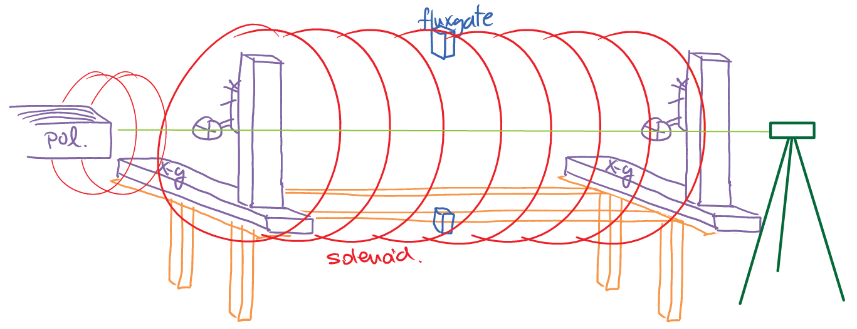
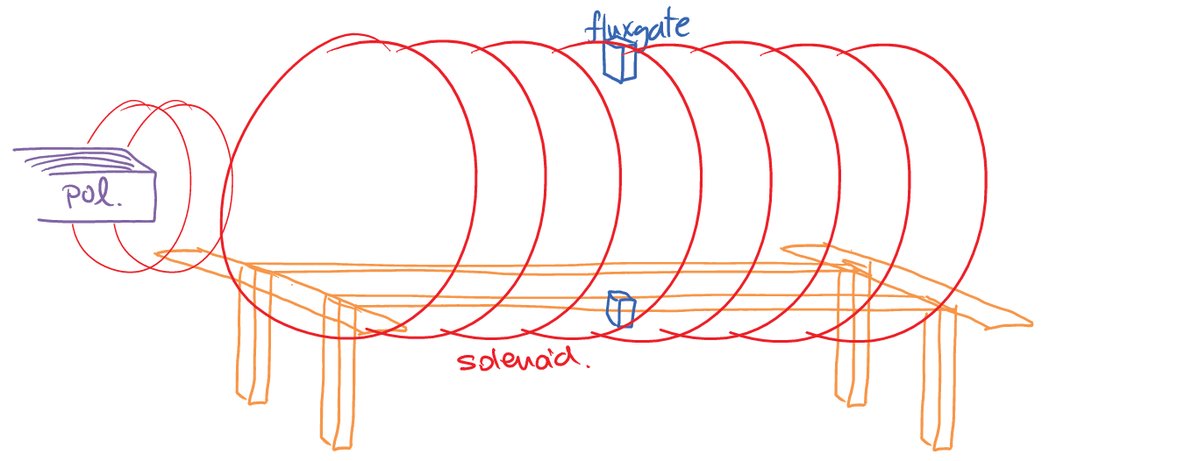
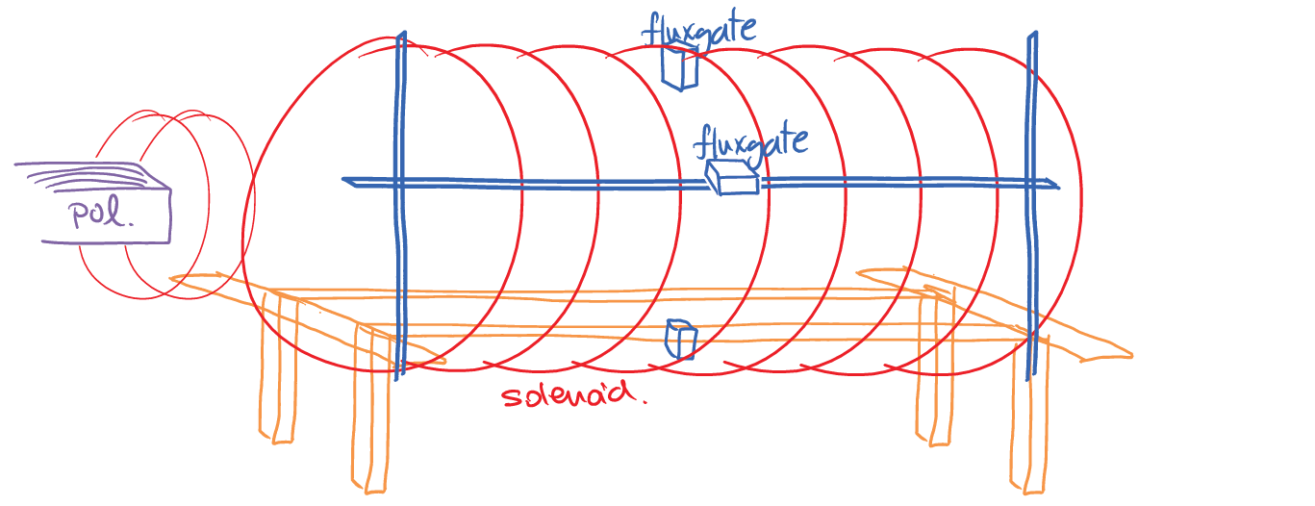
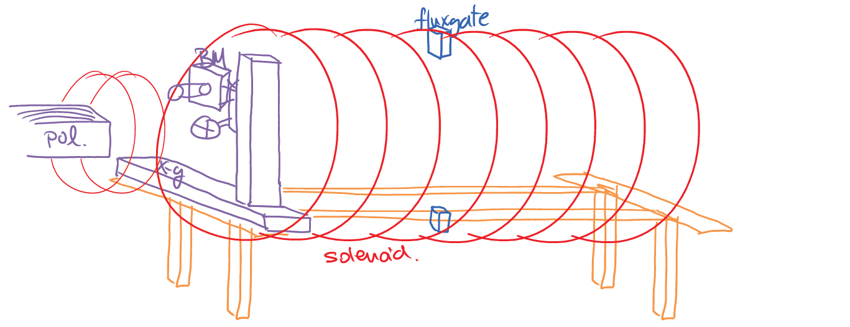
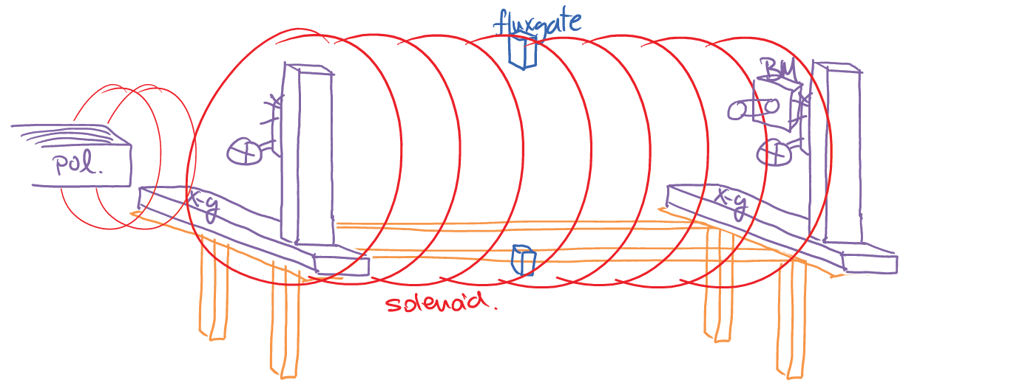
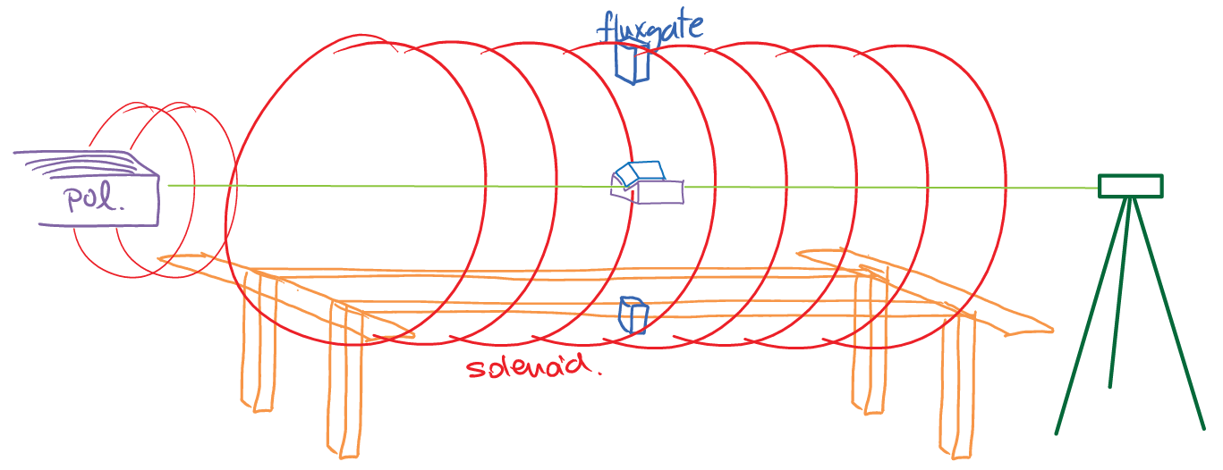
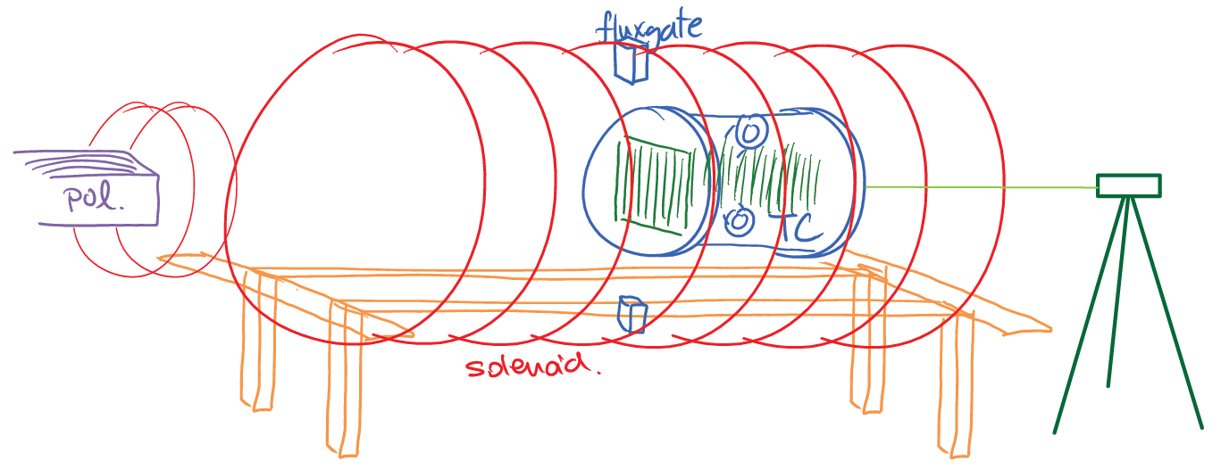
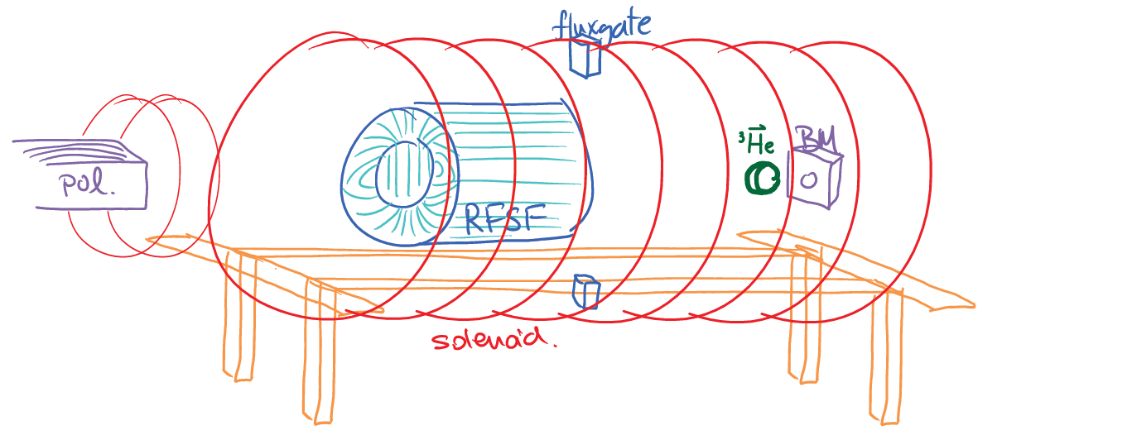
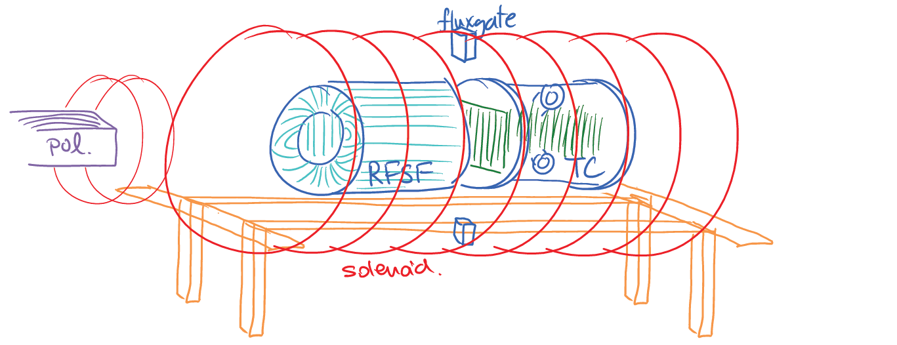
Commissioning / Run plan
IRR #2
IRR #1
Scan beam profile upstream and transfer centroid to crosshairs
Scan beam profile downstream
Align theodolite to crosshairs
Align B-field to theodolite
Field map in RFSR/Target region
Align the position / angle of target with theodolite / autocollimator
Tune RSFR / measure polarization
Measure physics asymmetry

Slide 30
Backups

Slide 31
n³He Calculations
Full four-body calculation of strong scattering wave functions
Evaluation of the weak matrix elements in terms of the DDH
potential (Work in progress on calculation of EFT low energy
coefficients)
DDH Weak Coupling | (A^{p}_{Z}) n³He →tp
a_{π}¹ | -0.189
a_{ρ}⁰ | -0.036
a_{ρ}¹ | 0.019
a_{ρ}² | -0.0006
a_{ω}⁰ | -0.0334
a_{ω}¹ | 0.0413
M. Viviani, R. Schiavilla, Phys. Rev. C. 82 044001 (2010)
L. Girlanda et al. Phys. Rev. Lett. 105 232502 (2010)

