Slide 1
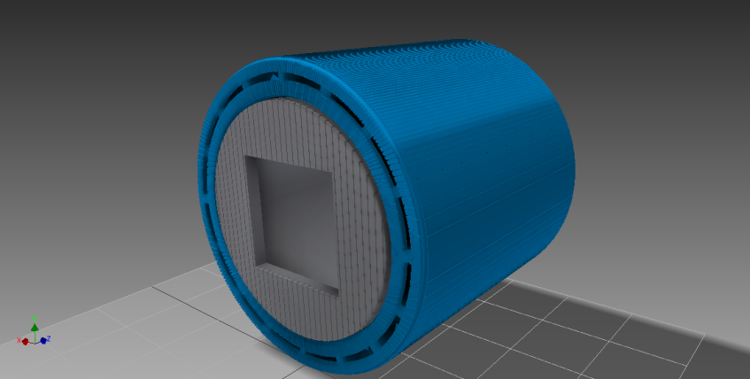
Resonant Frequency Spin Rotator For the n3He Experiment
Christopher Hayes
University of Tennessee, Knoxville

Slide 2
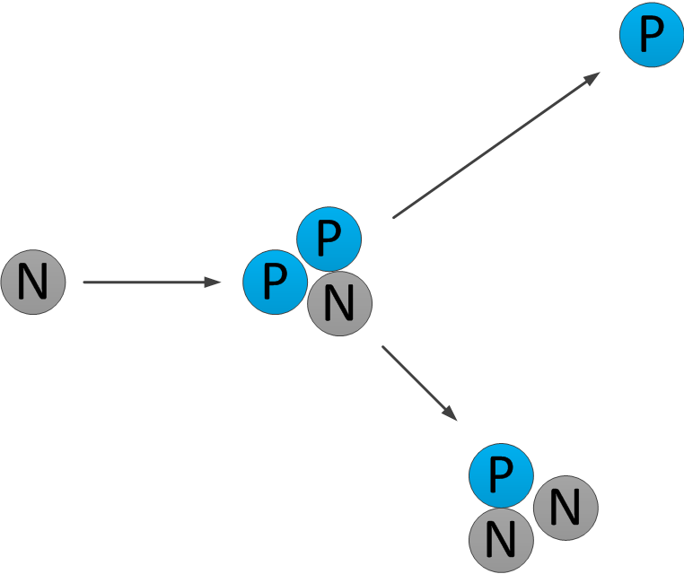
Neutron Scattering on He-3
Goal is Statistical Observation of Parity Violation in the Hadronic Weak Interaction (HWI)
Observable is which represents a correlation between the spin of the incoming neutron and the momentum of the outgoing proton

Slide 3
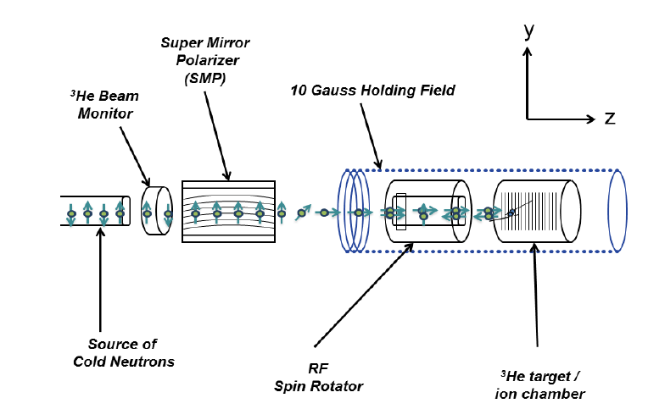
Details of the Experiment
Begin with a pulsed source of cold Neutrons (60 Hz)
Neutrons spins are aligned in a super mirror polarizer and the longitudinally polarized
Flip individual pulses of neutron spins
Strike a target filled with He-3 at 1 Atmosphere

Slide 4
Rotating Neutron Spins
y
z
x
Spin Rotator
Helicity = +1
Helicity = -1
Neutron Beam Direction

Slide 5
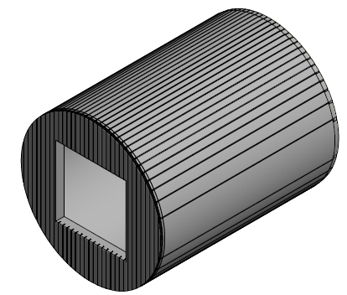
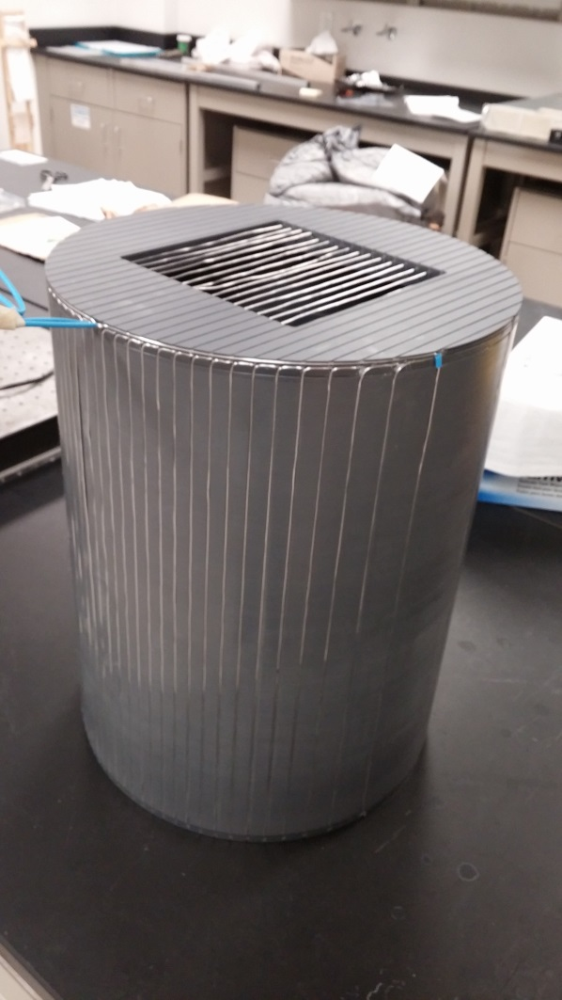
Cosine-Theta Coil
Produce a constant interior B-field by:
1. Wrapping wires longitudinally and parallel to the axis of coil
2. Spacing wires in a cosine winding pattern around the perimeter of the coil.

Slide 6
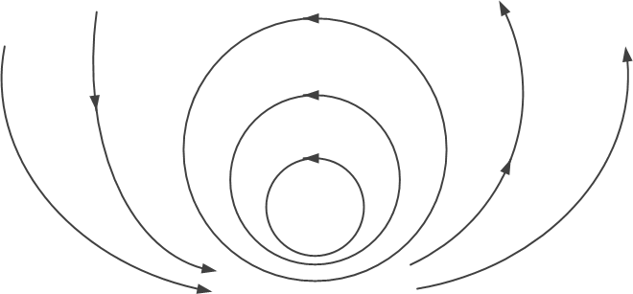
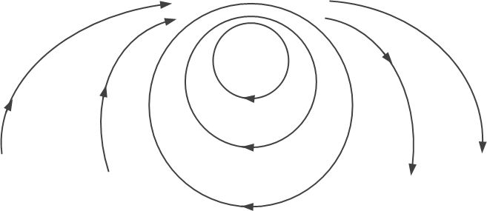
Fields of a Cosine Theta Coil
Surface Current Density:
Magnetic analog of electrostatic problem using a charge density glued to the cylinder wall.

Slide 7
Cosine Theta Coil For n3He Experiment?
Field of a Cosine Theta Coil will not work for the n3He experiment
Spin Rotator is placed next to the target chamber
External B-field interferes with delicate electronics and data acquisition producing uncontrollable false asymmetries
DAQ is Ineffective with an external B-field

Slide 8
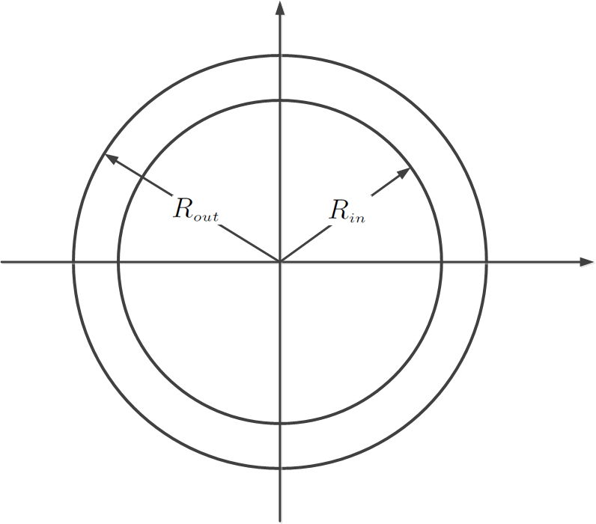
Fields of a Double Cosine Theta
Two Concentric Cosine theta coils
Currents flow in opposite directions

Slide 9
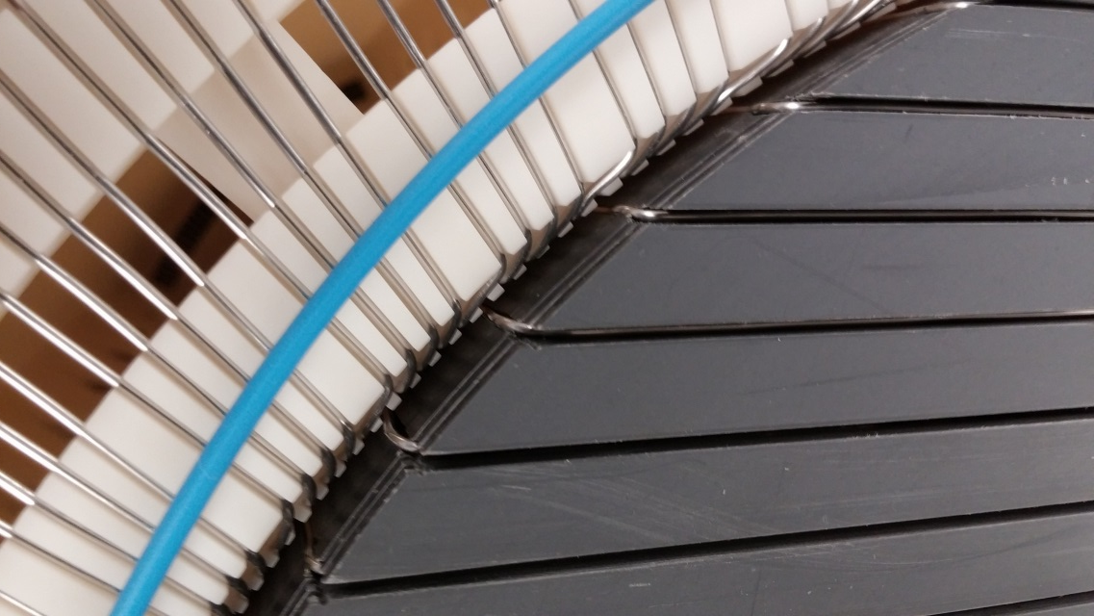
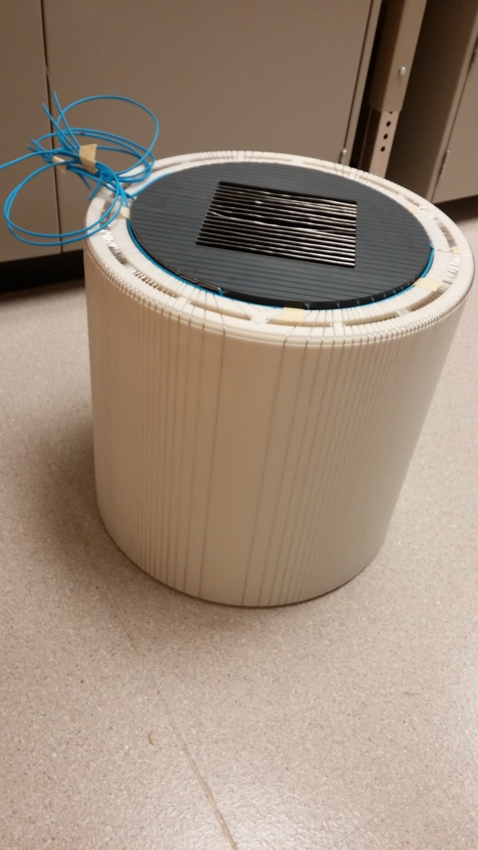
Pictures of the Double Cosine Theta Coil
Coil has a length of about 16.0 inches
Coil has outer diameter of about 16.5 inches
Inner cylinder constructed from PVC pipe
Outer coils made of plastic

Slide 10
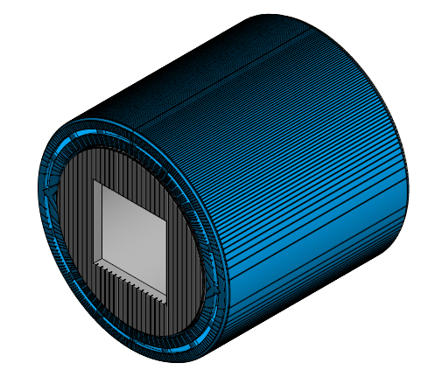
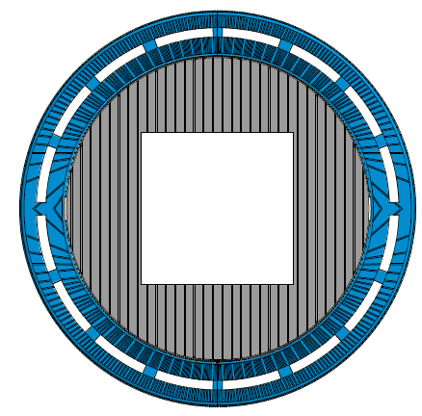
Pictures from CAD Drawings
360 wires along inner radius
248 wires along outer radius
Coil uses 868 feet of wire

Slide 11
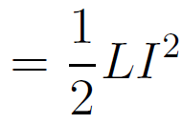
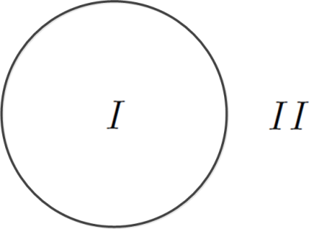
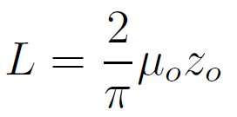
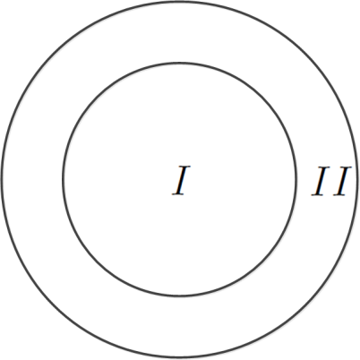
Inductance of Cosine-Theta Coils
Theory of a double cosine-theta coil allows for an exact calculation of inductance using
CTC:
DCTC:

Slide 12
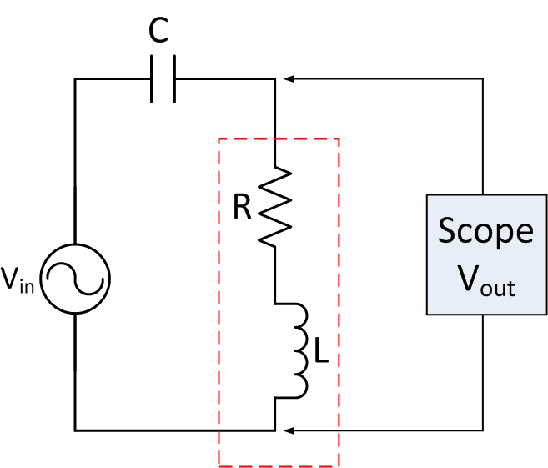
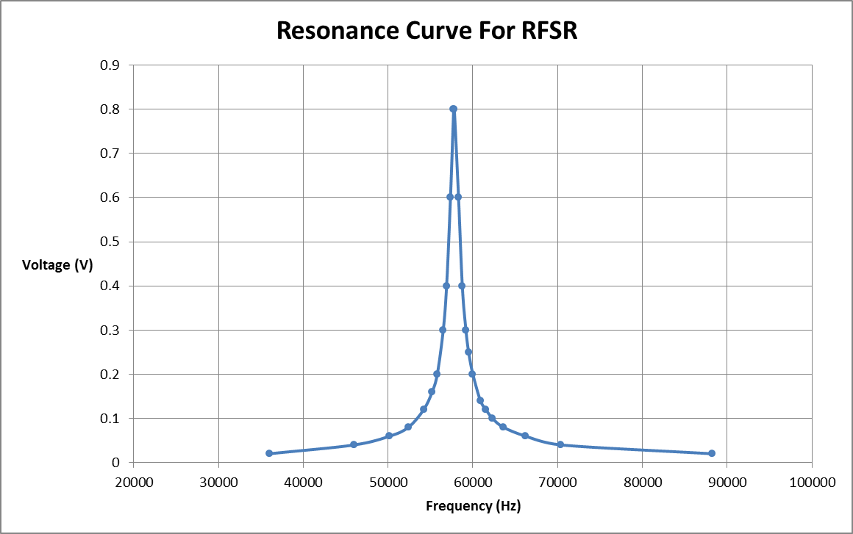
Double Cosine-Theta Coil as an RCL Circuit
R = 9.11 ohms L = 2.01 mH
Resonance Testing completed
Successful B-field Measurements internal and external to the coil
RFSR

Slide 13
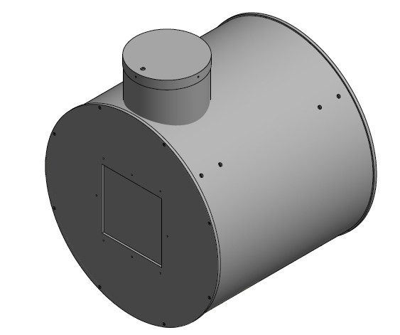
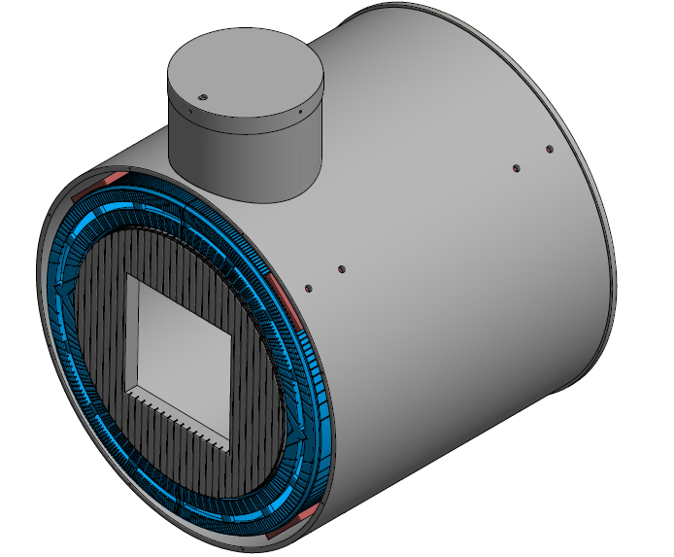
Aluminum Shell For Coils

Slide 14
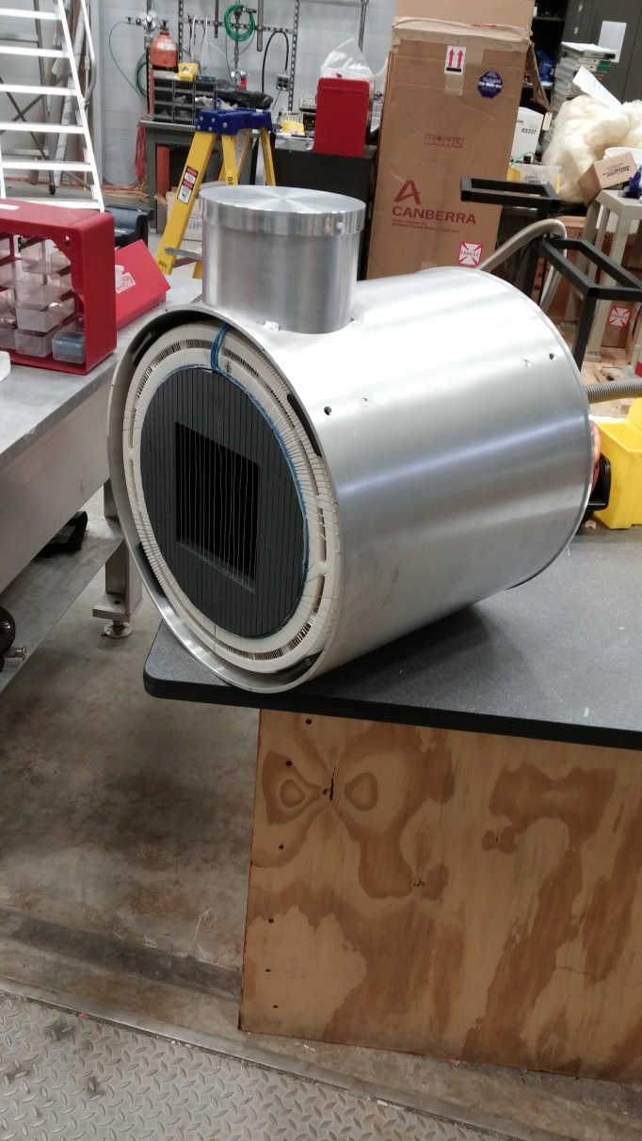
Aluminum Shell
Built by UT Knoxville Machine shop
Drum is ¼ inch rolled Aluminum
Two end plates are ¼ inch Aluminum sheet
Square insets on end plates are machined to 0.040 inches for neutron beam.
Designed to be filled with He-4 at one atmosphere to mitigate neutron scattering in the device.

Slide 15
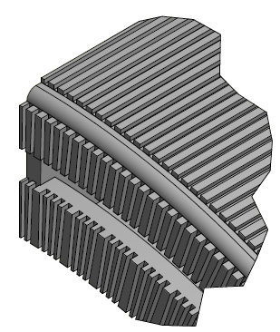
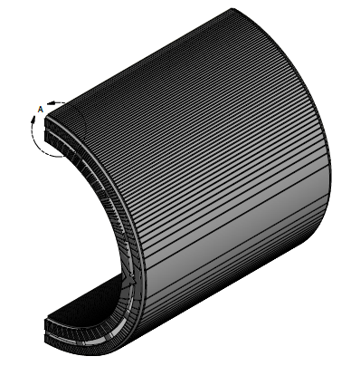
Details of Outer Coils
CAD drawings created using AutoDesk Inventor
Manufactured using 3D print Technology: Quickparts/ Proparts out of Atlanta
Coils manufactured using a laser sintering process in a vat of liquid resin (8 hours)
Precision manufacture to ~0.1 mm
Complete parts are ABS plastic

Slide 16
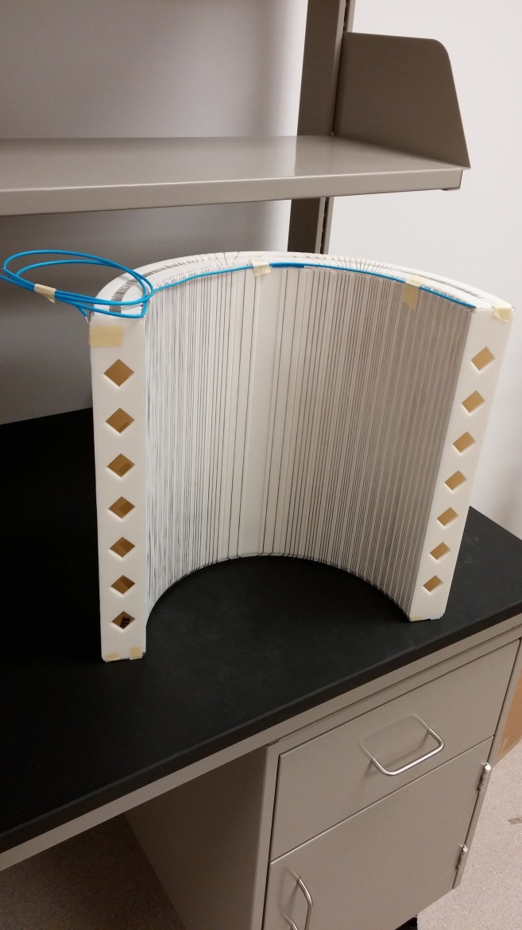
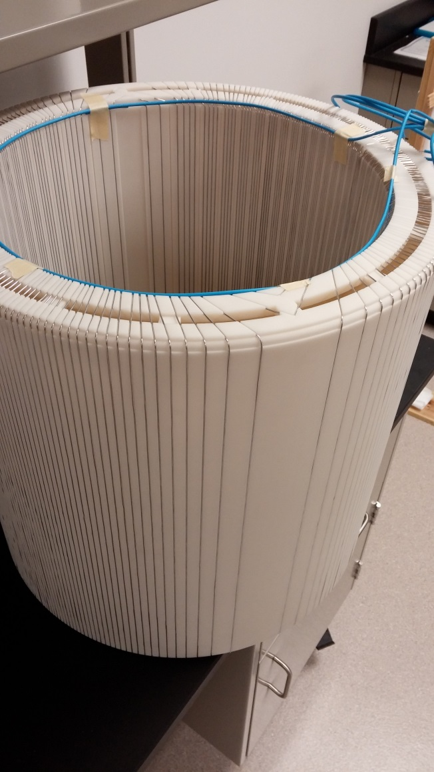
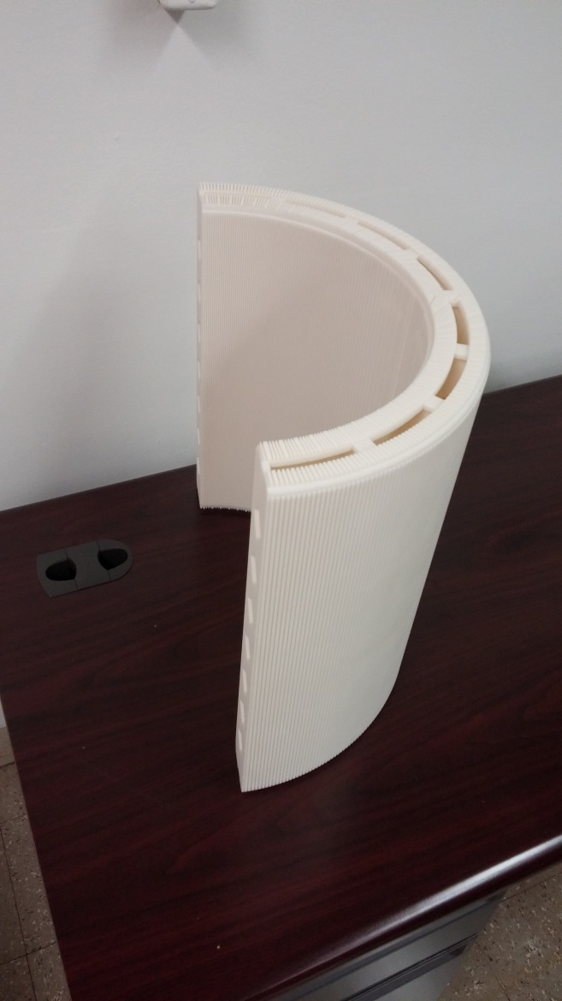
Pictures of Outer Coils

Slide 17
Summary
Design and Construction is essentially complete
Electrical tests are complete
Device scheduled for install this summer
Special Thanks to:
Chris Crawford, PhD: University of Kentucky, Lexington
Leading Expert on Cosine-Theta coils
Ricky Huff and Alvin Peak:
University of Tennessee machine shop

