Slide 1
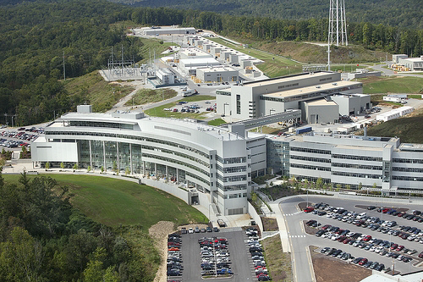
n³He Experiment:
Spin Flipper and
Neutron Polarimetry
Christopher Hayes
November 13th, 2014

Slide 2


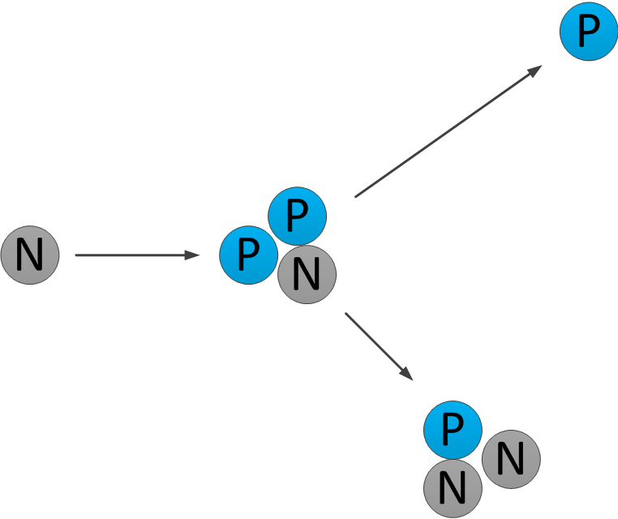
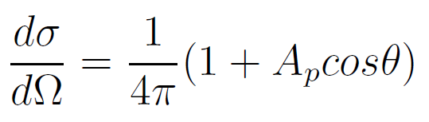



Neutron Scattering on He-3
Goal is Statistical Observation of Parity Violation in the Hadronic Weak Interaction (HWI)
Observable is which represents a correlation between the spin of the incoming neutron and the momentum of the outgoing proton

Slide 3
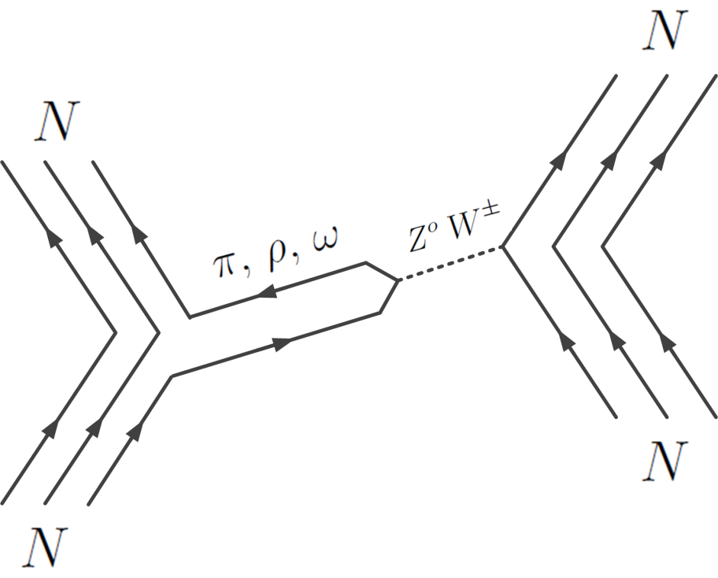

Theory of the Weak Hadronic Interaction
HWI described by the Meson Exchange Model.
Theory requires 6 coupling constants which must be measured experimentally.
Only three of 6 terms are significant for n3he.
For n³He Experiment:
+ small terms

Slide 4
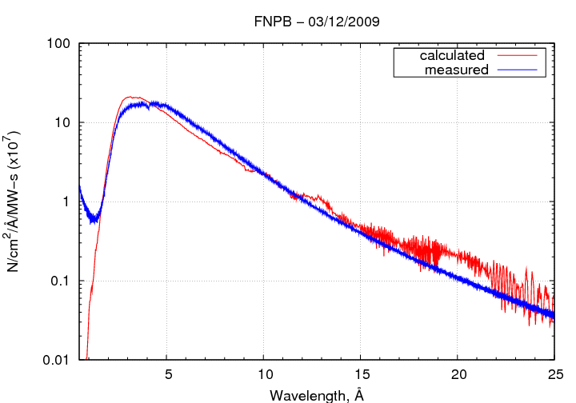
Neutron Beam at the SNS
SNS designed to provide high intensity 60 Hz pulses of neutrons
Source of neutrons is a 60 Hz
1 megawatt proton beam
colliding with a liquid Mercury
target
2 x10¹⁰ neutrons per second entering FNPB
Neutrons
Neutrons
Neutrons
To n³He
Beam
Choppers

Slide 5
Schematic of the n³He Experiment
DAQ
Computer
Beam Collimator
Beam Collimator
Super Mirror Polarizer
RFSR
(Spin Flipper)
He-3
Ion Chamber
Neutron Guide
Uniform External Magnetic Field (~10 G)

Slide 6
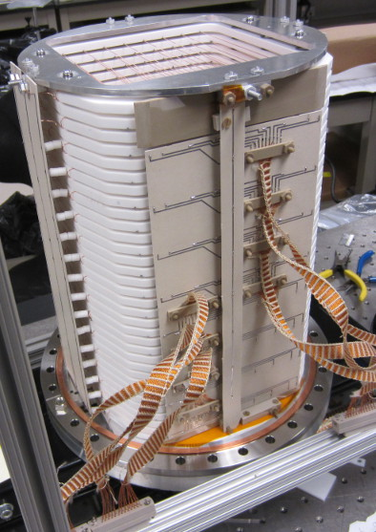
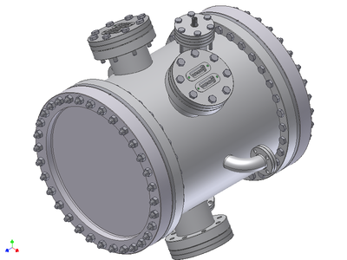
Ion Chamber
Frame stack holds alternating planes of high voltage and signal wires
17 High Voltage Wire Planes
16 Signal Wire Planes
144 Signal Wires Total

Slide 7
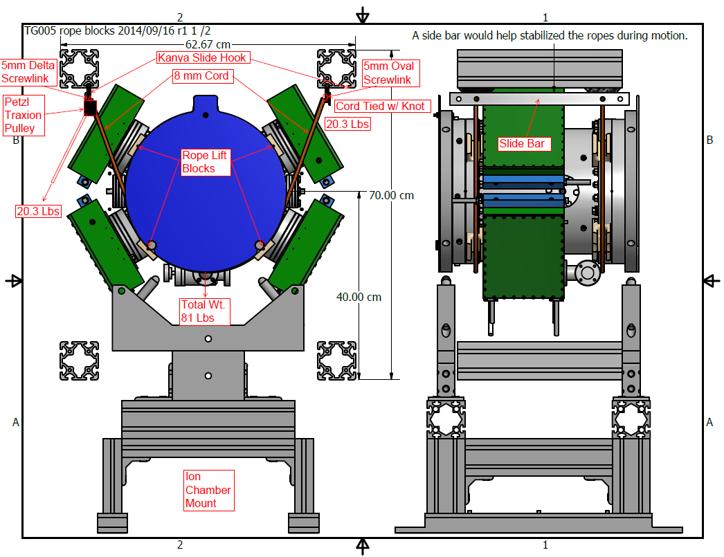
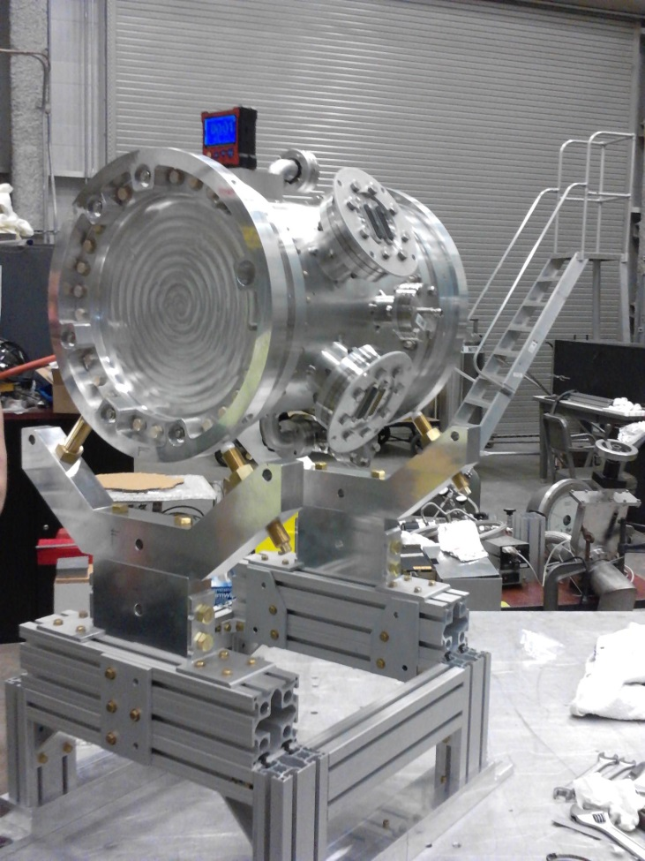
Ion Chamber with Mount
Four Pre-Amplifier boxes connected to the Ion chamber

Slide 8
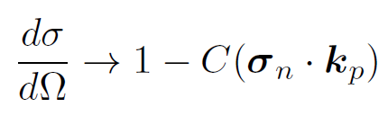
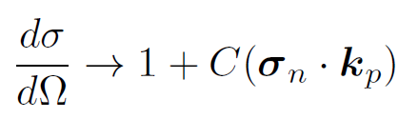






Currents in Wire Planes
N

Slide 9
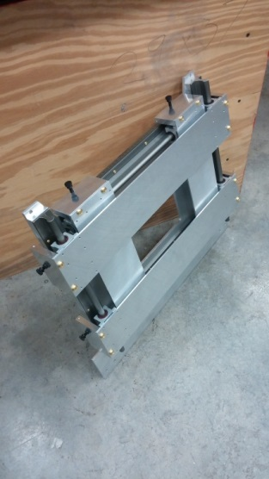
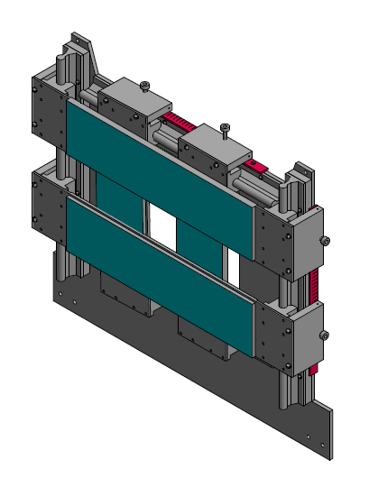
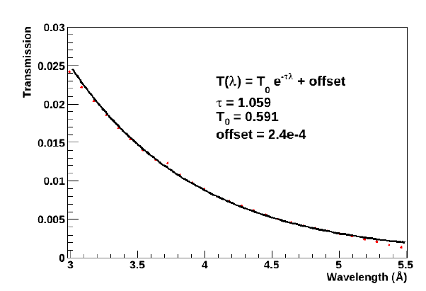
Four Jaw Collimator
Doors covered with Li-6 and Cd which absorbs 99% of beam
Adjustable doors can transmit a beam of any height and width

Slide 10
Requirements for a Spin Flipper
We want to build device that:
Must have a self-contained uniform B-field which will not interfere with the function of the target chamber, delicate DAQ electronics, or any other aspect of the experiment which can produce a false asymmetry.
Uses Spin Magnetic Resonance (SMR) to flip spins of all neutrons in the chopped beam (2.5 – 6.5A) with an efficiency approaching 100%.
Exists in a compact space and does not alter/interfere with the neutron beam.

Slide 11
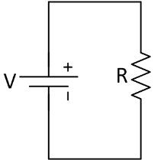
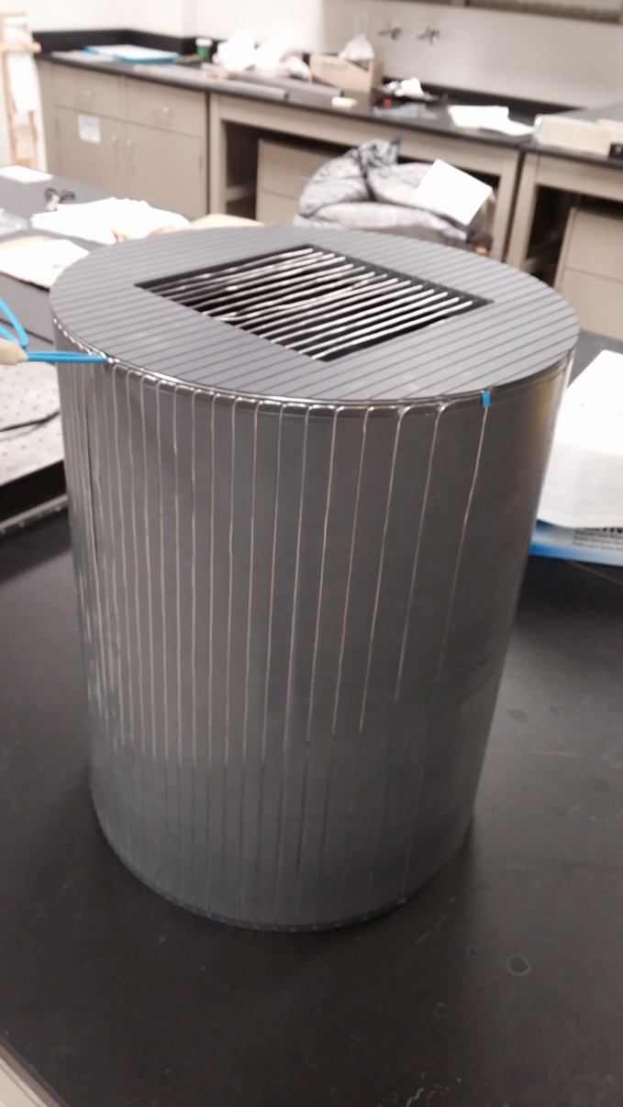

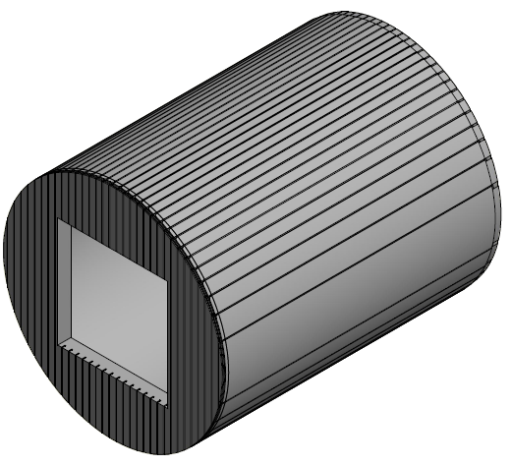
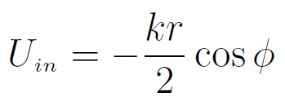
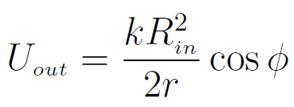
Design of a Cosine Theta Coil
Surface Current Density:
Wires on end caps routed along equi-potentials
Fields determined using theory
of a magnetic scalar potential:

Slide 12
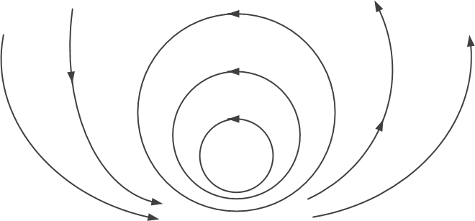

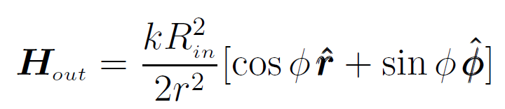

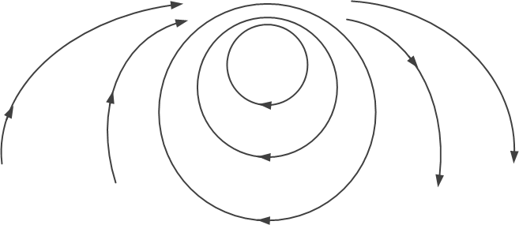

Fields of a Cosine Theta Coil
Magnetic analog of electrostatic problem using a charge density glued to the cylinder wall.

Slide 13

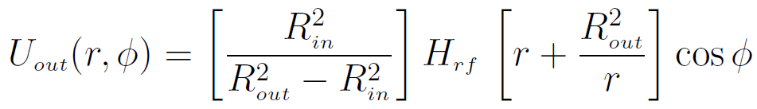
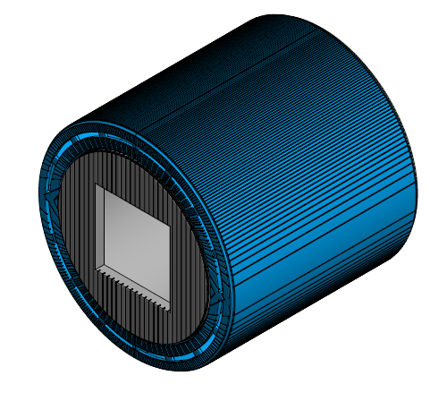




Design of a Double Cosine-Theta Coil
Two Concentric Cosine theta coils
Currents flow in opposite directions
Approximation of infinite coil still valid

Slide 14



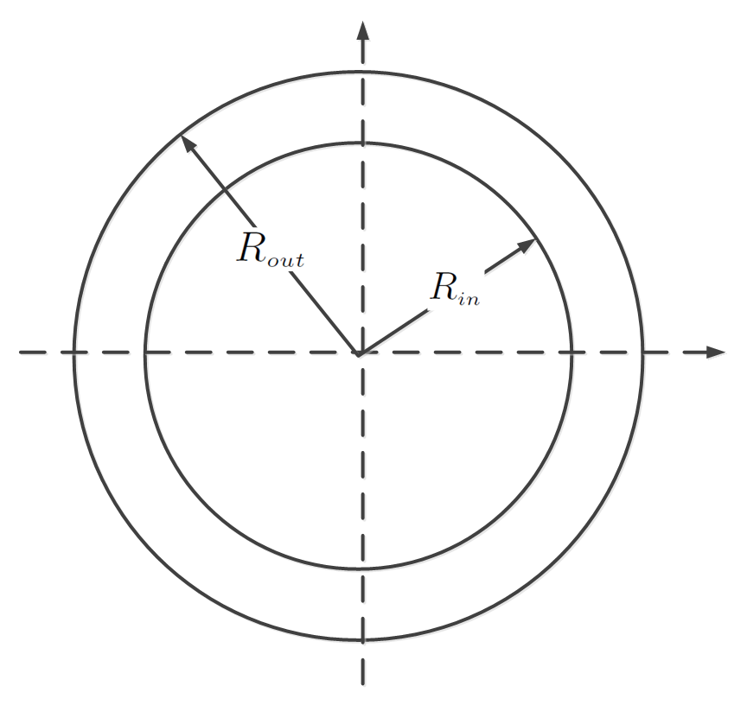
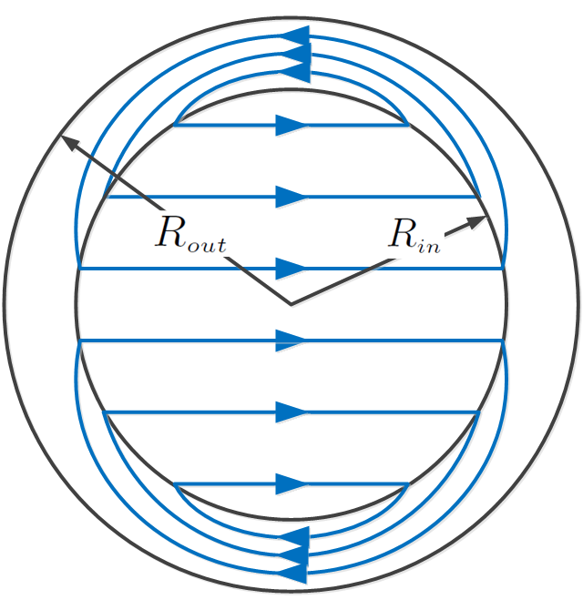






Fields of a Double Cosine Theta Coil
--A way to produce a self-contained magnetic field that doesn’t interfere with anything else.

Slide 15
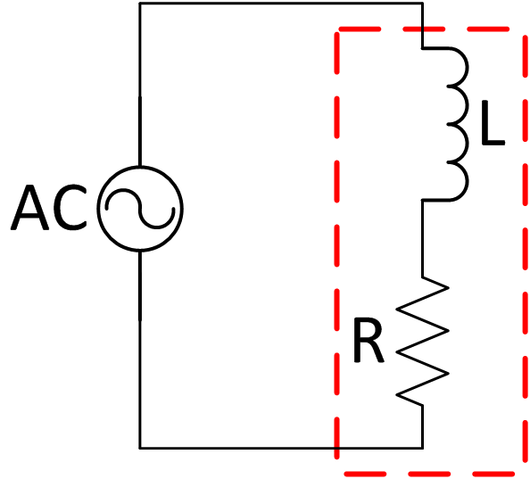
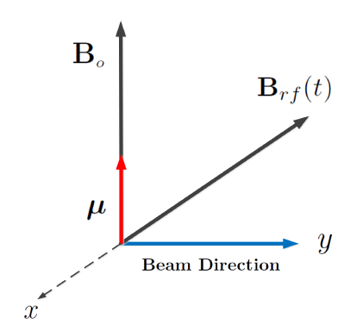



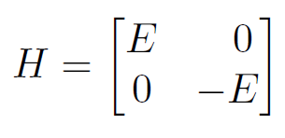
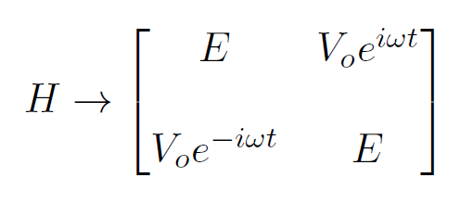


Spin Magnetic Resonance
Drive the Spin Flipper at the Larmor frequency of neutrons in the 10 Gauss B-field
Spin Flipper
N
N
Perturbed field inside the spin flipper rotates the state ket

Slide 16


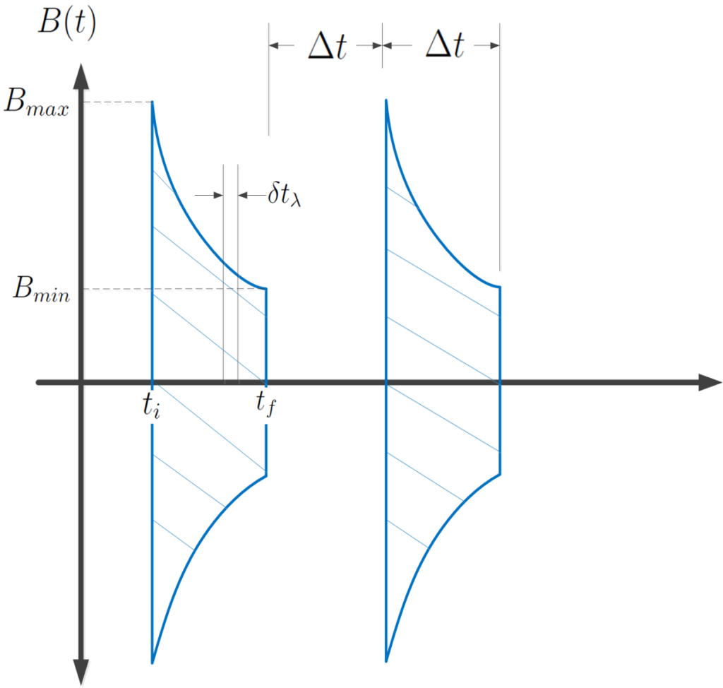
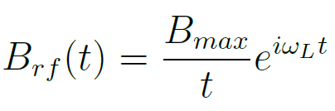

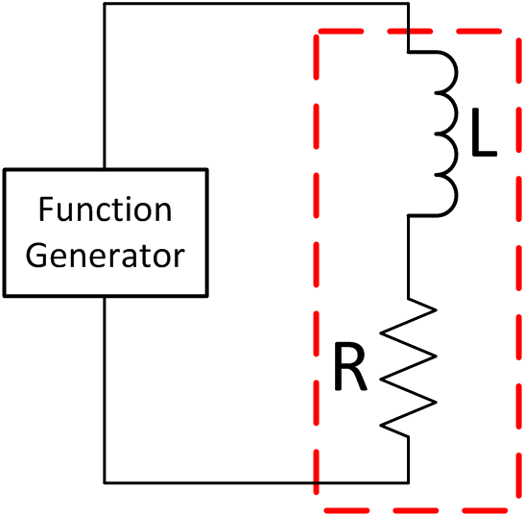
Flipping Neutrons with a Wavelength Spectrum 2.5 – 6.5 A
Energy of neutrons in the beam is function of TOF with well defined arrival times
To flip all neutrons in the beam, add a 1/t time dependence to envelope
B oscillates ~500 times within each envelope

Slide 17
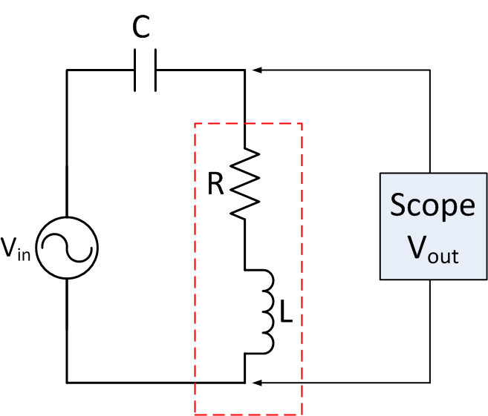
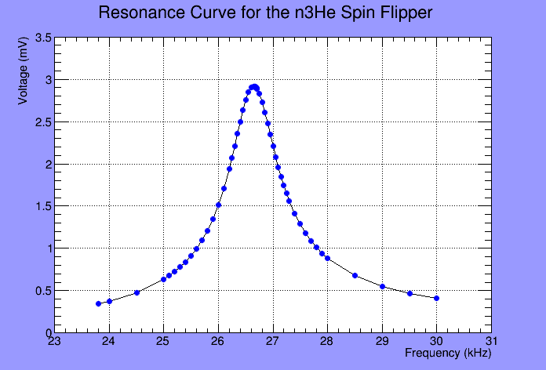
Double Cosine Theta Coil as a Resonant Circuit
Choose capacitor so that the circuit resonance at the Larmor Frequency
RFSR
R = 9.11 ohms
L = 2.01 mH
C = 17.70 nF
f = 26.655 +/- 0.005 kHz

Slide 18
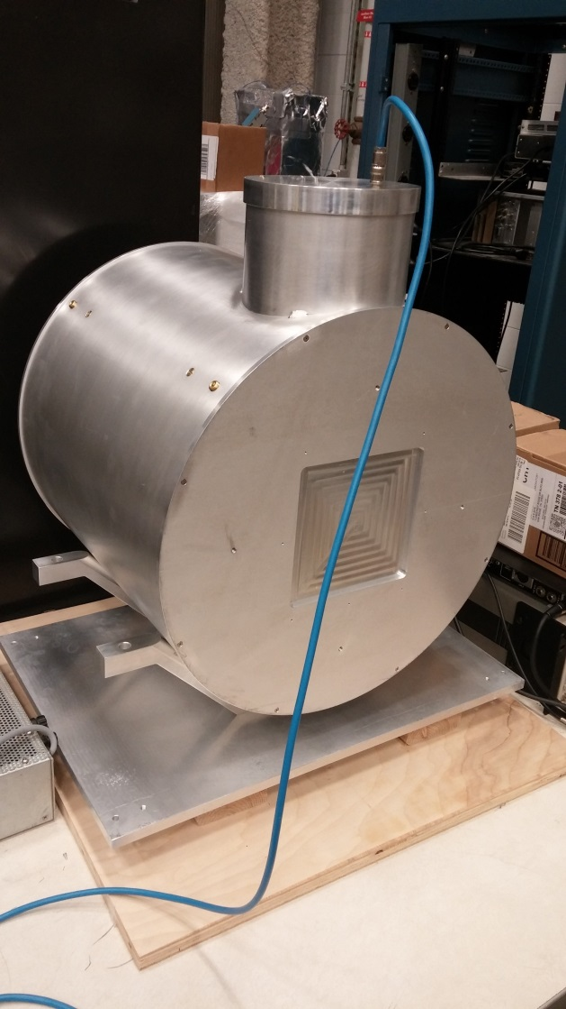
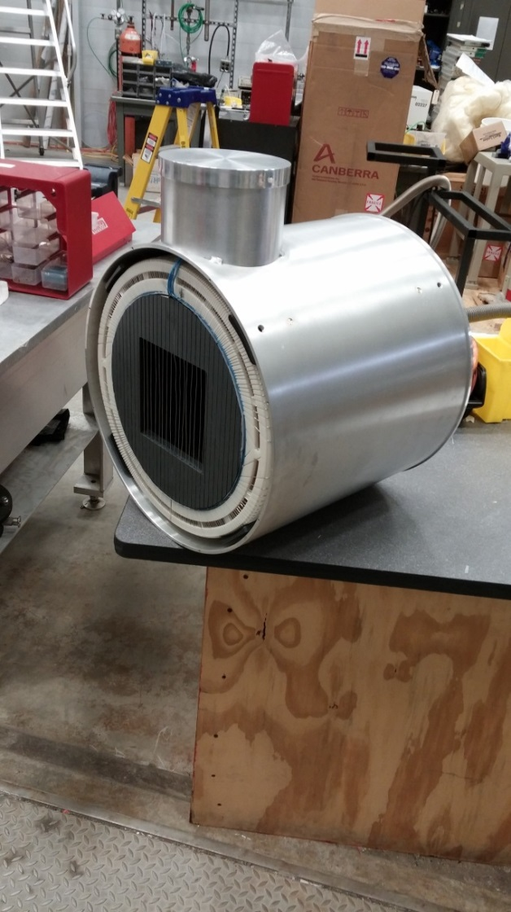
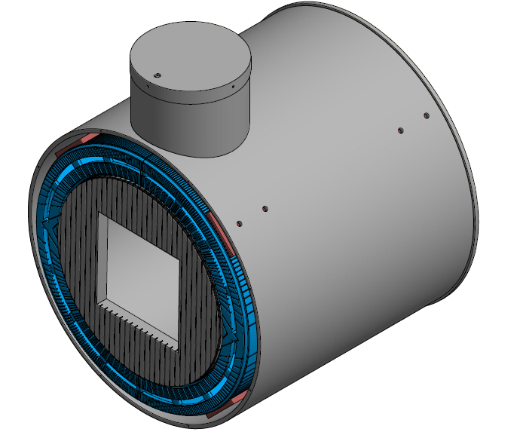
Spin Flipper for the n³He Experiment

Slide 19
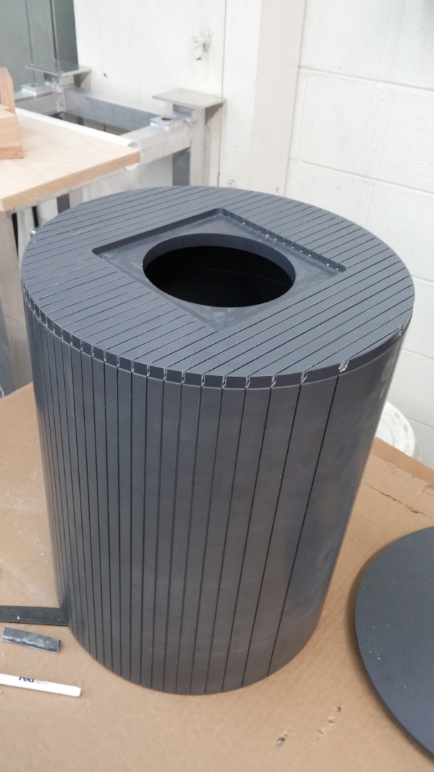

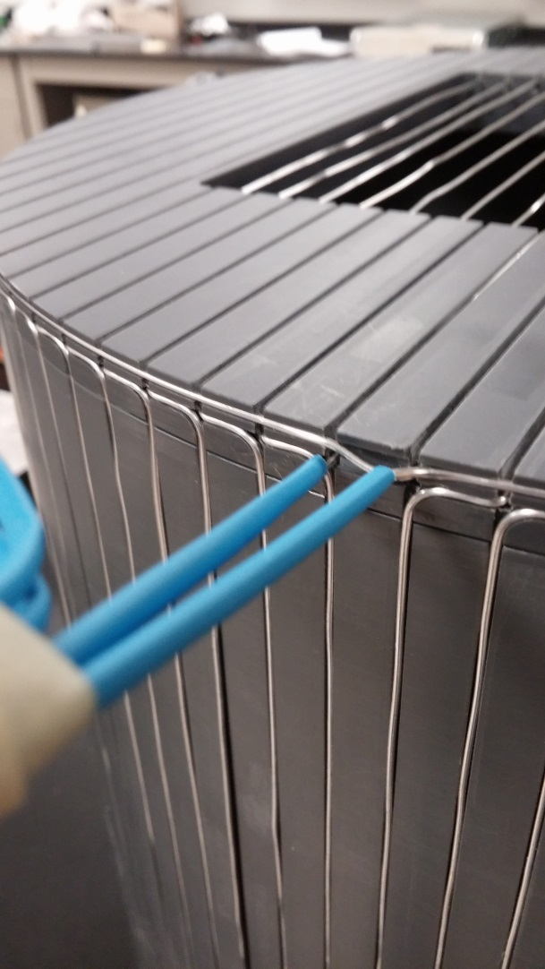
Pictures of Inner Cylinder

Slide 20
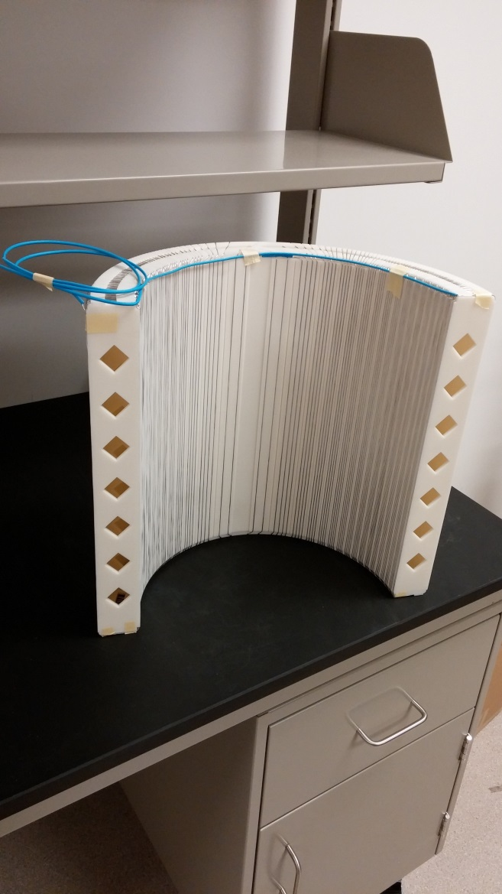
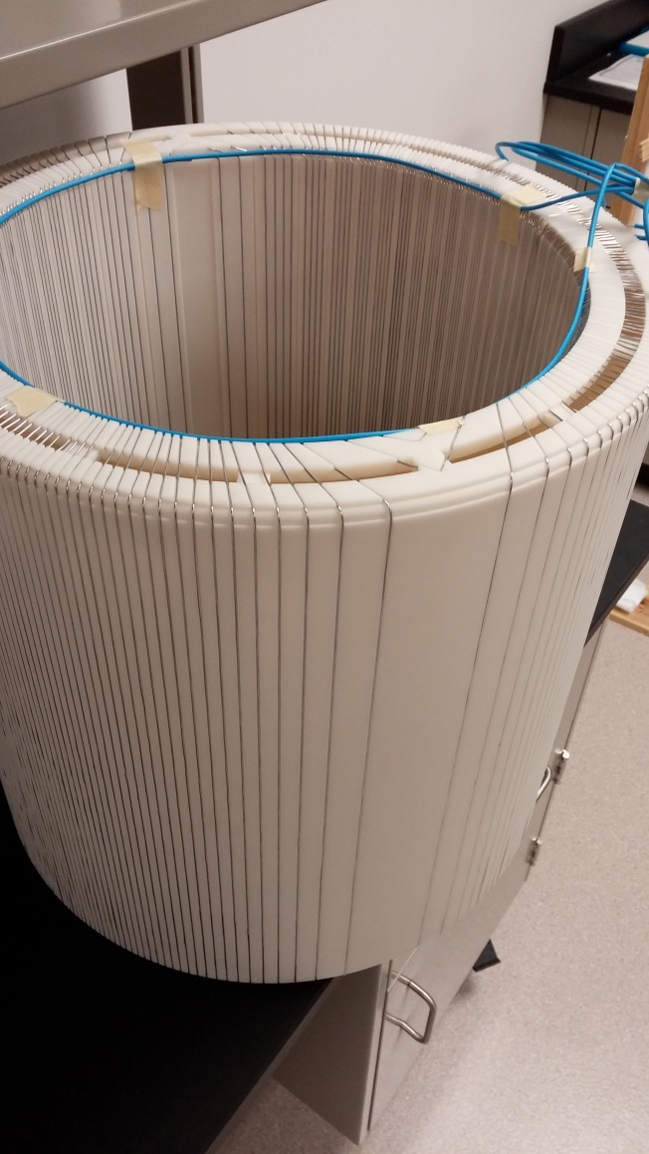
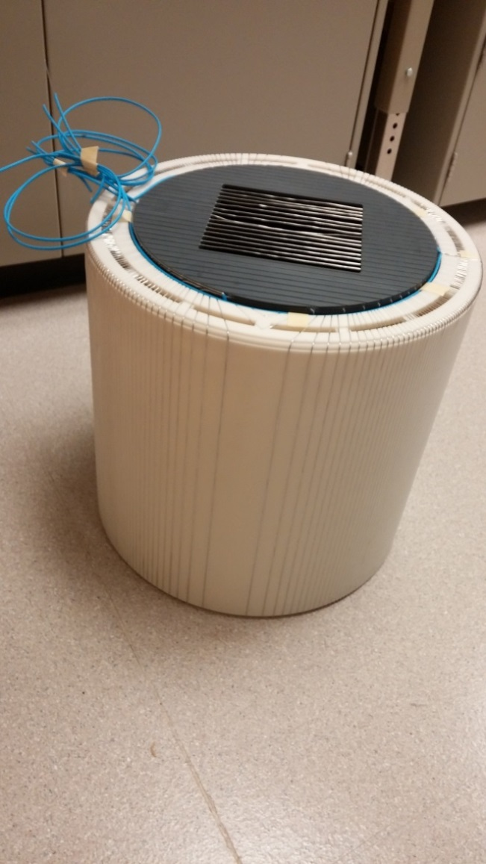
Pictures of Outer Coils

Slide 21
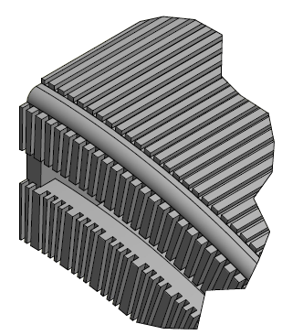
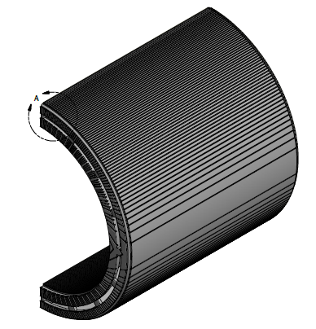
Details of Outer Coils
CAD drawings created using AutoDesk Inventor
Manufactured using 3D print Technology: Quickparts/ Proparts out of Atlanta
Coils extruded using SLA laser curing of a liquid resin (8 hours)
Precision manufacture to ~0.1 mm
Completed parts were a plastic
replica of the CAD drawings

Slide 22
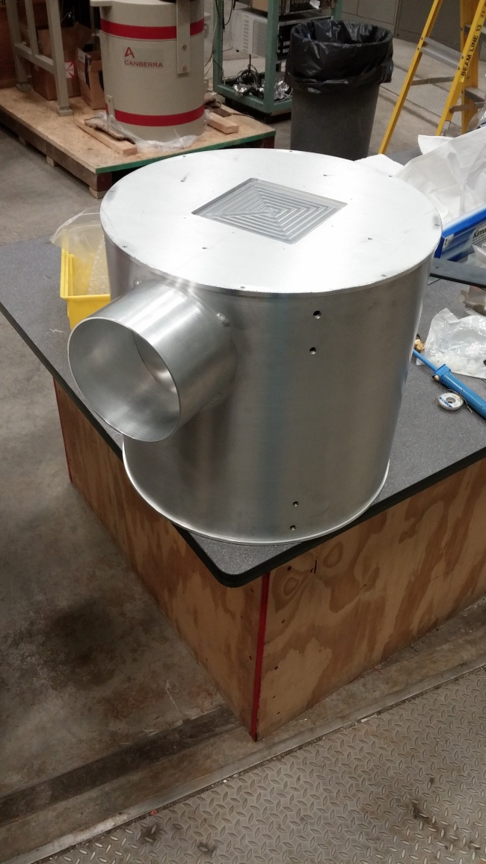
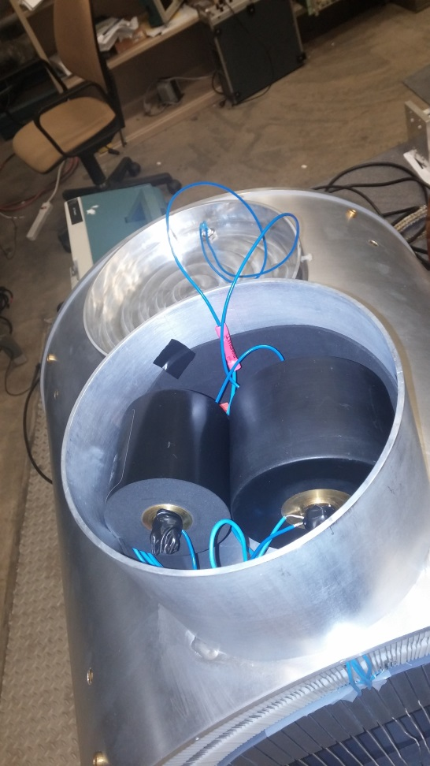
Aluminum Shell/Housing
Shell Made by UT machine shop
Shell is ¼ inch Aluminum
Feed thru holes are used to fill interior with ⁴He.
Housing holds two capacitors in parallel:

Slide 23
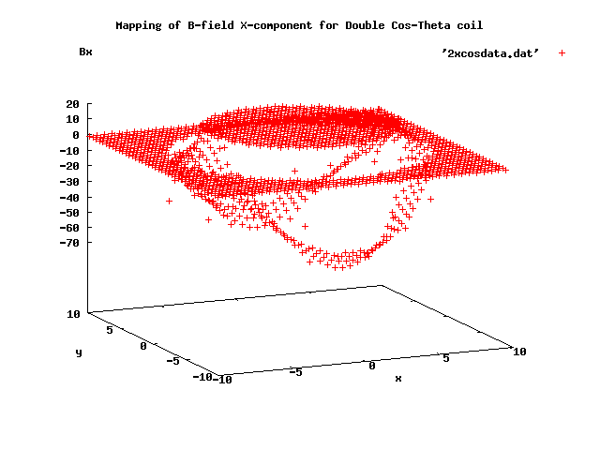
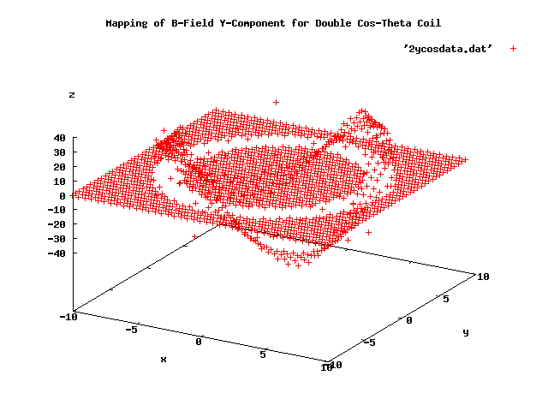
Field simulations for a Double Cosine-Theta Coil
B_{X}
B_{y}

Slide 24
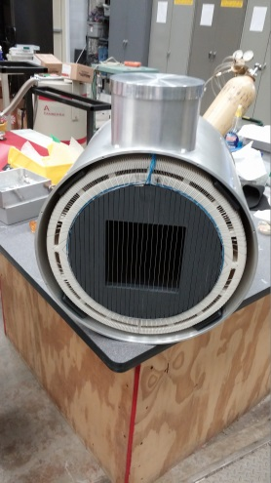
Field Measurements on the Spin Flipper
Blue Curve
Red Curve

Slide 25




Neutron Polarimetry
Essential Part of the n³He experiment:
………. Polarization of Neutron Beam ~95%
…….. Spin Flipper Efficiency ~100%

Slide 26
Polarimetry on a Beam of Neutrons
Computer
Spin Flipper
Ion Chamber
Neutrons
Beam
Monitor
Analyzer

Slide 27











Properties of a ³He Cell
N
P
P
N
P
N
N
P
Filled with: ³He, N₂, Rb
Individual ³He nuclei can be polarized thru Spin Exchange Optical Pumping
Hedy Lamarr

Slide 28
Spin Exchange Optical Pumping
¼ wave plate
Helmholtz coils
Oven
Laser
(795nm)
³HeCell
³He placed in a 10 Gauss external field and heated to 195 C to vaporize Rb Metal
Laser light interacts with vaporized Rb allowing it to transfer polarization to ³He nuclei thru hyperfine interaction
Cell polarizes overnight

Slide 29




Unpolarized Beam Thru Unpolarized Cell
³HeCell
Neutrons
Neutrons

Slide 30





Transmissions thru a Polarized Cell
Analyzing Power of the ³He cell:

Slide 31
Polarimetry with a Spin Flipper
Final element for doing neutron polarimetry is to introduce the Spin Flipper
Spin flipper flips individual SNS pulses at 60 Hz
Spin Flipper
Spin Flipper
Neutrons

Slide 32








Measuring Beam Polarization with the Spin Flipper
SF
SF
SF

Slide 33







Measuring Spin Flipper Efficiency
SF
SF
SF
SF

Slide 34



Tuning B_{o} to the Spin Flipper
Perform separate measurements of SFR while varying the value of B_{o} near maximum
Find a least squares parabolic fit to acquired SFR data points.
Adjust B_{o} to optimal setting

Slide 35
Accomplishments since May 2013
Completed all aspects of the design, construction, and testing of the Spin Flipper
Completed design and construction of the 4-Jaw collimator
Completed design of the V-Block/Sled alignment hardware
Completed design of two XY scanner mounts for location of Beam Centroid
Major contributor to the design/construction/implementation of the alignment laser beam
Major role in completing alignment of B-field in the cave
Presentations on the spin flipper for APS and ACNS

Slide 36
Plan for n³He Polarimetry Measurements
Nov-Dec 2014: Polarimetry 1 (Preliminary test)
Beam Down: Dec 22nd 2014 – Feb 6th, 2015
Feb 6th, 2015: Polarimetry 2 (Pre-production)
Jun 20th, 2015: Polarimetry 3 (Intermediate)
Beam Down: June 22, 2015 – Aug 8th 2015
Aug 9th, 2015: Polarimetry 4 (Pre-production)
Dec 22nd, 2015: Polarimetry 5 (Final)

Slide 37

n³He Collaboration

