Slide 1
B-Field Alignment

Slide 2
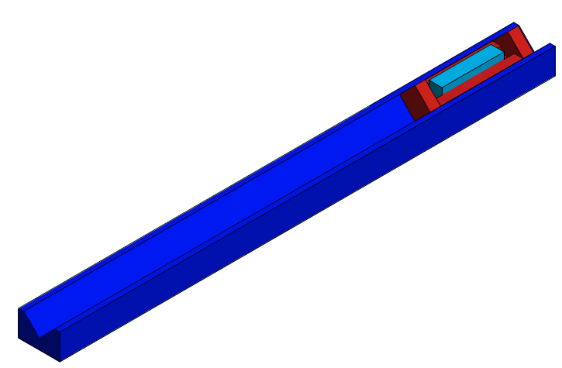
V-Block
V-Block needs to be ~42 inches long

Slide 3
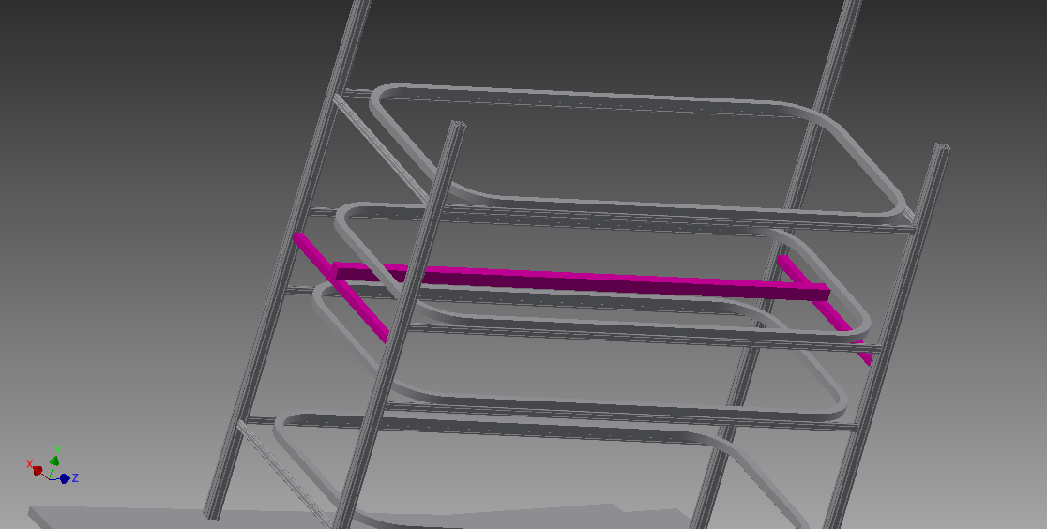
Kanya beams for Alignment
Mount aluminum roller guide on long Kanya beam
Can adjust position of large beam with respect to smaller beams
Can adjust positions of smaller beams at each corner

Slide 4
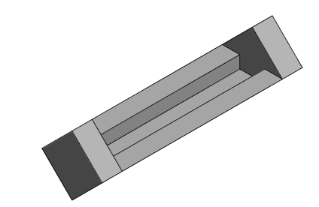
Sled For Track
Dimensions:
10.5 inches long
3 x 3 inch sides
Need 8.5 inches for magnetometer

Slide 5
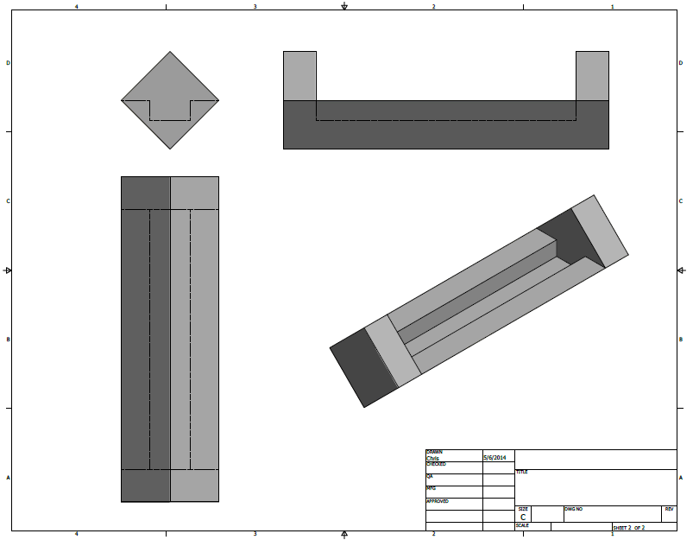
Sled with Mounted Magnetometer

Slide 6
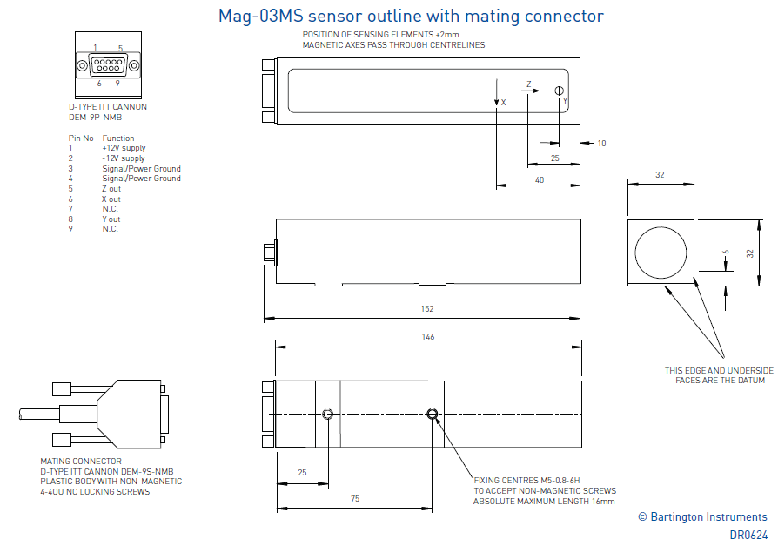
Magnetometer Drawing

