Slide 1
First tests with Wire Chamber
The DAQ team

Slide 2
Intro
Ran additional 2 weeks of tests featuring Wire Chamber, Preamp boards and ADC
Checked all preamp boards, all Chamber flanges and (9 out of 10) cables
Identified and classified all issues. Good news is that there are not many issues!:
1.) 2 Chamber wires f,g 1S (1st) layer shorted to each other.
2.) 1 noisy preamp H2_2 at Preamp Board #1 (Seppo is going through circuit to find out the problematic piece)
3.) One cable had a noisy channel*
Tested noise with Chamber+Preamp+ADC & Preamp+ADC configurations

Slide 3
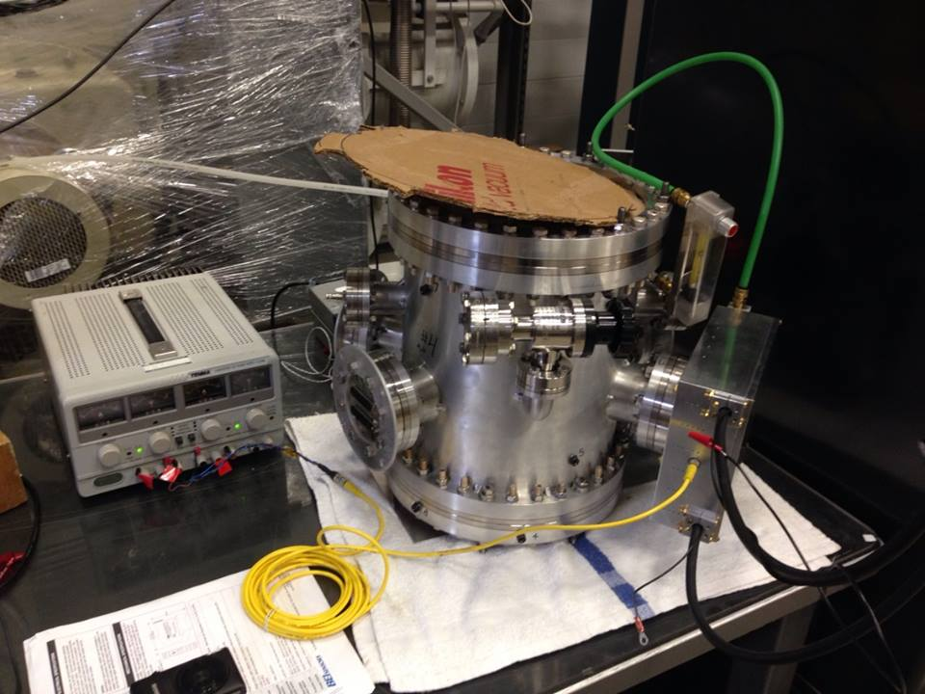
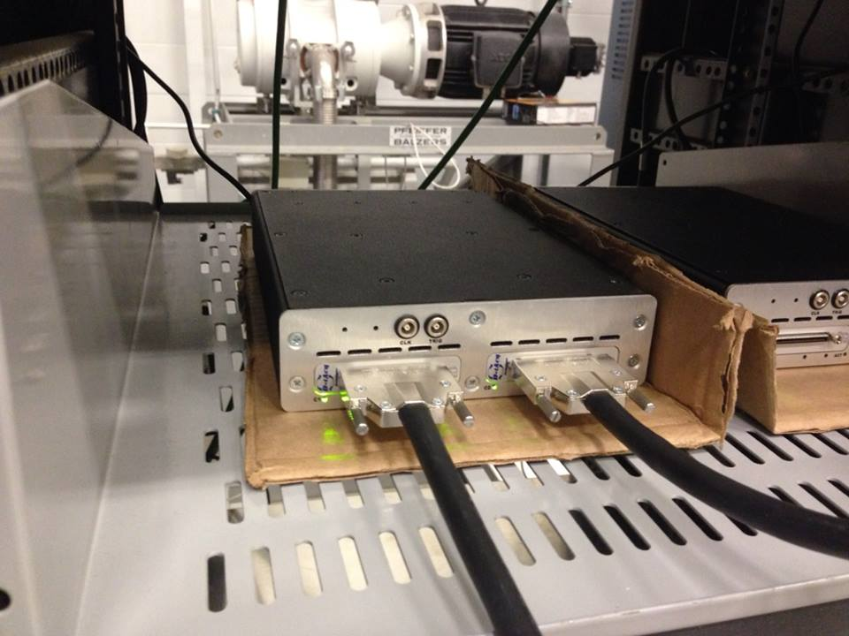
Full setup with chamber

Slide 4
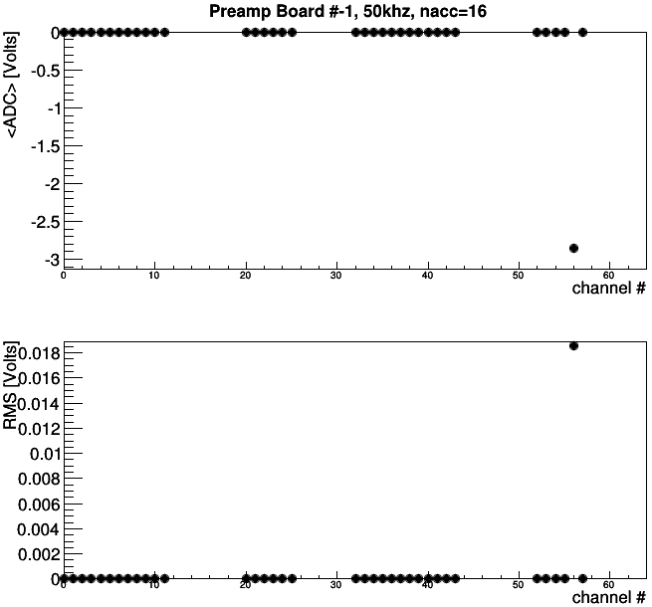
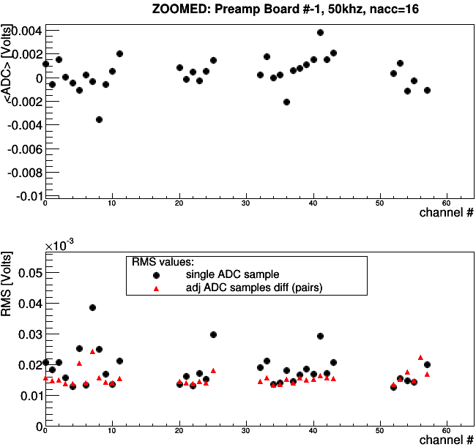
Preamp1 only
1 noisy (bad) pre-amp for the Board #-1
Problem is not visible if we plot only ADC pair differences distributions (red points)
Stable performance across the board if eliminate low frequency noise (red points)

Slide 5
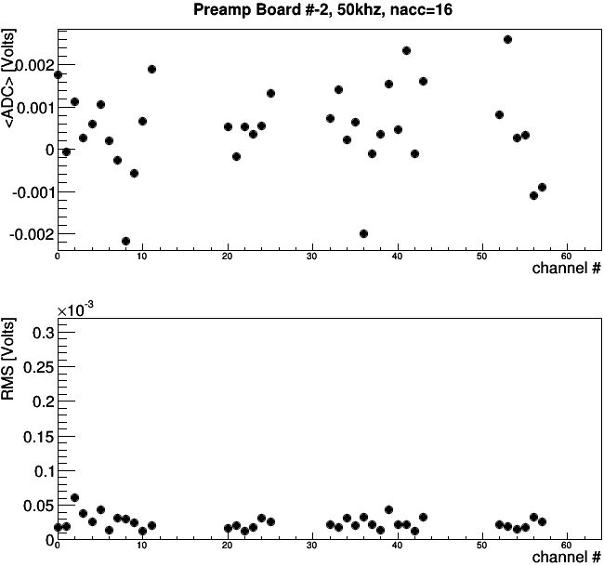
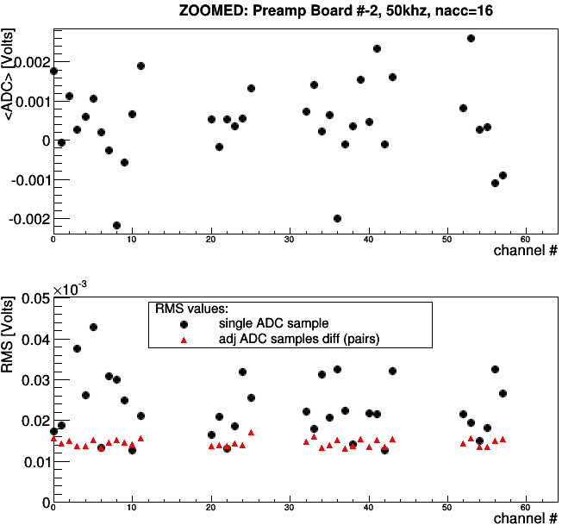
Preamp2 only

Slide 6
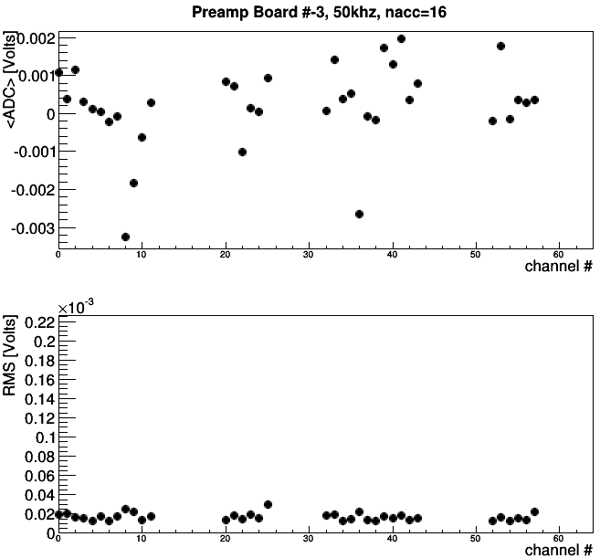
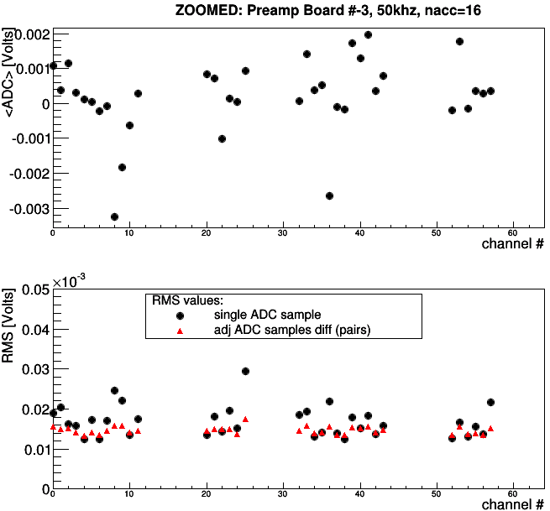
Preamp3 only

Slide 7
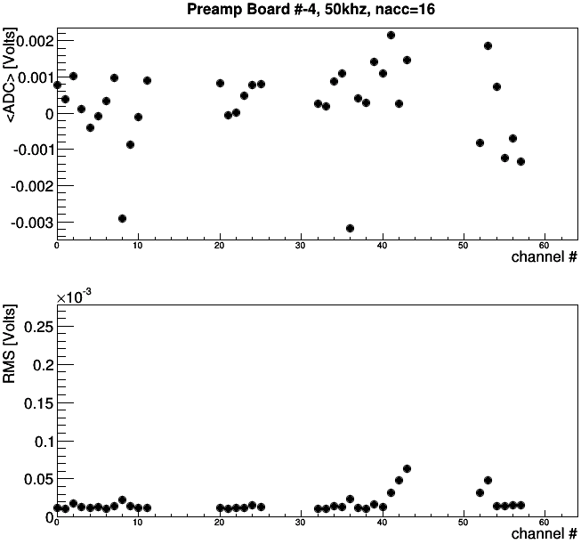
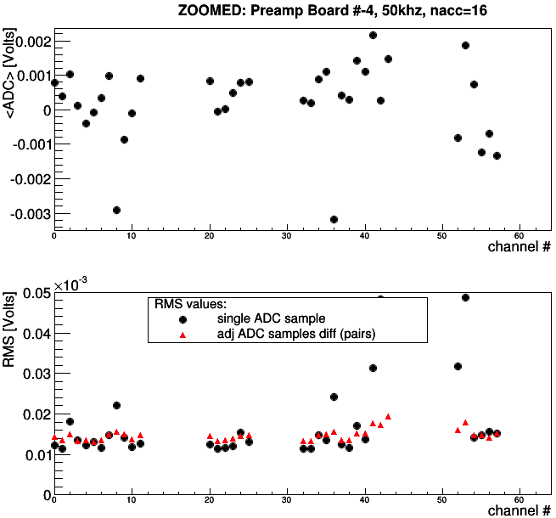
Preamp4 only

Slide 8
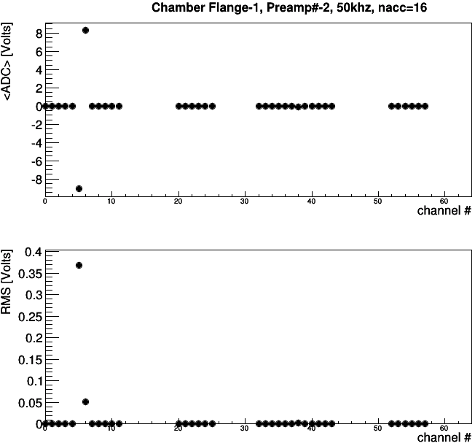
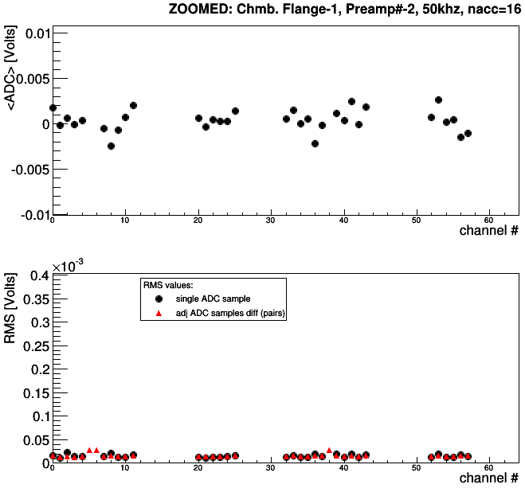
Shorted channels on Chamber Flange 1

Slide 9
Next steps
Fix preamp at board#1, faulty cable
Calculate false asymmetry using taken data (underway)
Setting up testing environment inside the cave
Any suggestions

Slide 10
Backup

Slide 11
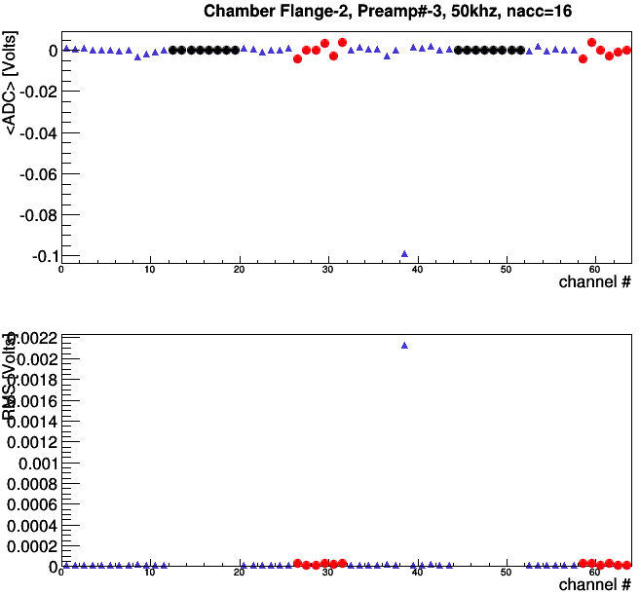
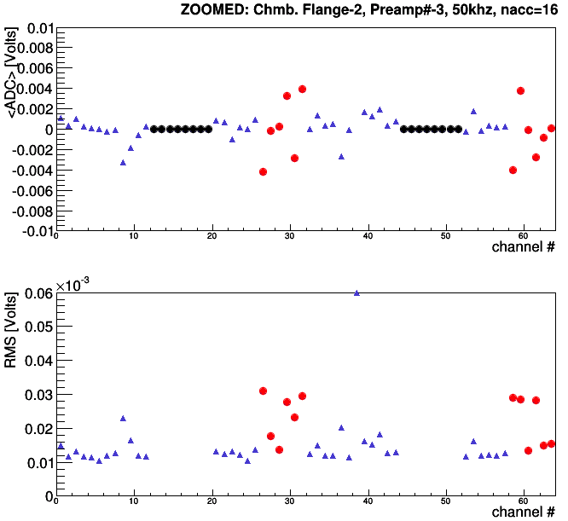
Preamp3 at Flange#2
Problem at channel 38 (counting
from 0)

Slide 12
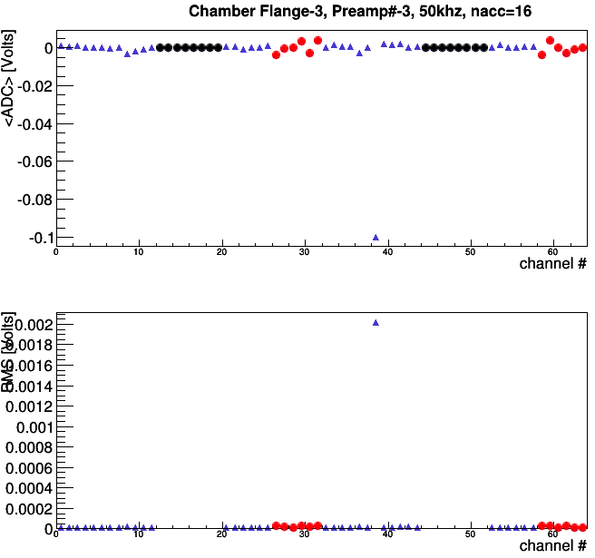
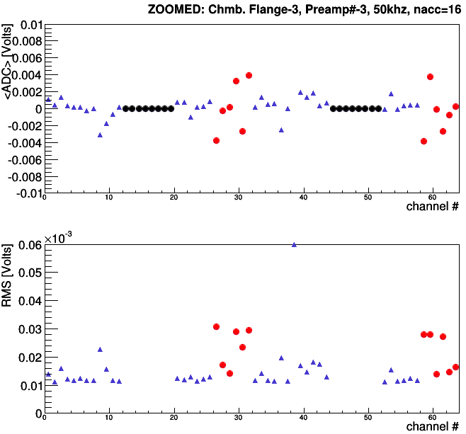
Preamp3 at Flange#3
Problem at channel 38 (counting
from 0)

Slide 13
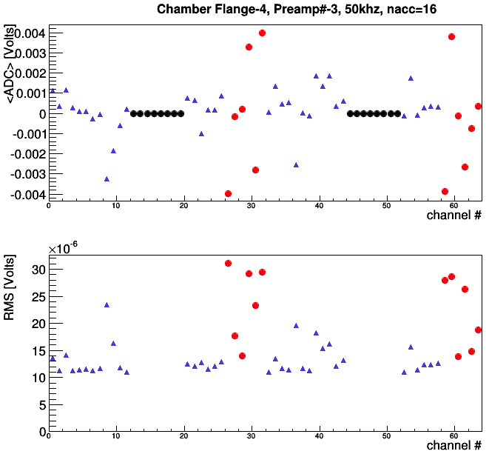
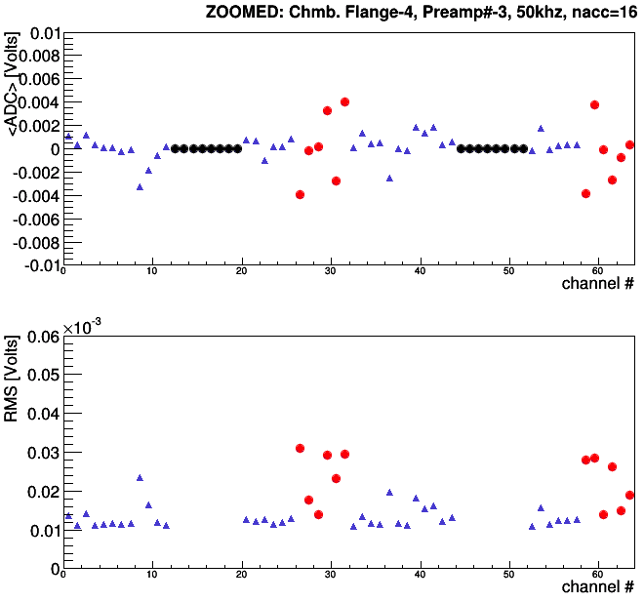
Preamp3 at Flange#4
Problem at channel 38 (counting
from 0)
Same pre-amp in the preamp board

Slide 14
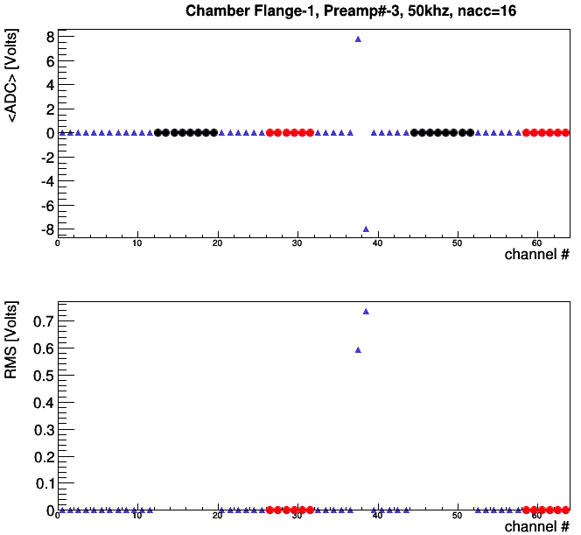
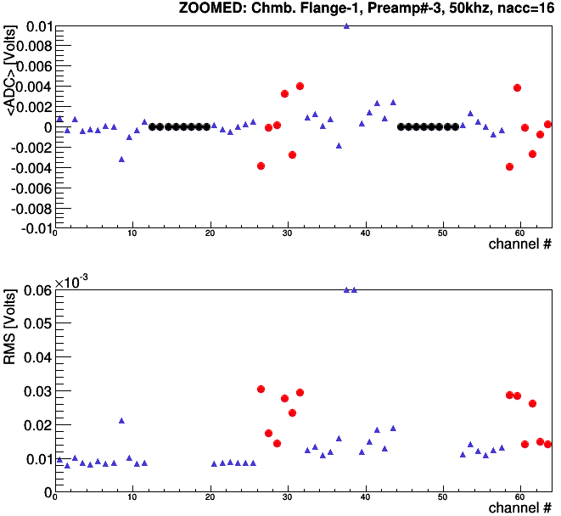
Preamp2(!!!) at Flange#1
Accidentally copied data with preamp#2
with cables switched up for testing
The 2 bad channels should be at 6&7 with
proper mapping
Preamp board #3 shows exactly the same
result…so it is most likely Wire chamber
issue

