Slide 1
First tests with Wire Chamber
The DAQ team

Slide 2
Intro
First tests involving Wire Chamber, Preamp boards and ADC
Data taken last couple of days (Mark, IG, Seppo) at 50kHz, in triggered mode, with FPGA averaging set to 16
Attached one preamp board to all 4 flanges one-by-one
Tested noise (RMS, average ADC) for all wires
There will be more tests (will discuss this)

Slide 3
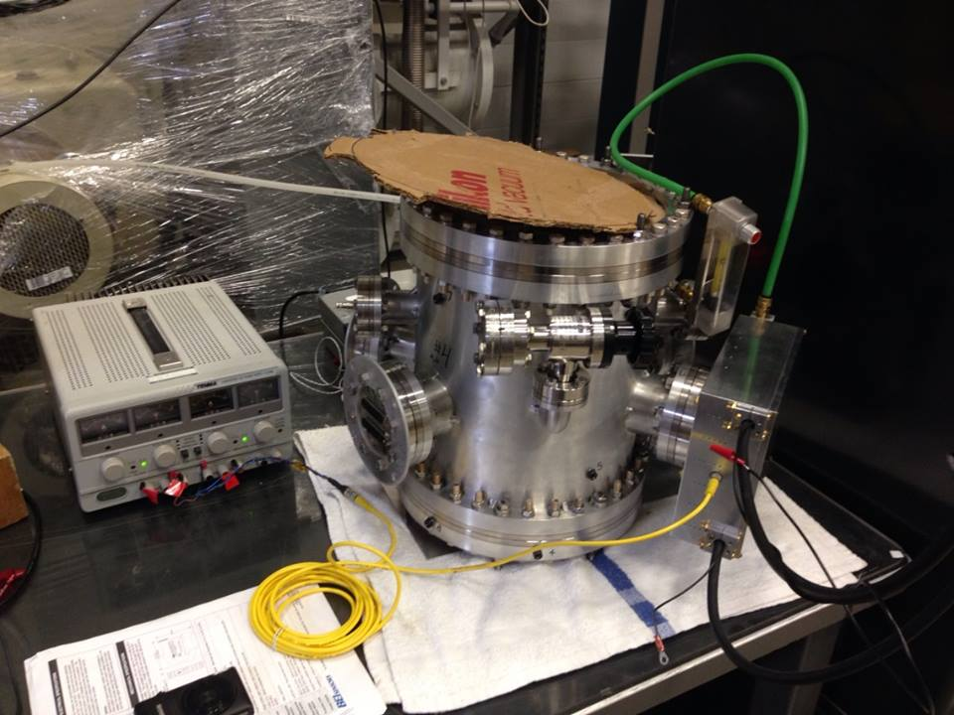
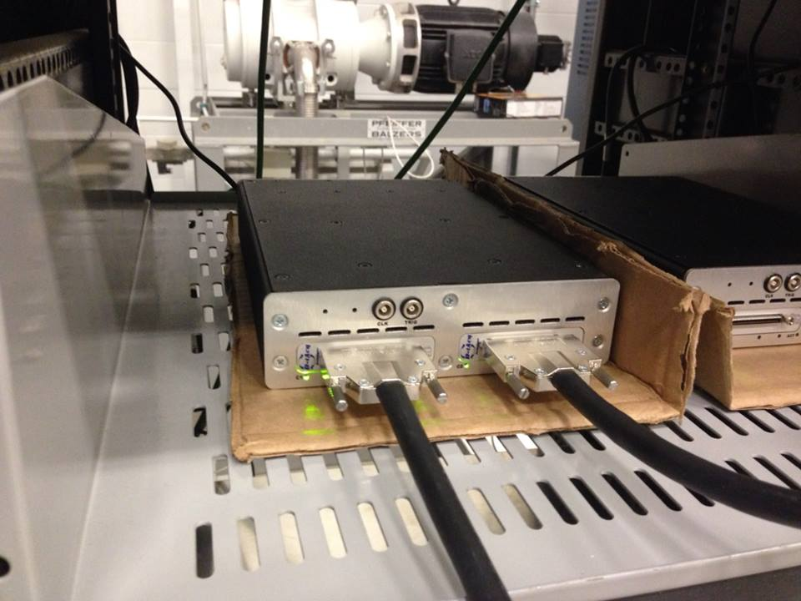
Full setup

Slide 4
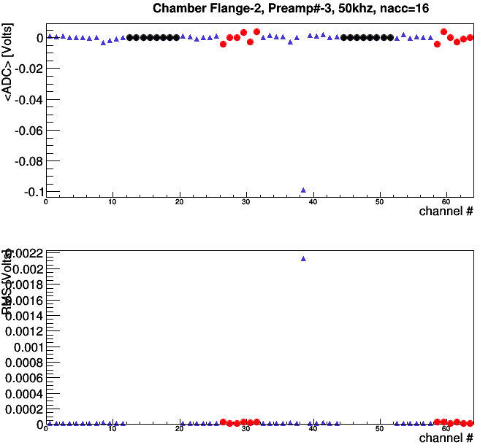
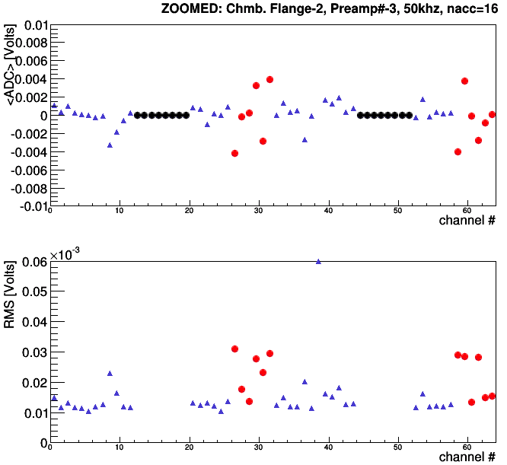
Preamp3 at Flange#2
Problem at channel 38 (counting
from 0)

Slide 5
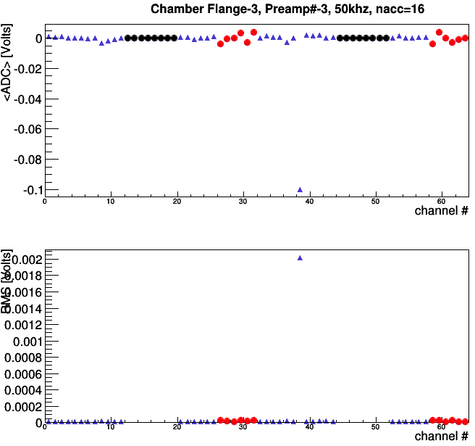
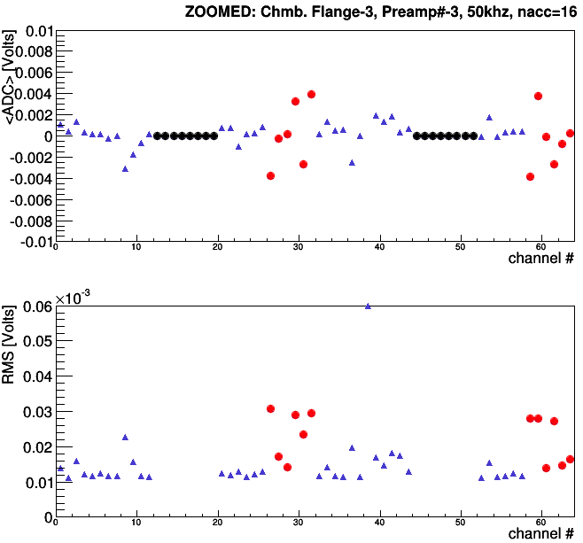
Preamp3 at Flange#3
Problem at channel 38 (counting
from 0)

Slide 6
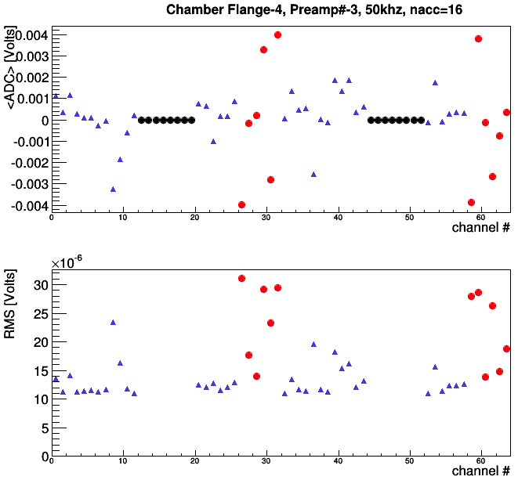
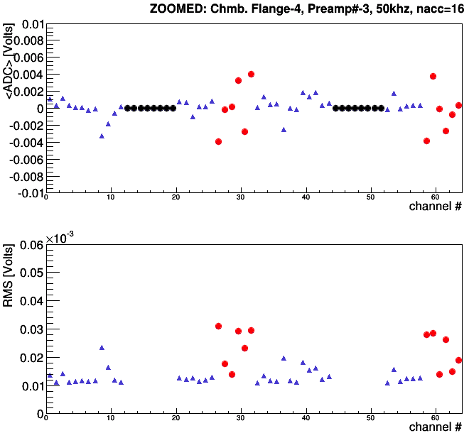
Preamp3 at Flange#4
Problem at channel 38 (counting
from 0)
Same pre-amp in the preamp board

Slide 7
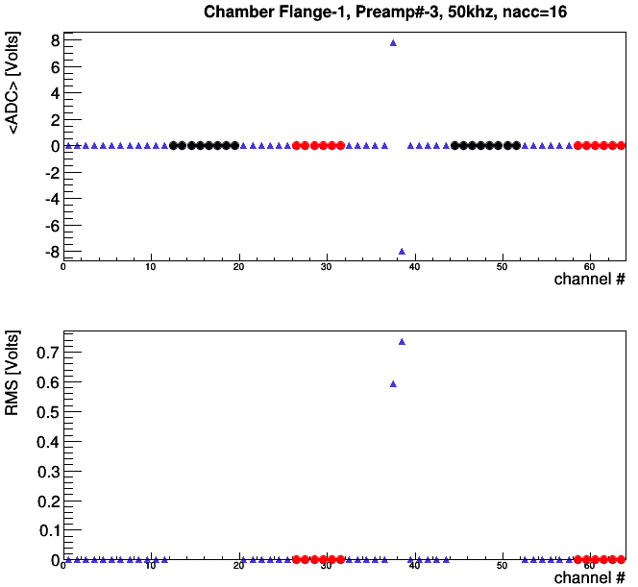
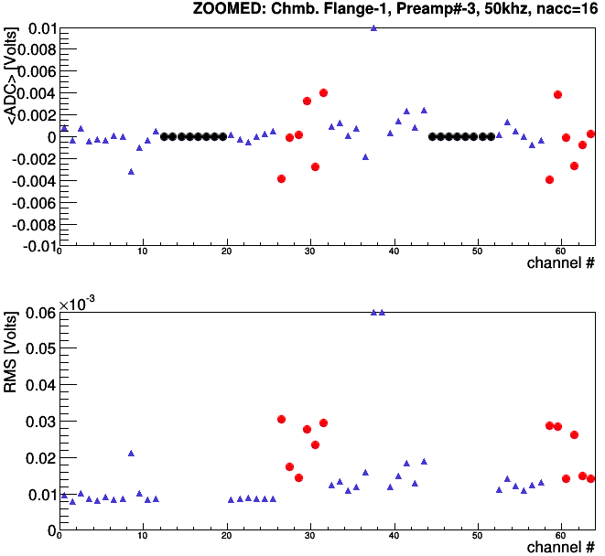
Preamp2(!!!) at Flange#1
Accidentally copied data with preamp#2
with cables switched up for testing
The 2 bad channels should be at 6&7 with
proper mapping
Preamp board #3 shows exactly the same
result…so it is most likely Wire chamber
issue

