Slide 1
XY Scanner Mount

Slide 2
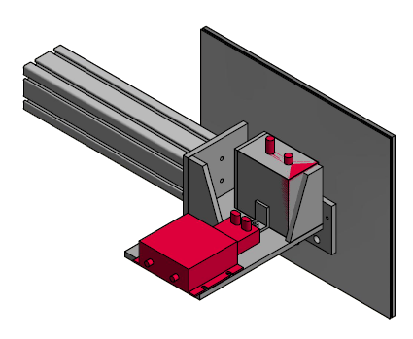
Back View
Screen Dimensions: 40 x 30 cm
15.75 x 13 inches
Screen: 1/8 inch aluminum
1/16 inch cadmium
1/4 inch Lithium
Beam Monitor with Pre-amp

Slide 3
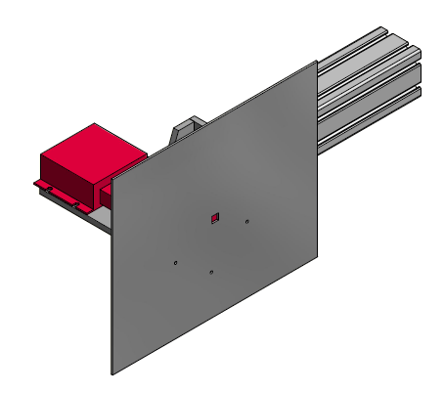
Front View
80 x 80 Kanya beam connects mount assembly to XY Tables
Opening for beam monitor:
1 cm x 1 cm

Slide 4
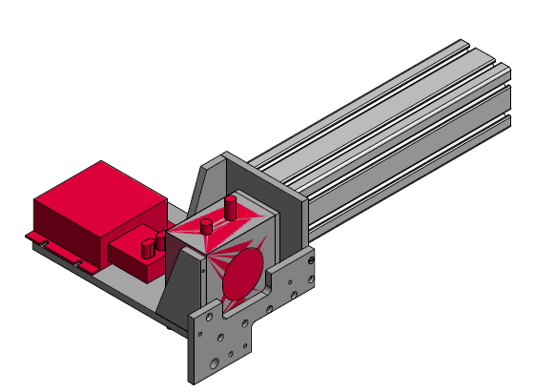
Mount with Screen Removed
Easy removal of screen which can be used on both XY tables.
Easy removal of beam monitor and pre-amplifier also used on both xy tables.

Slide 5
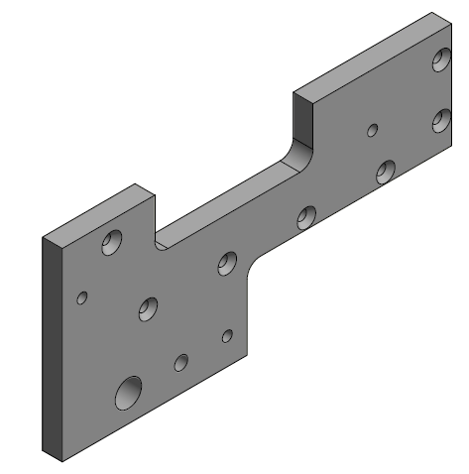
Front Plate
Seven 3/16 holes attach front plate to mount
Three 3/16 holes for attaching front plate to screen
Holes for laser alignment
Coordinates from center of aperture:
(-2.5, -3.45) and (-1.5, -3.45)

Slide 6
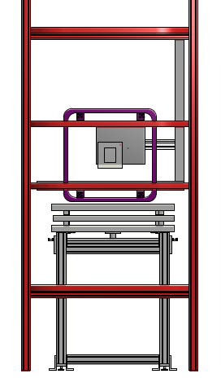
XY Table (approximate size)
Scanner Mount Assembly
Boxes show position of beam and 5 cm fringes around beam
NPDGamma coils

Slide 7
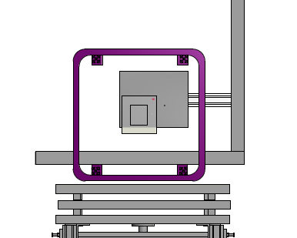
Inner box is 10 x 12 cm
Outer box is 20 x 22cm
At one centimeter increments we will have
440 beam monitor measurements
to determine centroid.
Motion inside coils is limited
Collision Protection ??
Some beam will escape screen
especially downstream

Slide 8
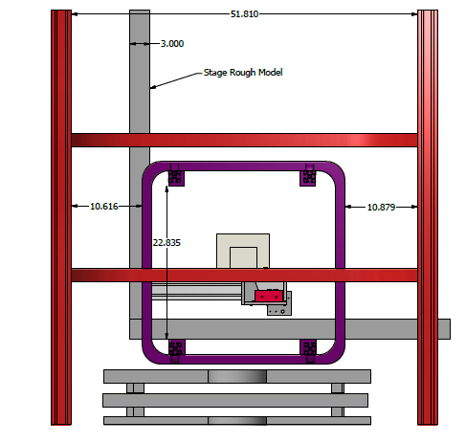
Need to move about
8.5 inches in the horizontal direction
Vertical motion constrained by screen
(not shown here)

