Slide 1
Polarization Of Neutrons Outside The Primary Pulse
TVC
7/4/2016

Slide 2
Algorithm
Generate “Negative Image Pulse”
TOF bin has 1-to-1 correspondence w/ neutron velocity.
Back-propagate to find entry and exit time at RFSF.
Use idealized RFSF pulse to determine neutron spin phase angle and polarization.

Slide 3
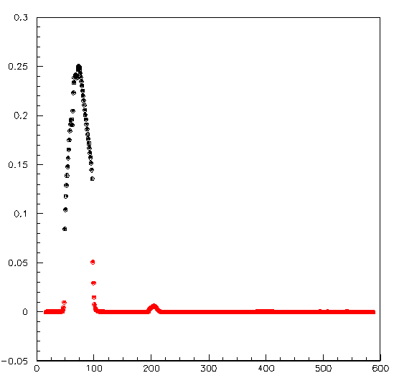
Negative-image Pulse
Use only 600-pulse sequences w/o irregular dropped pulse.
Sum yield from every pulse (N*600).
Normalize by N*599 to get perfect pulse.
Subtract pulse train from perfect pulse to get negative-image pulse (more-or-less equivalent to single-pulse data).
Note: because of the systematic intensity and spectral changes this procedure gives offsets that are visible near the back/edge of chamber.
Yield (Volts)
Wire=0; Layer=0
Black points are from primary pulse.
Pulse*49+itof

Slide 4
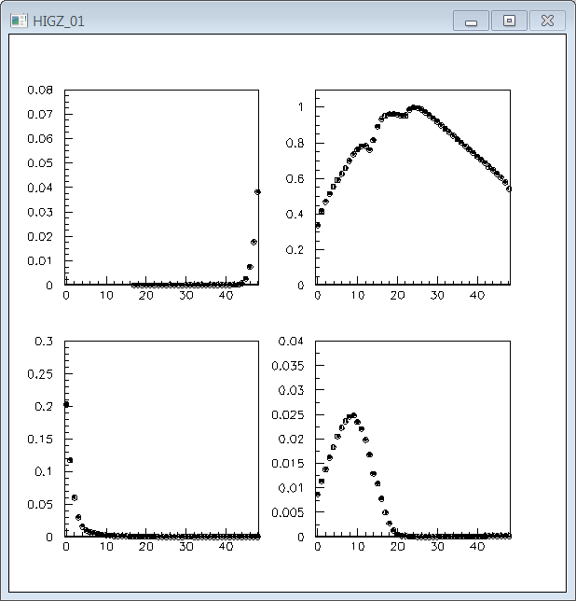
Wire = 0, Layer = 0
Pulse = -1
Pulse = 0
Pulse = 1
Pulse = 3
Relative Yield
TOF Bin

Slide 5
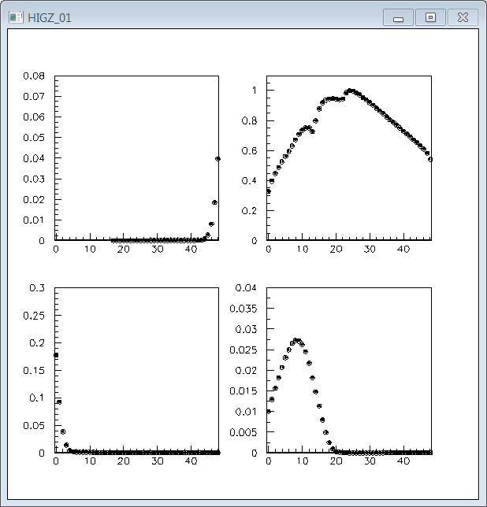
Wire = 4, Layer = 0
Pulse = -1
Pulse = 0
Pulse = 1
Pulse = 3
Relative Yield
TOF Bin

Slide 6
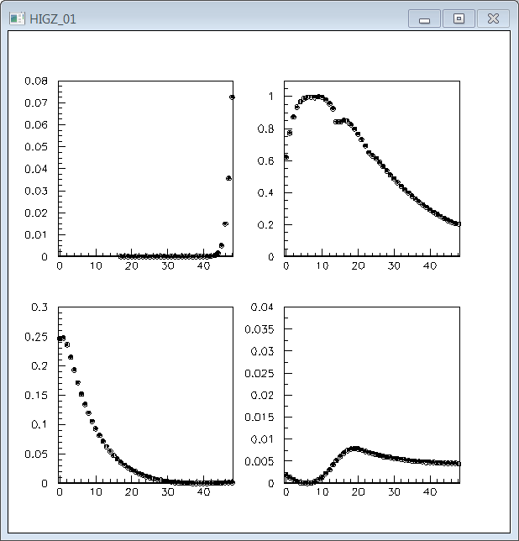
Wire = 0, Layer = 15
Pulse = -1
Pulse = 0
Pulse = 1
Pulse = 3
Notice: much bigger trailing edge.
Notice: shape weirdness (small wraparound at back of chamber + spectral/intensity changes).
Relative Yield
TOF Bin

Slide 7
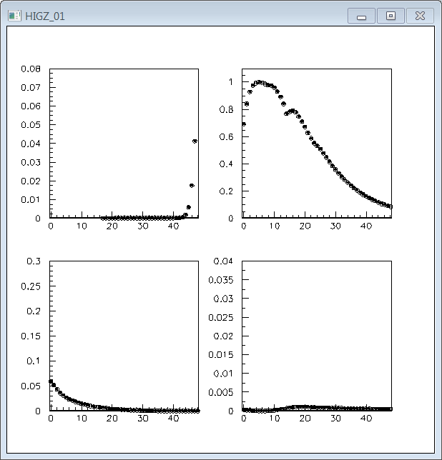
Wire = 4, Layer = 15
Pulse = -1
Pulse = 0
Pulse = 1
Pulse = 3
Relative Yield
TOF Bin

Slide 8
Beamline Geometry
Moderator
1st lead wall
RFSF entry window
Chamber
627.2”
20-1/4”
56-3/4”

Slide 9
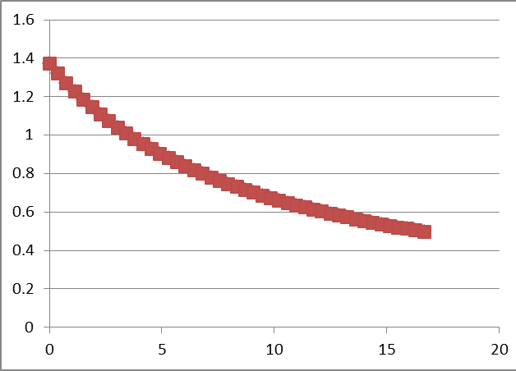
Idealized RFSF
B(t) = B_{max}/(1+αt)
Infinitely fast ramp.
B_{max} chosen to optimize polarization for λ=2.5A.
1.37 G
B(1/60) chosen to optimize polarization for neutrons that enter RFSF 1/60 seconds later
λ=6.5A
α=60*(B_{max}/B_{min} – 1)
B (G)
t_{RFSF}(ms)

Slide 10
Polarization Calculation
For each tof bin calculate RFSF arrival time (t_{a}) and exit time (t_{b}) .
Calculate integrated Bdt:
(B_{max}/α )log((α*t_{b} + 1)/(α*t_{a} + 1))
True when t_{a} and t_{b} arrive inside same RFSF-on pulse
Adjust integration limits as needed for other cases
Do this for both cases (RFSF on/off for primary pulse).
Polarization:
2sin²( γ_{n} ∫Bdt / 4) - 1

Slide 11
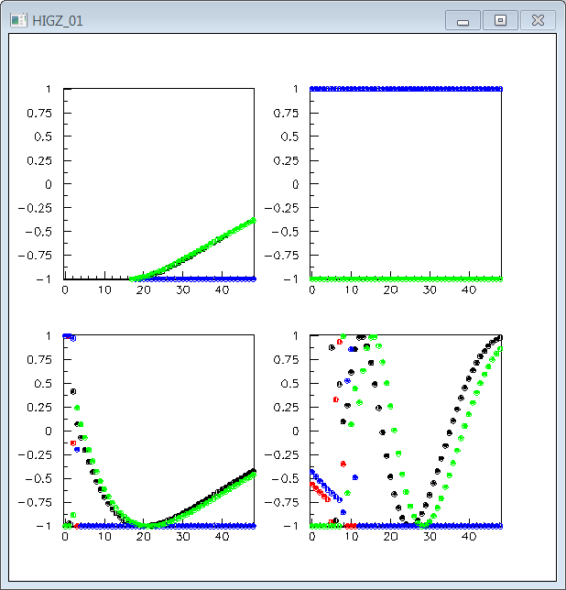
Pulse = -1
Pulse = 0
RFSF ON; Layer = 0
RFSF ON; Layer = 15
RFSF OFF; Layer = 0
RFSF OFF; Layer = 15
Pulse = 2
Pulse = 4
Polarization
TOF Bin

Slide 12
Understanding the Pattern on the Previous Page
First few bins of trailing edge were in RFSF when it was ON (beam more compressed upstream) (P ~ 1)
Primary pulse all hits RFSF when it is ON (P = 1)
The rest of the trailing edge hits RFSF when it is OFF (P = -1)
Leading edge all hits RFSF when it is OFF (P = -1)
First portion of wraparound pulse in RFSF when it was ON (beam more compressed upstream) (|P| <> 1)
The rest of the wraparound pulse hits RFSF when it is OFF (P = -1)
-1
0
1
2
3
RFSF “ON”
First few bins of trailing edge were in RFSF when it was OFF (beam more compressed upstream) (P ~ -1)
Primary pulse all hits RFSF when it is OFF (P = -1)
The rest of the trailing edge hits RFSF when it is ON (|P| <> 1)
Leading edge all hits RFSF when it is ON (|P| <> 1)
First portion of wraparound pulse in RFSF when it was OFF (beam more compressed upstream) (P = -1)
The rest of the wraparound pulse hits RFSF when it is ON (|P| <> 1)
-1
0
1
2
3
RFSF “OFF”

Slide 13
Polarization vs. Time
|P^{ON}_{t}| = |Y_{t,pulse=0}P^{ON}_{t,pulse=0} + Σ_{pulse=-1,1,3} Y_{t,pulse}P^{OFF}_{t,pulse}| / Σ_{pulse=-1,0,1,3} Y_{t,pulse}
|P^{OFF}_{t}| = |Y_{t,pulse=0}P^{OFF}_{t,pulse=0} + Σ_{pulse=-1,1,3} Y_{t,pulse}P^{ON}_{t,pulse}| / Σ_{pulse=-1,0,1,3} Y_{t,pulse}

Slide 14
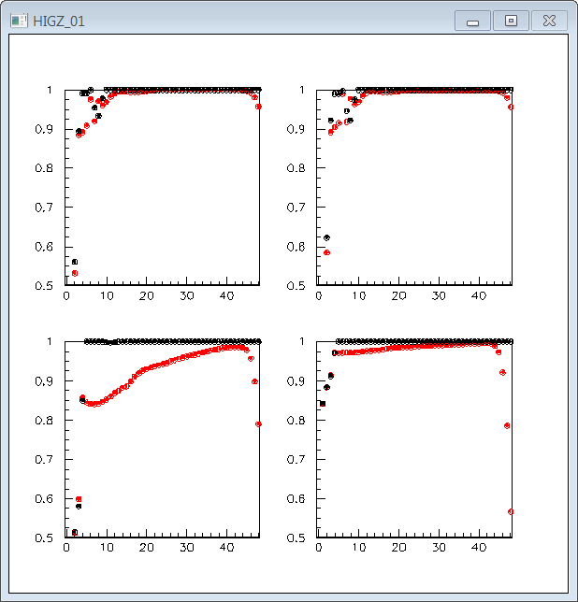
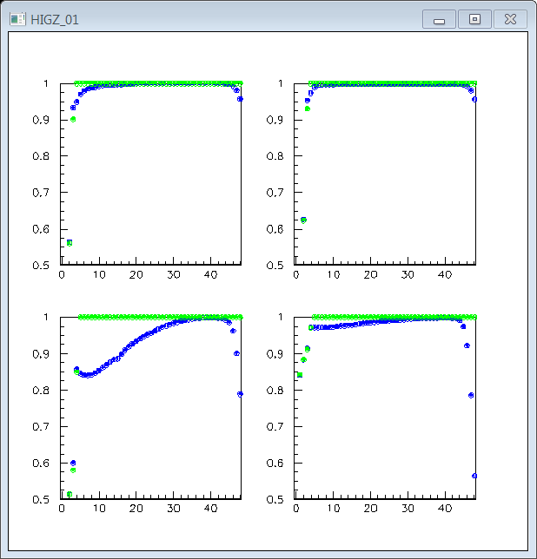
Polarization vs. Time Bin
Wire = 0; Layer = 0
Wire = 4; Layer = 0
RFSF ON; Layer = 0
RFSF ON; n/incl W.A.
RFSF OFF
RFSF OFF; n/incl W.A.
Wire = 0; Layer = 15
Wire = 4; Layer = 15
|Polarization|
TOF Bin

Slide 15
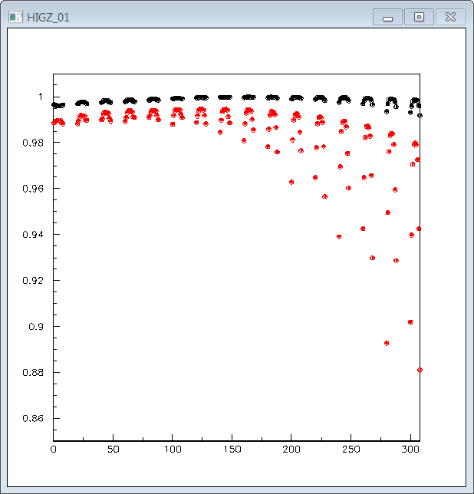
Polarization vs. Wire
RFSF ON
RFSF OFF
|P^{ON}| = Σ_{t=3-45} Y_{t}|P^{ON}_{t}| / Σ_{t=3-45} Y_{t}
|P^{OFF}| = Σ_{t=3-45} Y_{t}|P^{OFF}_{t}| / Σ_{t=3-45} Y_{t}
|Polarization|
Wire Index

