Slide 1
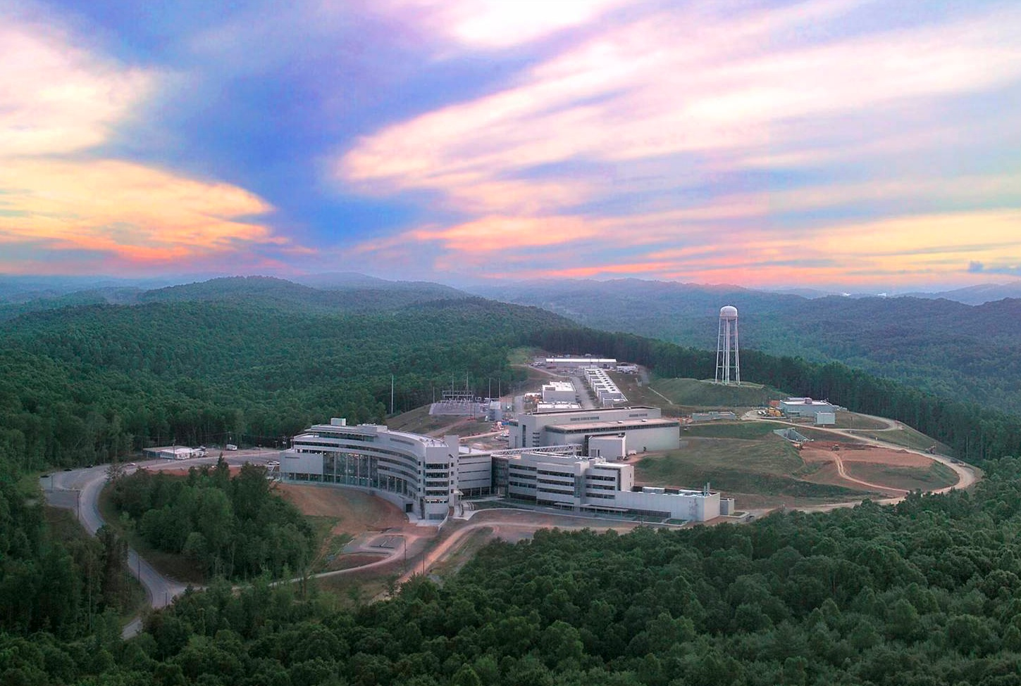
The n-³He Experiment
Christopher Crawford, University of Kentucky
for the n-³He collaboration
DNP Fall Meeting, Pittsburgh, PA, 2017-10-27

Slide 2
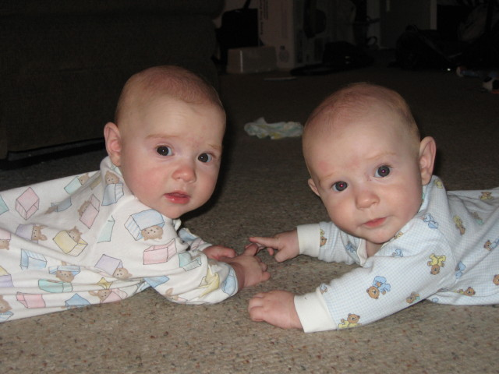
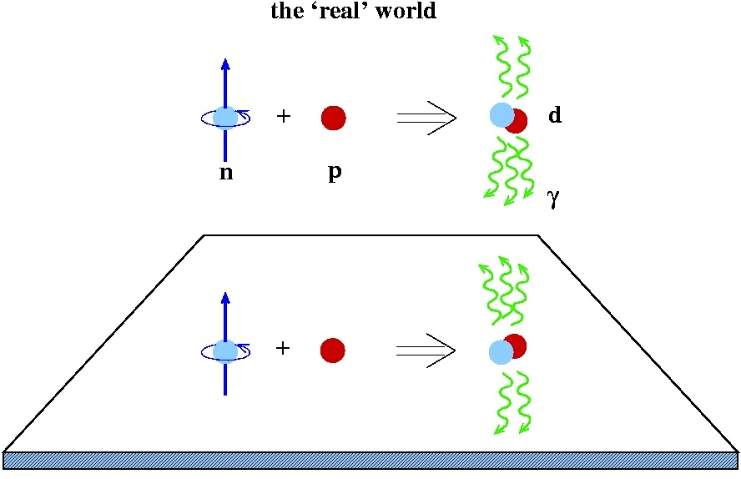
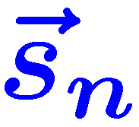
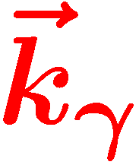
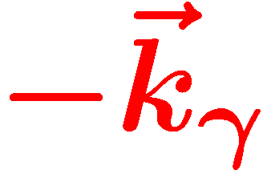

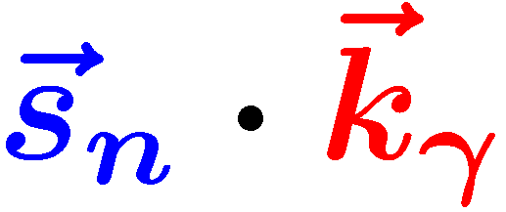

Overview
Hadronic Parity Violation
  Hadronic Weak Interaction (HWI) formalism
n-³He Experiment
  Setup / components
  Data analysis
  Physics results
Madison
Spencer
Is a parity odd pseudoscalar!
Notes:
Before we get started, let me introduce you to our parity doublet, Spencer and Madison, who were born just before I joined the NDPGamma experiment in Los Alamos 10 years ago. And they want you all to know is that this spin-momentum correlation in the n+p to d+gamma reaction is parity odd, and therefore is exclusively sensitive to weak contributions to the NN potential.

Slide 3
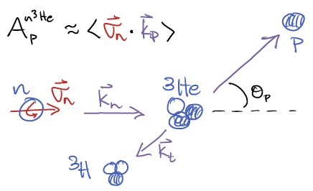

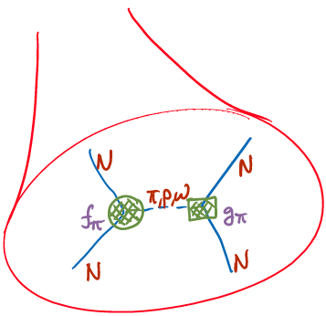
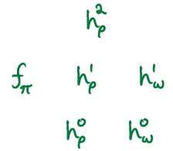
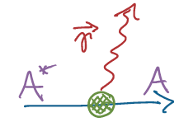
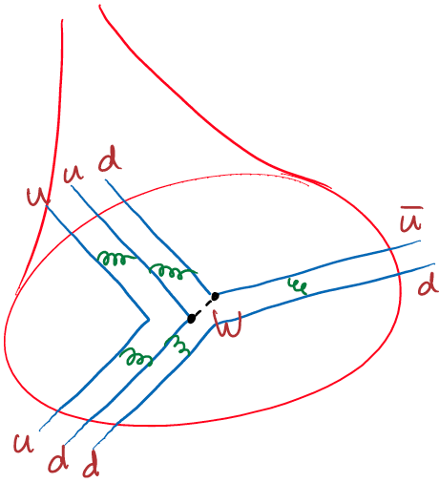

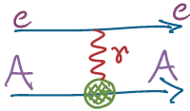

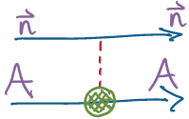

Hadronic Weak Interaction in a nutshell
Nuclear
<nuclear structure>
Hadronic
Nuclear PV
<QCD structure>
EW
Few-body PV
Notes:
The other experiment I will report on today, n + 3He to p + t , is similar except the correlation is with a proton instead of photon.
Under the hood, PV is attributed to a weak vertex in the NN potential, which is characterized by its spin and isospin structure.
At the quark level, the SM physics is well understood, so this is one of the only talks here NOT concerning BSM.
Instead the HWI lies at the intersection between nuclear and nucleonic structure, and is a unique probe of each.
Our experimental program is to measure enough independent observables to characterize the spin/isospin structure of the HWI.

Slide 4
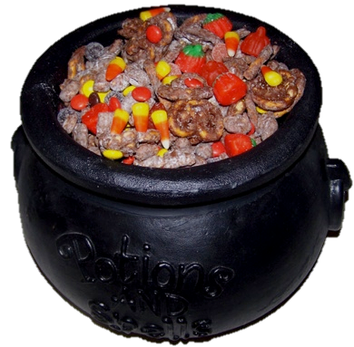



The Hallowe’en Interaction (HW’I)
Trick or Treat Diagram

Slide 5
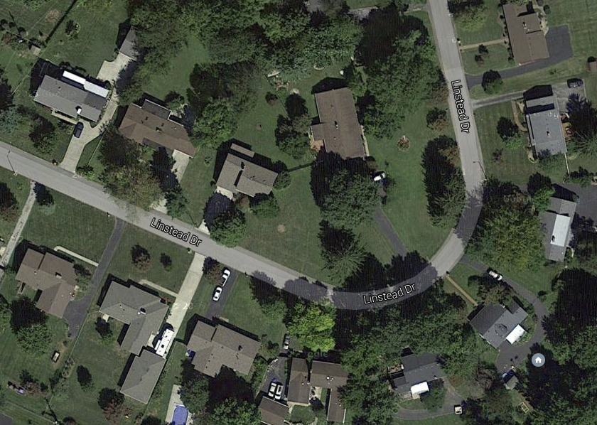
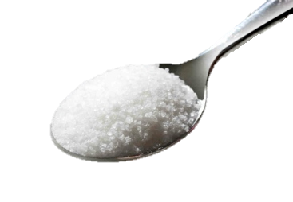








The Hallowe’en Interaction (HW’I)
What can we learn?
Must … have … sugar…

Slide 6
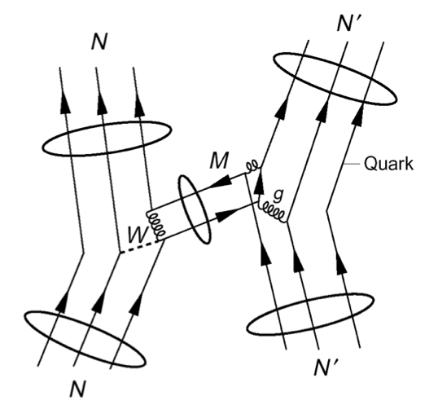
Motivation the studying the HWI
Least understood weak interaction
  EW: Quarks & Leptons, Semileptonic, Hadronic
  Complicated by nuclear structure
  Strongly suppressed by M_{π}^{2/}M_{W}² ~ 10⁻⁷
  Unique PV signature
Orthogonal probe of QCD structure
  test of QCD structure in ΔS = 0 sector
  (ΔI=1/2 rule not understood)
  Study the NC in hadronic systems –
  forbidden by ΔS = 1 by GIM mechanism
  W,Z range = 0.002 fm – probe of
  short-range quark correlations
  in QCD nonperturbative regime
  Nuclear and atomic PV test of nuclear structure models
  physics input to PV electron scattering experiments
  0νββ decay – matrix elements of 4-quark operators
  Same formalism used for Hadronic TRIV (complementary to EDM)
Notes:
Motivation for studying the HWI over the last 60 years has evolved according to theoretical interests,
starting with experimental searches for parity violation, and the role of neutral currents in hadronic systems,
and to elucidate the isospin dependence of kaon decays in the strangeness changing sector.
But in general the HWI is a complementary to strong reactions in studying the NN potential, nuclear and nucleonic structure.
The HWI couplings are also input for other experiments, including exciting new possibilities for discovery of time reversal violation and hadrons.

Slide 7
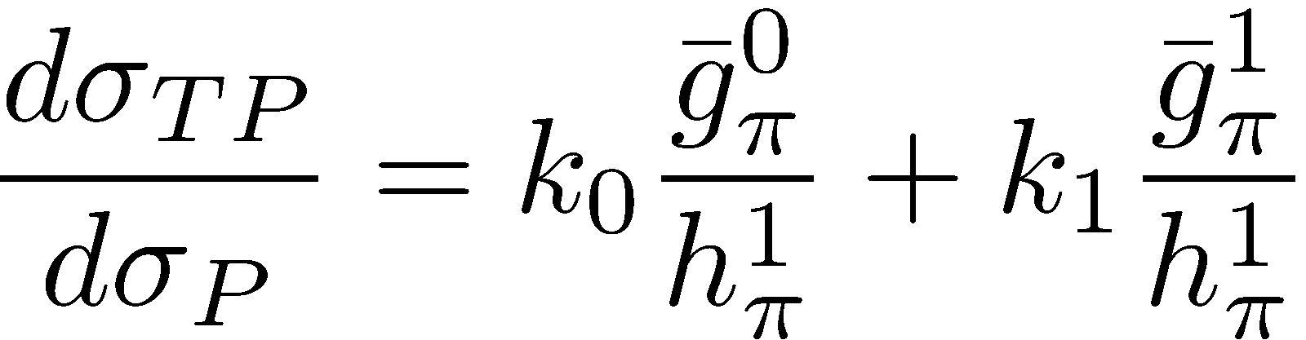
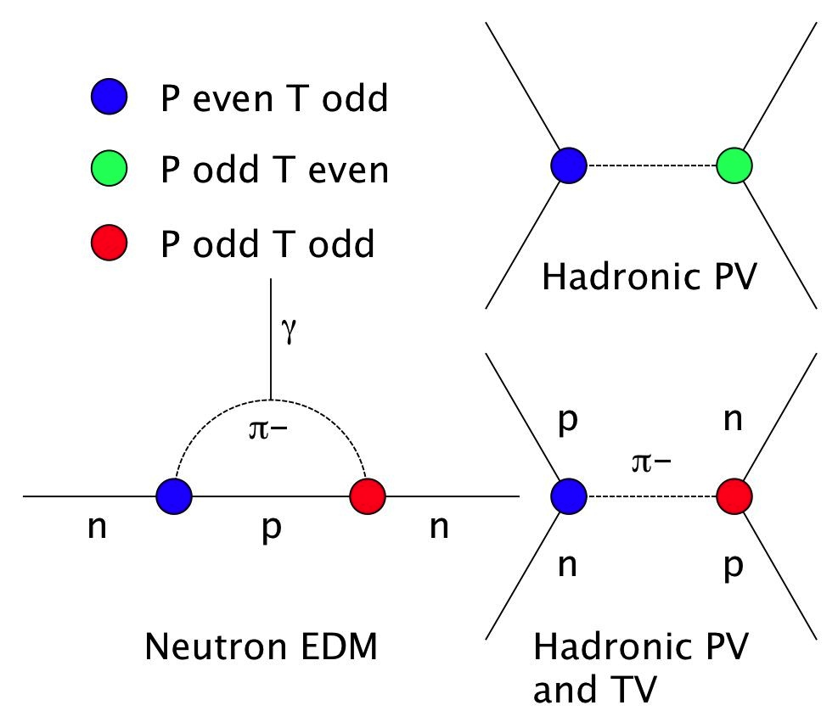

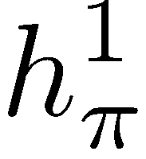
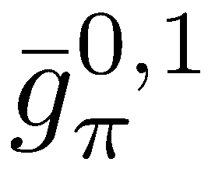
Relation between HPV and EDMs
Tree level diagrams
Bowman, Gudkov, PRC 90, 065503 (2014)

Slide 8
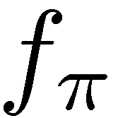
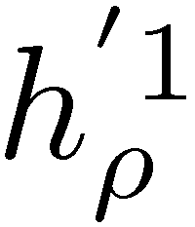
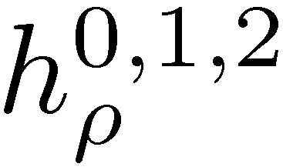
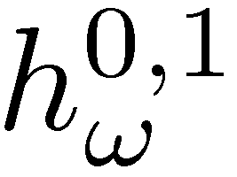

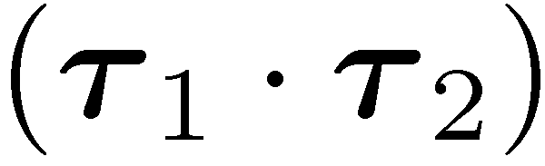
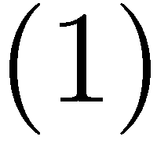
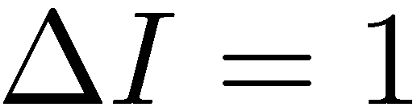
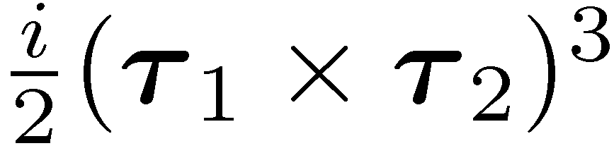
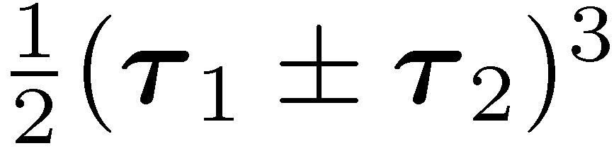
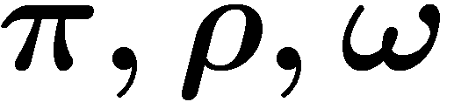
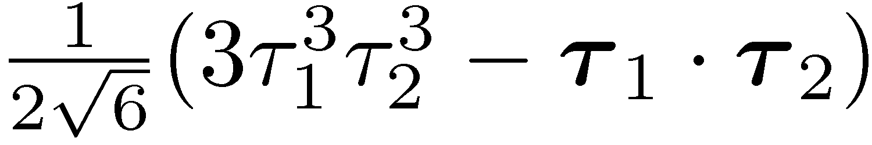
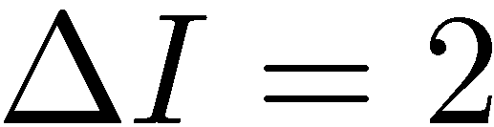
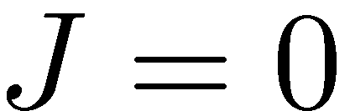
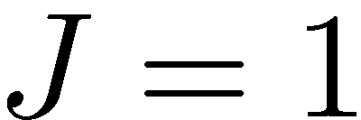
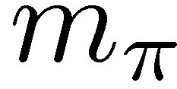
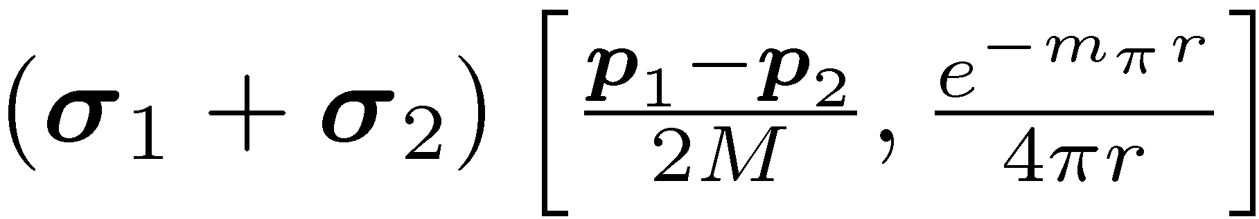
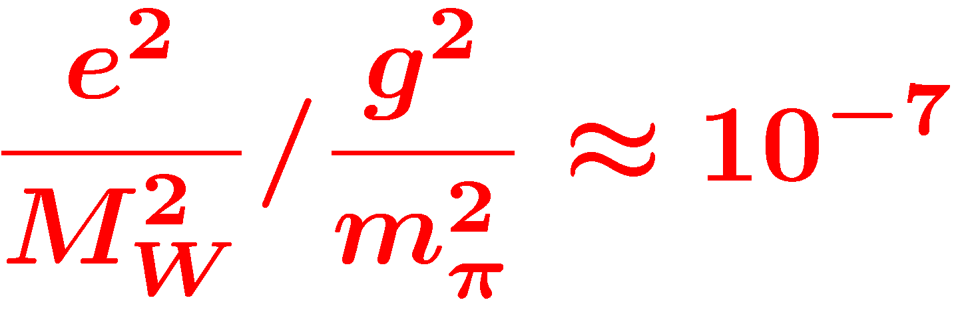
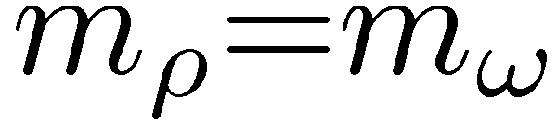

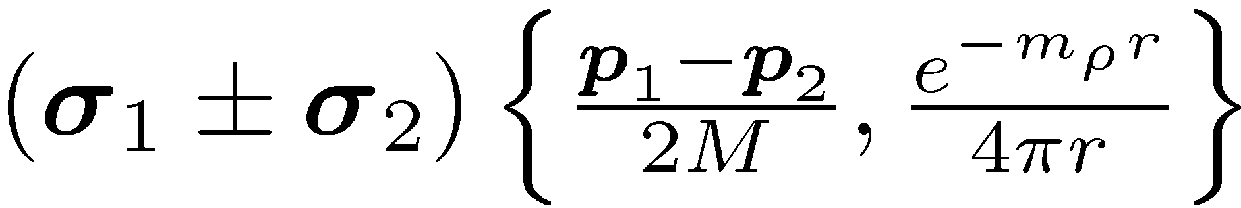
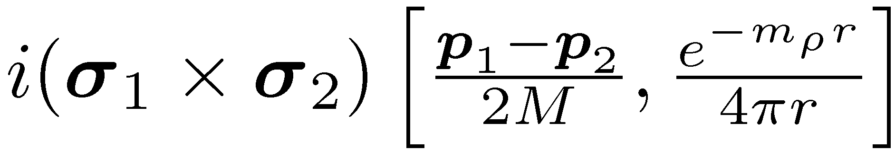
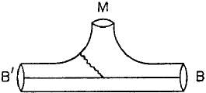
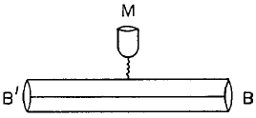
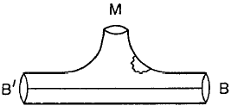
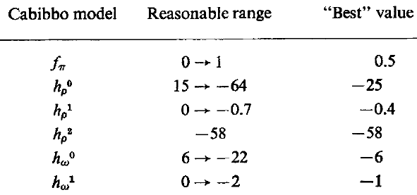
DDH Meson-exchange potential
PV meson exchange
isospin
N
N
STRONG
(PC)
WEAK
(PV)
Meson
exchange
range
N
N
Desplanques, Donoghue, Holstein,
Annals of Physics 124, 449 (1980)
Wasem, Phys. Rev. C 85 (2012) 022501
1st Lattice QCD result of f_{π} !!
Notes:
Here is a list of the various isospin, spin and spatial operators associated with the different couplings
in the de facto DDH meson exchange potential, with their reasonable ranges.
The ratio of weak to strong scales is about 10^-7, which is level of asymmetries we must observe to extract values of these couplings.

Slide 9
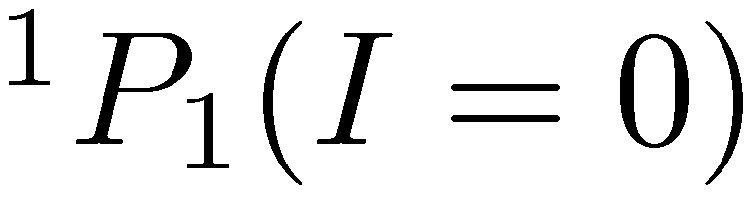
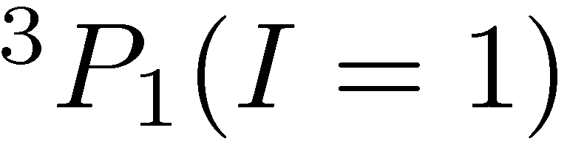
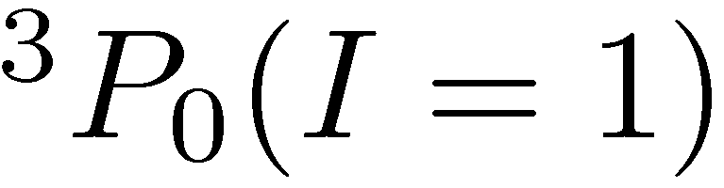
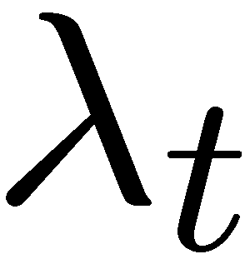





Danilov parameters / EFT
Elastic NN scattering
at low energy (<40 MeV)
S-P transition (PV)
S_{z}=±1/2 I₃=±1/2
Antisymmetric in L, S, I
Conservation of J
Equivalent to pion-less
Effective Field Theory (EFT)
in the low energy limit
C.-P. Liu, P.R.C. 75, 065501 (2007)
Haxton & Holstein, P.P.N.P. 7, 1851 (2013)
Notes:
Now days people use the EFT framework to characterize the HWI in a systematic model-independent way,
but as Haxton and Holstein showed, the low energy coupling constants are quite related.
In fact, they published a “Rosetta stone” to relate both theories back to the 5 basic S-P elastic scattering amplitudes.

Slide 10






Few-body HWI PV Observables
Longitudinal analyzing power in elastic scattering
  pp (15,45, 220 MeV), pd, pα
Circular polarization of gamma transitions
  np
n + p –> d + γ reaction
  Desplanques, NP A 335, 147 (1980)
  PV mixing in final bound state
  + PV transition amplitudes
  Dominated by long range h¹_{π}
n + ³He –> p + ³H reaction
  Viviani, et al, PRC 82, 044001 (2010)
  4-body wave functions + P_{odd} operators
  Sensitive to h¹_{π,} h¹_{ρ,} h¹_{ω}
n + ⁴He spin rotation
PV observables are LINEAR in weak couplings
20.578
19.815
Notes:
Few-body observables have a clean interpretation in terms of the couplings because the wave functions are exactly calculable using the strong NN potential.
Parity violation comes from both weak mixing in the initial and final states, as well as the transition operator.
NPDGamma is almost exclusively sensitive to the long range pion coupling, the same circular polarization from 18F transitions.
Although there is a way of extracting the relevant nuclear information from beta
while n3He is also sensitive to the isospin 1 couplings.

Slide 11
Sensitivities of few-body reactions
Adelberger, Haxton,
A.R.N.P.S. 35, 501 (1985)
Viviani (PISA), [n-³He]
P.R.C. 82, 044001 (2010)
Notes:
----- Meeting Notes (2013-01-23 09:38) -----
Here are the results of their calculation. You can see the strong I=1 dependence and the two I=0 terms. David went through the existing nuclear PV data and fit for 4 coefficients (ignoring the two other I=1 terms). If you use those values, you see that the total asymmetry is 1.15e-7, with a sizable I=0 contribution of two terms of opposite sign. Even if they completely cancel out, this is one of two linear combinations needed to resolve I=0 terms. Here is the improvement with n3He + NPDG excluding many-body reactions.

Slide 12

Isoscalar/isovector projections
Haxton & Holstein,
P.P.N.P. 7, 1851
(2013)
Notes:
With linear sensitivities of the observables to the couplings, you can create a sensitivity matrix, which you can invert to obtain each coupling with uncertainties.
Our goal with the NPDGamma and n-3He experiments is improve the precision of the four largest couplings, while dropping the dependence on few-body observables.

Slide 13
n-3He Collaboration

Slide 14




n-³He Experimental setup
10 Gauss
Holding field
FnPB cold
neutron guide
Super-mirror
polarizer
y
x
³He Beam
Monitor
RF spin
rotator
Collimator
³He target /
ion chamber
z
FNPB
n-³He
Notes:
14
----- Meeting Notes (2013-01-23 09:38) -----
Here is a schematic of the experiment.

Slide 15






Asymmetry extraction
PV physics asymmetry
  Extracted from weighted average
  of single-wire spin asymmetries
Geometry Factors$G=〈\cos{θ}〉$
Notes:
The neutron captures here, and we want to measure the proton asymmetry, or the proton angle as a function of spin.
But the event rate is too large to reconstruct tracks, so we must measure spin asymmetries on each wire.
The opposite triton dilutes the proton asymmetry, and also protons coming from decays downstream, but most decays happen at the front of the chamber.
Even with a large detector inefficiency, the event rates are so high that we expect an error of 1.6e-8, which may be the best relative precision for a few-body HWI experiment.

Slide 16

Experimental model

Slide 17

n-³He in the FnPB

Slide 18


Spallation neutron source
spallation sources: LANL, SNS
  pulsed -> TOF -> energy
LH2 moderator: cold neutrons
  thermal equilibrium in ~30 interactions
Notes:
226 us RMS width moderated pulse
18 m, TOF=11-27 ms, v = 1700-650 ms/s
E=15 – 2.3 meV

Slide 19



Neutron Flux at the SNS FnPB
Flux = 6.5x10¹⁰ n/s/MW
2.5 Å < λ < 6.0 Å
15 meV LH₂ threshold
SNS TOF window

Slide 20

Unfolding single-pulse spectrum

Slide 21
Single neutron “Negative image” pulse

Slide 22


Beam scanner / collimator
Tune the beam size/axis for longitudinal/transverse asymmetry
U. Tennessee, UNAM, Arizona State U.

Slide 23


Beam profile and collimation scans
Upstream 2-d scan
Collimated slice of beam
Downstream 2-d scan
Fit to MC

Slide 24




FnPB supermirror polarizer
T=25.8% transmission
P=95.3% polarization
N=2.2£10¹⁰ n/s output flux (chopped)
simulations using
McStas / ROOT ntuple
S. Balascuta et al., Nucl. Instr. Meth. A671 137 (2012)

Slide 25

Resonant RF spin rotator
Resonant RF spin rotator,
  1/t RF amplitude tuned to velocity of neutrons
  Affects spin only–NOT velocity (no static gradient)
essential to reduce instrumental systematics
  danger: must isolate RF field from the detector
  false asymmetries: additive & multiplicave
holding field
s_{n}
B_{RF}
Larmor precession
+ Rabi oscillation
P. Neo-Seo, et al. Phys. Rev. ST Accel. Beams 11 084701 (2008)

Slide 26




Transverse RF spin rotator
Double-cosine-theta coil
  Fringeless transverse RF field
  Longitudinal OR transverse
  Designed using scalar potential
Univ. Kentucky / Univ. Tennessee

Slide 27

³He analyzer cell
externally polarized
(SEOP) ³He cell
AFP spin reversal
of ³He
Used to measure
both the neutron
polarization and
the RFSF efficiency
Univ. Tennessee / ORNL

Slide 28





³He transmission polarimetry
Larmor
Resonance
Rabi
Oscillation
Polarization of ³He Cell
Beam Polarization
Spin Flip Efficiency

Slide 29


Active target / ion chamber
³He for both target and ionization gas
  Macor frames with 9 x 16 sense wires, 8 x 17 HV wires
  All aluminum chamber except for knife edges
  12” x 0.9 mm CF aluminum windows
  16 mCi tritium over life of experiment
University of Manitoba

Slide 30


Ion chamber yield from neutron beam
Detector yield in Correlation matrix
individual wire cells

Slide 31






Readout electronics
T₀
dirty ground
Ionization read out in current mode
  144 channels read out simultaneously
  Low-noise I-V preamplifiers mounted on chamber
  24-bit, 100 kS/s, 48 channel Δ-Σ ADC FMC modules
Oak Ridge National Lab, Univ. Kentucky, Univ. Tennessee
Divider
Sig.Gen
Amp.
RFSR
Electronic Tests:
Instrumental
false asymmetry
measurements:
δA_{in}<(.12±.07)x10⁻⁸
optical
isolator
Preamp
ADC
clean ground
Ion chamber ground

Slide 32

Electronic noise & false asymmetry

Slide 33
Data selection – I
cut on time-of-flight
  chopper opening/closing, RFSF ramping)

Slide 34
Data selection – II
cut on dropped pulses
  require complete 600 pulse dropped pulse sequence + previous
  averaged asymmetries with RFSF on vs. off during dropped pulse

Slide 35
Individual wire asymmetries
Up/down parity conserving asymmetry

Slide 36
Left/Right PC asymmetries

Slide 37

Chi square distributions
Distribution of individual wire physics asymmetries
$A_{i}^{phy}=A_{i}^{raw}/G_{i}$
Left/right PC asymmetry Up/down PV asymmetry

Slide 38

Covariance weighted averages
Individual wire asymmetries are not independent
  each proton/tritons ionizes gas in multiple cells in wire chamber
Two identical methods of properly weighting for covariance
  direct calculation: $w_{i}=Var{\left(A_{i}^{p}\right)}^{−1}→ \sum_{j}{Cov{\left(A_{i}^{p}, A_{j}^{p}\right)}^{−1}}$
  diagonalization: $S^{T}⋅Cov\left(A_{i}^{p}, A_{j}^{p}\right)⋅S=diag\left(σ_{i}\right)$
    asymmetry modes are statistically independent

Slide 39
Left/right PC asymmetry modes
batch 2 (typical)

Slide 40
Averaged left/right PC asymmetry
covariance weighted average over independent modes

Slide 41
Up/down PV asymmetry modes
batch 2 (typical)

Slide 42
Averaged up/down PV asymmetry
covariance weighted average over independent modes

Slide 43

Results
Parity conserving nuclear physics asymmetry (left/right)
$A_{PC}=\left(−4.4±0.56\right)×{10}^{−7}$ (statistical)
Parity violating nuclear physics asymmetry (up/down)
$A_{PV}=\left(1.0±1.0\right)×{10}^{−8}$ (statistical)
Systemic errors small but not fully characterized

Slide 44
Extraction of couplings
Haxton & Holstein, P.P.N.P. 7, 1851 (2013)

Slide 45



Conclusion
Hadronic Parity Violation
  We are close to a full
  complement of few-body
  HPV observables
  Using pp (45MeV),
  pp (220 MeV), pα, NPDGamma, n-³He,
  NSR-III, we can test the
  self-consistency of the
  HWI formalisms
n-3He Experiment
$$A_{PC}=\left(−4.41±0.56\right)×{10}^{−7}$$
$$A_{PV}=\left(1.0±1.0\right)×{10}^{−8}$$
Thank you!

