Slide 1
Fourier Analysis of Pulse Seq
Chris Crawford & Chris Coppola
2016-05-16

Slide 2
Fourier analysis of pulse sequence using Matlab / Octave and the ‘dst_ud.m’utility to load the wave function
>> dst_ud
>> plot(reshape(dsig(:,1,:,1),[1624*600,1]))
>> plot(real(fft(reshape(dsig(:,1,:,1),[1624*600,1]))))
You can see the overall beam current structure as harmonics of the fundamental frequency of 1*0.1Hz (continuous curve), as well as the structure of the perfect pulse with superharmonics of 600*0.1Hz (spikes).
It's not till you zoom way in do you see the mid-harmonics of 10*0.1Hz representing this periodic 1 Hz blip. There do not appear to be any subharmonics (for example 5*0.1 Hz) indicating that it really is periodic at 1 Hz.

Slide 3
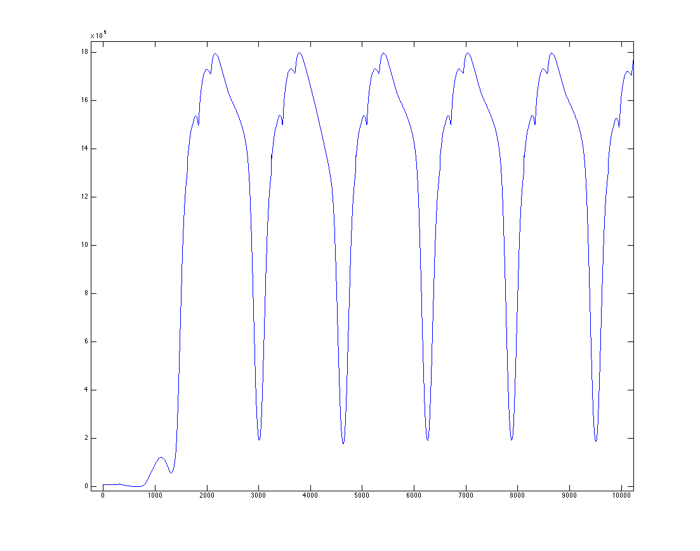
First 6 pulses / 600 in time domain

Slide 4
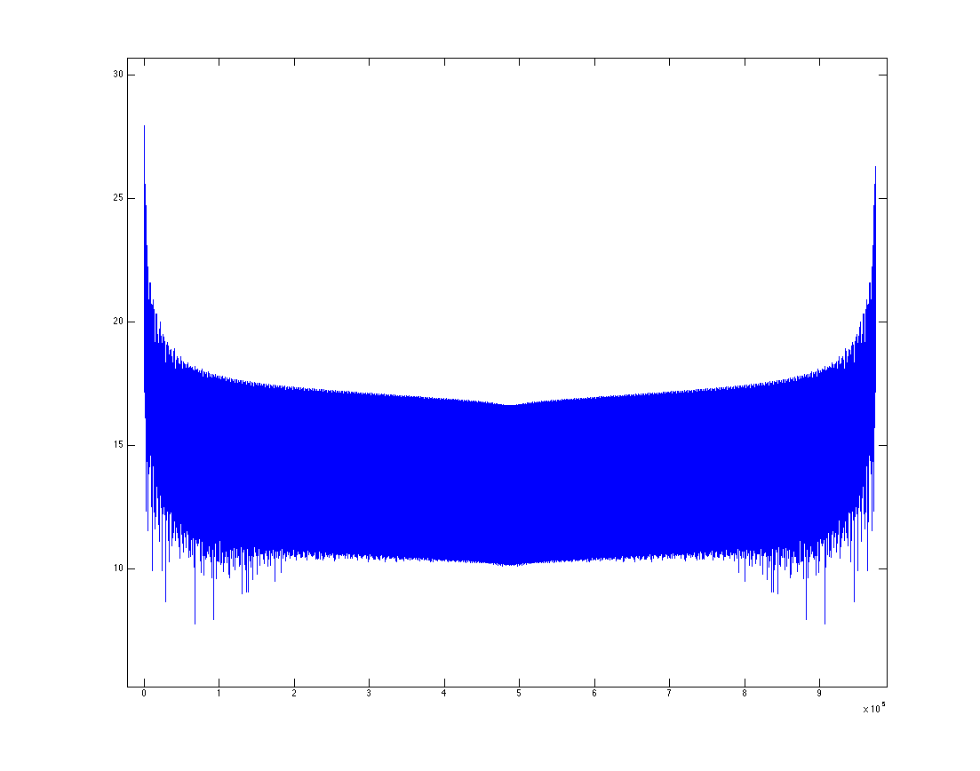
FFT magnitude, full range

Slide 5
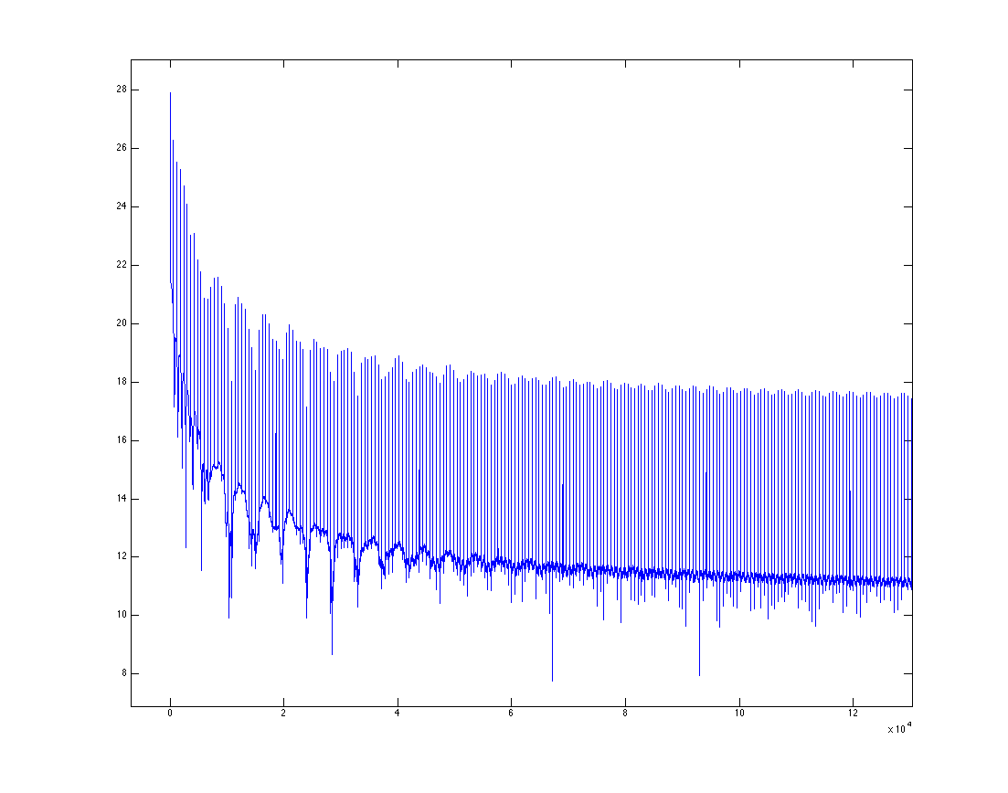
FFT magnitude, zoom

Slide 6
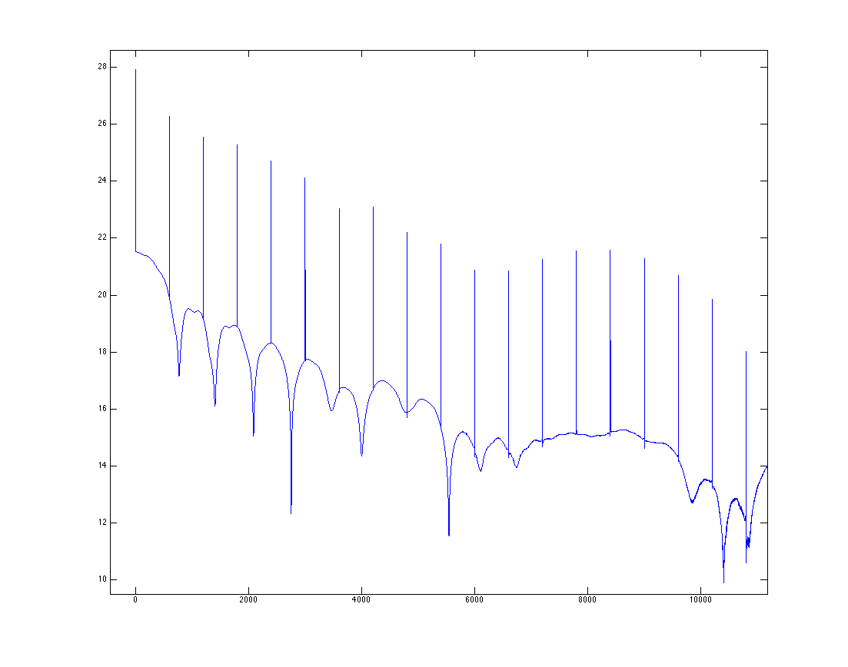
FFT magnitude, with 60 Hz spikes

Slide 7
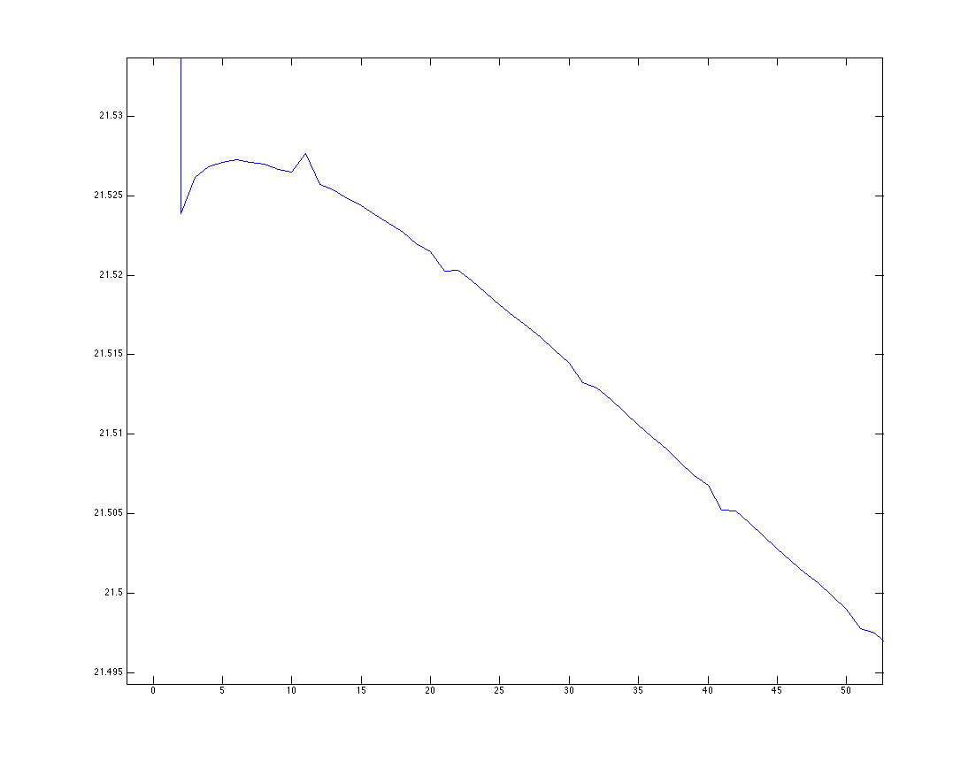
FFT magnitude, zoomed in to see 1 Hz peak

