Slide 1
The n-³He Simulation Using Geant4
A Prototype Version
(The slides include some animations and might require presentation mode)
Latiful Kabir
n-³He Weekly Meeting
November 28th 2016

Slide 2
Overview of Geant4
Steps :
1. Construct Materials and Detector :
G4VUserDetectorConstruction
2. Construct Primary Events Generator :
G4VUserPrimaryGeneratorAction
3. Implement Physics :
G4VUserPhysicsList
4. Scoring / Extract Useful Information :
G4UserEventAction , G4UserRunAction,
G4UserEventAction, G4UserTrackingAction etc.
5 . Customize run / events

Slide 3
Assumptions for this presentation:
Simple Geometry
Simple Beam Profile : Pencil beam

Slide 4
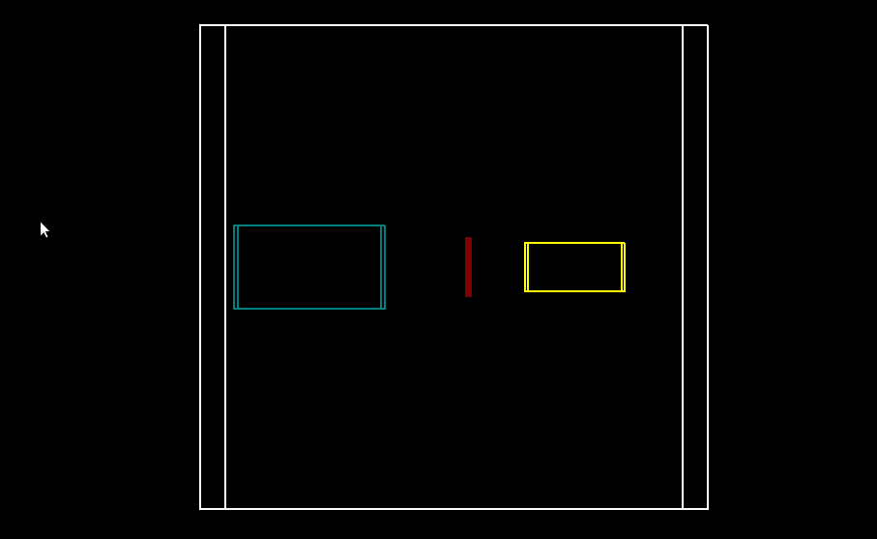
1. The Geometry and Materials
Y
z
X

Slide 5
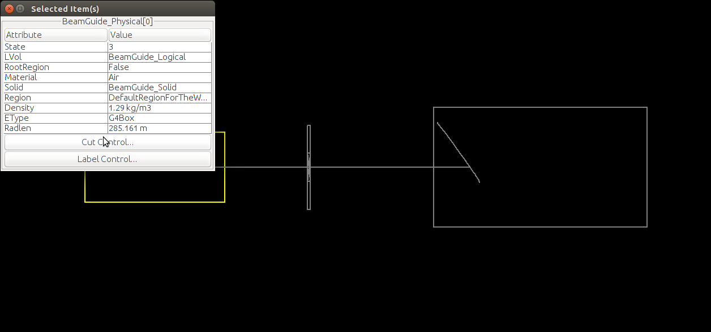
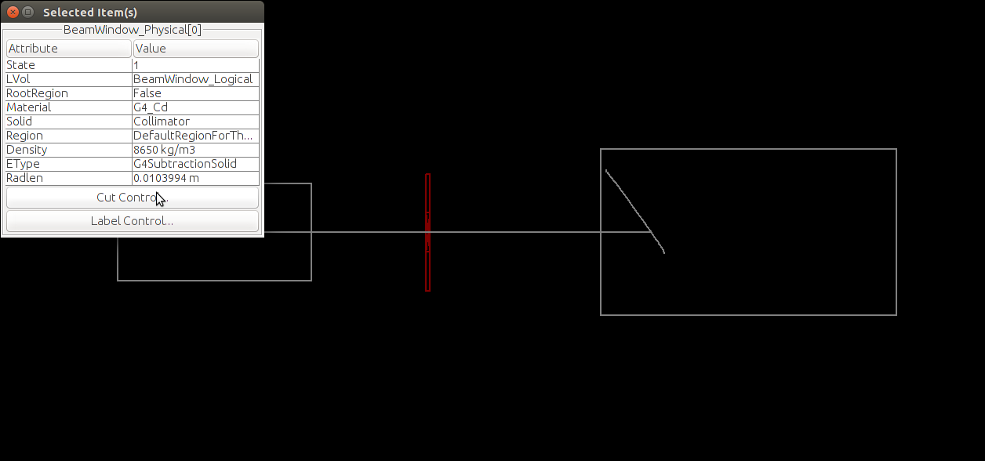
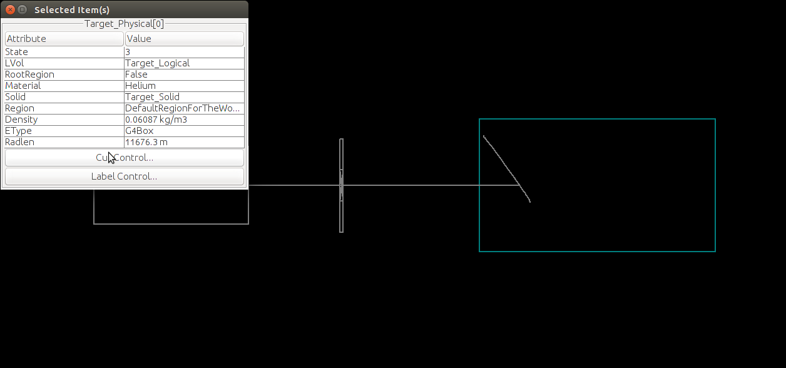
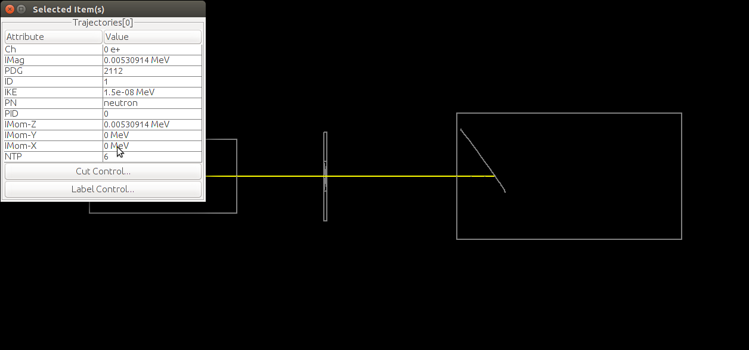
1 & 2. The Geometry and Materials with beam

Slide 6
3.The Physics
Modular based physics list from Geant4 is used : QGSP_BERT_HP
QGSP_BERT_HP Stands for ----
QGS: Quark Gluon String Model ( > ~ 20 GeV )
P : G4Precomputed model used for de-excitation.
BERT : Bertini-style cascade ( < ~ 10GeV )
HP : High Precision neutron model (< 20 MeV).

Slide 7
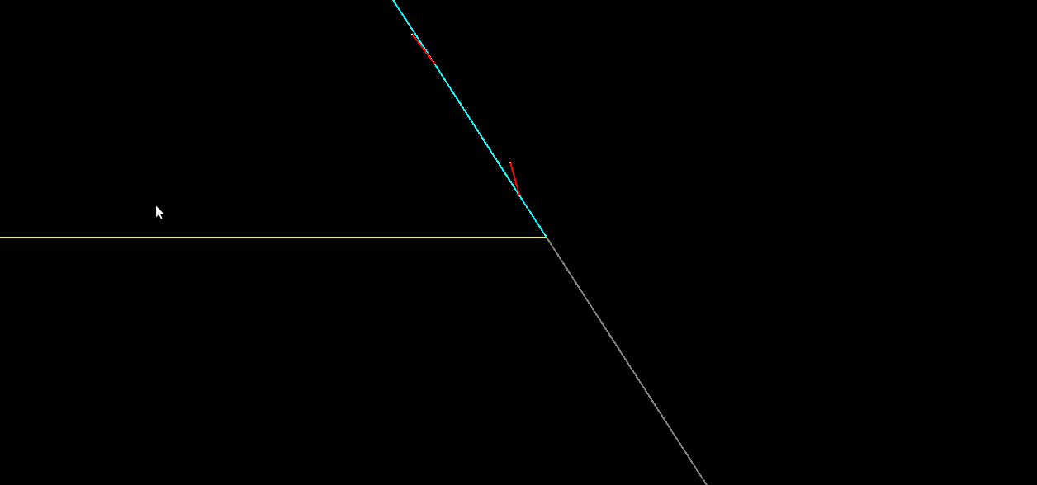
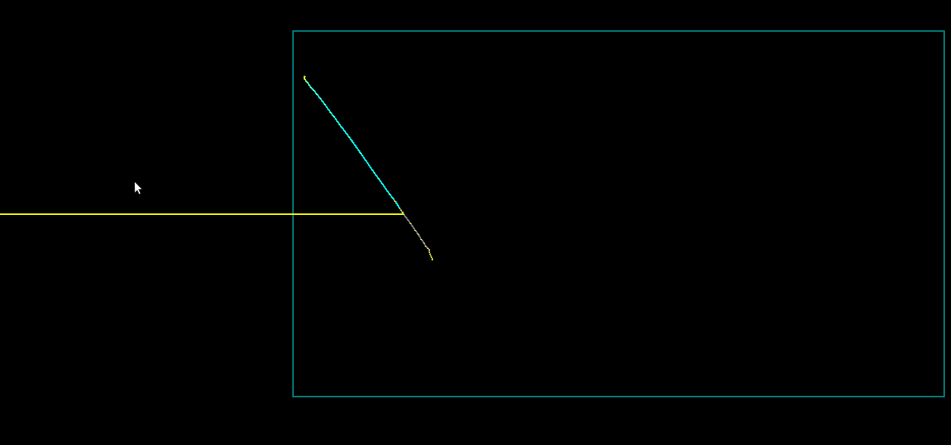
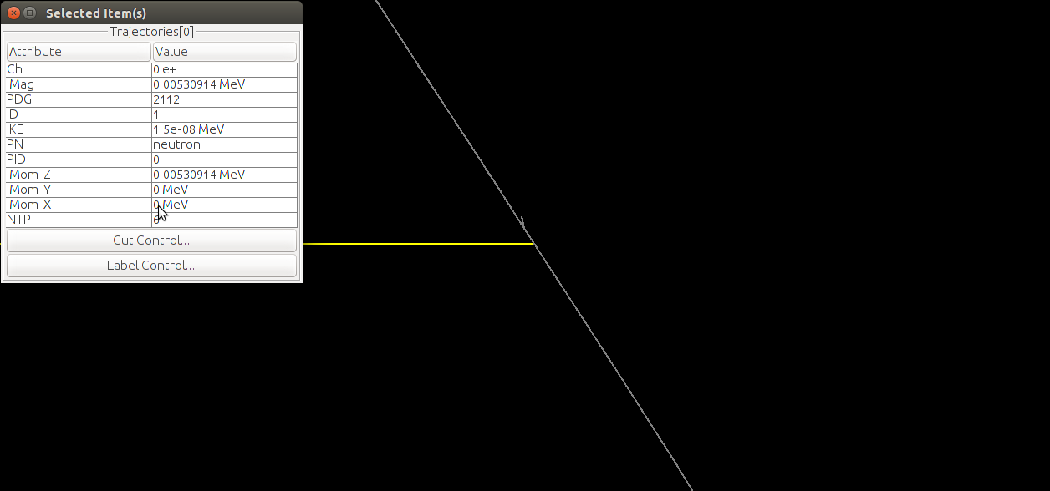
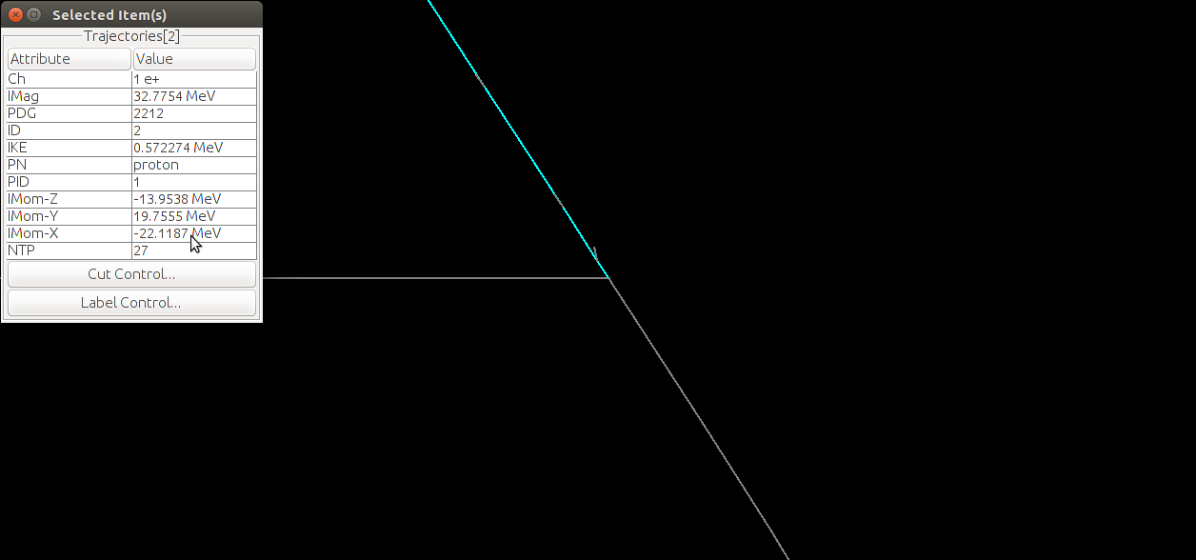
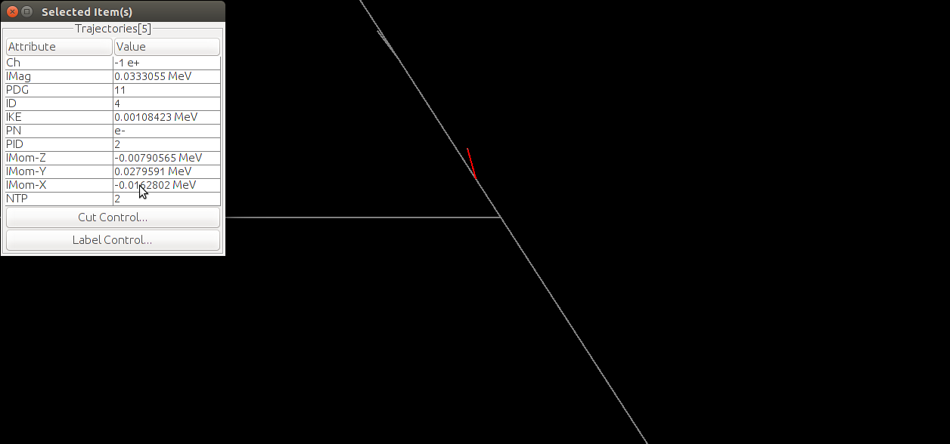
3.The Physics

Slide 8
3.The Physics : Accumulated Events

Slide 9
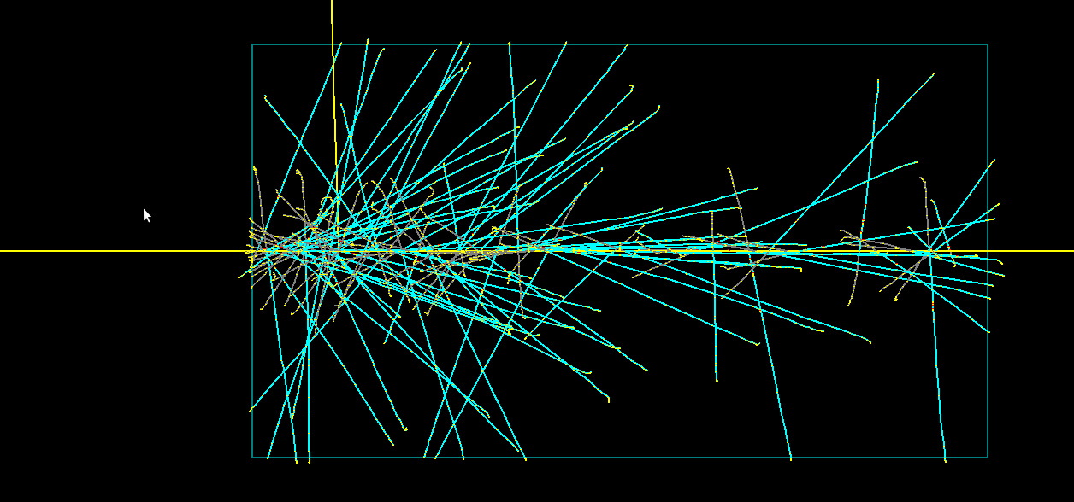
3.The Physics : Accumulated Events

Slide 10
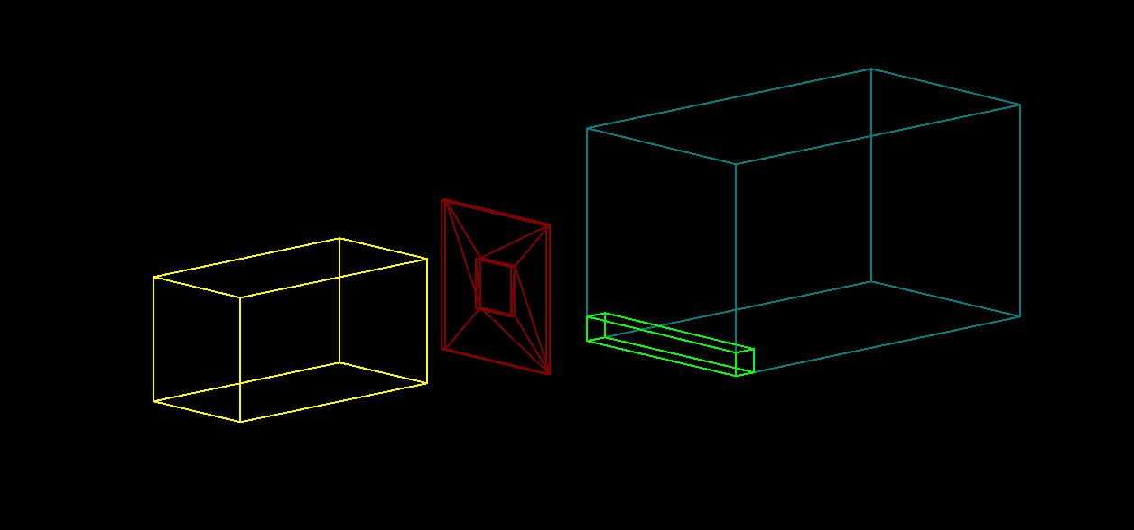
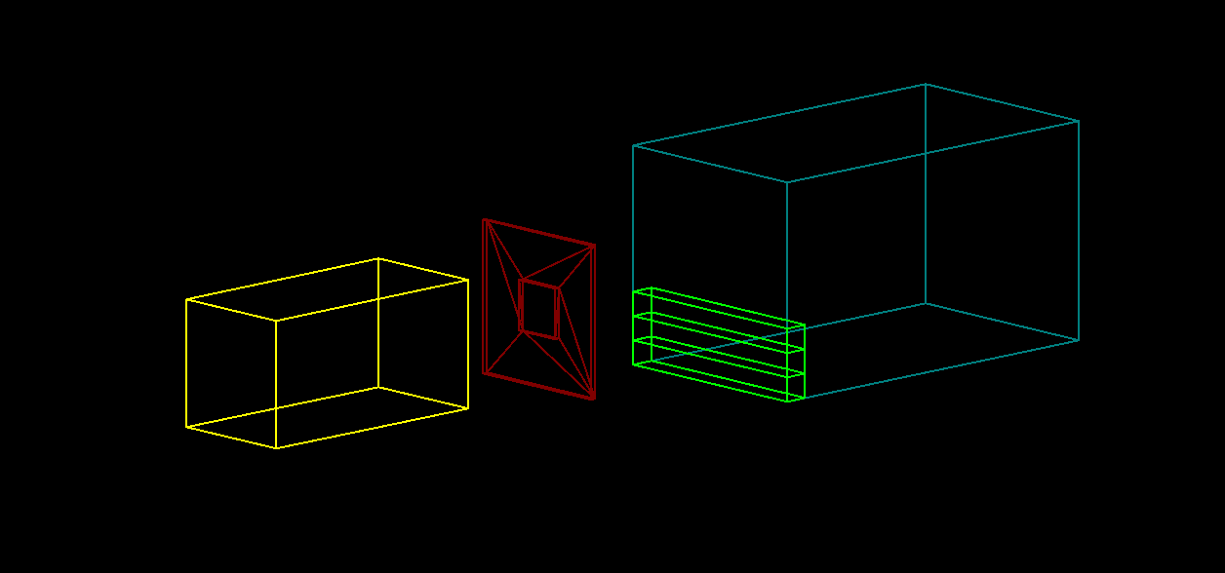
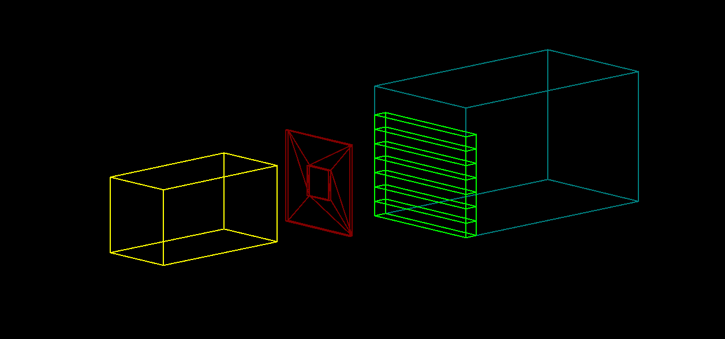
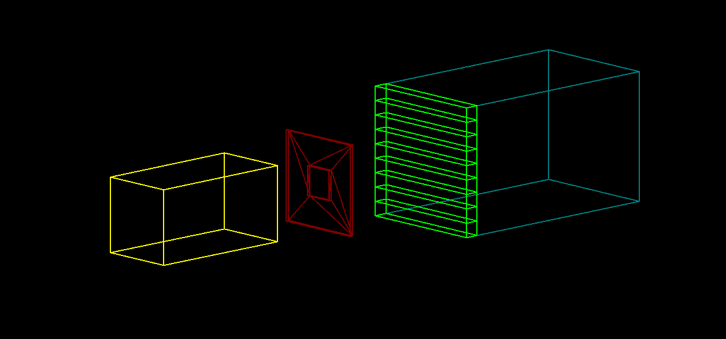
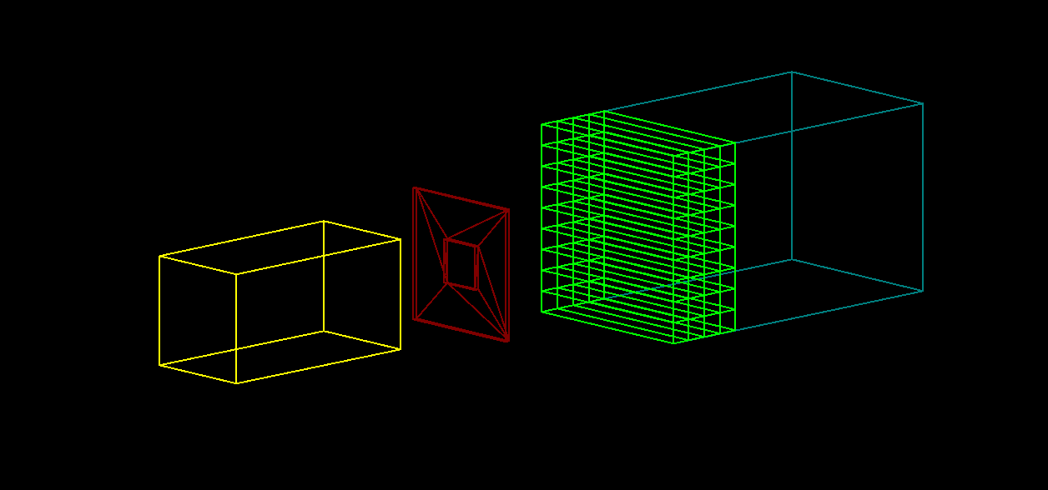
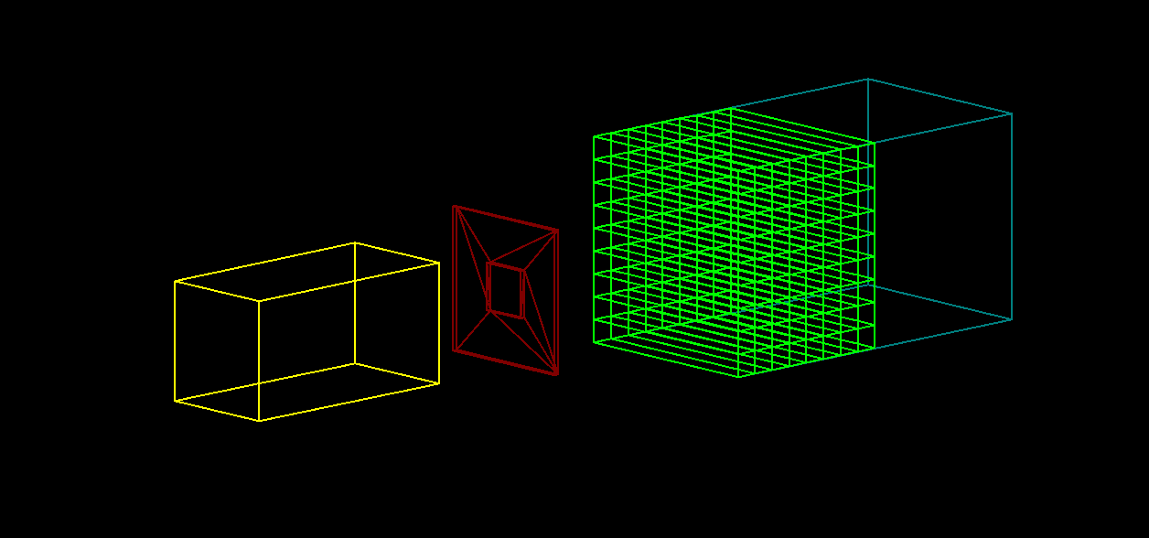
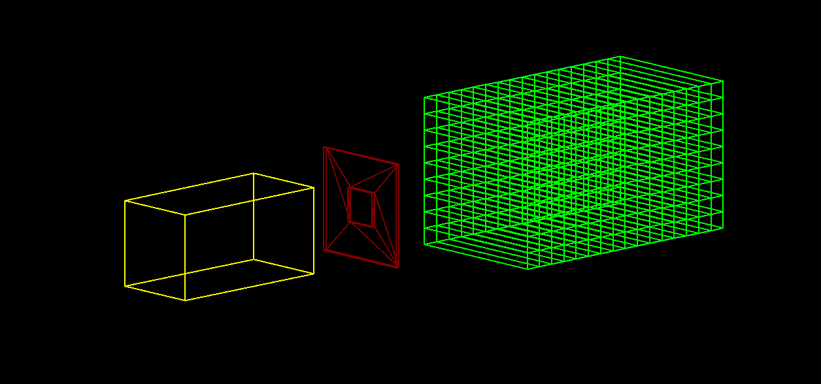
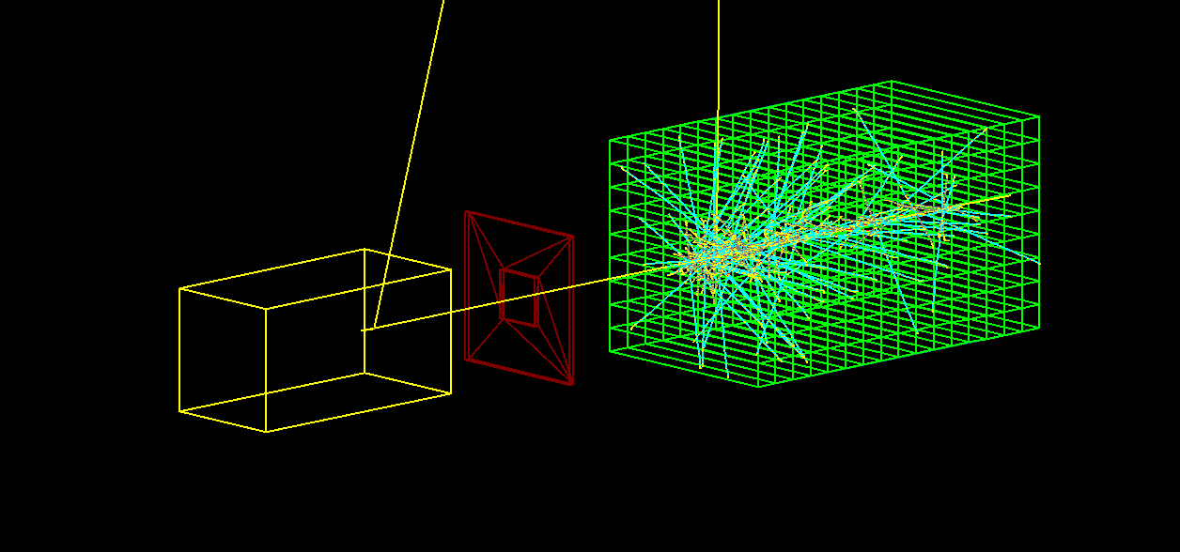
4. The Scoring : The Sensitive Volume (Detector)
10

Slide 11
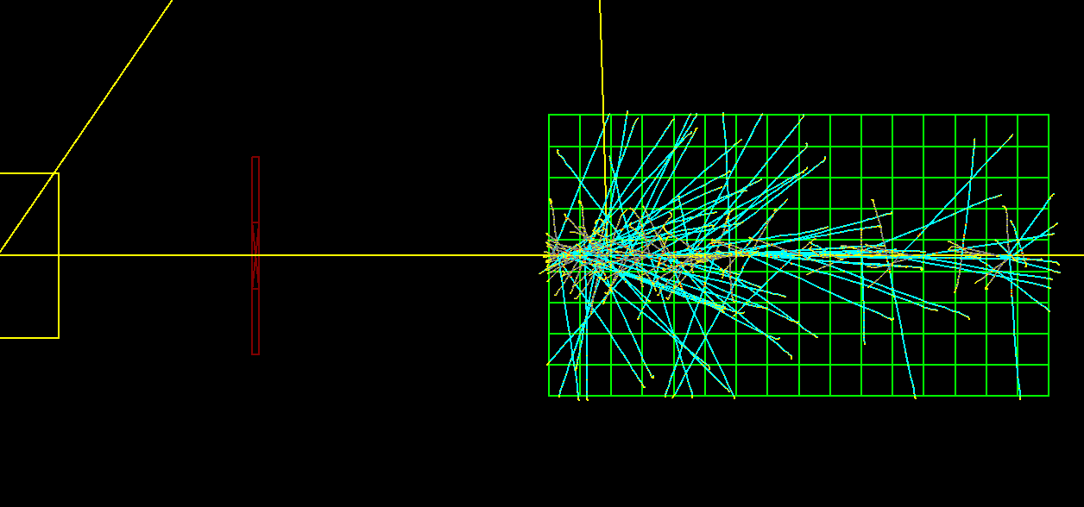
A prototype version of the experiment
11

Slide 12
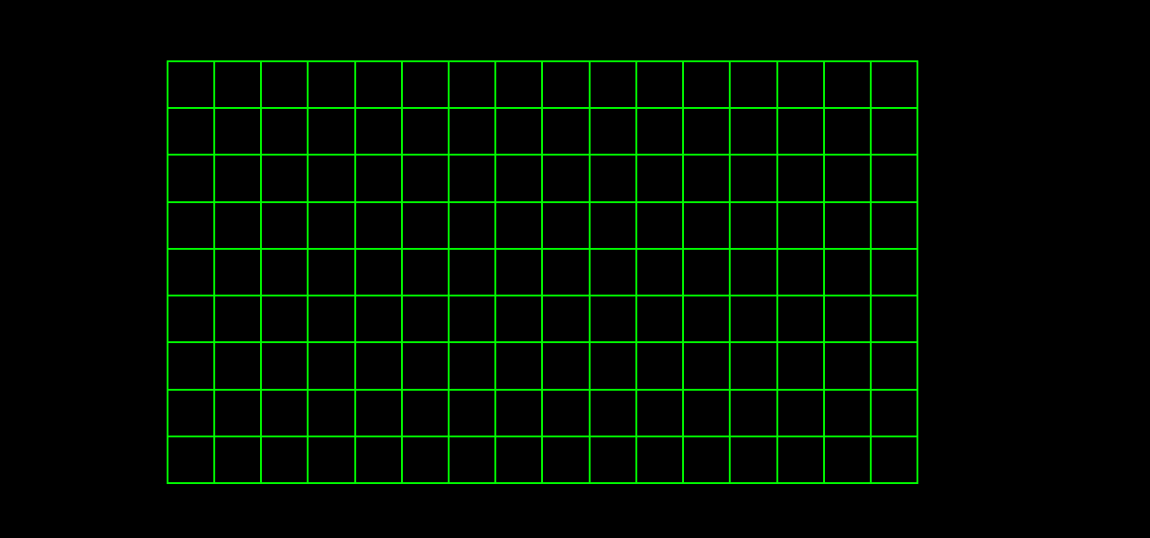
Wire (Cell) Labeling and Scale
30.4cm
W8
1.9cm
1.9x9 cm
W1
W0
L0
L1
L2
L15

Slide 13
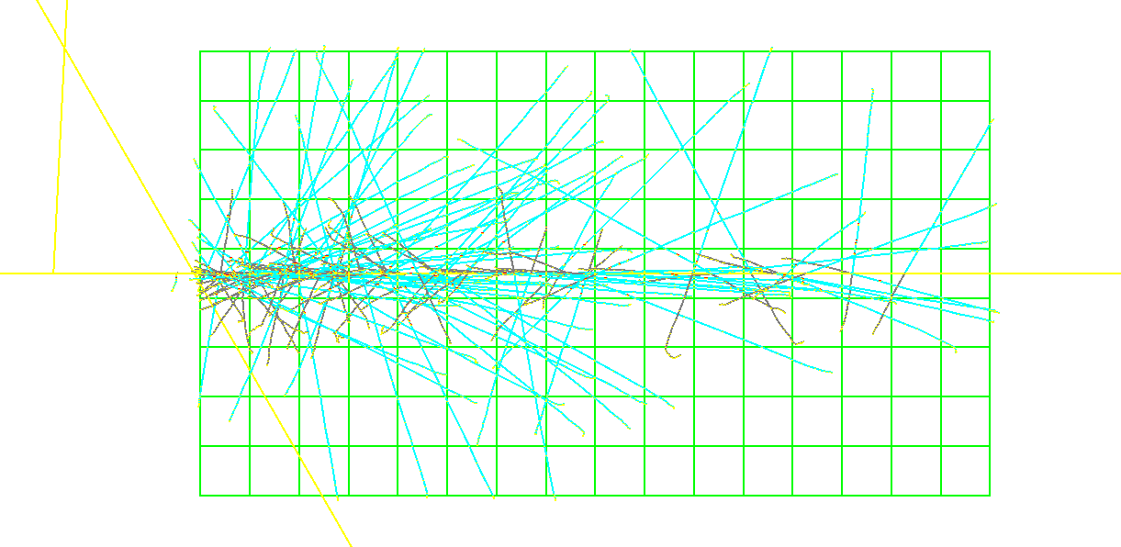
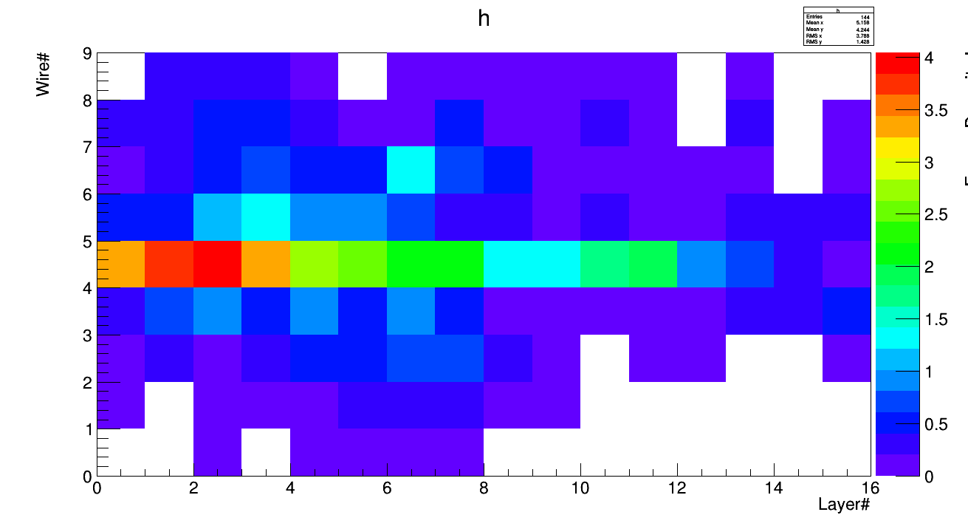
4. Scoring : Energy Deposition – 100 Events

Slide 14
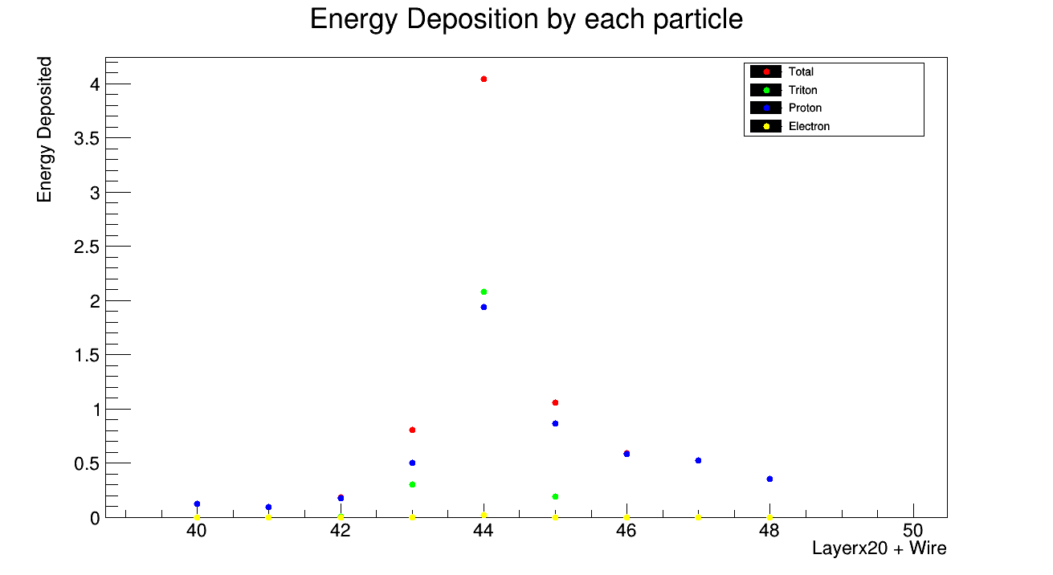
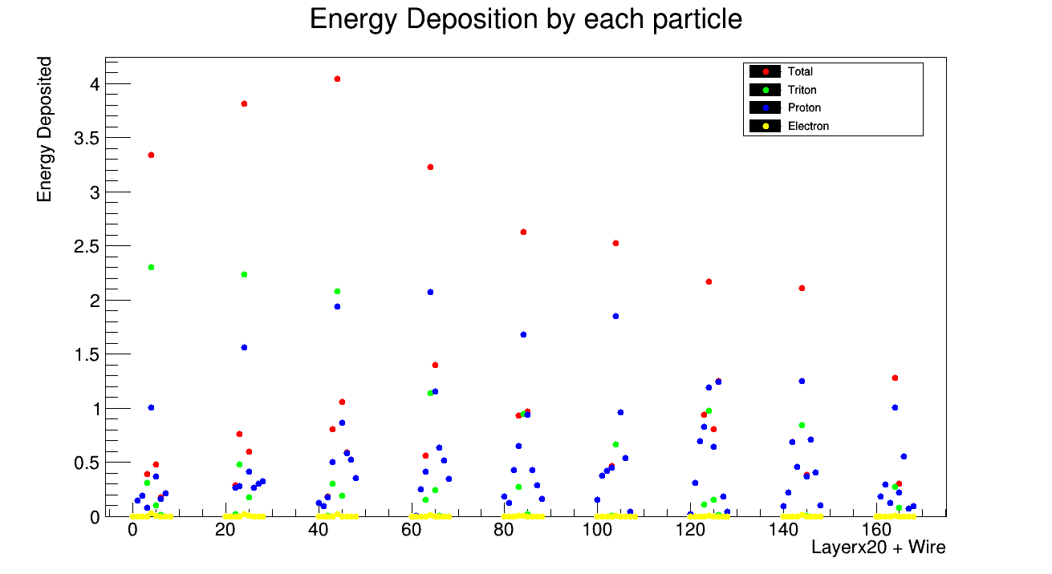
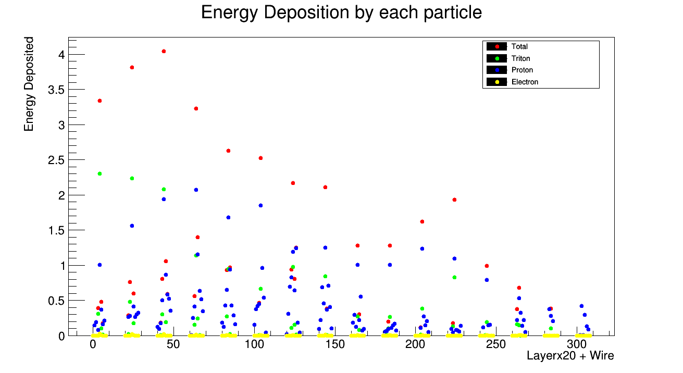
Energy deposition in the cells by each particle

Slide 15
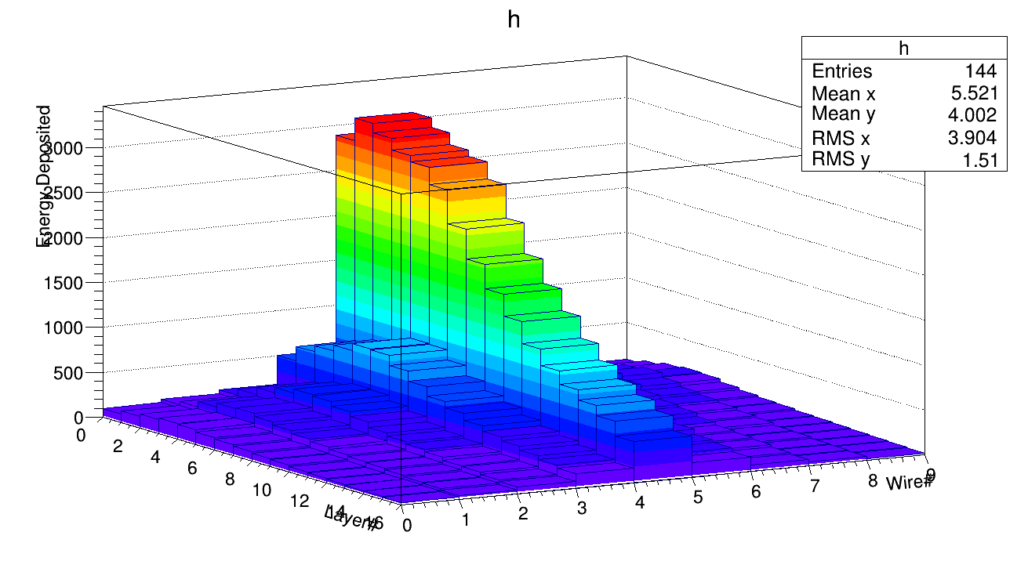
Distribution of total energy deposited in the cells – 10⁵ Events

Slide 16
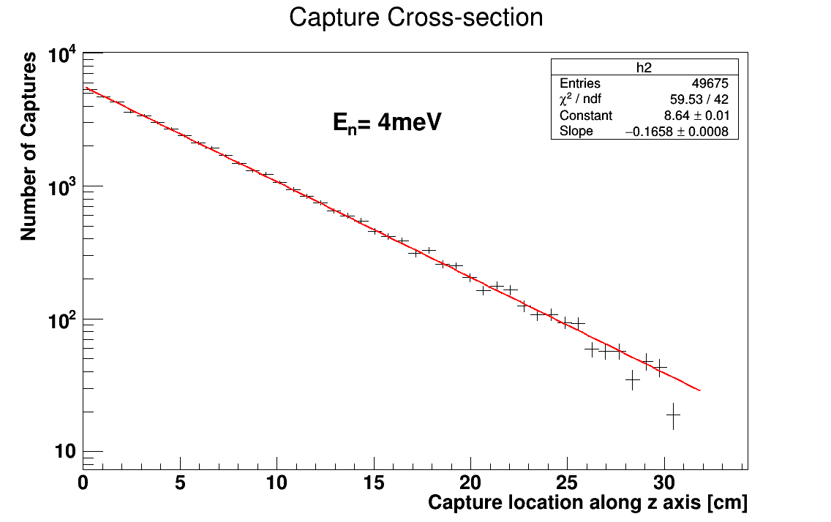
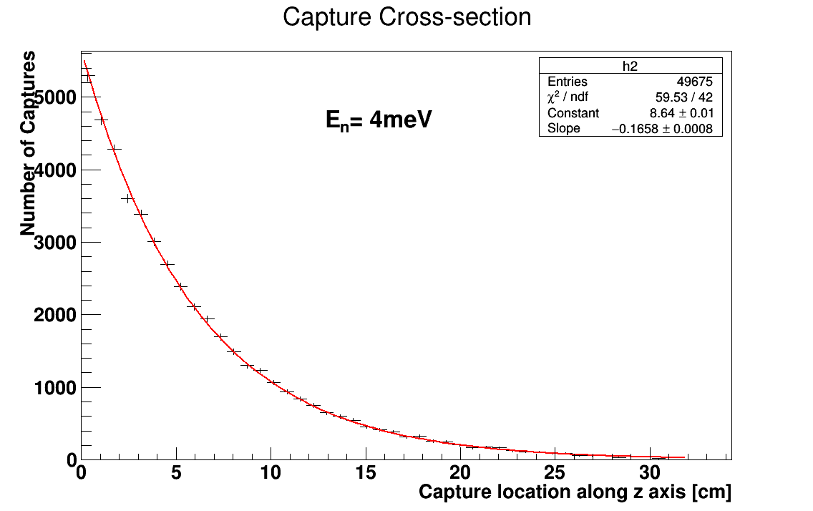
Capture Cross-section

Slide 17
Proton Track Momentum Direction Distribution
Proton
Y
Ф
ϴ
Neutron
z
X
Triton

Slide 18
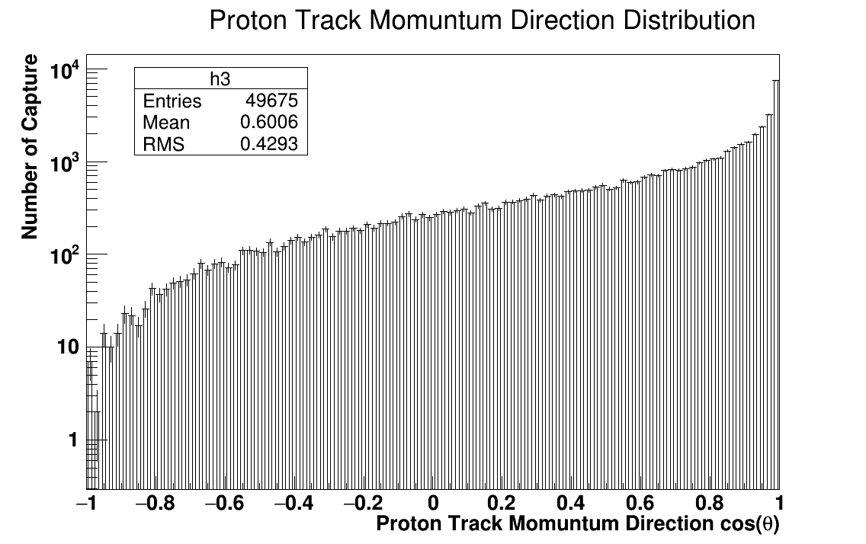
Proton Track Momentum Direction Distribution
Momentum

Slide 19
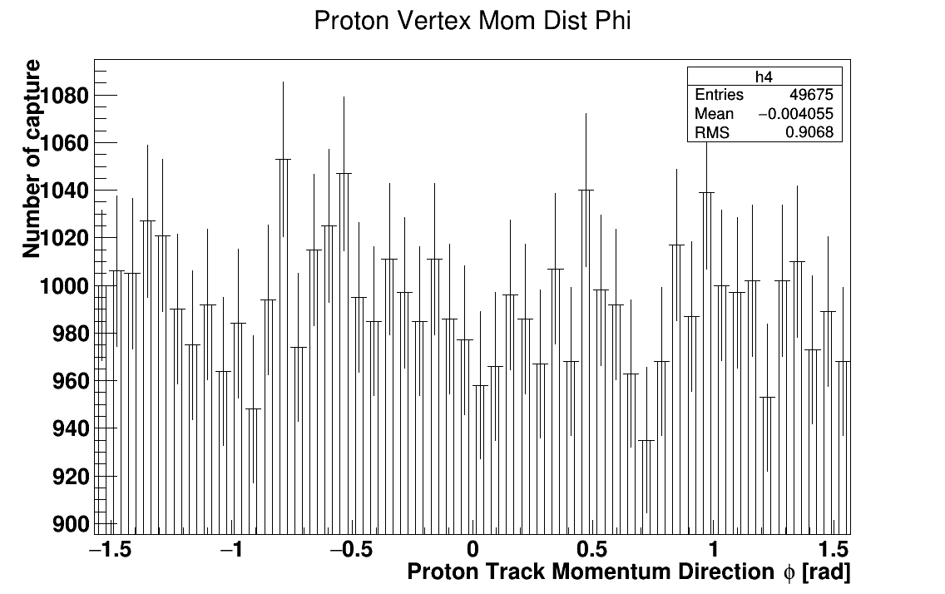
Proton Track Momentum Direction Distribution

Slide 20
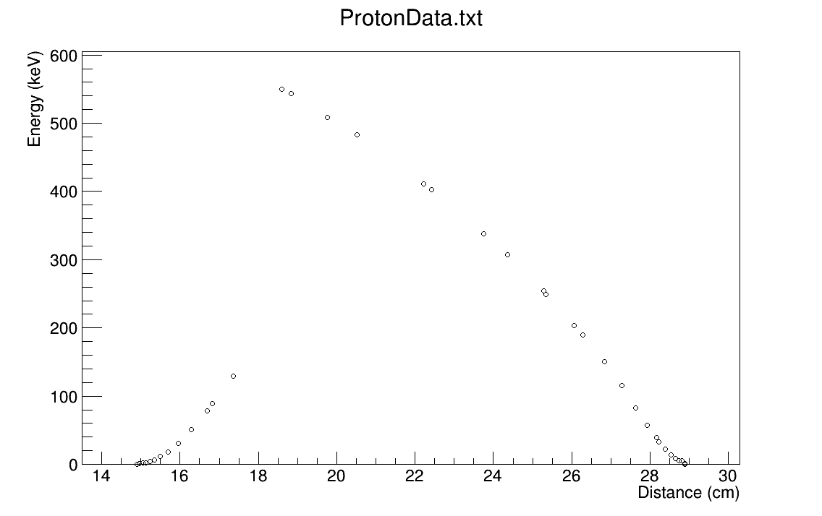
Energy vs distance
Proton
Triton
vertex

Slide 21
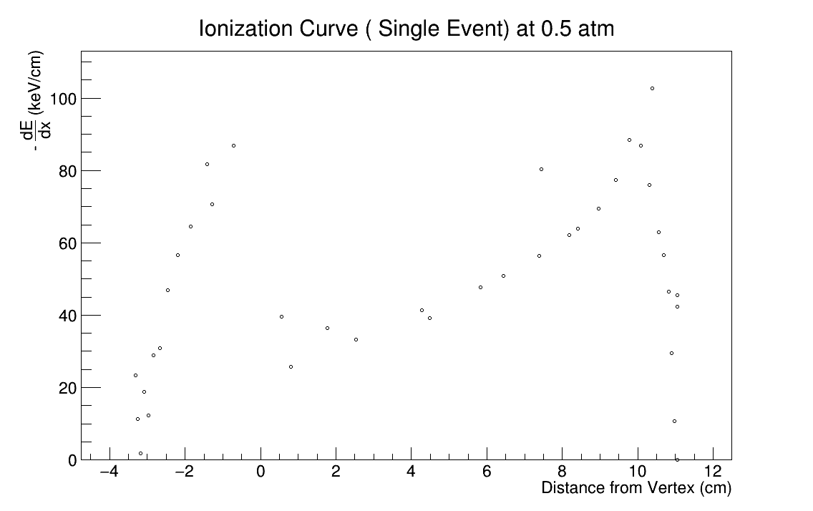
Ionization Curve
Triton
Proton
vertex

Slide 22
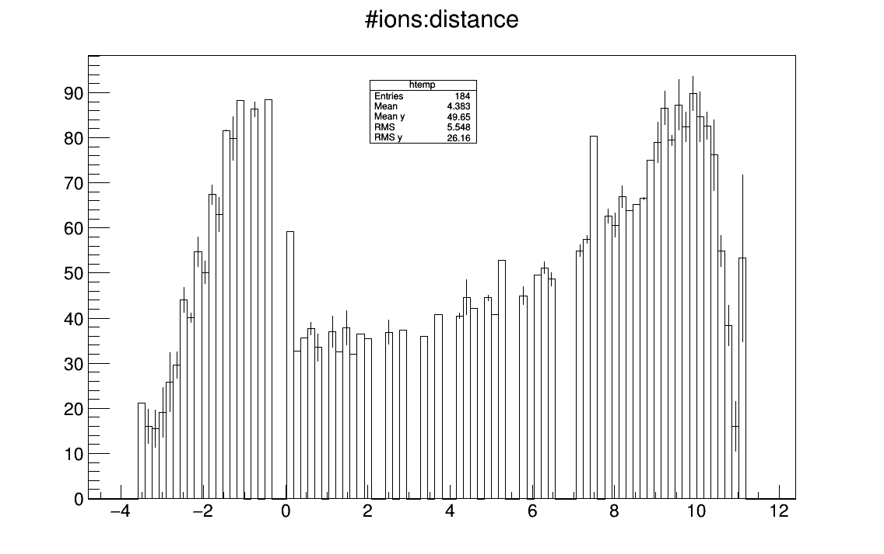
Ionization Curve (10 events)
-dE/dx
(keV/cm)
Triton
Proton
Distance from vertex [cm]
vertex

Slide 23
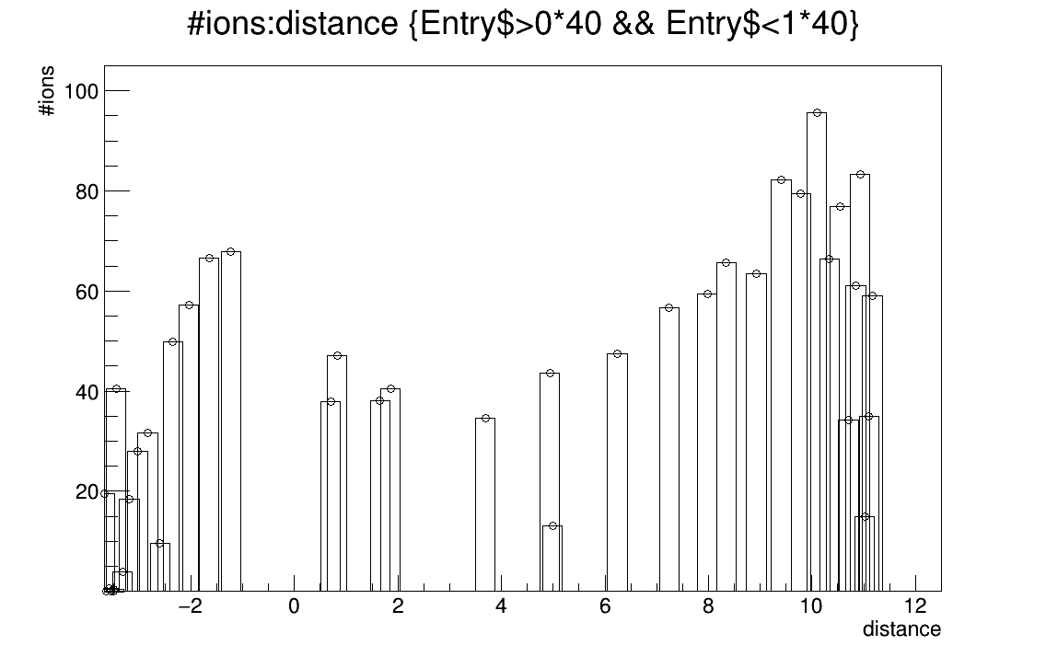
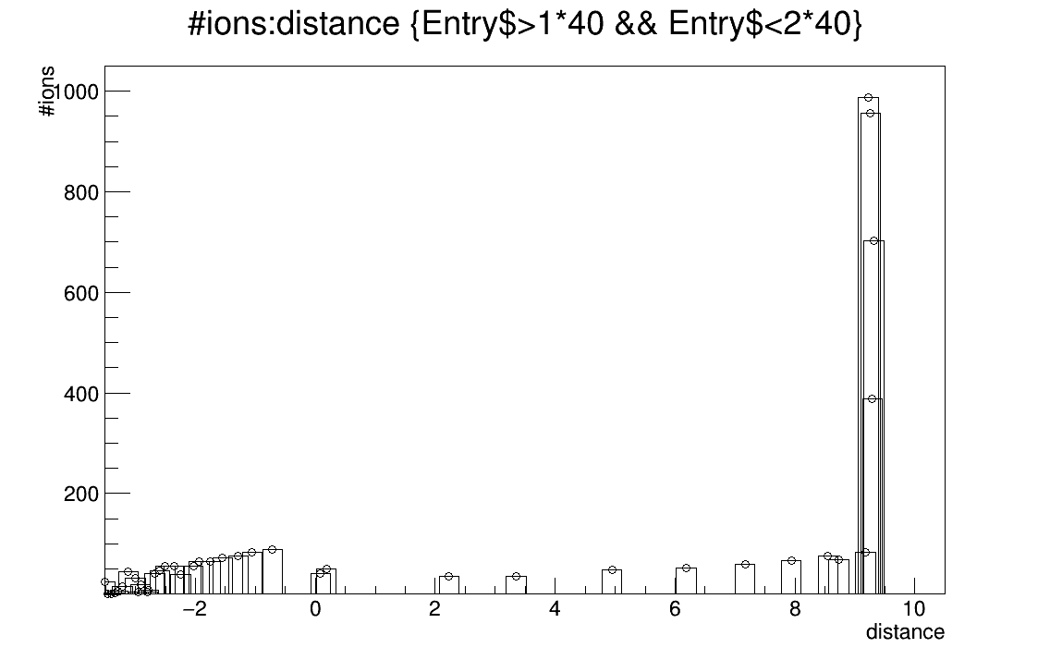
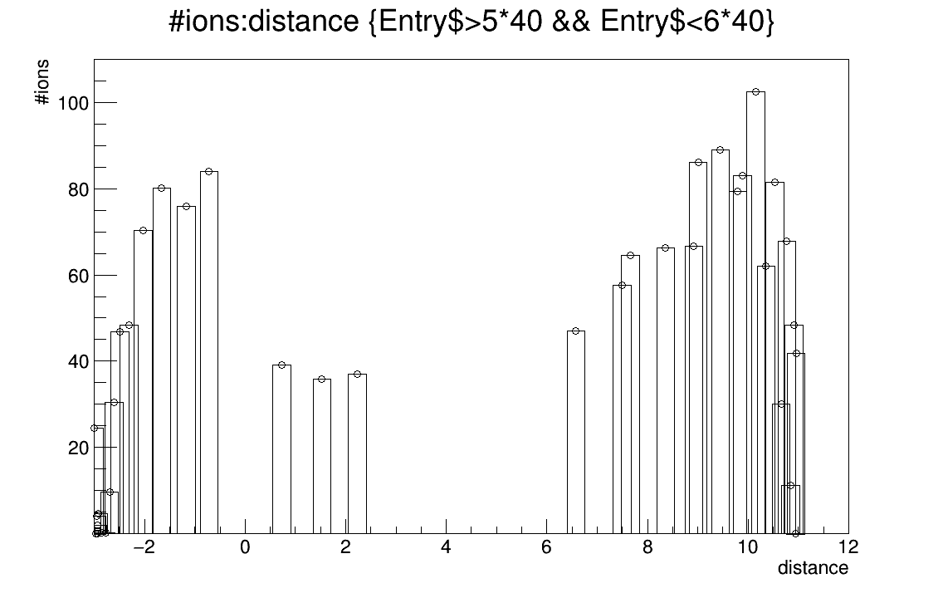
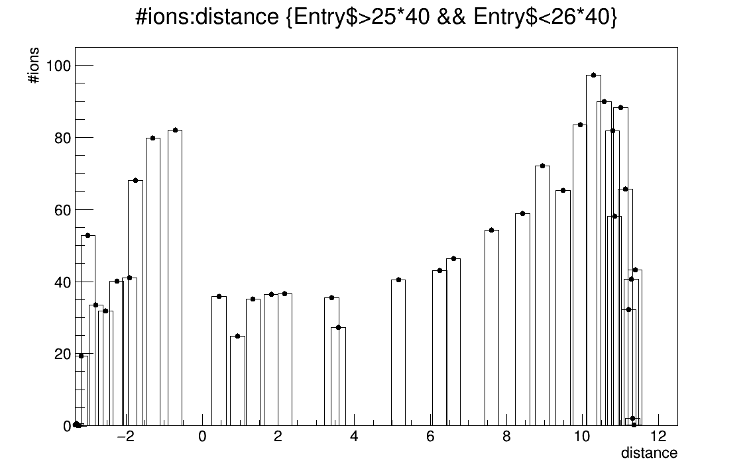
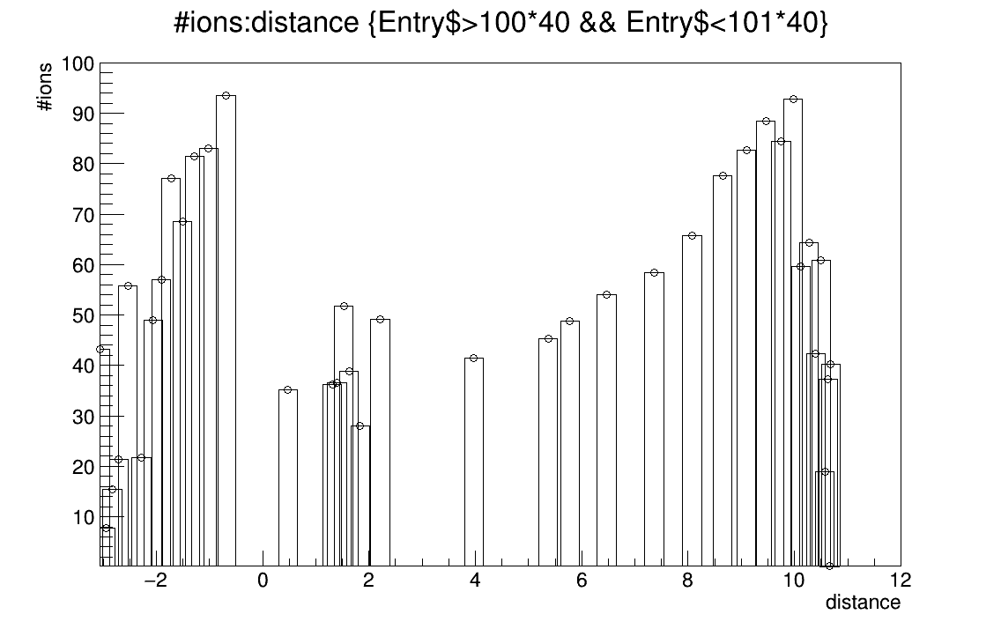
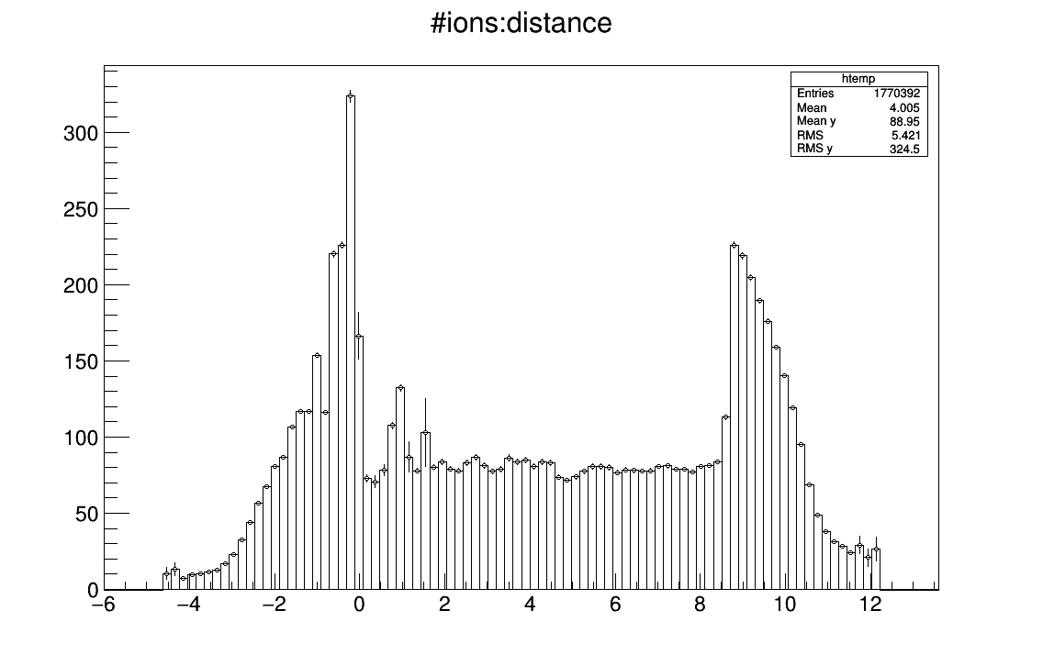
Ionization curve for different events
Event#1
Event#2
Triton
Event#6
Triton
Proton
Triton
Proton
Triton
Event#26
Triton
Event#101
Proton
Proton
Prof hist of 50K events
Triton
Proton

