Slide 1
The n-³He Simulation Using Geant4
A Prototype Version
(The slides include some animations and might require presentation mode)
Latiful Kabir
n-³He Weekly Meeting
October 24th 2016

Slide 2
Overview of Geant4
Steps :
1. Construct Materials and Detector :
G4VUserDetectorConstruction
2. Construct Primary Events Generator :
G4VUserPrimaryGeneratorAction
3. Implement Physics :
G4VUserPhysicsList
4. Scoring / Extract Useful Information :
G4Run , G4UserRunAction, G4UserEventAction,
G4UserTrackingAction etc.
5 . Customize run /events

Slide 3
Assumptions for this presentation:
Simple Geometry
Simple Beam Profile : Pencil beam

Slide 4
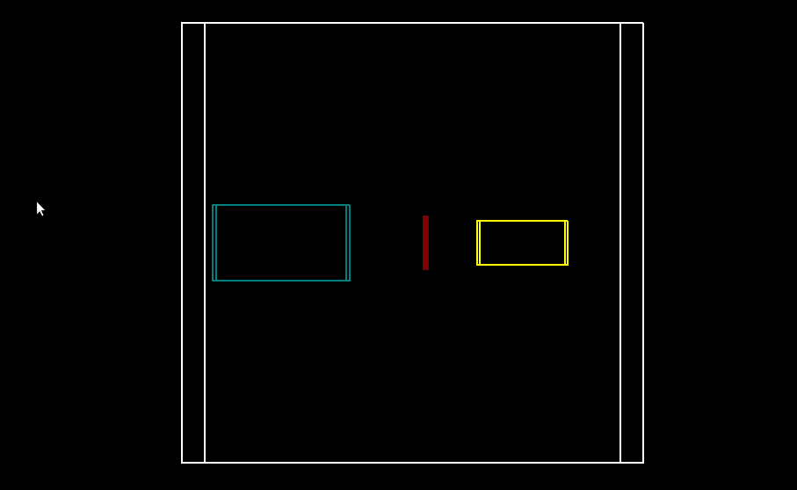
1. The Geometry and Materials
Y
z
X

Slide 5
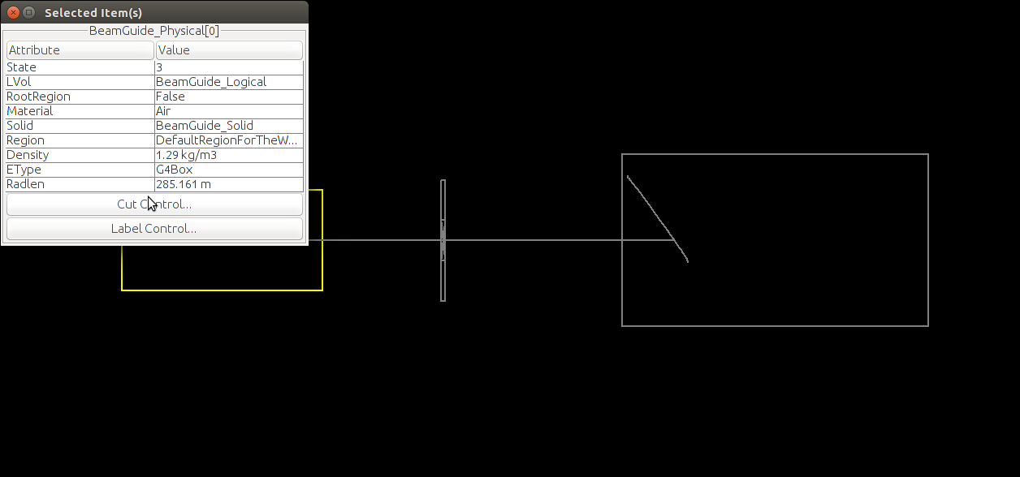
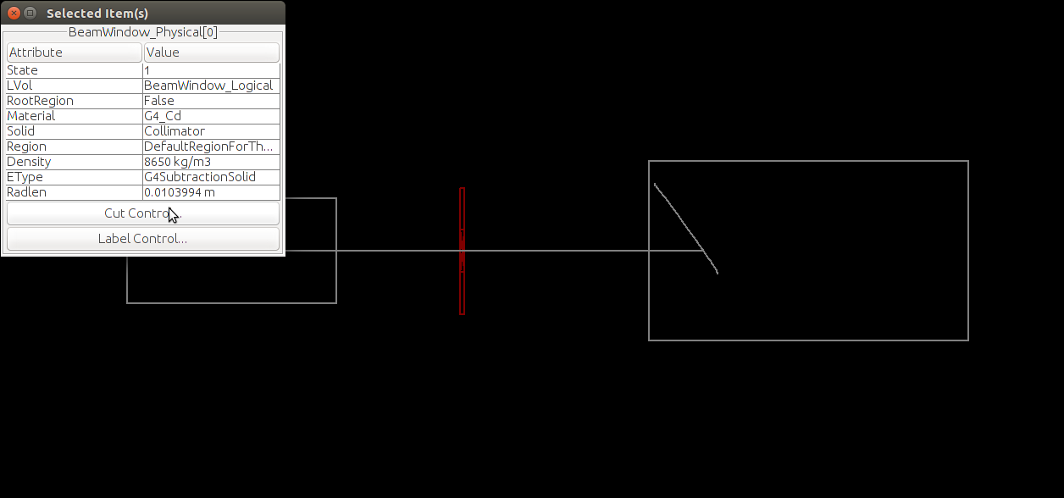
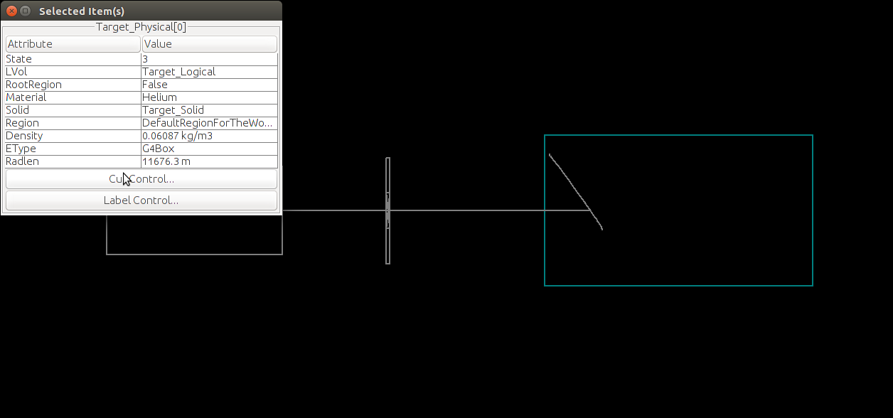
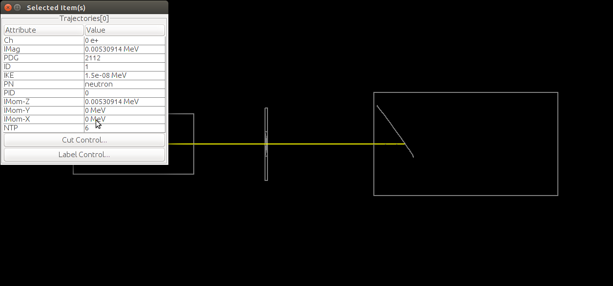
1 & 2. The Geometry and Materials with beam

Slide 6
3.The Physics
Modular based physics list from Geant4 is used : QGSP_BERT_HP
QGSP_BERT_HP Stands for ----
QGS: Quark Gluon String Model ( > ~ 20 GeV )
P : G4Precomputed model used for de-excitation.
BERT : Bertini-style cascade ( < ~ 10GeV )
HP : High Precision neutron model (< 20 MeV).

Slide 7
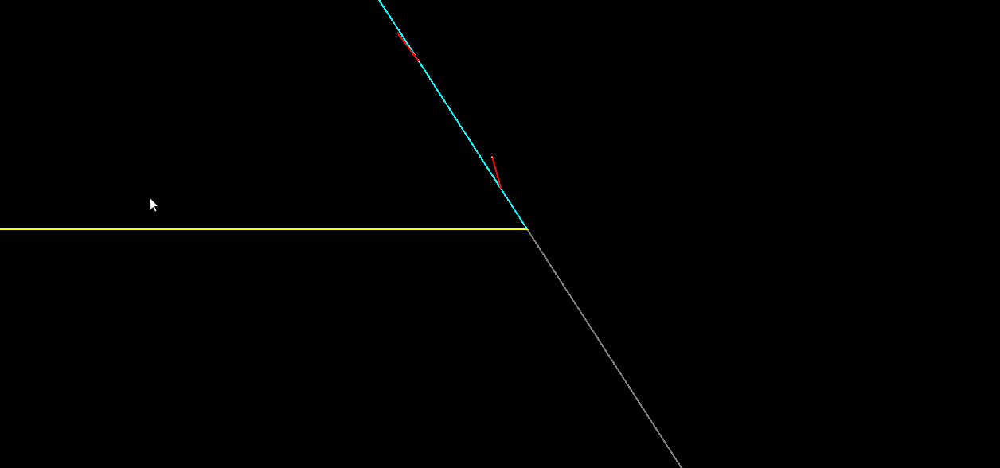
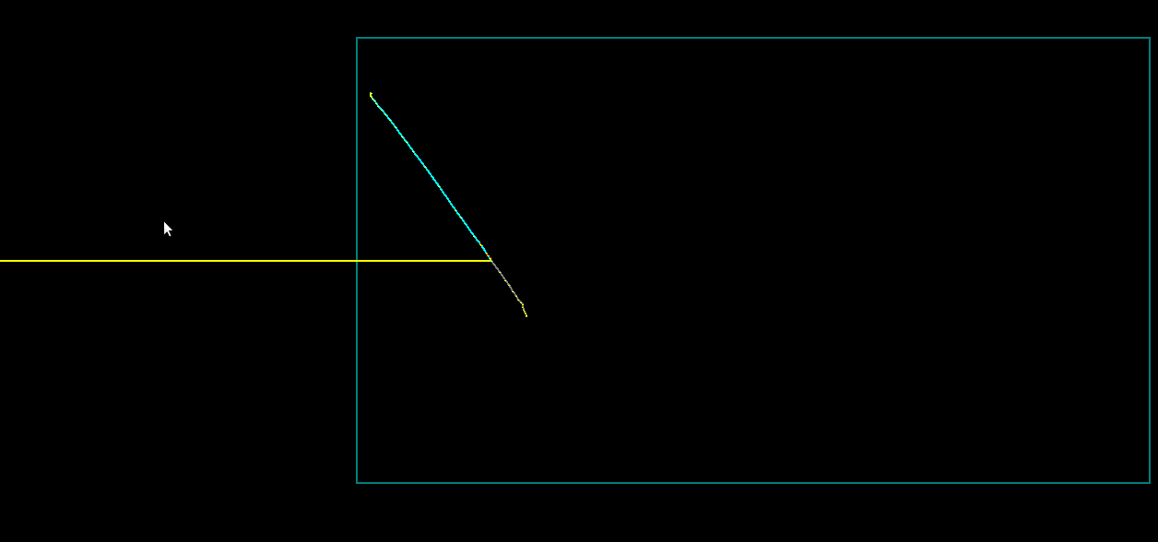
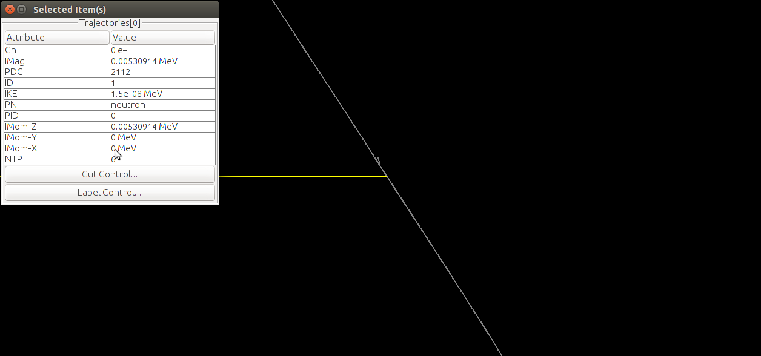
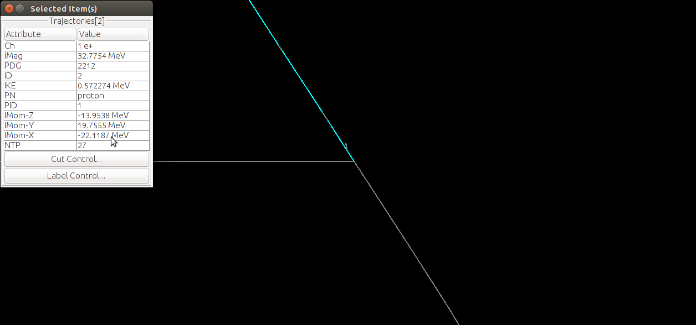
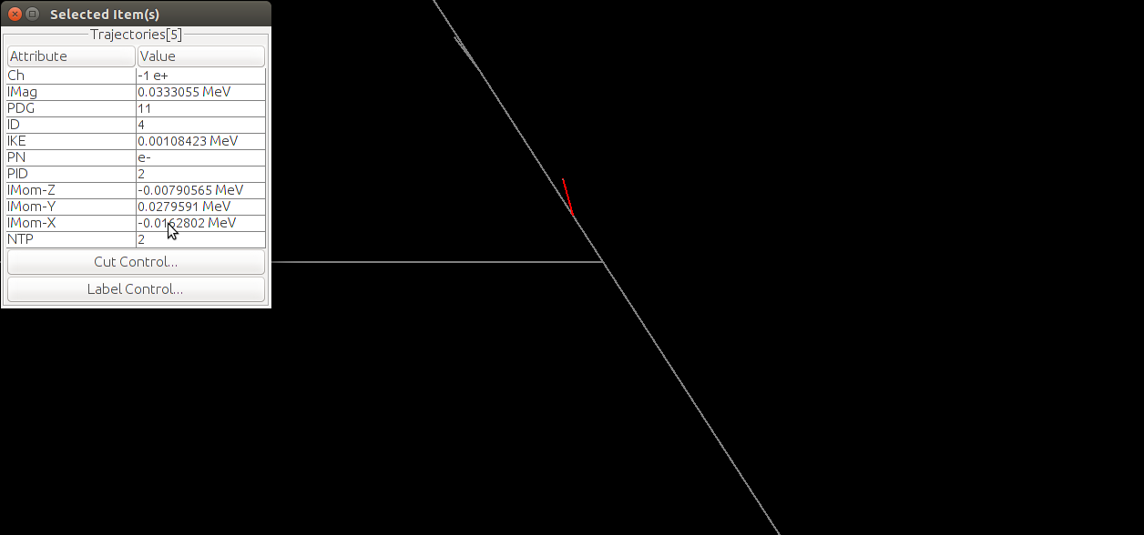
3.The Physics
Physics Here

Slide 8
3.The Physics : Accumulated Events

Slide 9
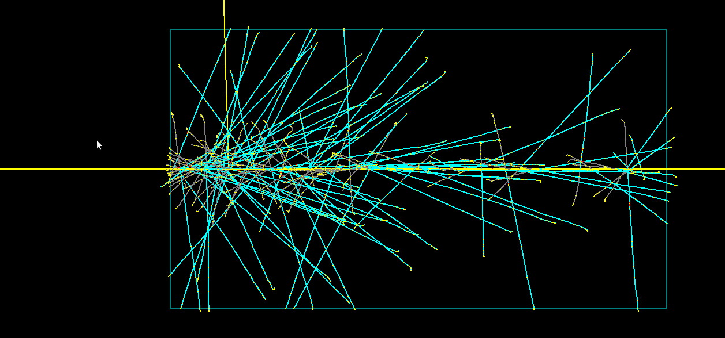
3.The Physics : Accumulated Events

Slide 10
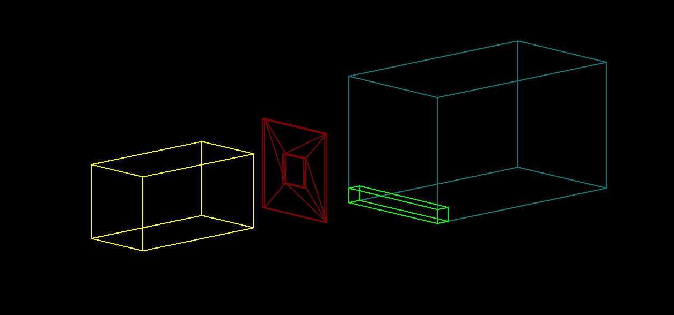
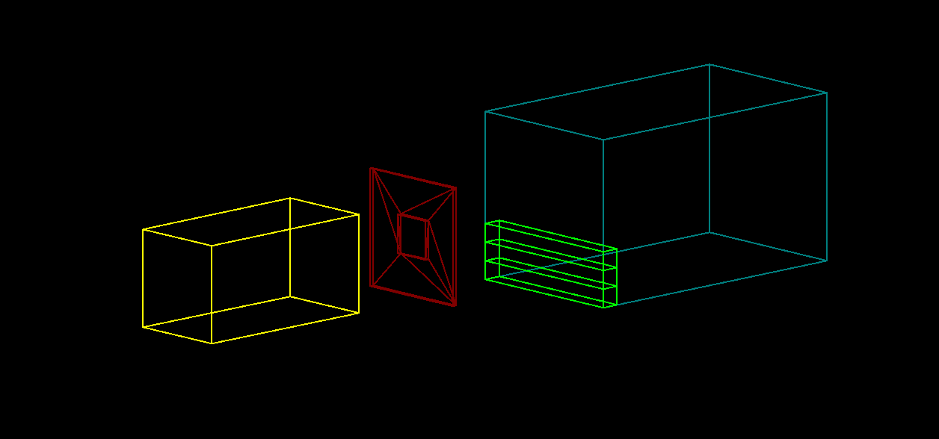
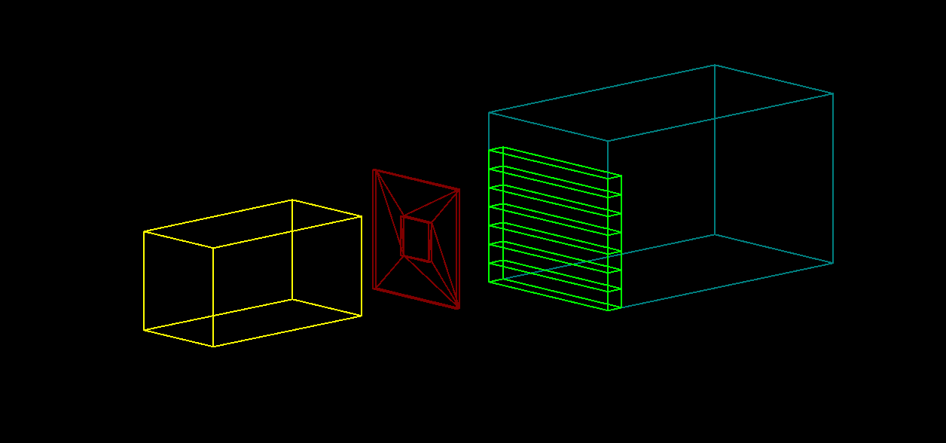
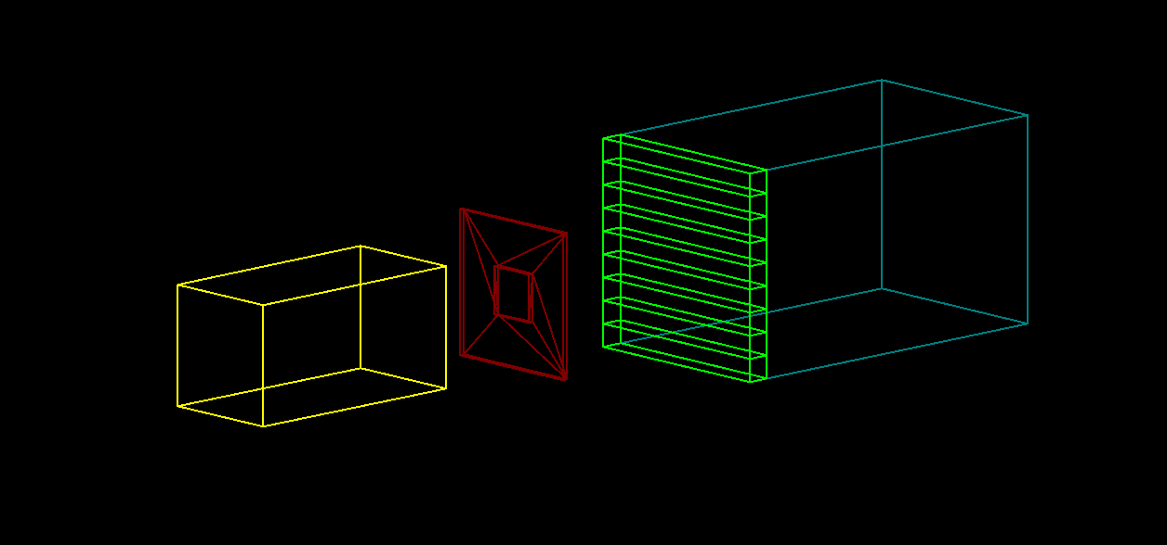
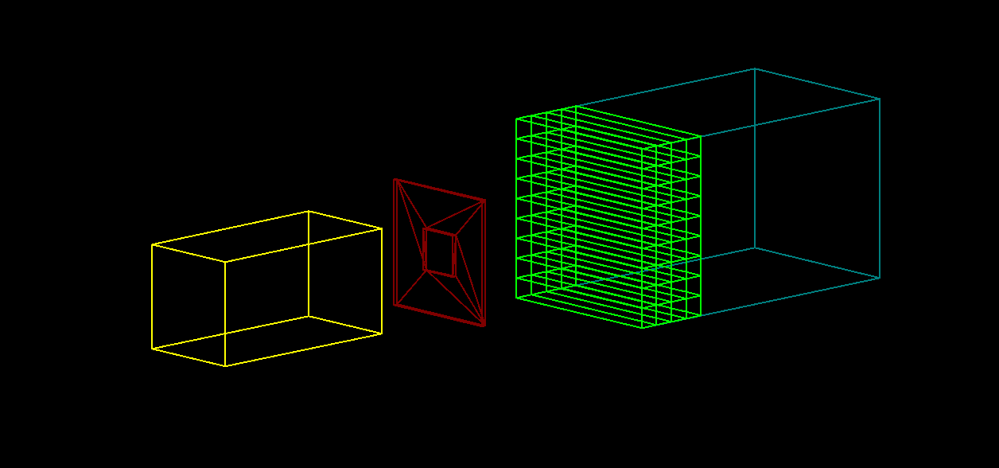
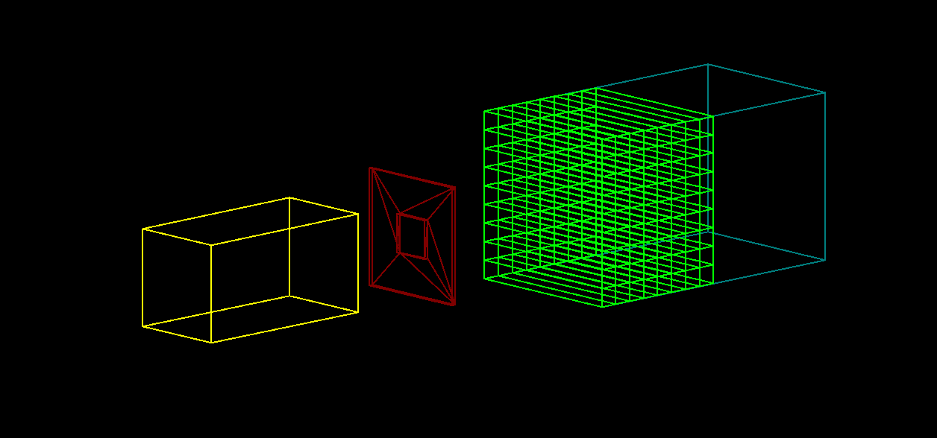
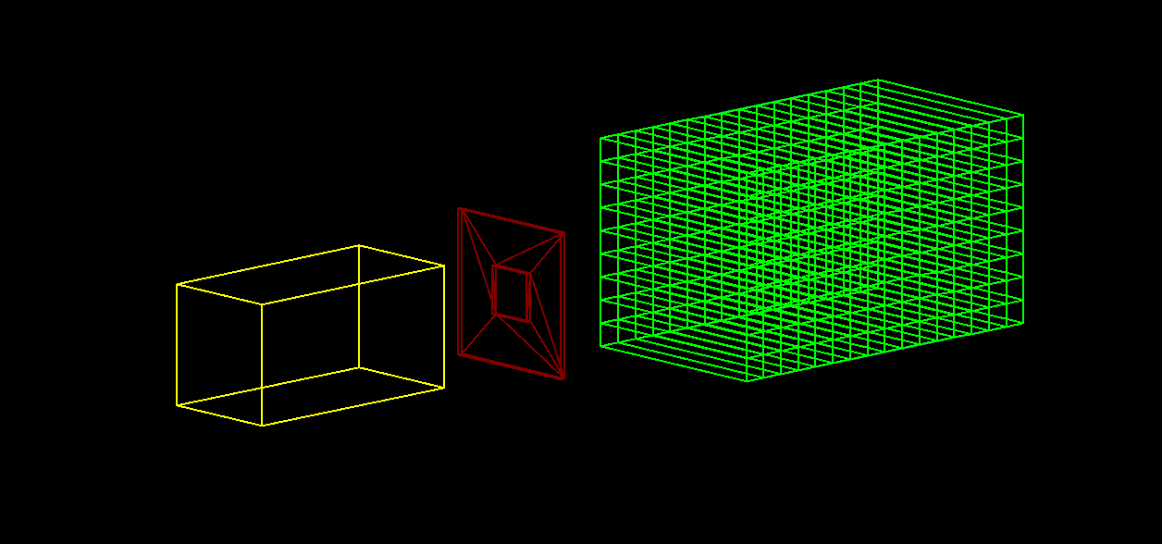
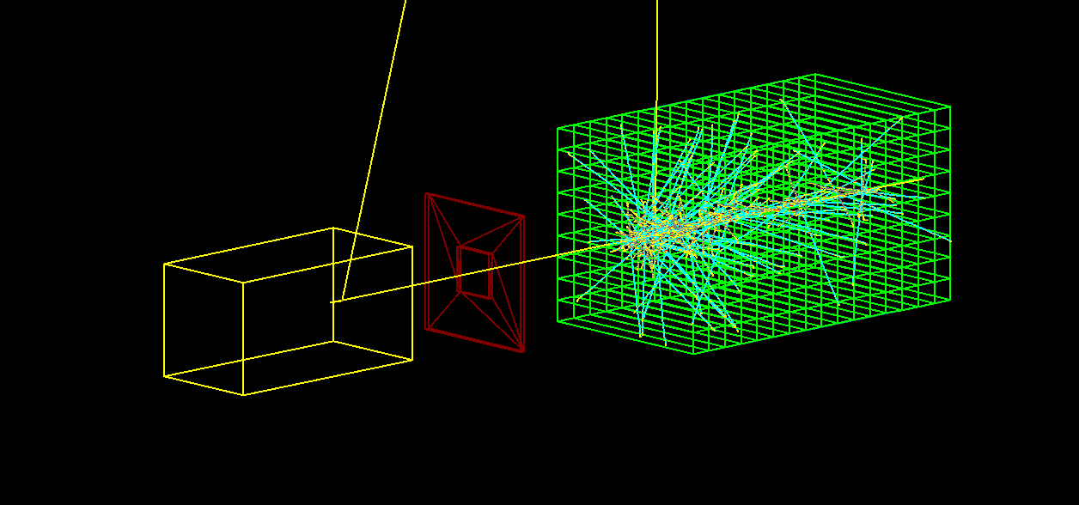
4. The Scoring : The Sensitive Volume (Detector)
10

Slide 11
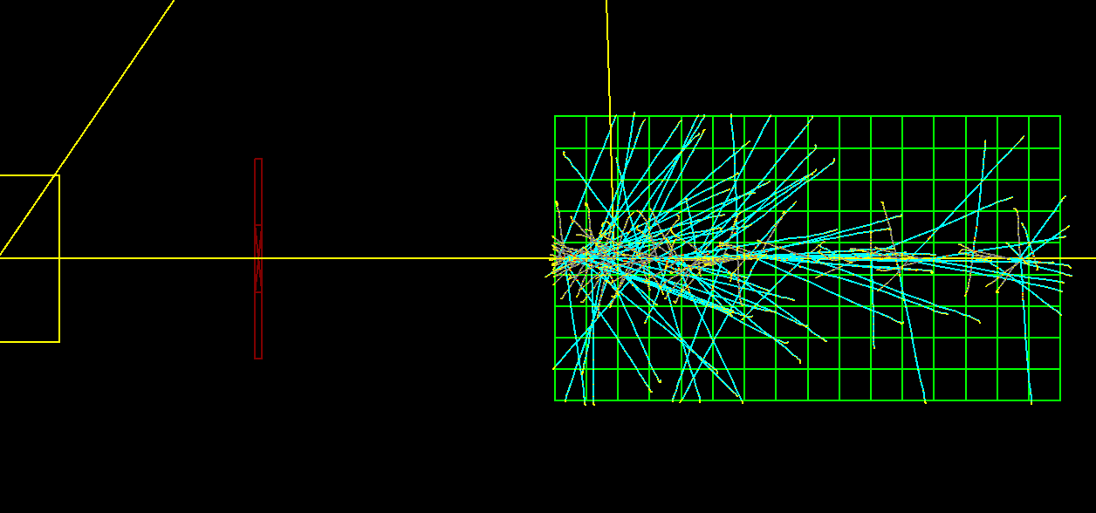
A prototype version of the experiment
11

Slide 12
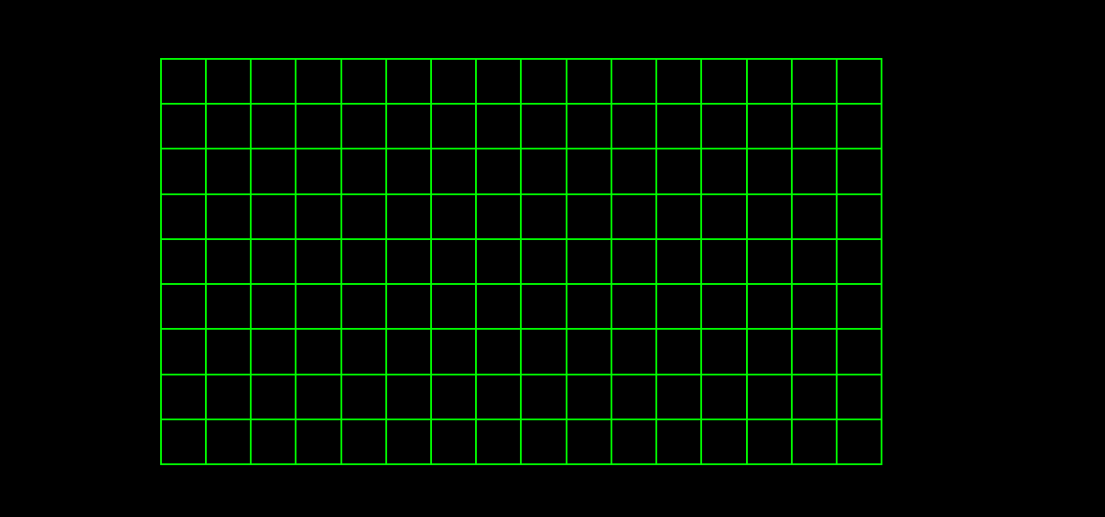
Wire (Cell) Labeling and Scale
30.4cm
W8
1.9cm
1.9x9 cm
W1
W0
L0
L1
L2
L15

Slide 13
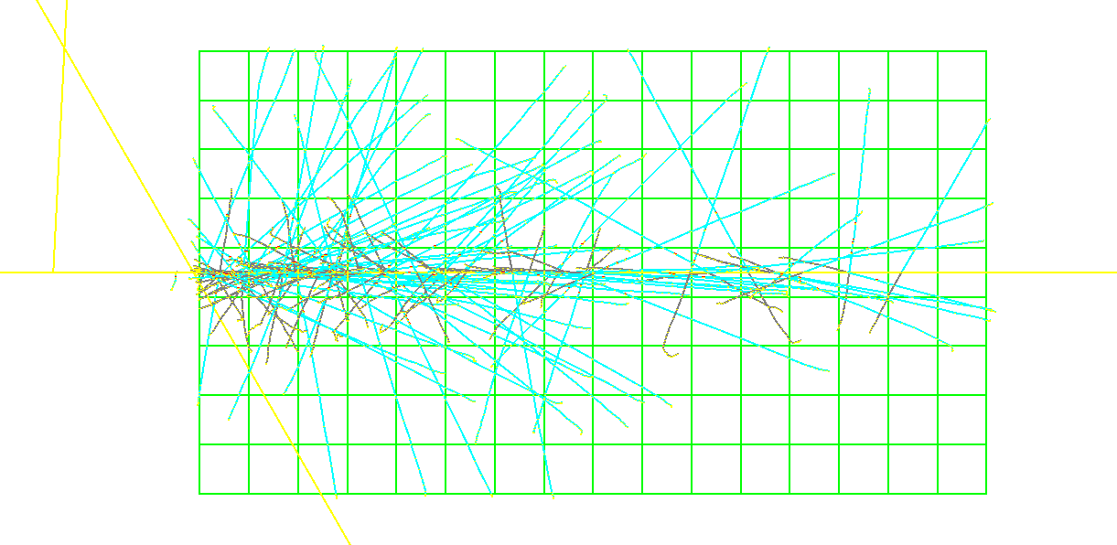
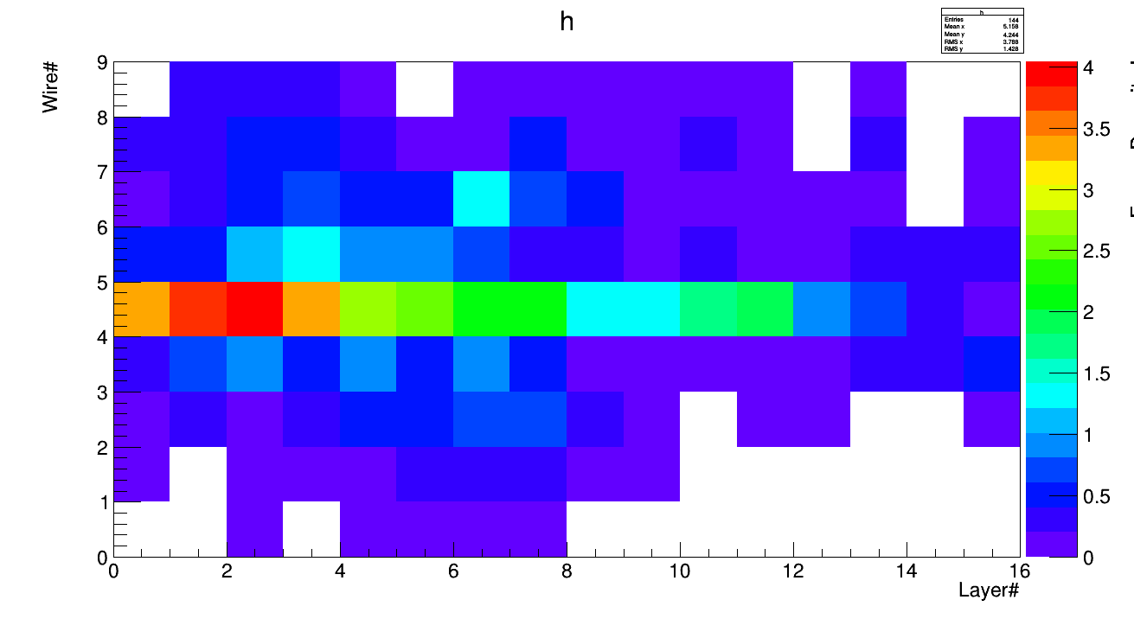
4. Scoring : Energy Deposition – 100 Events

Slide 14
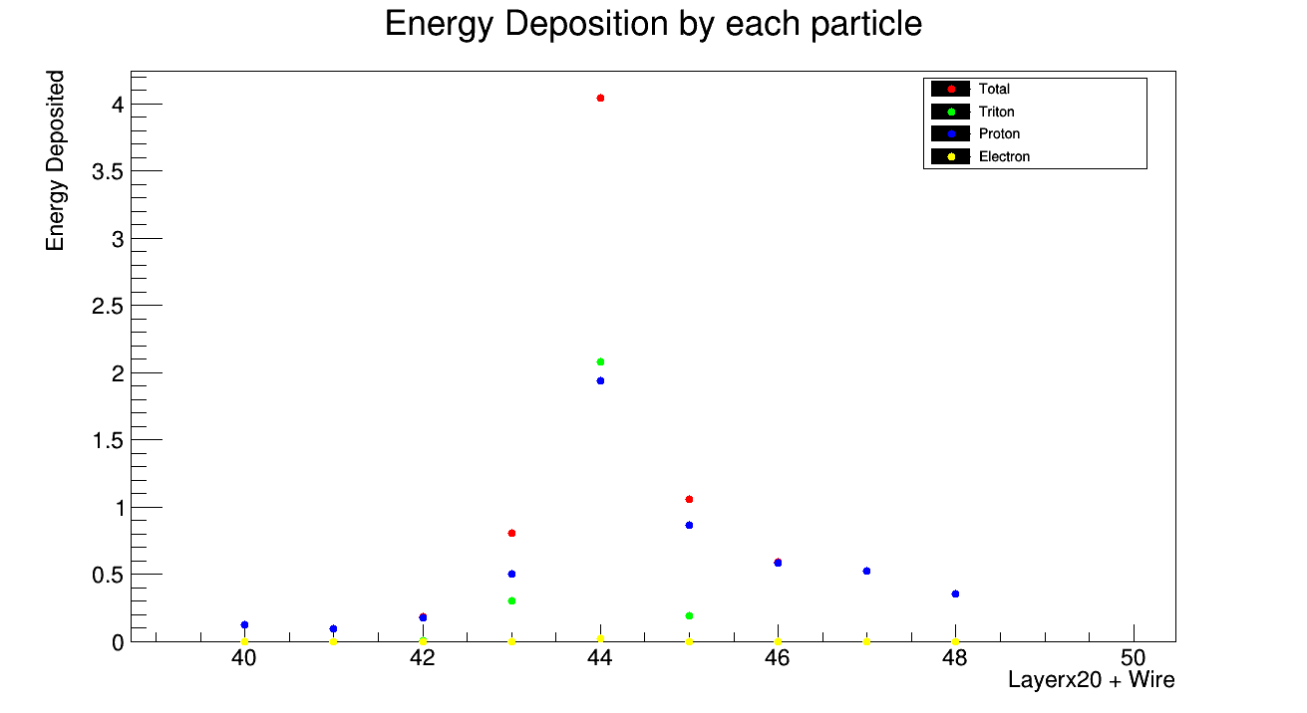
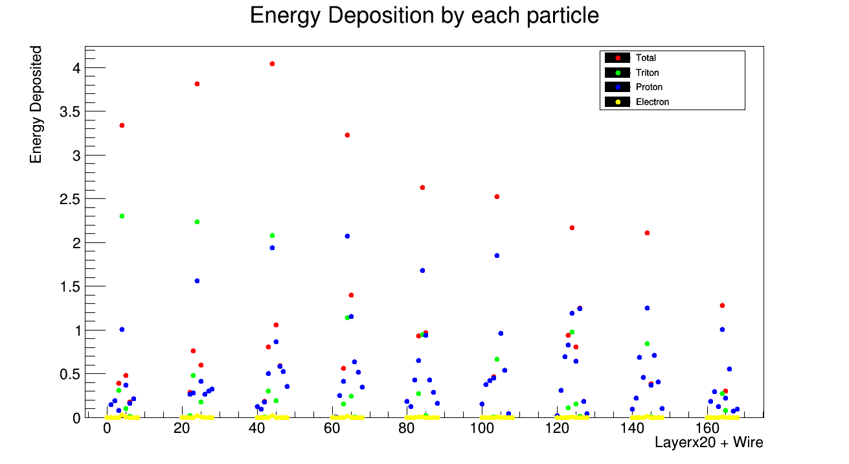
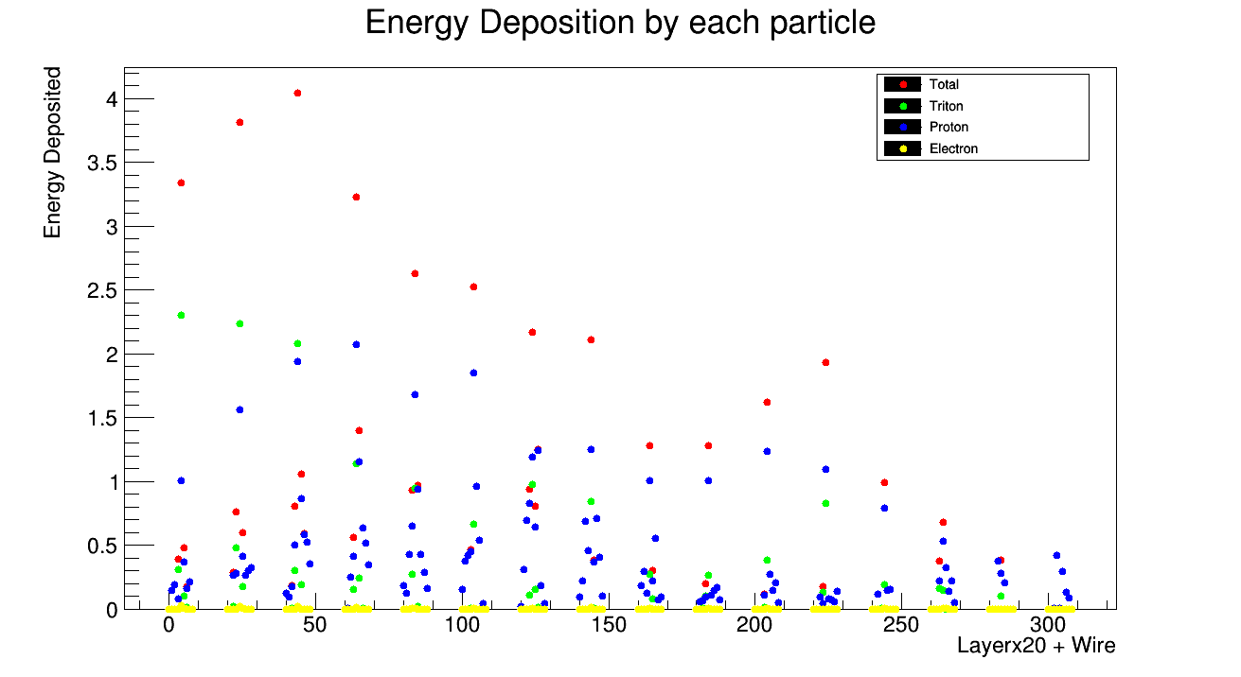
Energy deposition in the cells by each particle

Slide 15
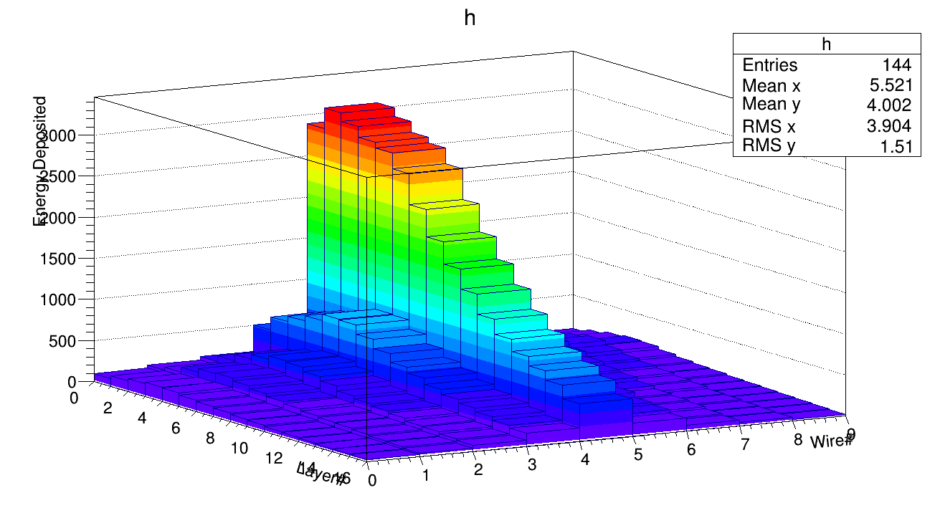
Distribution of total energy deposited in the cells – 10⁵ Events

Slide 16
Summary and future plan
Have a prototype simulation of the n-³He experiment using Geant4.
Things to be done
-- Extract track information.
-- Do other sanity check.
-- Compare with scan data.
-- If all go well, calculate the geometry factors.

