Slide 1
Scattering States
Deborah Ferguson, David Bowles, Zac Helton

Slide 2
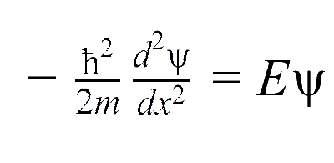
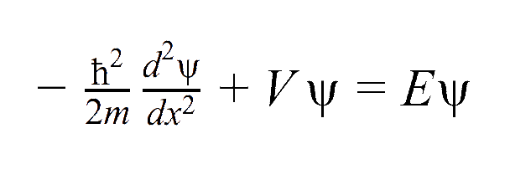
Free Particle
Time independent Schrödinger equation with zero potential
Time independent Schrödinger equation with nonzero potential

Slide 3
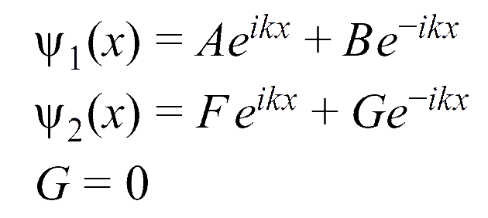
Delta Potential

Slide 4
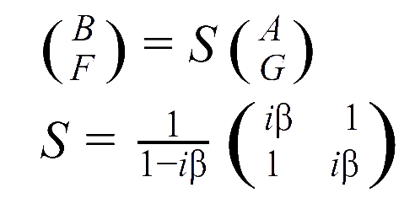
Delta Potential Scattering Matrix
Ψ must be continuous
A+B=F+G
dΨ/dx must be continuous where the potential is not infinite

Slide 5
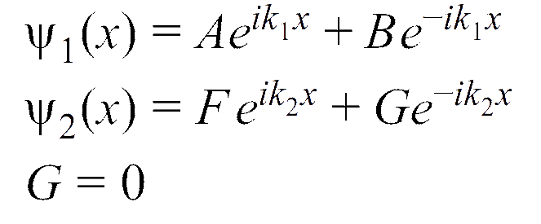
Step Potential

Slide 6
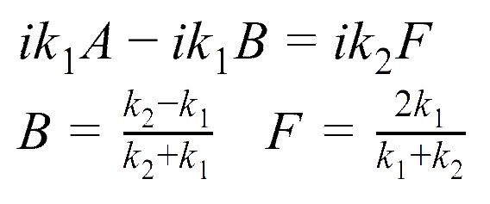
Step Potential Scattering
Ψ must be continuous
A+B=F
dΨ/dx must be continuous where the potential is not infinite

