Slide 1
TISE: Solution Eigenfunctions of various Potentials
PHYS 520
Group 4: Connor Johnstone, Jacob Hempel, and Amber Moore

Slide 2
Abstract
Preliminaries
Infinite Square Well Applet
Harmonic Oscillator Applet
Delta-Function Applet
Finite Square Well Applet

Slide 3

Preliminaries: Time Independent Schӧdinger Equation:
$$\frac{−ℏ^{2}}{2m}∗\frac{d^{2}Ψ\left(x\right)}{dx^{2}}+V\left(x\right)Ψ\left(x\right)=E_{n}Ψ_{n}\left(x\right)$$
Step 1
Step 3
Step 4
Write down with respect to potential of interest
$\frac{dΨ}{dx}$ continuous everywhere except where potential is infinite
𝑑Ψ/𝑑𝑥 continuous everywhere except where potential is infinite
Step 2
$Ψ\left(x\right)$continuous everywhere
Ψ(𝑥) continuous everywhere
Write final solution
Normalize to find any coefficients

Slide 4

Preliminaries: Potentials
Infinite Square Well
  $V\left(x\right)=\left\{\begin{aligned}0, \\ ∞,\end{aligned} {0≤x≤a \atop otherwise}\right.$
Harmonic Oscillator
  $V\left(x\right)=\frac{1}{2}mω^{2}x^{2}$
Delta-Function
  $V\left(x\right)=−αδ\left(x\right)$
Finite Square Well
  $V\left(x\right)=\left\{\begin{aligned}−V_{0}, \\ 0,\end{aligned} {−a≤x≤a \atop \left|x\right|>a}\right.$

Slide 5
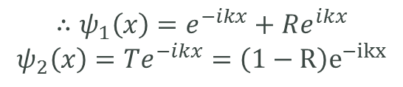
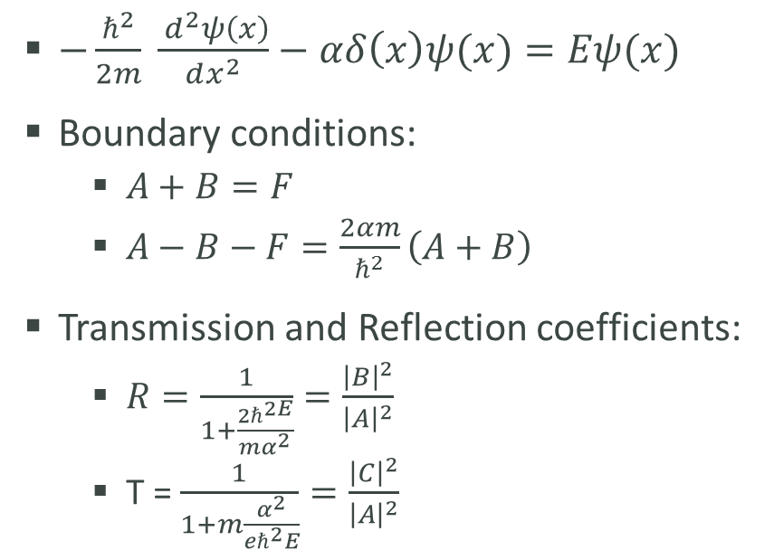
Example: Delta-Function
Scattering States
$−\frac{ℏ^{2}}{2m} \frac{{ d}^{2}ψ\left(x\right)}{dx^{2}}−αδ\left(x\right)ψ(x)=Eψ(x)$
Boundary conditions:
  $A+B=F$
  $A−B−F=\frac{2αm}{ℏ^{2}}\left(A+B\right)$
Transmission and Reflection coefficients:
  $R=\frac{1}{1+\frac{2ℏ^{2E}}{mα^{2}}}=\frac{{\left|B\right|}^{2}}{{\left|A\right|}^{2}}$
  T = $\frac{1}{1+m\frac{α^{2}}{eℏ^{2}E}}=\frac{{\left|C\right|}^{2}}{{\left|A\right|}^{2}}$
$$∴ψ_{1}\left(x\right)=e^{−ikx}+Re^{ikx}$$
$$ψ_{2}\left(x\right)=Te^{−ikx}=\left(1−R\right)e^{−ikx}$$

Slide 6
Applet Links
Infinite Square Well: 520 Infinite Well.nb
Harmonic Oscillator: Project Applet SHO Final.nb
Delta-Function: delta_function_solution_manipulationplot (1).nb
Finite Square Well: 520 Finite Well.nb, 520 Finite Well 2.nb

Slide 7
Works Cited
Griffiths, David J. Introduction to Quantum Mechanics. Pearson, 2005. Print.

