Slide 1
Time Dependent Schrödinger Equation: Evolution of Wave-functions in potentials
Austin Hinkel
Allyn Goatley
Daniel Eigelbach

Slide 2
Theory
The Time Dependent Schrödinger Equation details the evolution of a wave-function in a potential with time.
This is really just a representation of conservation of energy.
The potentials enforce certain boundary conditions on the spatial wave function that lend themselves to quantization of that wave function.

Slide 3
Theory Cont’d
Additionally, the equation admits a Time Independent solution as well as a time-dependent solution via separation of variables. The wave function is the product of these two solutions.
The superposition of states is the conglomerate of many different states, each with a given weight or “probability amplitude.”

Slide 4
Learning Objectives
Using the simple 1-dimensional infinite square well potential, users can build an intuitive understanding of the time evolution of the quantized sinusoids.
Building on this simple understanding, users can step up their potential game (step-potential pun intended) and work with the Quantum Harmonic Oscillator.
On both potentials, users will gain understanding of the superposition and time-evolution of quantized states that is difficult to convey through other means.

Slide 5
SIMULATION
For each potential, our simulation allows for the adjustment of the weight (amplitude), energy level (shape), and time-evolution of up to 3 physical states/wave functions, to observe the affect each characteristic has on a superposition of these states. In general, the superposition is a linear combo of weighted, physically-allowed states:
$$ψ\left(x,t\right) = c_{1}ψ_{1,n}\left(x\right)e^{−\frac{iE_{n}t}{ℏ}} + c_{2}ψ_{2,m}\left(x\right)e^{−\frac{iE_{m}t}{ℏ}} + c_{3}ψ_{3,l}\left(x\right)e^{−\frac{iE_{l}t}{ℏ}}$$

Slide 6
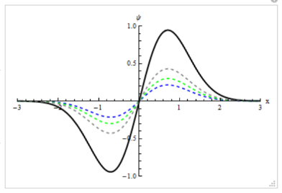
SIMULATION Cont’d
This example, from the infinite square well potential, shows how our simulation may be used to examine how adjusting the energy levels of states affects the shape of the superposition of these states.
Our simulation may be used to examine how adjusting the weights (amplitudes) of states affects the amplitude of the superposition, as in this example from the quantum harmonic oscillator potential case.

Slide 7
SIMULATION CONT’D
To observe time-evolution of the superposition of states, let’s go to the actual simulation…

Slide 8
The end. Thank you!
A+ !!!

