Slide 1
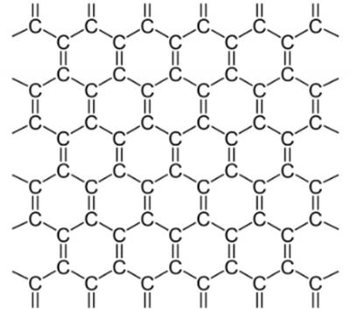
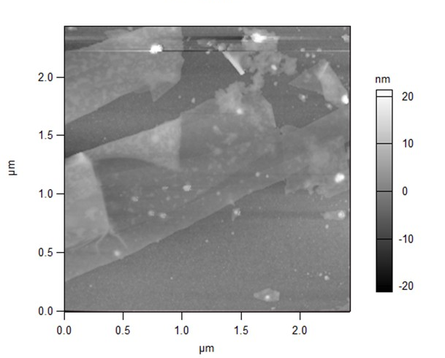
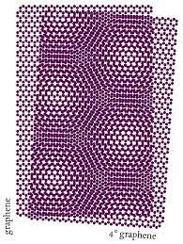
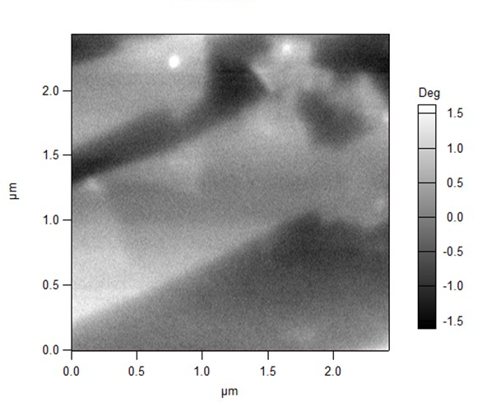
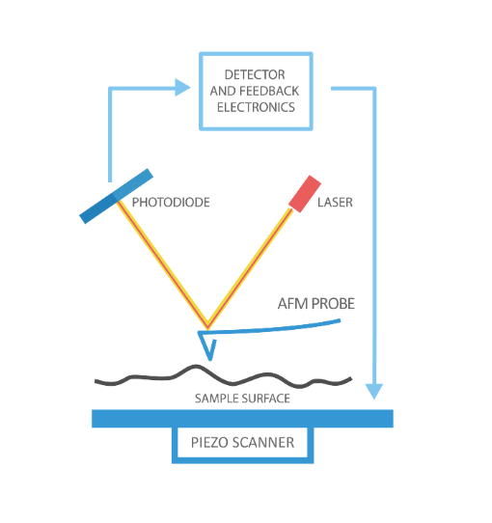
Probing Interfaces between Two-dimensional Van Der Waals Materials with Scanning Probe Microscopy
Andrew J. Tompkins, Kathryn A. Pitton, and Dr. Douglas R. Strachan, University of Kentucky, Department of Physics and Astronomy, Lexington, KY, 40505
Introduction
Van der Waal materials are the atomically thinnest materials in the world, with some being one atom thick, and have superb conductivity, allowing them to potentially revolutionize electronics. Stacking these 2D plane-like materials (2-3 layers) alter the electrostatic properties, creating a new avenue for quantum materials. Twisting the top or bottom layer creates Moiré lattices, a phenomena occurring from the mismatch of lattices structures that transforms coupling in the layers. If the Moiré patterns can be better understood, so could the coupling.
Graphene is the most interesting material due to its zero-bandgap structure, allowing for free-flowing in-plane electrons. Rotating the stacked graphene layers causes defects that have different electrostatic properties to appear within the layers. Like the Moiré patterns, studying these defects is key to understanding graphene.
AFM & EFM Measurements
The AFM tip acts as a Driven Harmonic Oscillator with a force gradient, the tip-sample interaction. The amplitude and phase shift are important values and can be derived.
$$ΣF=−kx+ β\dot{x}+F_{0}e^{−iωt}(f_{s}x+ f_{0})=m\ddot{x}$$
Where $−kx$ is Hooke’s Law, $β\dot{x}$ is the damping force, $F_{0}e^{−iωt}$ is the driving force, $f_{s}x$ is the tip-sample force gradient, $f_{0}$ is a constant force, and $m\ddot{x}$ is Newton’s second law . Solving this differentiable equation with the trial solution$A_{1}e^{−iωt}+A_{0}$ yields
$$\left|A_{1}\right|= \frac{F_{0}}{\sqrt{{(k−f_{s}−ω^{2}m)}^{2}+ {(ωβ)}^{2}}}$$
$$\left|A_{0}\right|= \frac{f_{0}}{k−f_{s}}$$
with the phase shift being
$$\tan\left(φ\right)= \frac{ωβ}{k− f_{s}−ω^{2}m}$$
There are multiple phase shift when working with the AFM, more specifically the phase shifts between the sample and ground plane (see Figure 4). Taking the difference between these two shifts gives
$φ_{s}−φ_{g} ≅ \frac{{f′}_{s}−{f′}_{g}}{kβ}$
When the tip is induced with a voltage, the tip-sample interaction acts as a parallel-plate capacitor, as seen in figure*. Using the fundamental equation of capacitance, the force gradient from the sample acting on the plates gives
$${f′}_{s}=\frac{1}{2}C′′{(ΔV)}^{2}$$
where ${f′}_{s}$ is the force gradient from the sample, $C^{′′}$ is the second derivative of capacitance with respect to distance between the tip and sample surface and $ΔV$ is the applied voltage. A connection between the above equation and the difference phase shifts is present, giving.
$φ_{s}−φ_{g} ≅ \frac{1}{2}\frac{{\left(ΔV\right)}^{2}}{kβ}({C′′}_{s}−{C′′}_{g})$
Data
The top image is an AFM scan of few layer graphene. The lighter the contrast, the thicker the sample is however, the white specs are artifacts. Understanding the sample’s surface is a priority before gauging the electrostatic potentials with EFM. Since there are folded layers within this sample, using EFM would prove useful.
The bottom picture is the respective EFM scan. The tip and sample induces an electric field that creates a force gradient that shifts the resonance frequency of the cantilever by some degrees. The higher the shift, the more attractive the force is.
1
Figure 1a. Lattice structure of graphene that, when twisted, create Moiré patterns seen in Figure 2a.
Figure 5a. AFM scan of FLG where the maximum x and y values are approximately 2.5 microns and the height of the sample is 20 nanometers.
2
Figure 5b. EFM scan of FLG where the maximum x and y values are approximately 2.5 microns and change in phase is between -1.5° and 1.5°. The more attractive forces have a higher degree shift.
Figure 1b. Moiré pattern of graphene due to the twisting of lattice layers. Better understanding these patterns will lead to major technological advances.
Methods
Van der Waal materials are the thinnest materials in the world, therefore human interaction is not possible. Atomic Force Microscopy (AFM) and Electrostatic Force Microscopy (EFM) are used to collect data from the stacked Van der Waal materials.
AFM uses a tip and cantilever that oscillates on the sample’s surface to map the topography of the surface. EFM uses the same tip to induce a voltage that scans across the surface at a fixed height, probing electrostatic properties.
Acknowledgments
This is work is funded in part by the National Science Foundation under grant PHY-1950795. The University of Kentucky, Department of Physics and Astronomy and the NSF made this work possible.
References
“Graphene: Structure and Shape | Graphene-Info.” Accessed August 9, 2022. https://www.graphene-info.com/graphene-structure-and-shape.
Ponor. English: Moiré Pattern Arising from the Superposition of Two Graphene Lattices Twisted by 4°. June 16, 2020. Own work. https://commons.wikimedia.org/wiki/File:Moire_of_twisted_bilayer_graphene.svg.
“What Is AFM? Learn about Atomic Force Microscopy! NanoAndMore.” Accessed August 9, 2022. https://www.nanoandmore.com/what-is-atomic-force-microscopy.
3
Figure 2. Simplistic overview of how an AFM works. The AFM probe is a cantilever that oscillates as the tip touches the sample surface. The photodiode senses the height of the oscillations via laser.
Figure 3. Pictorial description of sample and ground values. The phase shift for both values also depend on their force gradients.

