Slide 1
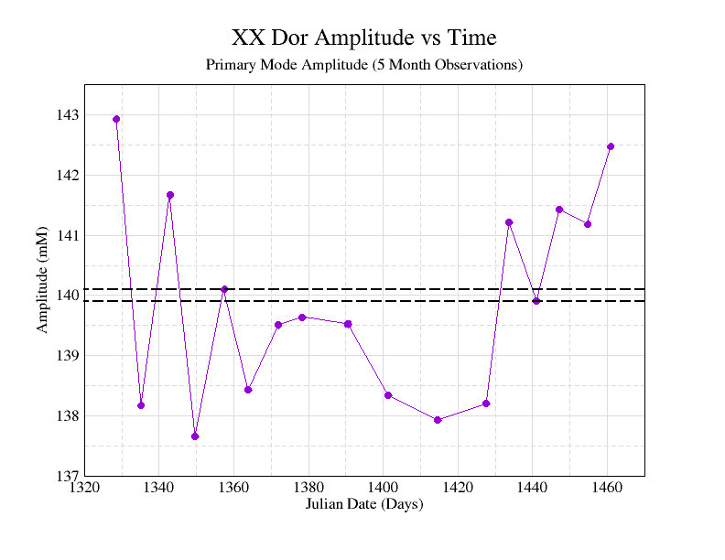
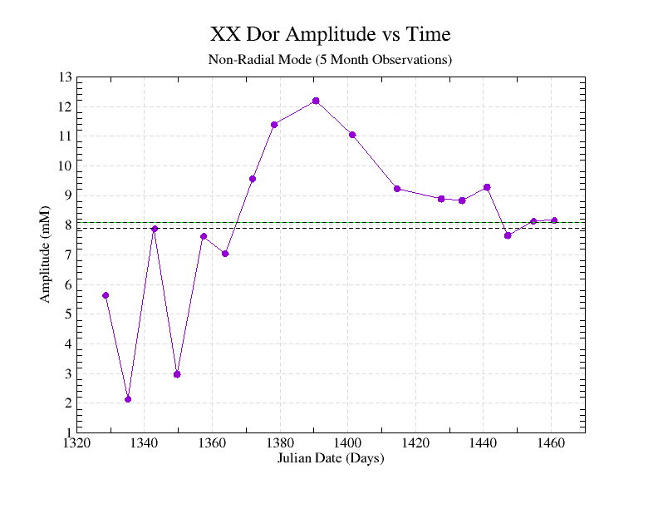
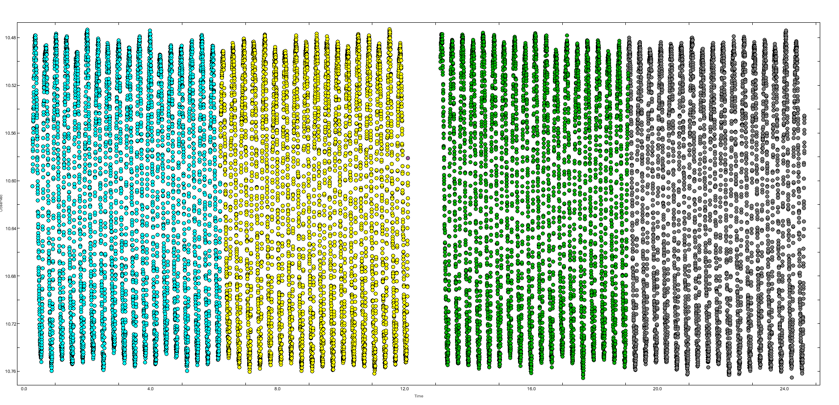
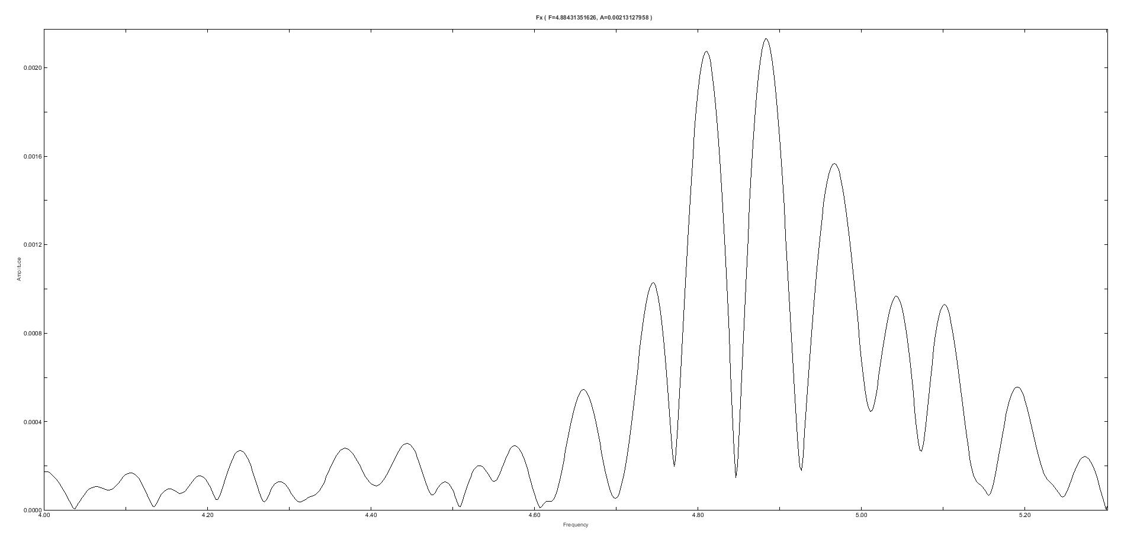
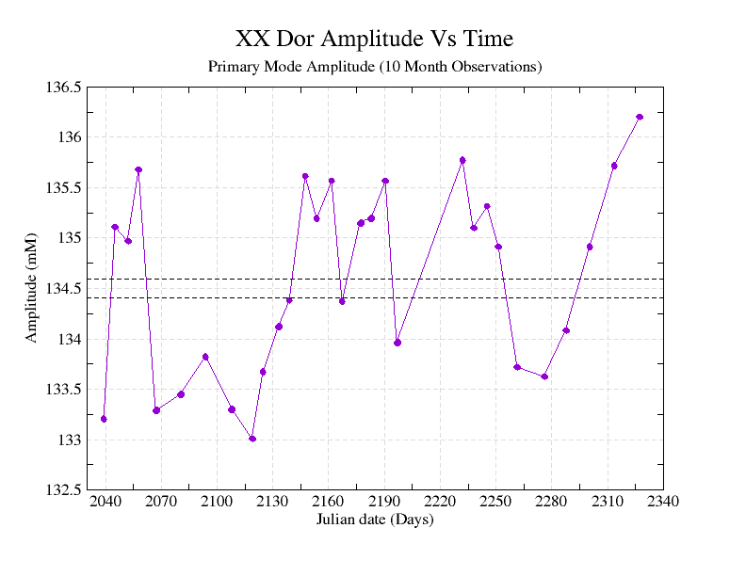
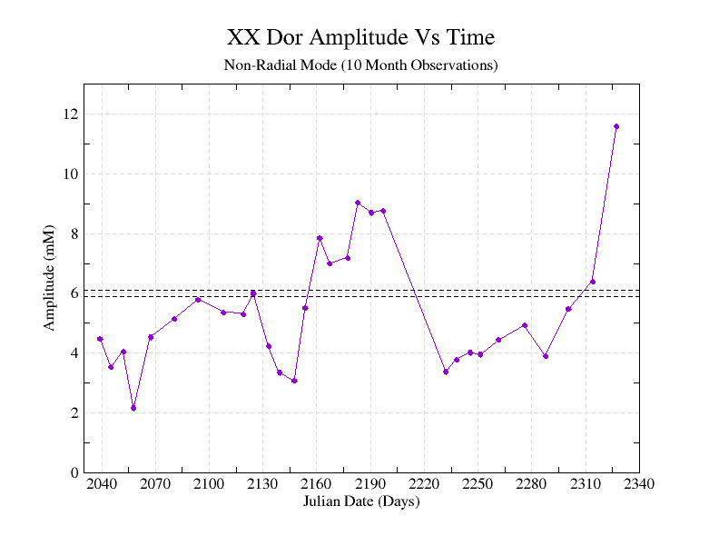
Investigating Non-Radial Pulsation in RR Lyrae Stars
Anthony Kelly, Ron Wilhelm (PHD)
Department of Physics and Astronomy, University of Kentucky
Abstract
Results
Methodology
RR Lyrae stars exhibit a non-radial pulsation that is not entirely well understood. We use Period04 (Fourier analysis software package) [1] to analyze the amplitude of the Fx (non-radial mode) mode over time in XX Dor by splitting light curve data into small groupings. We found that Fx can change quickly over short time spans and exhibits multiplets which could indicate a new physical process occurring in the star.
We split light curve data into smaller chunks so that we can analyze chunk by chunk what the non-radial mode is doing. We use Fourier decomposition in Period04 [1] as shown below to get the composite frequencies that make up the light curve.
Conclusion
There is a Significant amplitude difference between F1 in the 5-month data set and the 10-month data set
Potentially anti-correlation or correlation could be occurring between F1 and Fx but this is inconclusive
Fig. 1 (Black Dashed lines indicate the average error in amplitude). We see the Primary reach's a maximum at about 1330 days and quickly drops close to a minimum. In this graph there is some semblance of a wave pattern.
Fig. 2 (Black Dashed lines indicate the average error in amplitude) . We see the Fx amplitude peaks at about 12mM and appears to weakly correlated with Fig. 1. There is also evidence of anticorrelation from 1360 to 1425 Days.
Background
Future Plans
XX Dor clearly shows signs of multimodal behavior with a frequency peak of F1/Fx ~ 0.61 (F1 is the radial mode). Dziembowski in 2016 [2] predicted that this mode is a nonradial mode pulsation mode.
In other RRc stars Moskalik [3] found Fx modes in Kepler data and noted that they were anticorrelated with the F1 frequency mode. This would suggest that Fx and F1 share the same energy source. We look for similar anti-correlations in XX Dor. There also exists subharmonics of Fx such as (1/2)Fx and (3/2)Fx which we are also interested in seeing correlations with Fx.
Reality tests are needed (I.e., we need to know if there was an issue with the background subtraction etc.…
Comparisons with other stars that feature Fx modes
Comprehensive correlation tests
Test correlations between (1/2)Fx and Fx
Acknowledgements and References
[1] http://period04.net/
[2] Wojciech A. Dziembowski, Nonradial Oscillations in Classical Pulsating Stars. Predictions and Discoveries, 2016
[3] P. Moskalik, Kepler photometry of RRc stars: peculiar double-mode pulsations and period doubling, 2015
[4] Transiting Exoplanet Survey Satellite (TESS), https://tess.mit.edu/
Thank you to the College of Arts and Sciences SURF program for research funding and Dr. Chris Crawford for the opportunity to participate in the REU program.
Fig. 3 (Black Dashed lines indicate the average error in amplitude). There is a consistent local maximum at 135.5mM within the average error. A wave is the general shape with amplitude variations occurring somewhat rapidly.
Fig. 4 (Black Dashed lines indicate the average error in amplitude). Both Fx and F1 (Fig. 3) maximize at the end of the data suggesting a correlation. There is evidence of anticorrelation from 2040 to 2100 days roughly.
All Graphs were created using qtgrace

