Slide 1
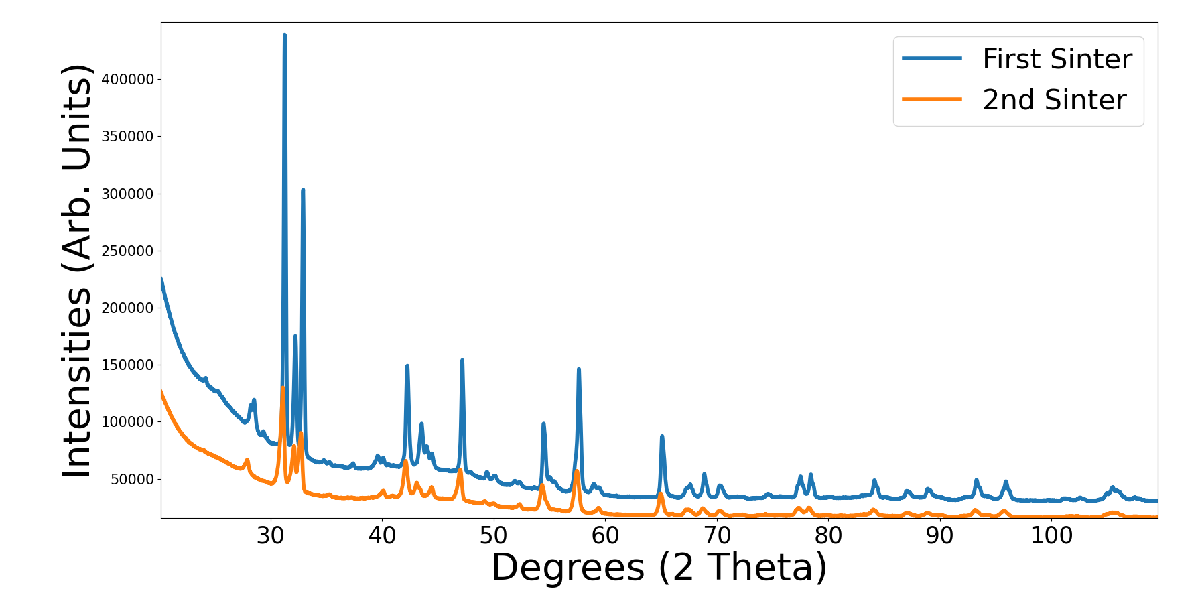
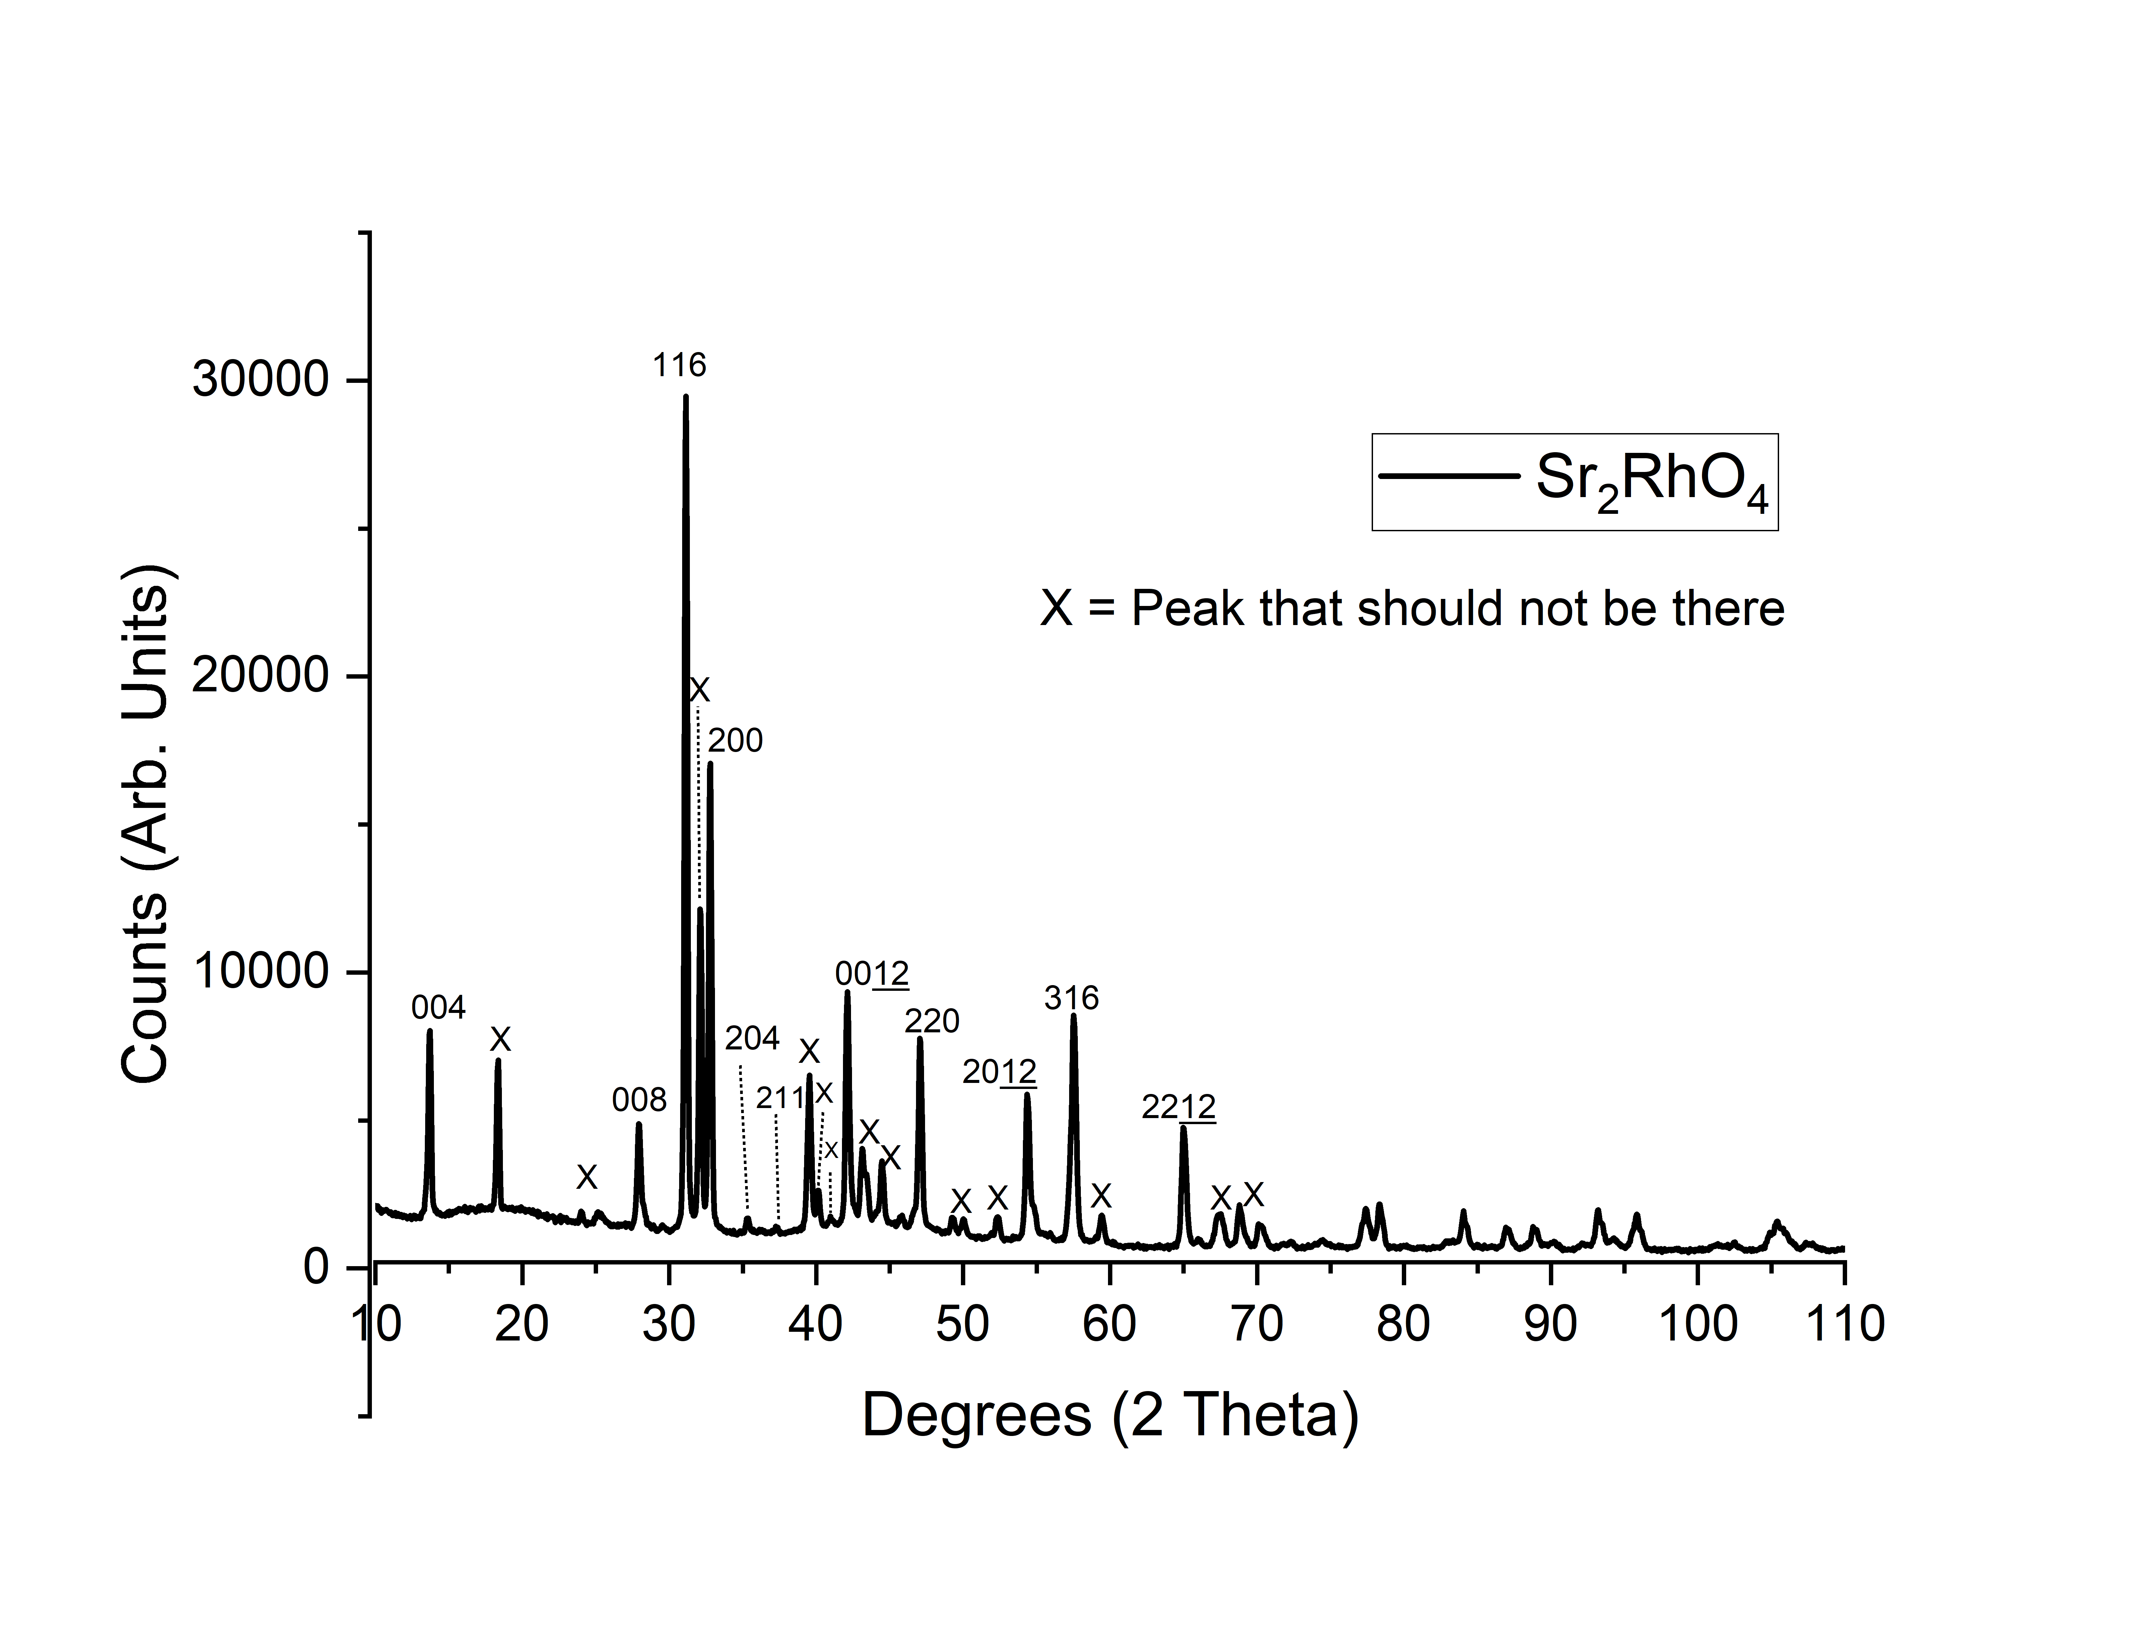
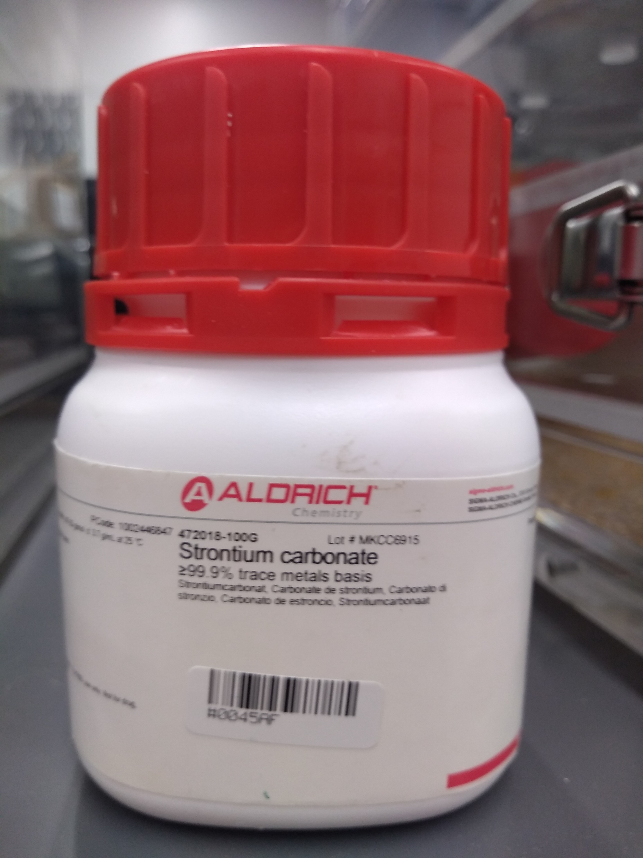
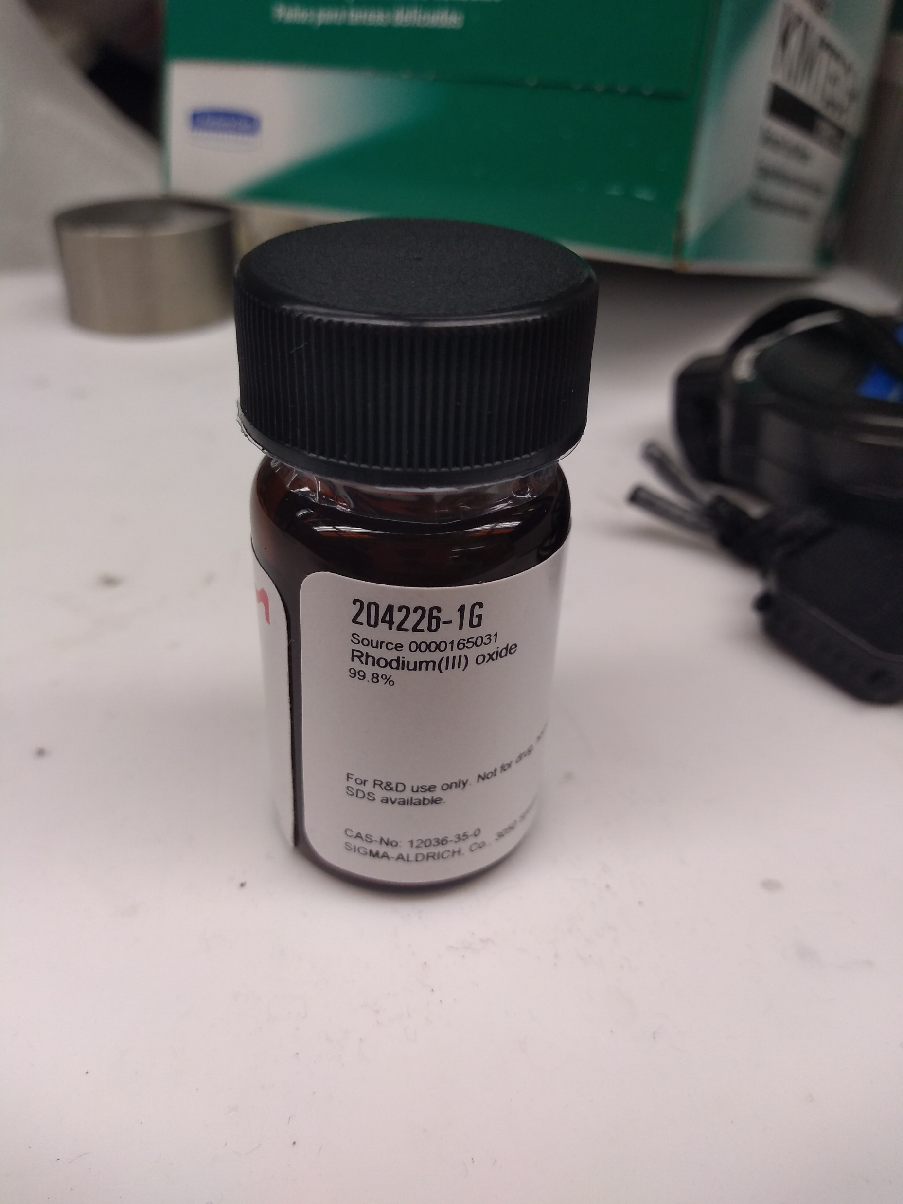
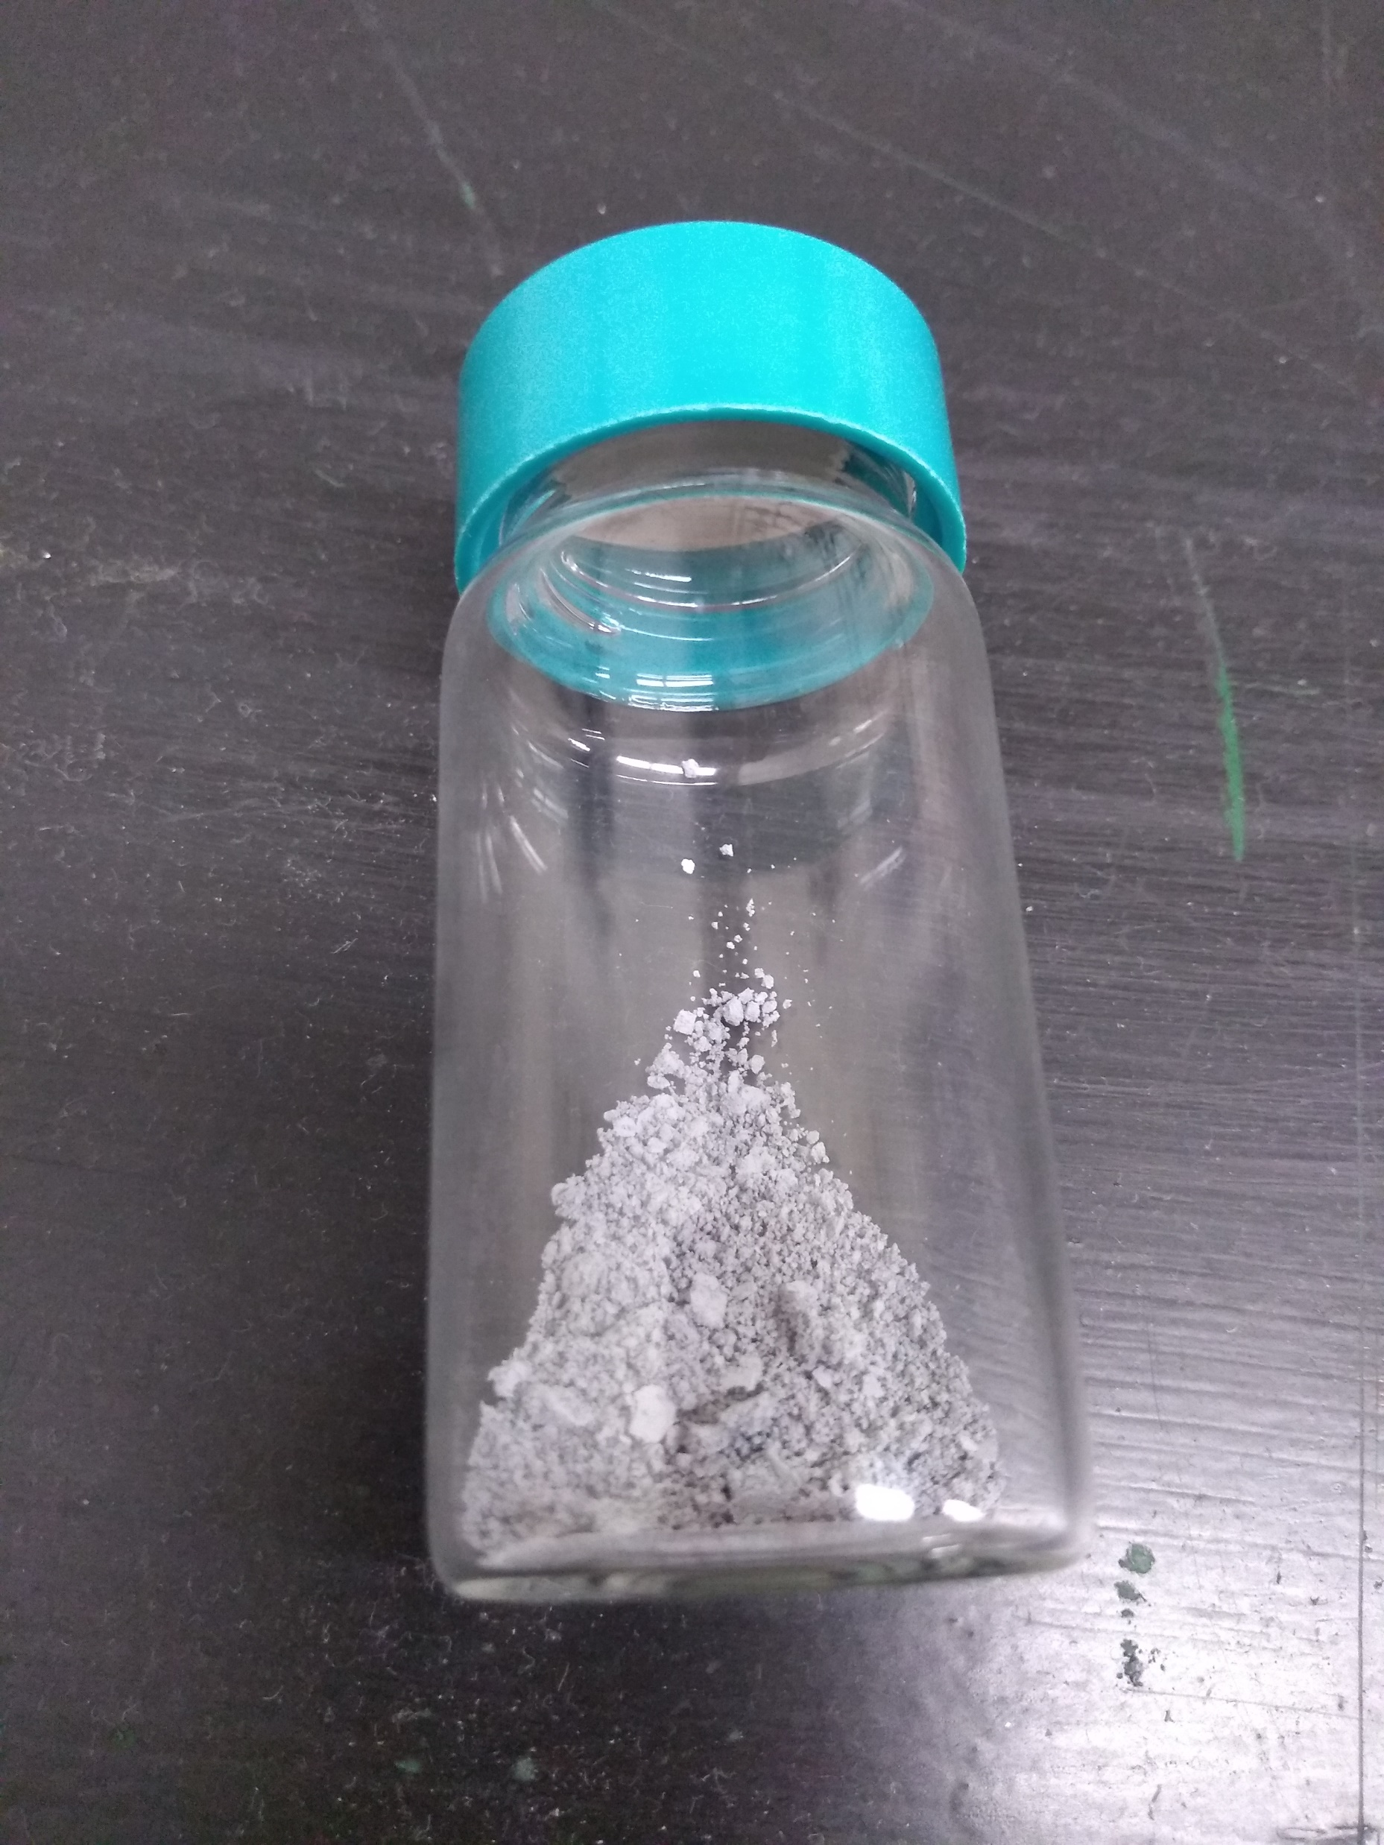
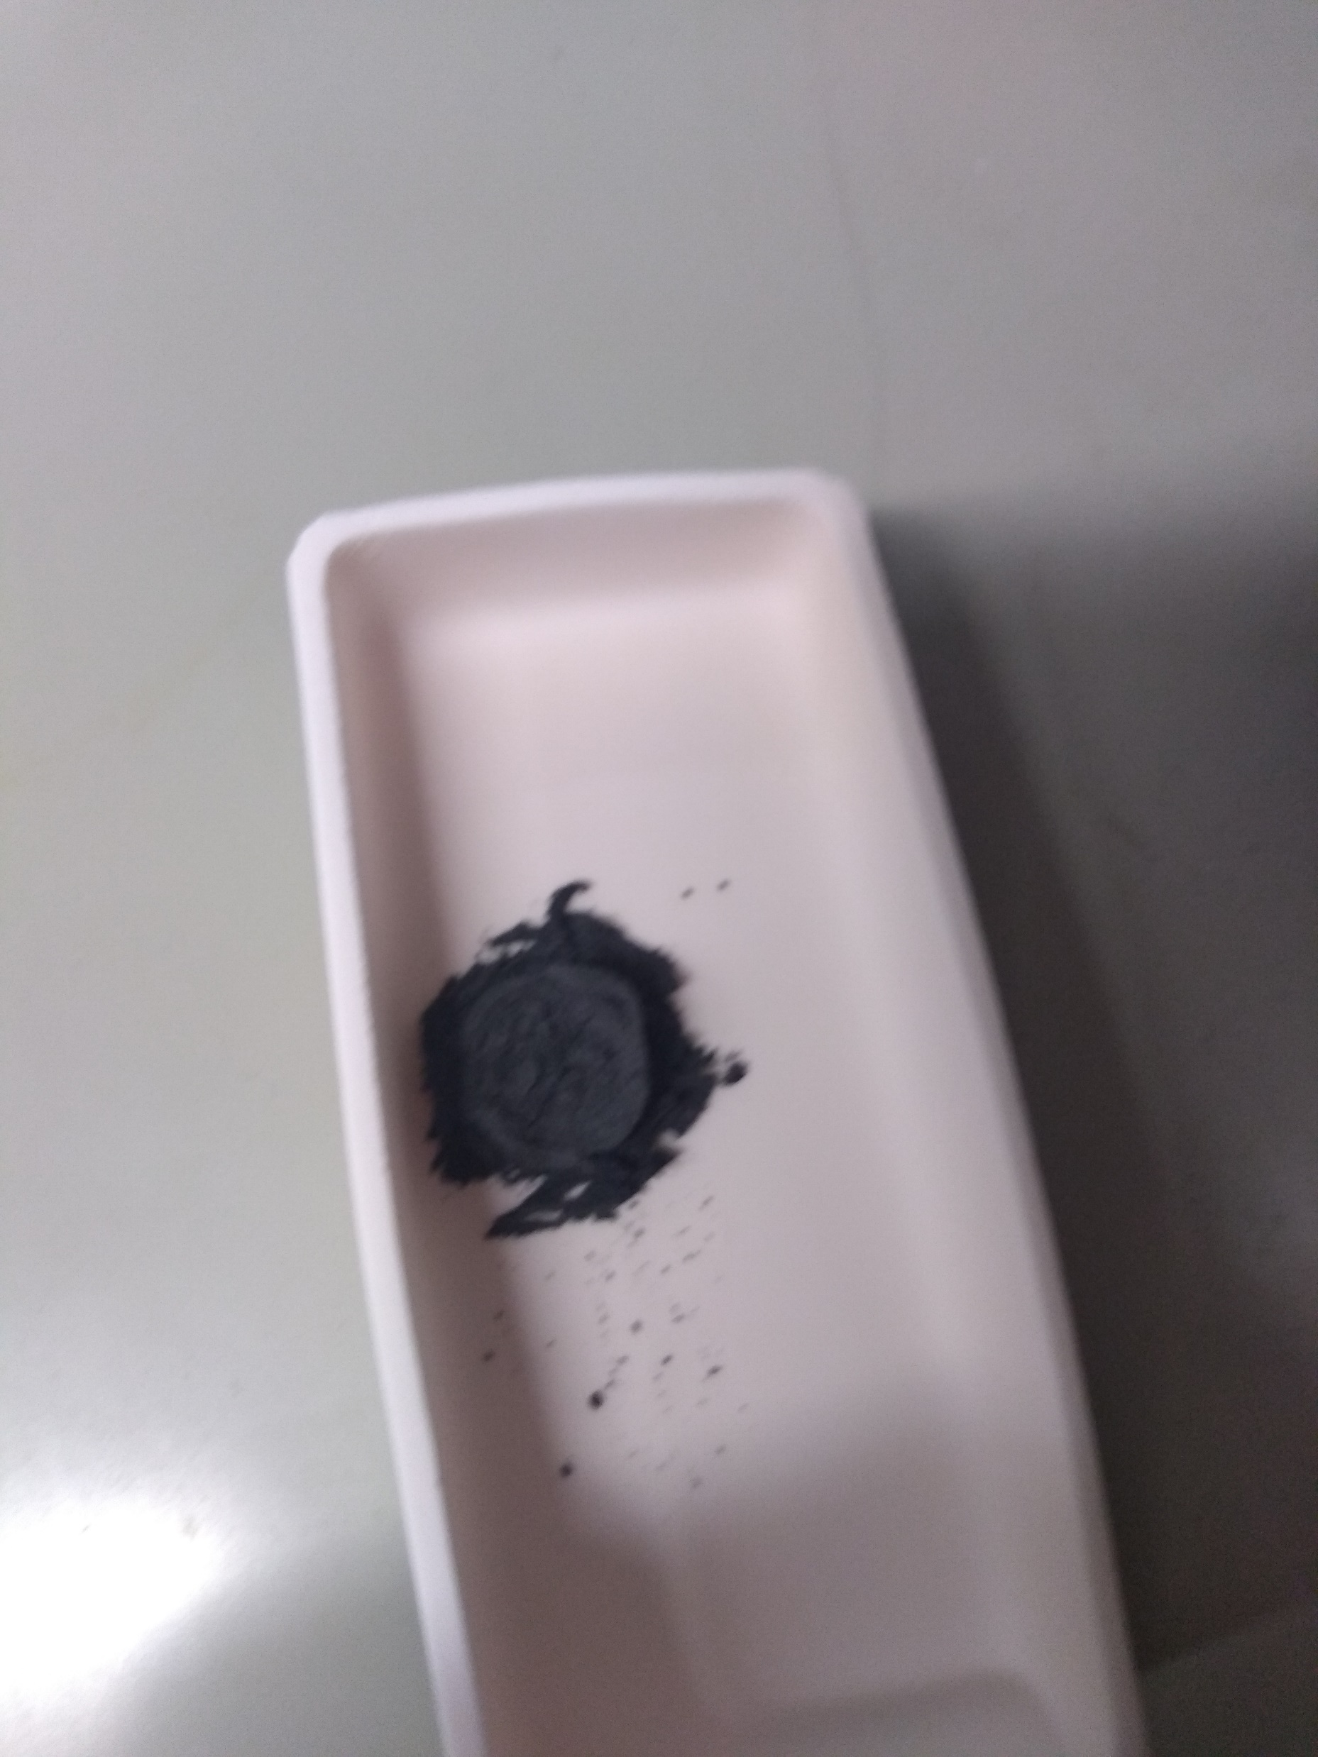
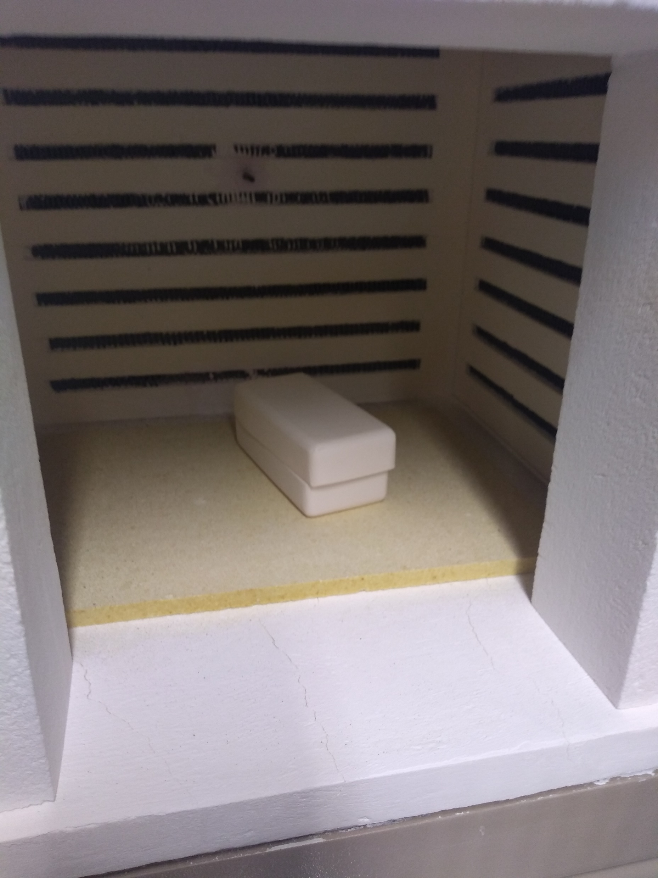
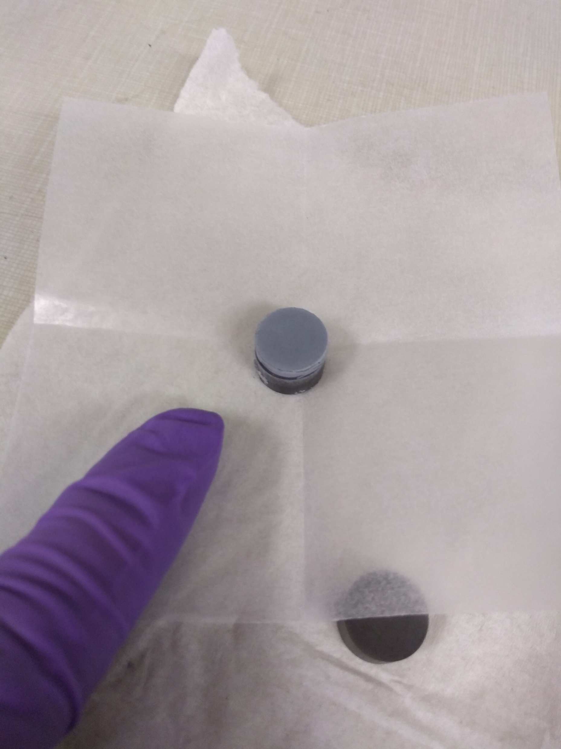
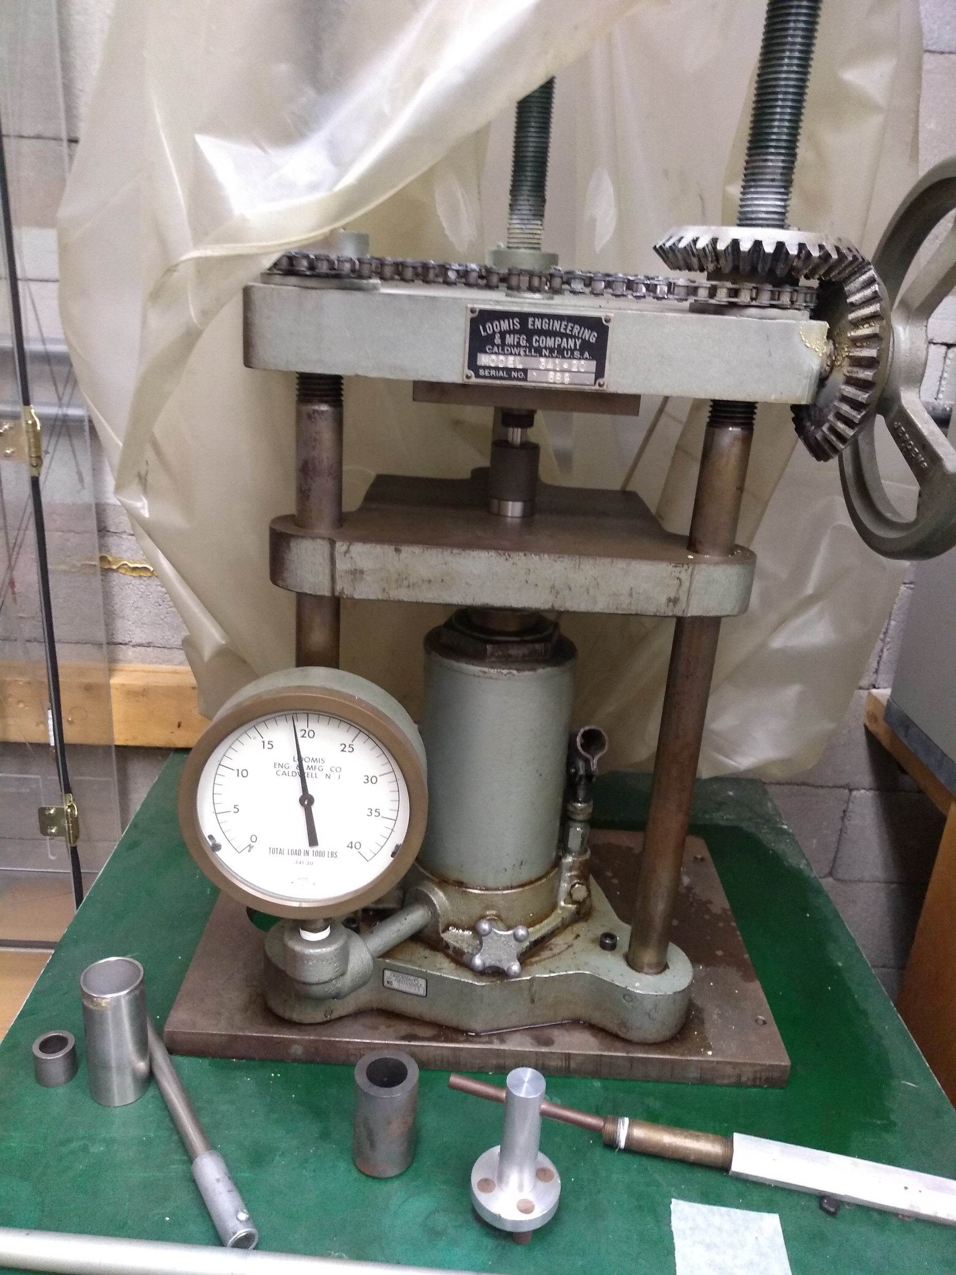
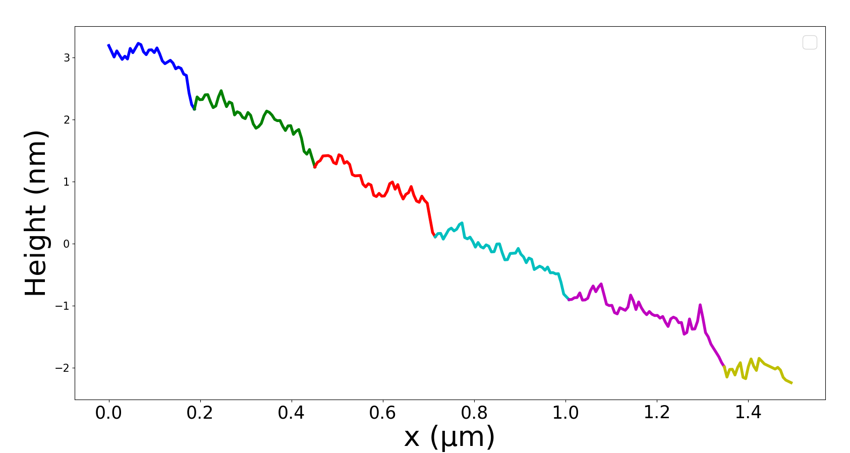
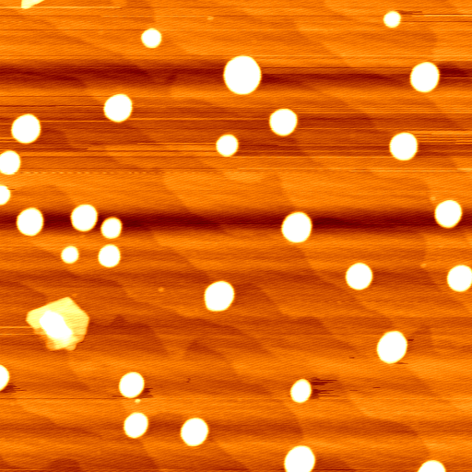
Synthesis of Sr₂RhO₄ Thin Film via Pulsed Laser Deposition
Genaro Lozano, Mackenzie Walker, Alkhatab Al Busaidi, Tina Tong, Sujan Shrestha, and Ambrose Seo
Department of Physics and Astronomy, University of Kentucky, Lexington, KY 40506, USA
p
p
p
Motivation
The goal of this research project was to create a thin film of Sr₂RhO₄ using Pulsed Laser Deposition. Sr₂RhO₄ was briefly investigated for superconductivity in the mid-90s but was found to exhibit no interesting phenomena at the time. Recently, it has been discovered that electrons in Sr₂RhO₄ have an extraordinarily long mean free path meaning they travel for a long distance before interacting with something which would make them change direction. This means it is easier to observe the De Haas-Van Alphen effect (DHVA^{)4.} The DHVA effect is quantum mechanical in nature and is when the magnetic susceptibility of a crystalline metal oscillates as a function of the magnetic field. Investigating the DHVA effect is outside the scope of this project, my goal was to just make the thin film of Sr₂RhO₄.
Figure 3: XRD Graph of Both Sinters
Pulsed Laser Deposition
Pulsed Laser Deposition (PLD) is a way to grow atomically thin films of substances. By keeping the target substance in a vacuum chamber and then firing a laser at it, the target substance will turn into a plasma which will then deposit onto a prepared substrate above the target which is being heated by a heater which aids thin film growth. Figure 6 gives a pictographic representation of the process. Chosen laser and chamber parameters for our deposition were : 10 Hz, 450 mJ energy, a pressure of 10mTorr and 700 °C substrate temperature.
Heater
Synthesis of Sr₂RhO₄ target
The balanced stoichiometric equation to create Sr₂RhO₄ is:
4SrCO₃ + 1Rh₂O₃ => 2Sr₂RhO₄+3CO₂+1CO
Laser
Substrate
Plasma Plume
19 tons of
pressure for one hour
0.863 grams
of SrCO₃
0.3709 grams
of Rh₂O₃
1.2339 grams of
mixed powder
Target
Figure 4: XRD Data with Background Subtracted and Miller Indices Labeled
After second sintering, we observed mostly Sr₂RhO₄ phases. The additional peak in my data are possibly Sr₄RhO₆³.
Figure 5: PLD Schematic
Substrate
The substrate LSAT was chosen as it has a lattice constant of 3.87 Å which is close to the lattice constant of Sr₂RhO₄ meaning that there will be a low amount of strain between the deposited layers of Sr₂RhO₄ and the substrate.
By leaching the substrate with deionized water and then annealing for two hours at 1150ºC it was hoped that the LSAT would singly terminate. After the first cycle singly terminated step-terraces were observed, but after a second cycle as recommended by Connell et al., huge clumps were observed to have grown on the substrate¹.
Results
The Sr₂RhO₄ PLD target was synthesized using solid state reaction. The few impurity phases can be adjusted by optimizing the growth condition of the Sr₂RhO₄ thin film in PLD chamber.
Unfortunately, we were not able to deposit the Sr₂RhO₄ thin film on LSAT substrate. The possible reasons might be larger aperture size of the laser, large clumps on the surface of LSAT substrate which may have inhibited thin film growth, and larger distance between the target and substrate.
Calcinated Pellet
Into oven at
900ºC for 24 hours
Pressed pellet
Figure 1: Flowchart of Sr₂RhO₄ target synthesis process
Calcination was done to remove the impurities, specifically carbon. After calcination, the pallet was re-grounded for 1.5 hours, repressed into a pellet and then sintered at 1250 ºC for 36 hours in order to create a more refined substance and a sturdier pellet. This was done once again after the XRD data didn’t match another paper, so there was one calcination and two sinters as shown in fig. 1².
Figure 5a: Line Profile of 5b
Future Work
As the pellet may not be the reason why the thin film didn’t develop, we can re-use this pellet in order to make it easier for the next researcher that tries to create a thin film of Sr₂RhO₄.
We need to figure out the optimum growth condition of the Sr₂RhO₄thin film.
X-ray Diffraction
The equation to provide constructive interference is Bragg’s Law:
nλ=2dsin$θ$
n is the diffraction order
d is the distance between the lattice levels
$θ$ is the angle between the wave and the plane of the lattice
Figure 5b: Singly Terminated Substrate post Leach Cycle
Figure 5c: Substrate after 2nd Leach Cycle
References
[1] J . G. Connell, et al. Applied Physics Letters 101, 25 (2012).
[2] M. Itoh, et al. Chemistry 118, 1 (1995).
[3] A. Varela, et al. Chemistry 7, 7 (2001)
[4] R. Perry et al. New Journal of Physics 8, 9 (2006).
$$θ$$
d
Acknowledgements
I’d like to acknowledge Sujan Shrestha for teaching me how to do this research, Professor Seo for mentoring, and the members of Prof. Gannon’s lab for allowing us to use their furnaces. This work is funded in part by the National Science Foundation under grant PHY-1950795 and by viewers like you, thank you.
Figure 2: Bragg’s Law in a Crystal Lattice

