Slide 1
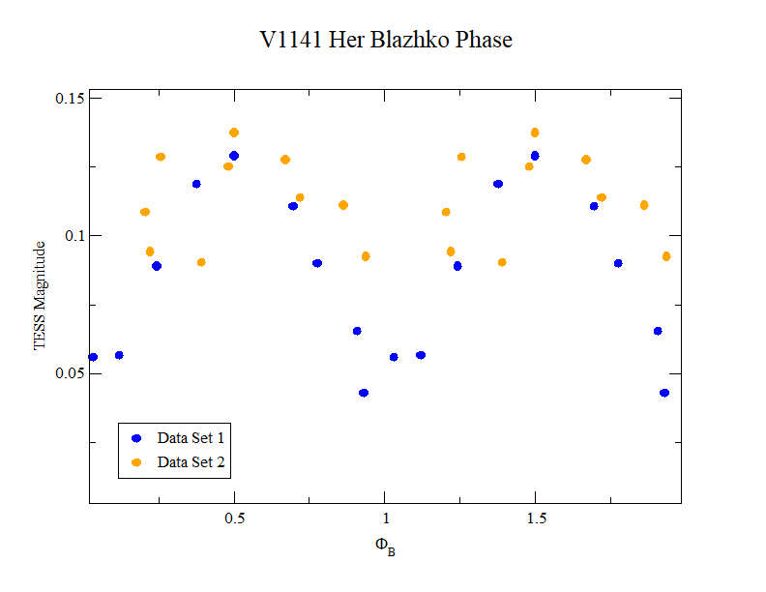
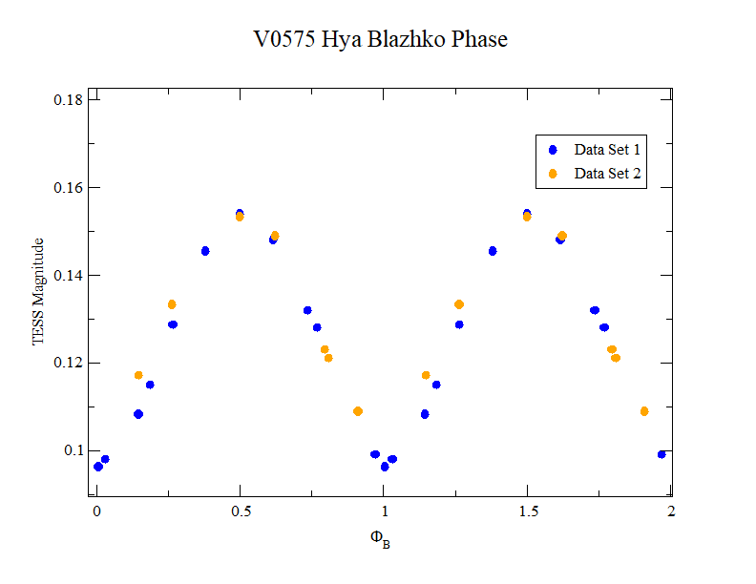
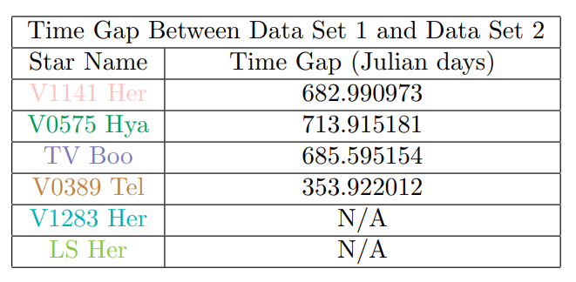
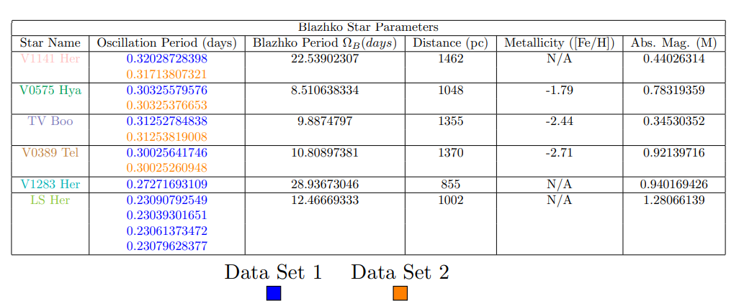
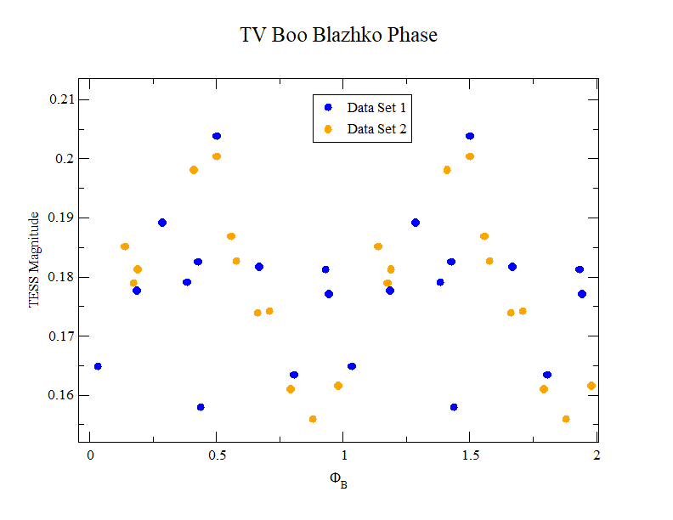
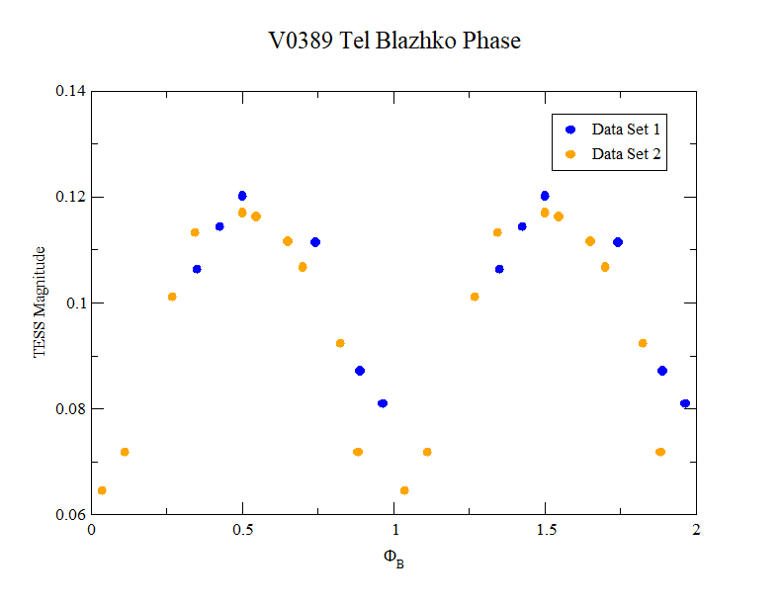
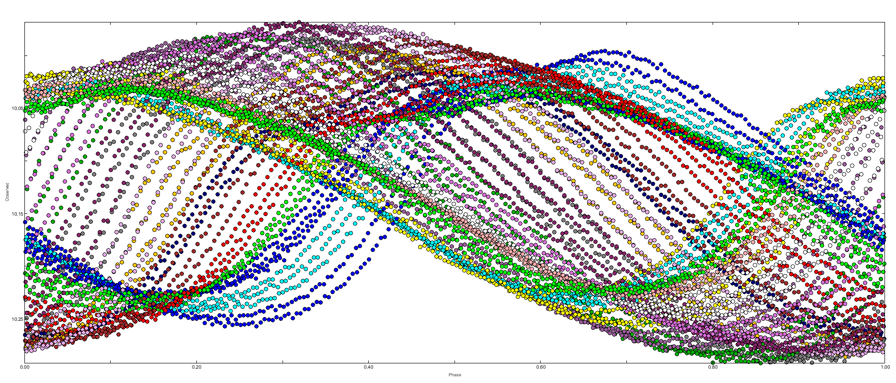
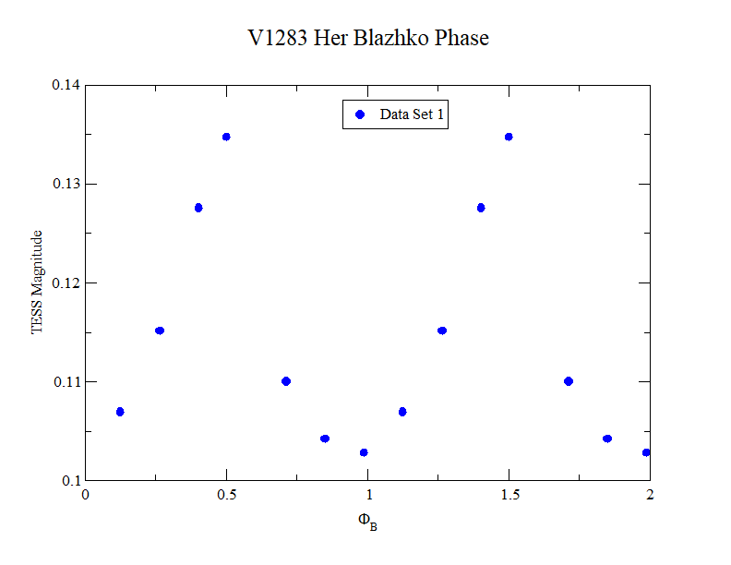
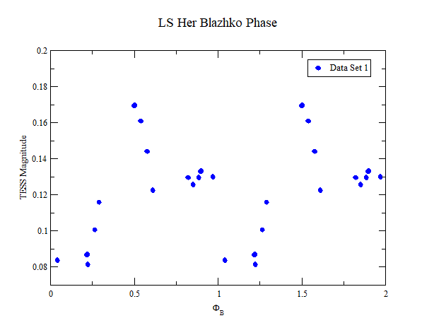
Knowing how the Blazhko Effect works is the key to figuring out why it happens in the first place.
Characterization of First Overtone Blazhko RRc Lyrae Variable Stars
Results
Some stars with second data sets, such as V0575 Hya, phased up more precisely than some other stars, such as TV Boo. This indicates there are variables causing period changes. For example, TV Boo may have a second modulation period (3) that causes the extreme amplitude variation.
V1283 Her and LS Her both only have one data set in this research, but how their amplitude changes at a certain percentage within the Blazhko period can be observed.
The time between when TESS data indicates that the Blazhko period can change a little to a lot in different stars in only a matter of years.
PRESENTER: Hannah Means
ADVISOR: Ron Wilhelm, PhD
Department of Physics and Astronomy, University of Kentucky
Abstract
Some RR Lyrae variable stars experience the Blazhko Effect, in which they undergo phase and amplitude modulation as seen in their light curves. Sergey Blazhko discovered this effect in 1907, and it still unknown today why this effect occurs. This research characterizes six RRc stars that experience the Blazhko Effect through different parameters, such as period, phase, and absolute magnitude (distance and metallicity were utilized from SIMBAD (1)). The results of this research indicate there are underlying variables to why the Blazhko Effect occurs, and some of the parameters measured may be reasons for this effect.
All of the observed stars are metal-poor. A correlation may exist between short-period Blazhko stars and low metallicity.
LS Her having such a low M may indicate it is not a Blazhko star, as it is out of range of typical RR Lyrae stars.
Methodology
The six stars being analyzed in this research are V1141 Her, V0575 Hya, TV Boo, V0389 Tel, V1283 Her, and LS Her. Each star was fitted in Period 04 (2), a multiple-frequency fitting software, and all data is from the TESS database.
Each star was analyzed in sectors, which are separated by time gaps. Sectors were then divided into smaller subsections in order to observe the behavior at different points in the light curves. The phase diagrams that result from this process all have the following general result:
What’s Next?
Moving forward, more light curve analysis will be conducted on these stars. TV Boo’s modulation (3) will be further observed as well as LS Her’s, as a modulation period for the Blazhko Effect has been noted (4).
References
V0575 Hya
Phase Diagram – Period 04
SIMBAD - arXiv:astro-ph/0002110
Period 04 - doi:10.1017/S1743921305009750
Skarka & Zejda 2012 - doi:10.1093/mnras/sts135
Wils et. al 2008 - doi:10.1111/j.1365-2966.2008.13269.x
This paper includes data collected by the TESS mission. Funding for the TESS mission is provided by the NASA's Science Mission Directorate.
Period 04 can not properly calculate the frequency, amplitude, and phase with the smaller subsections due to the decreased amount of data. The Fourier series can not converge the data and therefore widens the peaks, which allows for sidebands to be picked up. These sidebands, when included in the fit, can alter the amplitude corresponding to the primary frequency to a different degree of magnitude.
Larger subsections are needed to calculate more accurate amplitudes.
The Blazhko period and phase can now be analyzed accurately. These parameters can indicate how each star pulsates and modulates.
Acknowledgements
Thank you to Dr. Wilhelm for his support, guidance, and expertise throughout this program.
Thank you to the University of Kentucky and the Department of Physics and Astronomy for hosting me and this REU program.
This work is funded in part by the National Science Foundation under grant PHY-1950795.

