Slide 1
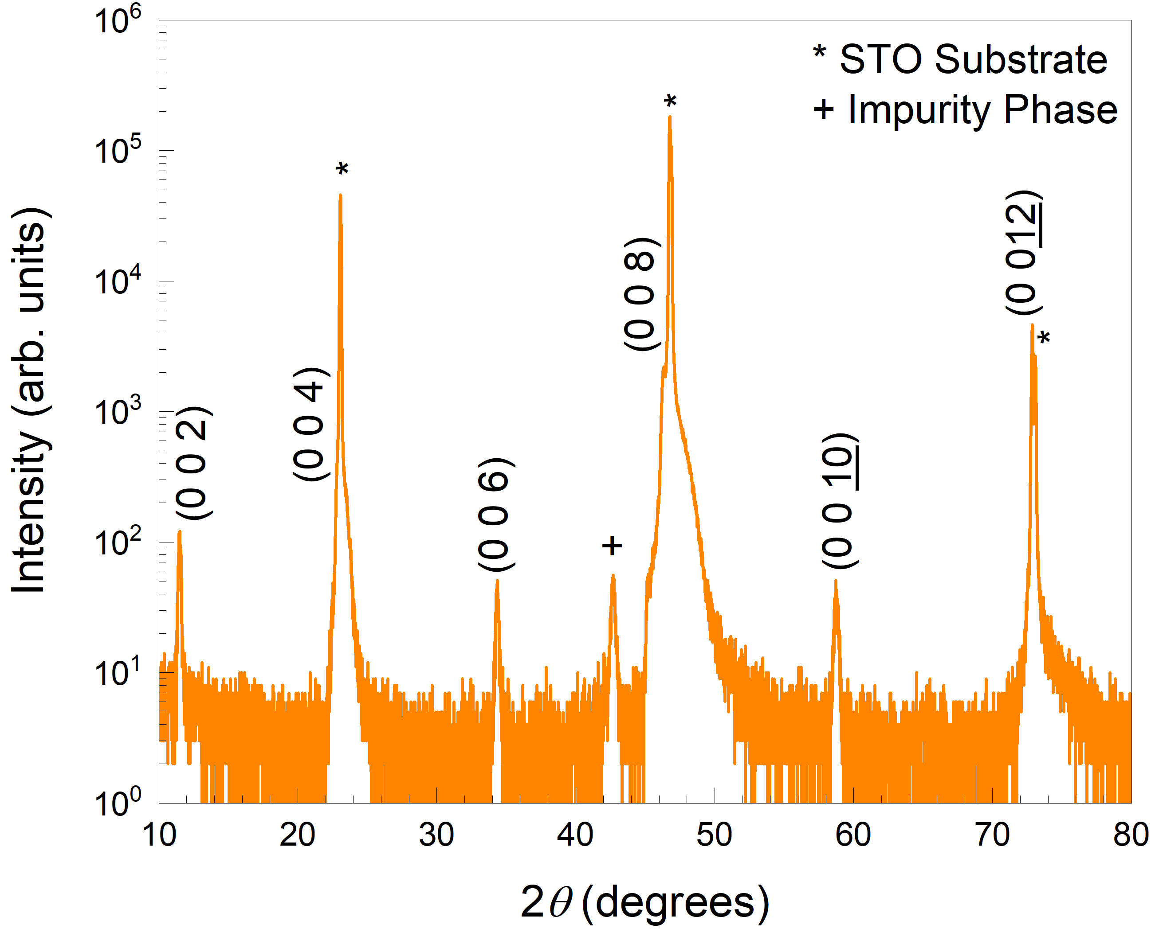
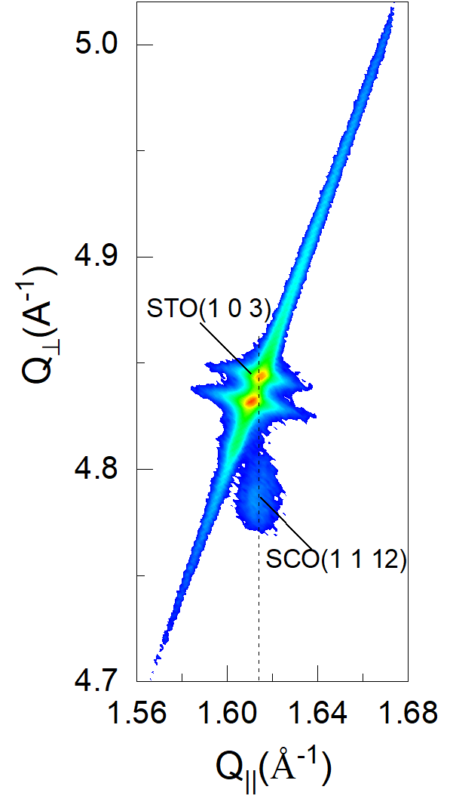
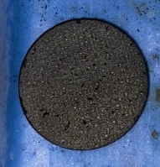
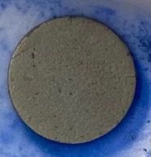
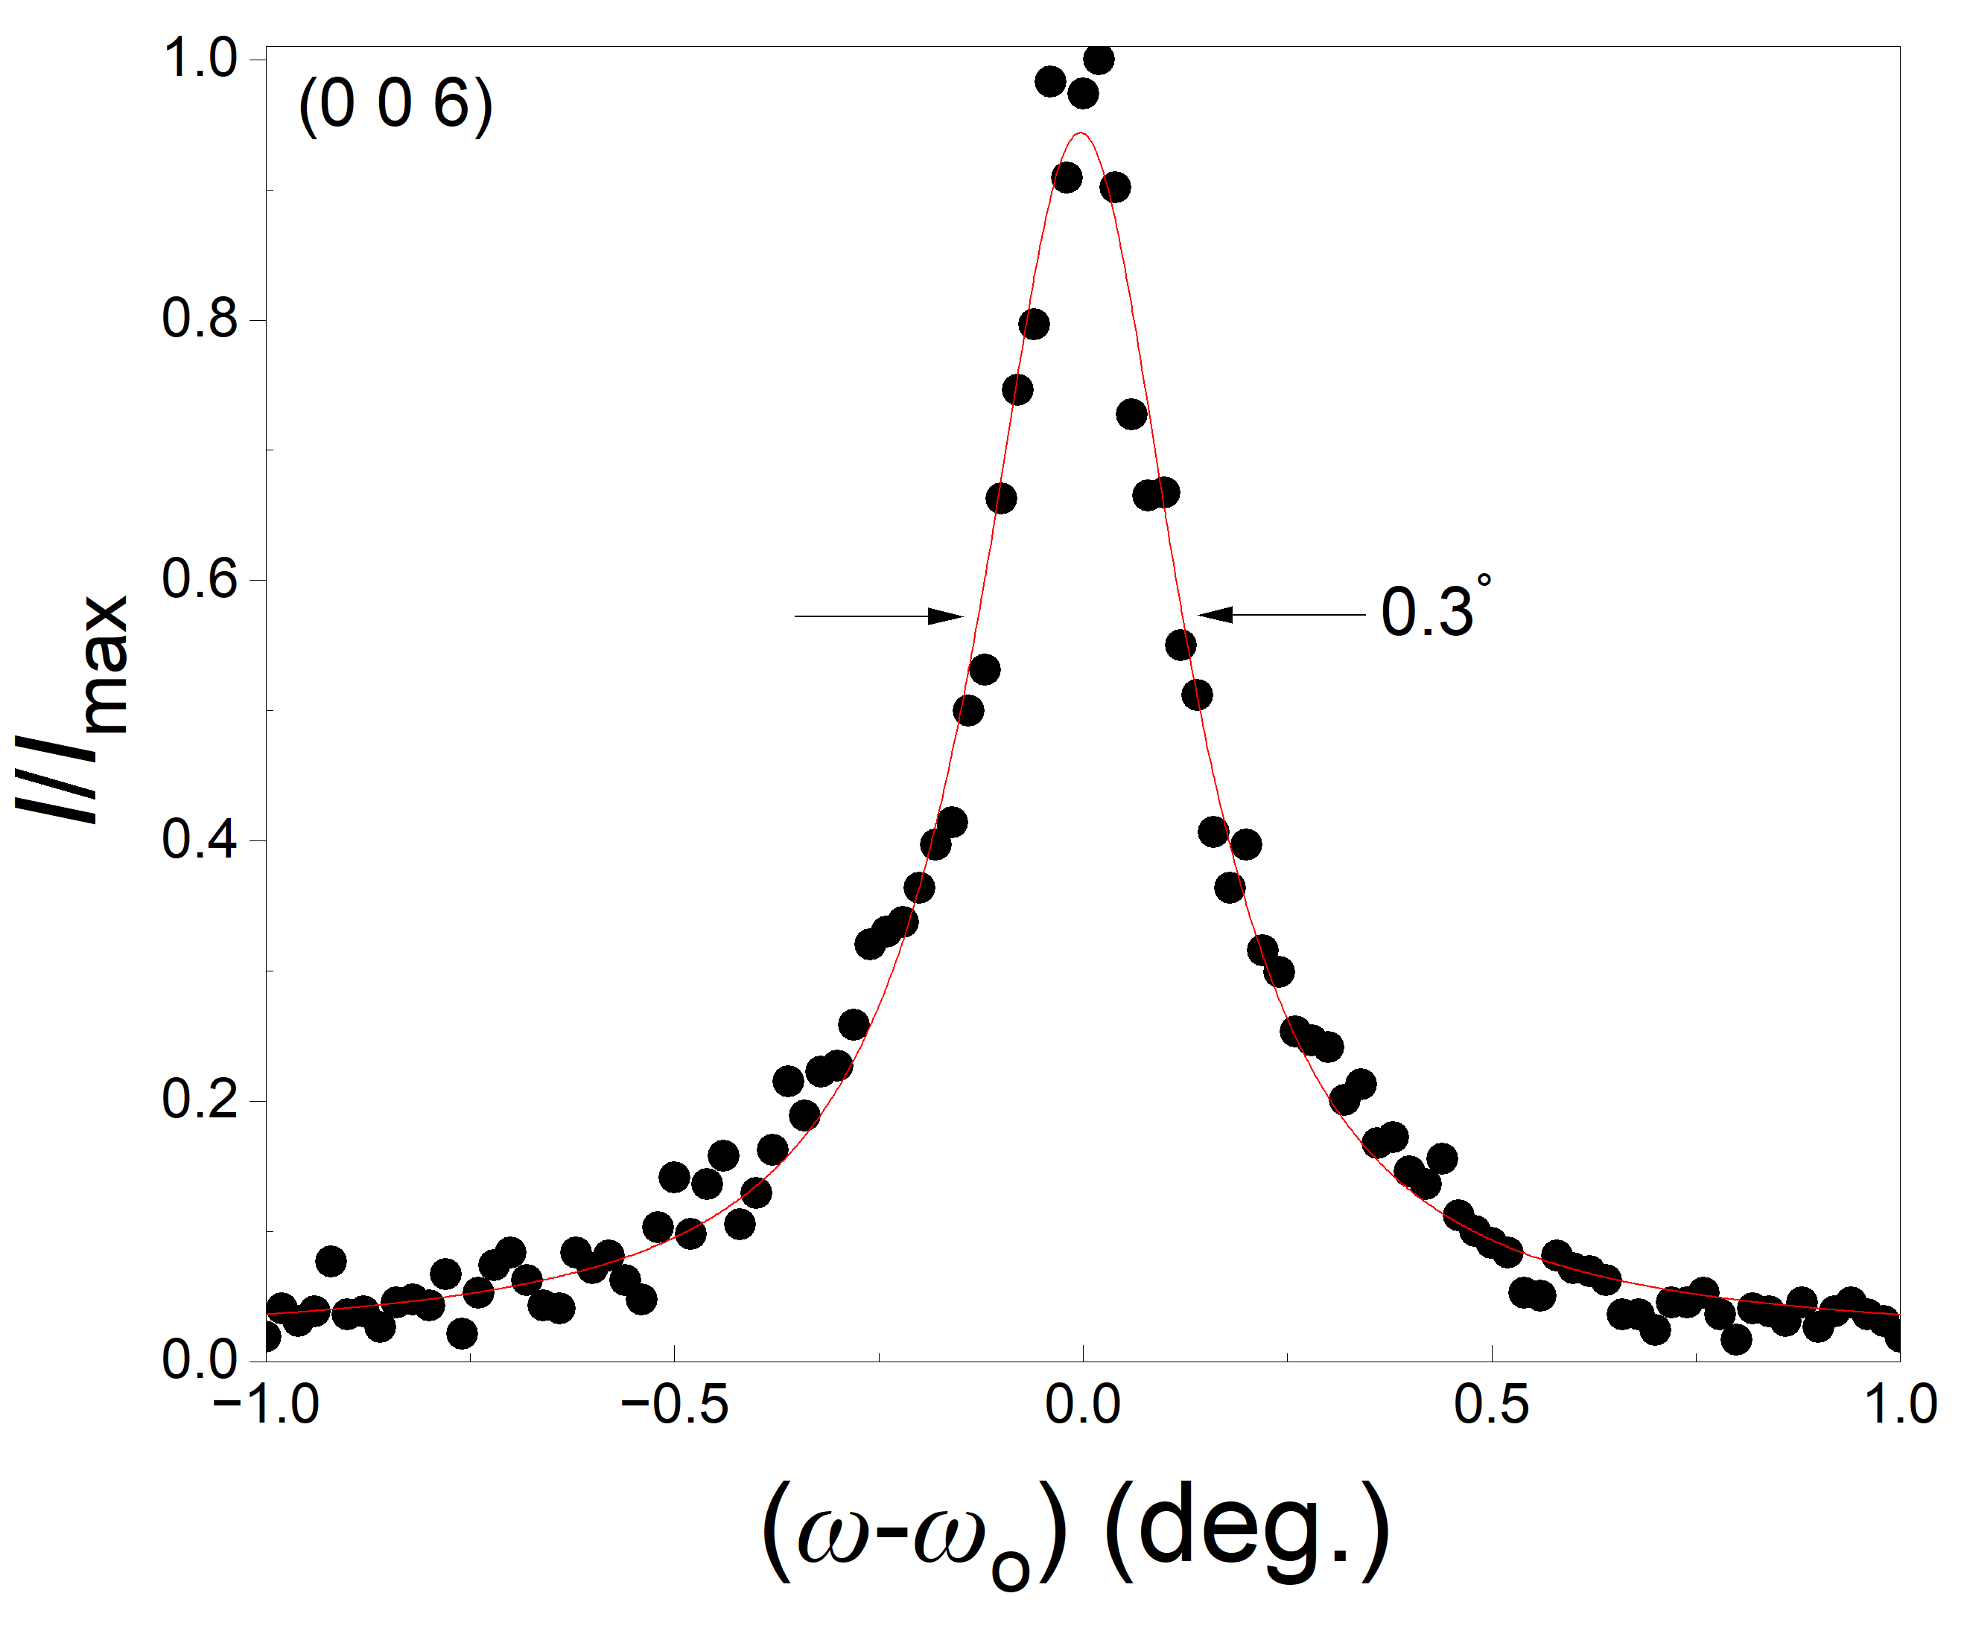
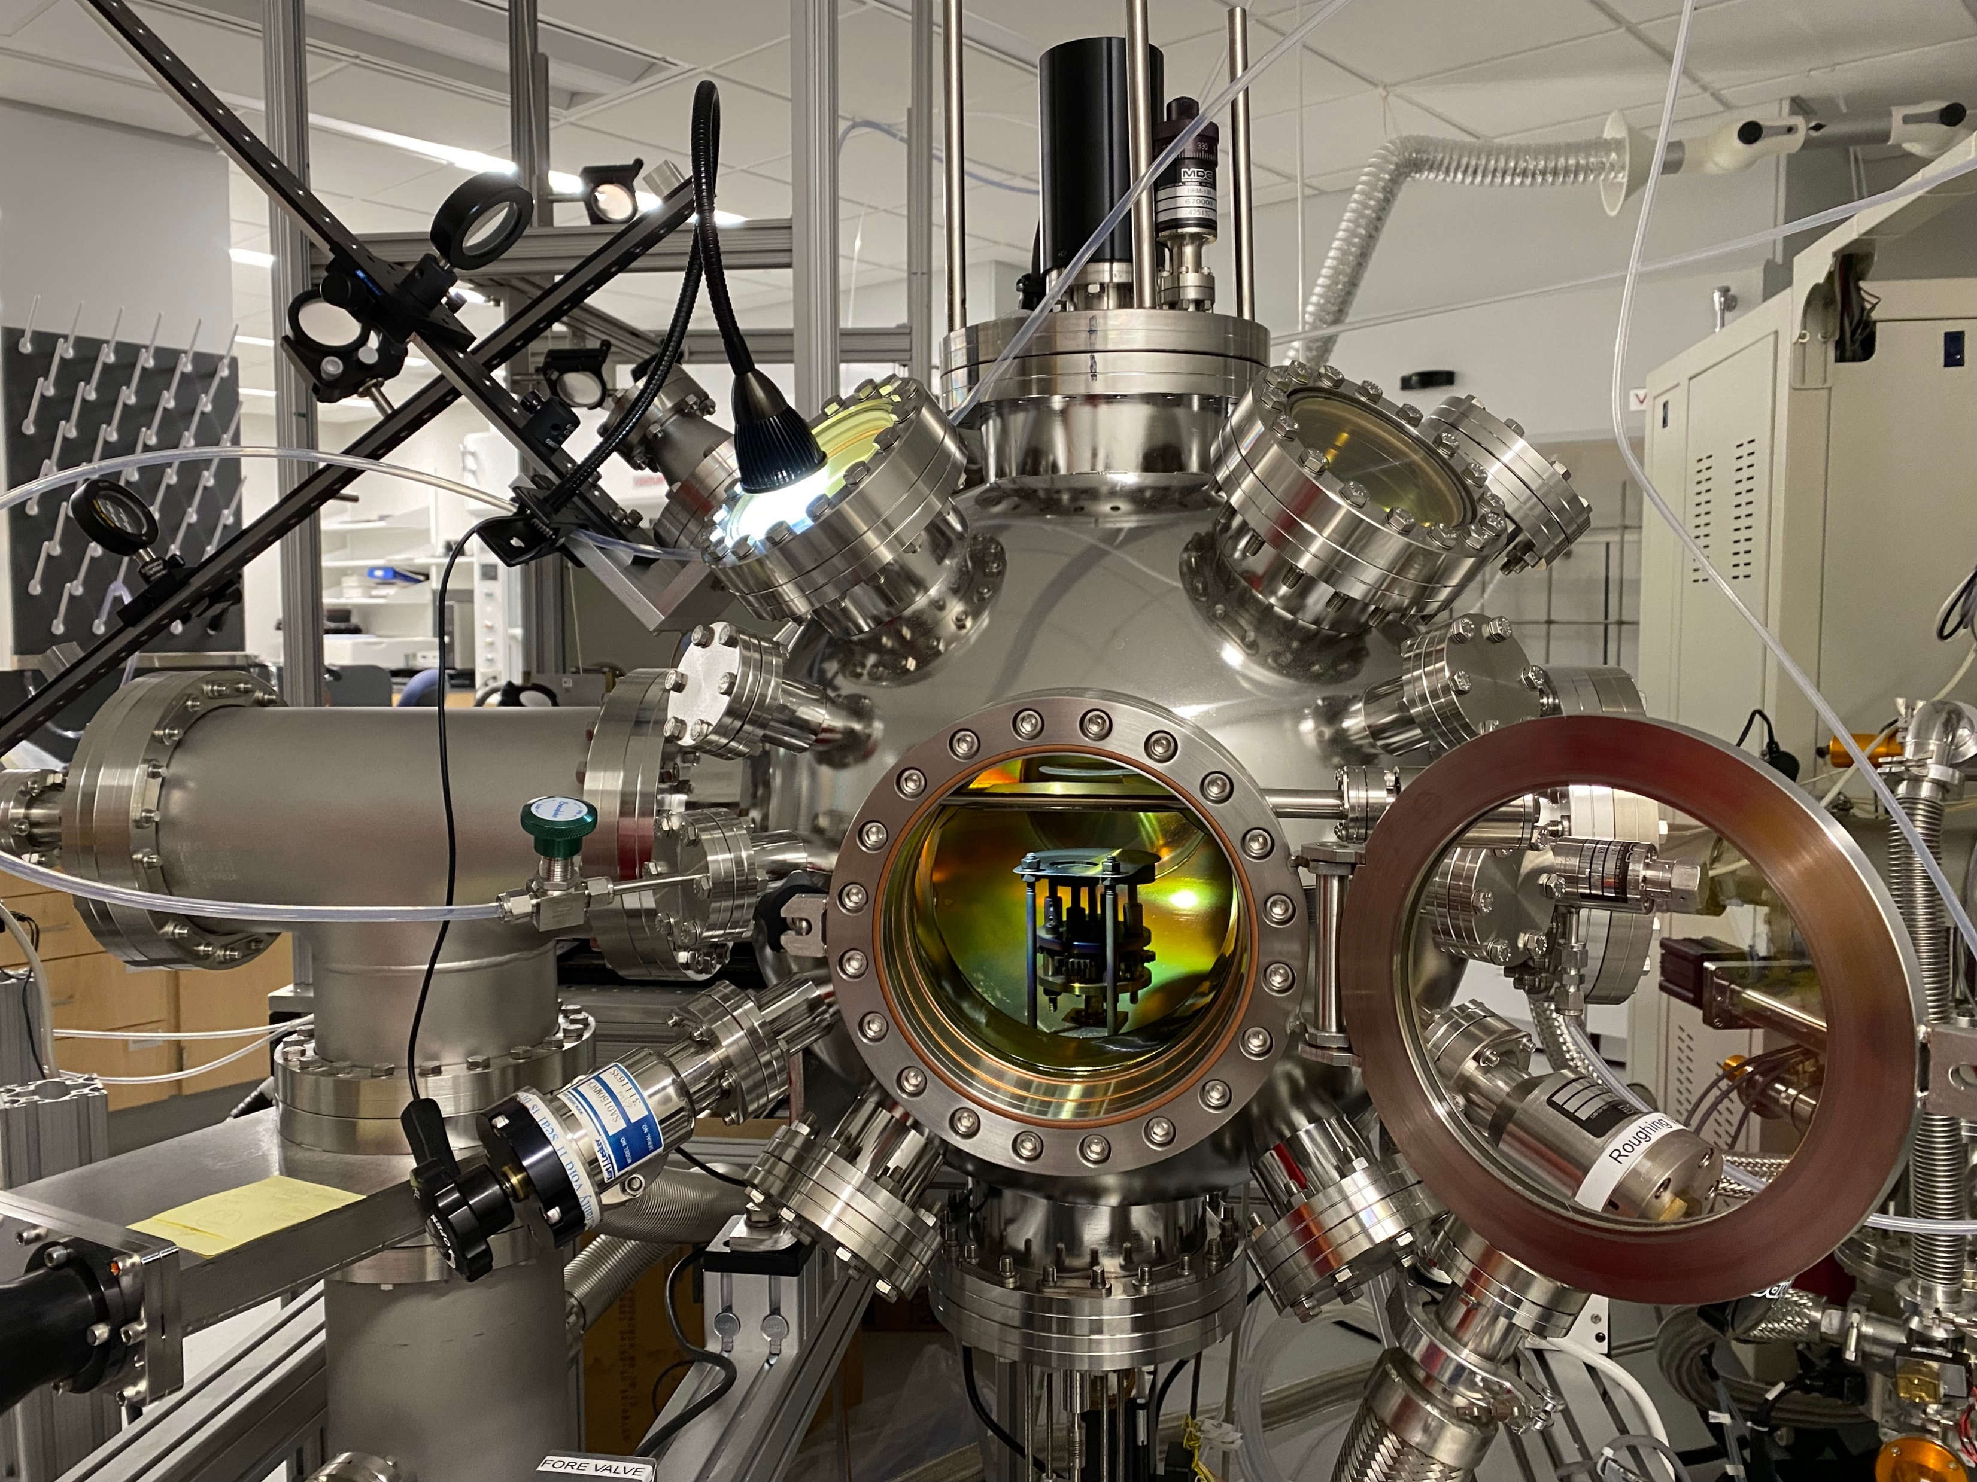
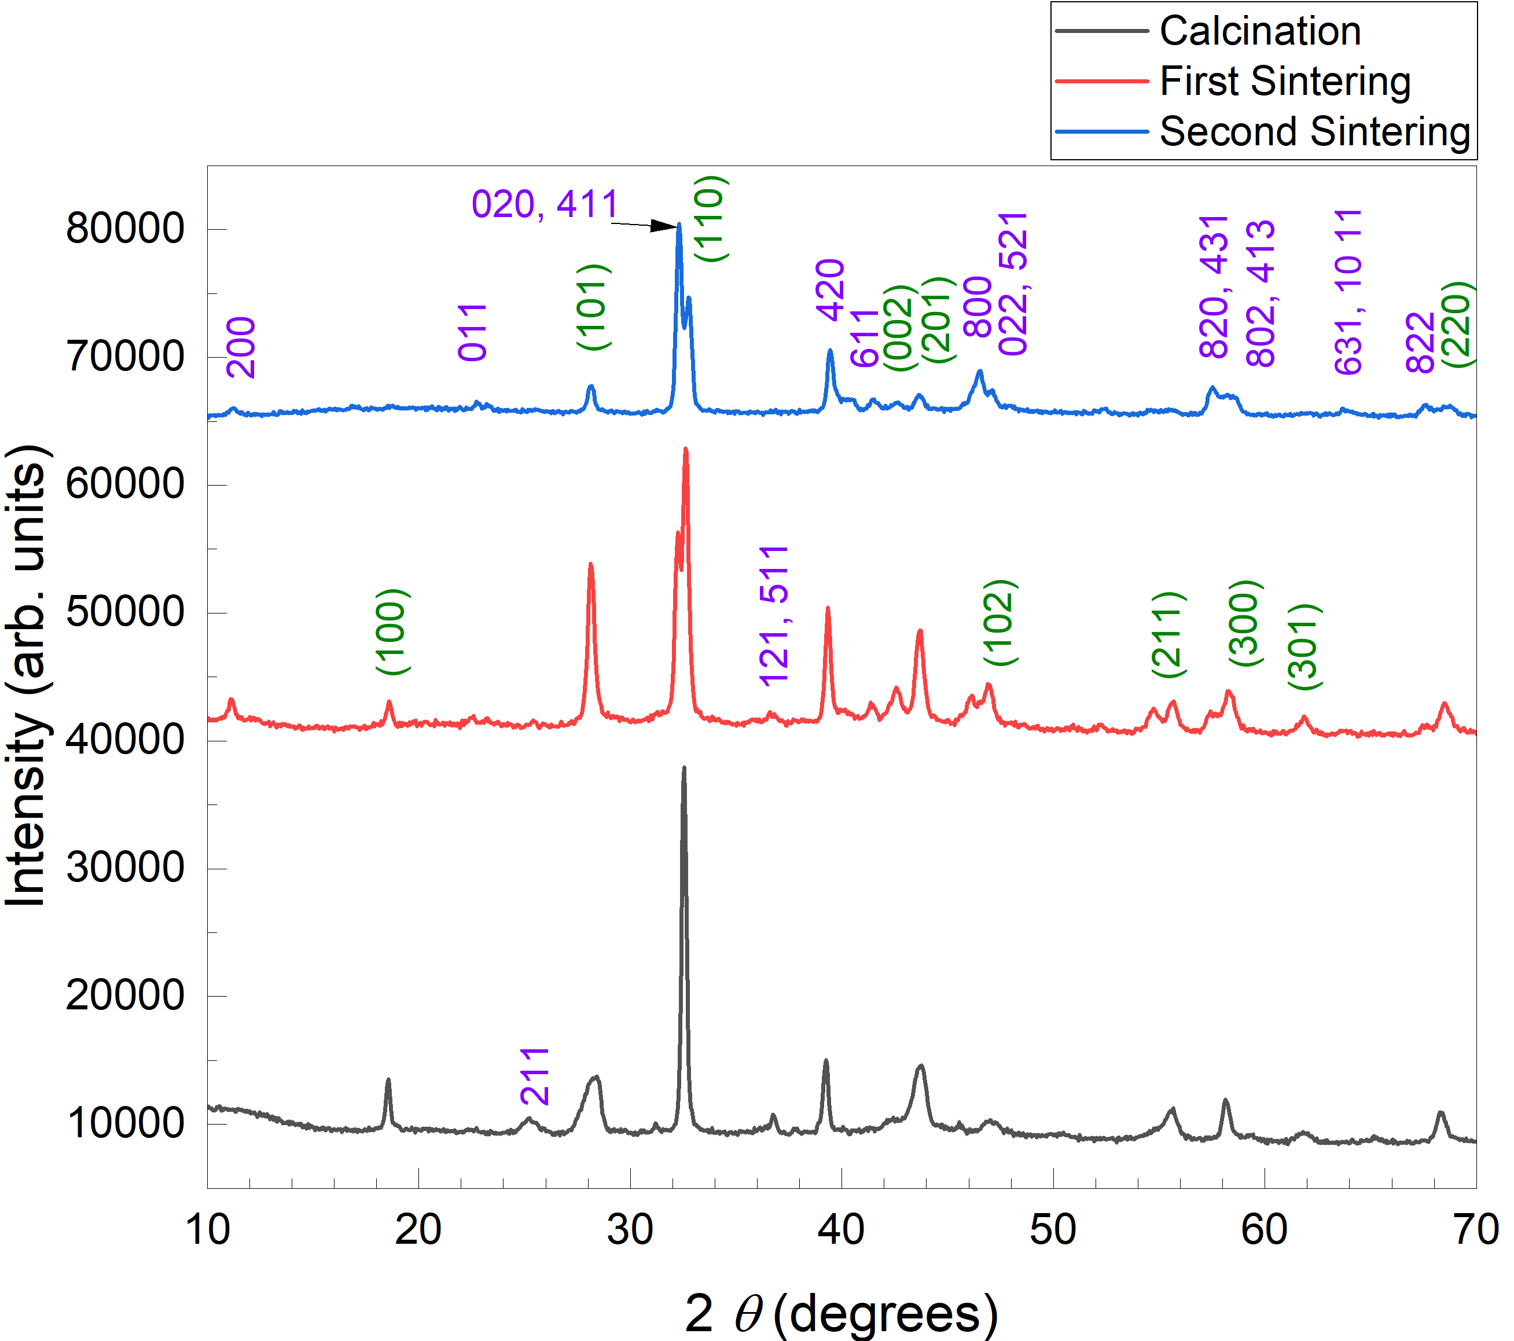
Synthesis of SrCoO_{2.5} Thin-Film By Pulsed Laser Deposition
Mackenzie Walker, Genaro Lozano, Alkhatab Al Busaidi, Tina Tong, Sujan Shrestha, Santosh Bhusal, Brennan Arnold, William Gannon, and Ambrose Seo
Department of Physics and Astronomy, University of Kentucky, Lexington, KY 40506, USA
Background and Motivation
As technology continues to get thinner and thinner, the materials inside of them need to also get thinner and smaller.
The thin-film Strontium Cobaltite can help solve this problem because it can store information and it is very thin and small.¹
There is also a major interest in of thin film heterostructures because of its potential of out preforming conventional semiconductors.²
The goal of this project is to create a Strontium Cobaltite (SrCoO_{2.5}) thin-film on the substrate Strontium Titanate, SrTiO₃ (001).
SrCoO_{2.5} Target
Strontium Carbonate (SrCO₃) and Cobalt (II, III) Oxide (Co₃O₄) powders were used to create Strontium Cobaltite (SrCoO_{2.5}).
Powders were mixed and grounded using a mortar and pestle and then calcinated at 600ºC for 6 hours.
Put into pellet die and placed under hydraulic press with 20,000 lbs. of pressure for 60 minutes.
Pellet sintered at 1100ºC for 24 hours.
Pellet was grounded and pressed another two times for a total of three sinters.
X-ray diffraction was used to check the current phase and crystalline structure.
This technique can help identify if the target SrCoO2.5 has the desired orthorhombic crystal structure. During the first sintering, the target structure was hexagonal and after the second sintering, the target has an orthorhombic crystal structure.
Surface Treatment of SrTiO₃ (001) Substrate
The substrate used was Strontium Titanate, SrTiO₃ (001), and was checked using Atomic Force Microscopy to check if they have step terraced surface as it is essential to have a deposition of high-quality thin film.
Substrate was water leeched in deionized water and then annealed. After this, the AFM did not show stairsteps on the substrate meaning the substrate needs to get water leeched and annealed again.
After the second annealing, the substrate has the desired stairstep pattern. The substrate was water leeched again and then prepared for Pulsed Laser Deposition.
Pulse Laser Deposition
Pulse Laser Deposition (PLD) is used to synthesize thin films. A laser gets magnetized and focused into the PLD chamber directly onto the target creating a plasma plume.
A plasma plume contains very small particles of the target. The plasma plume then gets deposited onto the substrate that is located above the plume. This deposited material creates the thin film on the substrate.
The thin film was deposited at 700 ◦C with 10mtorr O₂ of pressure, a repetition time of 10 Hz with 450 mJ of energy.
Results
A thin-film was deposited on the substrate. The X-ray diffraction(XRD) graph showed (0 0 l) peaks of SrCoO_{2.5} peaks that matched with the results from other experiments.³ We also observed some impurity phases.
The Reciprocal Space Mapping image shows that the SrCoO_{2.5} is fully strained along in-plane direction.
The Rocking curve along (0 0 6) peak shows that the crystallinity is still poor.
Conclusions and Future Works
The PLD target of brownmillerite SrCoO_{2.5} was successfully synthesized. We observed the transition from the mixed phase of hexagonal and brownmillerite SrCoO_{2.5} to the pure brownmillerite SrCoO_{2.5} phase after second sintering.
Despite some impurities, (0 0 l) oriented SrCoO2.5 thin film was successful deposited on SrTiO3 (001) oriented substrate. The SrCoO2.5 thin film is fully strained with substrate along in-plane direction.
For future work, the growth condition of the deposition should be optimized to deposit better quality SrCoO2.5 thin-film.
References
[1] L. Baldrati et al. Phys. Rev. Lett. 125, 077201 (2020).
[2] W. Li et al. Mater. Horiz. 7, 2832 (2020).
[3] H. Jeen et al. Nat. Mat. 12, 3736 (2013).
Acknowledgments
We thank Dr. William Gannon and lab for the help and the use of their furnace. We also thank Dr. Lance De Long for providing the die set and dry press and Nancy Miller for allowing the usage of the x-ray diffractor.
This work is funded in part by the National Science Foundation under grant PHY-1950795 and DMR-2104296.
Calcination
1st Sintering
2nd Sintering
Once the chamber is closed and the correct conditions are set, the plasma plume can be seen inside of the chamber during Pulse Laser Deposition (PLD).
The purple miller indices represent the orthorhombic crystal structure and the green miller indices represent the hexagonal crystal structure.
Heater
Substrate
Plasma Plume
Laser Beam
Target

