Slide 1
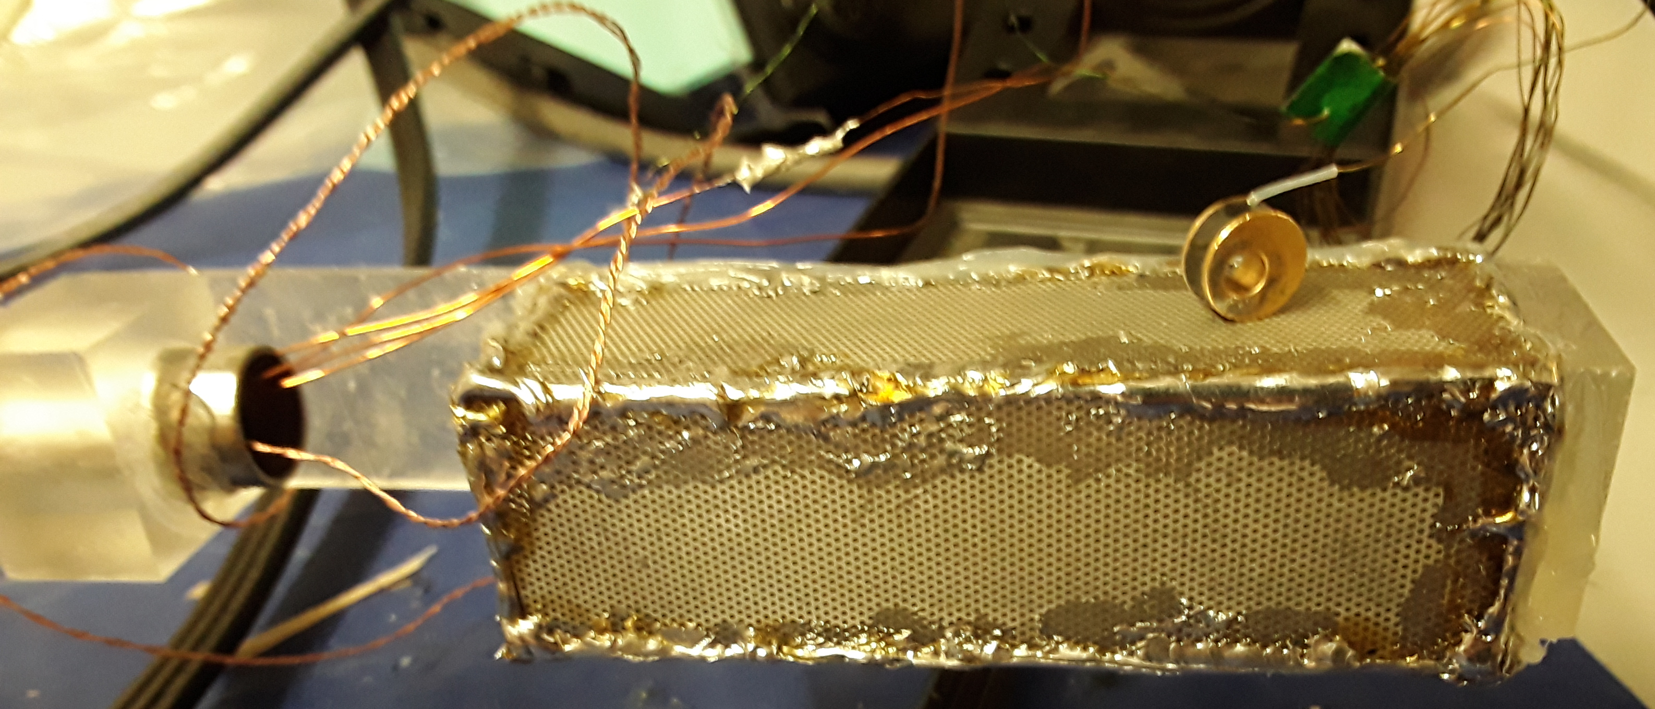
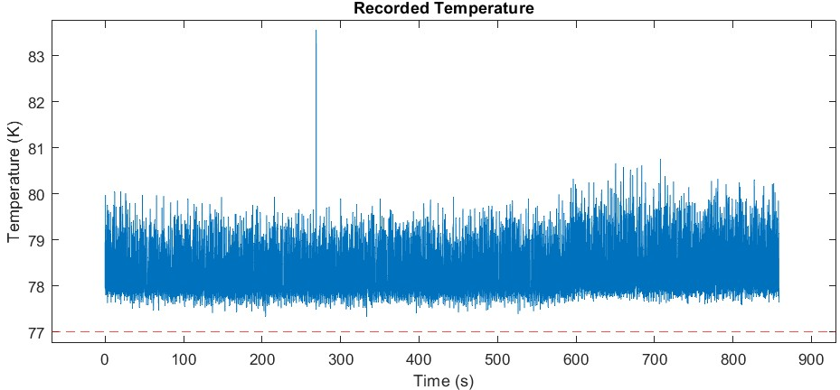
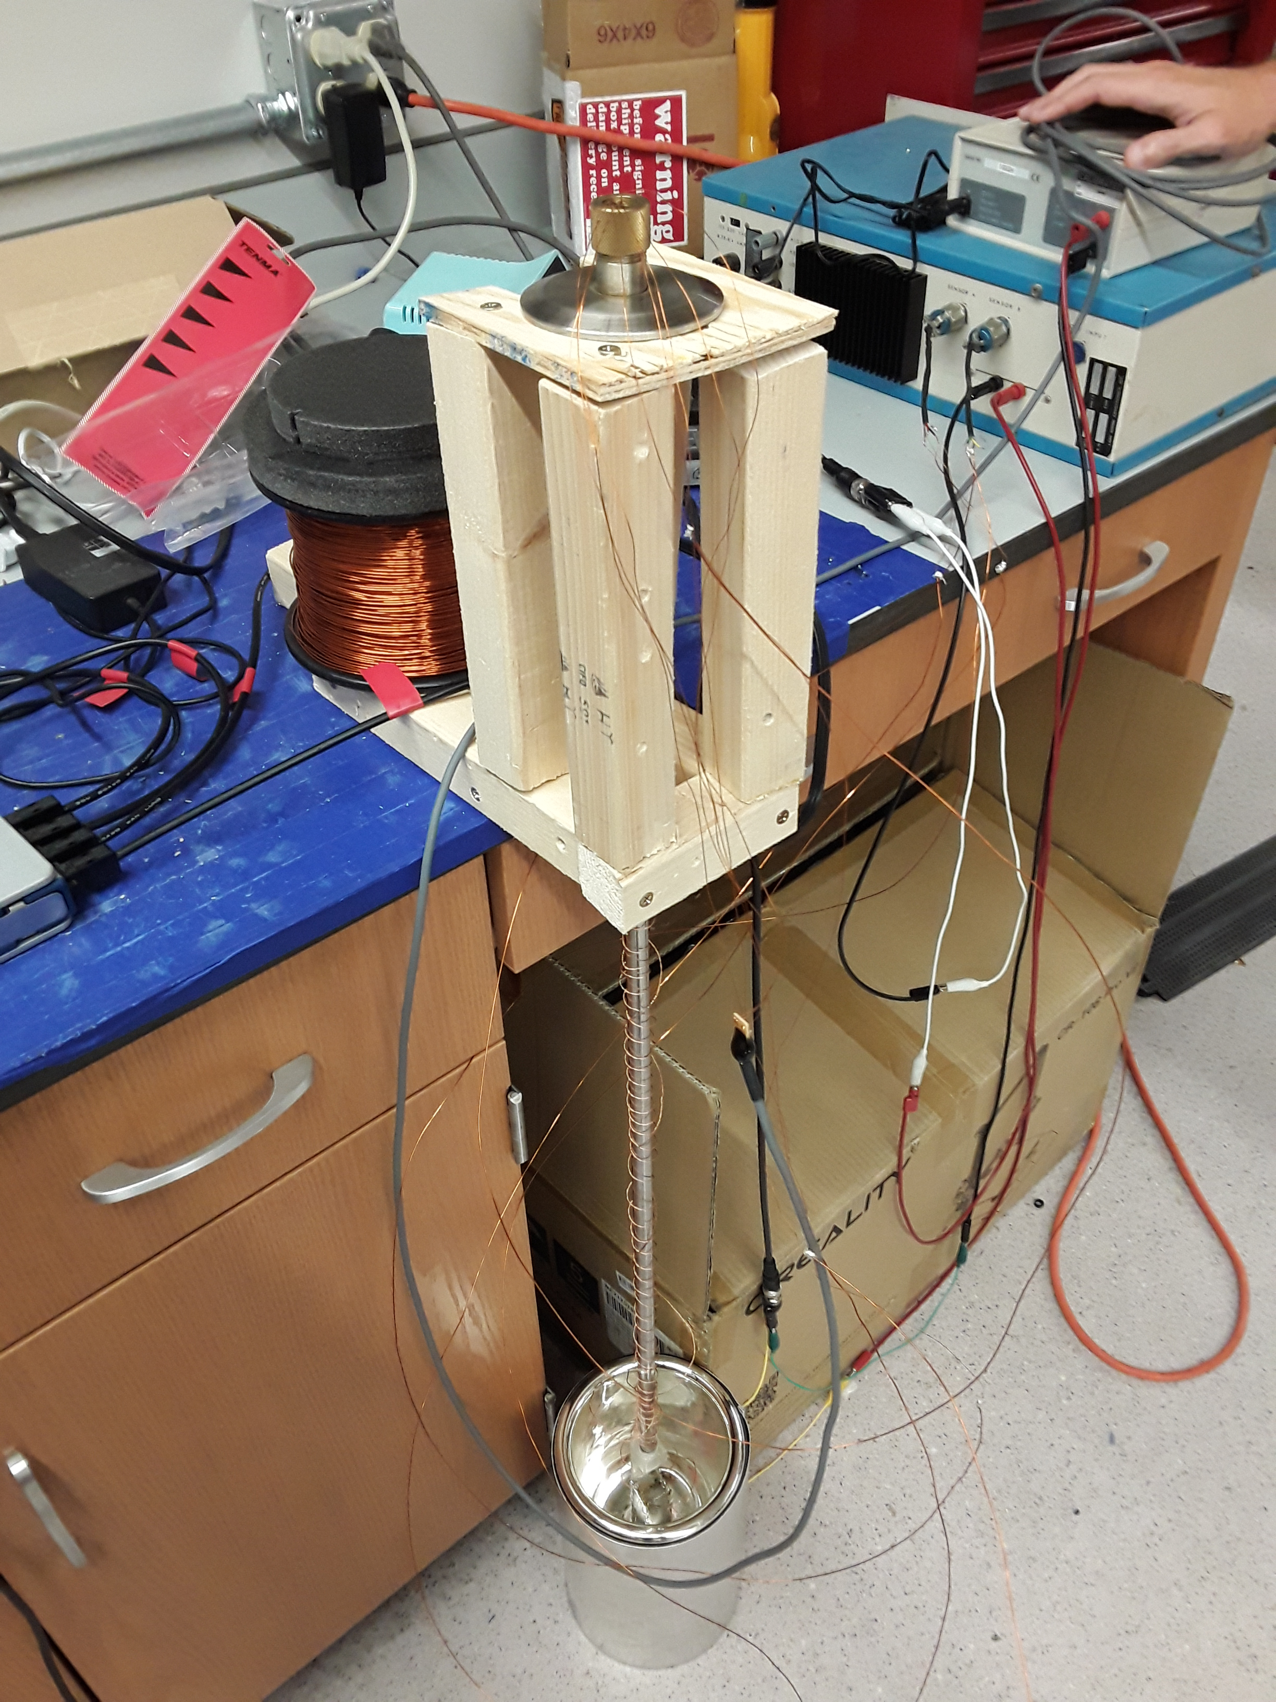
Superconducting Cage for Measuring the Neutron EDM
Rohan Rauch (Ohio State University); Cory Smith, Christopher Crawford (University of Kentucky)
Abstract
Cage Design
Results
Oak Ridge National Laboratory (ORNL) is performing an experiment at the Spallation Neutron Source (SNS) to measure the neutron’s electric dipole moment (nEDM), which will have important implications in physics if it is found to be non-zero, especially for the theorized origins of matter in the universe. The experimental process used in the SNS nEDM project requires a magnetic field that is constant across space and time, which a superconducting cage design could achieve by trapping magnetic field lines after a B-field is induced within it by an external field. To test this design, a small superconducting cage was created from lead, which is superconducting under liquid helium; sensors placed in and around the cage will determine its temperature and the magnetic field measured within. Liquid nitrogen tests indicate that the current design and experiment set-up will be able to resist cryogenic temperatures, allowing for a liquid helium test to confirm whether the design can produce the requisite magnetic field.
The superconducting cage is constructed of leaded PCBs with a grid of small holes, soldered together to create a rectangular prism. This cage is connected to an aluminum stand (originally resin) using varnish (originally epoxy). The stand is attached with epoxy to the end of a long, hollow metal rod, so that it can be safely lowered into a dewar during liquid helium tests.
Two thermometers and a magnetometer are attached to the cage - the thermometers are placed on the cage’s farthest and closest faces, in order to measure when the entire cage has reached the critical temperature, while the magnetometer is placed inside the cage. The sensors are wired through the hollow rod to separate control devices that convert the sensor data into voltages, after which NI 9239 DAQ device converts the two voltage streams into a single stream, which is read through a USB port by an external computer running the DAQ program.
The thermometers use the same control device, but data from only one of them is outputted at a time; during testing, we manually swap between them to check them both.
All tests were performed at a 10 Hz sampling rate, with varying numbers of samples. The magnetometer was present in all tests, but its data is omitted as it is irrelevant to the liquid nitrogen tests.
The first test was performed in two parts, a 605.25 second segment and an 858.73 second segment (started shortly after the first segment), along with two single-point reads from much later.
During the test, frost buildup was noticed on an end of the rod, and after sitting overnight while the nitrogen evaporated, the resin stand was found to have shattered, requiring replacement.
In both segments, the data indicated that the temperature fluctuated around 78.3 K – the first segment varying by at most 1 K (momentarily spiking from 205.83 K to 30.22 K) during thermometer swaps, and the second varying by at most 1.5 K (with a momentary 83.57 K spike).
The last two readings gave 93.23 K and 128.9 K, the difference likely caused by the liquid nitrogen evaporating over time, allowing the upper thermometer to warm before the lower one.
The first segment had manual swapping between the thermometers, leading to irregularities in the first segment’s data.
The second test was performed in two parts, a 230.38 second segment ended manually as the control devices were not on (so the signal was just noise), and a 1,132.40 second segment that terminated early due to an error caused by the external computer.
During the test, the metal stand held up, and frost formed again.
The data indicated that the temperature fluctuated around 77.7 K by at most 0.5 K.
All data was measured with one thermometer, with no swaps.
Figure 1: Cage with resin stand (top) and later metal stand (bottom)
Data Acquisition Software
The data acquisition program is written in Python, utilizing the nidaqmx library to set the sample rate of the sensors and read the data captured by the NI 9239.
First, the program creates an interpolated curve function translating voltage to temperature, based on a table of the control device’s output voltage at specific temperatures.
Then, the program requests a sample rate (samples/sec) and the number of samples to gather.
A for loop the starts that loops for the number of samples.
A while loop waits until a time period equal to the reciprocal of the sample rate has passed since the last loop iteration, after which a thread is created containing the read operation and the for loop restarts.
The thread clears any accumulated data in the buffer, reads a single set of new data that arrives into the buffer afterwards, and writes the stored data to a text file with a timestamp of when it was taken.
The thread also translates the thermometers’ voltage signal into a temperature value using the interpolated curve function, and notifies the user when this reading goes below or above the critical temperature.
After all iterations of the loop have completed, the program ends, leaving a text file containing the collected data.
Background
Create interpolated curve function
Request sample rate & num. samples
The electric dipole moment (EDM) is a property of particles characterized by electrically positive and negative poles, that defines their torque in electric fields. One of the questions currently being investigated in particle physics is whether the neutron has a non-zero electric dipole moment.
A discovery of a non-zero value for the neutron’s EDM (nEDM) would have important ramifications due to it violating charge and parity symmetries. This CP violation could satisfy one of the conditions necessary to explain baryogenesis, the theorized process by which the early universe had more matter than antimatter, leaving the matter that became the material universe after the two annihilated.
The ORNL SNS experiments to measure the nEDM involve inducing Larmor precession of the neutron spin in a strong electric field. While the outside magnetic field is small, the neutron’s large magnetic moment creates a precession in the field from this spin, and the resulting modulated signal can be detected to measure the nEDM.
The requirement for constant magnetic fields within the small size of the cryostat in which the experiment is being performed could be fulfilled by designing a superconducting cage.
Because superconductors can maintain a current almost indefinitely, exposing it to an outside B field induces a current by Lenz’s Law that opposes changes in this field, creating an internal B field that is maintained even when the external source is removed.
A cage design allows for current loops to form around each hole in the cage, “pinning” magnetic field lines that pass through such that they stay constant over space and time within the cage regardless of external B fields, fulfilling the nEDM experiment’s requirements.
Using a prototype superconducting cage design composed of lead, this project will accurately obtain temperature and magnetic field strength data on the cage during testing in liquid helium, and thus determine whether the design is able to produce the desired fields.
For num samples…
Start sample thread
Wait until time to sample
Figure 2: Diagram of DAQ program
Clear buffer
Read & write data to file
Check temperature
n=1
n=2
n=3
. . .
Figure 4: Data from first liquid nitrogen test, second segment
Blue: temperature data
Red: liquid nitrogen temperature (77 K)
Experiment Setup
Two sets of tests were planned for the prototype, one using liquid nitrogen and another using liquid helium. Both consist of dipping the cage into a cryogenic liquid, with the rod supporting the cage and taking readings from the magnetometer and thermometers through the DAQ program. The liquid helium test would also involve exposing the cage to a magnetic field, though no field source has been chosen yet. Currently, only the liquid nitrogen tests have been performed, due to unavailability of liquid helium, considerations on using other sensors, and time constraints.
The liquid nitrogen test uses a small container of liquid nitrogen as the cryogenic liquid. Due to the small container size and the rod’s length, a wooden stand was built to hold the rod during testing. Liquid nitrogen is only 77 K, so the lead cage will not superconduct (Pb critical temperature: 7.2 K). Instead, this test will help identify issues in the experiment before the liquid helium test.
The liquid helium test uses a large dewar of liquid helium as the cryogenic liquid. The rod is long enough to let the cage reach the liquid inside after being threaded through the dewar’s hole. Liquid helium is 4.2 K, allowing the lead to cool down enough to make the cage superconduct. Thus, this test will consist of cooling the cage below the critical temperature, then using an external B field to see if intended B-field is induced in the cage. The creation of said B-field will confirm the design’s viability in the SNS nEDM experiment.
Future Work
The next step in this project is performing a liquid helium test, in order to determine whether the superconducting cage can produce the desired constant magnetic field. Currently, the cage is attached to a long rod to facilitate inserting it into a dewer that holds the liquid helium, and allow data to be taken from the sensors after insertion. A source for the external magnetic field has not yet been selected, but would most likely consist of a simple wire coil, which becomes an electromagnet when a current is applied. An alternate method for measuring the magnetic field, by using a 3D field mapper to measure the induced B field lines external to the cage, is also being considered.
Figure 3: Experimental set-up for liquid nitrogen test, including wooden stand for rod (center), control devices (top right), and a small part of NI 9239 (center left)
Acknowledgements
This project was performed under the guidance of Cory Smith and Christopher Crawford.
This work is funded in part by the national Science Foundation under grant PHY-1950792, and by the Department of Energy under contract DE-SC0014622.

