Slide 1
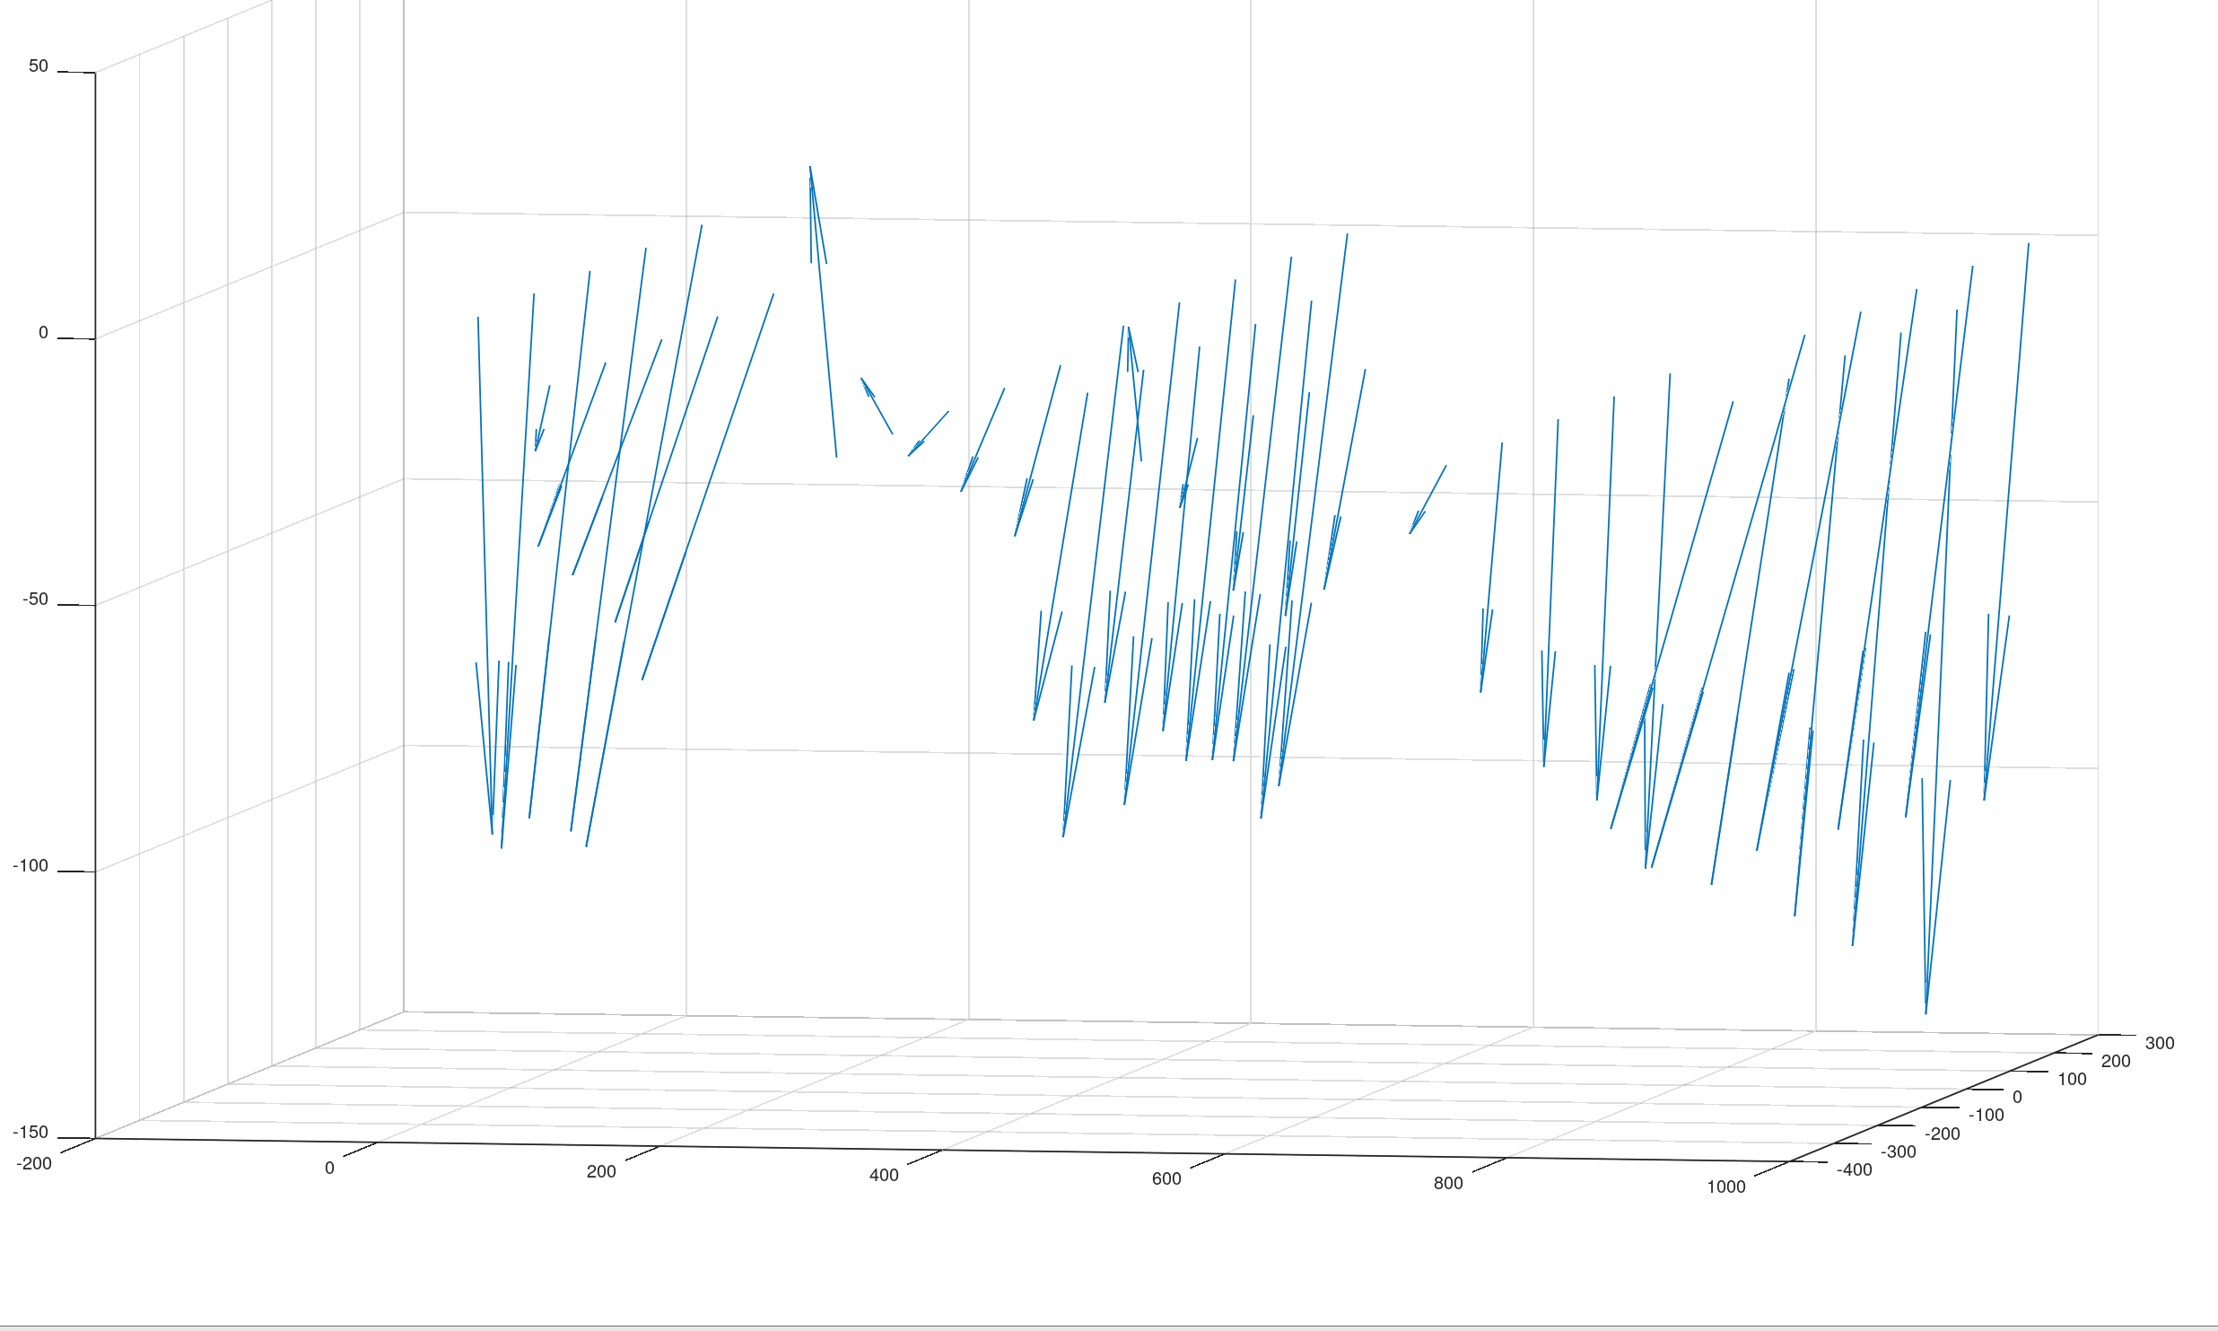
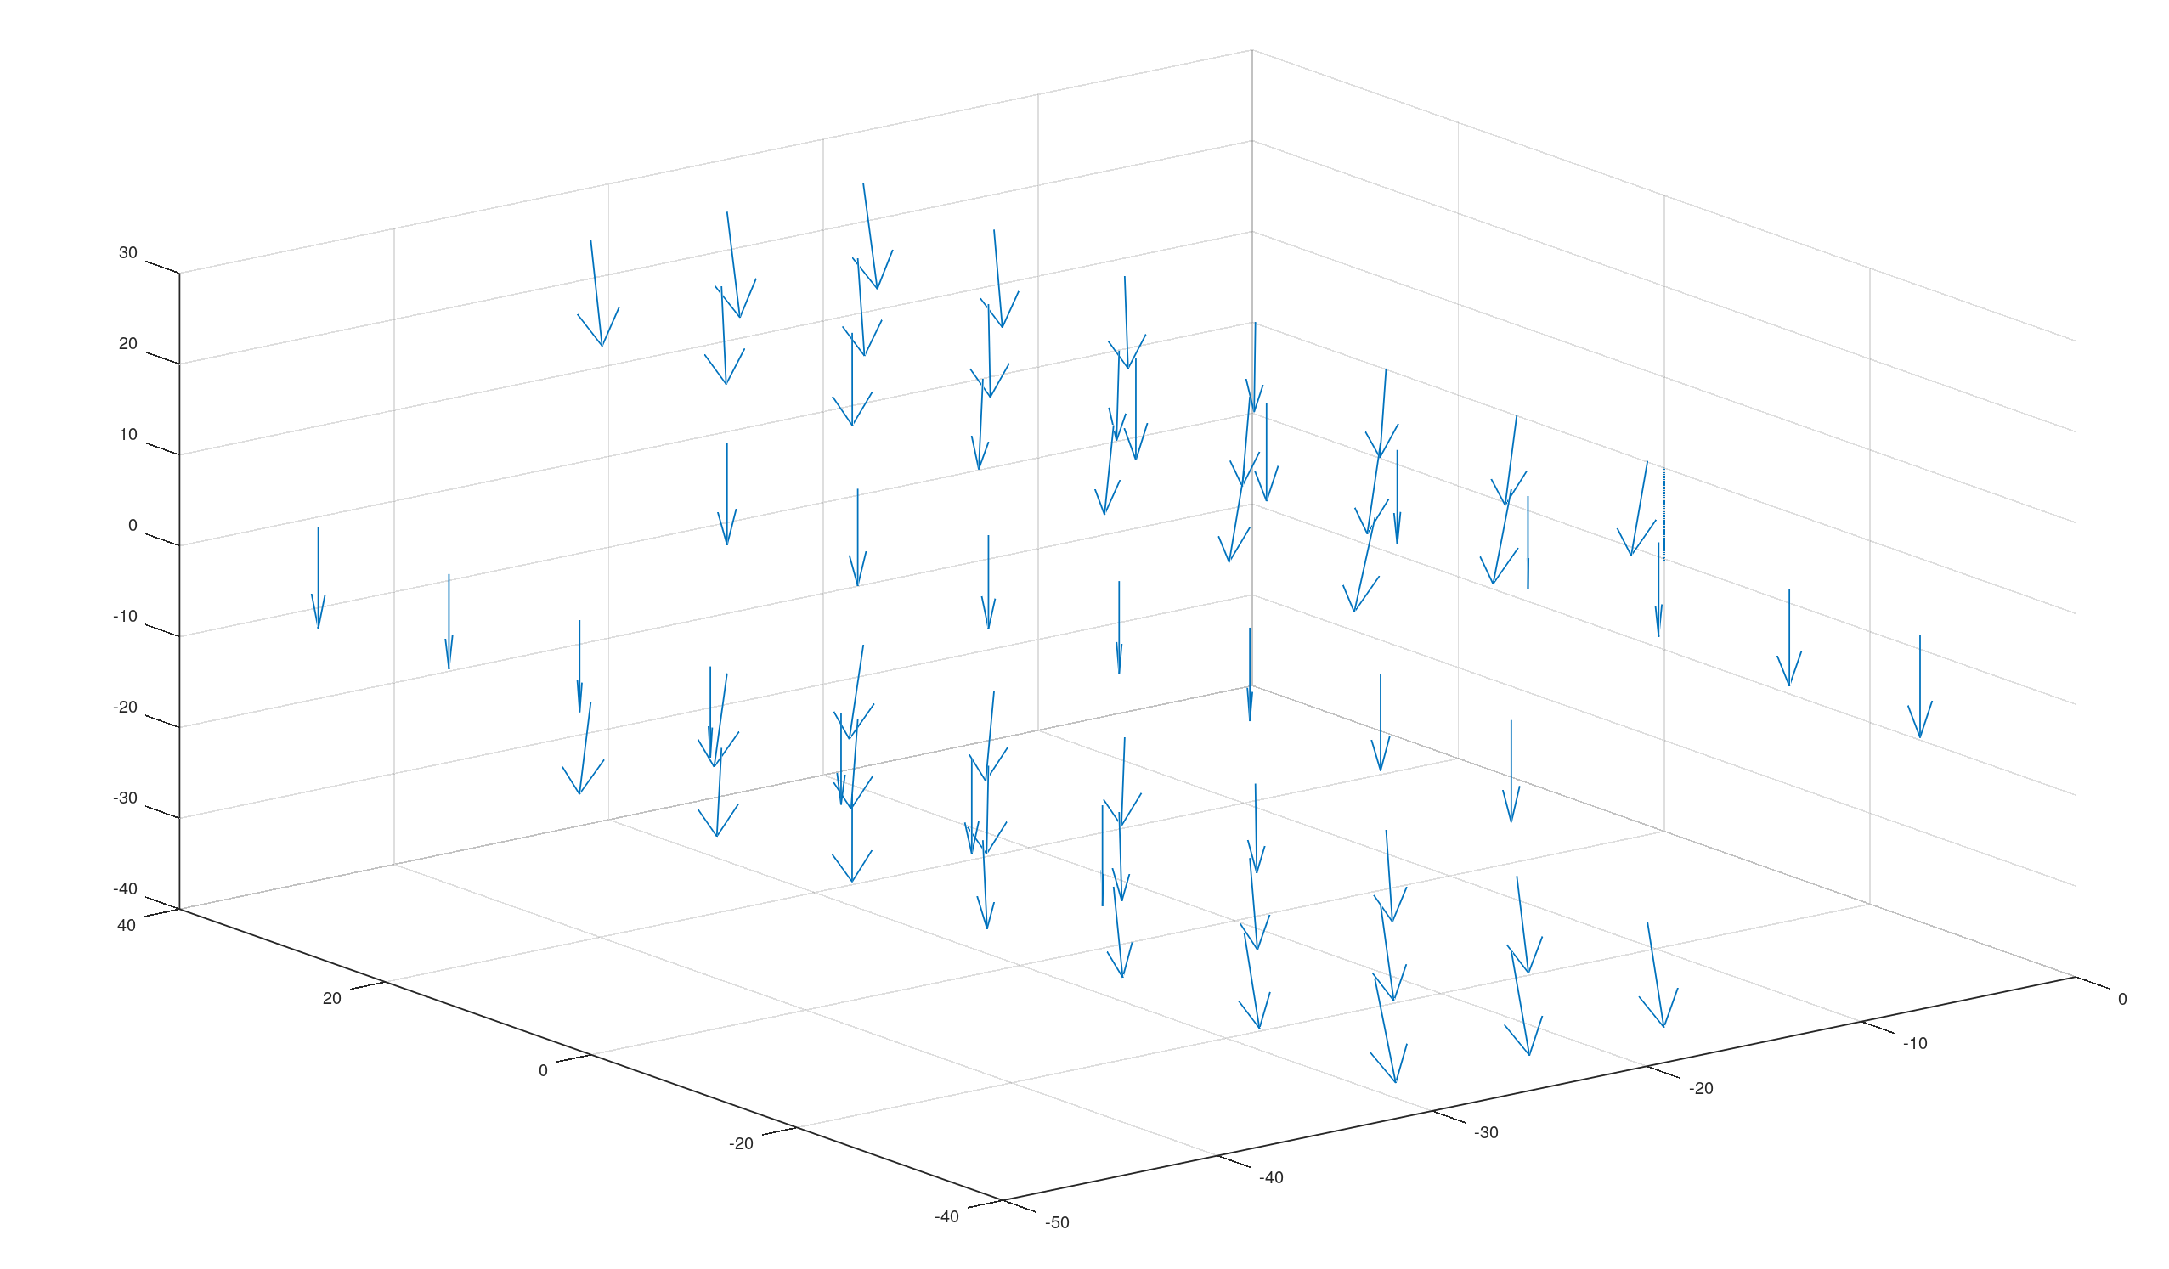
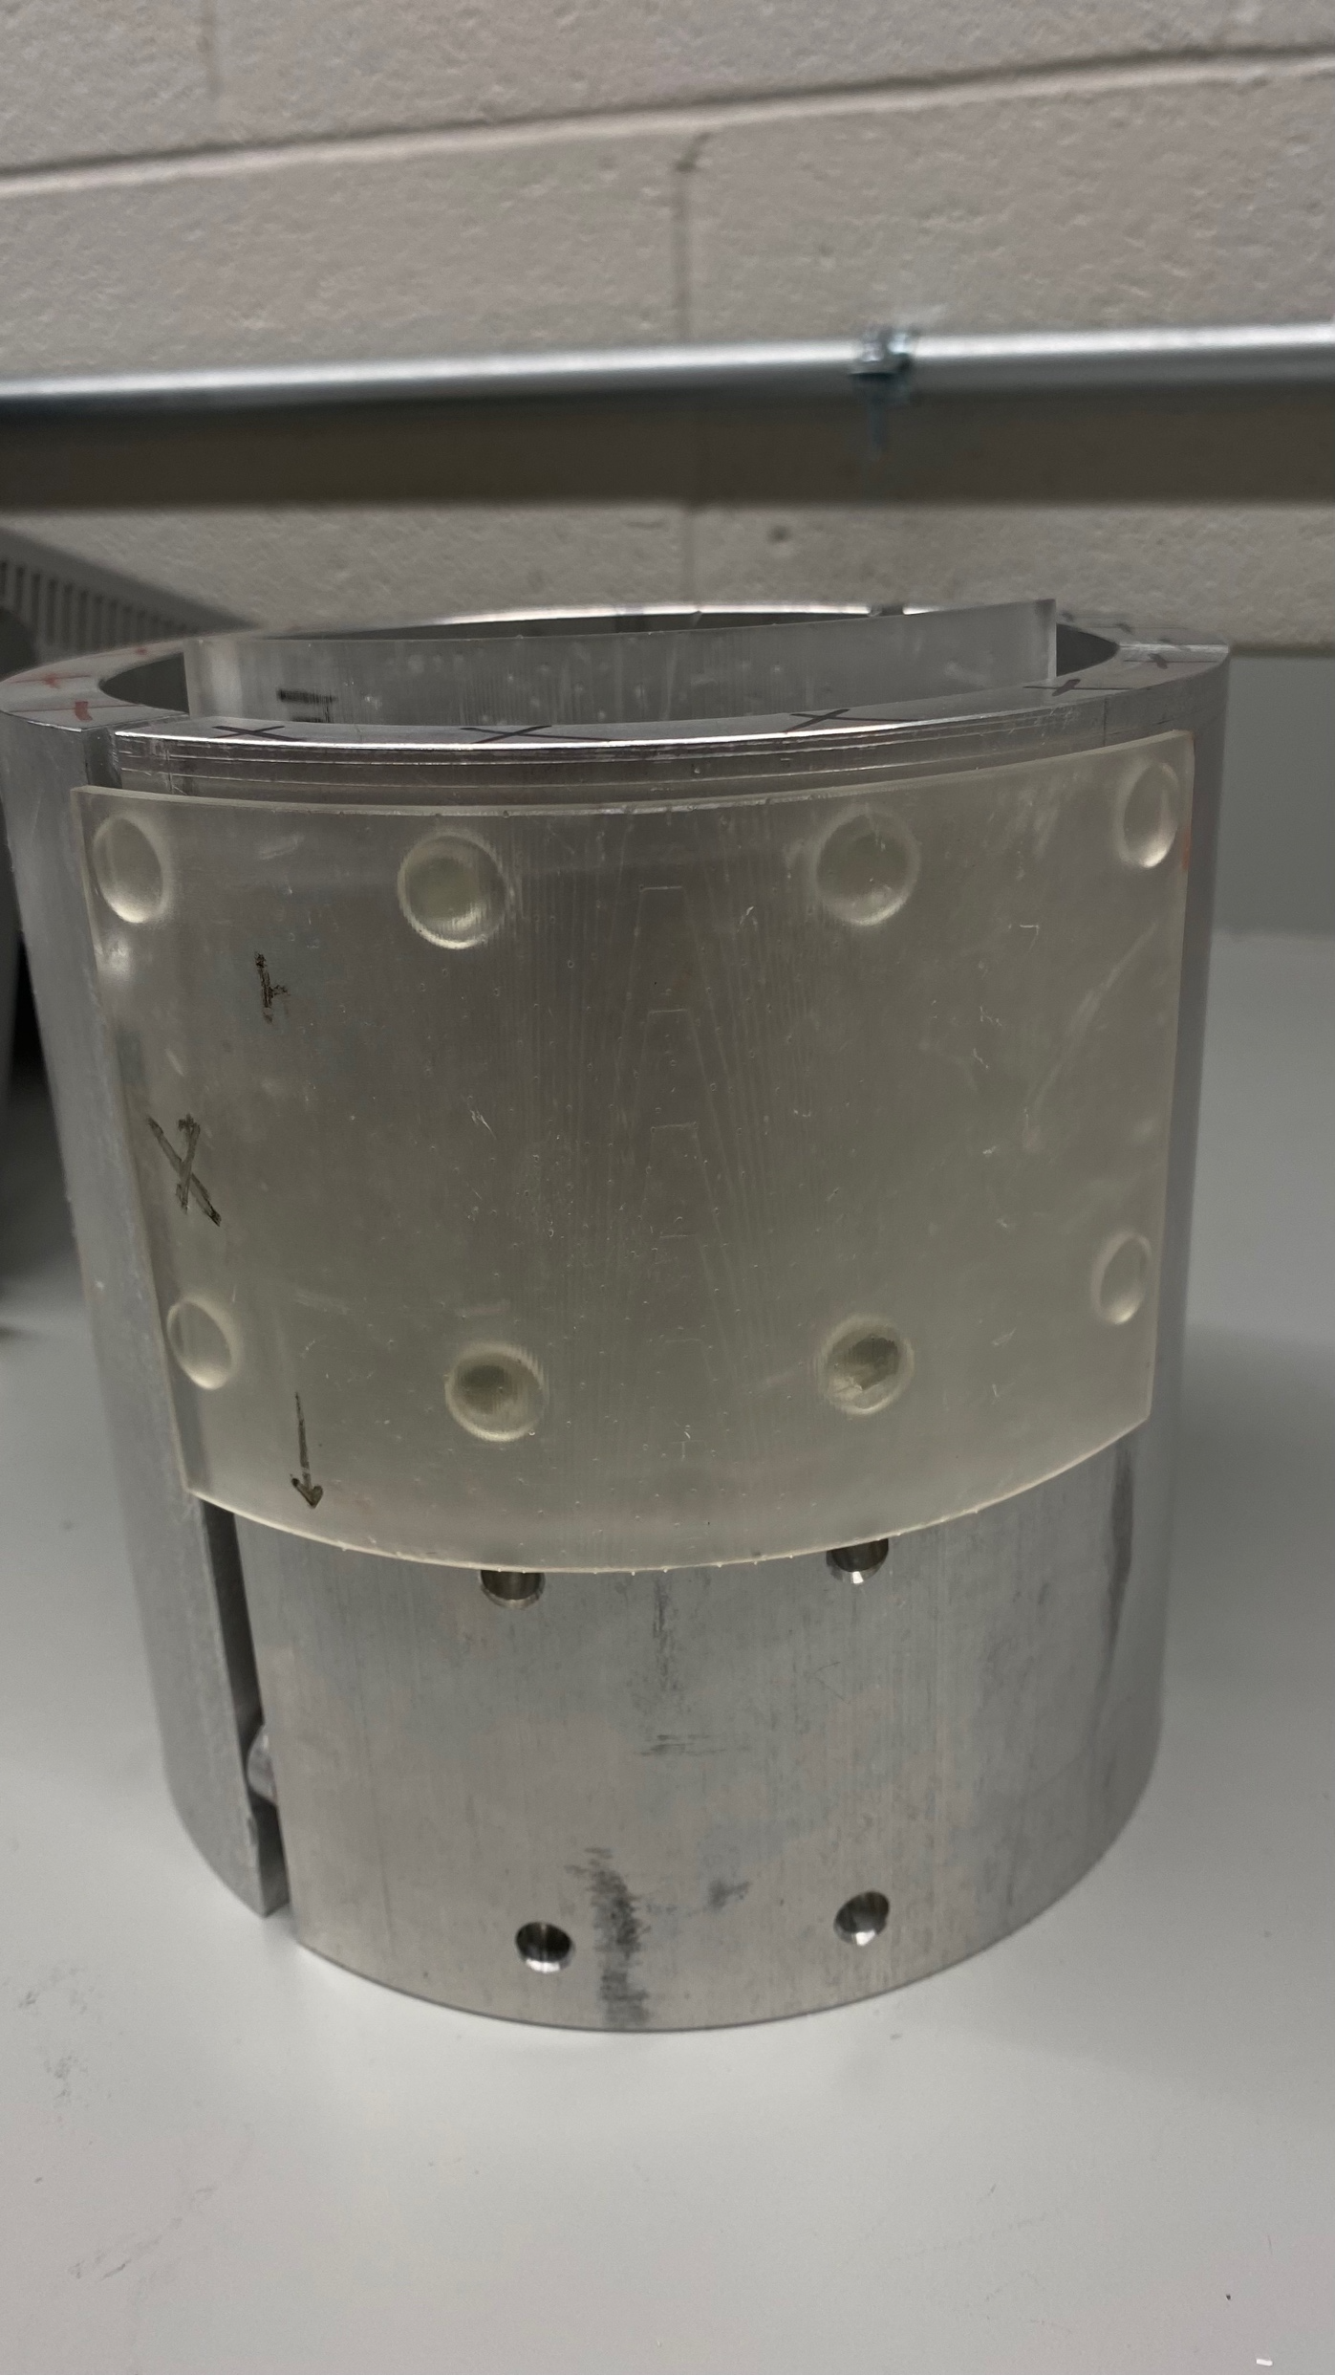
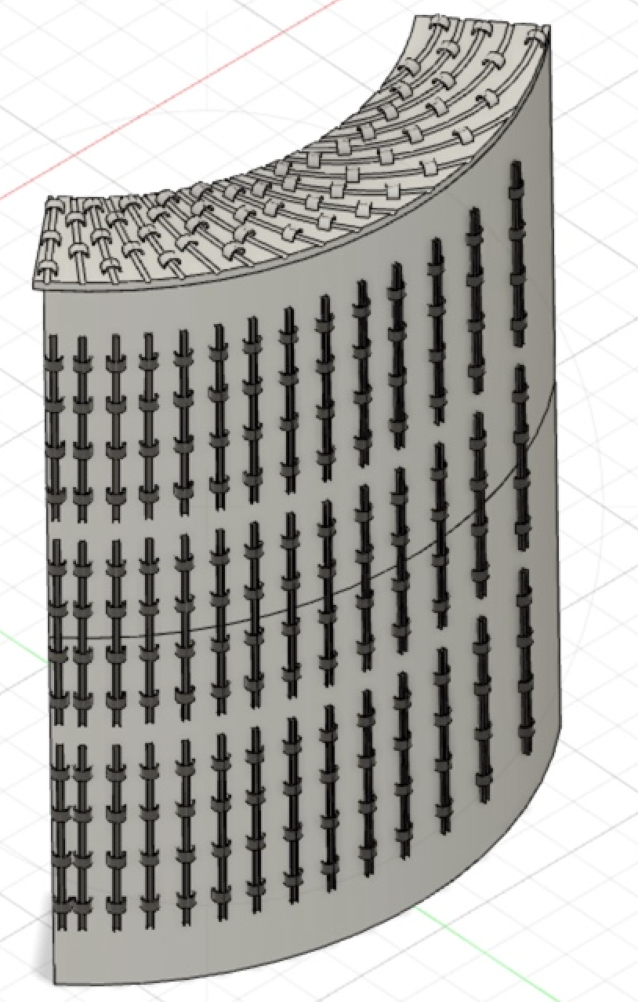
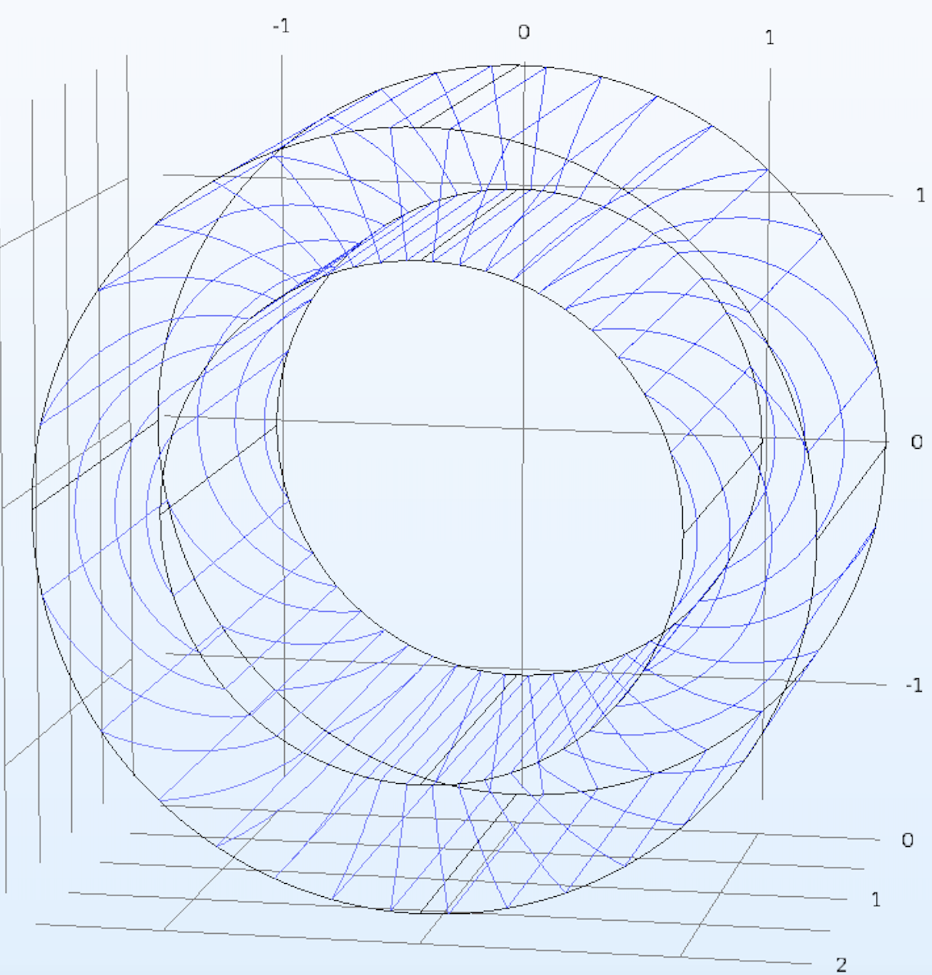
Motivation: In particle physics, neutrons can be manipulated to recess in a uniform magnetic field. To accomplish uniformity, CAD design was used to Design a uniform magnetic field that will be used in measuring the electric dipole moment of the neutron.
Non-Cognitive Predictors of Student Success: A Predictive Validity Comparison Between Domestic and International Students
Magnetic Field Mapping Takeaway:
In order to make accurate equipotential lines in a magnet, a field map is required
Designing a Uniform Magnetic Field for the nEDM
Mapping Magnetic Fields:
Manually measuring a magnetic field is possible by using a magnetometer and MATLAB
Stephanie Betancourt, Hena Kachroo, Christopher Delcher
Introduction
Detecting a non-zero electric dipole moment (nEDM) of a neutron would give immense insight to the matter-antimatter imbalance in the universe, known as the Baryon Asymmetry. A nEDM can be accurately detected with an extremely uniform magnetic field. A design which included an aluminum skeleton, skins, and clips was designed in CAD. The uniformity can then be tested and visualized using MATLAB and used to make changes and improve the electromagnet’s uniformity. ​
METHODS
Use Fusion 360 to design a prototype
Print the prototype using Preforms 3D printing
Use COMSOL to get the Double Cosine Theta Coils’ equipotential lines
CAD RESULTS
It is important to test different dimensions of the designs in small increments due to low resolution of printing. ​
E.g. the clips were pushed together by an estimated amount in Fusion 360 to keep the wires in place on the second print.​
Errors were mainly due to the abilities of the printer and not the internal design. ​
Some segments of the prints were broken off during construction or simply not printed at all. Since the printer neglects elements of the design after a certain size threshold, printing at a higher resolution would fix this problem.
Figure 1: Measured B-Field
Another way of mapping magnetic fields is by using MATLAB and a script created by Dr. Crawford
This format gives more precise mapping points
First Design
Was printed in $1/8$ sections
Was printed in 1⁄8 sections
Had no equipotential markings
Pegs were corrected
Clip design
Trial and error
A trench-like design was better fitting
Encapsulates the wiring to better aid in uniformity
Figure 2: MATLAB calculated B-Field
Magnetic Field Mapping Takeaway:
In order to make accurate equipotential lines in a magnet, a field map is required
Manually taking measurements is a good way to verify your work but has some margin of error
Skin with equipotential lines
Has an added lip at the top and bottom
Was printed in 1/4 sections vs 1/8.
COMSOL equipotential lines
Was integrated into the final skin design
Has precise equipotential lines
Conclusions/ Future Work
Make adjustments to inner skin designs based on the curvature of the skeleton​
Align clips on inner skins based on the equipotential lines​
Print skins to completely cover the skeleton ​
Wind the coil and map the magnetic field using the robotic mapper
Acknowledgements:
The University of Kentucky Department of Physics and Astronomy​
Funding by the Summer Undergraduate Research Fellowship​
This work is funded in part by the National Science Foundation under grant PHY-1950795​
National Science Foundation REU Program
Notes:
Notes:
In Powerpoint, click View > Guides
Keep text within gutter guides.
Author list: Don’t split names onto two lines (e.g., “Jimmy [break] Smith”). If that happens, use a new line, unless you need the space. Bold the first names of anybody who’s presenting in person.
Intro/methods/result: Do not drop below font size 28, but if you have extra space, jack up the font size until the space is full.
Do not use color in the sidebars except in graphs/figures. It’ll pull attention from the center and slow interpretation for passersby.

