Slide 1
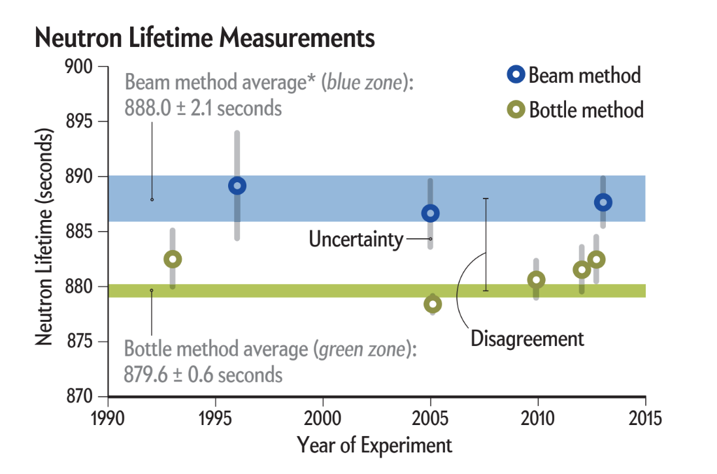
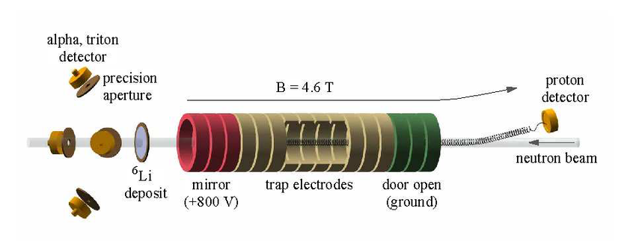
Calculating solid angle numerically, from Any starting point, to optimize for Uniformity
Non-Cognitive Predictors of Student Success: A Predictive Validity Comparison Between Domestic and International Students
Non-Cognitive Predictors of Student Success: A Predictive Validity Comparison Between Domestic and International Students
Creating Apertures to optimize solid angle uniformity for the BL3 proposal:
Method
Get surface defined only by points
Define starting point
Shift all points on surface and start so that the start is the origin
Cut a slice of the surface on the yz plane
Calculate a width for that slice
Determine normal vectors for 3 dimensions
Multiply height width and dot with normal
Sum results of all slices
Author Tyler J. Mason, Joshua A. Young, Dr. Christopher Crawford
Neutron Lifetime Disagreement
2 methods which are both successful in other particle lifetime experiments fail to agree on the neutron
BL3 Proposal
A beam method experiment that aims to lower experimental error in order decrease the inaccuracy of the experiment
Apertures
Apertures placed around the alpha triton detectors in order to make uniform solid angle from any particle.
Particles can come from any point across the beam width,
Neutron Lifetime Disagreement
2 methods which are both successful in other particle lifetime experiments fail to agree on the neutron
Results
Is possible to code and runs relatively quickly
Inaccurate results, cannot determine source of error
Approach created by Dr. Crawford is faster, and very accurate
Moving Forwards
Dr. Crawford's method fails when aperture is near z axis
Continue to search for error to fix the program
This method can be used to cover situations where Dr. Crawford's method fails
Why not analytically?
Speed and repeatability
Difficult to define the apertures with simple functions
tjma237@uky.edu
Notes:
Notes:
In Powerpoint, click View > Guides
Keep text within gutter guides.
Author list: Don’t split names onto two lines (e.g., “Jimmy [break] Smith”). If that happens, use a new line, unless you need the space. Bold the first names of anybody who’s presenting in person.
Intro/methods/result: Do not drop below font size 28, but if you have extra space, jack up the font size until the space is full.
Do not use color in the sidebars except in graphs/figures. It’ll pull attention from the center and slow interpretation for passersby.

