Slide 1
Probing Electrostatic Interfaces Between van der Waals Materials
AJ Tompkins
REU Program
July 5th, 2022

Slide 2
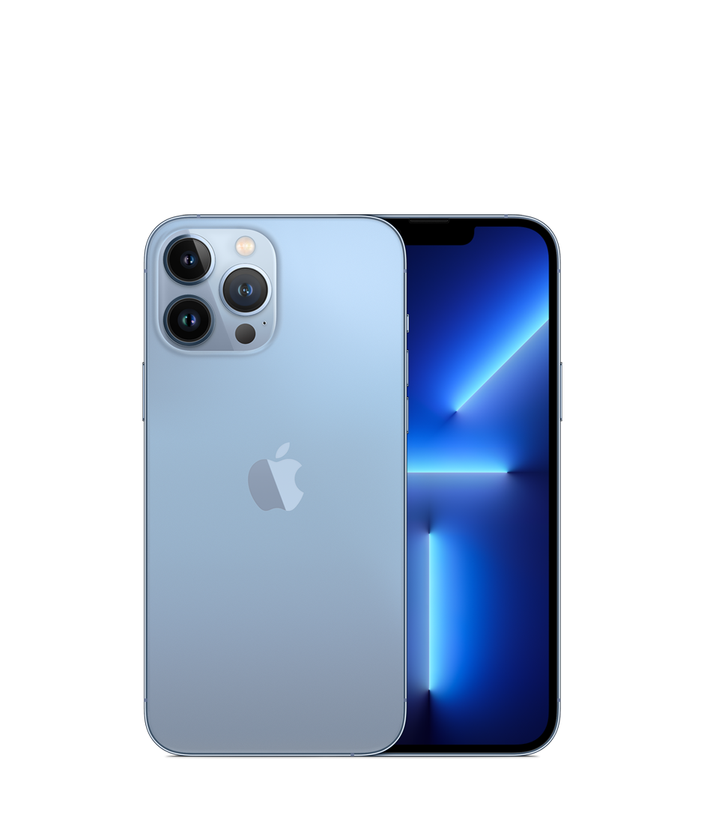
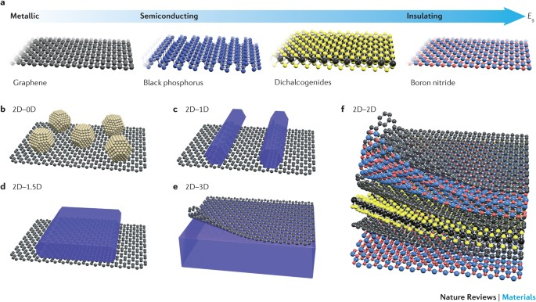
What are van der Waals Materials?
Two-dimensional material that emits a weak attractive force
Used in modern day technology
Liu, Yuan, Nathan O. Weiss, Xidong Duan, Hung-Chieh Cheng, Yu Huang, and Xiangfeng Duan. “Der Waals Heterostructures and Devices.” Nature Reviews MVanaterials 1, no. 9 (July 12, 2016): 1–17. https://doi.org/10.1038/natrevmats.2016.42.
https://www.apple.com/shop/buy-iphone/iphone-13-pro/6.7-inch-display-1tb-sierra-blue-unlocked

Slide 3
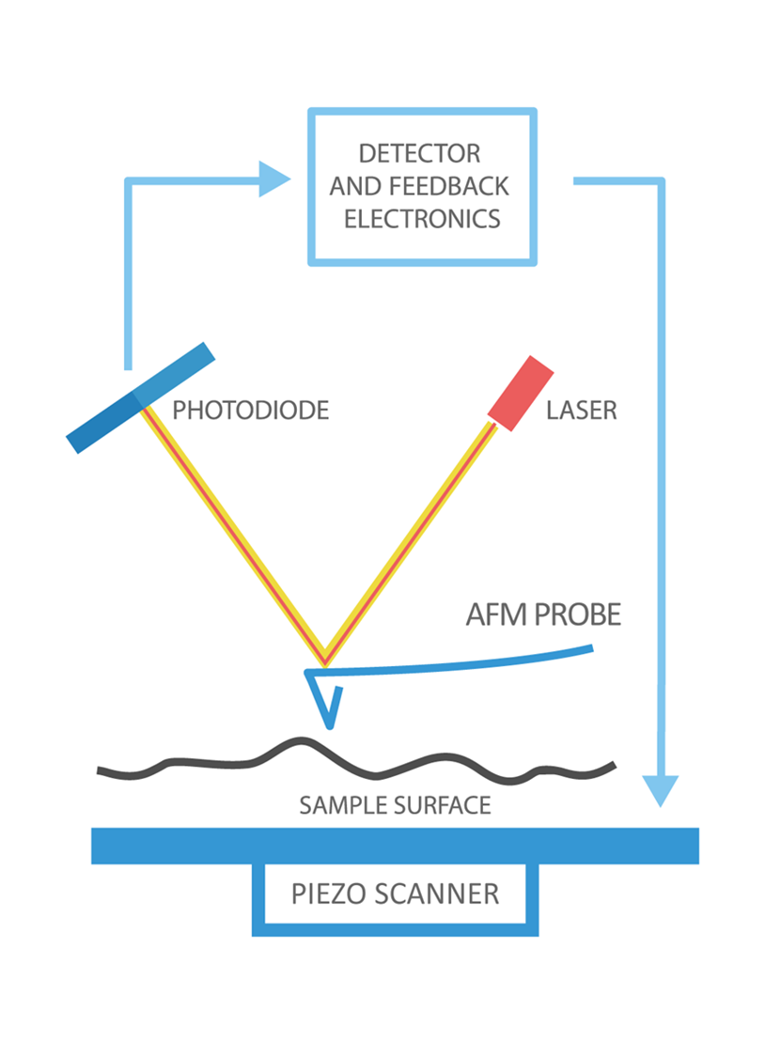
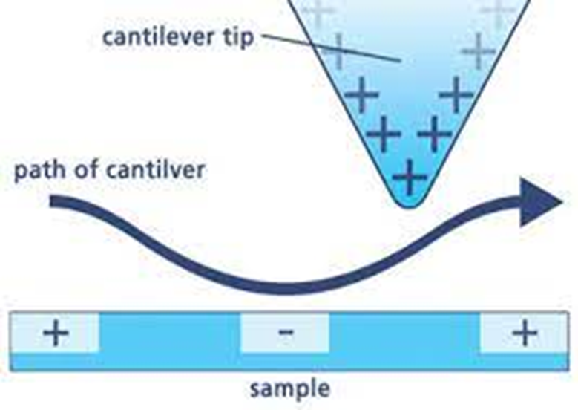
How to probe interfaces
Atomic Force Microscopy (AFM)
Creates topographic image of sample using
oscillating cantilever
Electrostatic Force Microscopy (EFM)
Reveals surface potentials of sample
“What Is AFM? Learn about Atomic Force Microscopy! - NanoAndMore.” Accessed July 3, 2022. https://www.nanoandmore.com/what-is-atomic-force-microscopy.
“Imaging the Electrostatic Force with an Atomic Force Microscope.” Accessed July 3, 2022. https://www.nanowerk.com/spotlight/spotid=15905.php.

Slide 4
Synthesizing heterostructures
hBN
Gold
hBN

Slide 5
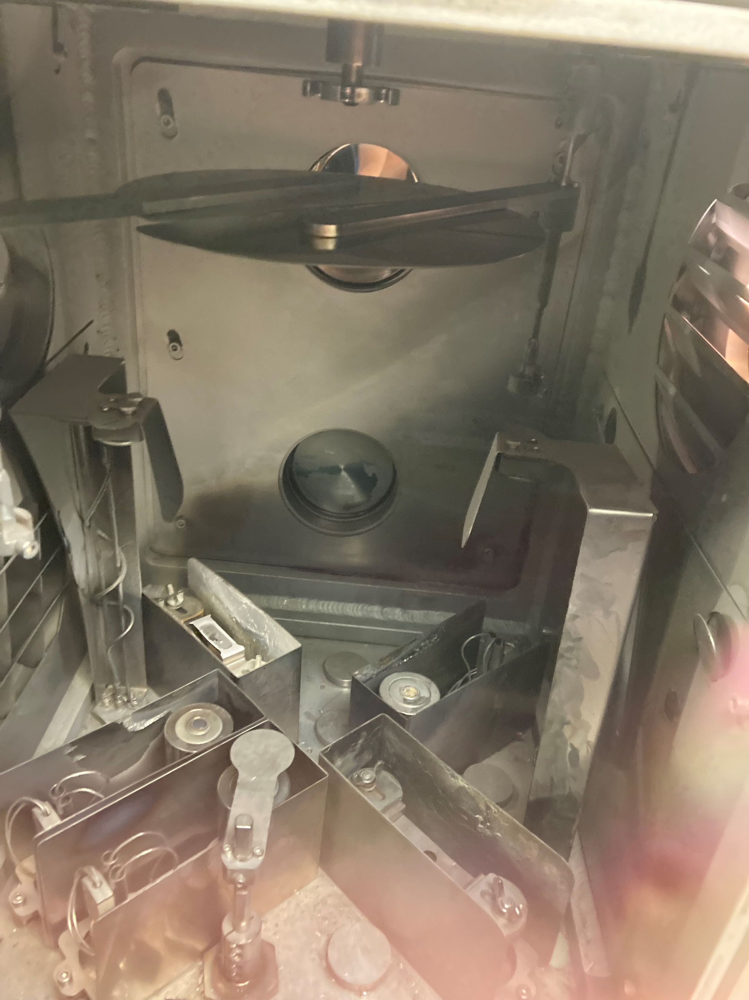
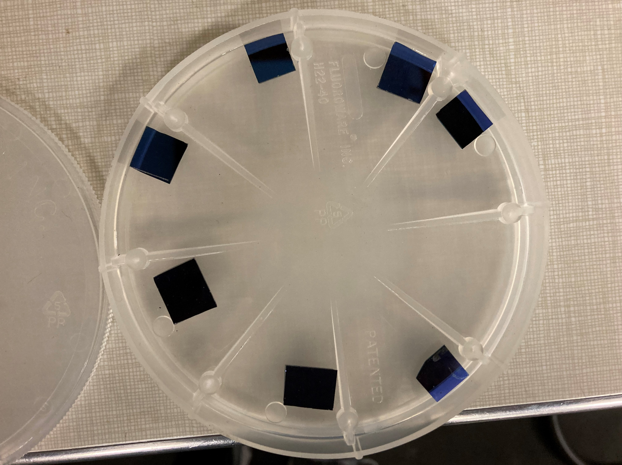
Putting Gold onto Silicon Wafer
Blue squares are silicon wafers
Gold is evaporated onto the wafer

Slide 6
Stamping
Polymer melts and captures hBN flakes
ResearchGate. “Figure 1. PDMS Stacking Process for Fabrication of VdW Heterostructure....” Accessed July 3, 2022. https://www.researchgate.net/figure/PDMS-stacking-process-for-fabrication-of-vdW-heterostructure-The-flake-exfoliated_fig1_334519290.

Slide 7
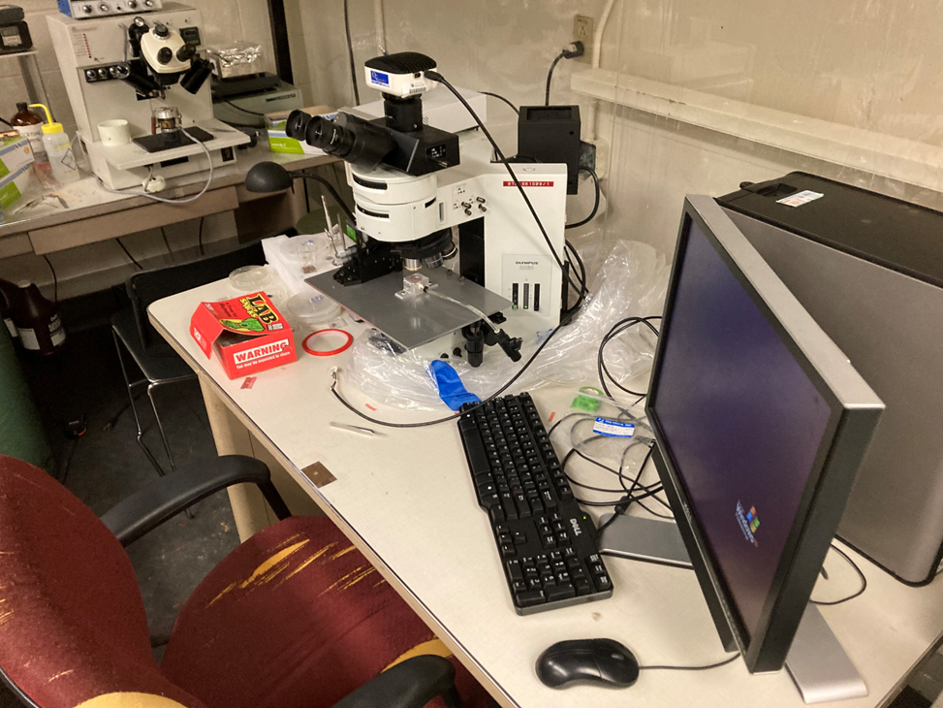
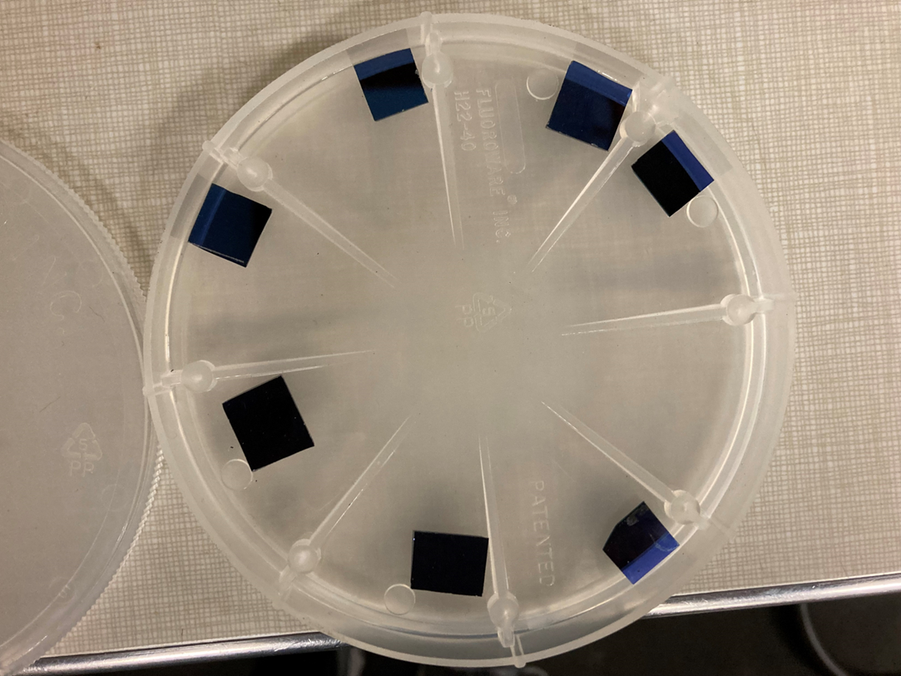
Finding thin flakes
Half are hBN; half are Au_hBN
Microscope is used to find flakes of interest

Slide 8
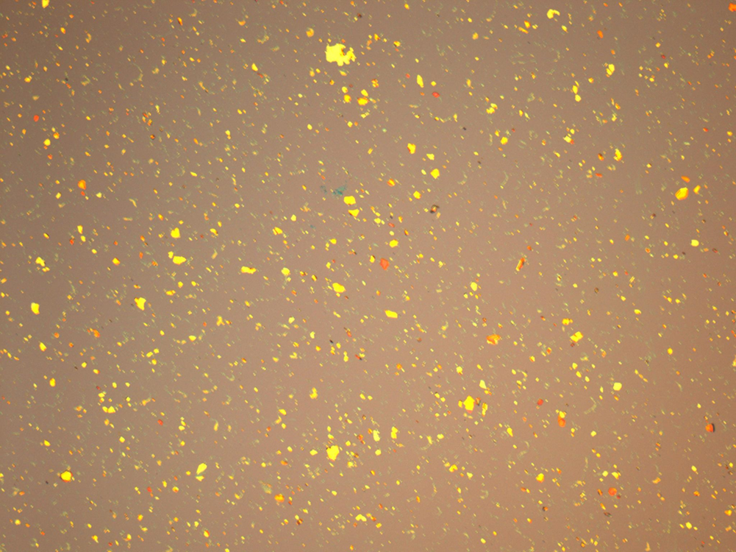
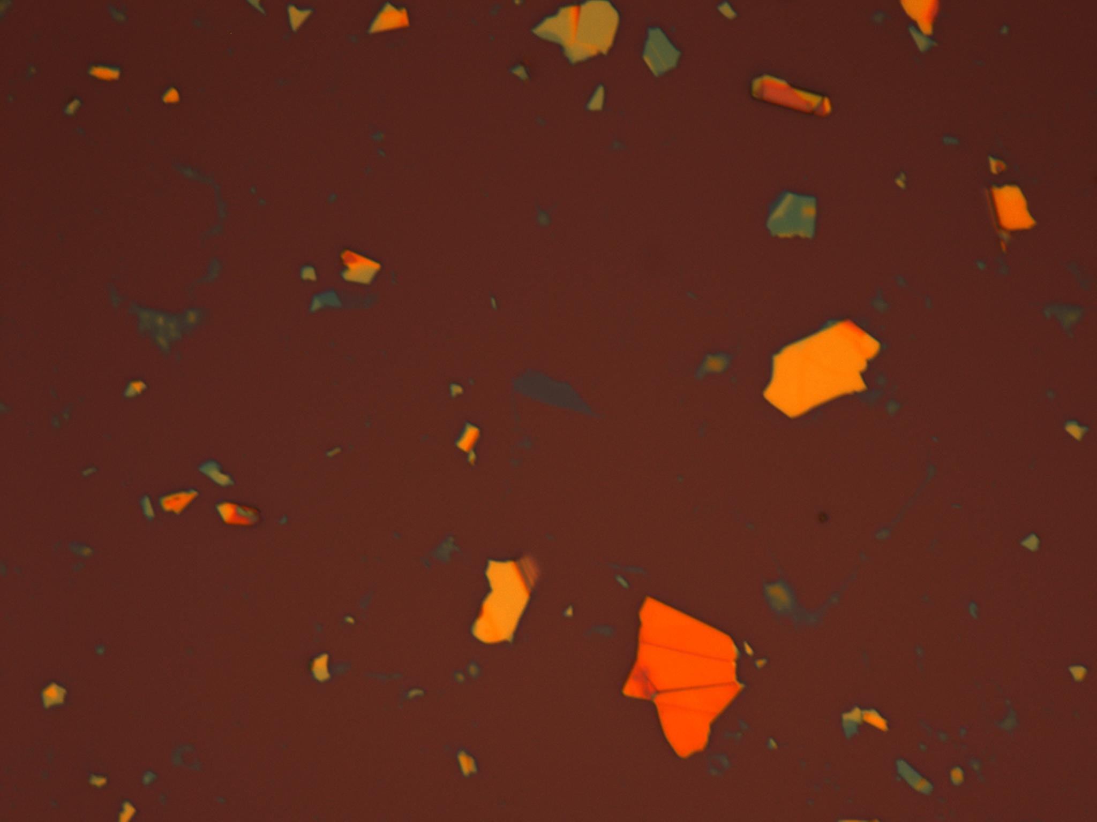
Top Layer
Orange flakes are thick; blue flakes are thin
After thin flake is found, polymer is used to capture it

Slide 9
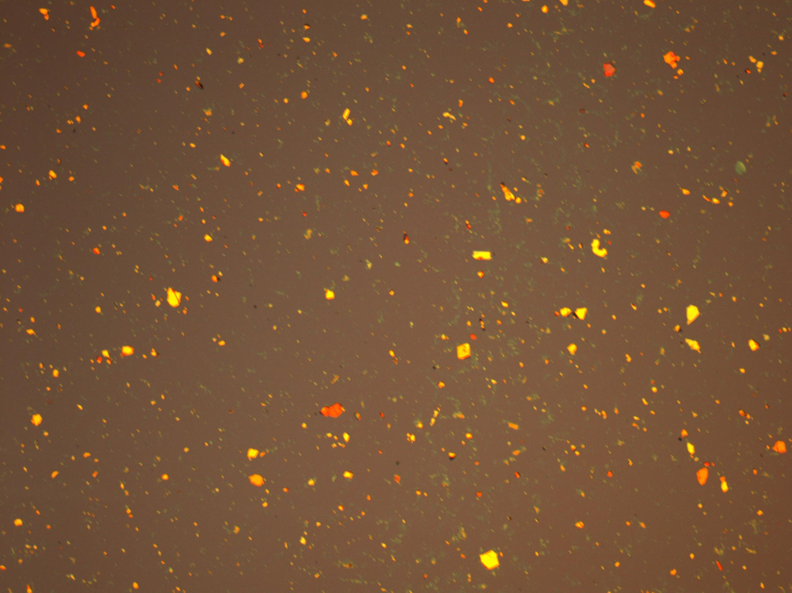
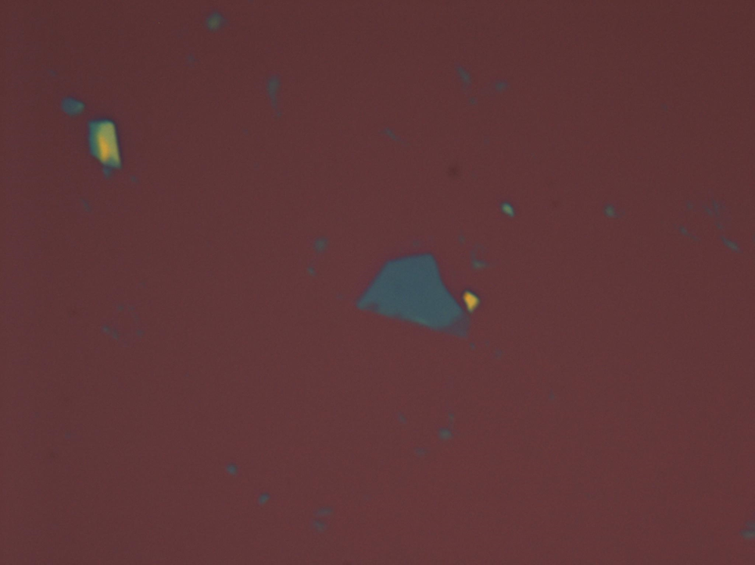
Bottom Layer
Same process, thin flake is found
Top layer is aligned with the bottom layer

Slide 10
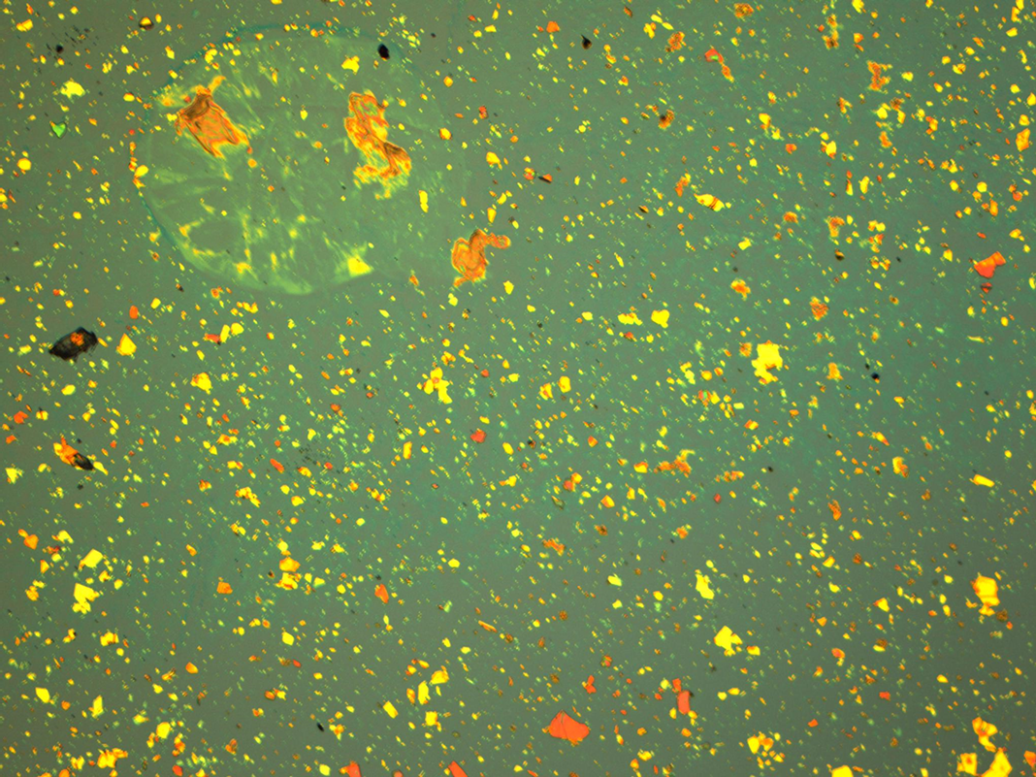
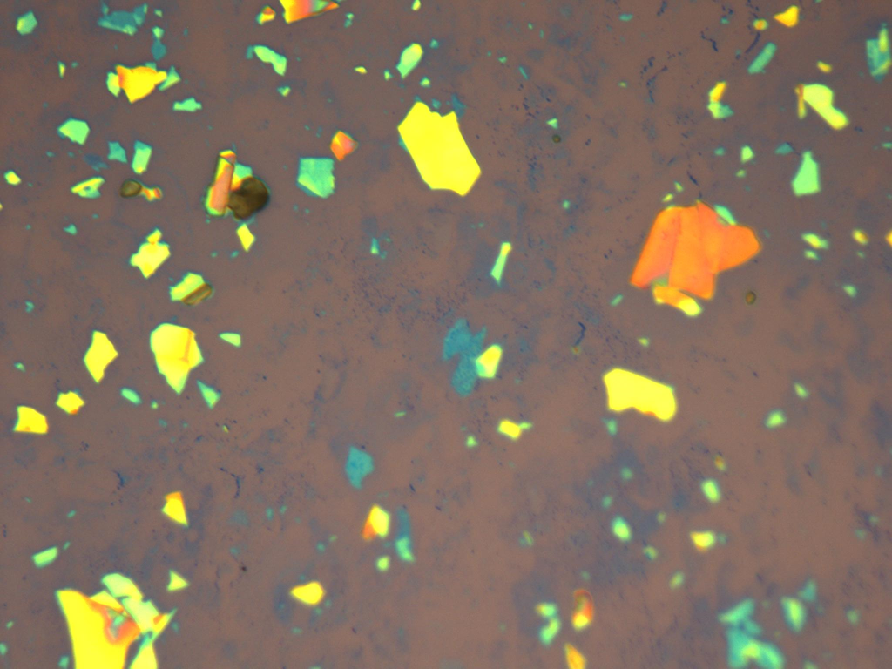
Completed Heterostructure
hBN_Au_hBN heterostructure
Now the sample can be analyzed via AFM and EFM

Slide 11
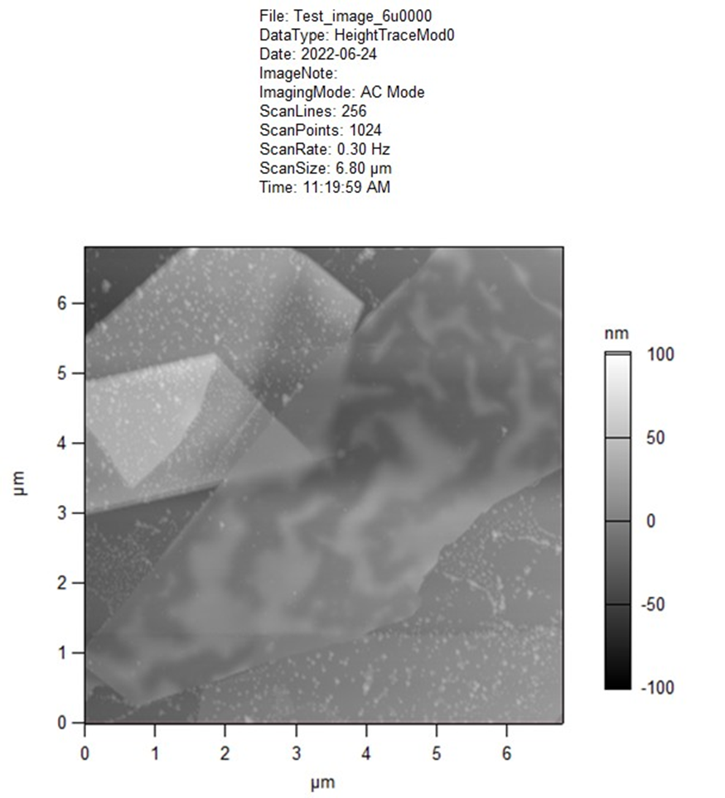
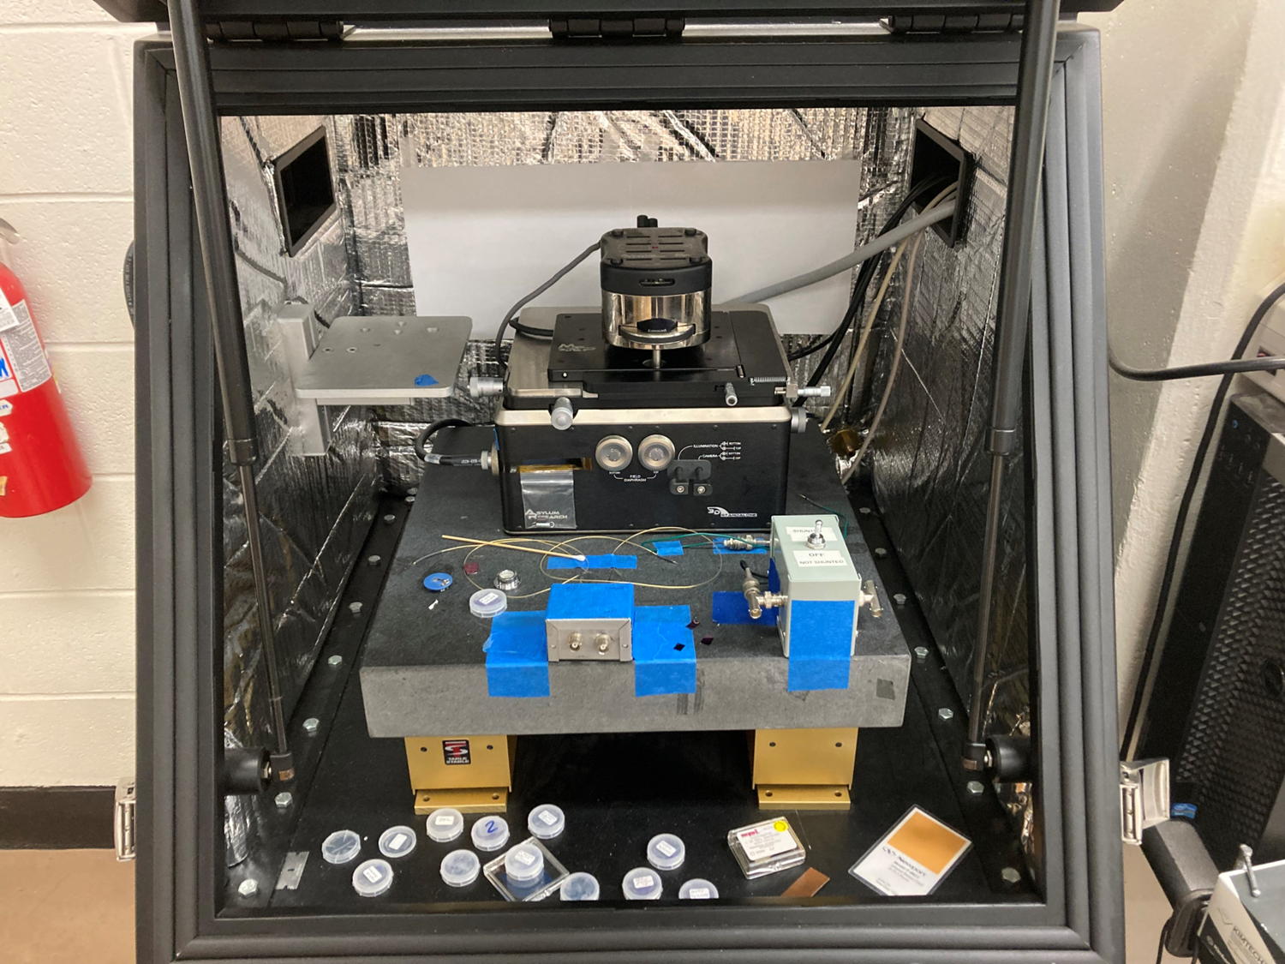
AFM Machine
Cantilever is located under the metallic head at the top
It takes several hours to collect data of the sample

Slide 12
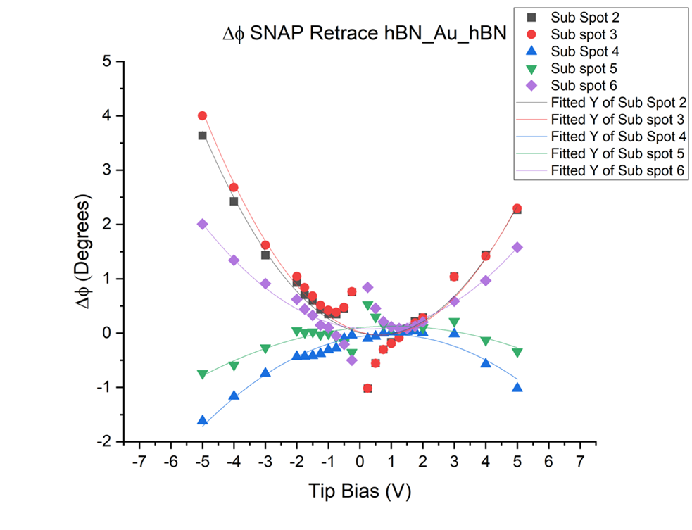
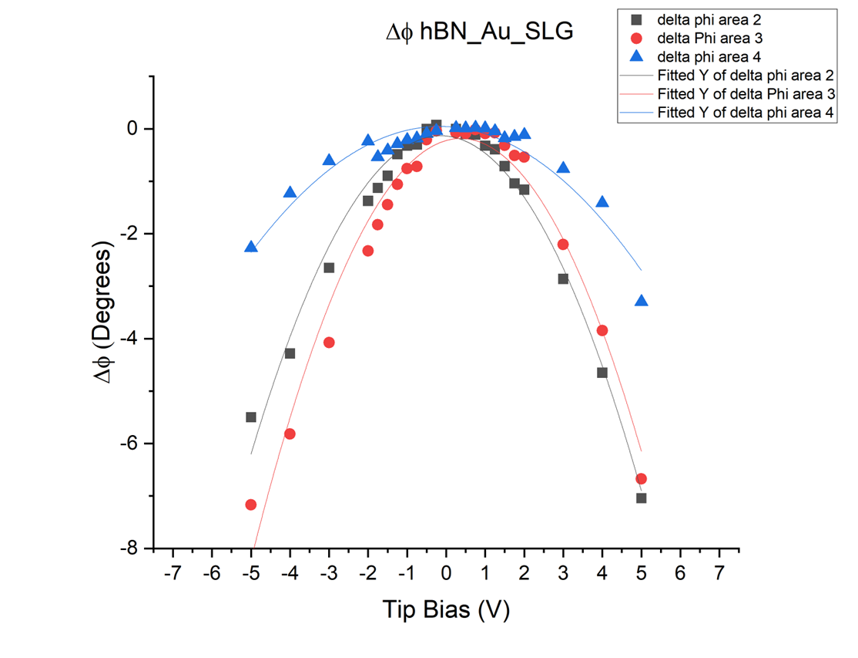
Analysis of Data
Normal graphs are parabolic, however this one is reciprocal

Slide 13
Summary
Van der Waal materials have conductive/inductive properties
AFM/EFM are used to measure these properties
Synthesizing heterostructures takes time and patience
In the future, twisted layer graphene will be analyzed
Questions?

Slide 14
Acknowledgments
University of Kentucky, Department of physics and astrology
Graham lab, Department of Chemistry
Dr. Doug Stratchen
Dr. Beth Guiton
Kathryn Pitton

