Slide 1
Non-Radial Pulsation in RR Lyrae Stars
By: Anthony Kelly
Faculty Mentor: Ron Wilhelm

Slide 2
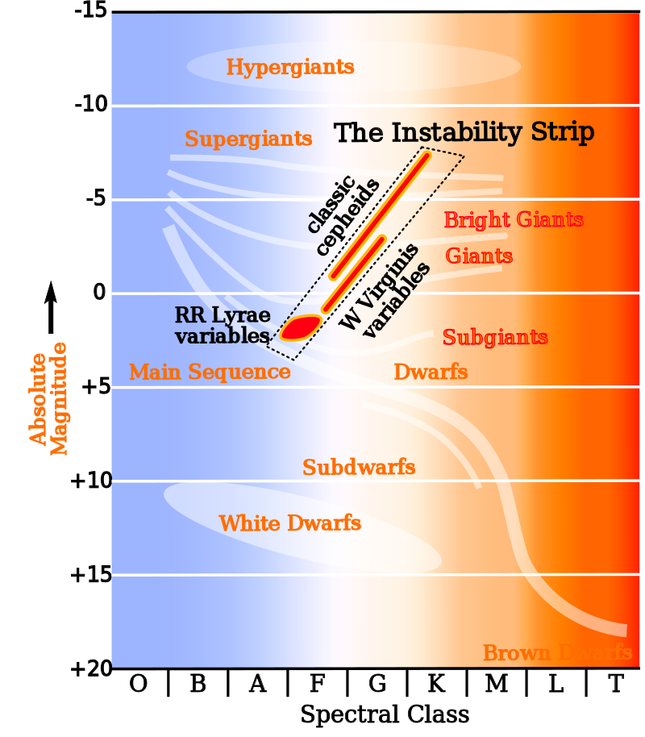
Reminder of HR Diagram

Slide 3
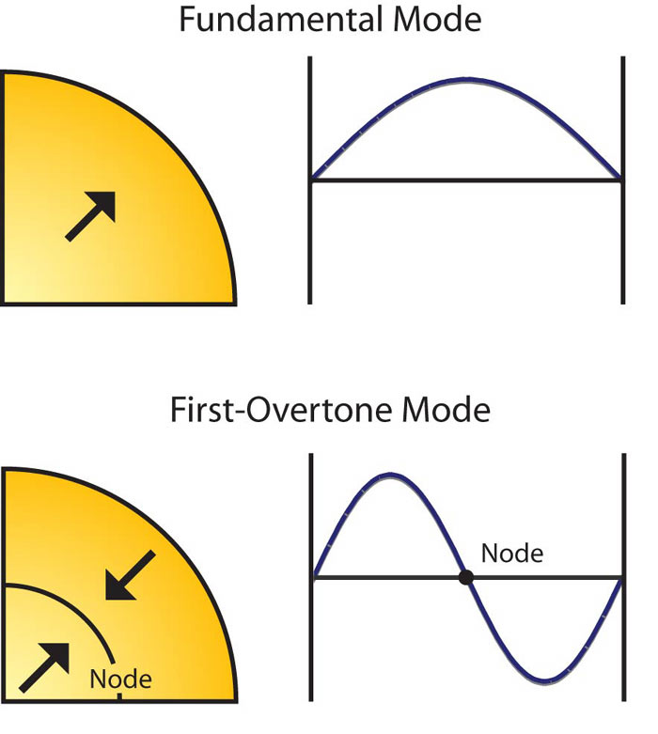
Properties of RR Lyrae Variable Stars
Burns Helium in their core
0.6-0.8 Solar Masses
Approximately 10 Billion years old (age of the Universe is 13.8 Billion years)
Well defined Luminosities (standard candle)
Subclassifications:
RRab (fundamental)
RRc (1st overtone pulsator)
RRd(both fund. & 1st overtone)

Slide 4
How does Radial Pulsation Work?
Kappa-mechanism (κ refers to the opacity)
Collapse of the partially-ionized Helium zone causes increased opacity (increasing heat trapped)
Pressure acts as a piston pushing the He zone past equilibrium

Slide 5
What is Non-Radial Pulsation?
Driving Mechanism is not well understood
Interested in how this mode changes in amplitude and eventually phase

Slide 6
Period04
Fourier Transform
Converts light curves to frequency space
There is an associated frequency for the Radial Pulsation and non-Radial Pulsation

Slide 7
Procedure
Split sectors into groups to see how Fx changes
Min 18 cycles

Slide 8
XX Dor
RRc variable star with 7 months and 12 months of observations
Features a non-radial mode which often splits into multiplets
Background subtractions are necessary due to large pixel sizes

Slide 9
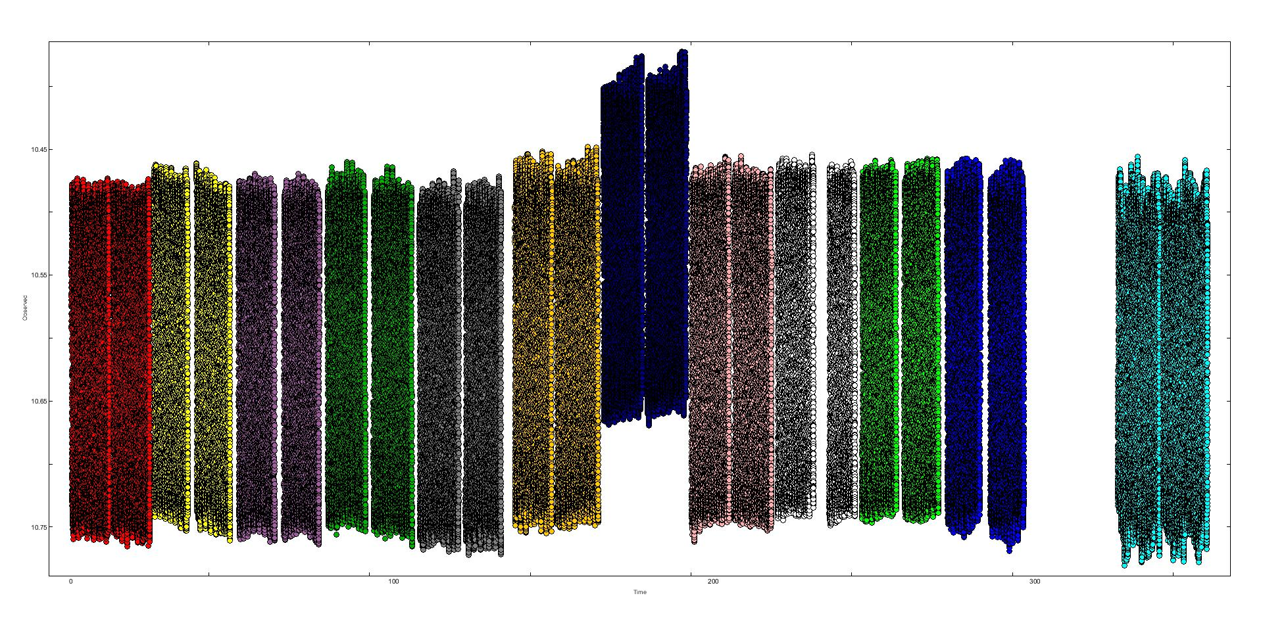
Problems
Dip in Amplitude for the Primary frequency
7th sector heavily zero-point shifted
Solution?
Set everything to the same zero-point

Slide 10
Latest Work
Wrote a python script that zero-point shifted every sector to the same zero-point
Result: Nothing changed
Used a different background subtraction
Result: Original background subtraction affecting the results
Using Python to automate data analysis

Slide 11
Summary
Interested in how the non-radial mode changes
Can give more insight on what happens in stars during their evolution
Maybe be linked to the Blazhko effect
Found better techniques for research
Whenever something might be a problem it probably is

