Slide 1
Building an STM using a 3D Printer
Anthony Ornelas
Advisor: Dr. Kwok-Wai Ng

Slide 2
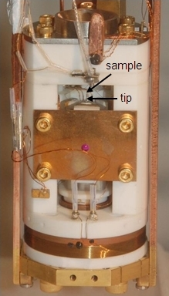
What is an STM?
An STM is a non-optical electron microscope that is used to image surfaces at the atomic level.
An STM allows researchers to characterize the topology of different metals as well as allowing them to examine surface roughness and defects.
An STM can also be used to study the electric properties of materials.

Slide 3
Advantages and Disadvantages
Advantages
STMs can operate in cold temperatures.
STMs can capture a high amount of detail.
STMs are versatile.
Disadvantages
STMs are difficult to use because they must be very stable and very clean.
STMs are fragile and costly.
STMs can only image conductive samples.

Slide 4
Quantum Tunneling
Quantum tunneling is a phenomenon where a subatomic particle acts as a wave and can penetrate a potential barrier with a height greater than the total energy of the particles.

Slide 5
Parts of an STM

Slide 6
How an STM Works

Slide 7
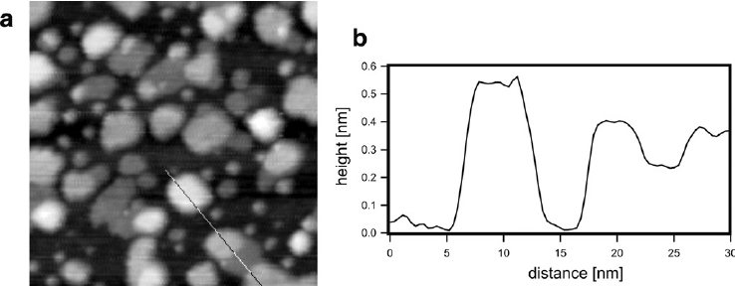
Interpreting STM Data

Slide 8
3D Printed Parts
Piezo tube and Inchworm motor attachment piece.
Piezo tube and Tip attachment
Sample mount

Slide 9
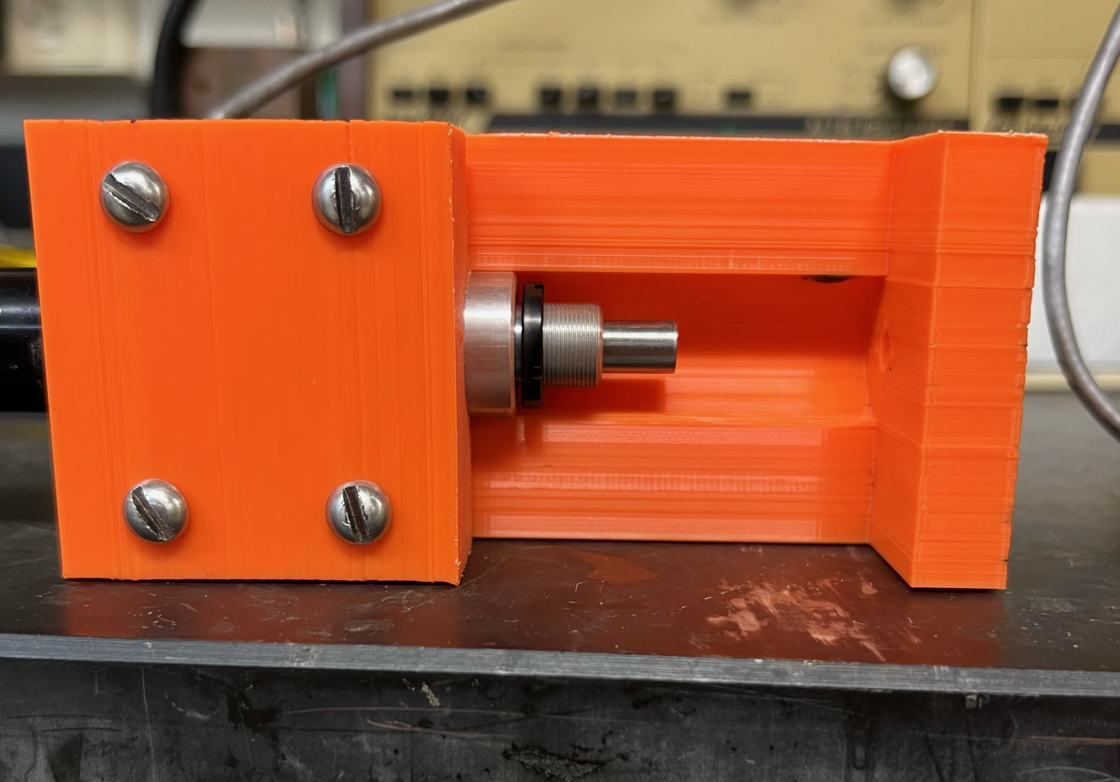
My current progress

Slide 10
Future Steps
Finalize 3D printing
Finish Assembly
Connect Electronics
Tunneling Current Amplifier
Processing and Feedback Unit
Test our product

