Slide 1
Making Ce₂Ge₂Mg
Catie Robinson
Brennan Arnold, Santosh Bhusal, Liam Scanlon, Bill Gannon

Slide 2
Quantum Spin Liquids
Disordered ground state of magnetic moments
Superposition of multiple singlet states
Studied for their use with quantum information
Lucile Savary and Leon Balents 2017 Rep. Prog. Phys. 80 016502
Notes:
Ok so a quantum spin liquid is a disorder ground state of magnetic moments. In general these things are just cool but people want to study them for their potential use in quantum information
So if we want to study quantum spin liquids y r we making CeGeMg???
MAgnaetic ground state in an irl material

Slide 3
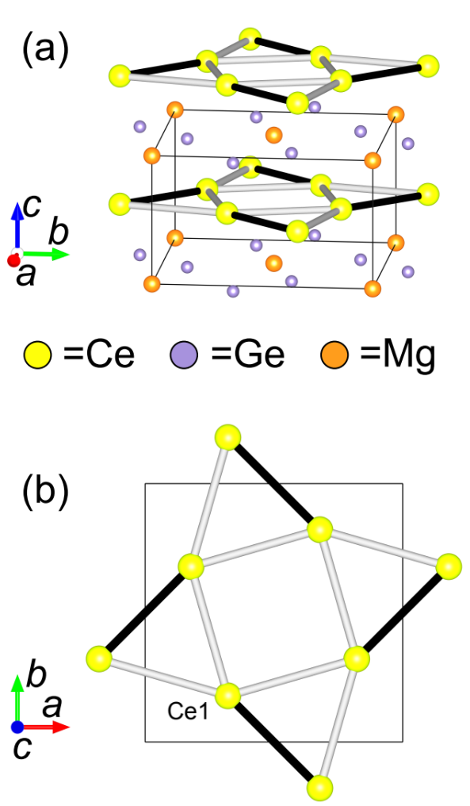
Why Ce₂Ge₂Mg?
Part of greater family of metallic materials - R₂T₂X
The R’s of these sit in a crystal lattice that can host a QSL
Yb₂Pt₂Pb has similar magnetic excitations necessary for QSLs
W. J. Gannon et al…
Notes:
Greater family each made of 2 parts rare earth metal, 2 parts transition metal, and 1part main group element should I just put htat part in YB.. has the 1 dimensional version of the magnetic excited states necessary in quantum spin liquids

Slide 4
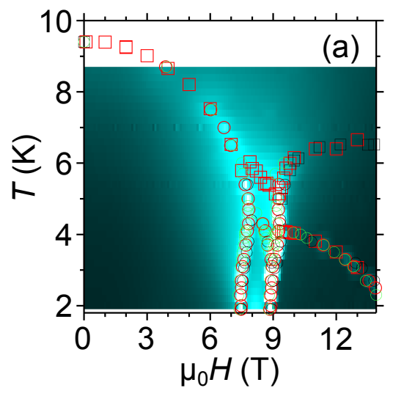
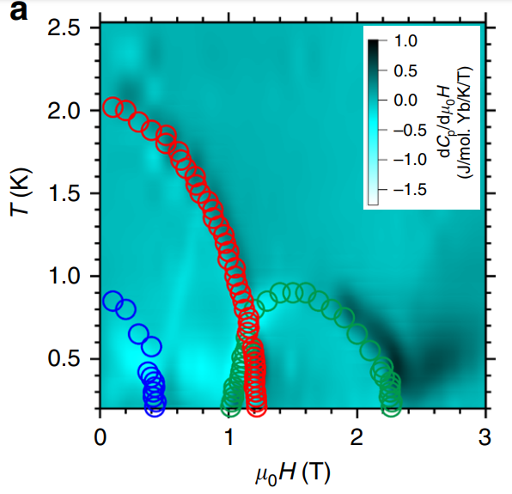
Magnetic Phase Diagrams
Ce₂Ge₂Mg Yb₂Pt₂PB
W. J. Gannon et al…
Gannon, W.J., Zaliznyak, I.A., Wu, L.S. et al….
Notes:
Color is specific heat shapes manetizations and resistance
So we want to make CEGE MG because it has this crystal lattice and looks a lot like this substance with similar excitations

Slide 5
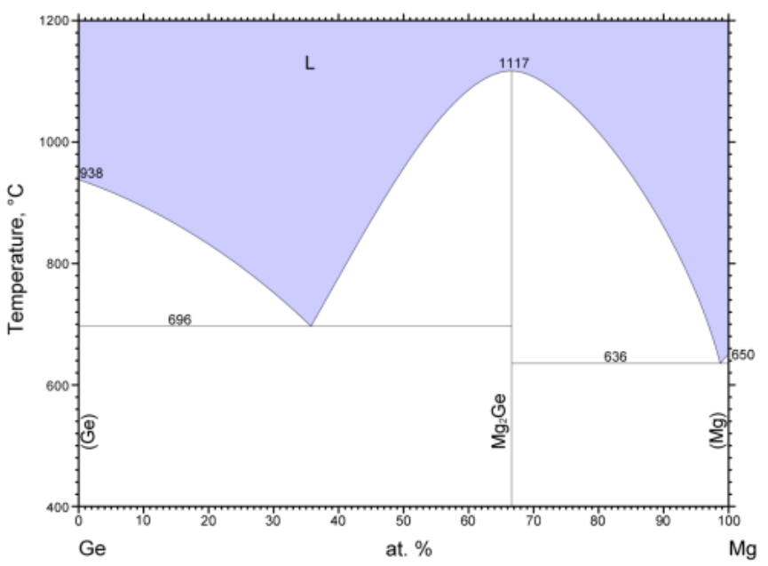
Flux Method
Like sugar Crystals
Melt elements of material in a solvent and let them crystalize slowly as they cool
Elements are proportioned and heated based on previous trials analyzing the binary phase diagrams
Binary Alloy Phase Diagrams, II Ed., Ed. T.B. Massalski,1990,2,,1961-1964,Nayeb Hashemi A.A., Abbaschian G.J., Clark J.B.
Notes:
First point
Second point then “if we take a look at these phase diagrams we see that in a magnesium rich solution with thismuch Ce and thisMuch Ge we get this kind of compound and then they worked it all ou until they found proportions that worked well, similarly the cooling of the solution form the certain temperatures also affectswhat is formed

Slide 6
Issues
Have to use a magnesium as the flux solvent
But magnesium has a high vapor pressure
Must contain sample in strong material to hold the pressure
Done successfully in Gannon’s lab with tantalum tubing
Can we make it with the much cheaper niobium tubing???
Notes:
Previous eperiemnts have shown that the only effective way of making this material is with a magnesium flux The whole flux system must be contained in a material strong enough that the magnesium vapor can create enough pressure to keep liquid magnesium

Slide 7
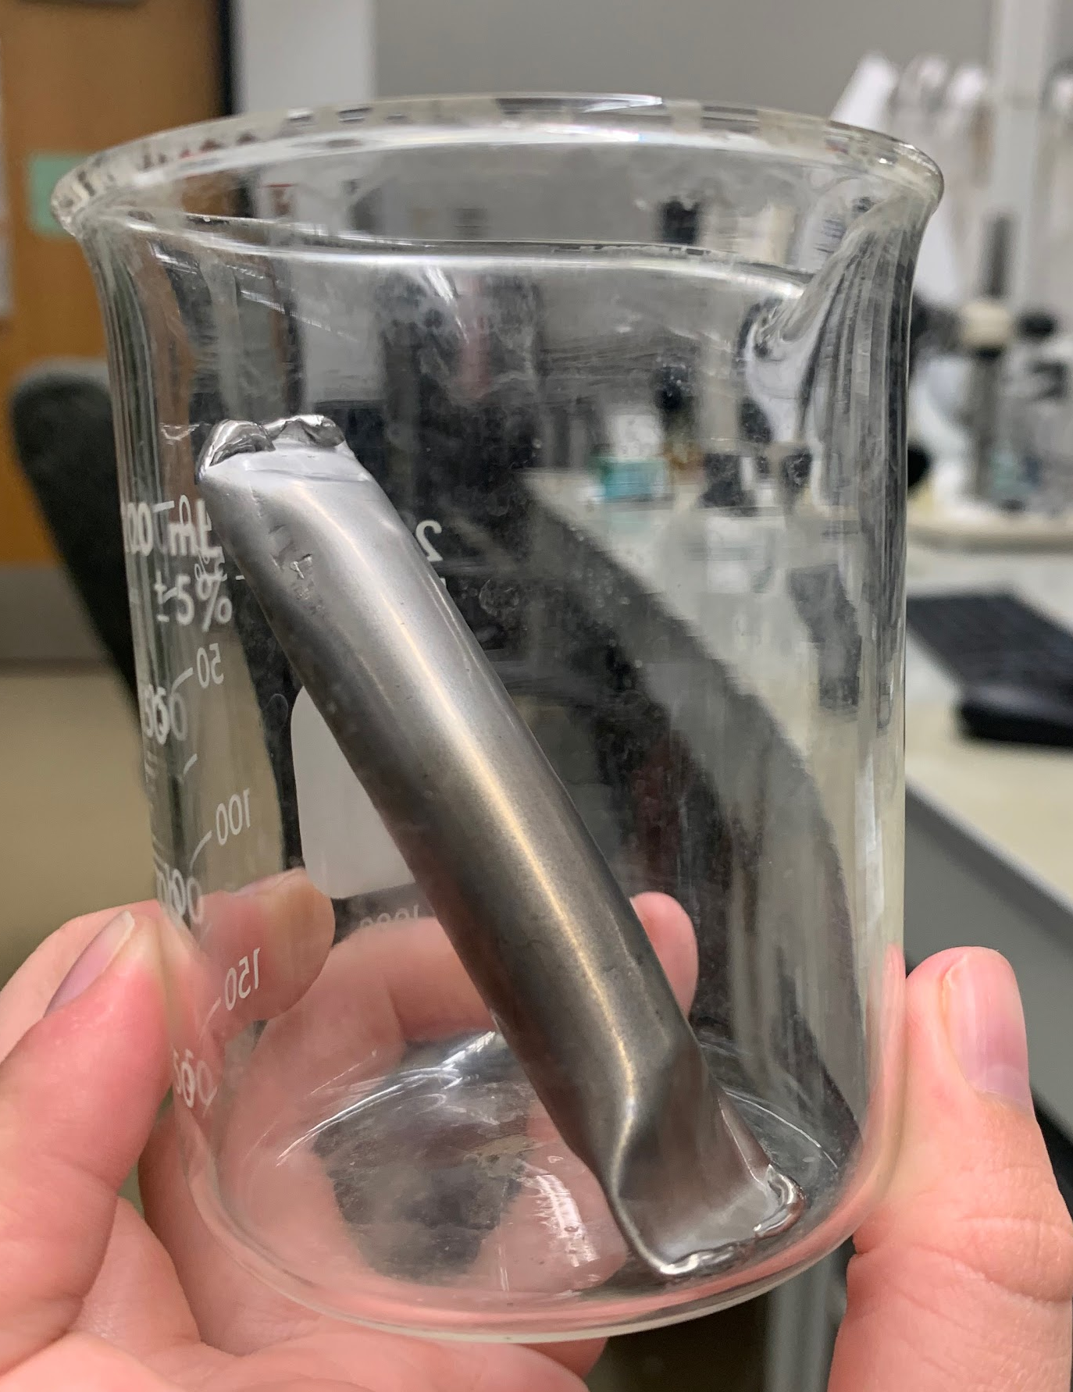
Prepping the samples
Prepared two samples of Ce Ge and Mg with proportions 8.54 : 1.06 : 90.82
Sealed it all in a niobium tube with a clamp and arcmelter
Seal the tube in a quartz tube for a controlled atmosphere
Notes:
Prepped the samples “we can see that theres a lot more magnesium beccasue that what is acting as our flux
Sealed in tube where I Broke the arcmetler three times in hte process
Sealed tube in quart tube which when I wasn’t breaking the arcmelter is where I spent a lot of time just practicing the glassblowing

Slide 8
In the furnace
Put it in the furnace 4 hrs to heat up to 1050° C and then soak at 1050° pulled out at 750.
Took it out early because we heard noises
Little noises are normal
Mainly a test to see if the niobium could handle getting up to those temperatures

Slide 9
Sample Temperature over time
1050°C
soaking
Removal
cooling
4hrs
heating
760°C
152hrs
4hrs

Slide 10
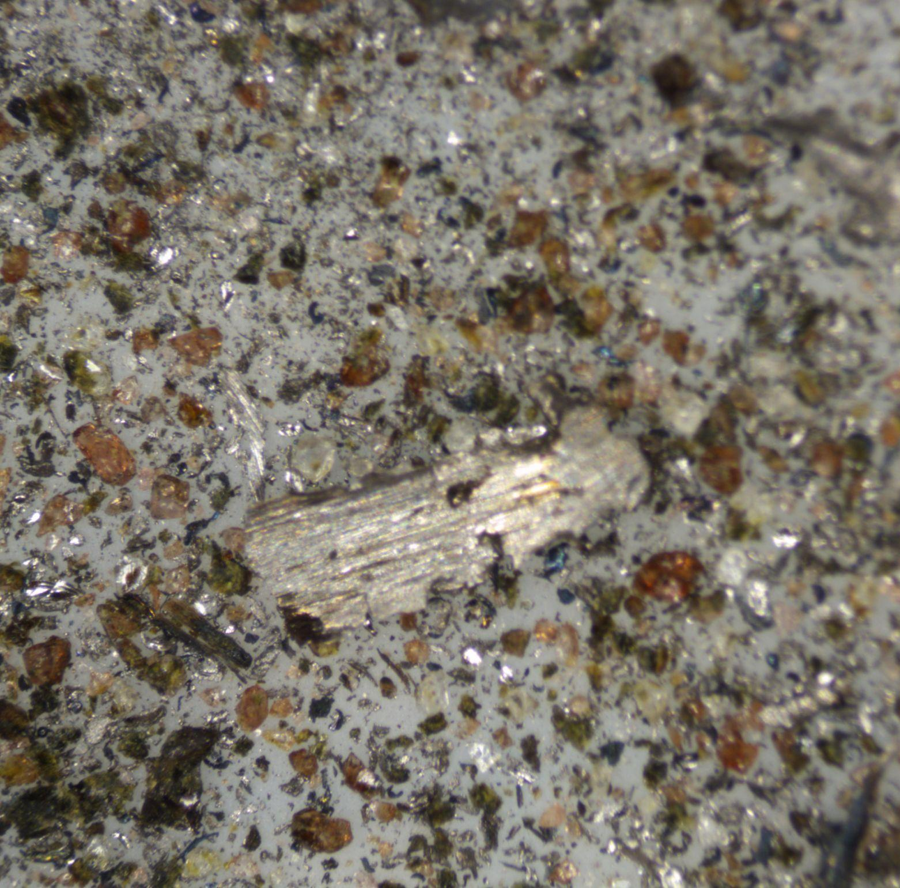
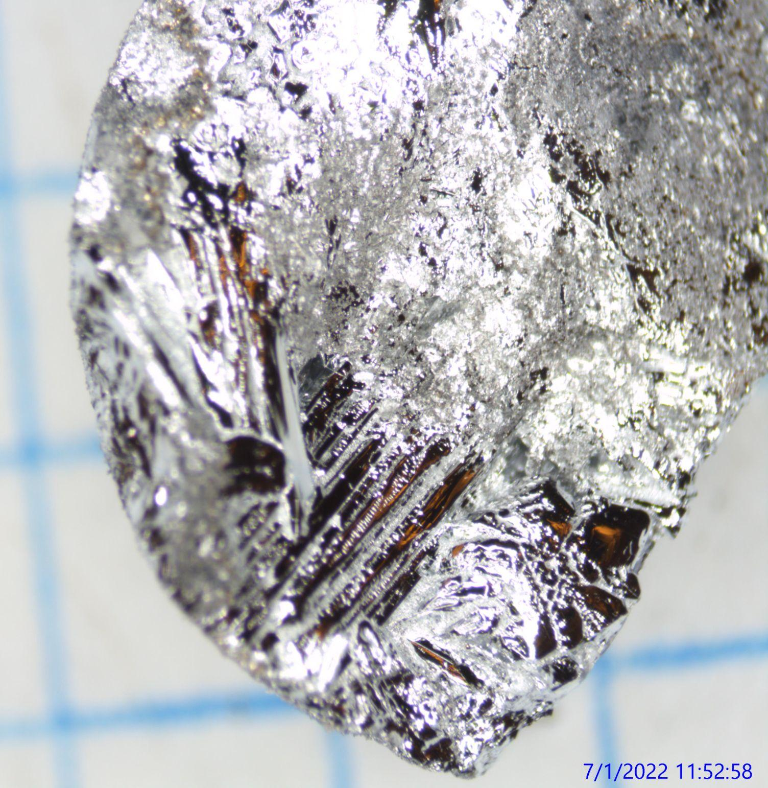
Out of the furnace
Pics pics pics
Notes:
Kinda crystalline already
Weird powder in the crucible

Slide 11
What we’ll do next
Use Scanning Electron Microscope for Energy-Dispersive X-ray spectroscopy to examine the composition and find any niobium contamination in our sample
Repeat the heating process on the other sample to make crystal
Use x-ray diffraction to study the structure of the crystal

Slide 12
Summary
Making Ce₂Ge₂Mg to study quantum spin liquids
Making it using the flux method in a niobium tube
We’ve prepared heated one test sample in the furnace
We’re now looking at the composition of the sample
Thank you :)
Notes:
Go over this then
Before we talk about CEGEMG, we need to talk a little obout these things called quantum spin liquids’

Slide 13
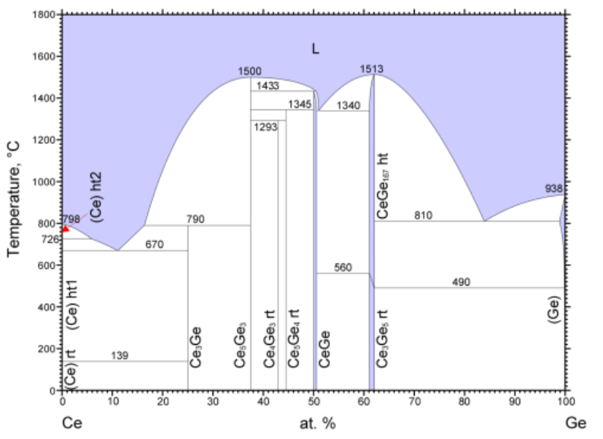
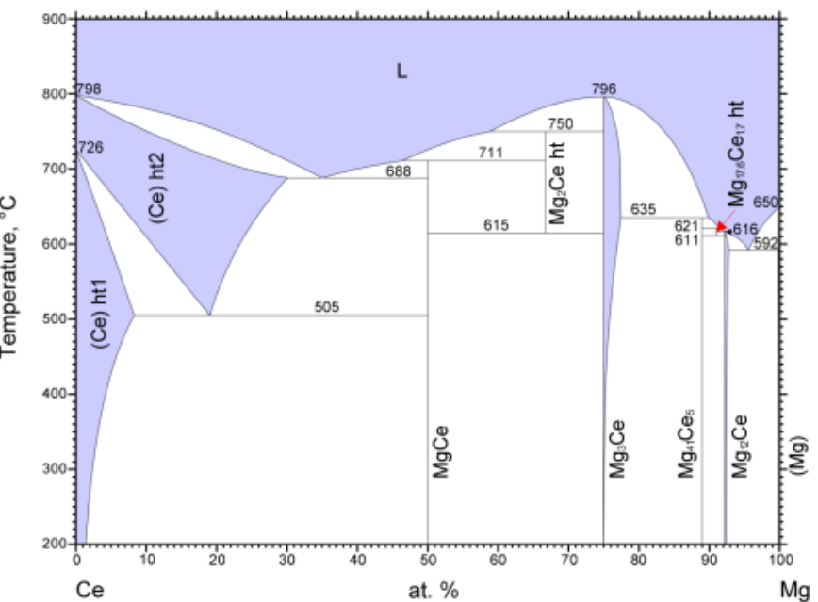
The other phase diagrams

Slide 15
Outline
Why Ce₂Ge₂Mg
How are we gonna make it
What have we done so far
What were about to do
Notes:
Go over this then
Before we talk about CEGEMG, we need to talk a little obout these things called quantum spin liquids’

