Slide 1
The Trouble With Sr₂RhO₄
By Genaro Lozano
Notes:
How should I refer to the compound? Strontium Rhodate

Slide 2
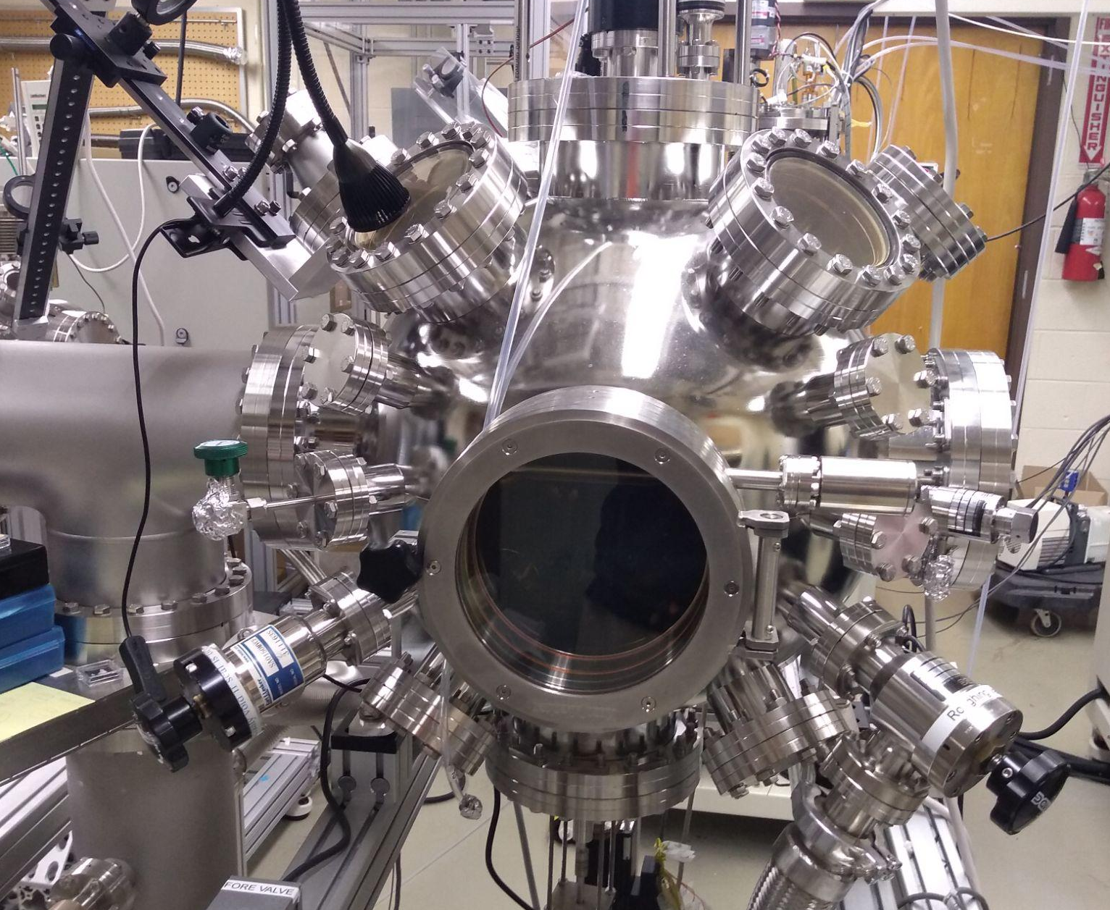
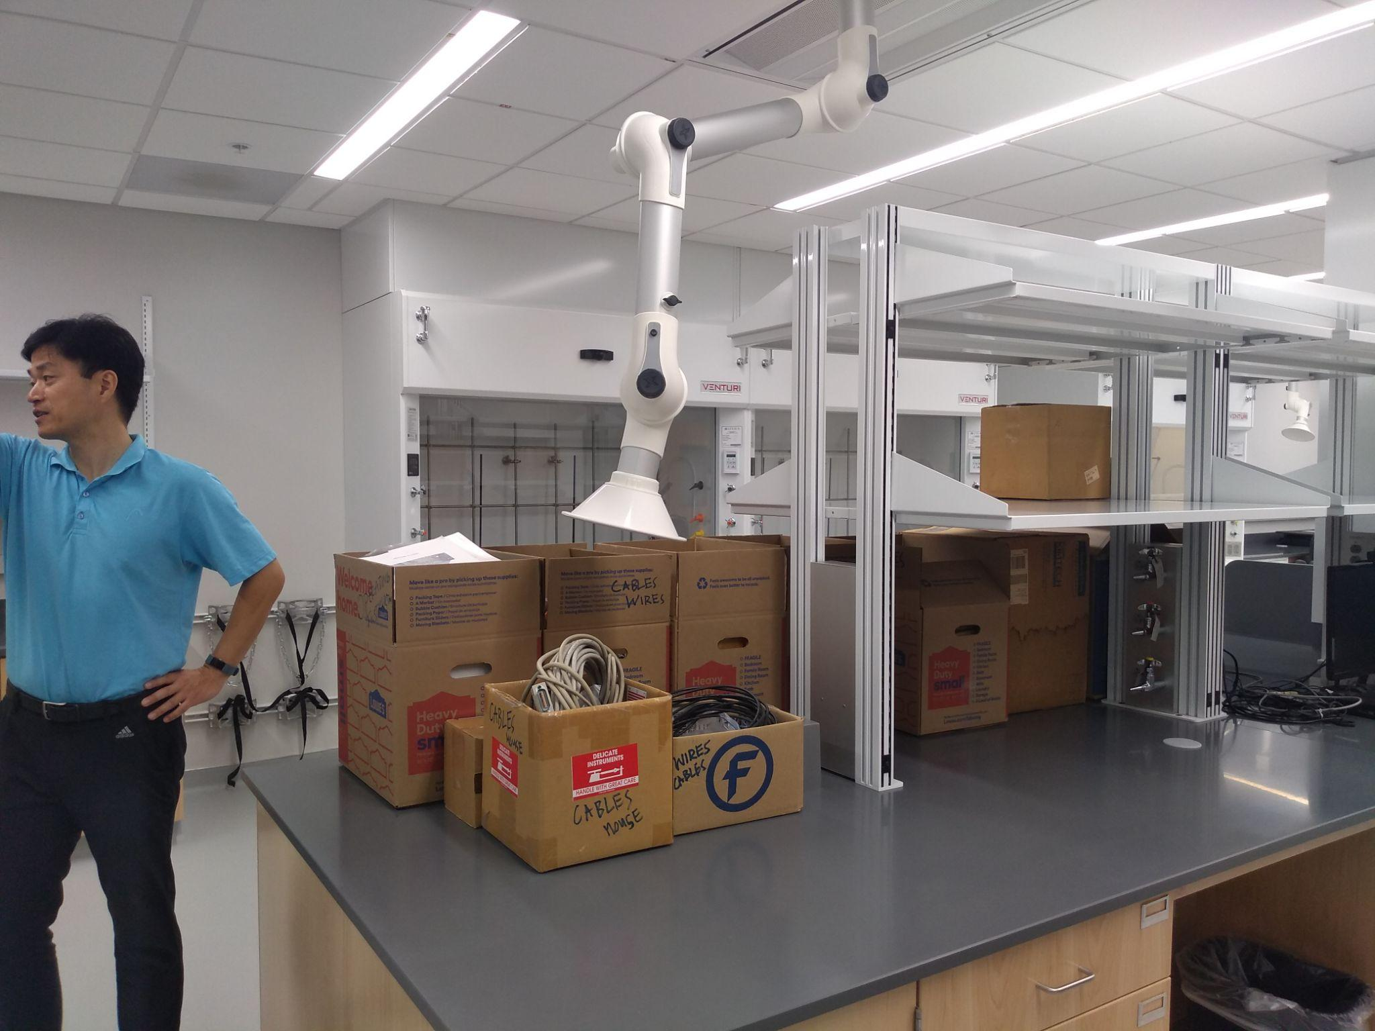
Moving a working laboratory
Notes:
Why we had to move, difficulties, tools, how long it took

Slide 3
Reasons to make Sr₂RhO₄
Sr₂RuO₄ discovered to be superconductive at super low temperatures
Sr₂RhO₄ was found to be non-superconductive at all temperatures
Currently Sr₂RhO₄ is being used a baseline to understand why it has no currently unexplainable phenomenon where other similar metals do
Notes:
Mention that we will be using the laser chamber mentioned in previous slide to make thin film
We will eventually use Atomic Force Microscopy for a topographical map of Sr₂RhO₄

Slide 4
Stoichiometric Equation
4SrCO₃ + 1Rh₂O₃ => 2Sr₂RhO₄ + 3CO₂ + 1C + 1O
Sr= 87.62 g/mol
C = 12.011 g/mol
O = 15.999 g/mol
Rh = 102.9055 g/mol
Translates to .863g of SrCO₃ and .371g of Rh₂O₃ for 1 gram of Sr₂RhO₄
Notes:
Go through this fast. Just mention that math was involved and we needed the numbers in bold

Slide 5
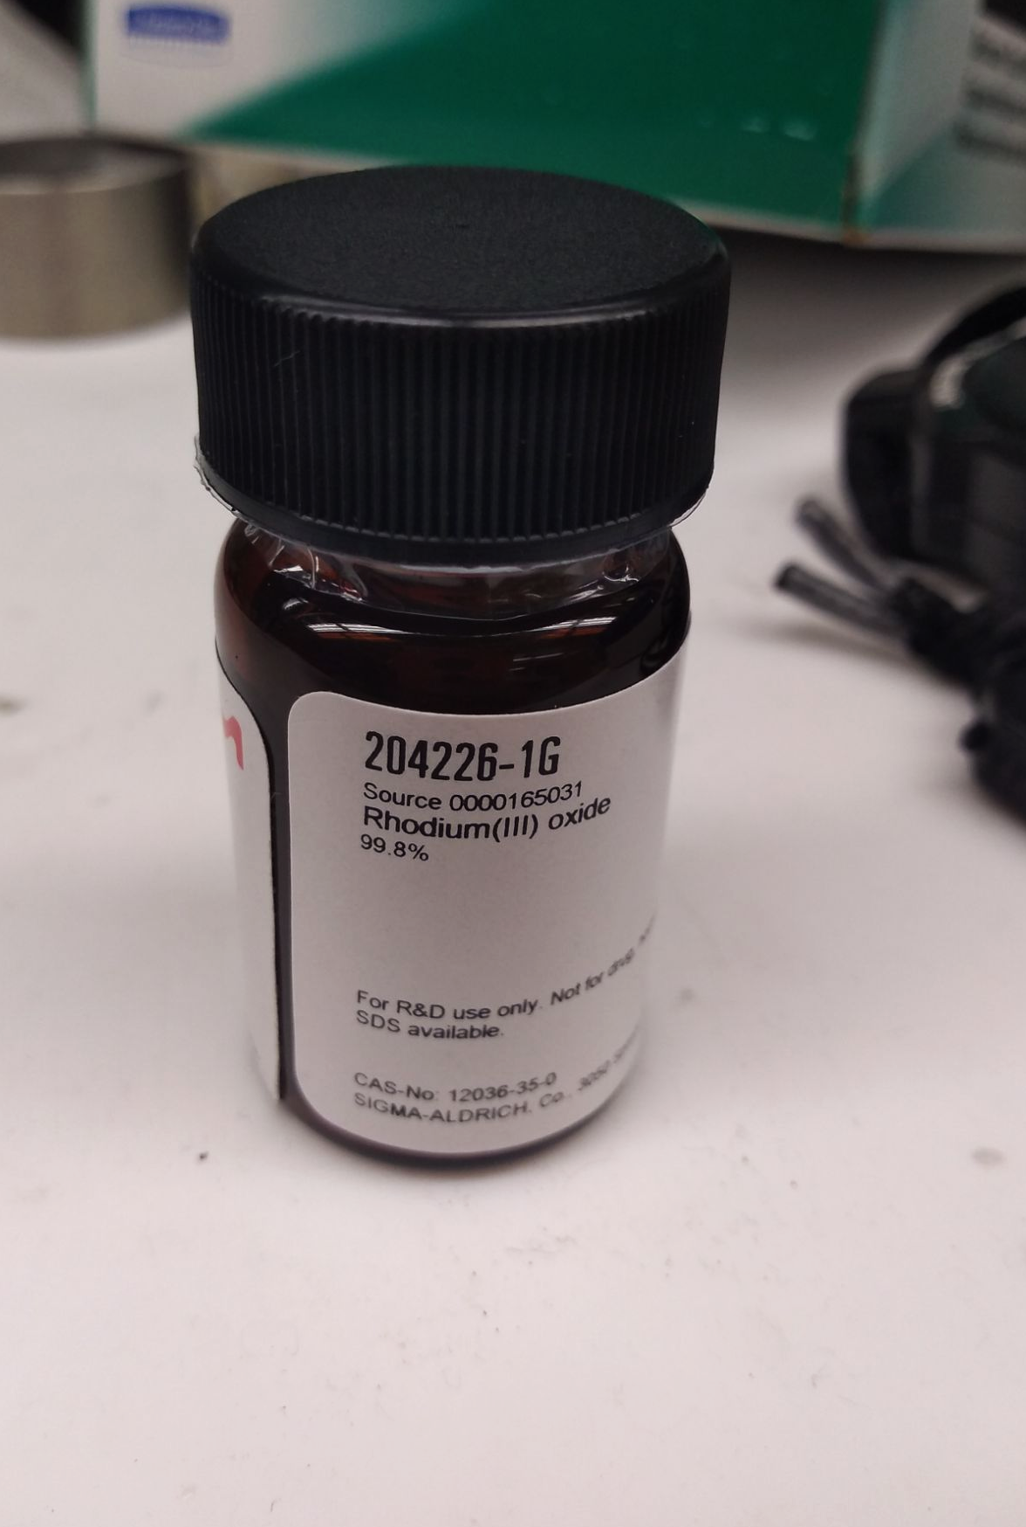
All about Rh₂O₃
Expensive!
Gold Price per gram as of July 1st: $58.26
Rhodium Price per gram as of July 1st: $446.90
Our sample took a full year to arrive
Notes:
Mention that the other reactant is not nearly as expensive or as uncommon.

Slide 6
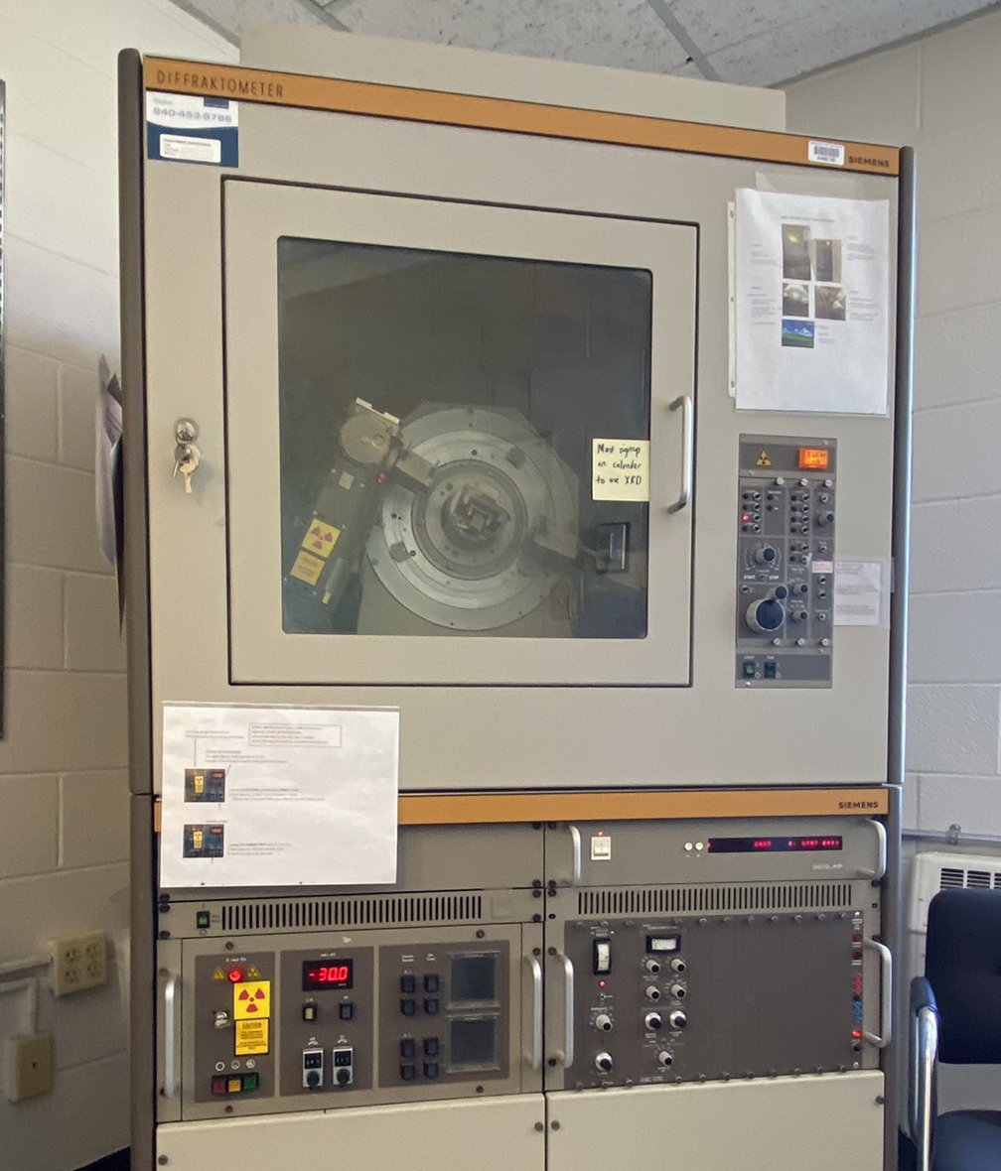
Using X-Ray Diffraction
We begin by placing small amount of compound on prepared slide with special grease.
XRD machine will bombard sample at different angles
Through the use of constructive interference we can learn about the crystal structure of our compound
Notes:
Explain how it uses constructive interference.

Slide 7
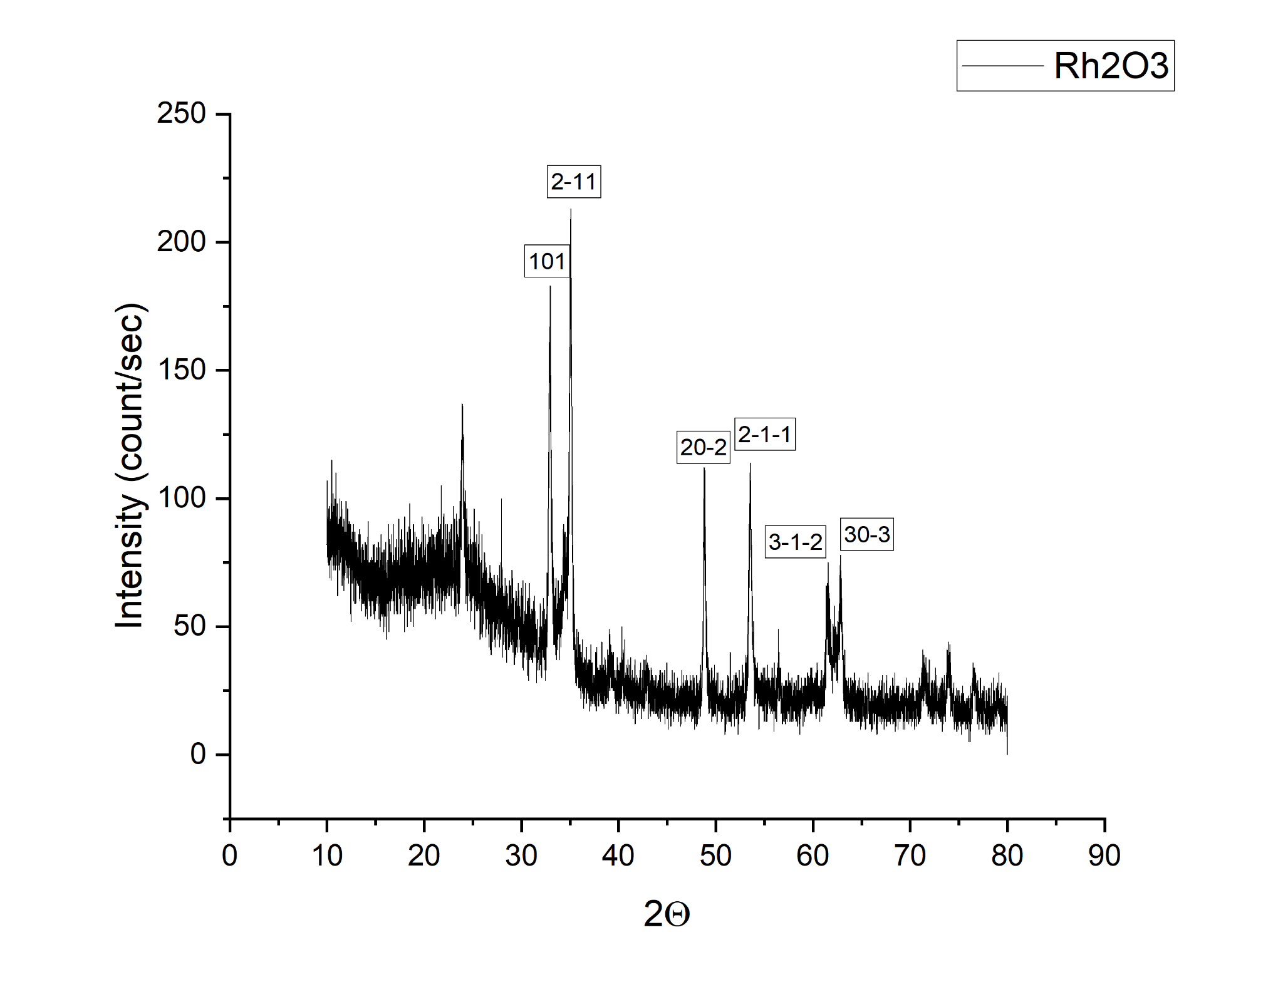
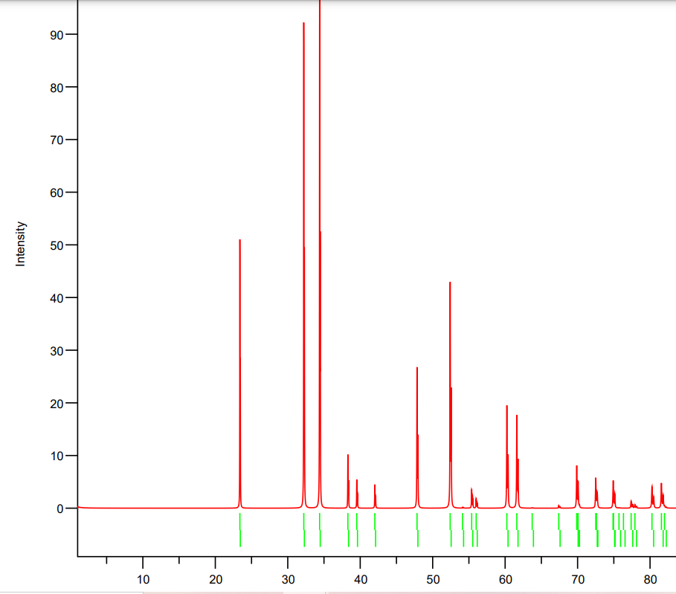
X-Ray Diffraction Discombobulation
Notes:
My results are in black, the results taken from the internet are in red. There is unfortunately a slight shift I can’t explain. We may need to recalibrate the XRD

Slide 8
Grinding for a (noble) cause
Rhodium is considered a noble metal because of its aversion to react.
By grinding reactants for long periods of time prior to firing we can achieve better reaction rates
3 hours recommended, but the reactants were only ground for the time it took me to watch an episode of the Simpsons.

Slide 9
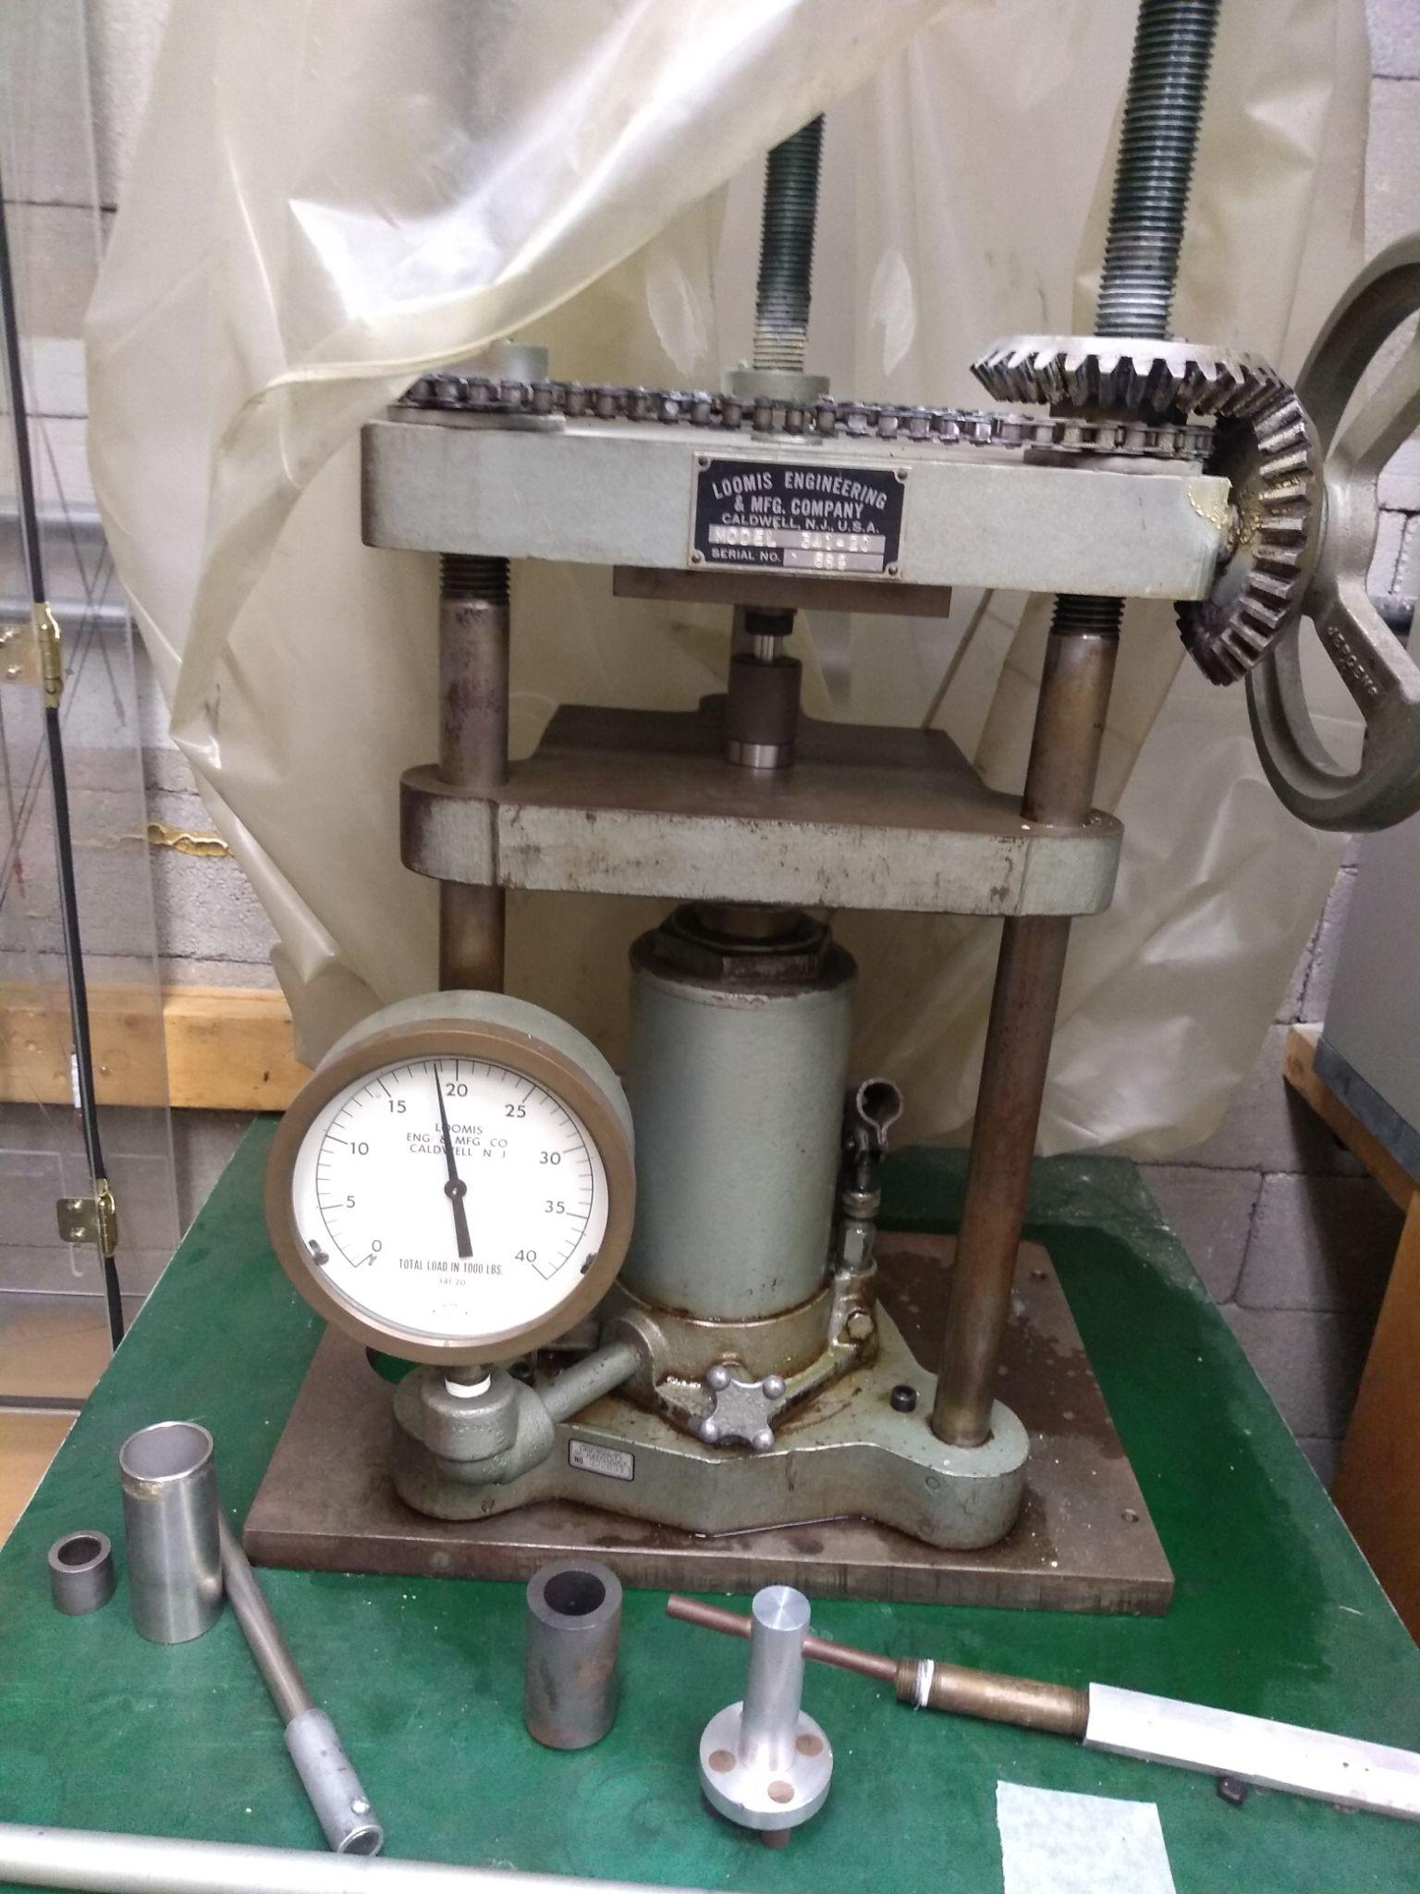
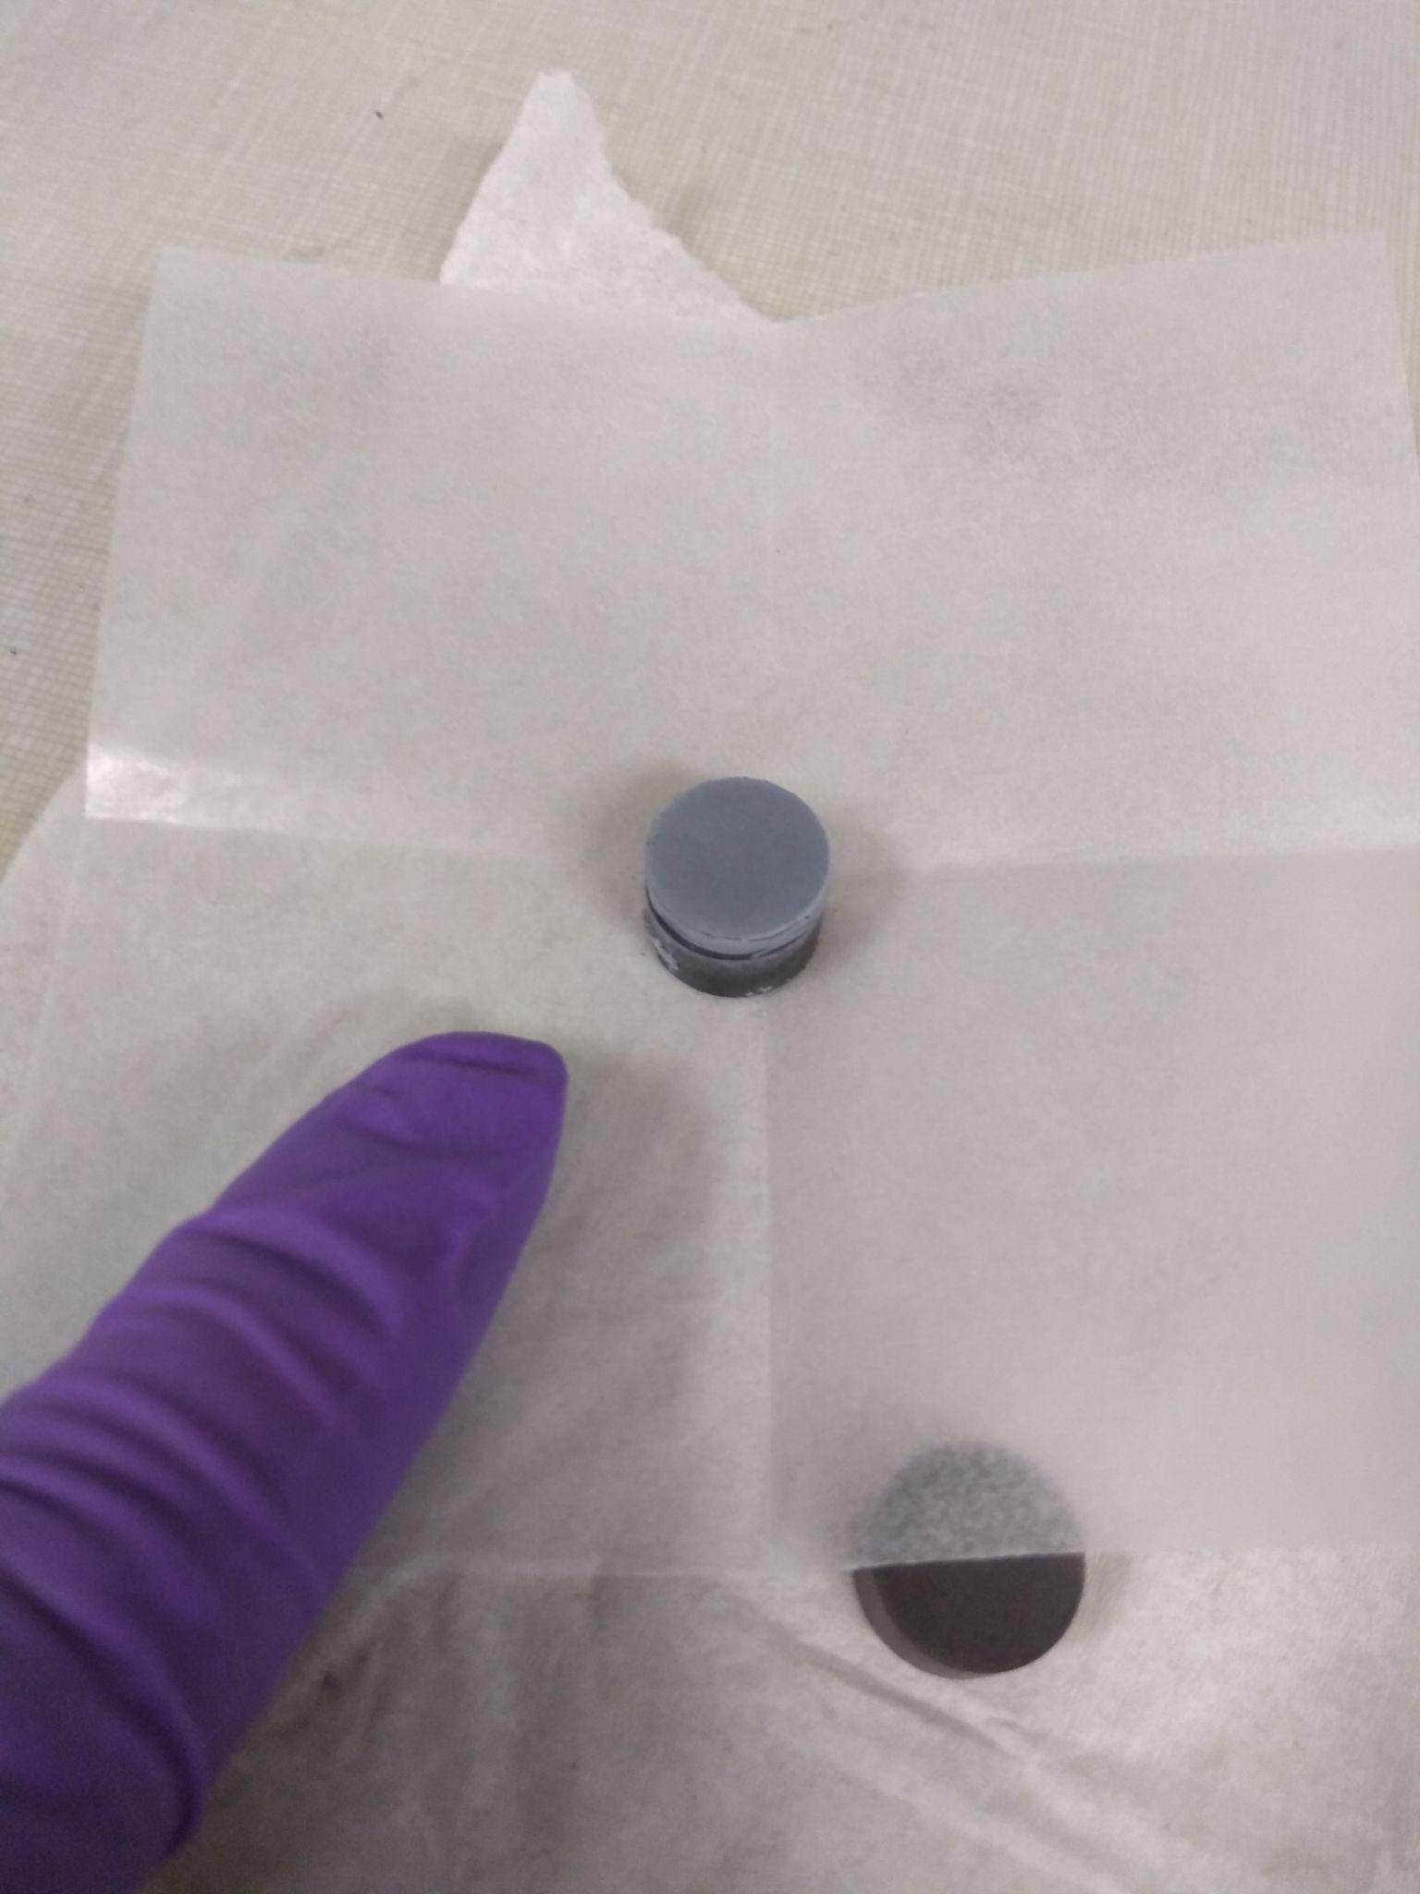
Notes:
Left: Press Machine, started at 19 tons of pressure for one hour. When we released the pressure it was at 17 tons.
Right: finished pellet of 1 gram of SrCO₃ and Rh₂O₃

Slide 10
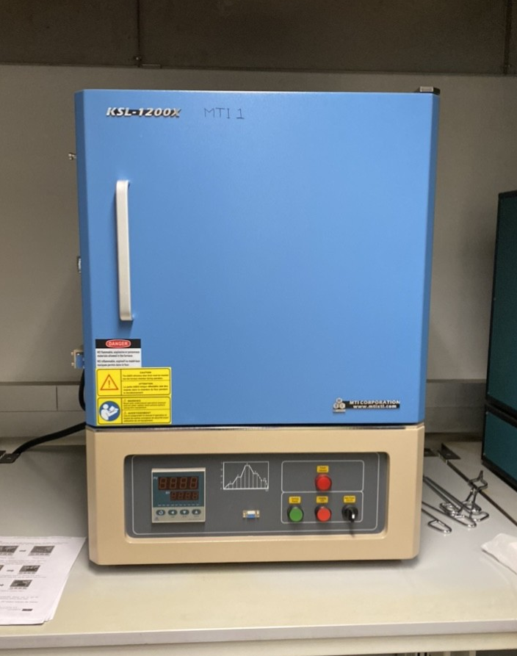
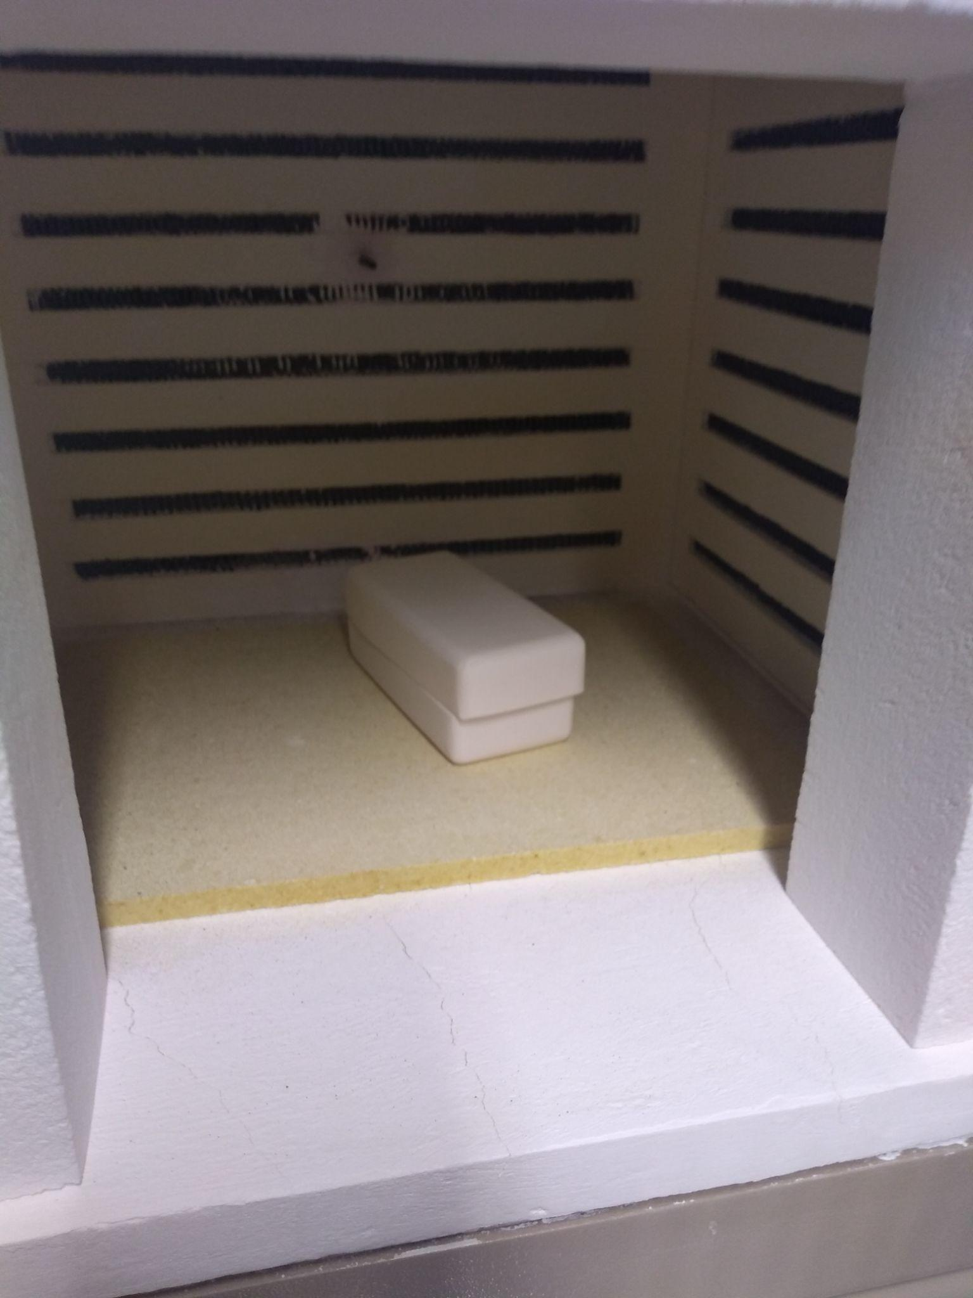
Notes:
Furnace on left. Pellet in aluminum crucible in furnace on right

Slide 11
Temperature
Temperature of Furnace vs. Time
🔥
🔥
🔥
—900 ^{O}C
🥵
🔥
🔥
🔥
(^{O}C)
🔥
🔥
~20 ^{O}C
Time (Hours)
15 Hours
39 Hours
54 Hours

