Slide 1
Measuring the Electric Dipole Moment of the Neutron
Hena Kachroo

Slide 2
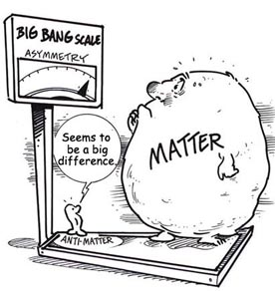
Background
The Big Bang Theory
Equal parts of matter and antimatter should have been created
Now it is predominantly matter
Explanation?

Slide 3
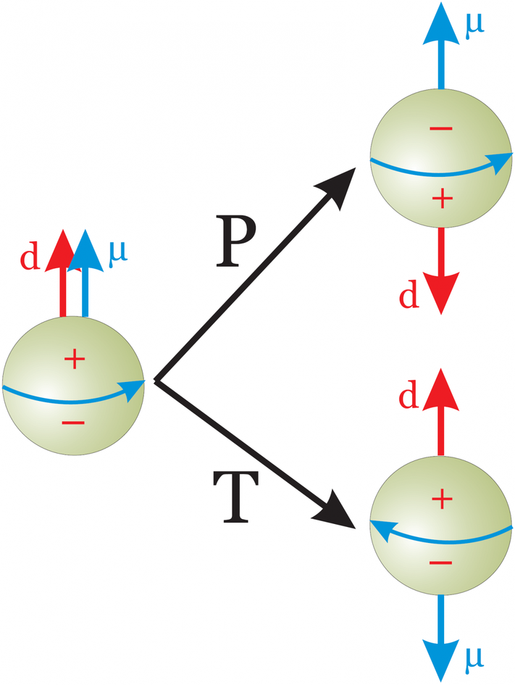
Background
Neutron electric dipole moment (nEDM)
Violates Temporal and Charge Parity Symmetry
Temporal symmetry: time reversal
Parity: mirror image interactions
Charge Parity: particle ↔︎ antiparticle
Neutron’s spin magnetic moment changes with reversal of time but EDM does not – violates Temporal symmetry
Notes:
Symmetries: properties of a physical system that remain unchanged under the standard model of physics.

Slide 4
Measuring the nEDM
Slow neutrons down, confine, and watch
Exposed to magnetic fields → measure precession frequency
Nuclear reaction with He – 3
If EDM were present, spin axis would precess when exposed to field
Precession frequency shifts according to strength of field

Slide 5
This Project
Neutrons = hypersensitive to magnetic fields
Magnetic moment is large – precesses significantly in a weak field
If not uniform – neutrons precess differently at different points
Design of uniform field is crucial
This project: designing a uniform magnetic field to help in testing for nEDM

Slide 6
Design Elements
Double cosine theta coil
2 cylindrical layers
Prevents fringe field
Aluminum skeleton
Resin skins surround skeleton
Clips on skin

Slide 7
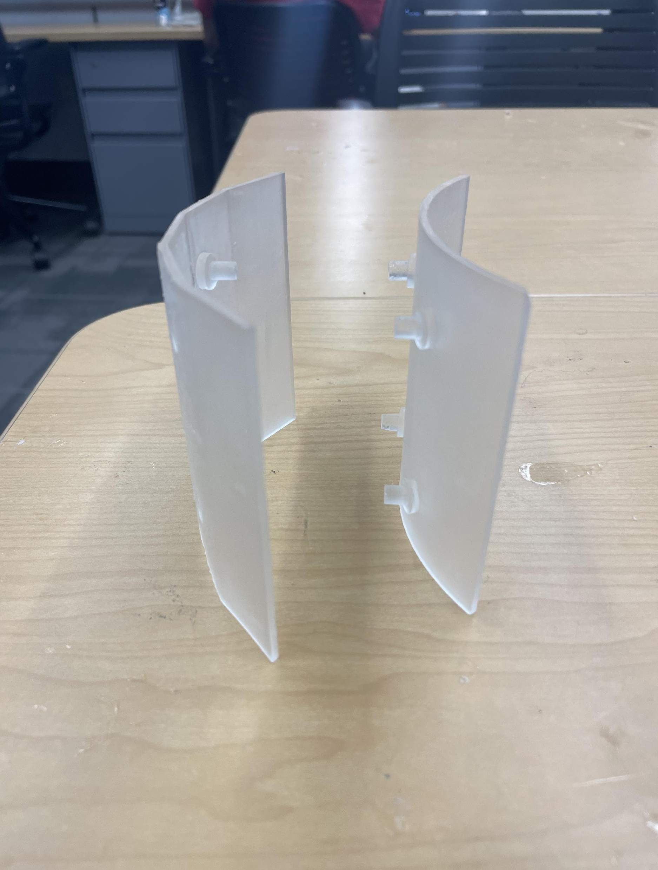
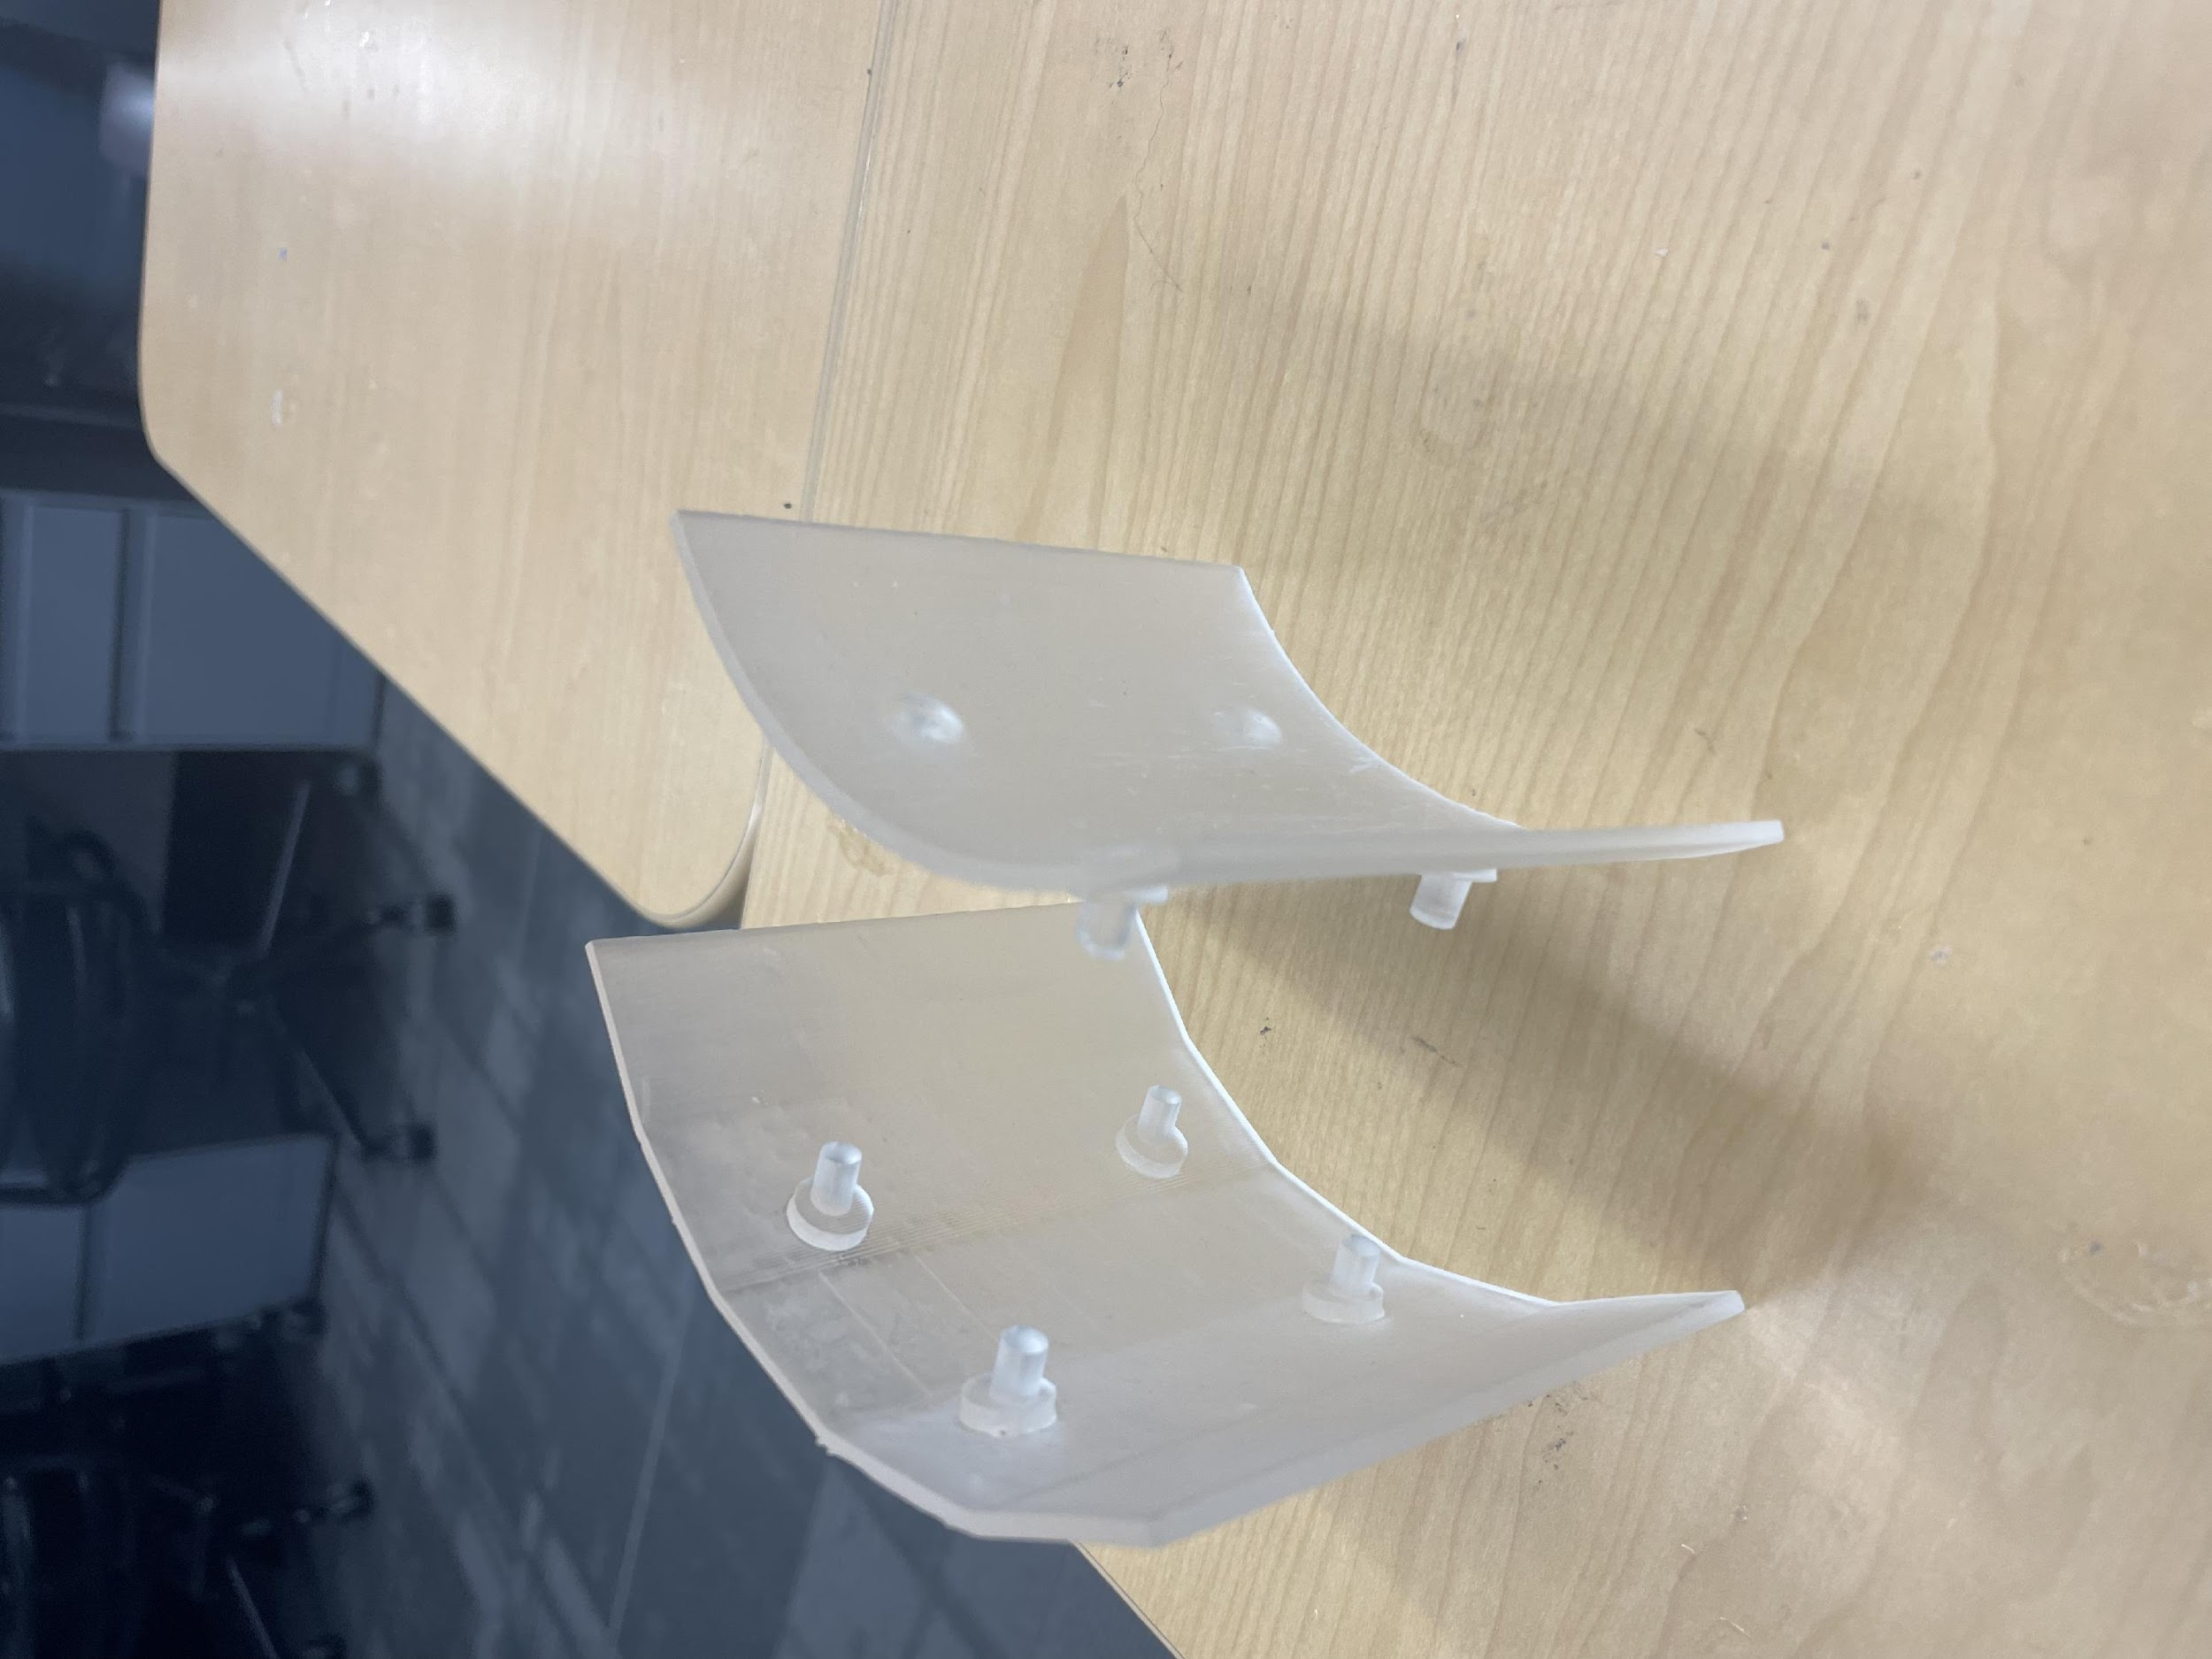
Skin
Skin printed in sections of ¼ the skeleton
Repeated for outer and inner sections
Skins have small pegs
Pegs will fit into each other

Slide 8
Skin
Adjustments made to skin:
Pegs made smaller
Dimensions changed
Addition of lip to cover top and bottom of skeleton

Slide 9
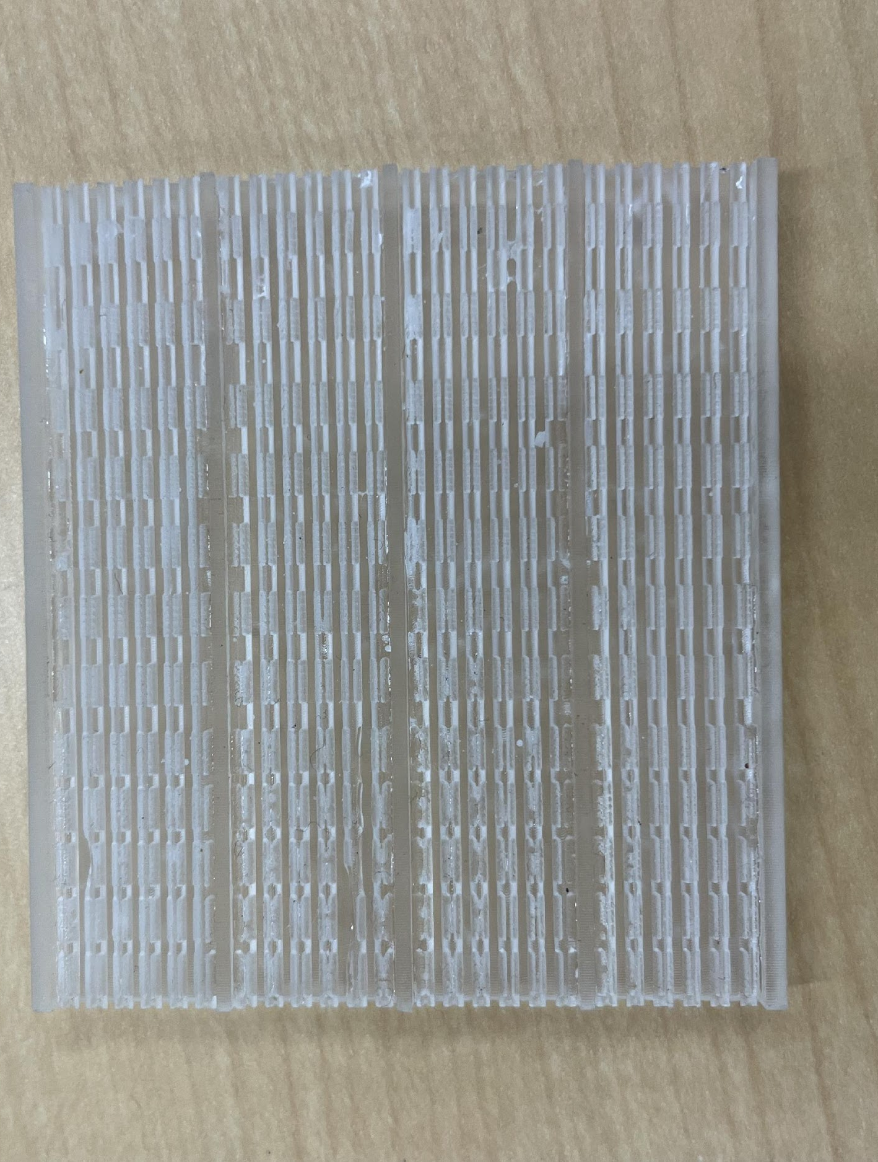
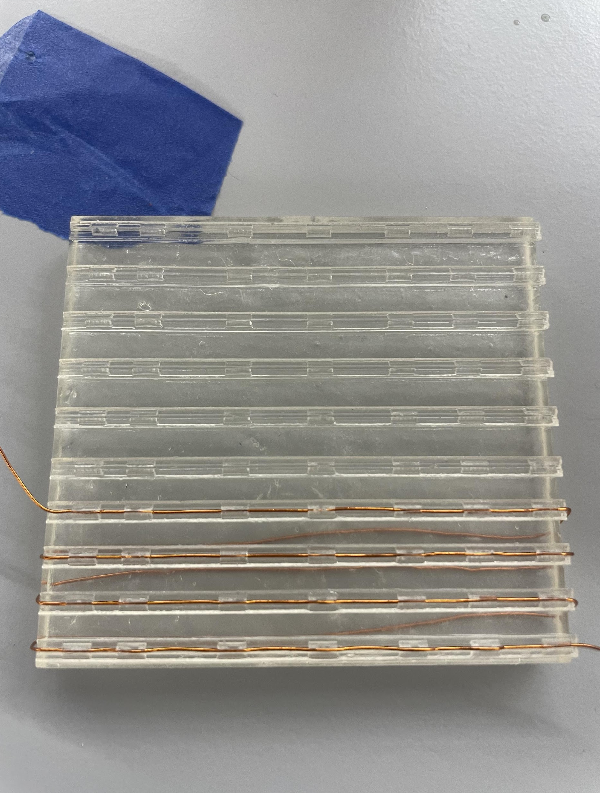
Clips
Clips line equipotential lines
Design of clips:
Trenches
Short clips
Small enough to hold wire in precisely

Slide 10
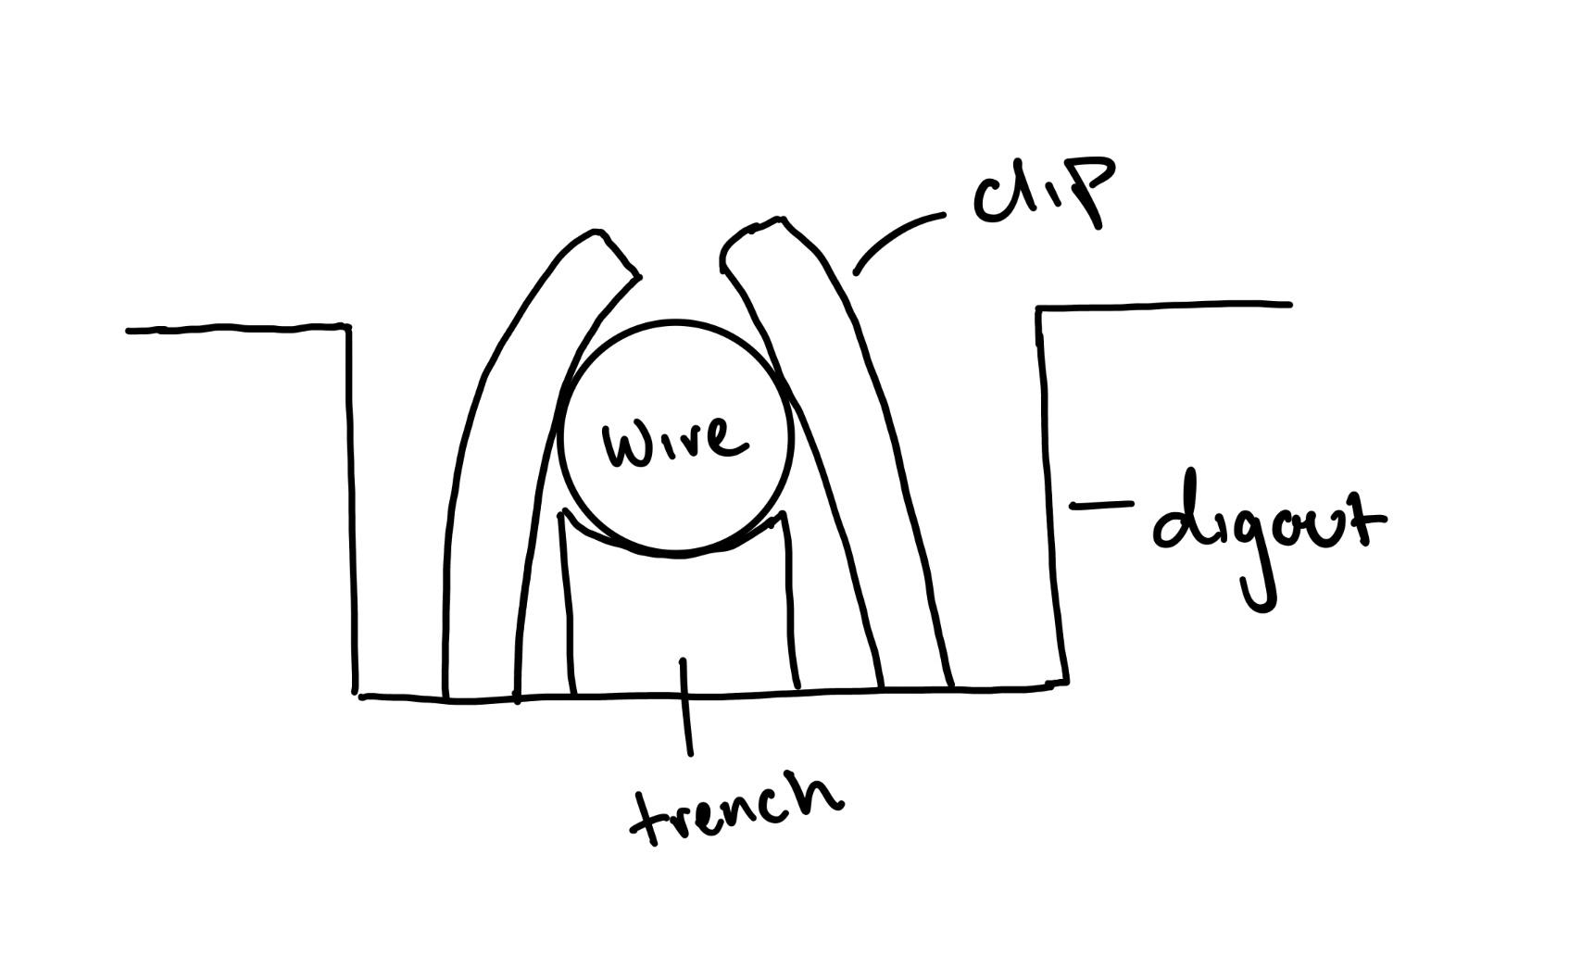
Clips Design
Trench
Clip
Digout

Slide 11
Summary
Designing a uniform magnetic field using a 3D printer
Coil used in measuring the nEDM
Detection of nEDM would help to explain the imbalance between matter and antimatter

