Slide 1
NEDM , CAD, B – Field Mapping: How Does it All Connect?
REU Project by Ian Delcher
In Collaboration with Stephanie Betancourt and Hena Kachroo

Slide 2
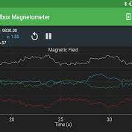
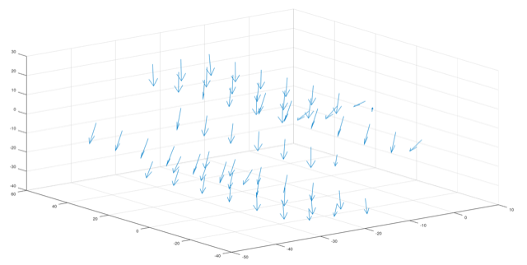
Agenda
Background
CAD Components and Implementations
Magnetic Field Mapping
Hopes for this Project
Possible Applications

Slide 3
Baryon Asymmetry of the Universe
This is the stage on which our project lies

Slide 4
Where Did It All Go?
If there was a balance between these two types of matter, we wouldn’t be here.
This phenomena is sometimes known as the baryogenesis
Baryon Number is the number of leftover baryons in a pair; constant
The answer to this might be found in electroweak physics and its corresponding symmetries
What distinguishes a particle from an anti-particle?

Slide 5
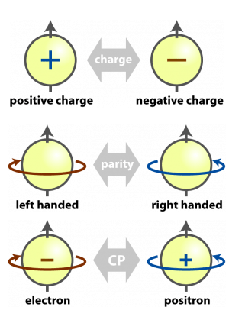
Neutron Electric Dipole Moment (nEDM)
If the symmetries were consistent, then there would be no imbalance.
Weak Interactions within quarks violates CP Symmetry.
Violation originates from weak interactions that change the charge of quarks.

Slide 6
We want to simulate, design, and test an electromagnet for this purpose.

Slide 7
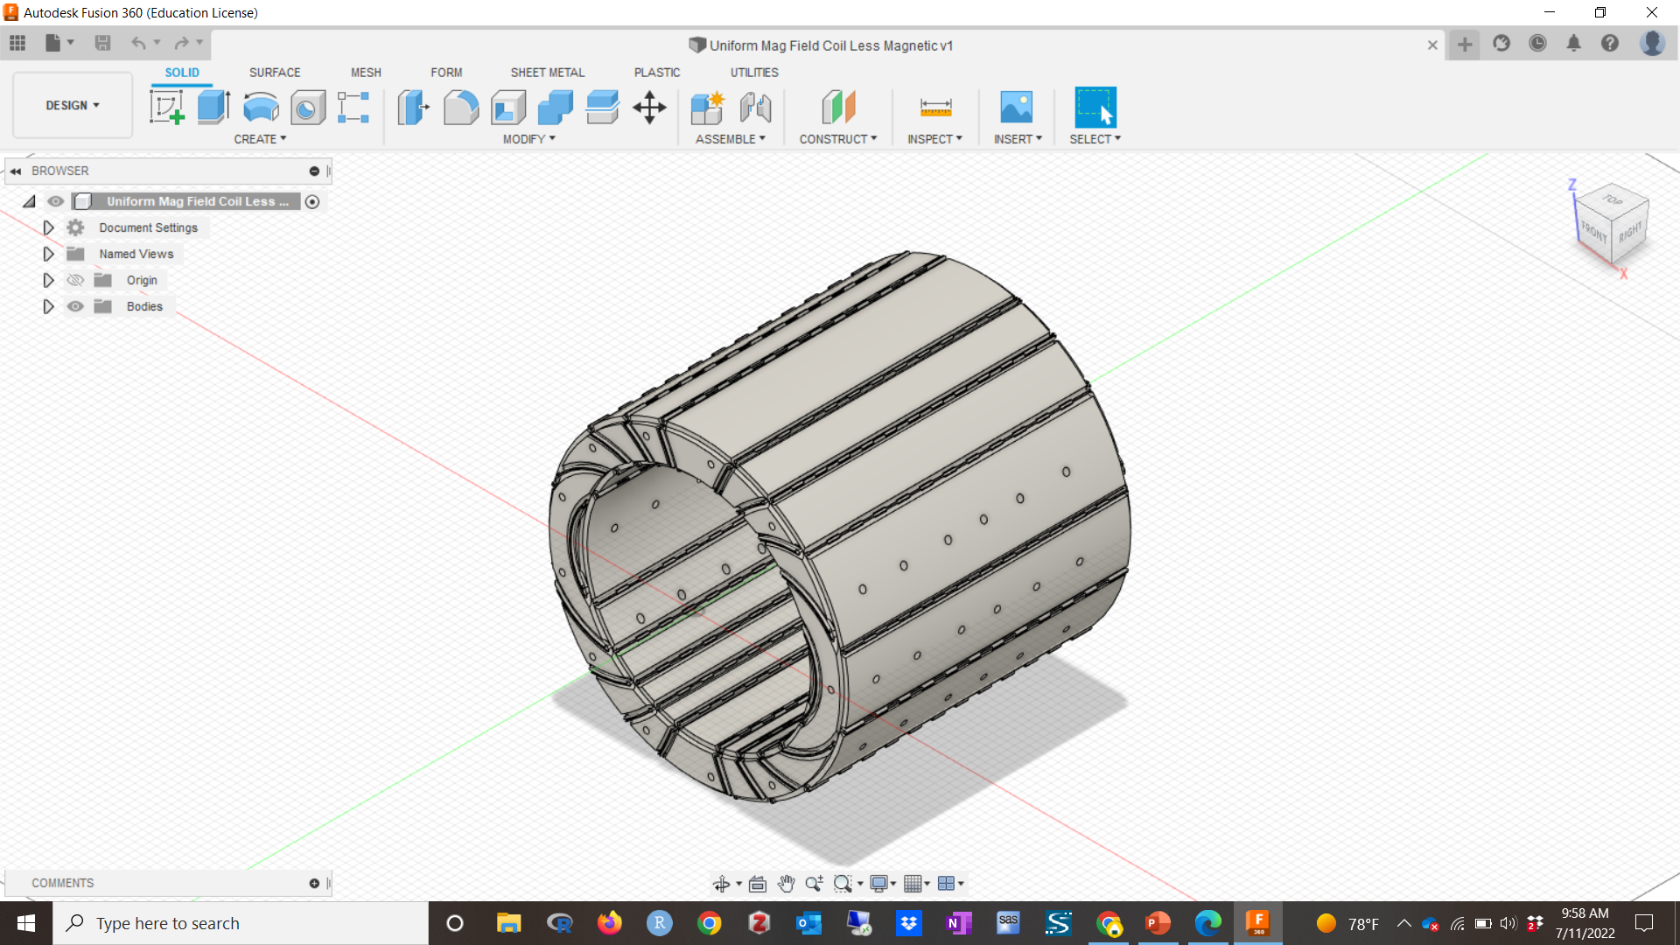
Using CAD
Redesigning a Faulty Prototype

Slide 8
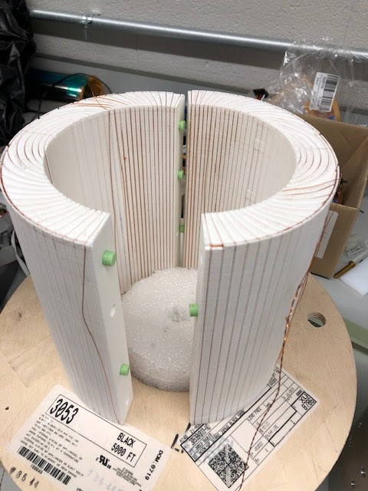
Faulty Design
Our goal is to redesign this electro-magnet, so it fulfills its purpose.
The grooves surrounding the plastic do not hold the wire in place.
This is a problem for the uniformity of the magnetic field.
We’ve produced an alternative design

Slide 9
ALUMINUM SKELETON

Slide 10
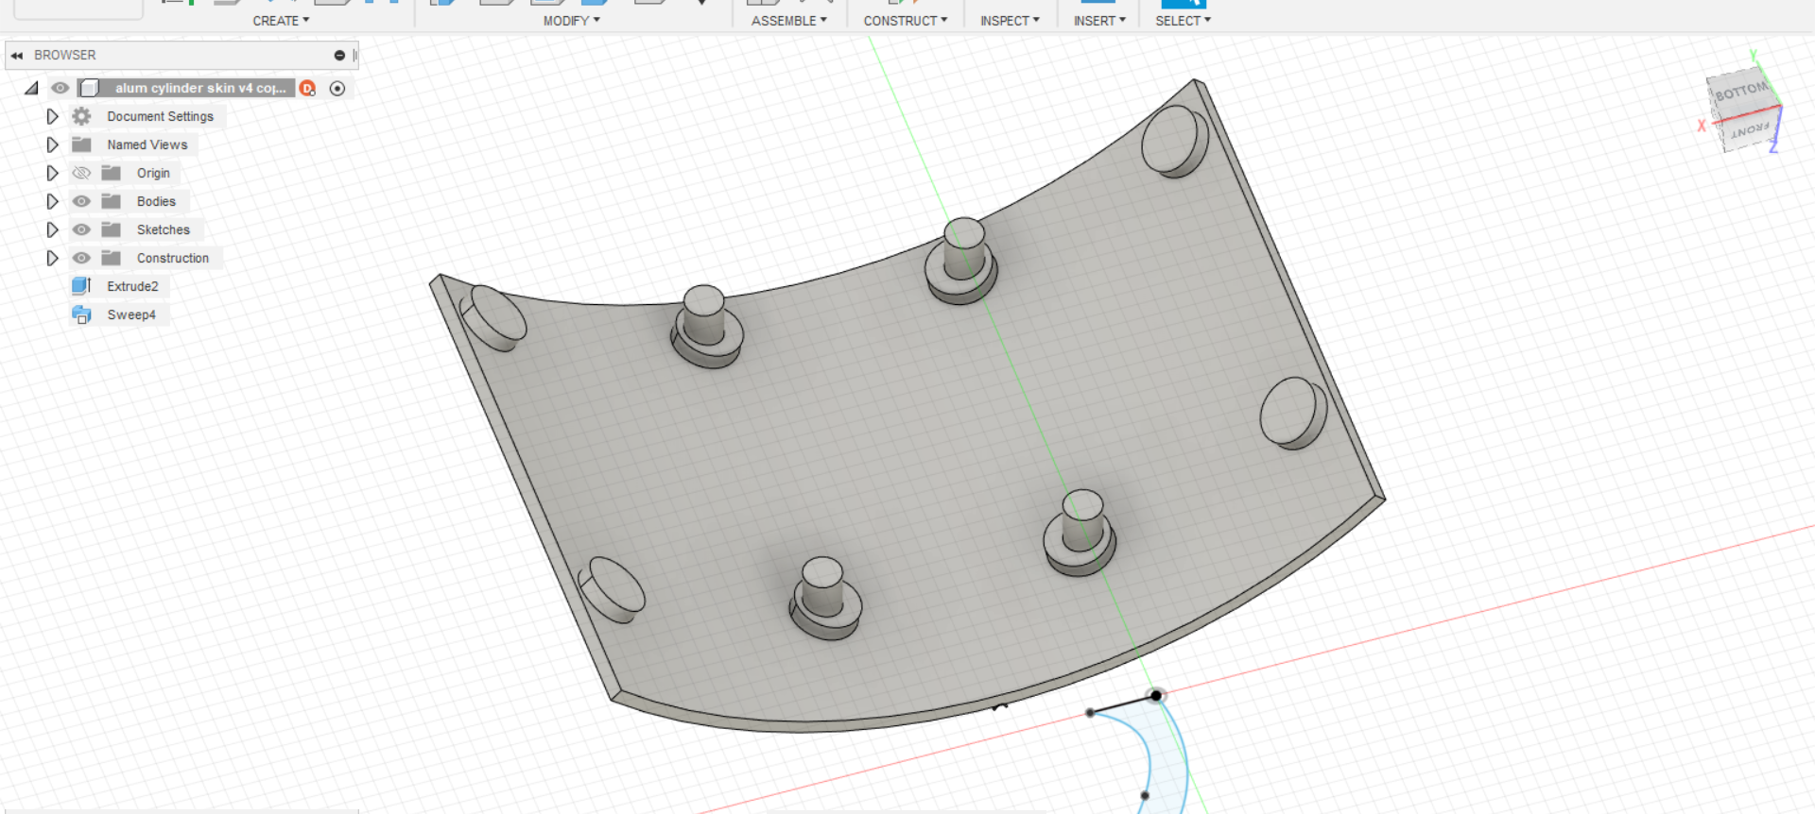
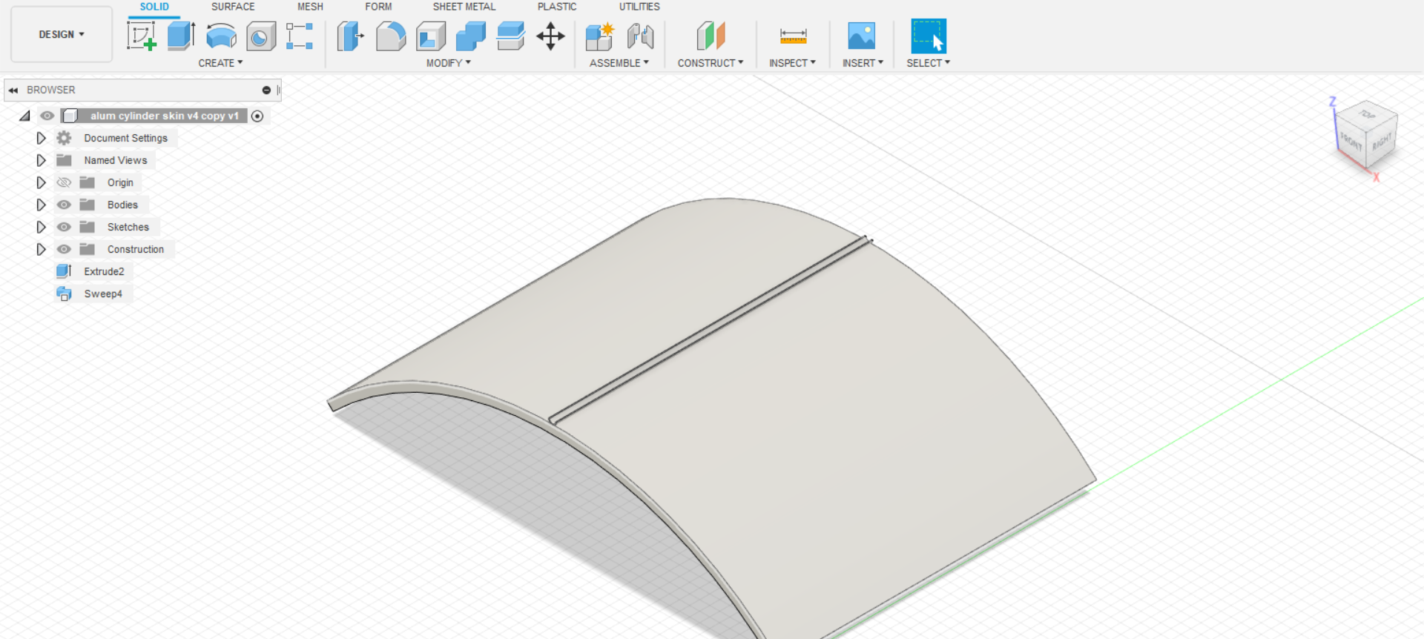
Skins
Made of resin from the resin printer
Pegs fit into the holes around the aluminum skeleton
Each of the skin designs cover around one eighth of the total surface area of the aluminum skeleton

Slide 11
Clips

Slide 12
B-Field Vector Mapping
Using MATLAB and Student-Developed Procedures

Slide 13
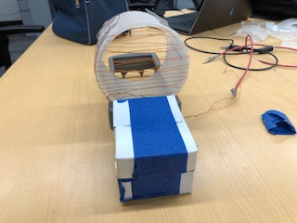
Defining Axes
X axis is horizontal to the circular face. The sensor will be placed to the far left, right, or in the center.
Z axis is vertical to the face . Sensor will be placed at -1, 0 , or 1 inches.
Y axis goes into the cylinder. Separated into increments of ½’’.

Slide 15
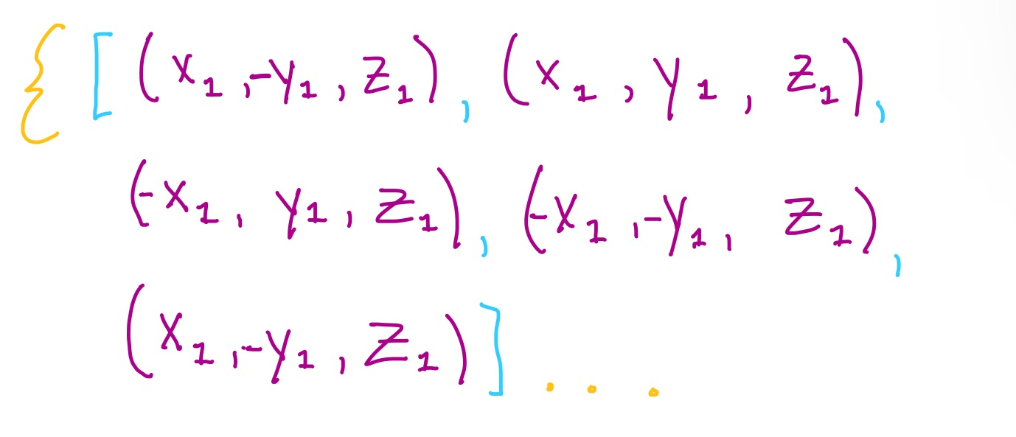
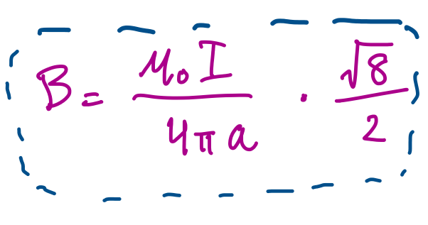

Slide 16
WHAT CAN WE DO WITH THIS?

Slide 17
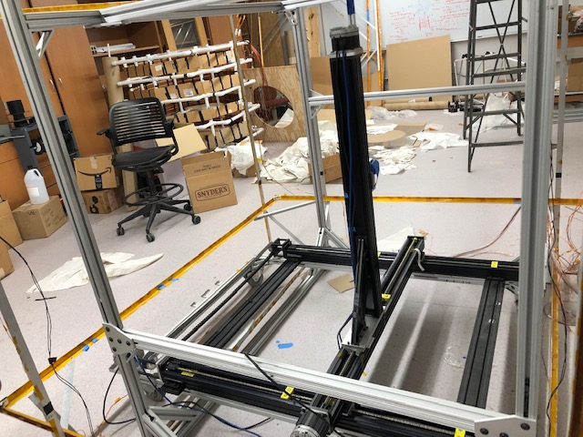
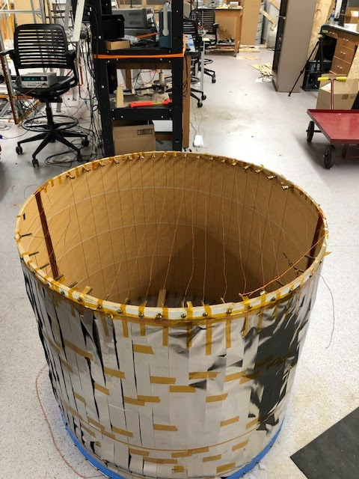
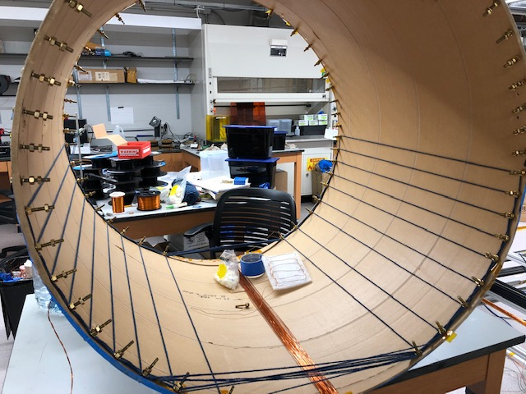

Slide 18
Summary
Why is there an imbalance in baryons and anti-baryons in the universe? The answer may be found in the difference between matter and anti-matter
The current magnet design is not very effective in producing a uniform magnetic field. So, we came up with another design.
After the electromagnet is complete, the robotic mapper can detect the uniformity of the field. We can apply techniques to various other things.
Baryon Asymmetry
nEDM
CAD/Fusion
Mapping and Testing
Future Applications
A non-zero nEDM is crucial to understanding difference between matter and anti-matter. We must induce this using an extremely uniform electromagnet.
We used a simulation with a prototype coil to understand how B-Field strength is calculated as well as what changes we need to make.

Slide 19
Thank You
Questions?

