Slide 1
High Speed Data Acquisition With FPGAs
JT Mills

Slide 2
The NOPTREX Experiment
Searching for time-reversal symmetry violation in n=>𝜸 resonances in heavy nuclei
Polarized low-energy neutron beam => heavy nuclei target => gammas
Fundamental symmetry violations help to explain the baryon asymmetry in the Big Bang

Slide 3
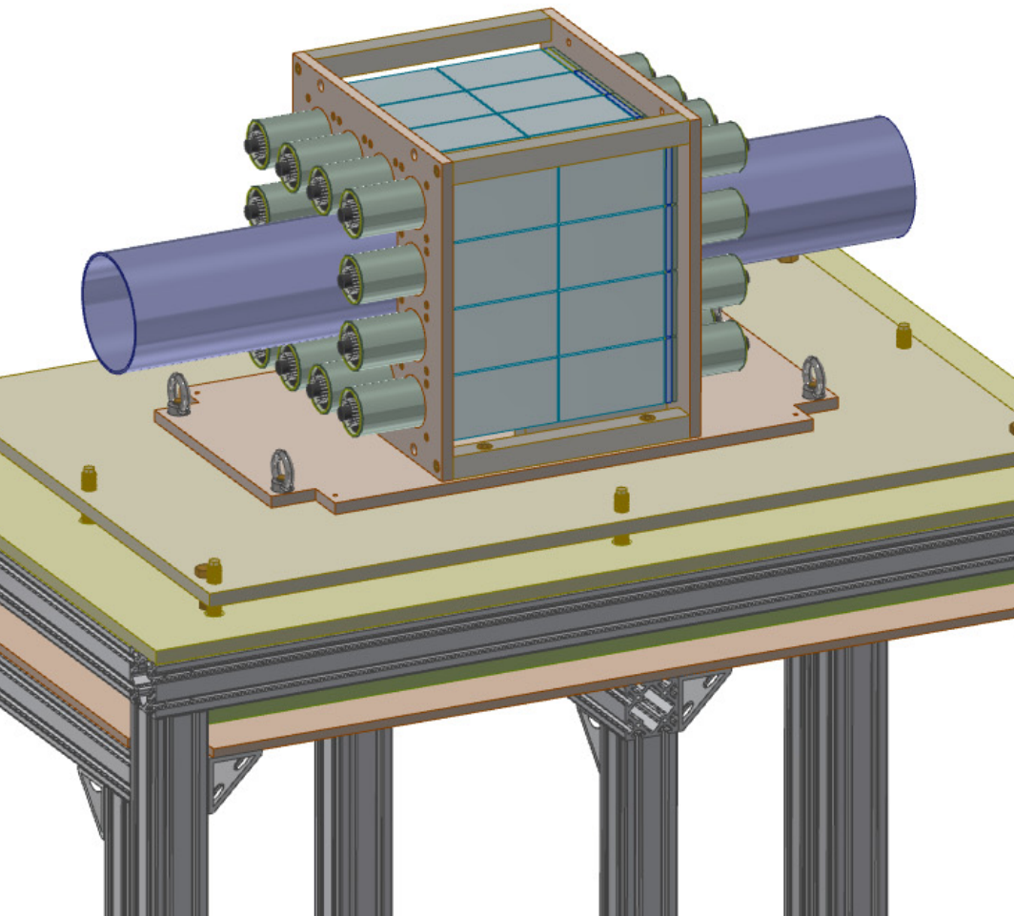
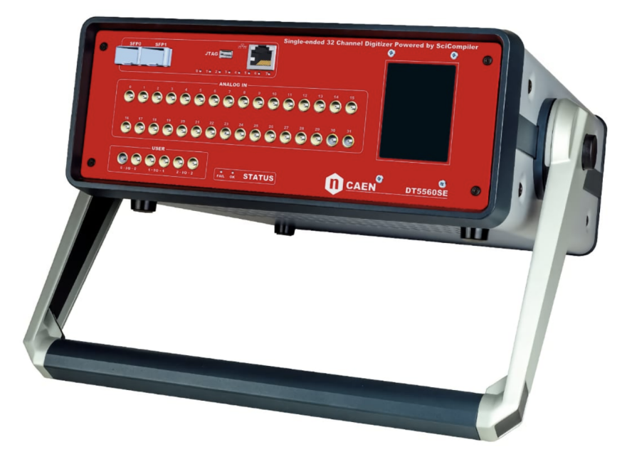
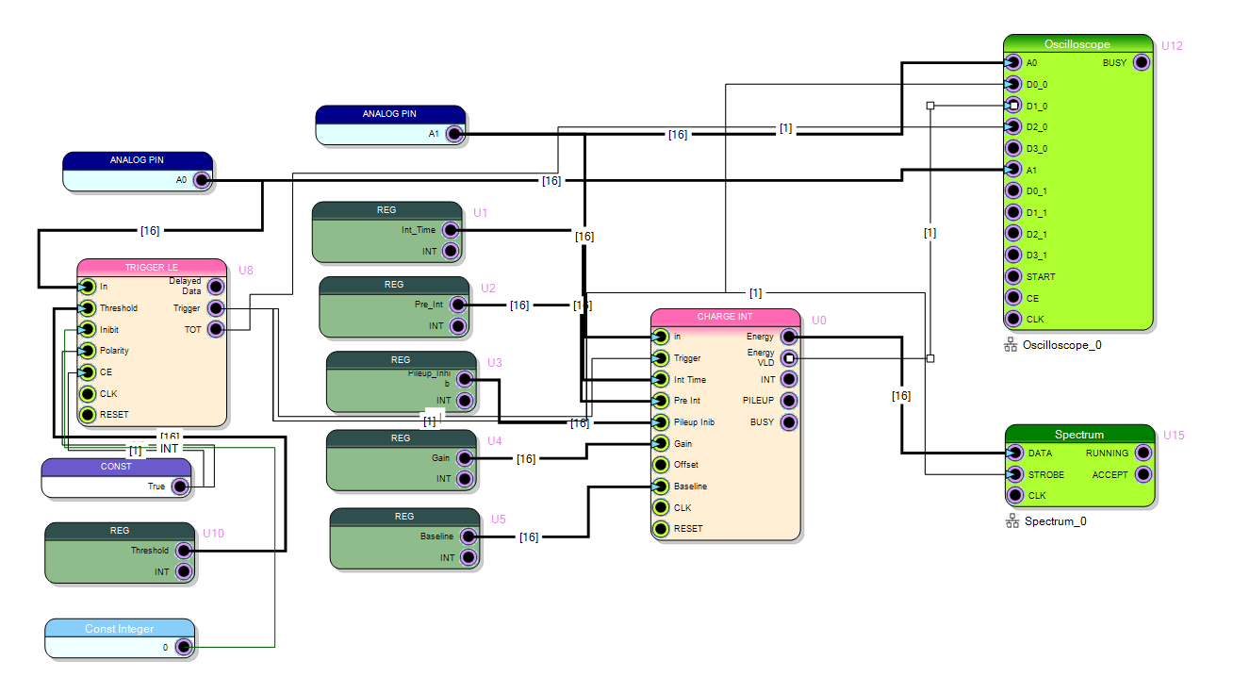
Nuclear Physics Data Acquisition (DAQ)
24 NaI Scintillation Detector Array
(IU, UK, EKU)
CAEN DT5560SE 32 Channel Open FPGA Digitizer
Custom SciCompiler Firmware
J. Doskow (IU)

Slide 4
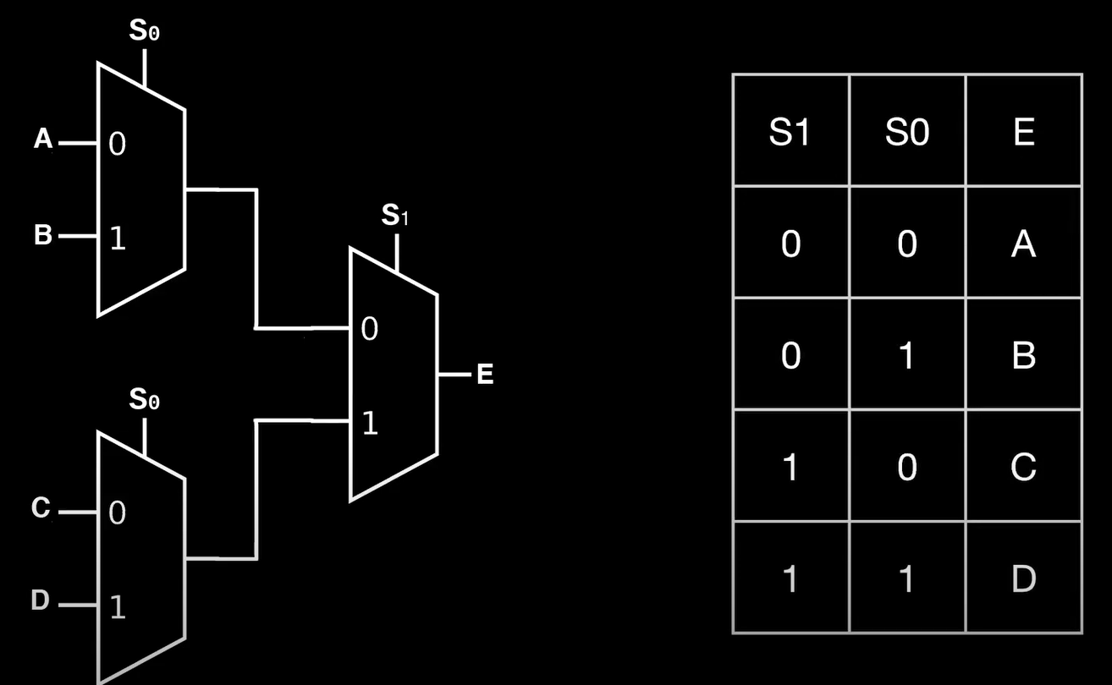
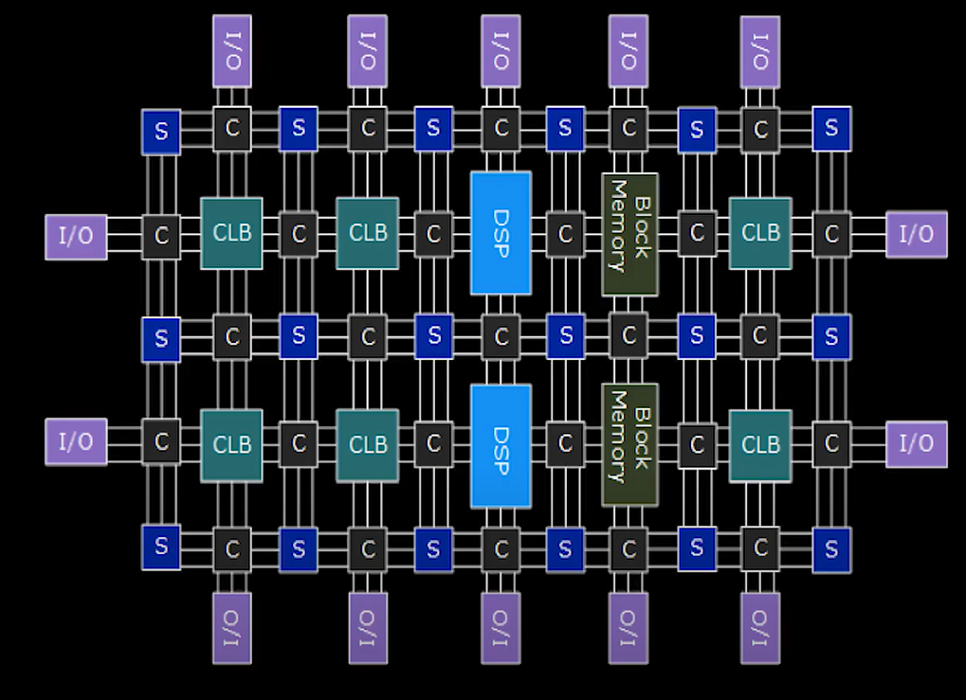
What is a Field Programmable Gate Array (FPGA)?
FPGAs allow for customization of the digital logic within the computer
By stacking logic gates, lookup tables (LUTs) can be made which can be programmed to define the logic
LUTs and Flip-Flops are combined to form configurable logic blocks (CLBs), which are connected by interconnects to route signals
The variable configurability of FPGAs make them useful for efficiently performing specific tasks, such as processing digital signals

Slide 5
SciCompiler
CAEN software for developing custom FPGA firmware
High-level block coding makes development easier
Works with Vivado and Visual Studios

Slide 6
Charge Integration Firmware
Charge Integration calculates the area under a digital signal within a given time period
Using a leading edge trigger to trigger on an external clock signal
Output data is visible on a spectrum and oscilloscope

Slide 7
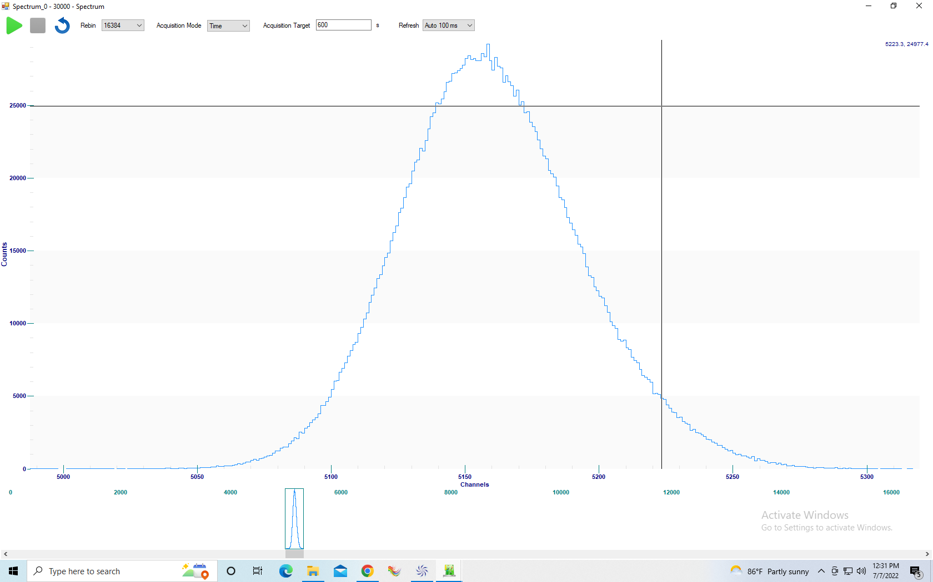
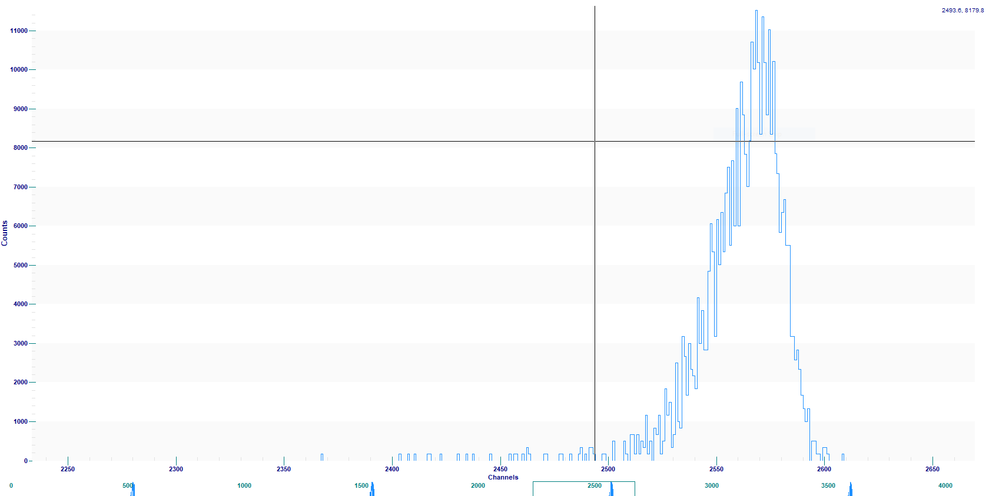
Results
Cesium 137 Spectrum from a NaI detector using leading-edge trigger and charge integration
Cesium 137 spectrum using external trigger signal and long integration time

Slide 8
Summary and Next Steps
By using an open FPGA digitizer, we can efficiently process detector signals in real-time using custom filters
Need to expand the firmware to 32 channels
Need to develop more detailed and accessible readout software to work with the firmware
Currently updating firmware to trigger on a 20Hz external signal to begin integration over 100 microsecond and 10 microsecond time intervals

Slide 9
References
J. Doskow, Indiana University
Yuke Wang, University of Michigan

