Slide 1
Simulation of πE5 Beam Line at Paul Scherrer Institute
Jason Sikes

Slide 2
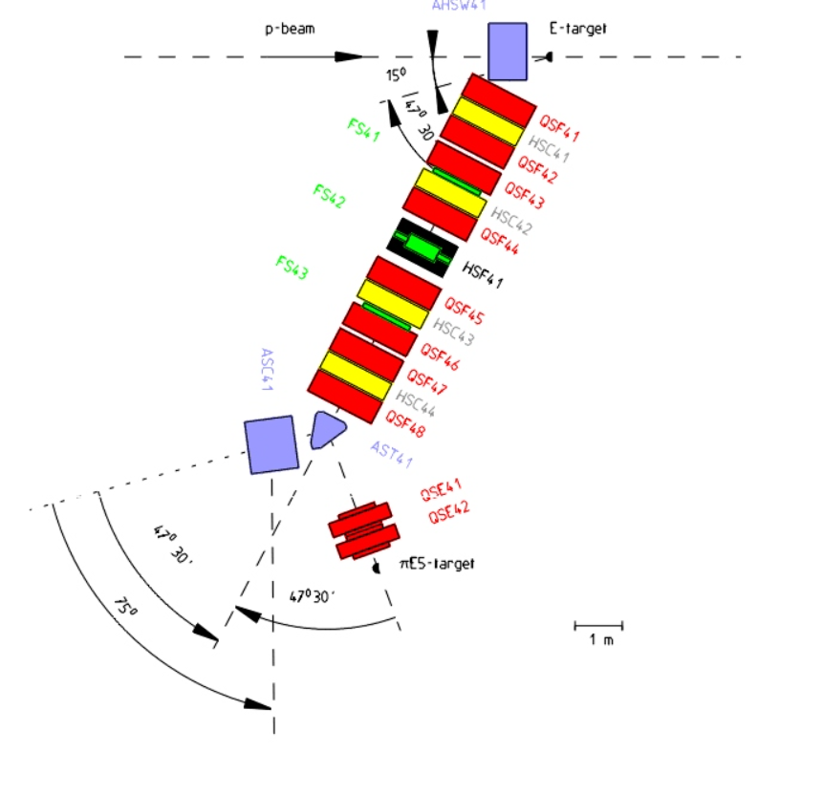
What is the πE5 beam line?
πE5 is a particle beam line located at Paul Scherrer Institute in Switzerland
It consists of pions and muons
PIONEER Experiment
Intends on using πE5 to more accurately measure Pion decay rates

Slide 3
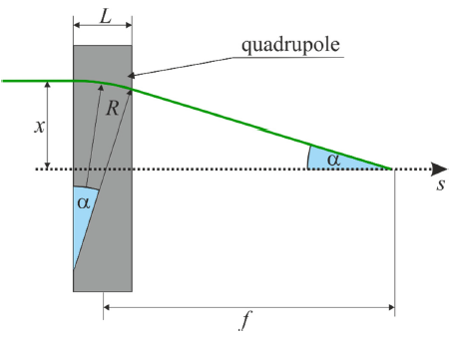
Moving Particles
We direct particles using magnets
Mostly Dipoles and Quadrupoles
We can use the angle of deflection to create “lenses” and treat particles like light
Now we can use optics to track particle movement

Slide 4
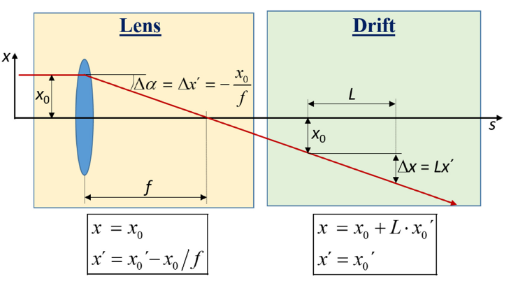
Optics Application
Two Types of Beam Line Elements
Lens
Quadrupole magnets
Changes the angle of the particle
“Focuses” or “Defocuses” the particle
Drift
No magnets
Mostly empty space

Slide 5
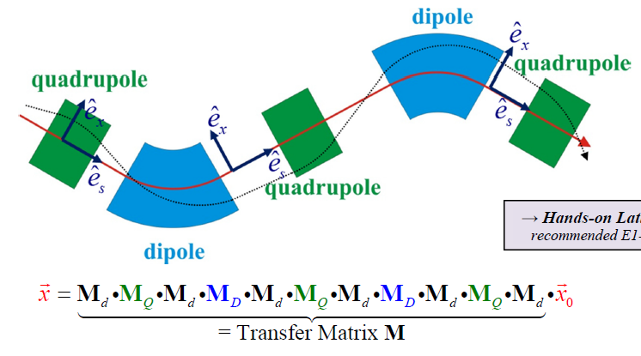
Matrix Representation
We use matrices to track particle positions
Ray Tracing
We can create complex beam lines using matrix multiplication

Slide 6
Matrix Representation (contin)
Let’s construct a beam line
FODO Lattice
“Equivalent Matrix”

Slide 7
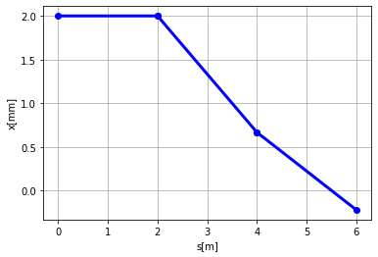
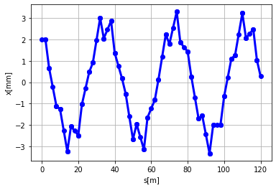
Beam Line Visualization
Single FODO Lattice
L = 2 m
f = 3 m
20 FODO Lattices
Same specs

Slide 8
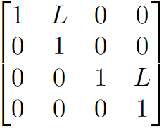
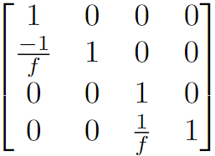
Expanding Ideas to 3D
3rd Dimension
Position
Drift
Lens

Slide 9
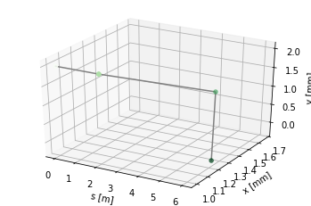
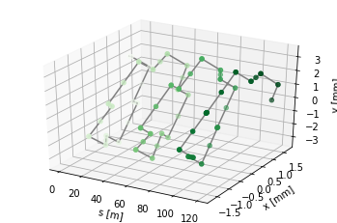
3D Beam Line Visualization
Single FODO Lattice
L = 2 m
f = 3 m
20 FODO Lattices
Same specs

Slide 10
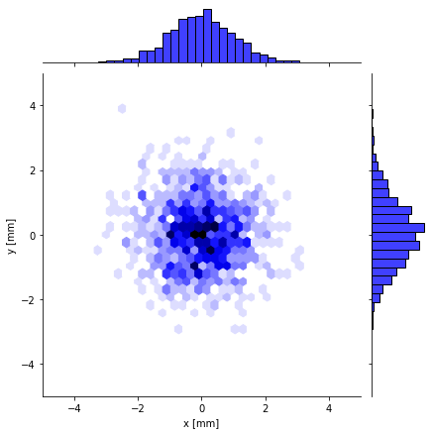
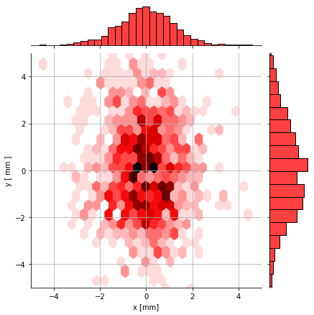
Needs More Particles
Realistic beam lines have thousands of particles, not just one
We can track them all!
Initial Distribution
Final Distribution
N = 1000
L = 0.5
f = 1.5

Slide 11
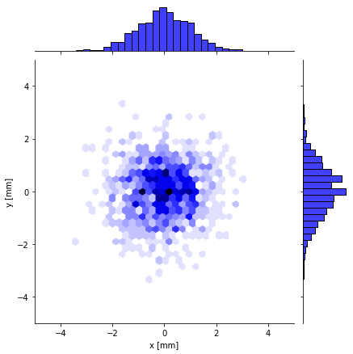
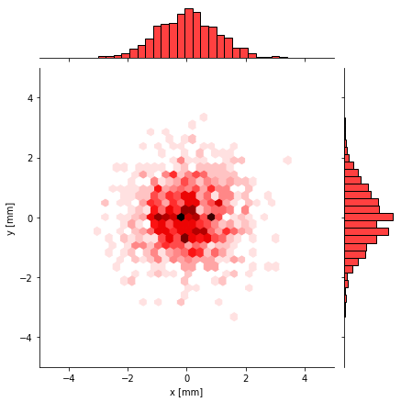
Interesting Find with Double FODO Lattice
This beam line consists of two FODO Lattices
Initial Distribution
Final Distribution
N = 1000
L = 2
f = $\sqrt{2}$
Both standard deviations did not change!

Slide 12
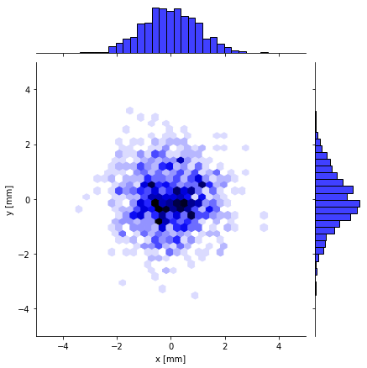
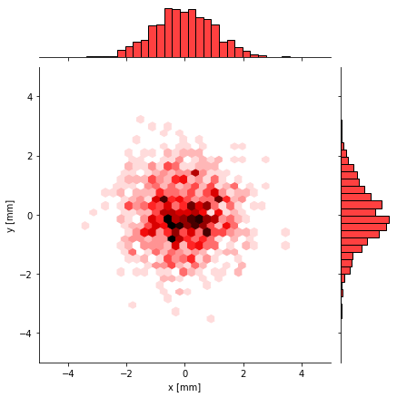
Interesting Find with Double FODO Lattice
This beam line consists of four FODO Lattices
Initial Distribution
Final Distribution
N = 1000
L = 2
f = $\sqrt{2}$
No change!

Slide 13
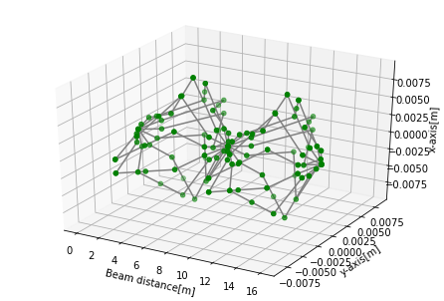
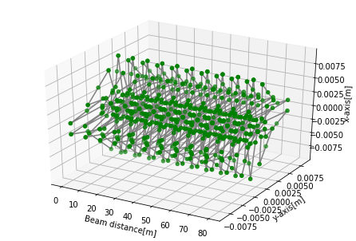
Interesting Find with Double FODO Lattice
Associated 3D Plot
N = 10
L = 2
f = $\sqrt{2}$

Slide 14
Peculiar Pattern
Associated Equivalent Matrix
When $f= \sqrt{L}$

Slide 15
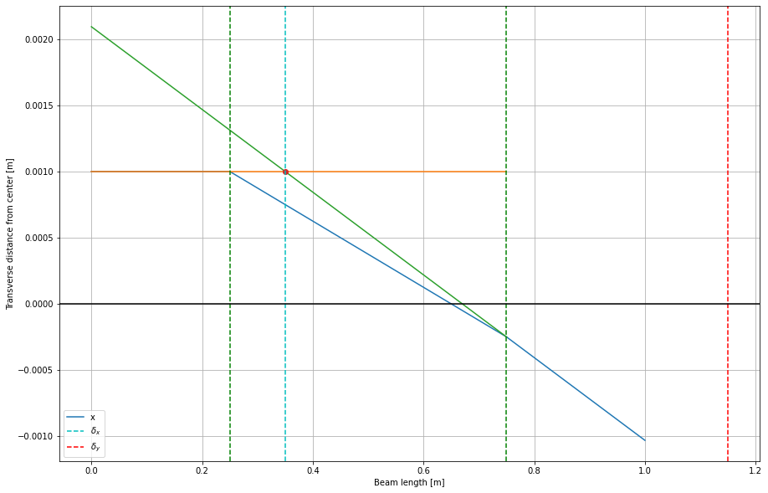
Other Findings in the Works
Equivalent Lenses and their Locations

Slide 16
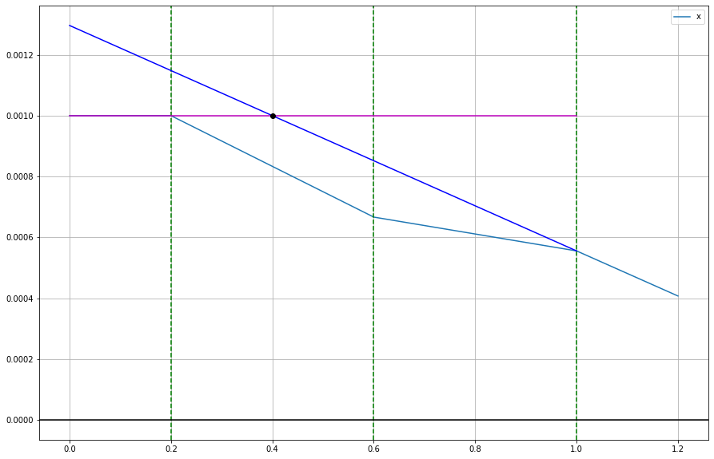
Triplets
Triplet Equivalent Lens

Slide 17
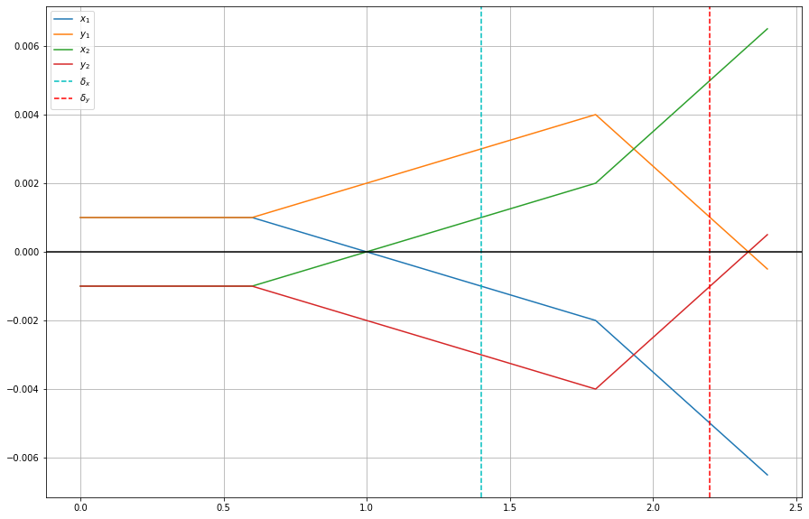
Optical Astigmatism

Slide 18
Questions?

