Slide 1
Creating the Pellet: SrCoO_{2.5}
By: Mackenzie Walker
Mentor: Dr. Ambrose Seo

Slide 2
Motivation Behind SrCoO_{2.5}
Antiferromagnetic insulator
Information is stored in the electrons and in the spin associated with the magnetic moment
Major interest in field to try and keep long-range spin information communication and storage
Notes:
Thin film can hold a lot of information/storage
https://www.nature.com/articles/s43246-020-0022-5

Slide 3
Step-By-Step
Balance equation with the reactants
Stoichiometry to figure out how much of each reactant is needed to create the target mass of product
X-Ray Diffraction (XRD) to check powders for possible impurities
Calcinate the powder mixture
Powder in Dry Powder Hydraulic Press to create a pellet
Sinter the pellet

Slide 4
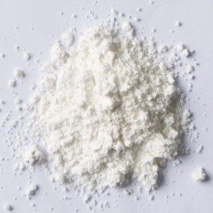
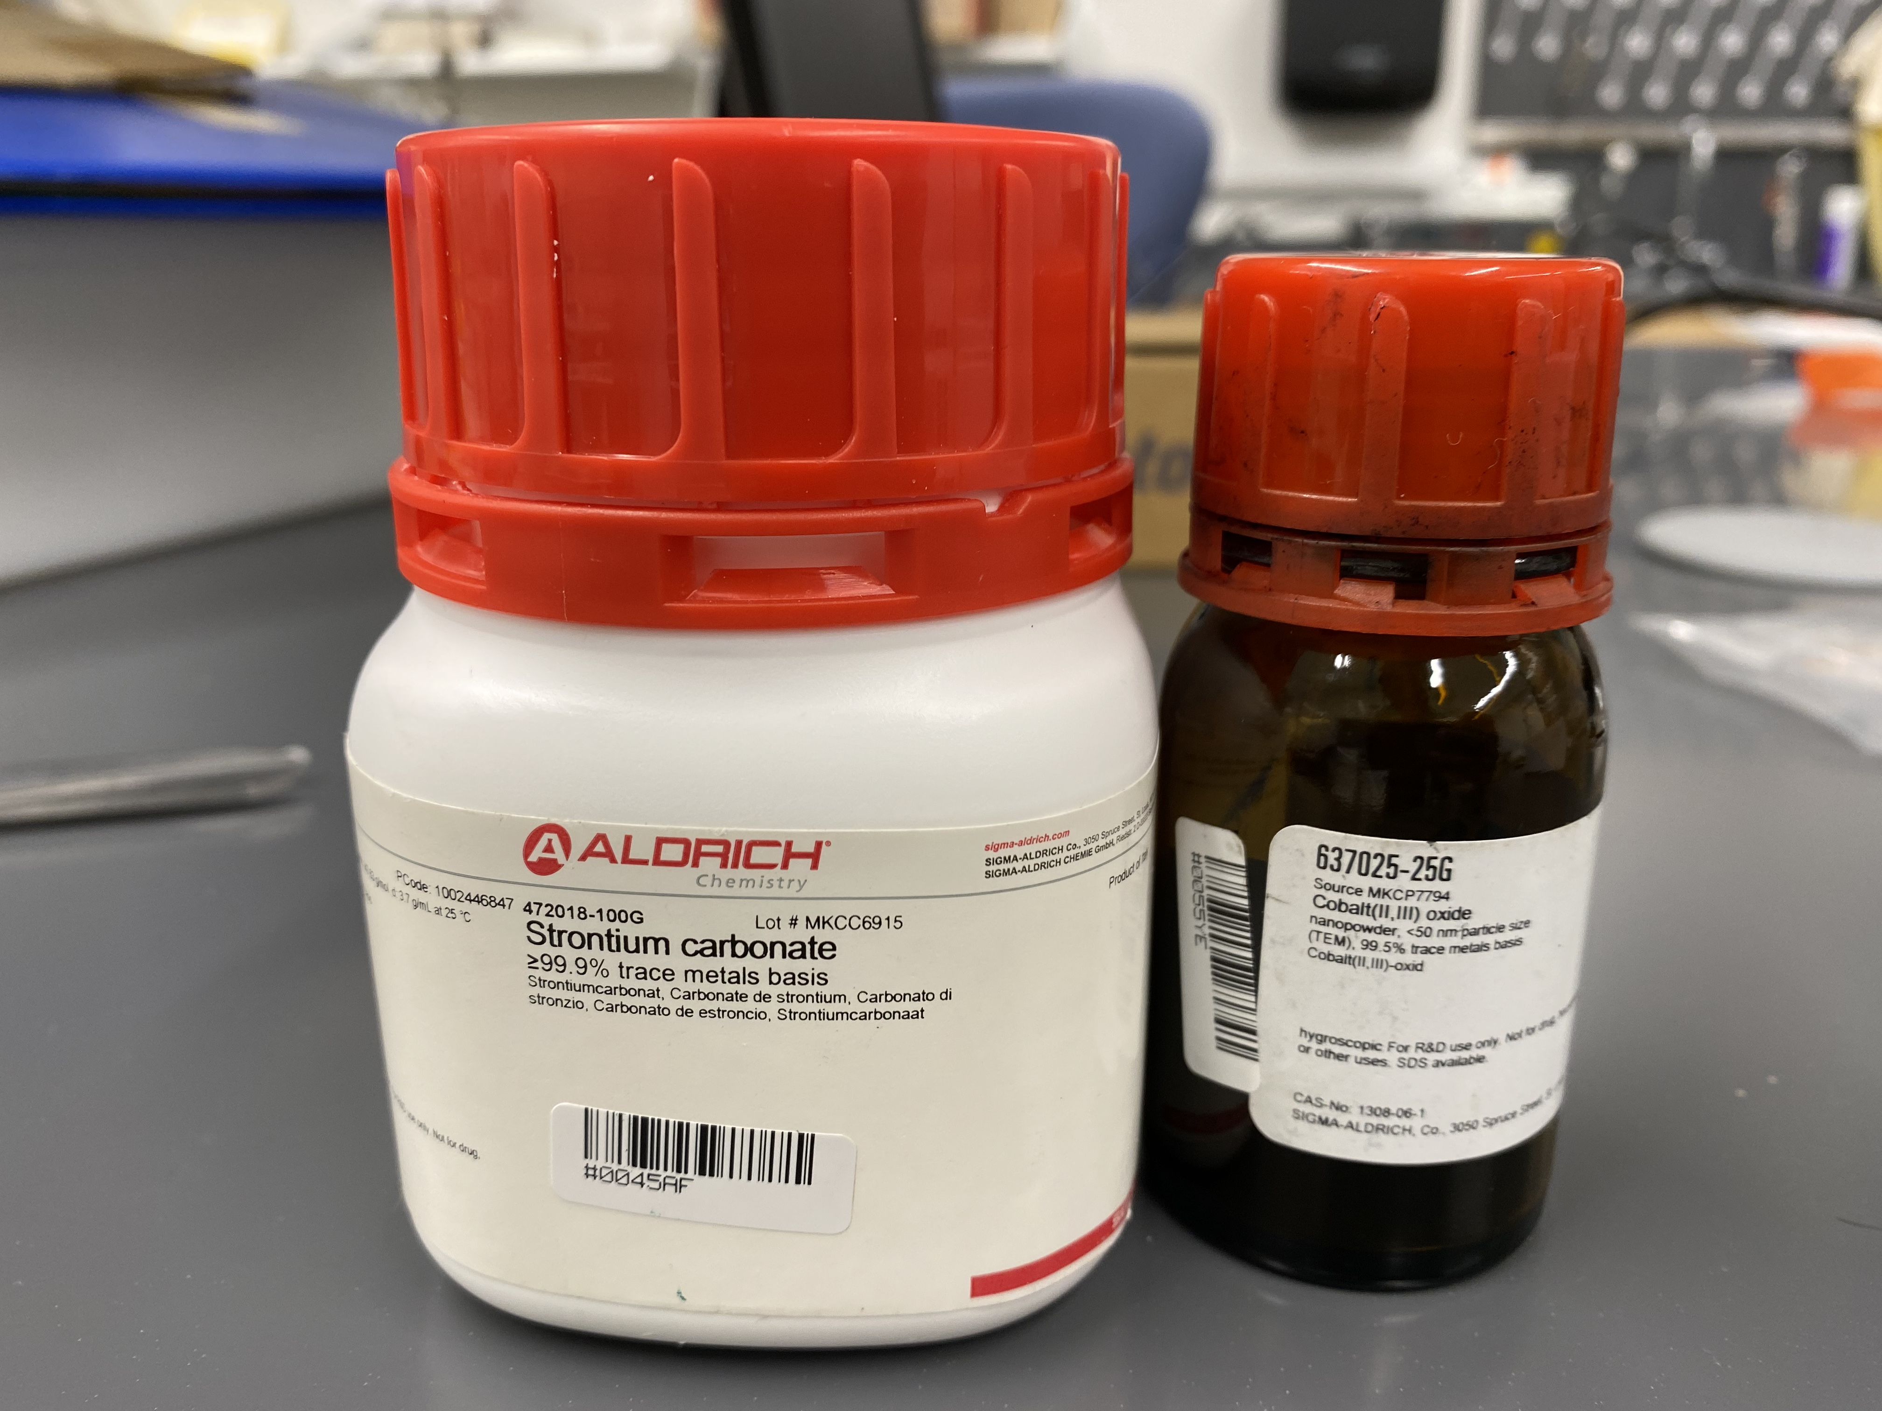
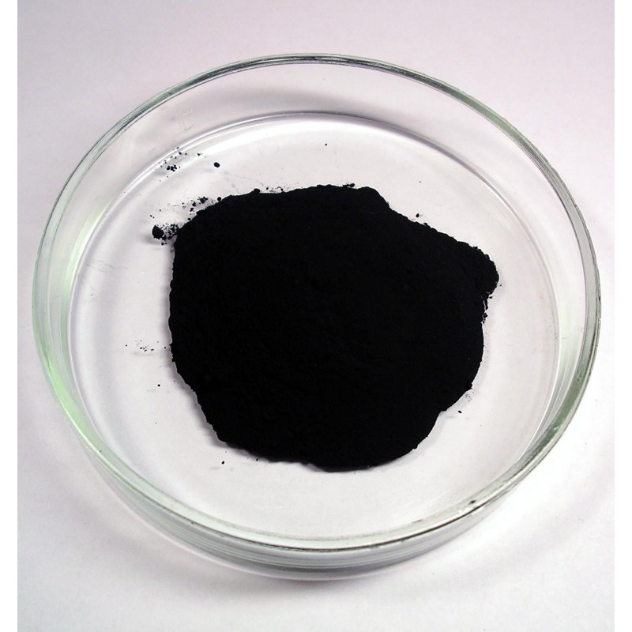
Background: Strontium Cobaltite (SrCoO_{2.5})
Made using Strontium Carbonate (SrCO₃) and Cobalt (II, III) Oxide (Co₃O₄) powders
12 SrCO₃ + 4 Co₃O₄ $→$ 12 SrCoO_{2.5} + 11 CO₂ + 1 C
3:1 Ratio
SrCO₃
Co₃O₄
Notes:
Add pictures of the powders

Slide 5
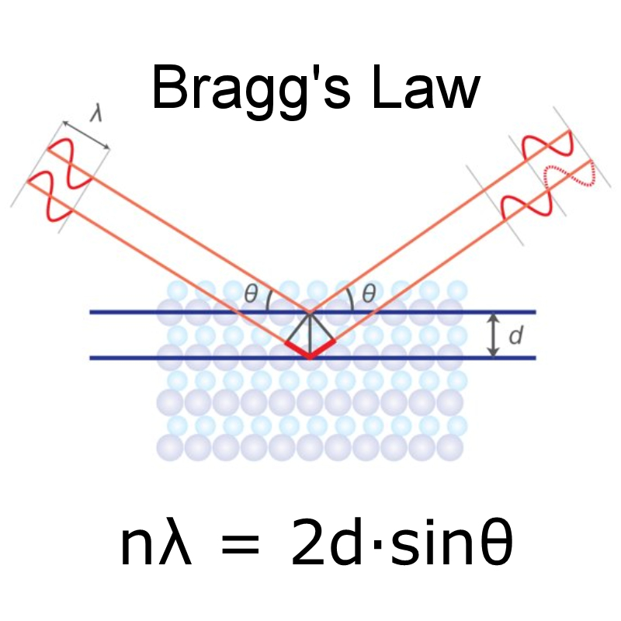
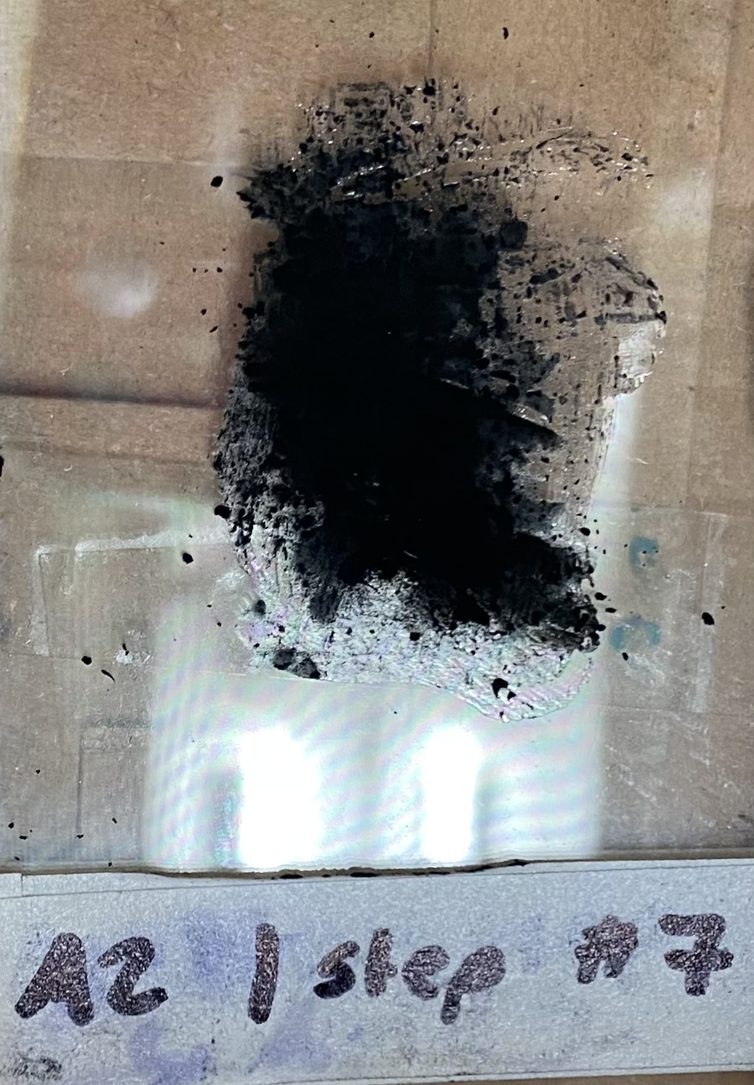
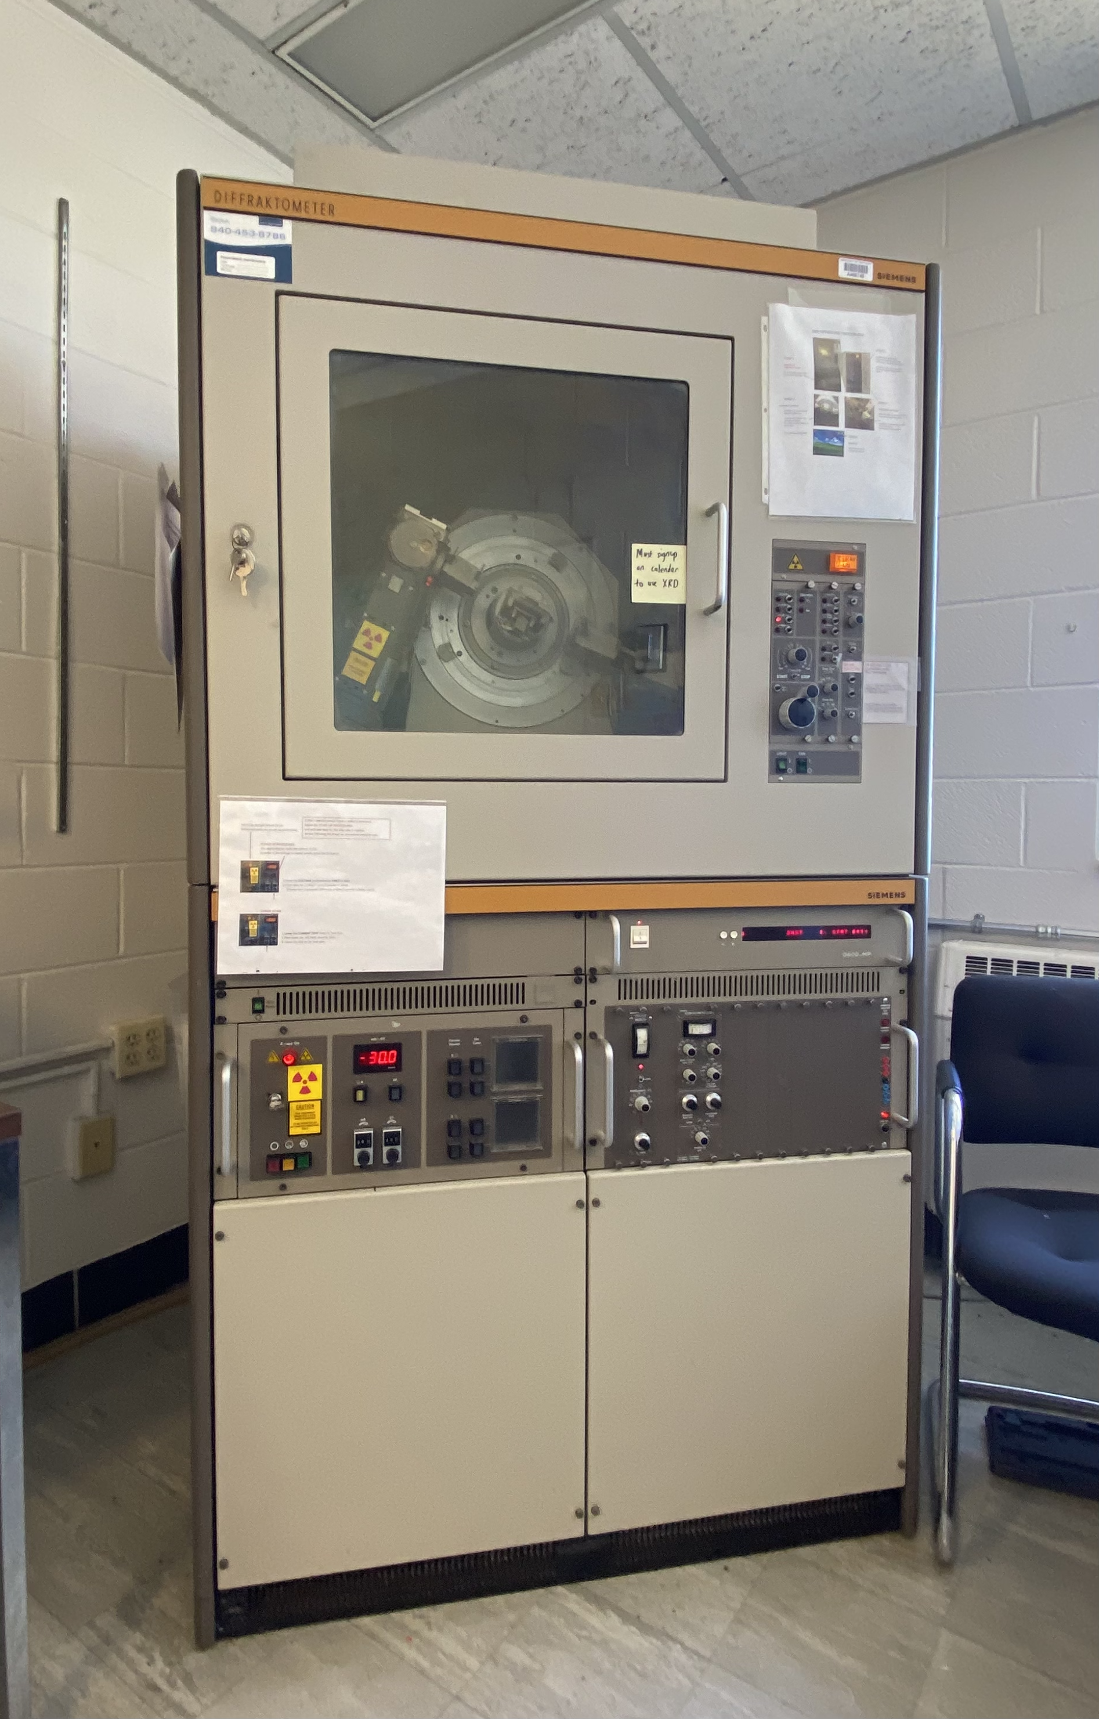
X-Ray Diffractor (XRD)
Co₃O₄
Determine The Three Dimensional Structure Of Matter. Rigaku. https://www.rigaku.com/techniques/x-ray-diffraction-xrd
Notes:
The XRD is a non-destructive technique that can find the crystallographic structure of a material and can find the purity of the samples
It works by emissions of x-rays onto the sample.
The diffracted x-rays then get collected and then the sample’s structure can be analyzed

Slide 6
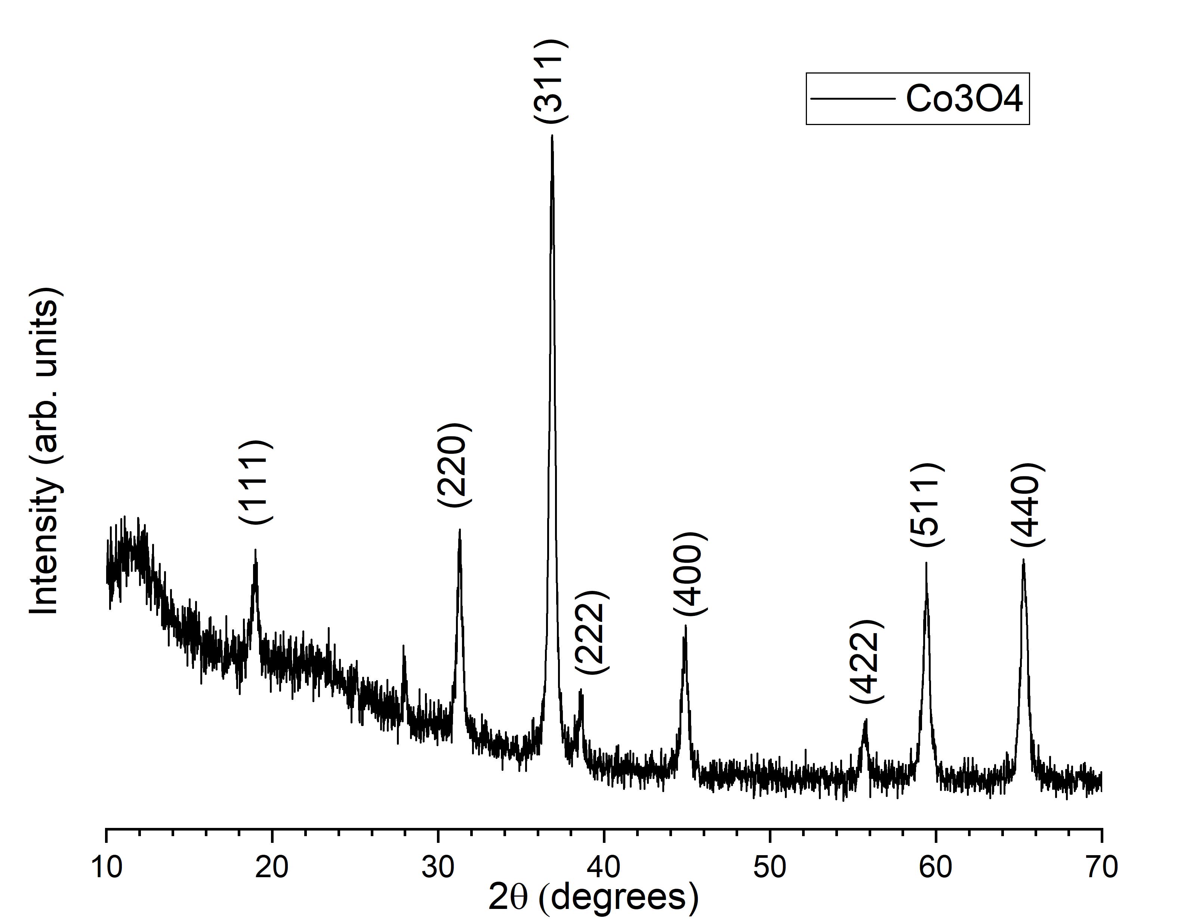
Comparing XRD Data
From XRD
Theoretical using VESTA
Co₃O₄

Slide 7
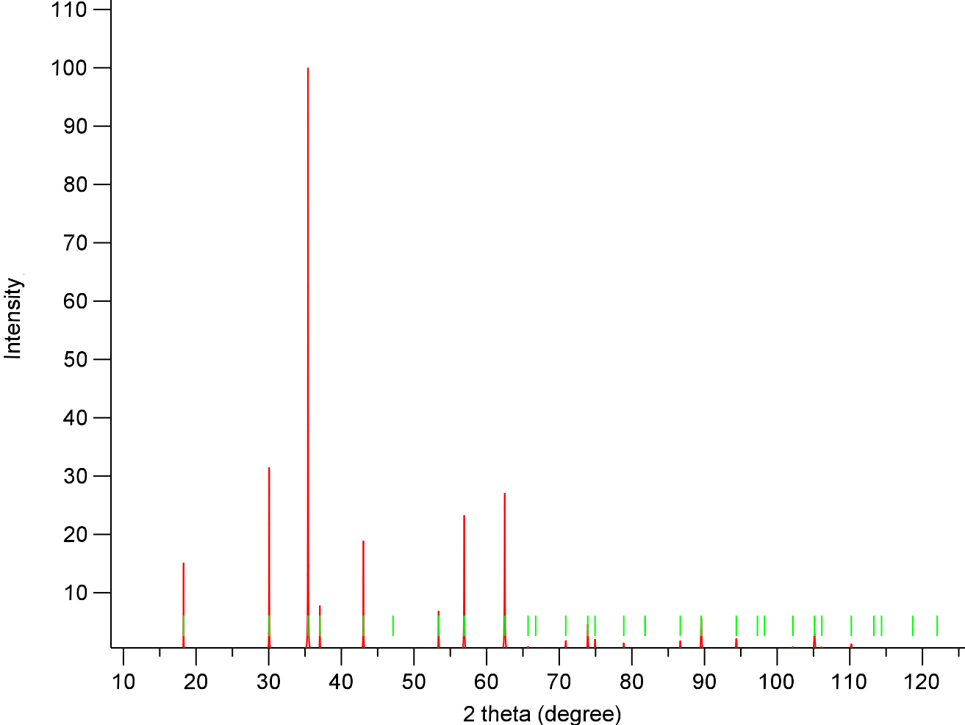
The Y-Axis are arbitrary units
As the X-Values increases, the shift increases
Notes:
X values shift difference from about 0.7 degrees to about 2.3 degrees. This does not sound like a lot, but for an xrd graph, it is a lot.
There is also another peak in the graph that should not be there it is the second peak starting from the left. This mean that peak is an impurity

Slide 8
Mixing the SrCO₃ and Co₃O₄
Target amount of SrCoO_{2.5} is 2 grams
1.5827g SrCO₃ and 0.8605g of Co₃O₄ needed
1.583g SrCO₃ and 0.863g of Co₃O₄ used
Finely grounded using a mortar and pestle

Slide 9
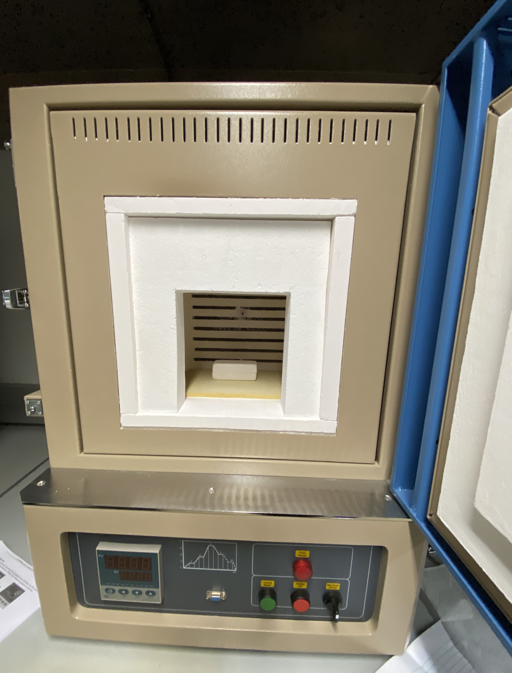
Calcination of the SrCO₃ + Co₃O₄
Mixture placed in crucible
Calcinated in furnace at 900ºC for 6 hours
Notes:
Calcination is the heating of solids to a high temperature for the purpose of removing volatile substances and oxidizing a portion of mass. It is essentially a method of purification

Slide 10
SrCO3 + Co3O4 Before Calcination
SrCO3 + Co3O4 After Calcination
Notes:
This is it before and after calcination. As seen here, there was not much of a color change

Slide 11
Creating the Pellet
Powder put into Dry Pellet Pressing Die
Hydraulic Press puts about 36,000 lbs. of pressure for 60 mins. on the powder

Slide 12
Oops

Slide 13
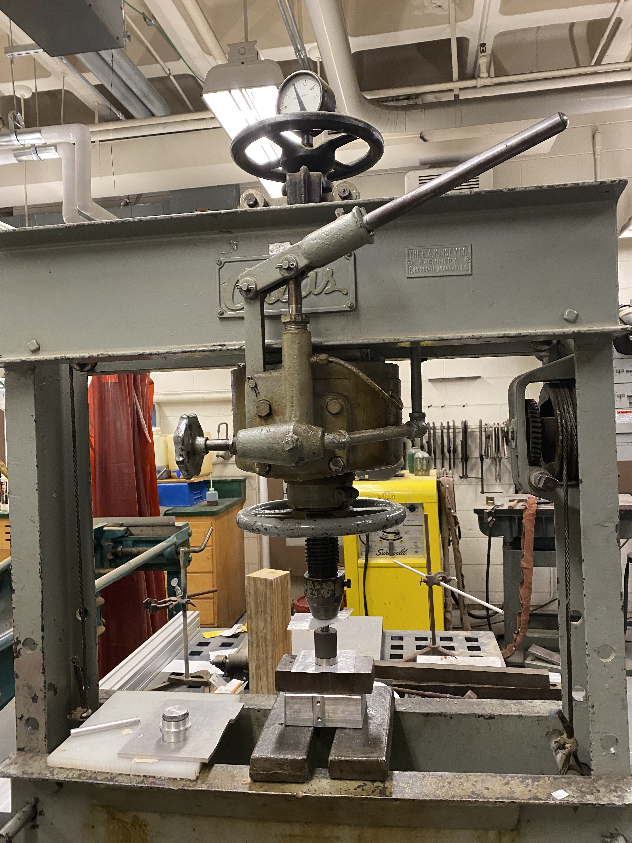
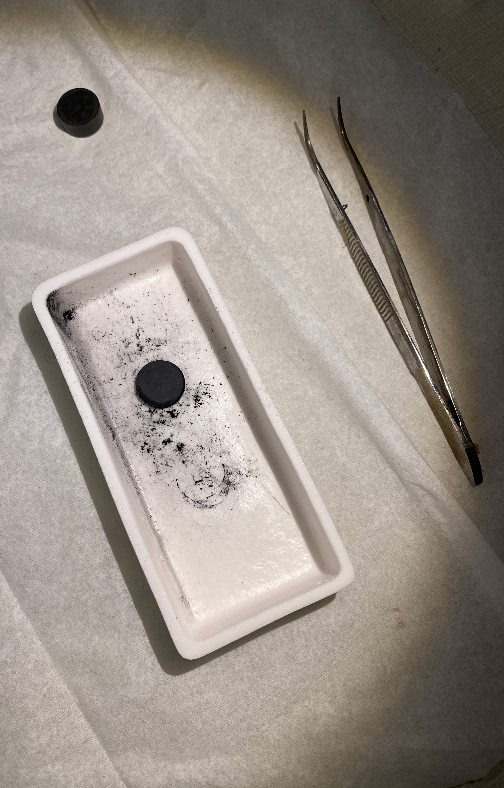
Creating the Pellet Again
Powder in Dry Pellet Pressing Die
Hydraulic Press puts about 20,000lbs. of pressure for 60mins.

Slide 14
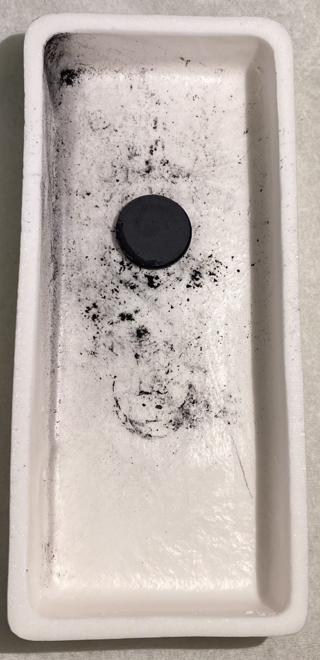
Back to the Furnace: Sintering
1100ºC for 24 Hours
Notes:
Sintering is a process of forming a solid mass of material and it increases the density. It allows the pellet to keep its properties as it gets tightly fused together

Slide 15
Summary
Balance equation with the reactants
Stoichiometry to figure out how much of each reactant is needed to create the target mass of product
X-Ray Diffraction (XRD) to check powders for possible impurities
Calcinate the powder mixture
Powder in Dry Powder Hydraulic Press to create a pellet
Sinter the pellet
Questions?

