Slide 1
Percolating Conductive Systems and Critical Exponents
By Matt Golden
Undergraduate Research Intern

Slide 2
What is a Percolating System?
Percolation theory describes the behavior of a system when connections are added or removed.
The links between each two sites have probability p of being connected, or not connected with probability 1 – p, and they are independent of each other.

Slide 3
Does a path exist?
At a critical threshold ${p=p}_{c}$, large clusters and long-range connectivity first appears, and this is called the percolation threshold. $p<p_{c}$: No Path $p>p_{c}:$A path exists

Slide 4
Critical Exponents
Percolation has a singularity at the critical point $p=p_{c}$
As one approaches $p_{c}$, various quantities either diverge or go to a constant value by a power law in ${\left|p−p_{c}\right|}^{β}$, and the exponent of that power law is the critical exponent.
A percolation transition is characterized by a set of universal critical exponents
Critical exponents describe the behavior of physical quantities near continuous phase transitions. It is believed, though not proven, that they are universal
Notes:
There are also “higher order” or “continuous” phase transitions, where the material on the two sides is very similar, but there is singular behavior associated with the phase transition itself.

Slide 5
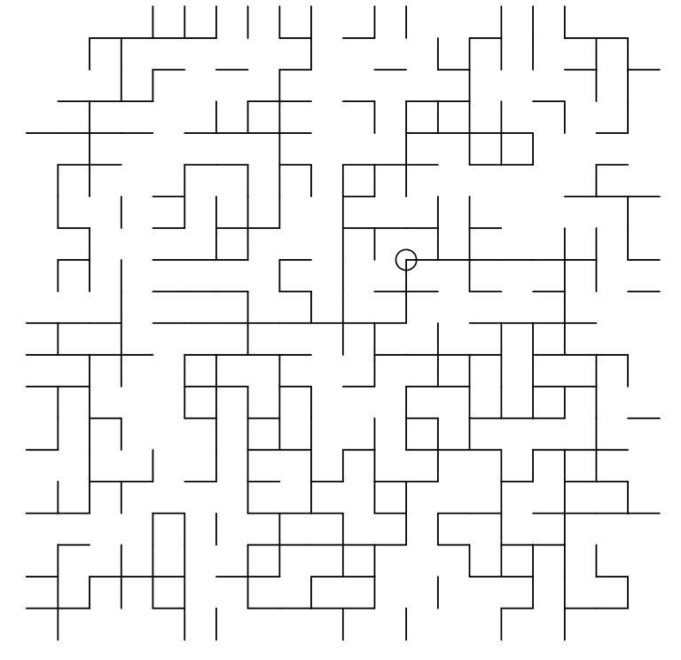
The Conduction Problem
In our conductive system the links represent conductors, with specified conductance; equal to 1(connected link) or 0(missing link).
The boundaries of the square will either be grounded(V = 0) or not allow current to exit.
What is the total conductance of the system with various sizes of N? $〈G〉≈N^{−t}$
How does the distance from the boundary affect the conductance of the system? $〈G〉≈{Distance}^{−t^{′}}$

Slide 6
Methods of solving these questions
Run variations of a FORTRAN program(written by Dr. Straley) that simulates conductive percolating lattices and calculates the average conductance
Use the Lipscomb Compute Cluster(LCC) to run the program numerous times with large lattices
Use python to do scientific computing, analyze data, and construct plots

Slide 7
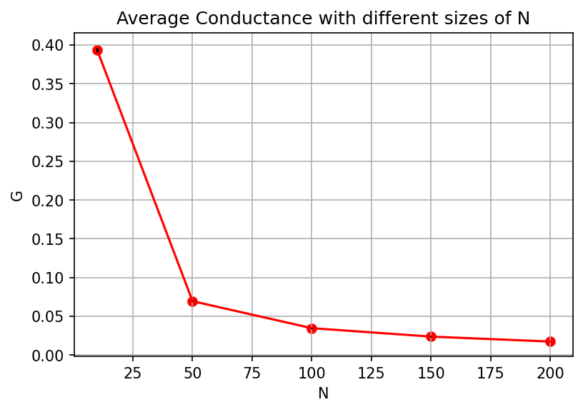
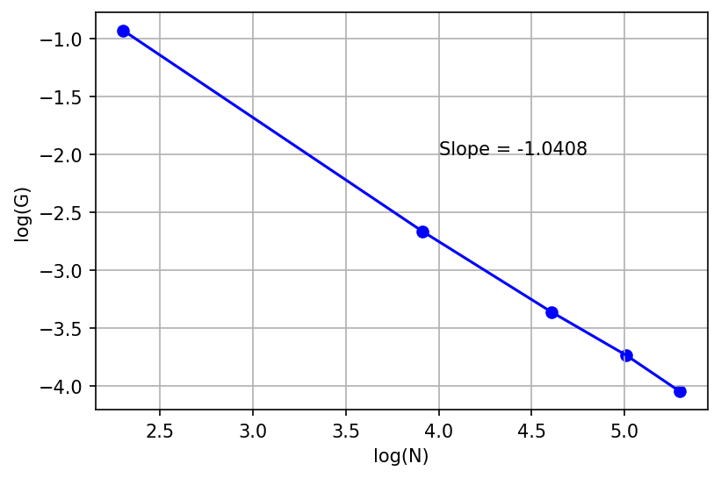
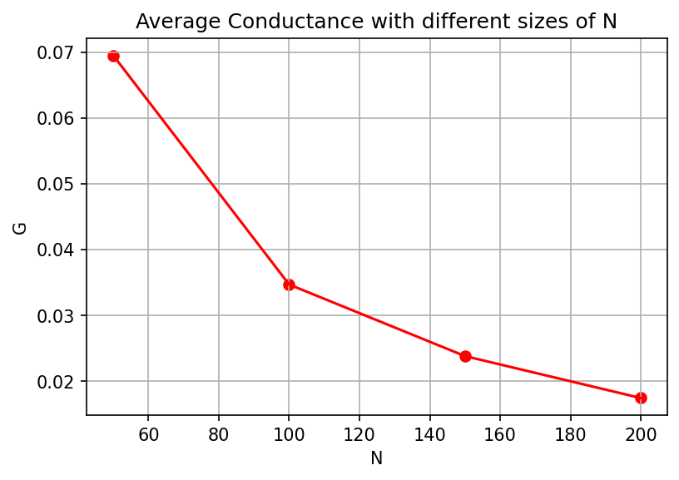
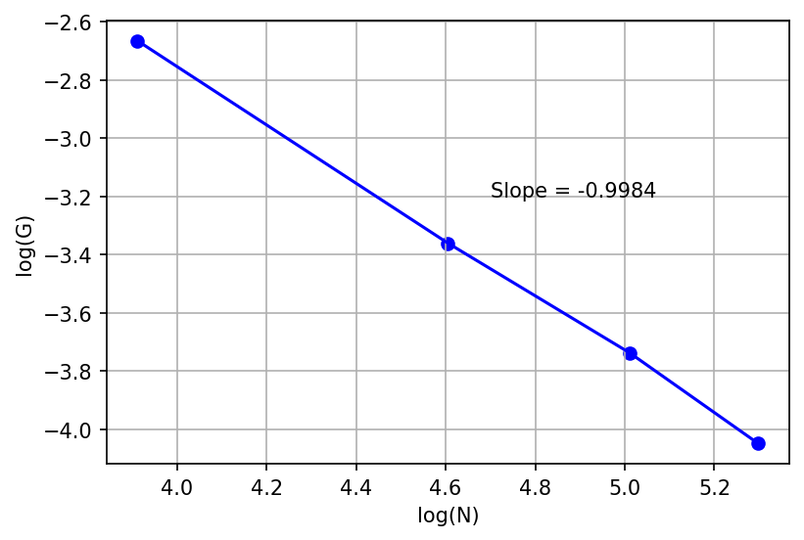
Conductance with various sized lattices
$$〈G〉≈N^{−t}$$
$$\ln\left(〈G〉\right)≈−t×\ln\left(N\right)$$

Slide 8
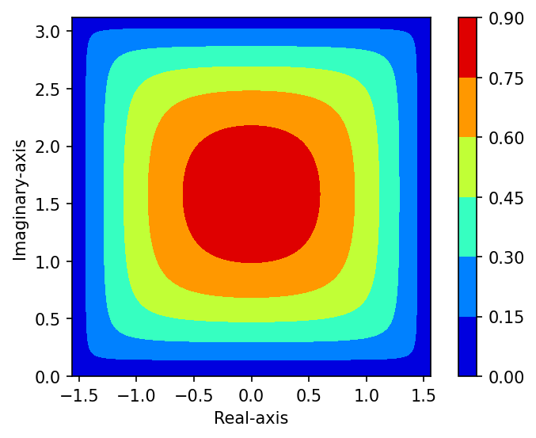
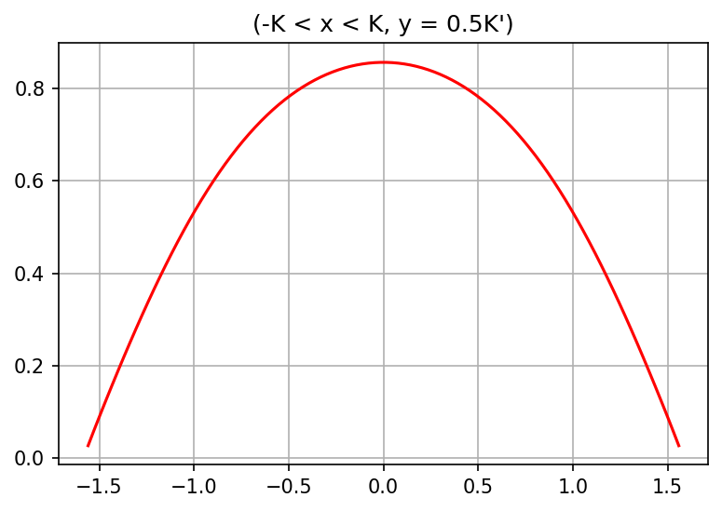
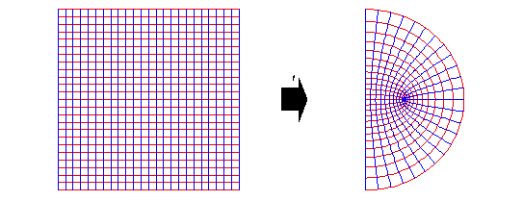
Conformal Mapping
$$Distance∼C{\left[\frac{Im\left(sn\left(z|k\right)\right)}{\left|cn\left(z | k\right)×dn\left(z | k\right)\right|}\right]}^{−t}$$

Slide 9
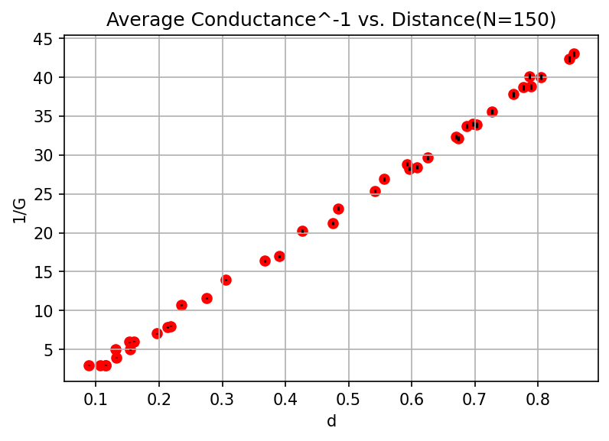
Conductance at various points in lattice

Slide 10
Conclusions(so far…)
We have verified that conductance to the boundary depends only on the "distance“
There are still more variations of the problem to tackle!

