Slide 1
Design of a Superconducting Cage for Use in the SNS nEDM Experiment
Rohan Rauch
Notes:
Welcome to my talk?

Slide 2
What is the nEDM?
Electric dipole moment (EDM): particle property characterized by the separation of the positive & negative charge (poles), which causes a torque in electric fields
Question: Is the neutron’s electric dipole moment (nEDM) non-zero?
Non-zero nEDM implies charge-parity (CP) symmetry violation
It is essential for baryogenesis, the asymmetry in matter and antimatter in the early universe
Notes:
To start, this project is based on the measurement of the nEDM
Electric Dipole Moment is property of particles characterized by separation of positive & negative charges (i.e. polarity), which causes it to experience a torque in electric fields
One question in particle physics: is neutron EDM non-zero?
A non-zero nEDM would imply CP violation in the Standard Model, i.e. differences in how physical laws treat a charge-parity reversed system
Greater CP violation necessary for explaining baryogenesis, assumed asymmetry in matter & antimatter in early universe which, after annihilation, led to remaining matter that created the universe

Slide 3
Measuring the nEDM
Oakridge National Laboratory’s (ORNL) Spallation Neutron Source (SNS) is being used to measure the nEDM
ORNL SNS experiment involves inducing Larmor precession of the neutron’s spin in a strong electric field
Spin causes neutrons to precess in magnetic fields
nEDM will slightly modify precession frequency due to a strong electric field, which is used to detect the nEDM
Setup requires constant B-fields within small area of a cryostat
A superconducting cage can temporarily stabilize the B-fields
Notes:
ORNL’s SNS is being used to measure the nEDM, by inducing Larmor precession
Neutron’s spin causes precession after experiencing torque in magnetic field from magnetic moment
In a strong electric field nEDM slightly modifies precession frequency, and this can be used to detect the nEDM
nEDM experiment set-up will require constant magnetic fields, and within the small area of a cryostat (maintains low temperatures of a volume)
Superconducting cage design can temporarily stabilize the magnetic field and increase precision of nEDM measurements

Slide 4
Superconducting Cage for Constant B-Field
Superconductor loops able to maintain current indefinitely
Lenz’s Law: external B-fields induce current within loops that opposes changes in said B-field
∴ A superconducting loop will maintain the enclosed B-field, even after the external field is removed
Notes:
Superconductor cage design operates based off two principles
Superconductors have zero resistance, so superconducting loops can maintain electric currents indefinitely
Via Lenz’s Law, an external magnetic field induces a current in a conductive loop such that loop creates a magnetic field that opposes changes in the external field
By both of these principles, a superconducting loop will be able to maintain the enclosed magnetic field indefinitely, even after the external field is removed

Slide 5
Superconducting Cage for Constant B-Field
Cage design creates multiple loops, which “pin”/constrain the ends of field lines that pass through them
Forces field to stay constant in strength over time within the cage
An external magnet can be used to induce the opposing field, initializing the setup before the experiment begins
Notes:
Cage design has additional effect – grid creates multiple loops in each side of the cage, and pairs of them “pin” the ends of field lines that pass through them
This forces the field to stay constant in strength over time within the cage’s volume, as the field lines have their parameters constrained
Thus, after an external magnet is used to induce the opposing field, the field will stay constant during the course of the experiment, allowing for precise measurements

Slide 6
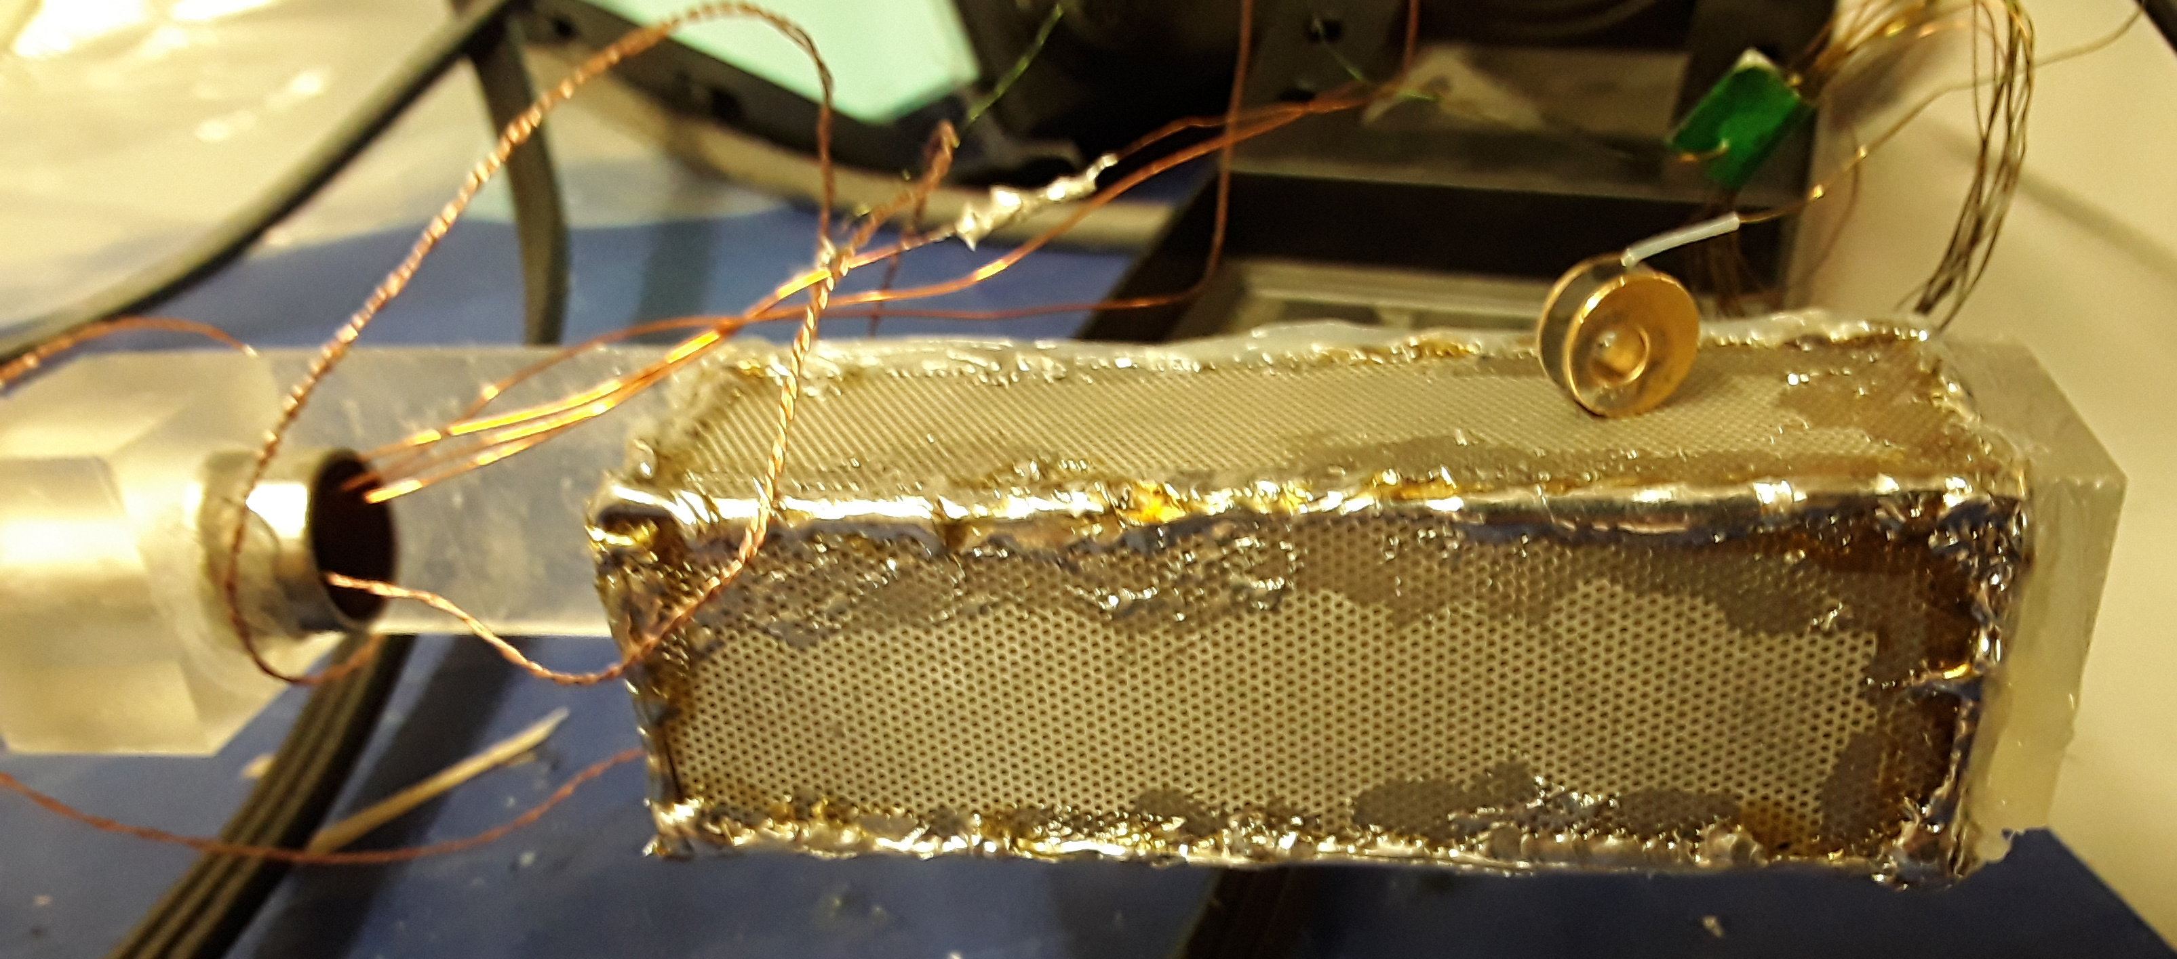
Current Design of Superconducting Cage
Cage made of soldered, leaded PCB pieces with grids of small holes
Lead goes superconducting at the critical temperature of 7.2 K
Apparatus attached to long metal rod to lower into dewar containing cryogenic helium during testing
Notes:
Current design of superconducting cage is shown here: Made up of leaded PCB pieces with grids of small holes, soldered together into a box shape
Lead has critical temperature of 7.2K, so liquid helium can be used to make the cage superconducting
Whole apparatus is attached to a long rod, so that it can be lowered into a dewar containing liquid helium during testing

Slide 7
Current Design of Superconducting Cage
Sensors: Magnetometer and two thermometers attached to the top and bottom of the cage
When both thermometers measure below the critical temperature, then the entire cage has reached the critical temperature and is fully superconducting
Notes:
Three sensors connected to cage: magnetometer inside cage (not show), two thermometers at top & bottom
Two thermometers used because cage won’t cool evenly, so need to confirm that it is all under critical temperature before testing; bottom of cage will likely cool before top one, so when both are under critical temp, whole cage is superconducting

Slide 8
Data Acquisition Software
The thermometers and magnetometer are connected to external equipment to convert sensor readings into voltage signals
Voltage signals are then sent to an NI 9239 to be packaged and transmitted to an external computer
To computer
NI 9239
Thermometers
Magnetometer
Notes:
Sensors are connected to external equipment which converts the readings into voltage signals
Note that for thermometers, both connected to same convertor, but only one of them has the signal sent out; will manually change between them during testing
Voltage signals are sent to an NI 9239, which converts 4 channels of data into 1 channel that is sent to an external computer
Diagram shows lines from Magnetometer and Thermometer, two Unused Channels, the NI 9239, and the line To the Computer

Slide 9
Data Acquisition Software
Python code written to read sensor data from the NI 9239 for a given number of samples at a given frequency of samples per second
Uses nidaqmx library to read NI 9239’s data signal, as well as threading to improve performance
Primary function: Write the data to a text file for later analysis
Secondary function: Notify when the cage has gone below the critical temperature, as well as when it goes back above this temperature
Notes:
The part of the project I worked on
The external computer runs Python code to read the data from the NI 9239’s buffer, taking a user-set number of samples at a user-set frequency of samples per second
Program uses the nidaqmx library to read the data signal
Additionally, multithreading was implemented to isolate the read function in a separate thread, so that multiple read operations could run simultaneously and optimize performance
The primary function of the program was to take the data that was read and store it in a text file for later analysis after tests
Secondary function was to notify us when the cage had gone below or back above the critical temperature, and thus when it was superconducting

Slide 10
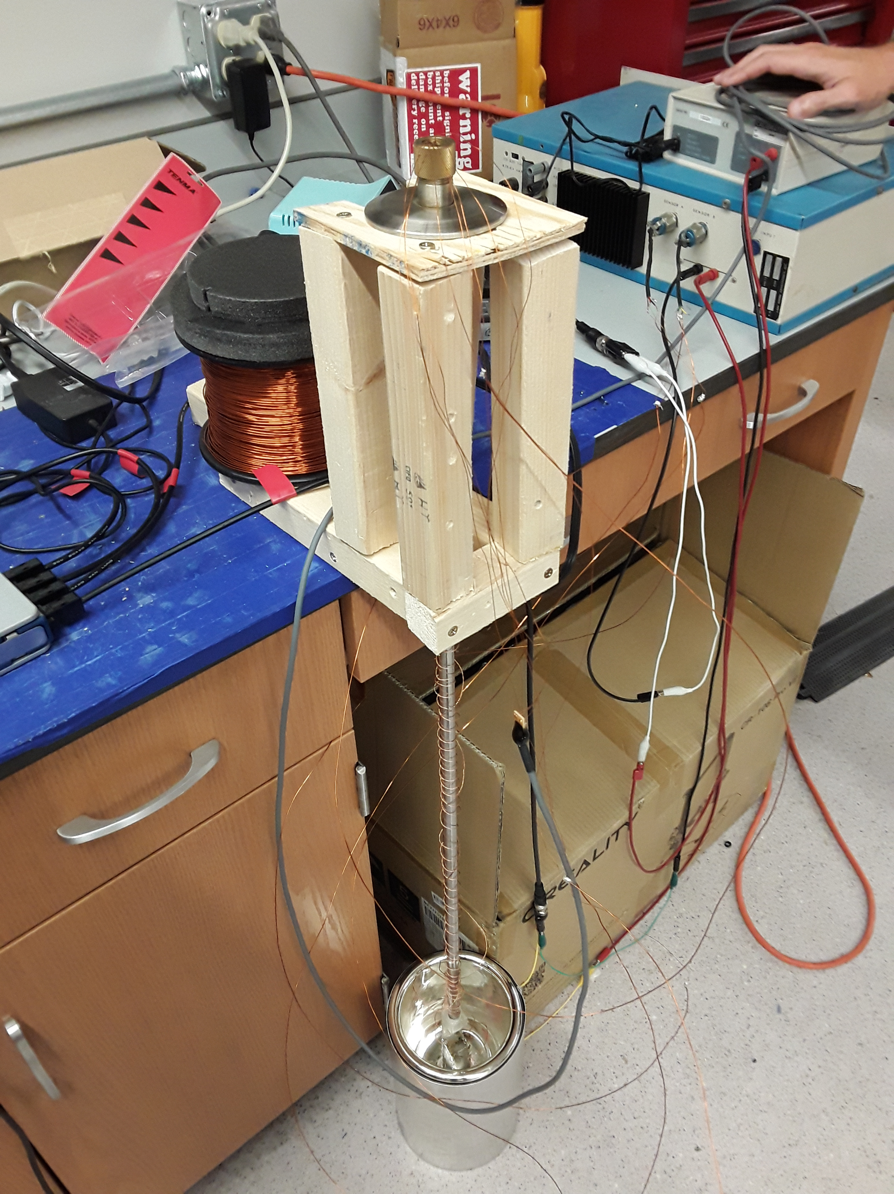
Future Work
Testing will consist of dipping cage into cryogenic liquid and observing sensor readings when exposed to an outside B field
First test: Liquid nitrogen stress test (77 K)
Cage will not become superconducting
Test how components hold up at cryogenic temperatures
Second test: Liquid helium (4.2 K)
Cage will become superconducting
Test whether the design can maintain the requisite B-fields
Notes:
The future of this project will be performing the long-awaited tests, as soon as we can get the cryogenic liquids necessary for them
Tests will consist of dipping the cage into cryogenic liquids and observing the sensor readings while it is exposed to an outside B field
The first test is a liquid nitrogen stress test
Liquid nitrogen is 77K, so cage will not become superconducting; test is to see if components like plastic parts can hold up at cryogenic temperatures
Second test is with liquid helium
Liquid helium is 4.2K, so cage will become superconducting, and we can test whether it can maintain the magnetic fields it was designed for

