Slide 1
Investigating mental health distress and help-seeking perceptions in first-year engineering students
Sara Lamer

Slide 2
Help-seeking in distressed engineers
Have you ever received counseling or therapy for a mental health concern?
Distressed engineers are less likely to have received help than non-engineers
¹Mitchell, Caroline, Brian McMillan, and Teresa Hagan. 2017. "Mental health help-seeking behaviours in young adults." The British journal of general practice : the journal of the Royal College of General Practitioners 67 (654):8-9.ç

Slide 3
Increasing help seeking can improve the prognosis of disorders and reduce the potential for progression to more chronic or severe disorders¹ ¹Mitchell, Caroline, Brian McMillan, and Teresa Hagan. 2017. "Mental health help-seeking behaviours in young adults." The British journal of general practice : the journal of the Royal College of General Practitioners 67 (654):8-9.

Slide 4
Theoretical framework: The integrated behavioral model
Attitude
Perceived norm
Personal agency
Direct mediators
Intention
Driver
Seeking help
IBM allows for determination of beliefs that are predictive of behavior.
IBM focuses on beliefs that can be targeted by interventions.

Slide 5
Direct Mediators
Attitude
Perceived norm
Personal agency
A student’s beliefs about outcomes or attributes of seeking help.
Whether important referent individuals approve or disapprove of seeking help.
The presence or absencece of facilitators and barriers to seeking help.

Slide 6
Research questions
How do we measure help-seeking perceptions and intention in first-year engineering students?
How does mental health status vary across gender in first-year engineering students?
Do help-seeking perceptions and intention vary across gender and mental health distress level in first-year engineering students?

Slide 7
Study population
356 students participated in this study.

Slide 8
Prevalence of anxiety and depression
Anxiety
Depression
There is a significant difference in the amount of male and female participants.
Women were more likely to self-report severe depression symptoms compared to men.

Slide 9
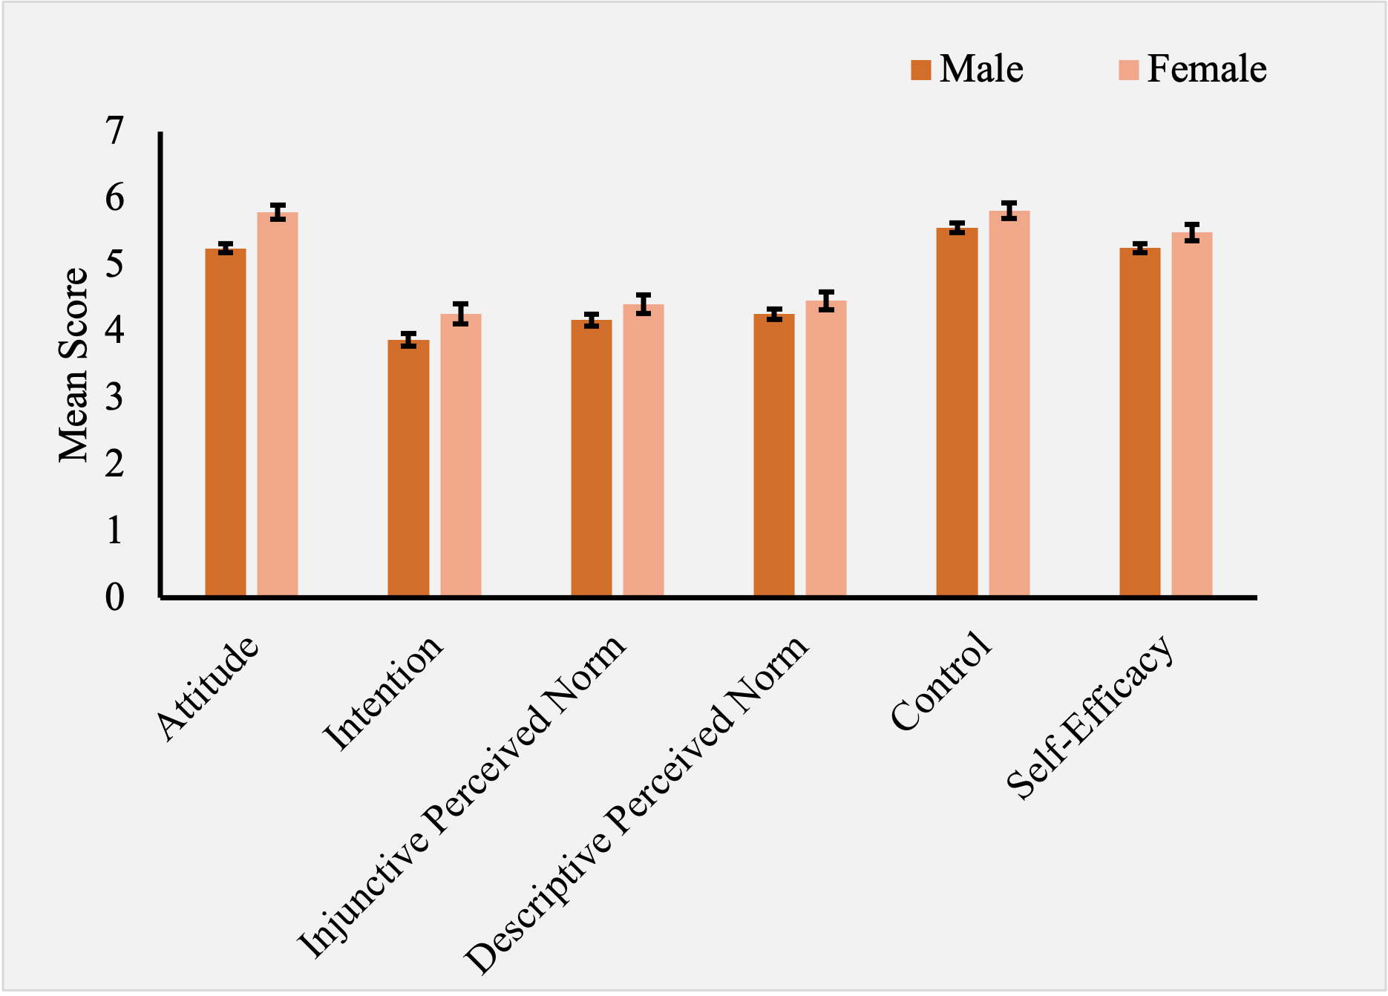
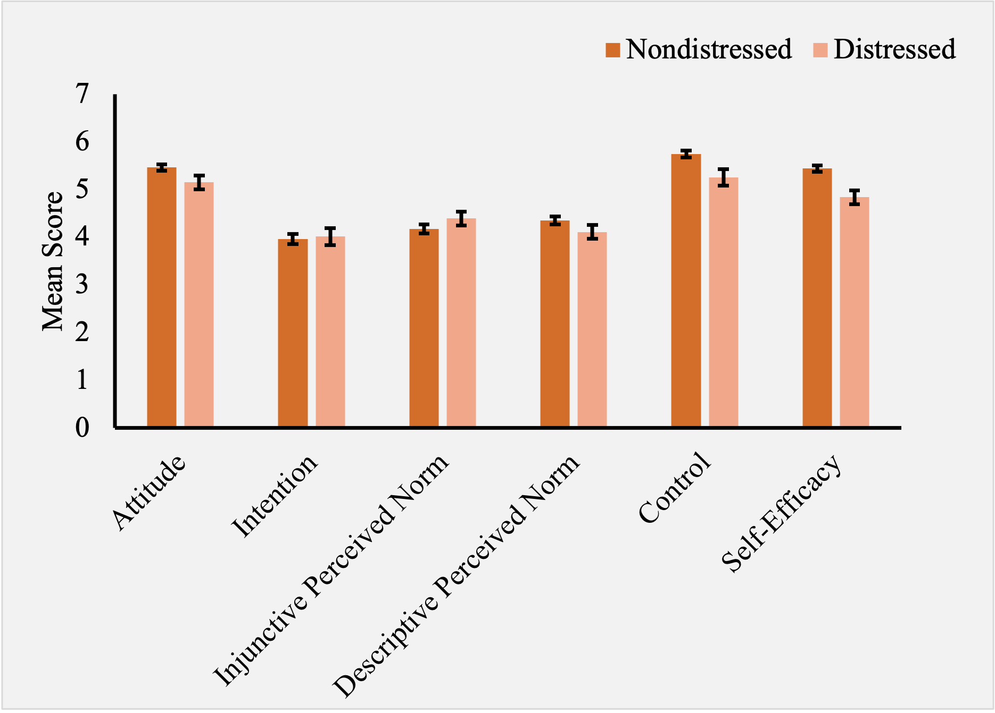
Beliefs about help seeking
*
*
*
*
*
Women are showing a greater intention to seek help for mental health concerns.
Non-distressed students showed a more positive attitude towards seeking help than distressed students.

Slide 10
Conclusions
Men may be experiencing more symptoms of anxiety and depression, but the difference between population sizes may be showing that change.
Women are self-reporting higher levels of depression compared to men, even with the population difference.
Women had more positive beliefs about seeking help compared to men.
Non-distressed students had more positive beliefs about seeking help compared to distressed students.

